Slide 1
Computation for Physics 計算物理概論
Introduction to Matplotlib

Slide 2
Matplotlib
Matplotlib is a python 2D plotting library which produces publication quality figures in a variety of hardcopy formats and interactive environments across platforms.
Matplotlib is the whole package; pylab is a module in matplotlib that gets installed alongside matplotlib; and matplotlib.pyplot is a module in matplotlib.
Pyplot provides the state-machine interface to the underlying plotting library in matplotlib. This means that figures and axes are implicitly and automatically created to achieve the desired plot. For example, calling plot from pyplot will automatically create the necessary figure and axes to achieve the desired plot. Setting a title will then automatically set that title to the current axes object:
Pylab combines the pyplot functionality (for plotting) with the numpy functionality (for mathematics and for working with arrays) in a single namespace, making that namespace (or environment) even more MATLAB-like. For example, one can call the sin and cos functions just like you could in MATLAB, as well as having all the features of pyplot.
The pyplot interface is generally preferred for non-interactive plotting (i.e., scripting). The pylab interface is convenient for interactive calculations and plotting, as it minimizes typing.

Slide 3
Pylab: plot, show
from pylab import *
>>>from pylab import plot, show
>>>y = [ 1.0, 2.4, 1.7, 0.3, 0.6, 1.8 ]
>>>plot(y)
>>>show()

Slide 4
Pylab: plot, show
>>>from pylab import plot, show
>>>x = [ 0.5, 1.0, 2.0, 4.0, 7.0, 10.0 ]
>>>y = [ 1.0, 2.4, 1.7, 0.3, 0.6, 1.8 ]
>>>plot(y)
>>>show()

Slide 5
Pylab+Numpy
>>>from pylab import plot, show
>>>from numpy import linspace, sin
>>>x = linspace(0,10,100)
>>>y = sin(x)
>>>plot(x,y)
>>>show()

Slide 6
Pylab+Numpy
>>>from pylab import plot, show
>>>from numpy import loadtxt
>>>data=loadtxt("values.txt",float)
>>>x = data[:,0]
>>>y = data[:,1]
>>>plot(x,y)
>>>show()

Slide 7
Pylab+Numpy
from pylab import plot,show
from math import sin
from numpy import linspace
xpoints = []
ypoints = []
for x in linspace(0,10,100):
xpoints.append(x)
ypoints.append(sin(x))
plot(xpoints,ypoints)
show()

Slide 8
Pylab: xlim, ylim, xlabel, ylabel
xlim
Get or set the *x* limit of the current axes.
ylim
Get of set the *y* limit of the current axes.
xlabel
Set the *x* axis label of the current axes.
ylabel
Set the *y* axis label of the current axes.

Slide 9
Pylab
from pylab import plot, show
from numpy import linspace, sin
x = linspace(0,10,100)
y = sin(x)
plot(x,y)
ylim(-1.1,1.1)
xlabel("x axis")
ylabel("y = sin x")
show()

Slide 10
Pylab: Plot Style
Color
r: red
g: green
b: blue
c: cyan
m: magenta
y: yellow
k: black
w: white
Line style
"-": solid line
"--": dashed line
".": mark points with a point
"o": mark points with a circle
"s": mark points with a square

Slide 11
Plot
from pylab import plot, show
from numpy import linspace, sin, cos
x = linspace(0,10,100)
y1 = sin(x)
y2 = cos(x)
plot(x,y1,"k-")
plot(x,y2,"k--")
ylim(-1.1,1.1)
xlabel("x axis")
ylabel("y = sin x")
show()

Slide 12

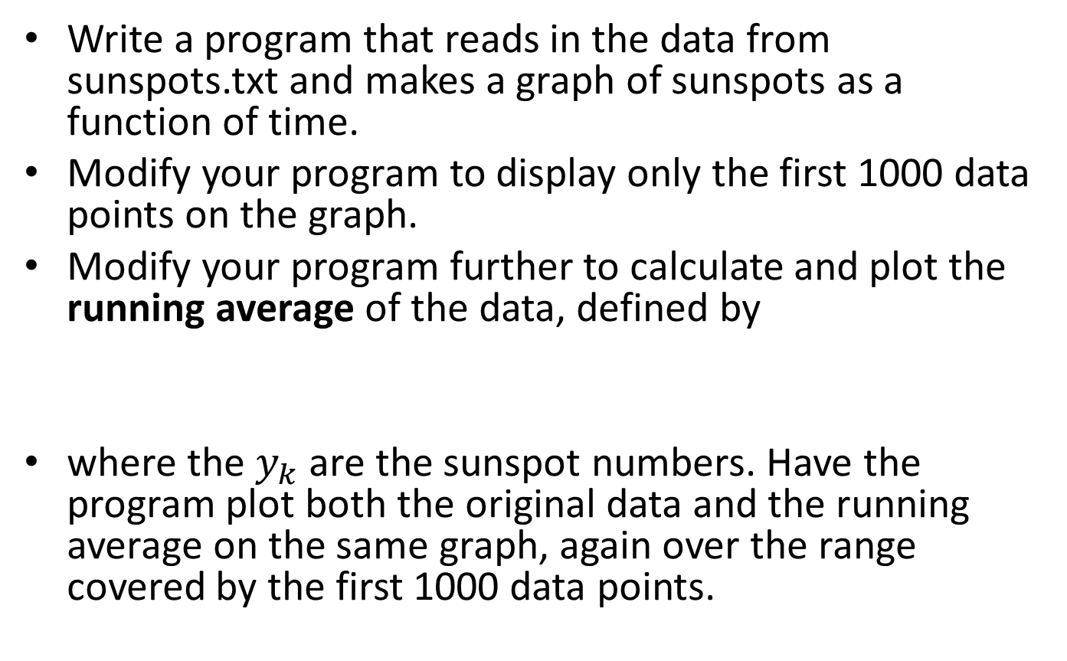
Try: Plotting Experimental Data
Write a program that reads in the data from sunspots.txt and makes a graph of sunspots as a function of time.
Modify your program to display only the first 1000 data points on the graph.
Modify your program further to calculate and plot the running average of the data, defined by
where the $y_{k}$ are the sunspot numbers. Have the program plot both the original data and the running average on the same graph, again over the range covered by the first 1000 data points.
$$Y_{k}=\frac{1}{10}\sum_{m=−5}^{5}{y_{k+m}}$$

Slide 13
Pylab: Scatter Plots
from pylab import scatter,xlabel,ylabel,xlim,ylim,show
from numpy import loadtxt
data = loadtxt("stars.txt",float)
x = data[:,0]
y = data[:,1]
scatter(x,y)
xlabel("Temperature")
ylabel("Magnitude")
xlim(0,13000)
ylim(-5,20)
show()

Slide 14
Density Plot: imshow()
data=2D array
imshow(data)
Change origin
imshow(data,origin="lower")
Change color to grey scale
gray()
Change the scale marks (but not the actual content)
imshow(data,extent=[0,10,0,5])
Change aspect ratio
imshow(data,aspect=2.0)

Slide 15

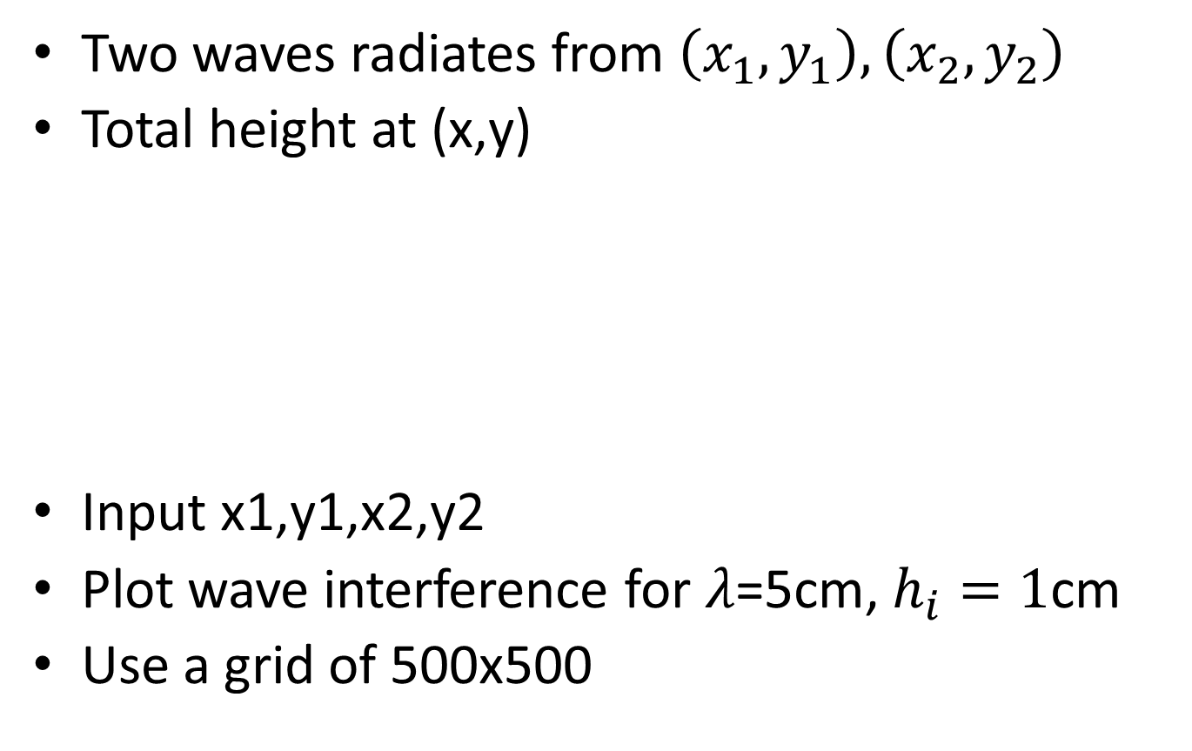


Try: Wave Interference
Two waves radiates from $\left(x_{1},y_{1}\right),\left(x_{2},y_{2}\right)$
Total height at (x,y)
Input x1,y1,x2,y2
Plot wave interference for $λ\text{=5}$cm, $h_{i}=1$cm
Use a grid of 500x500
$$h\left(x,y\right)=h_{1}sin\left(kr_{1}\right)+h_{2}sin\left(kr_{2}\right)$$
$$r_{i}=\sqrt{{\left(x−x_{i}\right)}^{2}+{\left(y−y_{i}\right)}^{2}}$$
$$k=2π/λ$$

Slide 16
Try: STM
There is a file in the on-line resources called stm.txt, which contains a grid of values from scanning tunneling microscope measurements of the (111) surface of silicon. A scanning tunneling microscope (STM) is a device that measures the shape of a surface at the atomic level by tracking a sharp tip over the surface and measuring quantum tunneling current as a function of position. The end result is a grid of values that represent the height of the surface and the file stm.txt contains just such a grid of values. Write a program that reads the data contained in the file and makes a density plot of the values. Use the various options and variants you have learned about to make a picture that shows the structure of the silicon surface clearly.

Slide 17
Pylab: Subplots
subplot(*args, **kwargs)
Return a subplot axes positioned by the given grid definition.
subplot(nrows, ncols, plot_number)
Where nrows and ncols are used to notionally split the figure into nrows * ncols sub-axes, and plot_number is used to identify the particular subplot that this function is to create within the notional grid. plot_number starts at 1, increments across rows first and has a maximum of nrows * ncols.
In the case when nrows, ncols and plot_number are all less than 10, a convenience exists, such that the a 3 digit number can be given instead, where the hundreds represent nrows, the tens represent ncols and the units represent plot_number.
For instance: subplot(211)

Slide 18
Pylab: Logplot
semilogx(*args, **kwargs)
Make a plot with log scaling on the x axis.
semilogy(*args, **kwargs)
Make a plot with log scaling on the y axis.
loglog(*args, **kwargs)
Make a plot with log scaling on both the x and y axis.

Slide 19
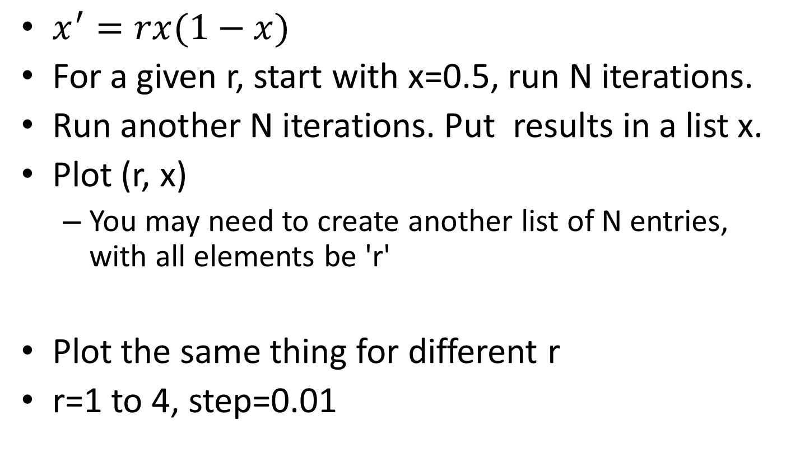
Try: Deterministic Chaos
$x^{′}=rx(1−x)$
For a given r, start with x=0.5, run N iterations.
Run another N iterations. Put results in a list x.
Plot (r, x)
You may need to create another list of N entries, with all elements be 'r'
Plot the same thing for different r
r=1 to 4, step=0.01

Slide 20
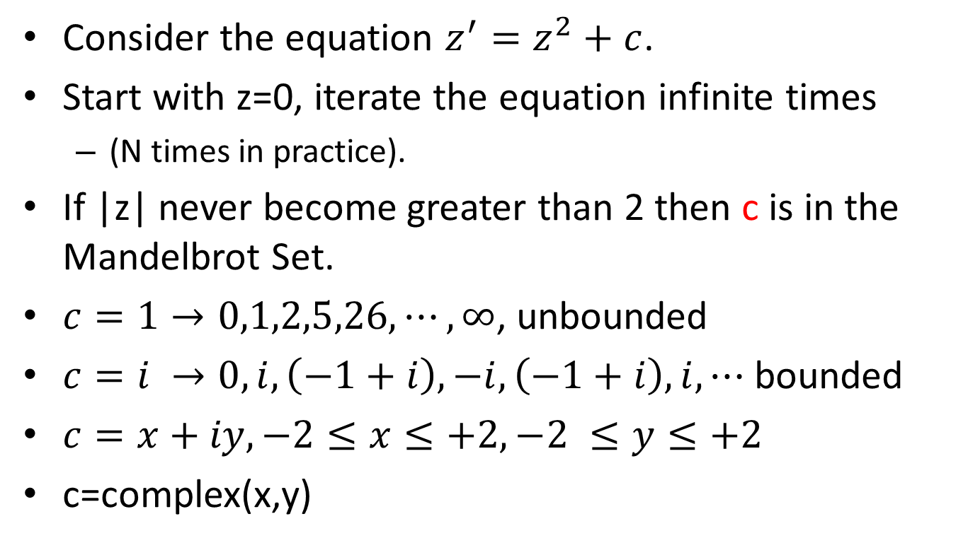
Mandelbrot Set
Consider the equation $z^{′}=z^{2}+c$.
Start with z=0, iterate the equation infinite times
(N times in practice).
If |z| never become greater than 2 then c is in the Mandelbrot Set.
$c=1→0,1,2,5,26,⋯,∞$, unbounded
$c=i →0,i,\left(−1+i\right),−i,\left(−1+i\right),i, ⋯$ bounded
$c=x+iy, −2≤x≤+2, −2 ≤y≤+2$
c=complex(x,y)

Slide 21
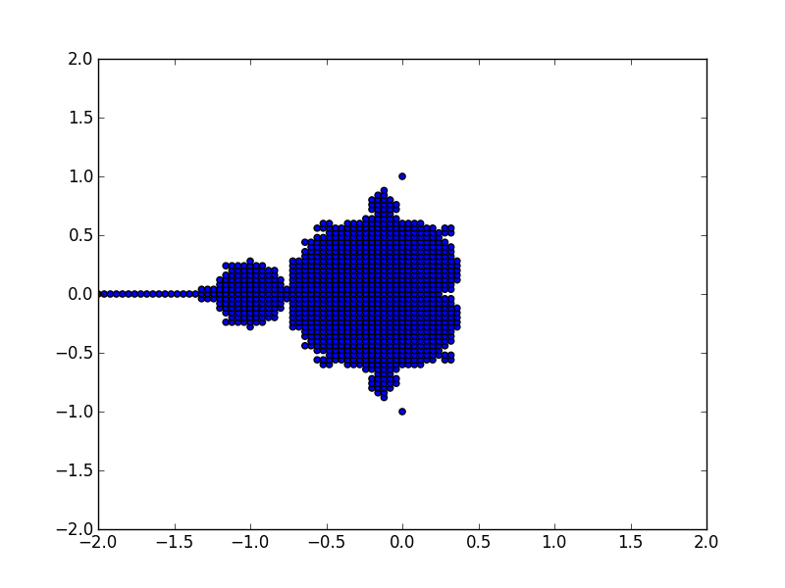
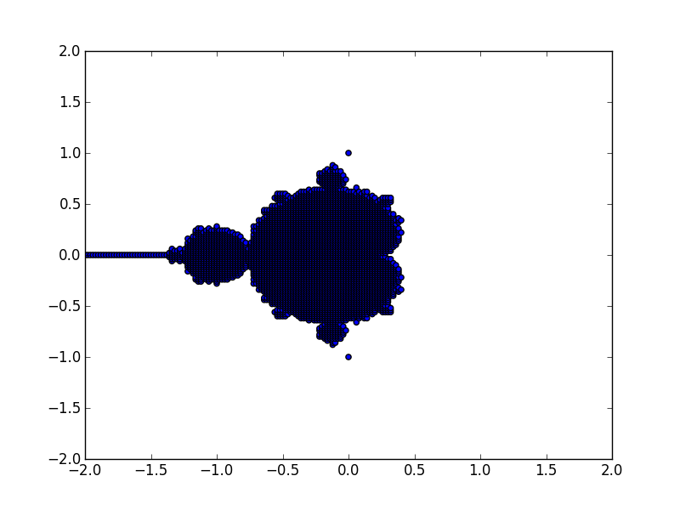
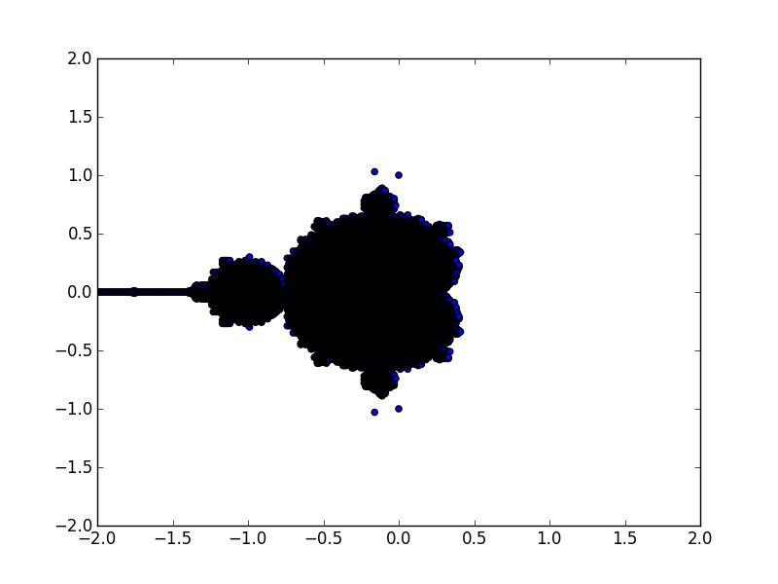
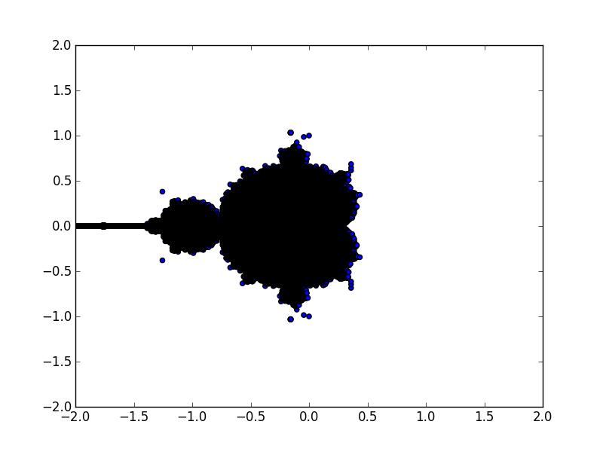
Mandelbrot Set
100X100
200X200
400X400
800X800

Slide 22
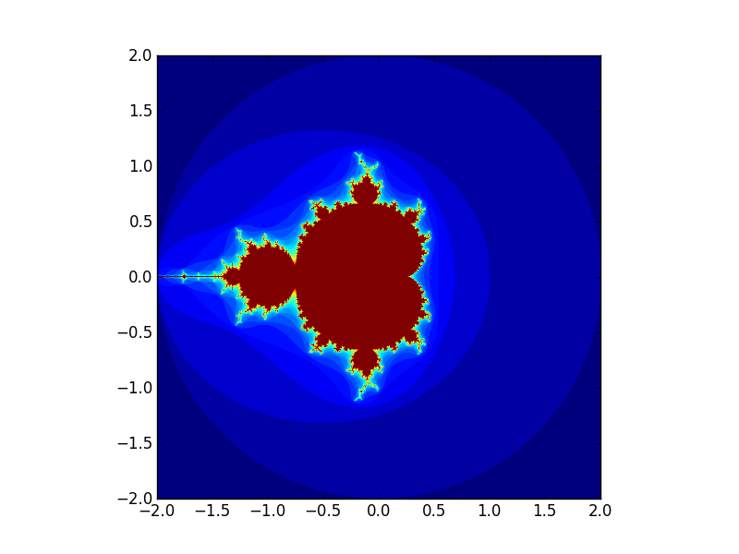
Mandelbrot Set

