Slide 1
Transport by non-overlapping magnetic cells at large Kubo number
B. Y. Zhang¹, P. H. Diamond², H. Che³
1. Research Institute for Applied Mechanics, Kyushu University
2. Department of Physics, University of California
3. Goddard Space Flight Center, NASA

Slide 2
Outline
Background and original results
New progress
Problems and another method
Summary and future plan

Slide 3
Background and original results
How particles transport between non-overlapping cells is an important topic in fusion plasma.
Overlapping case: particles can transport directly from cell to cell while streaming along wandering filed lines.
(a)
Non-overlapping case (cells sit at near overlap):
transport is a synergy of motion due cells and random kicks.
(b)
?
The key of transport over gap is random kicks (ambient diffusion): collision, micro-turbulence
Motion due cell
Small gap
Notes:
重新画图，画梯度
要记住，没有diffusion，就什么都没有；如果重合，就是雪崩

Slide 4
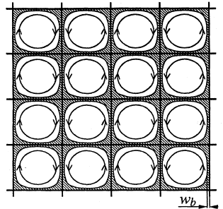


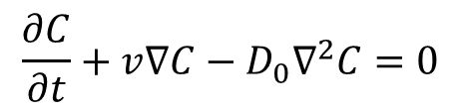
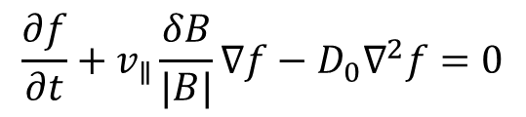
Background and original results
This relates to classic problem studied by Taylor, Moffat, Rosenbluth, … , which discusses the laminar convective flows under the condition of infinite Kubo number.
?
The convective diffusion transport is equivalent to the transport by magnetic cells.
Large Kubo number means strong scattering and long correlation.
Fluid case
MHD case
$$\vec{v}=∇ψ×\hat{z}$$
$$\vec{δB}=∇ψ×\hat{z}$$
$$\frac{∂C}{∂t}+v∇C−D_{0}∇^{2}C=0$$
$$\frac{∂f}{∂t}+v_{∥}\frac{δB}{|B|}∇f−D_{0}∇^{2}f=0$$
Small Ku
Large ku
kick
Notes:
In the case of infinite Kubo number, the whole cell is correlated, leading to particle trapped inside the cell if there is no random kick.
The ambient diffusion plays a key role for particles to transport between cells.

Slide 5

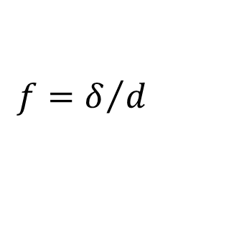
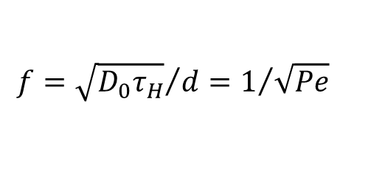





Background and original results
Definition of effective diffusion coefficient D*:
$$D^{∗}={L^{2}}/{τ_{conf}}$$
The key to solve convective flow problem is boundary layers packing fraction f:
?
$$f=δ/d$$
Define:
$$τ_{H}=d/v$$
$$τ_{D}=d^{2}/D_{0}$$
d
Peclet number:
$Pe=$ $τ_{D}$/ $τ_{H}=vd/D_{0}$
L
$${δ^{2}=D}_{0}τ_{H}$$
$$f={\sqrt{D_{0}τ_{H}}}/d=1/{\sqrt{Pe}}$$
M. N. Rosenbluth et al., Phys. Fluids 30, 2636 (1987)
$$D^{∗}=fd^{2}/τ_{H}=\sqrt{Pe}D_{0}$$
The previous work was under the condition of near-overlapping cells and regular pattern. How about the transport under the condition of multiple sizes and irregular pattern?
Notes:
tau_D is the time for molecular diffusion of a particle through a roll
Where $τ_{H}=d/v$is the time for circulation around the roll.

Slide 6
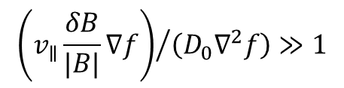
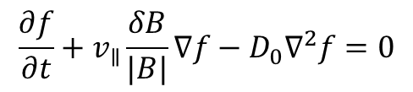
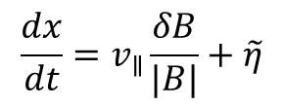

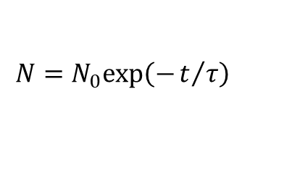
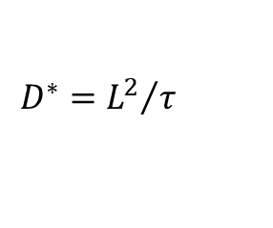
Background and original results
Setup magnetic cells
$$\frac{∂f}{∂t}+v_{∥}\frac{δB}{|B|}∇f−D_{0}∇^{2}f=0$$
$$\frac{dx}{dt}=v_{∥}\frac{δB}{|B|}+\tilde{η}$$
Random force
Video: it’s too big for email
Large Peclet number condition:
$${\left(v_{∥}\frac{δB}{|B|}∇f\right)}/{\left(D_{0}∇^{2}f\right)}≫1$$
$$v_{∥}≫\tilde{η}$$
$$N=N_{0}exp\left(−t/τ\right)$$
-t/τ dependence of ln(N/N0)
$$D^{∗}={L^{2}}/τ$$
Notes:
A particle trapped in one cell, unless it is kicked to another cell by ambient diffusion.

Slide 7

Background and original results
Rosenbluth condition (gap width ~ 0)
$$D^{∗}=\sqrt{Pe}D_{0}∝{Pe}^{1/2}$$
Simulation and theory fit well at Rosenbluth condition.
Notes:
应该是m=5，n=5:15

Slide 8
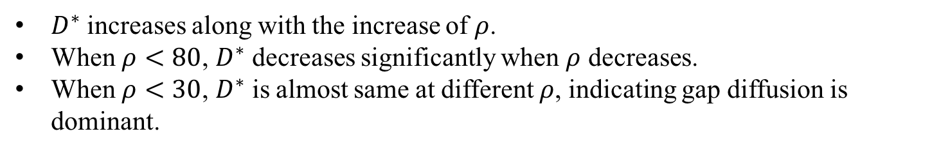
New progress
Case 1: Scan of gap width (size ratio $ρ$=cell width /gap width)
$D^{∗}$ increases along with the increase of $ρ$.
When $ρ<80$, $D^{∗}$ decreases significantly when $ρ$ decreases.
When $ρ<30$, $D^{∗}$ is almost same at different $ρ$, indicating gap diffusion is dominant.

Slide 9
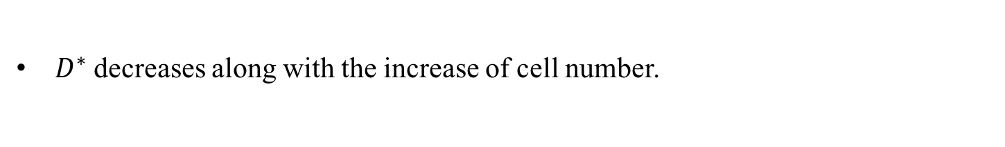
New progress
Case 2: Scan of cell number at fixed ratio
$D^{∗}$decreases along with the increase of cell number.

Slide 10
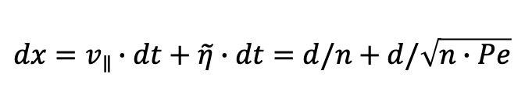
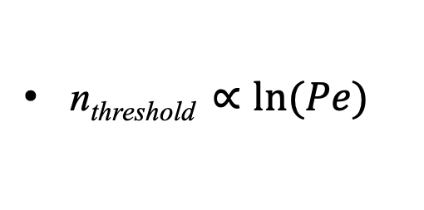
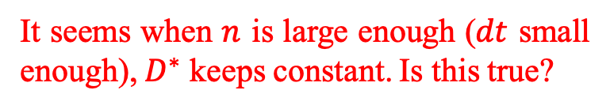
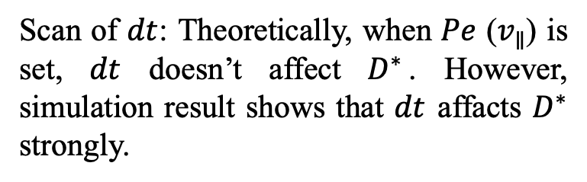





Problem: the method ($D^{∗}={L^{2}}/τ$) doesn’t work well
Problem 1, in convective diffusivity case:
Scan of $dt$: Theoretically, when $Pe$ ($v_{∥}$) is set, $dt$ doesn’t affect $D^{∗}$. However, simulation result shows that $dt$ affacts $D^{∗}$ strongly.
$$dx=v_{∥}·dt+\tilde{η}·dt$$
n_{threshold}
where $v_{∥}$ and $\tilde{η}$ is determined by
$$D_{0}={\tilde{η}}^{2}·dt$$
$$Pe=v_{∥}d/D_{0}$$
Define: $n=d/\left(v_{∥}dt\right)$, large $n$ means small $dt$
$$dx=v_{∥}∙dt+\tilde{η}∙dt=d/n+d/\sqrt{n∙Pe}$$
$$n_{threshold}=n\left(slope=1\right)$$
n_{threshold} $∝ln⁡(Pe)$
It seems when $n$ is large enough ($dt$ small enough), $D^{∗}$ keeps constant. Is this true?

Slide 11
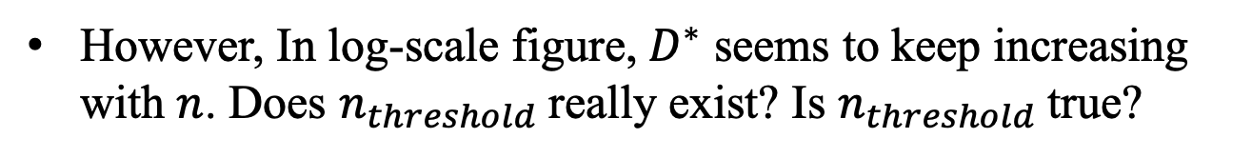
Problem: the method ($D^{∗}={L^{2}}/τ$) doesn’t work well
Problem 1, in convective diffusivity case:
However, In log-scale figure, $D^{∗}$ seems to keep increasing with $n$. Does $n_{threshold}$ really exist? Is $n_{threshold}$ true?

Slide 12
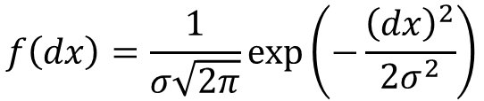
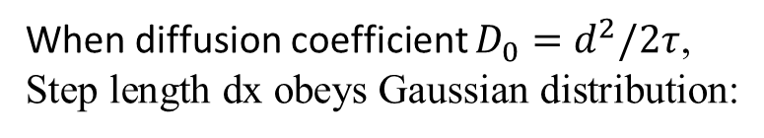
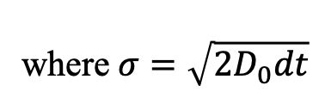
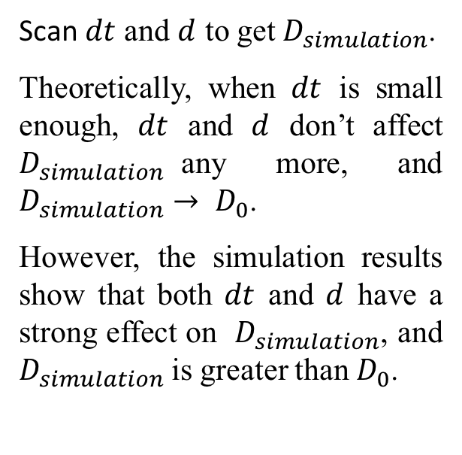
Problem: the method ($D^{∗}={L^{2}}/τ$) doesn’t work well
Problem 2, in pure diffusive case (1D):
When diffusion coefficient $D_{0}=d^{2}/2τ$, Step length dx obeys Gaussian distribution:
$$f\left(dx\right)=\frac{1}{σ\sqrt{2π}}\exp\left(−\frac{{\left(dx\right)}^{2}}{2σ^{2}}\right)$$
where $σ=\sqrt{{2D}_{0}dt}$
Howard C. Berg, Random Walks, Princeton University Press, 1993
Scan $dt$ and $d$ to get $D_{simulation}$.
Theoretically, when $dt$ is small enough, $dt$ and $d$ don’t affect $D_{simulation}$any more, and $D_{simulation}→ D_{0}$.
However, the simulation results show that both $dt$ and $d$ have a strong effect on $D_{simulation}$, and $D_{simulation}$is greater than $D_{0}$.
Notes:
$\left\langle \left|dl\right|\right\rangle =\sqrt{D_{0}∗2dt}$
$\left\langle \left|dx\right|\right\rangle =2\sqrt{\frac{D_{0}∗dt}{π}}<\left\langle \left|dl\right|\right\rangle$
$\text{注意} σ\left(dx\right)=RMS\left(dx−\left\langle dx\right\rangle \right)≠\left\langle \left|dx\right|\right\rangle$,其中中间部分<dx>项为0
前两者平方后先平均再开根号，后者先开根号再平均

Slide 13
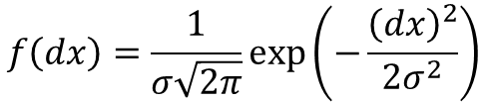
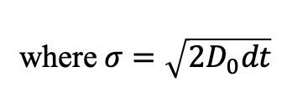

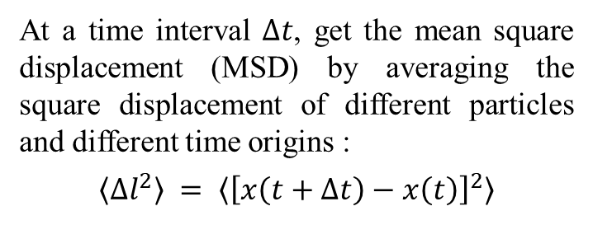
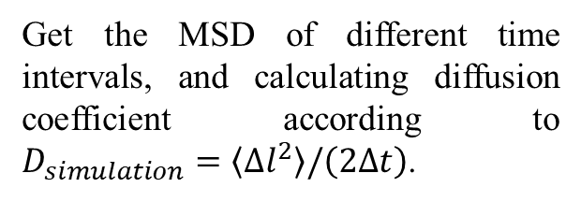
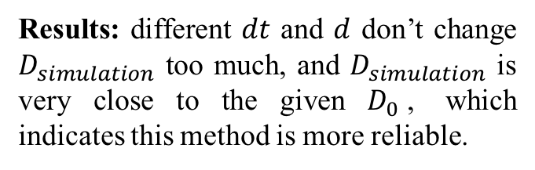
Another method
In pure diffusive case (1D):
$D_{0}=d^{2}/2τ$, set $D_{0}=1$
$$f\left(dx\right)=\frac{1}{σ\sqrt{2π}}\exp\left(−\frac{{\left(dx\right)}^{2}}{2σ^{2}}\right)$$
where $σ=\sqrt{{2D}_{0}dt}$
At a time interval $Δt$, get the mean square displacement (MSD) by averaging the square displacement of different particles and different time origins :
$$\left\langle {∆l}^{2}\right\rangle = \left\langle {\left[x\left(t+∆t\right)−x\left(t\right)\right]}^{2}\right\rangle$$
Get the MSD of different time intervals, and calculating diffusion coefficient according to $D_{simulation}=\left\langle {∆l}^{2}\right\rangle /\left(2∆t\right)$.
Results: different $dt$ and $d$ don’t change $D_{simulation}$ too much, and $D_{simulation}$ is very close to the given $D_{0}$, which indicates this method is more reliable.
D. Keffer, The Working Man‘s Guide to Obtaining Self Diffusion Coefﬁcients from Molecular Dynamics Simulations, University of Tennessee, Knoxville, Online, 2001.

Slide 14
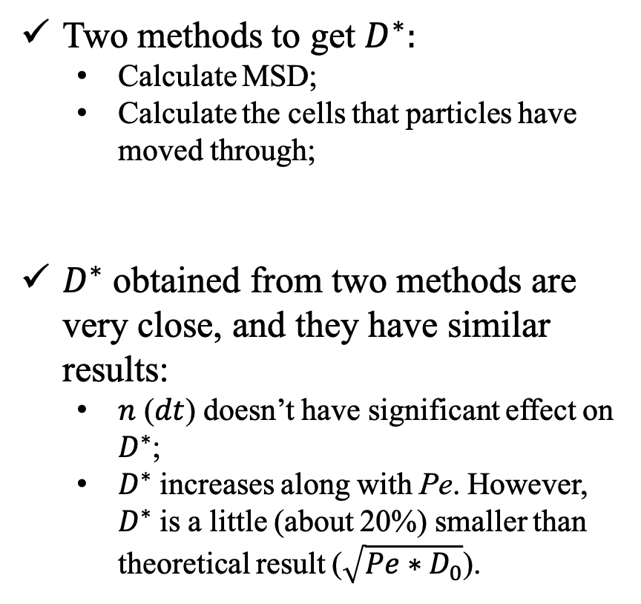
Another method
In convective diffusivity case (1D):
Two methods to get $D^{∗}:$
Calculate MSD;
Calculate the cells that particles have moved through;
$D^{∗}$ obtained from two methods are very close, and they have similar results:
$n$ ($dt$) doesn’t have significant effect on $D^{∗}$;
$D^{∗}$ increases along with Pe. However, $D^{∗}$ is a little (about 20%) smaller than theoretical result ($\sqrt{Pe∗D_{0}}$).
Rosenbluth et al., 1987, Phys. Fluids 30, 2636

Slide 15
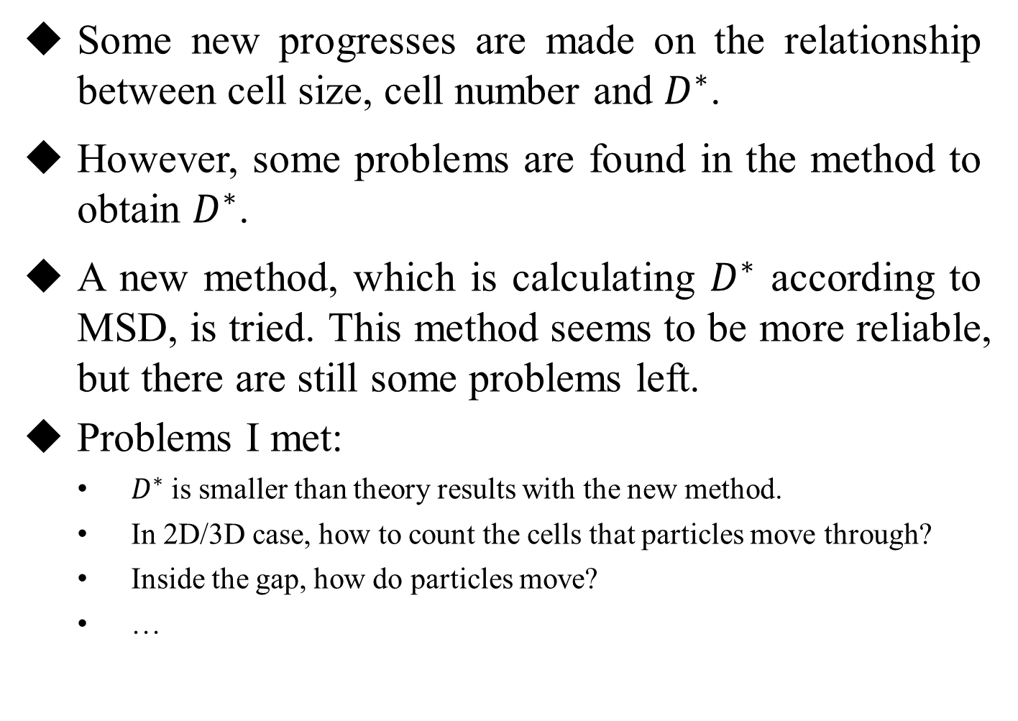
Summary
Some new progresses are made on the relationship between cell size, cell number and $D^{∗}$.
However, some problems are found in the method to obtain $D^{∗}$.
A new method, which is calculating $D^{∗}$ according to MSD, is tried. This method seems to be more reliable, but there are still some problems left.
Problems I met:
$D^{∗}$ is smaller than theory results with the new method.
In 2D/3D case, how to count the cells that particles move through?
Inside the gap, how do particles move?
…

