Slide 1
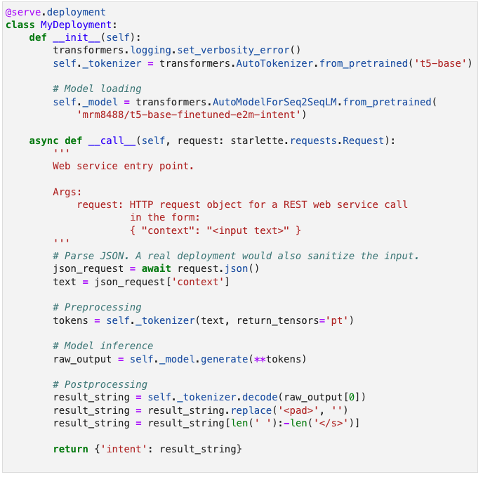
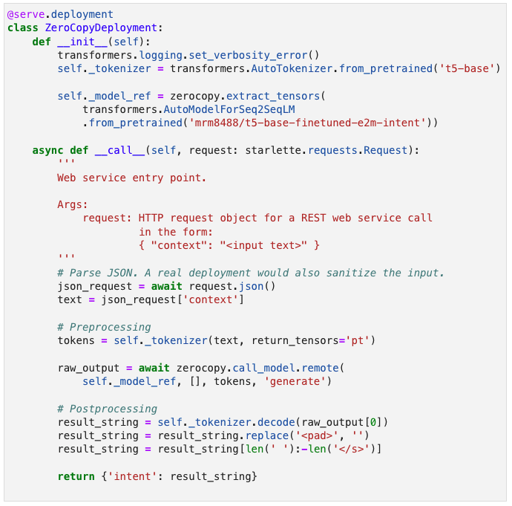
Deep learning model deployment with Ray Serve
The same deployment
using zero-copy model loading
Change 1: Store model on Plasma
Change 2: Run inference in stateless background teasks.

