Slide 1
Monte Carlo Control for Grid-Based Path Finding
Machine Learning Exercise 3 – Reinforcement Learning
Group Members (Group 16)
Felix Schmidt (12002283)
Muhammad Adeel Shakir (12414972)
Muhammad Abid (12436490)
Machine Learning (2025W)
TU Wien

Slide 2
Problem Definition
Goal: learn an optimal policy to navigate an agent to a target cell
Environment modeled as a 2D grid world
Some cells are blocked by obstacles
Agent starts from a fixed start position
Episode ends when:
  the target is reached, or
  a maximum number of steps is exceeded
Notes:
The task is a path-finding problem where an agent must learn how to reach a target position in a grid while avoiding obstacles. The environment is episodic, and the agent does not know the dynamics in advance.

Slide 3
Environment and Grid World Setup
Environment represented as a grid of cells
Each cell can be:
  free space
  obstacle
  target (goal)
Agent state includes:
  grid position (row, col)
Action space:
  discrete moves (up, down, left, right)
Reward structure:
  negative reward per step
  positive reward for reaching target
Notes:
The environment is implemented as a grid world. The agent observes its current position and chooses one of the available actions. Rewards are designed to encourage reaching the target quickly while penalizing unnecessary movement.

Slide 4
Monte Carlo Control (First-Visit, ε-Greedy)
Reinforcement Learning method based on Monte Carlo Control
Learns action-value function Q(s, a) from complete episodes
Uses First-Visit Monte Carlo updates
Policy improvement via ε-greedy exploration
No model of environment required (model-free RL)
Notes:
We use First-Visit Monte Carlo Control, which updates Q-values only on the first occurrence of a state–action pair in an episode. The policy is improved using an epsilon-greedy strategy to balance exploration and exploitation.

Slide 5
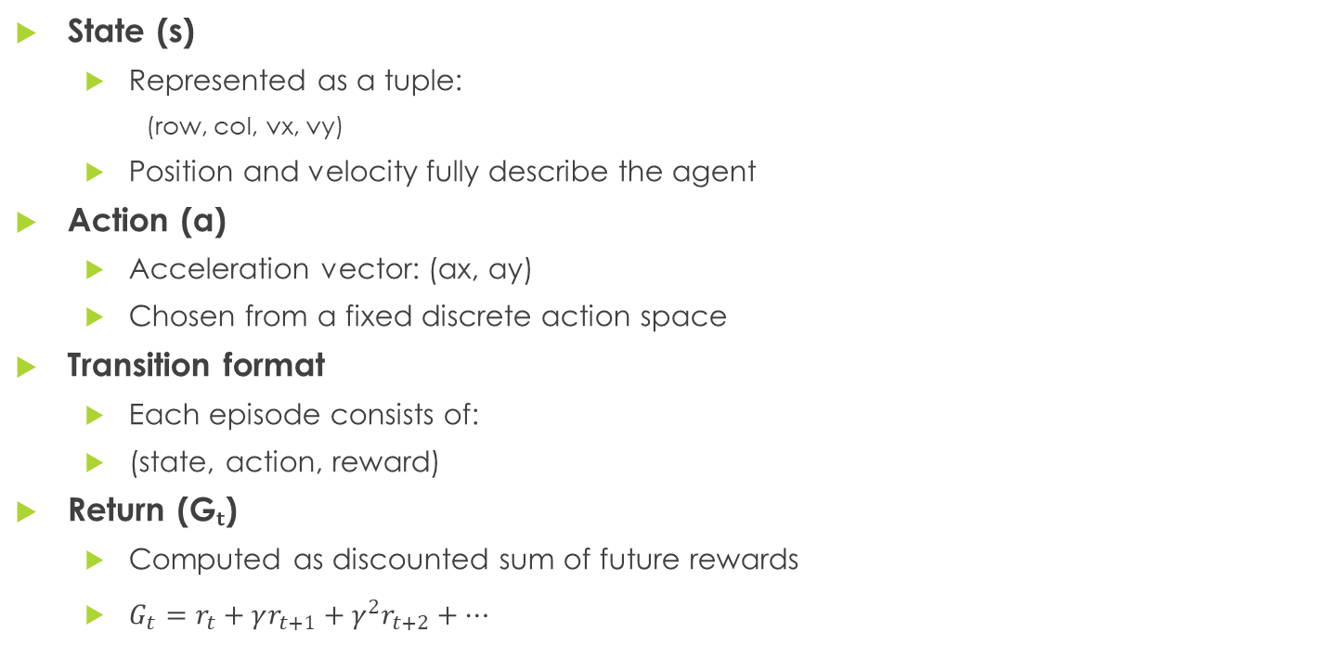
State, Action and Return Representation
State (s)
  Represented as a tuple:
    (row, col, vx, vy)
  Position and velocity fully describe the agent
Action (a)
  Acceleration vector: (ax, ay)
  Chosen from a fixed discrete action space
Transition format
  Each episode consists of:
  (state, action, reward)
Return (Gₜ)
  Computed as discounted sum of future rewards
  $G_{t}=r_{t}+γr_{t+1}+γ^{2}r_{t+2}+…$
Notes:
We explicitly define state, action, and transitions ourselves. Returns are computed after the episode ends, which is a key property of Monte Carlo methods.

Slide 6
Episode Generation using ε-Greedy Policy
Policy type
  ε-greedy policy derived from current Q-values
  Balances exploration and exploitation
Action selection
  With probability ε → choose random action
  With probability 1 − ε → choose action with highest Q(s, a)
Episode generation
  Start from environment reset
  Collect transitions: (state, action, reward)
  Stop when:
    target reached (done=True), or
    maximum steps reached
Notes:
Episodes are generated on-policy using ε-greedy exploration. This allows the agent to gradually shift from exploration to exploitation as training progresses.

Slide 7
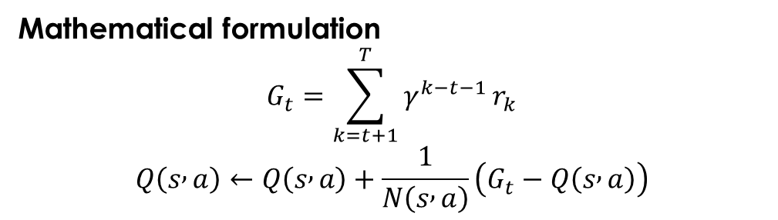
First-Visit Monte Carlo Update Rule
Learning method
  First-Visit Monte Carlo Control
  Updates Q(s, a) once per episode
Return calculation
  Full episode is generated first
  Returns computed backward using discount factor γ
Update rule
  Uses incremental mean to estimate expected return
Mathematical formulation
$$G_{t}=\sum_{k=t+1}^{T}{γ^{k−t−1}}r_{k}$$
$$Q\left(s , a\right)←Q\left(s , a\right)+\frac{1}{N\left(s , a\right)}\left(G_{t}−Q\left(s , a\right)\right)$$
Notes:
We use first-visit Monte Carlo, meaning each state-action pair is updated only on its first occurrence per episode. This avoids bias from repeated visits within the same trajectory.

Slide 8
Training Configuration and Hyperparameters
Training algorithm
  Monte Carlo Control (First-Visit)
  ε-greedy exploration policy
Main hyperparameters
  Number of episodes: 5,000 → 15,000
  Discount factor γ = 1.0
  Initial ε = 0.2
  Final ε = 0.05
  Maximum steps per episode = 500 / 800
Exploration strategy
  Linear ε-decay over episodes
Notes:
We gradually reduce exploration using linear epsilon decay. For the hard grid, we increased both the number of episodes and the episode length, which significantly increased training time but still did not guarantee convergence.

Slide 9
Experimental Setup
Evaluated on three grid environments:
  Easy grid: small size, few obstacles
  Medium grid: moderate size and obstacles
  Hard grid: larger grid with many obstacles
For each grid:
  Train Monte Carlo Control agent
  Measure:
    training runtime
    learned Q-table size
    greedy policy performance
Final policy evaluated using greedy action selection (ε = 0)
Notes:
We trained and evaluated the agent on three grids of increasing difficulty. For evaluation, we used a greedy policy to assess whether the learned Q-values result in a successful path to the target.

Slide 10
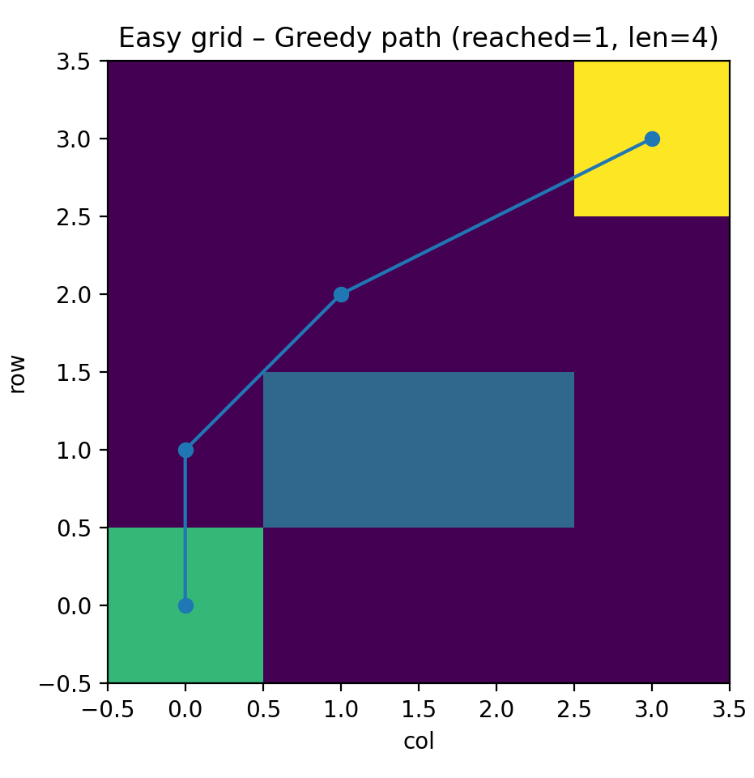
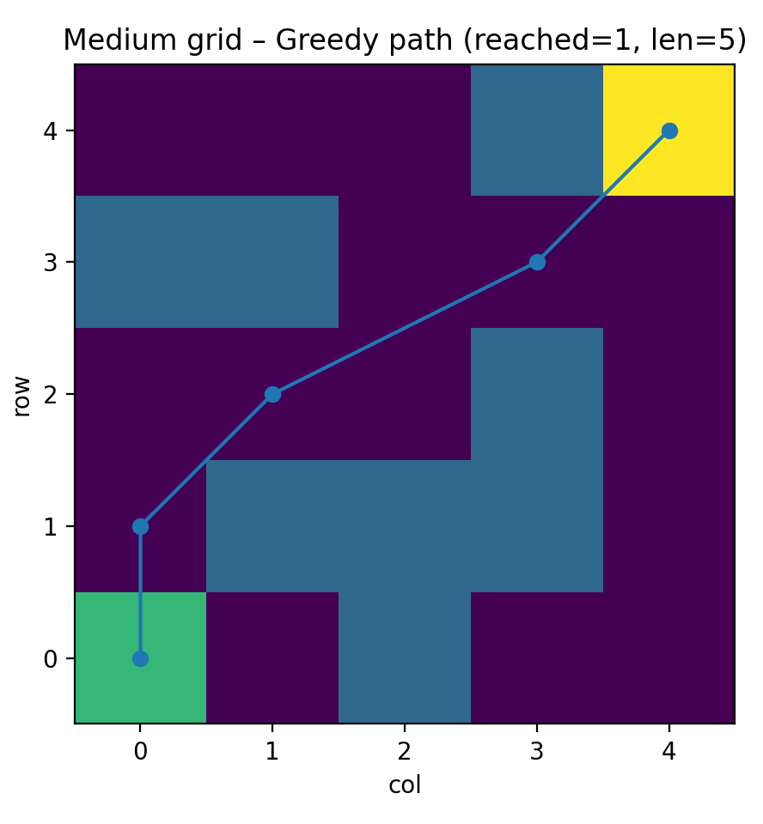
Results on Easy and Medium Grids
Easy grid
  Agent successfully learns a short path to the target
  Fast convergence
  Stable greedy policy
Medium grid
  Requires more exploration
  Still converges to a valid solution
  Slightly longer paths, but consistent success
Greedy policy evaluation
  ε set to 0
  Policy follows highest Q-value actions
Notes:
For the easy and medium grids, the Monte Carlo agent learns a reliable policy. The greedy rollout clearly shows that the agent reaches the target efficiently after training.

Slide 11
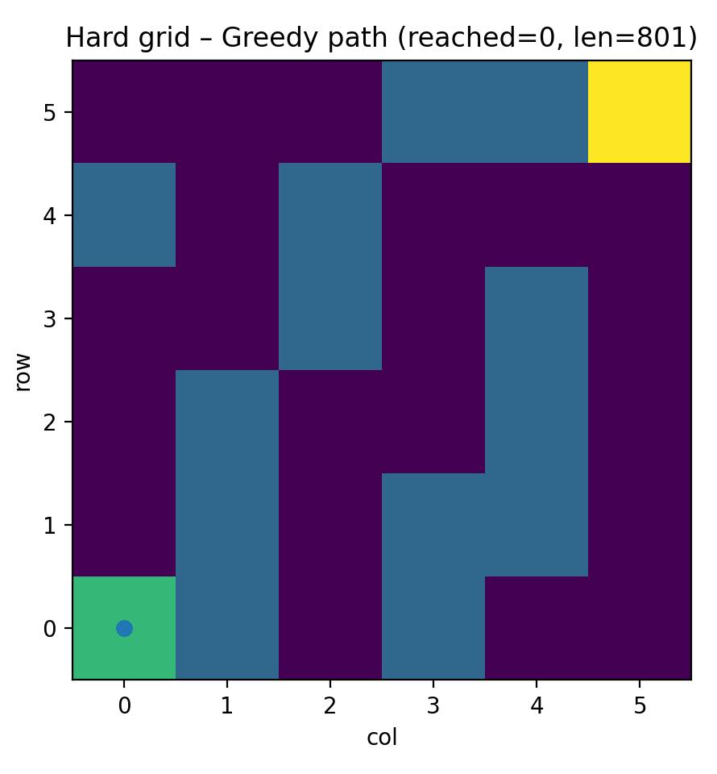

Results on Hard Grid – Failure Analysis
Hard grid characteristics
  Larger grid size
  High number of obstacles
  Much larger state–action space
Observed behavior
  Training time increases drastically
  Q-table grows, but policy does not converge
  Greedy policy fails to reach the target
Key reason
  Sparse rewards and long episodes
  Monte Carlo updates require full episode completion
Notes:
On the hard grid, Monte Carlo Control struggles due to the large state space and sparse reward signal. Even with increased training time and episode length, the learned policy does not reliably reach the target.

Slide 12
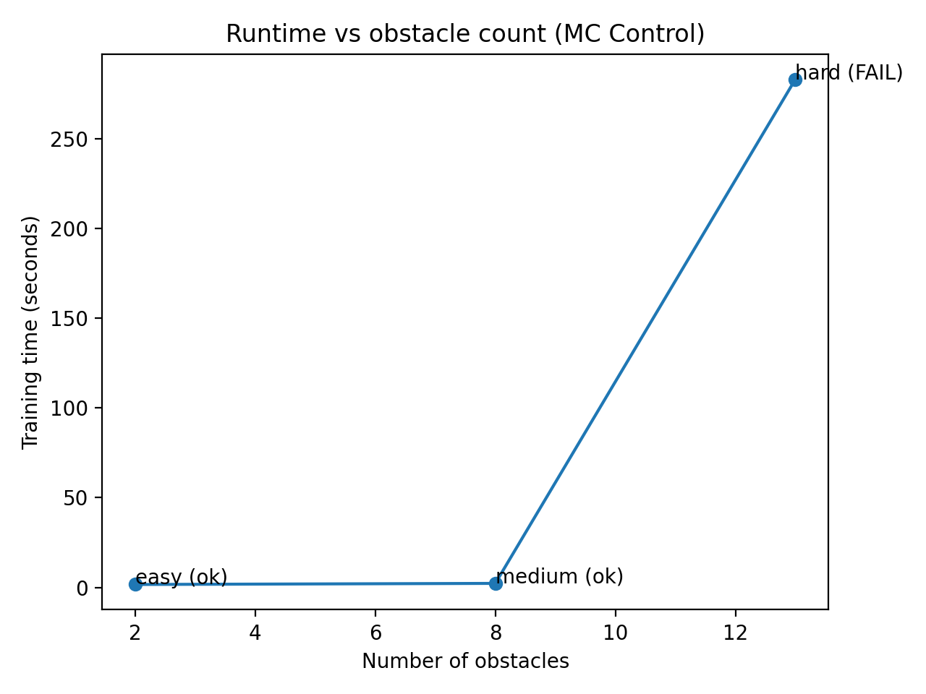
Runtime Analysis and Key Takeaways
Runtime behavior
  Training time increases sharply with grid complexity
  Hard grid requires orders of magnitude more computation
Scalability limitation
  Monte Carlo Control does not scale well to large state spaces
  Long episodes + sparse rewards slow convergence
Key takeaway
  Monte Carlo Control works well for small and medium problems
  Alternative methods (e.g., TD learning) are better suited for harder grids
Training runtime as a function of grid difficulty (number of obstacles)
Notes:
Our experiments show that Monte Carlo Control is effective for smaller environments but becomes computationally expensive and unreliable as the environment complexity increases. This highlights an important limitation of Monte Carlo methods in reinforcement learning.

Slide 13
Reproducibility and Implementation Details
From-scratch implementation
  No RL libraries used (e.g., no Gym, no Stable-Baselines)
  All components implemented manually
Reproducibility
  Fixed random seeds during training
  Deterministic environment dynamics
Code structure
  Clear separation:
    environment (grid.py)
    episode generation (episode.py)
    learning (montecarlo.py)
    evaluation (benchmark.py)
Results reproducibility
  Same trends observed across repeated runs
  Hard grid consistently fails due to algorithmic limitations

