Slide 1

Computer System Servicing

Slide 2
Power ISO Software
PowerISO is a powerful CD / DVD / BD image file processing tool, which allows you to open, extract, burn, create, edit, compress, encrypt, split and convert ISO files, and mount ISO files with internal virtual drive.

Slide 3
Features of Power ISO Software
• Support almost all CD / DVD / BD-ROM image file formats (ISO, BIN, NRG, CDI, DAA and so on).
• DAA file (Direct-Access-Archive) is an advanced format for image file, which supports some advanced features, such as compression, password protection, and splitting to multiple volumes.
• Create ISO file or BIN file from hard disk files or CD / DVD / BD discs.
• Edit ISO image file directly.
• Mount ISO file with internal virtual drive. PowerISO can mount all popular disc image files to built-in virtual drive.
• Convert image files between ISO / BIN and other formats. PowerISO can not only convert BIN to ISO, but also convert almost all image file formats to standard ISO image file.
• Create bootable USB drive. PowerISO allows you to setup Windows through USB drive.
• Make bootable ISO file and create bootable CD, DVD disc.
• Support both 32-bit and 64-bit Windows.

Slide 4
Disc Image
Disc images are copies of optical media -- CDs and DVDs -- that are saved as files on your computer's hard drive. These files can serve as backups if the original disc is damaged or lost. It's also possible to use the disc images by mounting them on a virtual CD/DVD drive, which makes your computer treat the disc image file as if it were a physical disc in a physical disc drive. This way you can use the disc without causing wear or damage to the physical CD or DVD.

Slide 5
ISO Vs. BIN Vs. DAA
ISO, BIN and DAA are three different file formats for storing disc images, or virtual copies of physical discs. ISO is the most common of the three formats, while DAA is the least common. Each format has advantages and disadvantages.

Slide 6
ISO File
ISO files contain a copy of the data on the disc as well as information about the disc's structure, such as file headers. Because the ISO format is so widespread, it's easy to find free programs to create and open them, which means you won't lose access to your data just because you lost access to a commercial disc image program.

Slide 7
BIN File
The file extension BIN stands for "binary." A BIN disc image file contains the data from a disc stored in binary format. A BIN file does not usually contain information about the disc's contents, like an ISO file does. Instead, it saves this information in a separate file with the same file name but a different extension -- usually CUE.

Slide 8
DAA File
The file extension DAA stands for "Direct-Access-Archive." DAA is a proprietary format created for PowerISO. A proprietary format is exclusive to a particular company or program; this means very few programs can open or convert DAA files compared to BIN or ISO files.

Slide 9

How to Install Power ISO Software
1. Insert the CD/DVD Installer to your ODD.

Slide 10
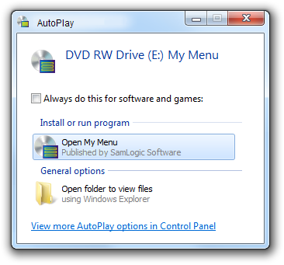
How to Install Power ISO Software
2. AutoPlay windows will appear.

Slide 11
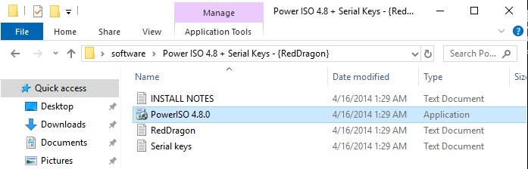
How to Install Power ISO Software
3. Select POWER ISO 4.8.0

Slide 12
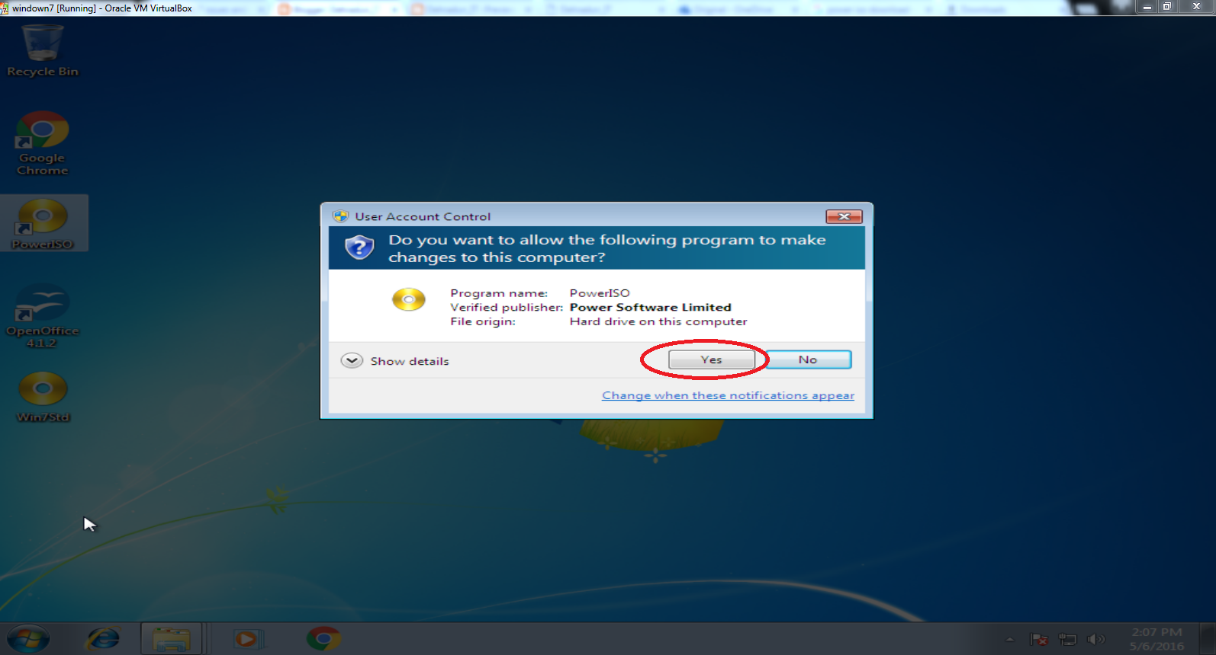
How to Install Power ISO Software
4. User Account Control icon will appear, Click YES

Slide 13
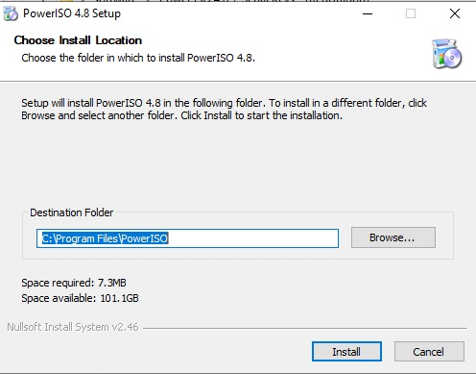
How to Install Power ISO Software
5. Click Install

Slide 14
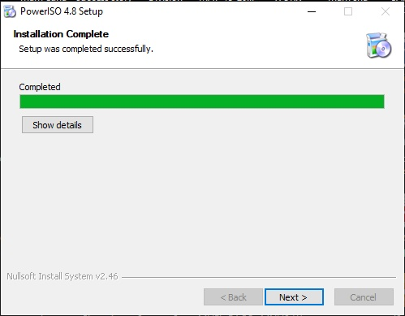
How to Install Power ISO Software
6. Click Next

Slide 15
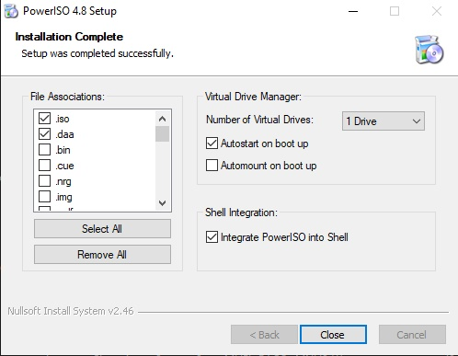
How to Install Power ISO Software
7. Select .ISO FILE, Click Close

Slide 16
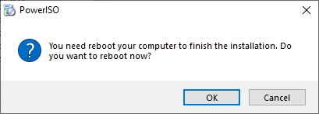
How to Install Power ISO Software
8. Computer will Reboot, Click OK

Slide 17

How to Install Power ISO Software
9. Computer’s Desktop, Select POWER ISO shortcut icon

Slide 18
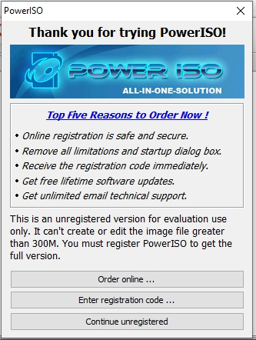
How to Install Power ISO Software
10. Open Power ISO 4.8.0

Slide 19
How to Install Power ISO Software
11. Select Enter Registration Code

Slide 20
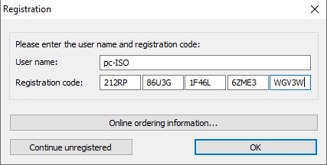
How to Install Power ISO Software
12. Enter Registration Code

Slide 21
How to Install Power ISO Software
13. Click OK

Slide 22
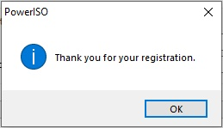
How to Install Power ISO Software
14. Confirmation Icon will Appear, Click OK

Slide 23

Create Bootable USB Drive using POWER ISO Software
1. Insert the Flash Drive to the USB Port.

Slide 24
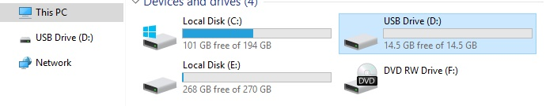
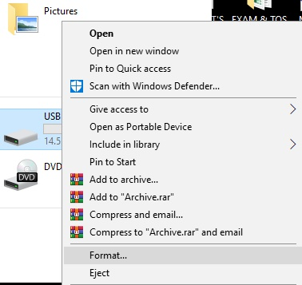
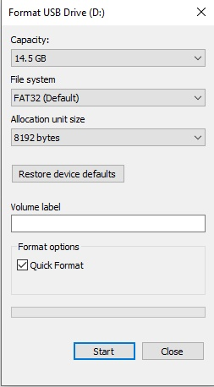
Create Bootable USB Drive using Command Prompt (CMD)
2. Format the Flash Drive
(Open My Computer/Select the Flash Drive/Right click/Select FORMAT/Choose START)

Slide 25
Create Bootable USB Drive using POWER ISO Software
3. Computer’s Desktop, Select POWER ISO shortcut icon

Slide 26
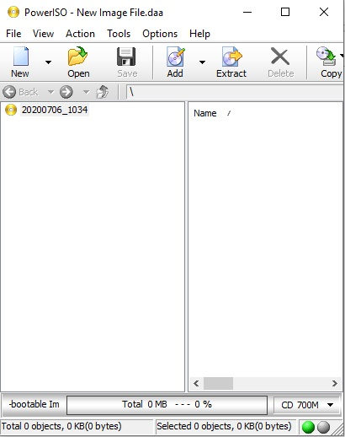
Create Bootable USB Drive using POWER ISO Software
4. Select TOOL TAB

Slide 27
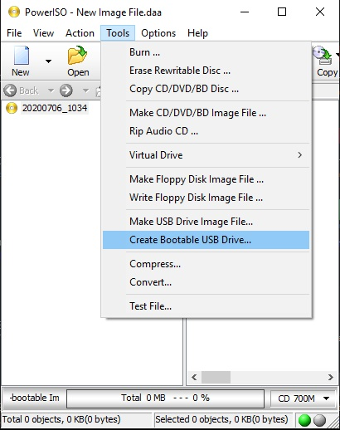
Create Bootable USB Drive using POWER ISO Software
5. Select Create Bootable USB Drive

Slide 28
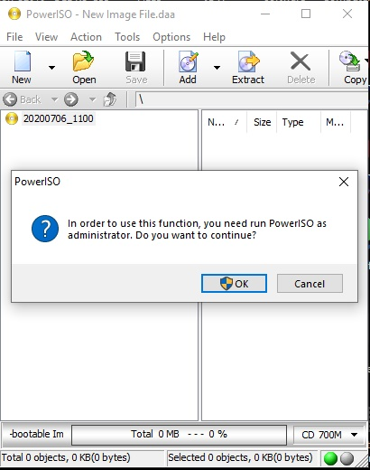
Create Bootable USB Drive using POWER ISO Software
6. Select run as Administrator/Click OK

Slide 29
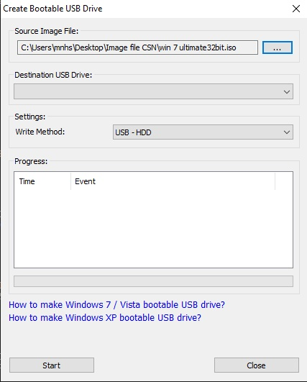
Create Bootable USB Drive using POWER ISO Software
7. Select Source Image File (….)

Slide 30
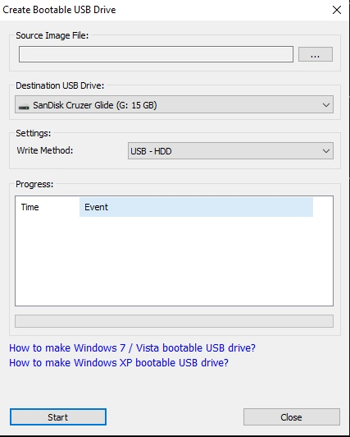
Create Bootable USB Drive using POWER ISO Software
8. Select Destination USB Drive

Slide 31
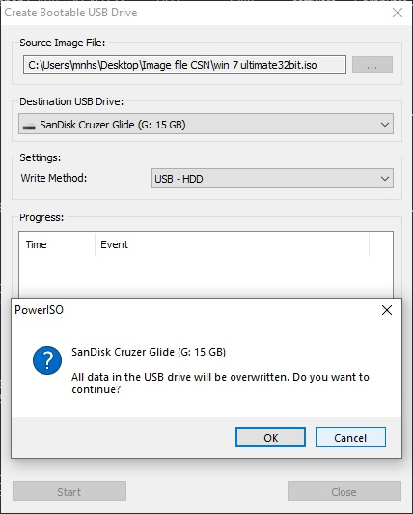
Create Bootable USB Drive using POWER ISO Software
9. Select Start button/Click OK

Slide 32
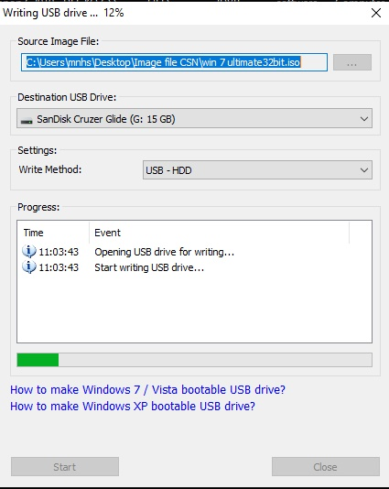
Create Bootable USB Drive using POWER ISO Software
10. Installation Progress will appear

Slide 33
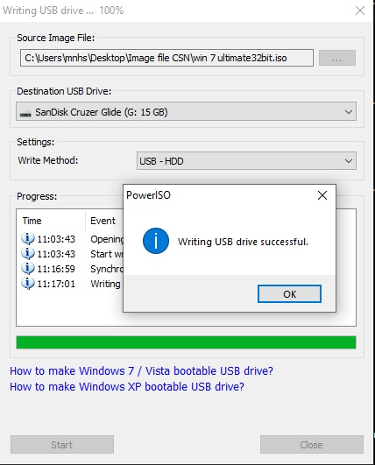
Create Bootable USB Drive using POWER ISO Software
11. Installation Progress Completed

Slide 34
THANK YOU!!!

