Slide 1

Computer System Servicing

Slide 2
Command Prompt
Command Prompt is a command line interpreter application available in most Windows operating systems. It's used to execute entered commands. Most of those commands automate tasks via scripts and batch files, perform advanced administrative functions, and troubleshoot or solve certain kinds of Windows issues.

Slide 3
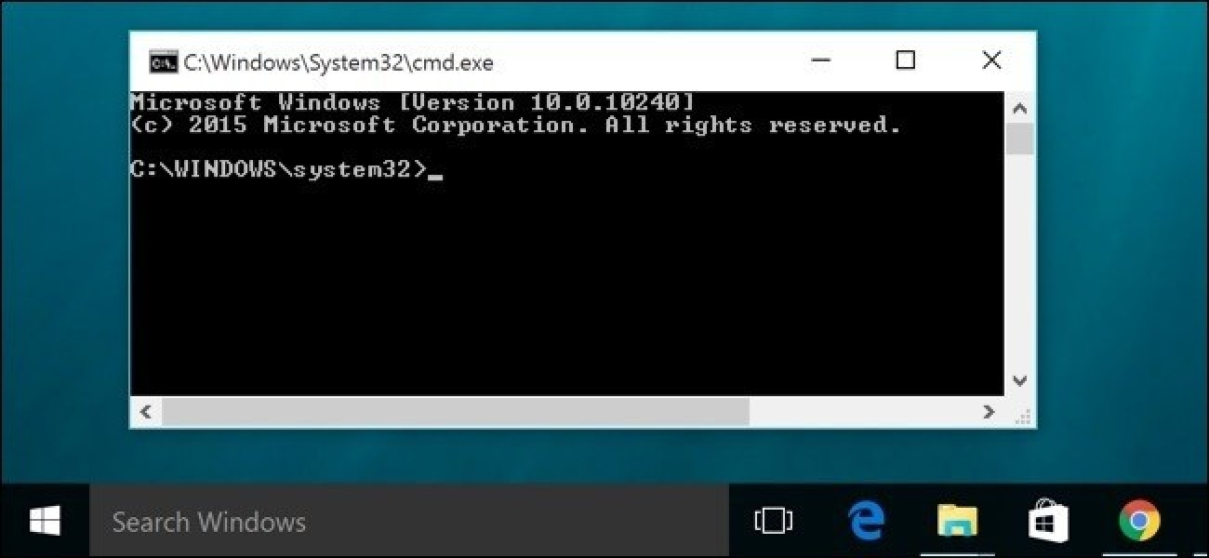
Command Prompt

Slide 4
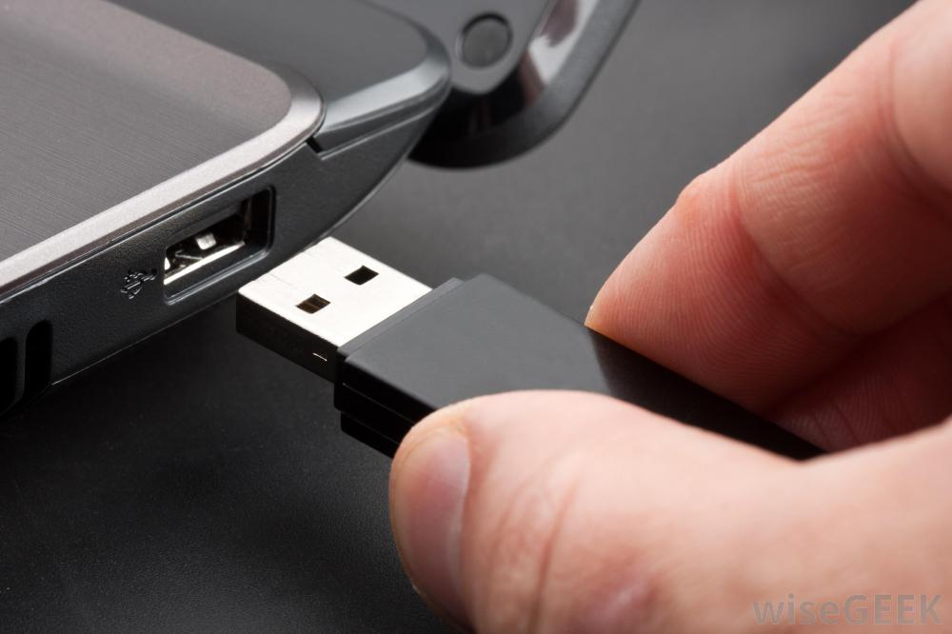
Create Bootable USB Drive using Command Prompt (CMD)
1. Insert the Flash Drive to the USB Port.

Slide 5
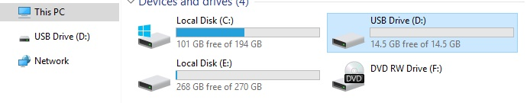
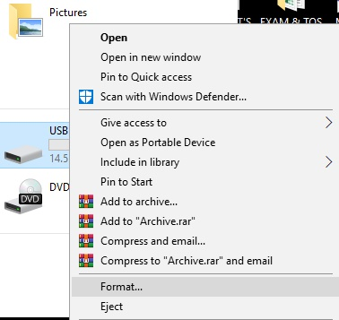
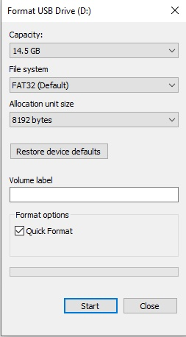
Create Bootable USB Drive using Command Prompt (CMD)
2. Format the Flash Drive
(Open My Computer/Select the Flash Drive/Right click/Select FORMAT/Choose START)

Slide 6
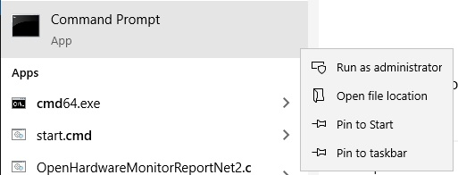
Create Bootable USB Drive using Command Prompt (CMD)
3. Open Command Prompt run as Administrator

Slide 7
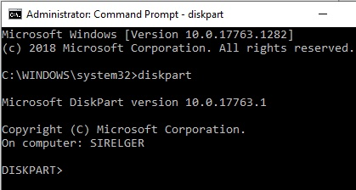
Create Bootable USB Drive using Command Prompt (CMD)
4. Type: DISKPART (Press ENTER)

Slide 8
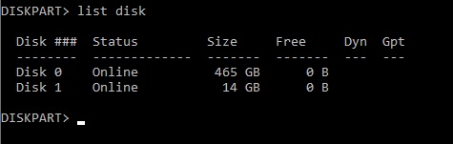
Create Bootable USB Drive using Command Prompt (CMD)
Type: LIST DISK
(Press ENTER)

Slide 9
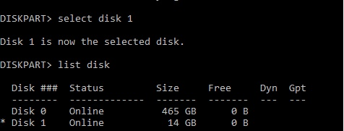
Create Bootable USB Drive using Command Prompt (CMD)
6.Type Select Disk 1
(Press ENTER)

Slide 10

Create Bootable USB Drive using Command Prompt (CMD)
7.Type: Clean
(Press ENTER)

Slide 11
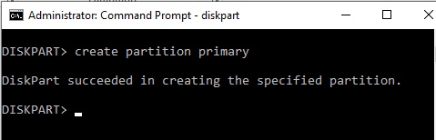
Create Bootable USB Drive using Command Prompt (CMD)
8.Type: Create Partition Primary (Press ENTER)

Slide 12
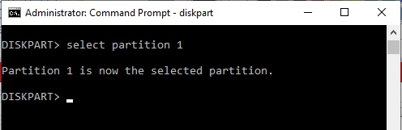
Create Bootable USB Drive using Command Prompt (CMD)
Type: Select Partition 1
(Press ENTER)

Slide 13
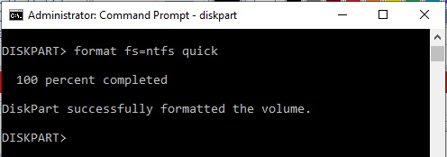
Create Bootable USB Drive using Command Prompt (CMD)
10.Type: format fs=ntfs quick
(Press ENTER)

Slide 14
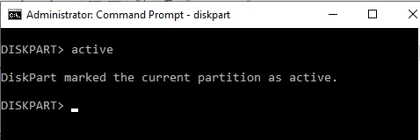
Create Bootable USB Drive using Command Prompt (CMD)
Type: ACTIVE
(Press ENTER)

Slide 15
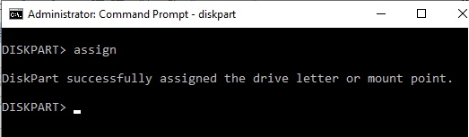
Create Bootable USB Drive using Command Prompt (CMD)
12. Type: ASSIGN
(Press ENTER)

Slide 16
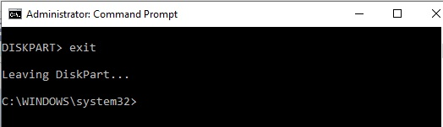
Create Bootable USB Drive using Command Prompt (CMD)
Type: EXIT
(Press ENTER)

Slide 17
Create Bootable USB Drive using Command Prompt (CMD)
14. Type: EXIT
(Exit DISKPART PROMPT)
(Press ENTER)

Slide 18
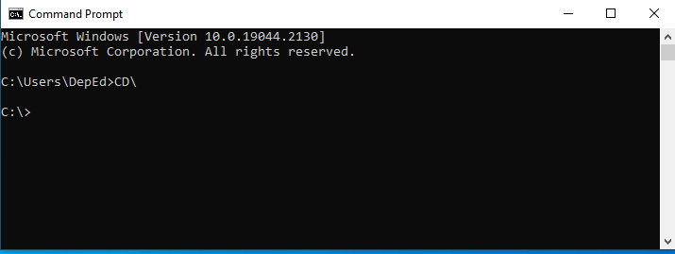
Create Bootable USB Drive using Command Prompt (CMD)
15. Type: CD\
(To Enter CD Prompt)
(Press ENTER)

Slide 19
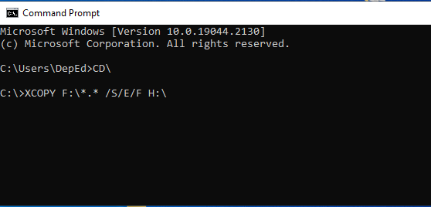
Create Bootable USB Drive using Command Prompt (CMD)
16. Type:XCOPY G:\*.* /S/E/F H:\
(To copy files from CD to Flash Drive)

Slide 20
THANK YOU !!!

