Slide 1
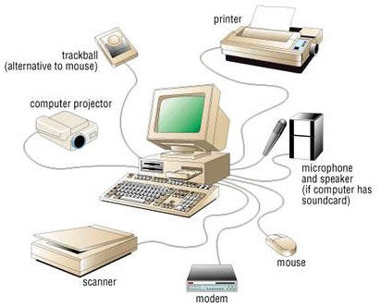
Computer Peripherals
is any external device that provides input and output for the computer.

Slide 2
Input Device
An input device is any device that provides input to a computer. There are dozens of possible input devices, but the two most common ones are a keyboard and mouse.

Slide 3
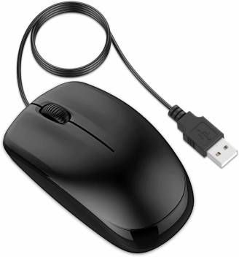
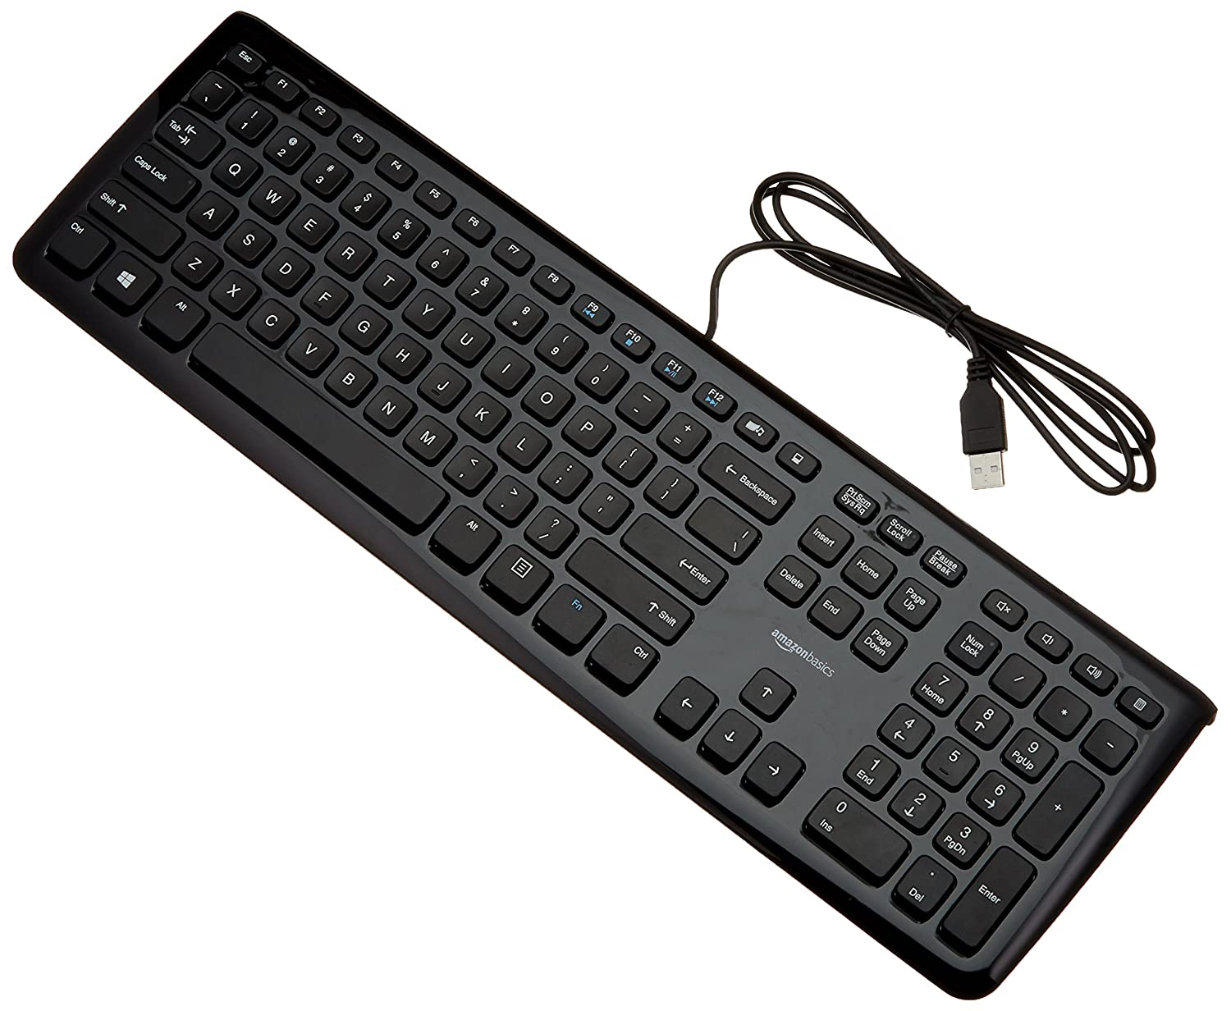
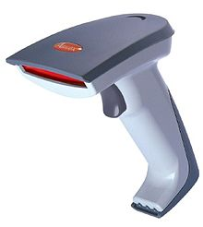
Example of Input Devices
Mouse
Keyboard
Barcode Reader

Slide 4
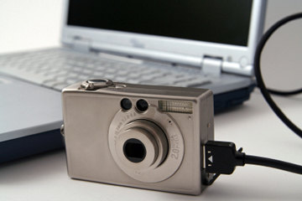
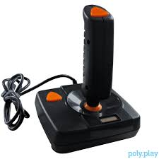

Example of Input Devices
Digital Camera
Joystick
Optical Pen

Slide 5
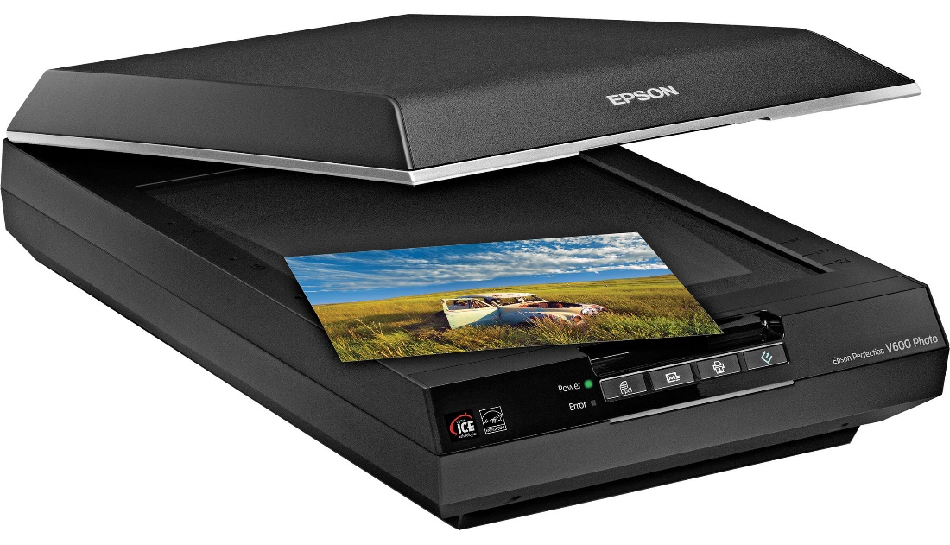
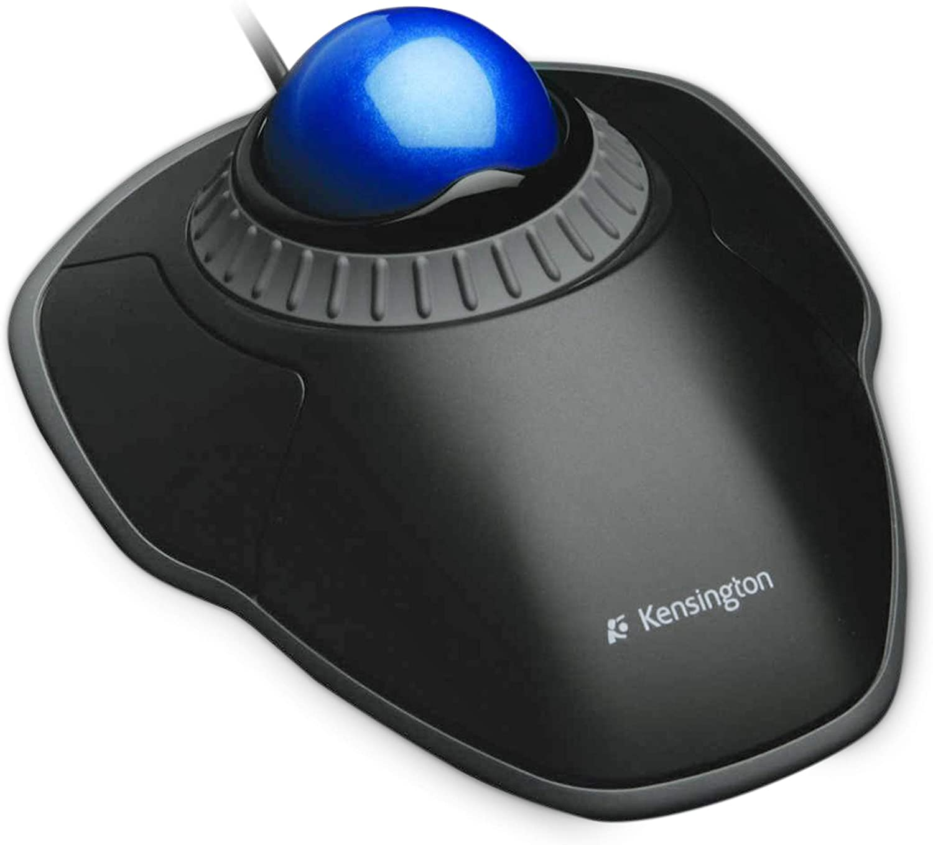
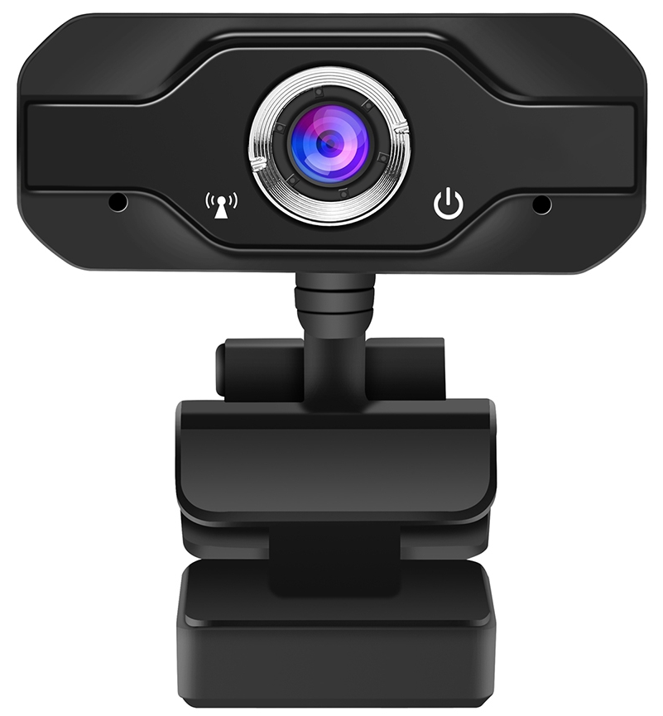
Example of Input Devices
Scanner
Trackball
Web Camera

Slide 6
Output Devices
An output device is any piece of computer hardware equipment which converts information into human-readable form.

Slide 7
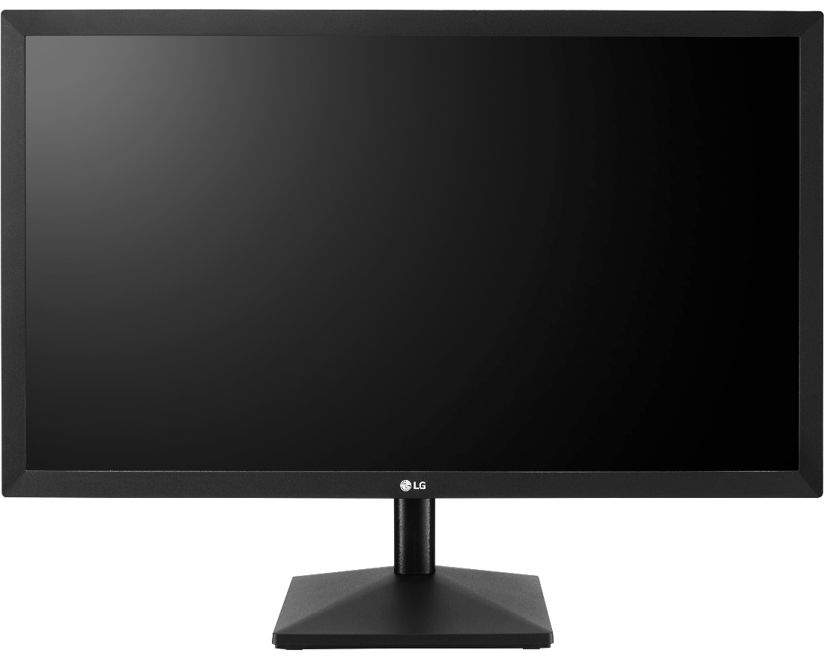
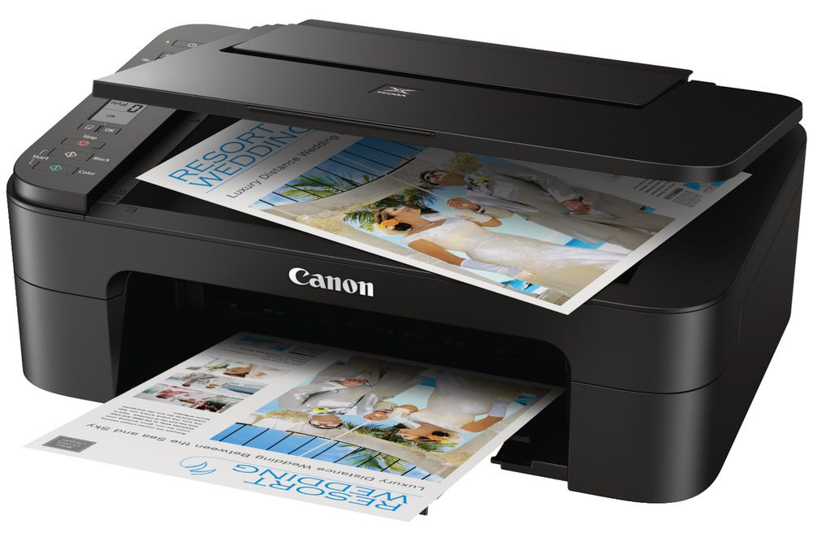
Example of Output Devices
Monitor
Printer

Slide 8
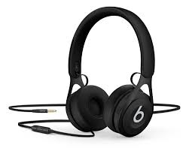
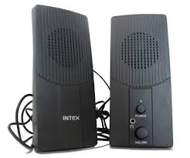
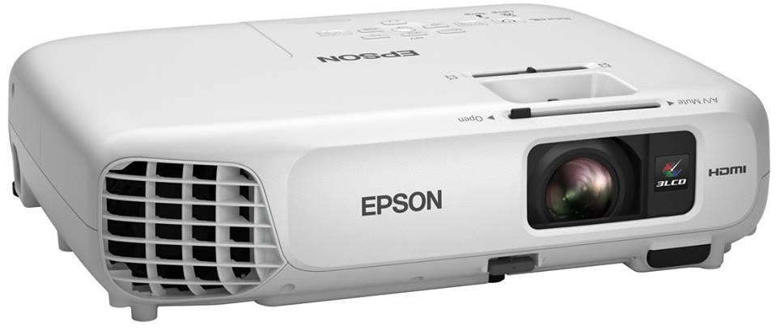
Example of Output Devices
Headphone
Speaker
Data Projector

Slide 9
Communication Devices
is device capable of sending and receiving a signal to allow computers to talk to other computers over the telephone.

Slide 10
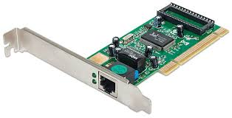
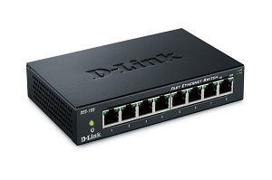
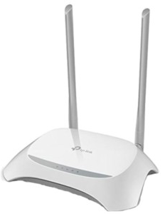
Example of Communication Devices
Network Adapter
HUB
Router

Slide 11
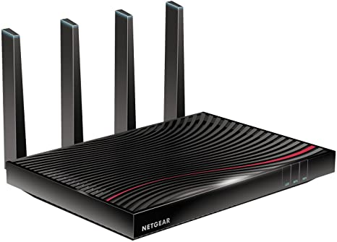
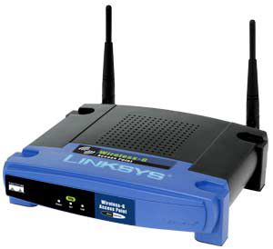
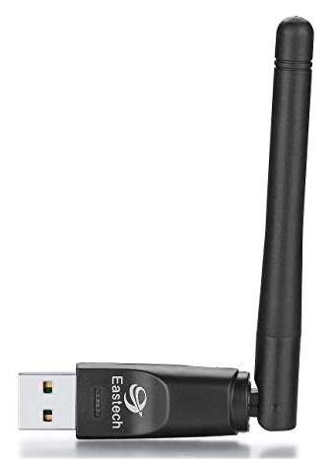
Example of Communication Devices
Modem
WAP
USB Dongle

