Slide 1
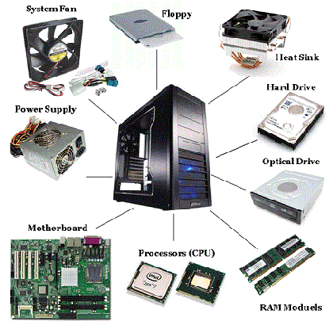
Computer Components
Device that is located inside the system unit.

Slide 2
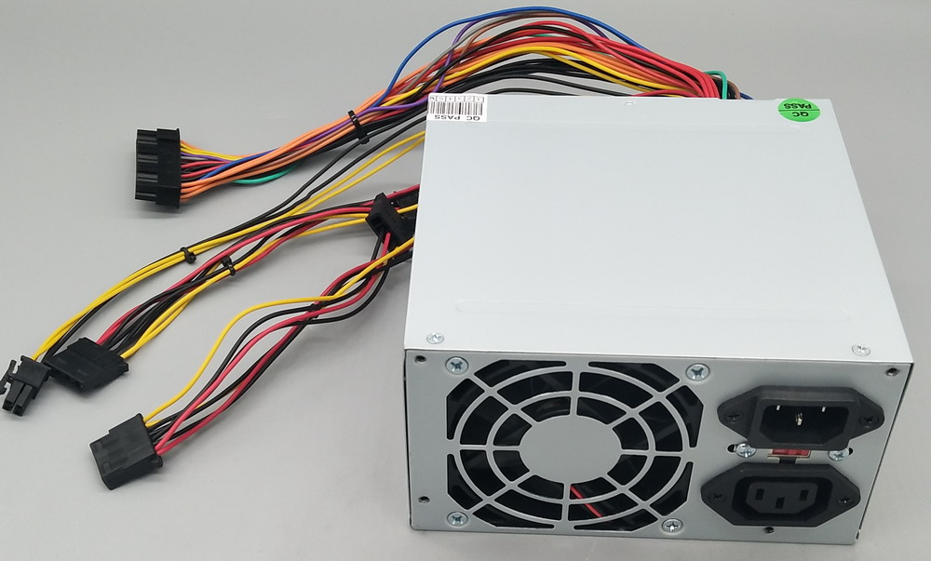
Power Supply Unit (PSU)
converts mains AC to low-voltage regulated DC power for the internal components of a computer.

Slide 3
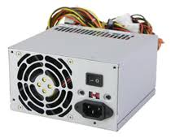
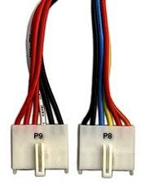
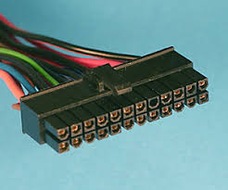
Types of Power Supply Unit (PSU)
AT PSU
ATX PSU
P8 & P9 Power
Connector
P1 Power
Connector

Slide 4
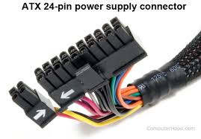
PSU Connectors
P1 Power Connector
This is the connector that goes to the motherboard to provide it with power. The connector has 20 or 24 pins.

Slide 5
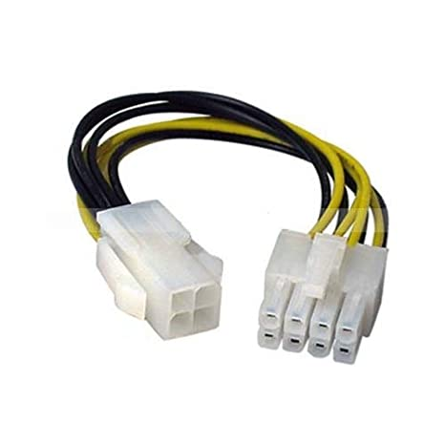
PSU Connectors
P4 Power Connector
The P4 connector is a 12V power supply cable used with motherboards that have an Intel Pentium 4 or later processor.
PCIe 8pin Power Connector
This connector is used to provide extra 12 volt power to PCI Express expansion cards. They are also occasionally called “PEG cables” where “PEG” stands for PCI Express Graphics.

Slide 6
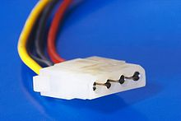
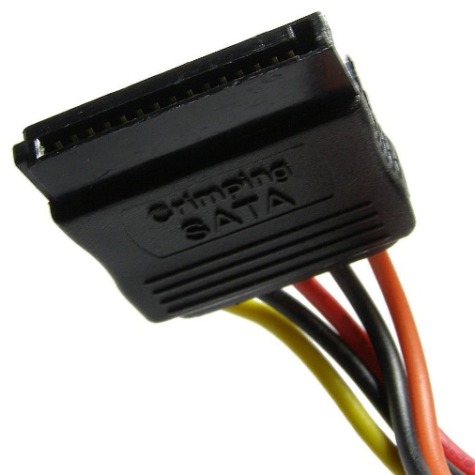
PSU Connectors
MOLEX Power Connector
are used for providing power to the cooling fans, IDE CD/DVD drive and IDE Hard drive.
SATA Power Connector
Used to for providing power to the SATA ODD and SATA HDD.

Slide 7
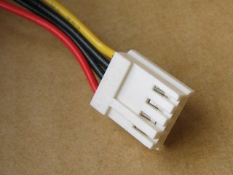
PSU Connectors
Mini Power Connector
are used for providing power to the Floppy disk drive.

Slide 8
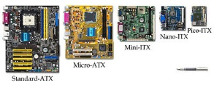
Motherboard (MoBo)
is the main circuit board of your computer and is also known as the mainboard or logic board.

Slide 9
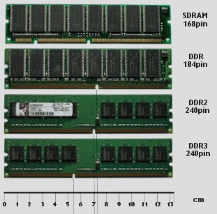
Random Access Memory (RAM)
a type of super-fast storage that your computer uses to hold data it needs in the short term.

Slide 10
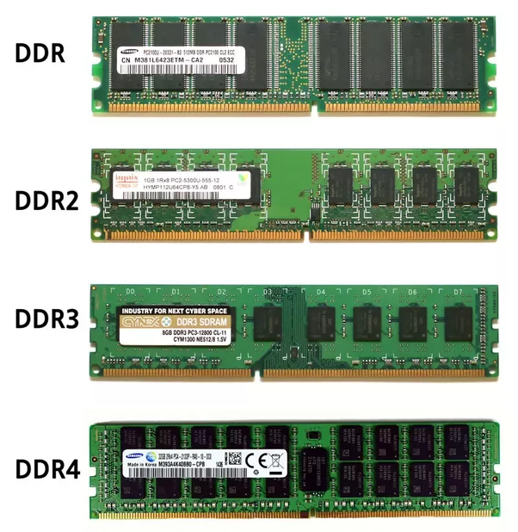
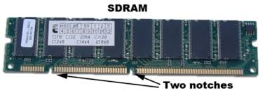
Types of Random Access Memory

Slide 11
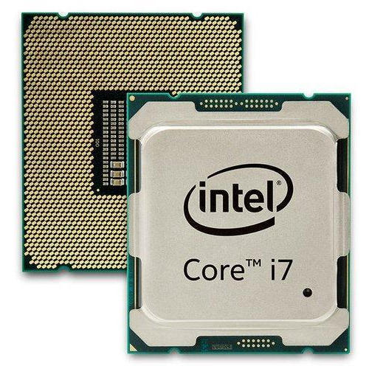
Central Processing Unit (CPU)
principal part of any digital computer system, generally composed of the main memory, control unit, and arithmetic-logic unit.

Slide 12
Two Manufacturer of CPU
There are two primary manufacturers of computer microprocessors. Intel and Advanced Micro Devices (AMD) lead the market in terms of speed and quality. Intel's desktop CPUs include Celeron, Pentium and Core. AMD's desktop processors include Sempron, Athlon and Phenom.

Slide 13
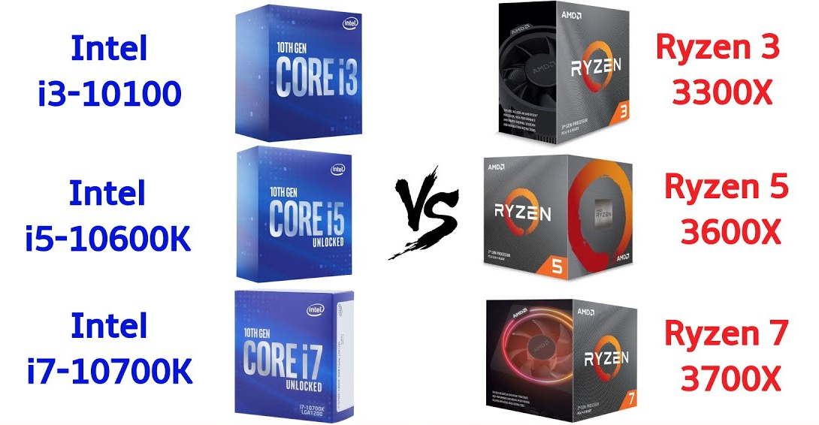
AMD vs INTEL

Slide 14
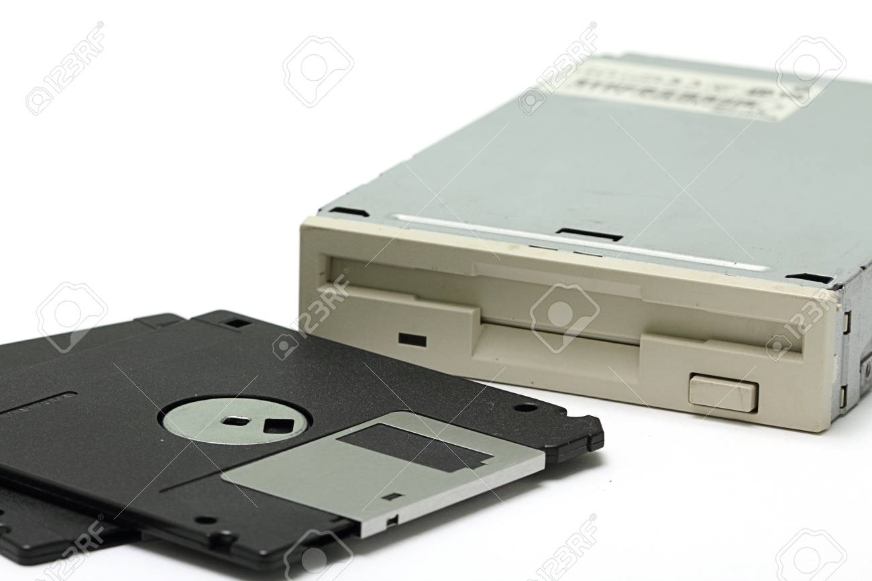
Floppy Disk Drive(FDD)
is a hardware device that reads data storage information from Diskette.

Slide 15
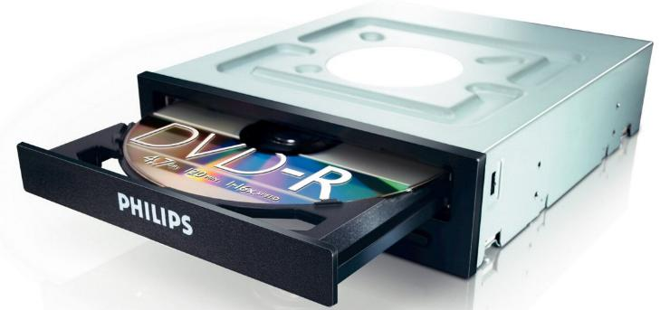
Optical Disk Drive(ODD)
is a disc drive that uses laser light or electromagnetic waves within or near the visible light spectrum as part of the process of reading or writing data to or from optical discs.

Slide 16
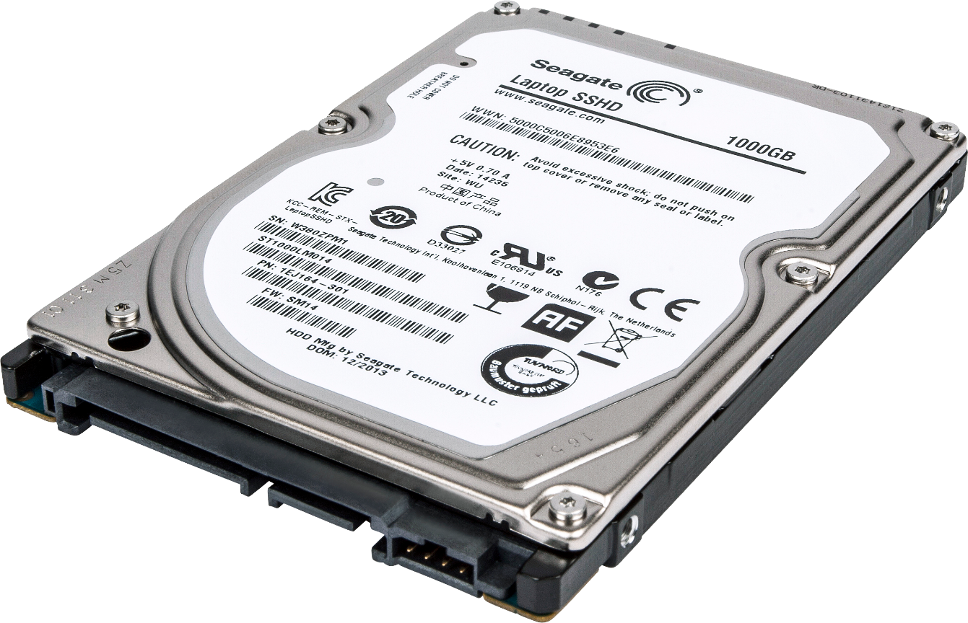
Hard Disk Drive(HDD)
hardware component that stores all of your digital content. Your documents, pictures, music, videos, programs, application preferences, and operating system represent digital content stored on a hard drive.

Slide 17
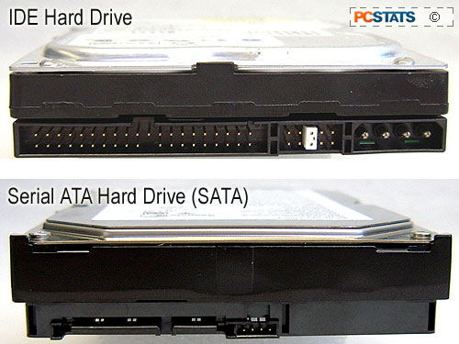
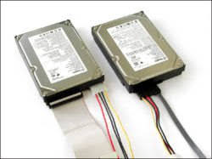
Type of HDD

Slide 18
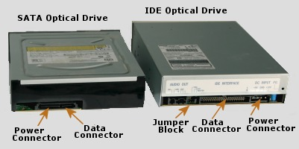
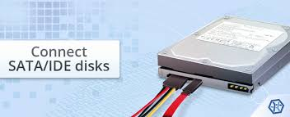
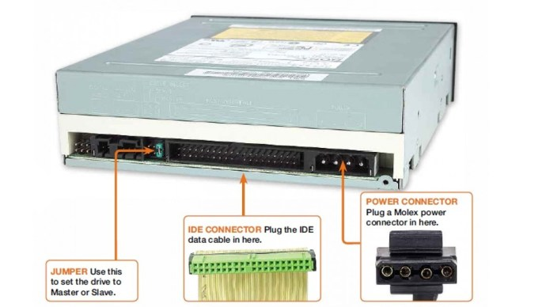
Type of ODD

Slide 19
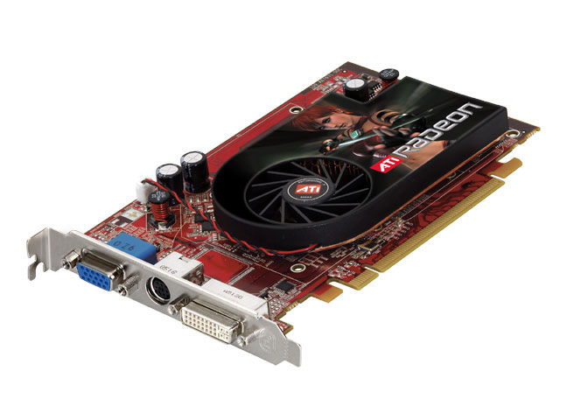
Video Card
is an expansion card which generates a feed of output images to a display device (such as a computer monitor).

Slide 20
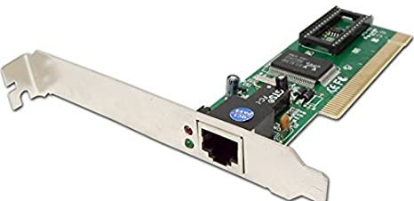
LAN Card
A network interface controller is a computer hardware component that connects a computer to a computer network.

Slide 21
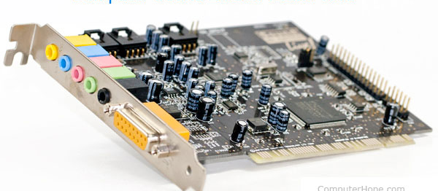
Sound Card
is an internal expansion card that provides input and output of audio signals to and from a computer under control of computer programs.

