Slide 1

Computer System Servicing

Slide 2








Which is Which….
A
B
C
D
1
2
3
4

Slide 3
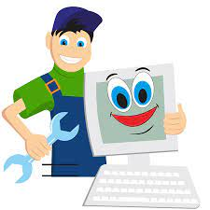
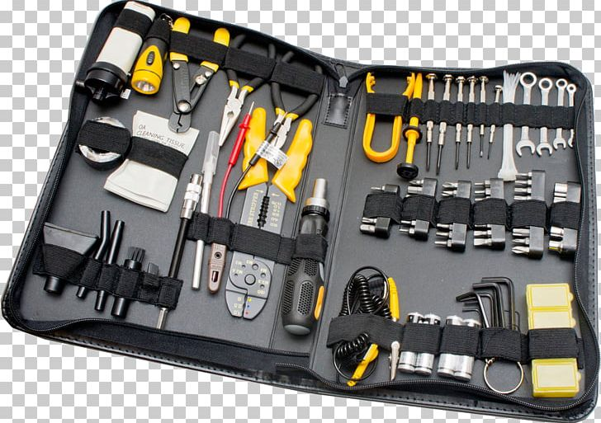
Computer Technician

Slide 4
Computer Hand Tools
A tool is a handheld device that aids in
accomplishing a task. Tools range from a
traditional metal cutting part of a machine to
an element of a computer program that
activates and controls a particular function.

Slide 5
Electro-Static Discharge (ESD)Tools
Electro-Static Discharge (ESD) Tools
Static electricity is easily generated by friction on carpets, tile flooring, clothing, hair, fabric, and etc. The friction of moving air alone will charge suspended particles and cause the buildup of static electrical charges on people and objects in the environment. Grounded antistatic work mats used with antistatic wrist straps provide the most basic means for the controlled discharge of electrostatic electricity.

Slide 6
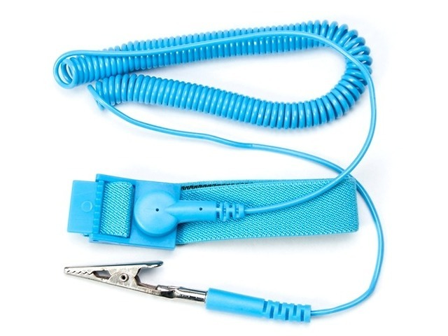
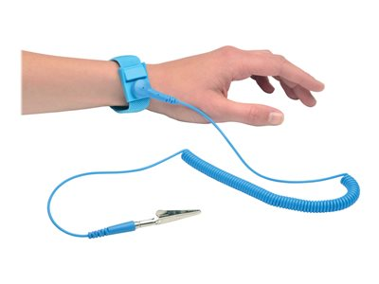
Electro-Static Discharge (ESD)Tools
Anti-static wrist strap – Used to prevent ESD damage to computer equipment.

Slide 7
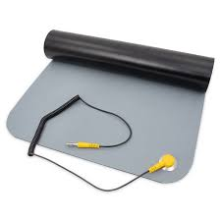
Electro-Static Discharge (ESD)Tools
Anti-static mat – Used to stand on or place hardware on to prevent static electricity from building up.

Slide 8
Hand Tools
Hand Tools
A hand tool is a device for performing work on a material or a physical system using only hands. Hand tools can be used manually or electrically powered, using electrical current.

Slide 9
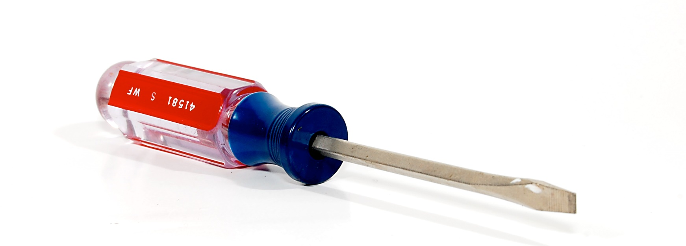
Hand Tools
Flat Head Screwdriver – Used to loosen or tighten slotted screws.

Slide 10
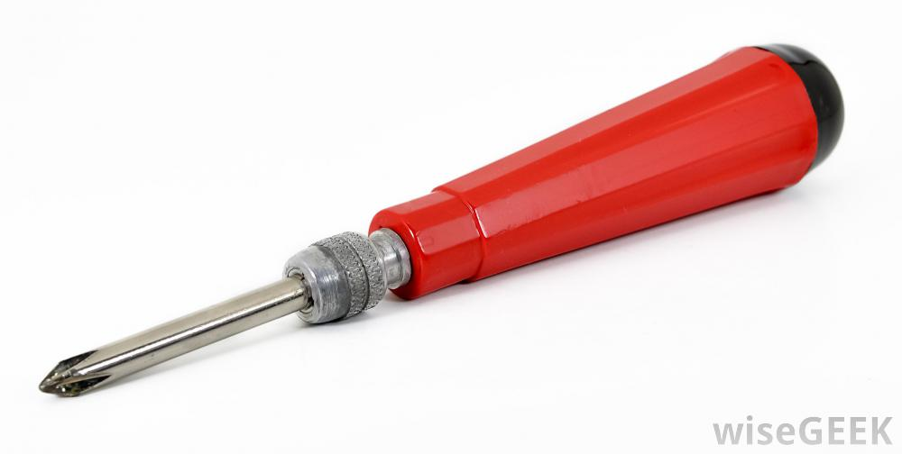
Hand Tools
Philips Head Screwdriver – Used to loosen or tighten cross-head screws.

Slide 11
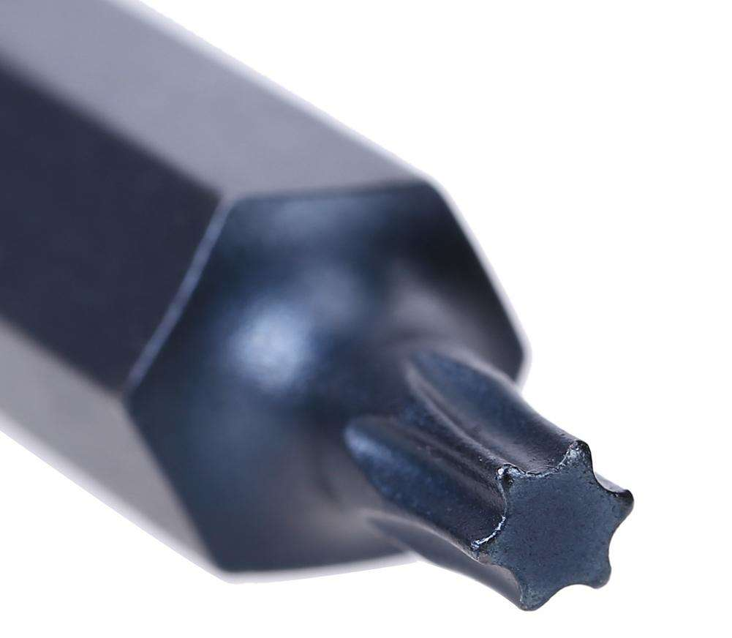
Hand Tools
Torx Screwdriver - Used to loosen or tighten screws that have a star-like depression on the top, a feature that is mainly found on laptop.

Slide 12
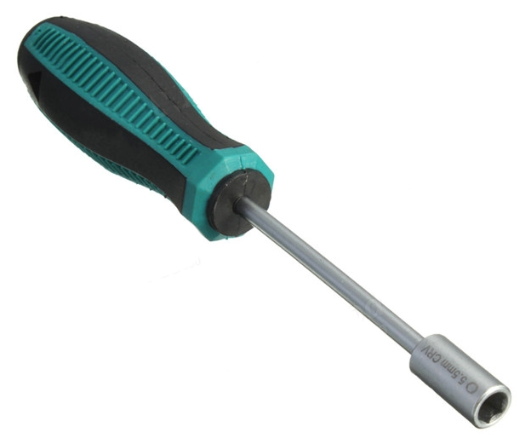
Hand Tools
Hex Driver – Sometimes called a nut driver, is used to tighten nuts in the same way that a screwdriver tightens screws.

Slide 13
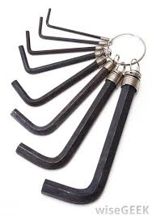
Hand Tools
Allen Wrench– is a simple tool used to drive bolts and screws with hexagonal sockets in their heads.

Slide 14
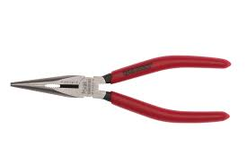
Hand Tools
Needle-Nose Pliers – Used to hold small parts.

Slide 15
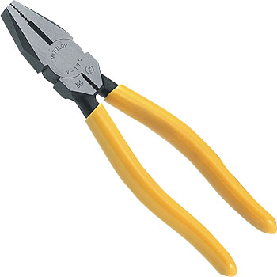
Hand Tools
Standard Pliers – Pliers are a hand tool used to hold objects firmly, They are also useful for bending and compressing a wide range of materials..

Slide 16
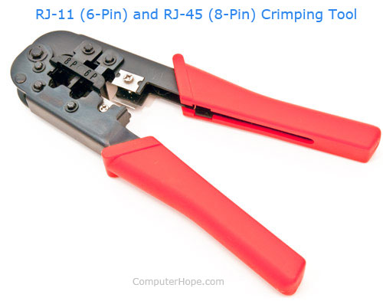
Hand Tools
A crimping tool is a device used to conjoin two pieces of metal by deforming one or both of them to hold each other.

Slide 17
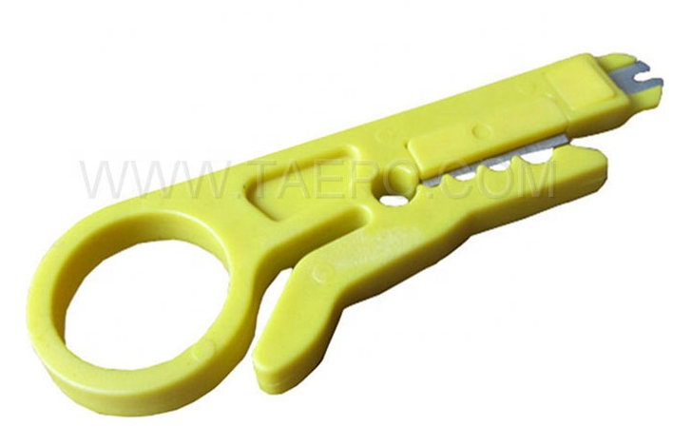
Hand Tools
Wire Stripper – is a small, hand-held device used to strip the electrical insulation from electric wires.

Slide 18
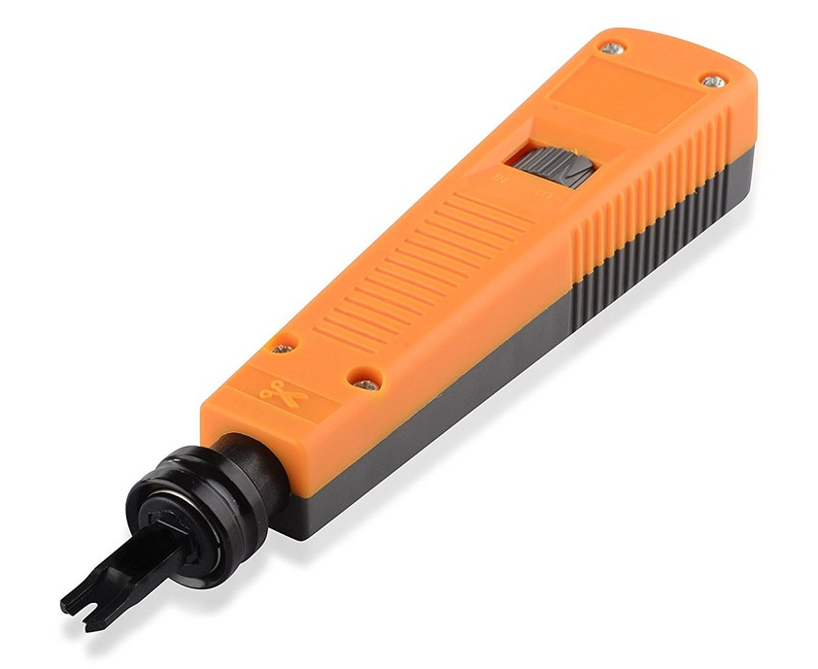
Hand Tools
Impact Tool – is a hand tool used to connect telecommunications and network wires to a patch panel, punch down block, keystone module, or surface mount box.

Slide 19
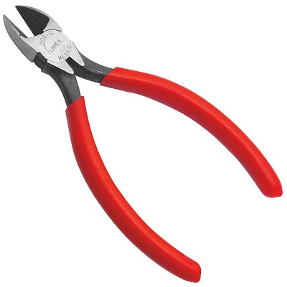
Hand Tools
Diagonal Cutting Pliers– are pliers intended for the cutting of wire.

Slide 20
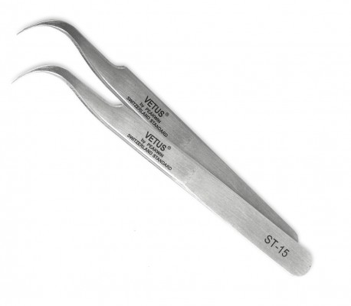
Hand Tools
Tweezers – Used to manipulate small parts.

Slide 21
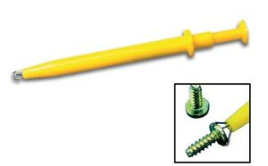
Hand Tools
Part Retriever – Used to retrieve parts from location that is too small for your hand to fit.

Slide 22
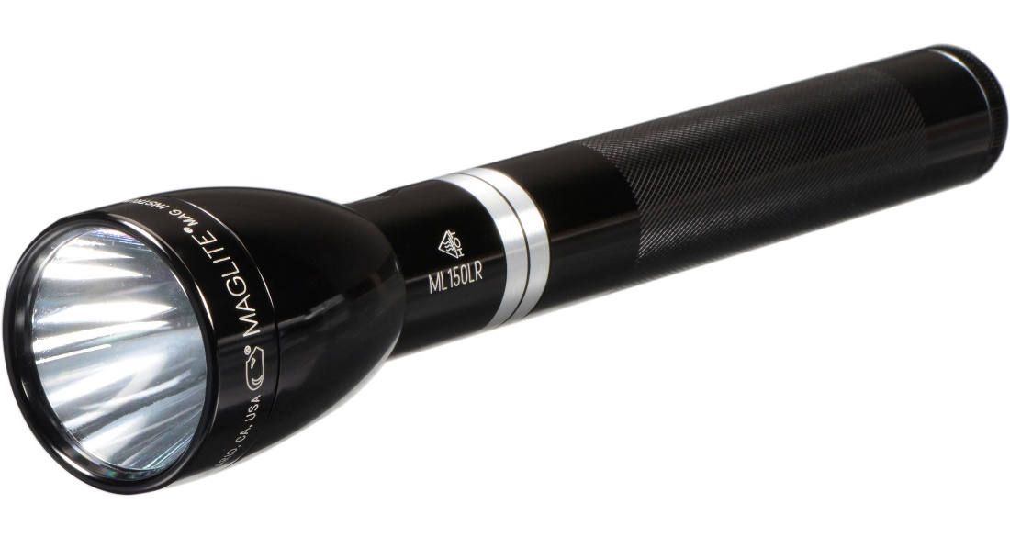
Hand Tools
Flashlight – Used to light up areas that you cannot see well.

Slide 23
Cleaning Tools
Cleaning Tools
Having the appropriate cleaning tools is essential when maintaining or repairing computers. Using these tools ensures that computer components are not damaged during cleaning.

Slide 24

Cleaning Tools
Lint-free Cloth – Used to clean different computer components without scratching or leaving debris.

Slide 25
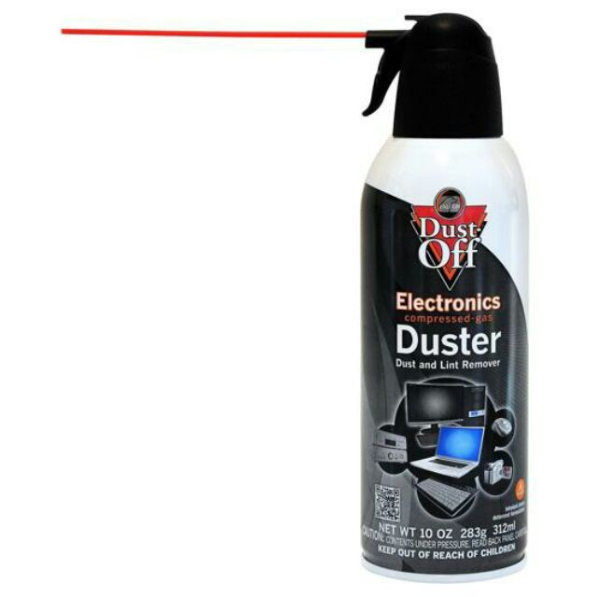
Cleaning Tools
Compressed Air – Used to blow away dust and debris from different computer parts without touching the components.

Slide 26
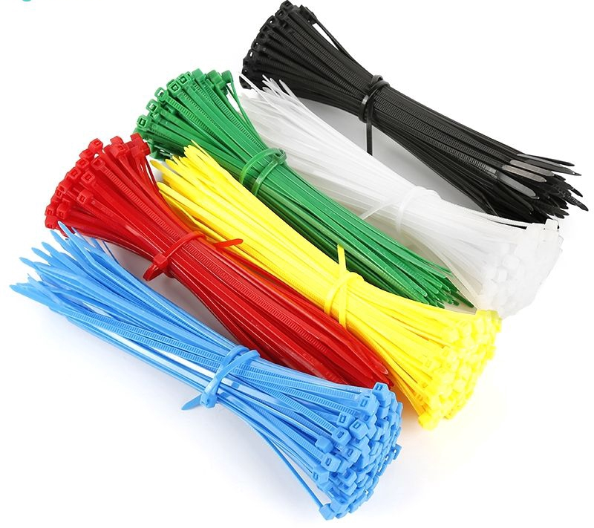
Cleaning Tools
Cable Ties – Used to bundle cables neatly inside and outside of a computer.

Slide 27
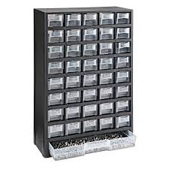
Cleaning Tools
Parts Organizer – Used to hold screw, jumpers, fasteners and other small parts and prevents them from getting mixed together.

Slide 28
Diagnostic Tools
Diagnostic Tools
tools are made to find problems that may be disrupting your computer's normal performance.

Slide 29
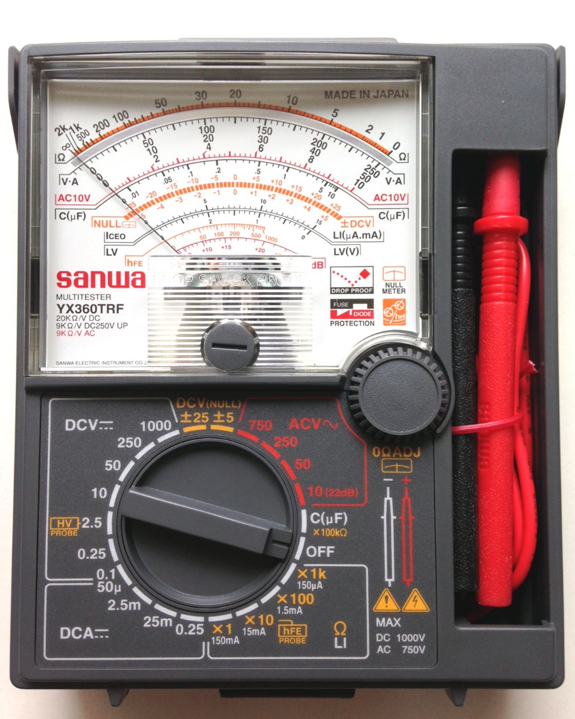
Diagnostic Tools
Multimeter – Used to test the integrity of circuits and the quality of electricity in computer components.

Slide 30
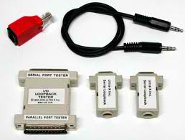
Diagnostic Tools
Loopback Adapter – Used to test the functionality of computer ports.

Slide 31
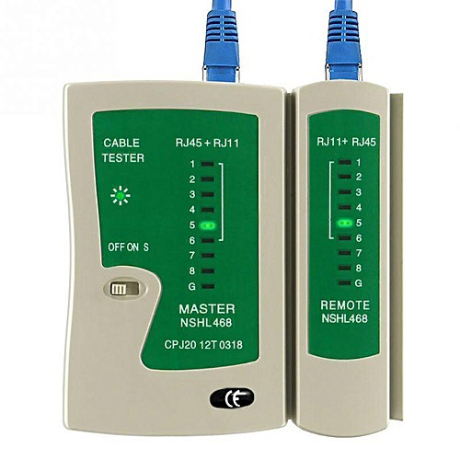
Diagnostic Tools
Cable Tester - is an electronic device used to verify the electrical connections in a signal cable or other wired assembly.

Slide 32
THANK YOU!!!

