Slide 1

Computer System Servicing

Slide 2
Rufus Software
Rufus (The Reliable USB Formatting Utility, with Source) is a free and open-source portable application for Microsoft Windows that can be used to format and create bootable USB flash drives or Live USBs.

Slide 3
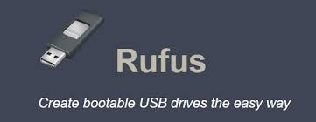
Rufus Software

Slide 4
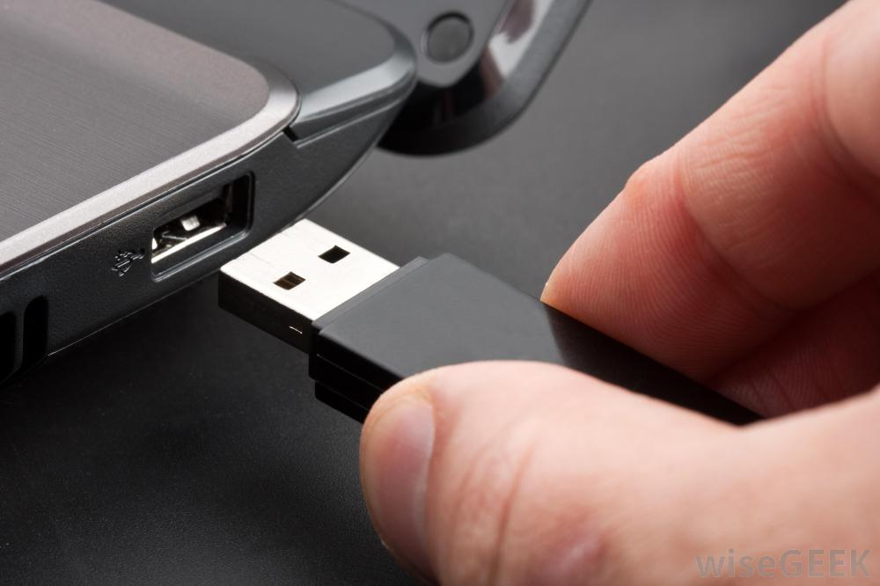
Create Bootable USB Drive using Rufus Software
1. Insert the Flash Drive to the USB Port.

Slide 5
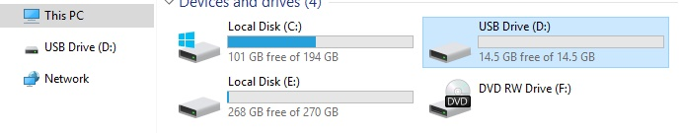
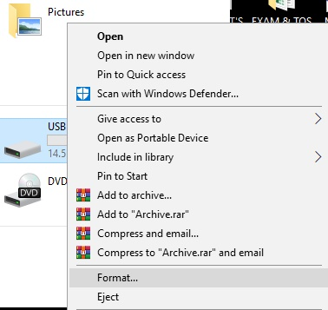
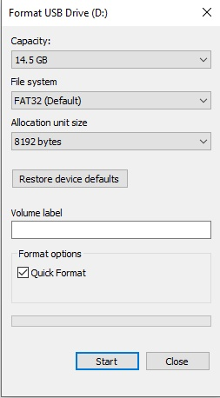
Create Bootable USB Drive using Command Prompt (CMD)
2. Format the Flash Drive
(Open My Computer/Select the Flash Drive/Right click/Select FORMAT/Choose START)

Slide 6
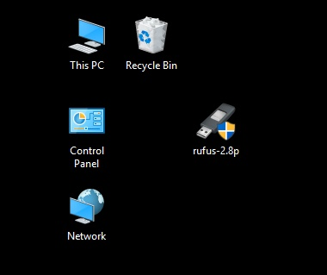
Create Bootable USB Drive using Rufus Software
3. On your Computer, Open your RUFUS Software

Slide 7
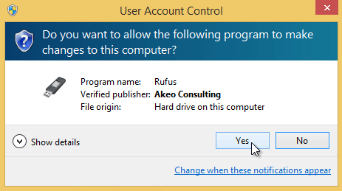
Create Bootable USB Drive using Rufus Software
4. User Account Control will appear, Select YES

Slide 8
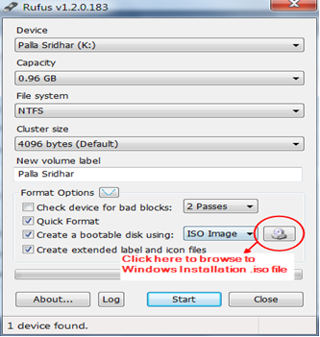
Create Bootable USB Drive using Rufus Software
Select Source Image File Icon

Slide 9
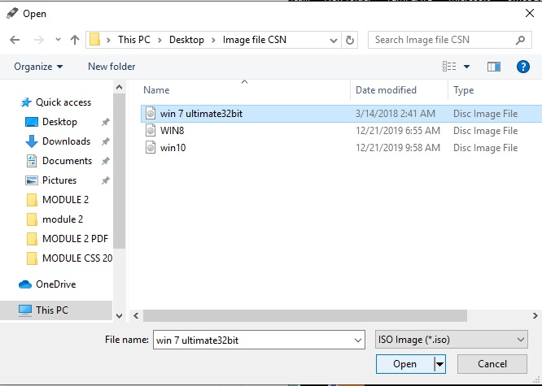
Create Bootable USB Drive using Rufus Software
6. Select an Image File, Click Open

Slide 10
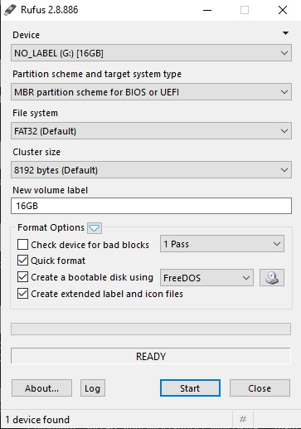
Create Bootable USB Drive using Rufus Software
7. Click Start

Slide 11
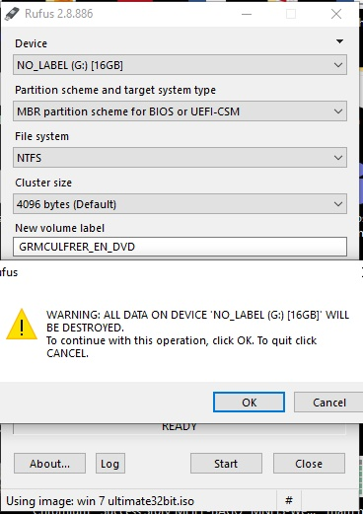
Create Bootable USB Drive using Rufus Software
8. Notification Warning will appear, Click OK

Slide 12
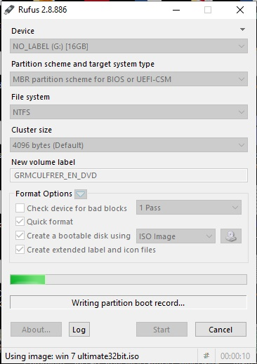
Create Bootable USB Drive using Rufus Software
Installation Progress will appear.

Slide 13
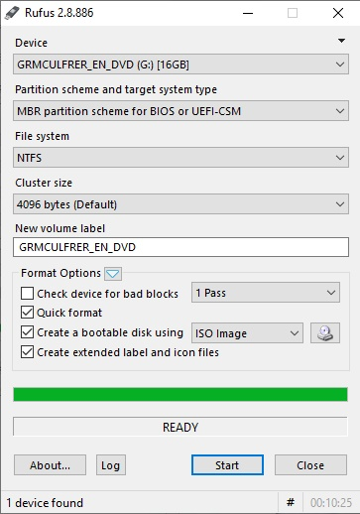
Create Bootable USB Drive using Rufus Software
10. Installation Progress Completed (Ready)

Slide 14
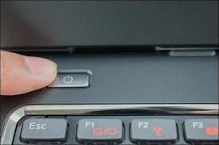
Check the Functionality of a Bootable USB Drive
1. Turn On your Computer by Pressing the Power Button.

Slide 15
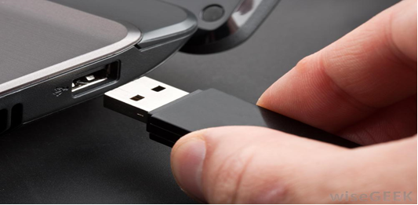
Check the Functionality of a Bootable USB Drive
2. Insert the Bootable USB Drive to the USB port.

Slide 16
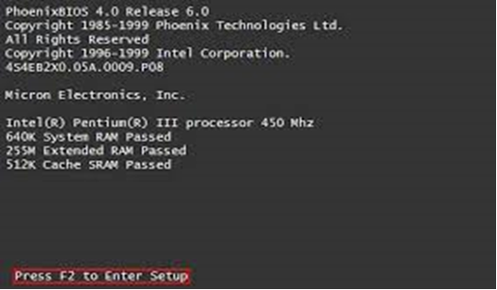
Check the Functionality of a Bootable USB Drive
3. Enter your computer's BIOS. When the BIOS screen appears or you are prompted to do so, press Del, F1, F2, F10, or F9 (depending on your computer’s motherboard) to enter the system BIOS.

Slide 17
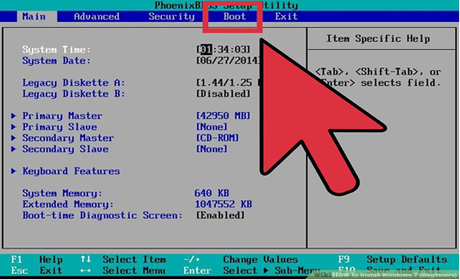
Check the Functionality of a Bootable USB Drive
4. Choose Advanced BIOS Features/Startup/Boot Tab. To change the booting sequence of your computer.

Slide 18
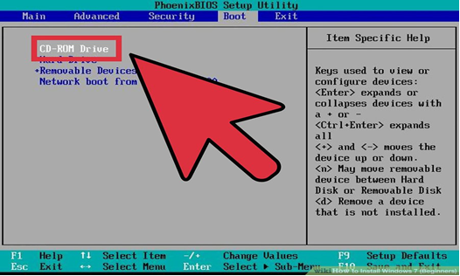
Check the Functionality of a Bootable USB Drive
5. Select the Flash drive as the first boot device of your computer.

Slide 19
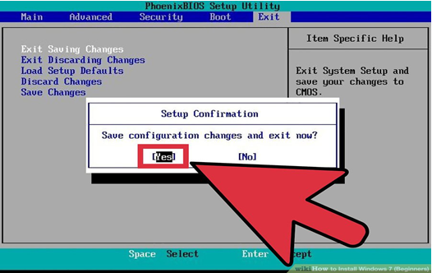
Check the Functionality of a Bootable USB Drive
6. Press F10 ( Save and Exit)

Slide 20
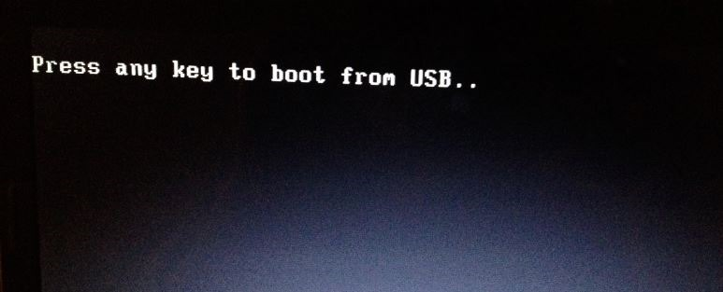
Check the Functionality of a Bootable USB Drive
7. Press any key to boot from USB will appear (Press Spacebar)

Slide 21
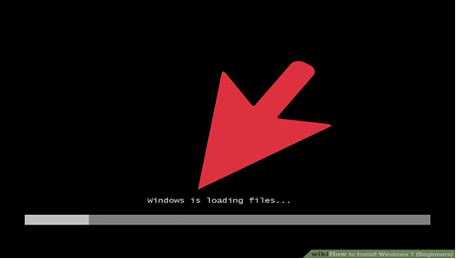
Check the Functionality of a Bootable USB Drive
8. Windows is Loading Files will appear

Slide 22
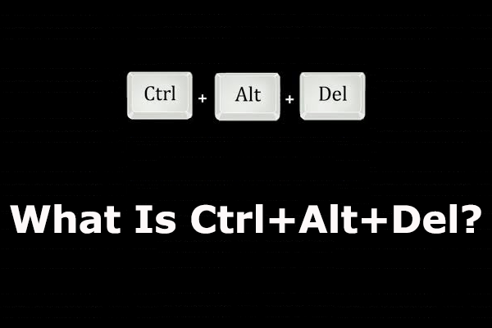
Check the Functionality of a Bootable USB Drive
9. Press CTRL+ALT+DEL simultaneously to restart your computer

Slide 23
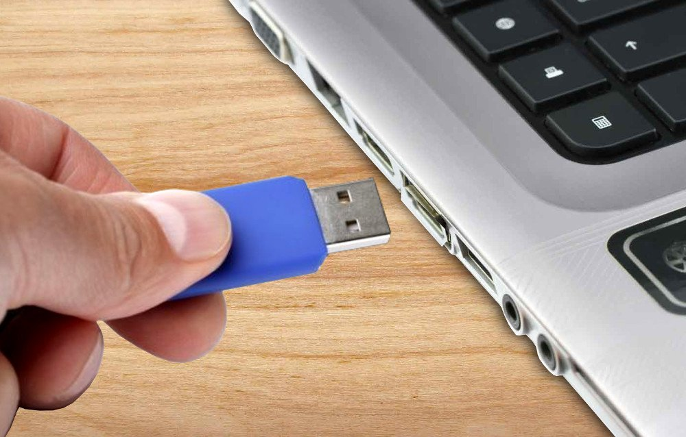
Check the Functionality of a Bootable USB Drive
10. Remove the bootable Flash Drive

Slide 24
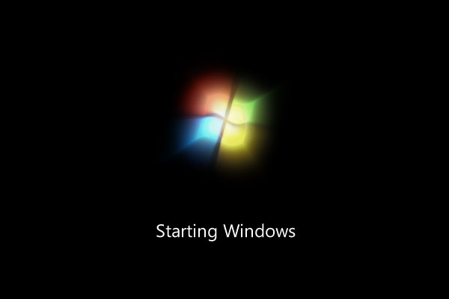
Check the Functionality of a Bootable USB Drive
11. Computer will load the Operating System.

Slide 25
THANK YOU !!!

