Slide 1
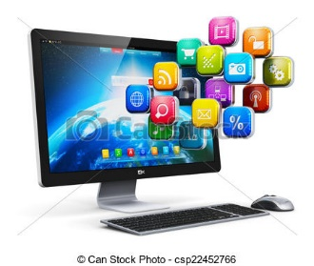
How do Major Computer Components Communicate?

Slide 2
Software
Software is a program or a set of instructions that tells the computer what to do.

Slide 3
Software
Computer hardware is useless without software.
Software is the set of instructions and associated data that direct the computer to do a task.
Software can be divided into two categories:
system software and application software.
System software helps the computer to carry out its basic operating tasks.
Application software helps the user carry out a variety of tasks.

Slide 4
Two Types of Software
System Software
Application Software

Slide 5
System Software
The System Software consist of the Operating System and all the utilities that enable the computer to function.
System software actually controls the hardware so that application software can perform any action or task.

Slide 6
Example of System Software
1. Operating System - software takes care of effective and efficient utilization of all hardware and software components of a computer system.
2. Utilities - Utility programs are a set of programs that help users in system maintenance tasks, and in performing tasks of routine nature. It also helps in maintenance and problem solving of a computer.

Slide 7
Example of System Software
3. Device Drivers - is actually a communication device
between device and computer. It loads every time in memory. When a new device is added the driver should be installed in order to run the program
4. Programming Language Translators - It transforms the instructions prepared by programmers in a programming language into a form that can be interpreted and executed by a computer system.

Slide 8
Example of System Software
Operating System - (Windows,Linux and Macintosh)
Utility Software – (antivirus software, backup software and disk tools)

Slide 9
Example of System Software
Device Driver Software- (Windows, Linux and Macintosh)
Programming Language Translator – ( Compiler, Interpreter and Assembler

Slide 10
Application Software
Application software (app for short) is a program or group of programs designed for end users.

Slide 11
Some commonly known application software are:-
(1). Word-processing software:- It make use of a computer for creating, editing, viewing, formatting, storing, retrieving, and printing documents.
(2). Spreadsheet software:- Spreadsheet software is a numeric data-analysis tool that allows us to create a kind of computerized
ledger.

Slide 12
Some commonly known application software are:-
(3). Database software:- A database is a collection of related data stored and treated as a unit for information retrieval purposes.
(4). Graphics software:- It enables us to a computer system for creating, editing, drawings, pictures, graphs, etc.

Slide 13
Some commonly known application software are:-
(5). Education software:- Education software allows a computer to be used as a teaching and learning tool.
(6). Entertainment software:- It allows a computer to be used as an entertainment tool.

Slide 14
Operating System
An Operating System (OS) is a set of programs that manage computer hardware resources and provide common services for application software. The operating system is a vital component of the system software in a computer system.

Slide 15
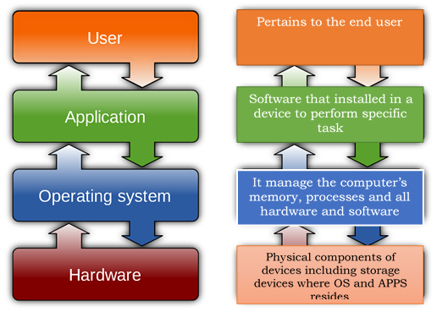
How Operating System works?

Slide 16
Three most common Operating System
MICROSOFT
1. Microsoft Windows is one of the largest and most influential computer company founded in 1975 by Paul Allen and Bill Gates. Microsoft has a big contribution in almost every area of computer software, from Operating systems, programming tools to end-user applications.

Slide 17
Three most common Operating System
APPLE MACINTOSH OS
2. MAC OS is a series of proprietary graphical operating systems developed and marketed by Apple Inc. since 2001. It is the primary operating system for Apple's Mac computers. Apple Computer was invented by Steve Wozniak and Steve Jobs and the Apple Company is founded by Steve Wozniak, Steve Jobs with Ron Wayne in April 1, 1976.

Slide 18
Three most common Operating System
LINUX
3. Linux is a free and open-source operating system developed by Linus Torvalds and was first introduced in 1991. The Linux kernel runs on numerous different platforms including the Intel and Alpha platform and is available under the GNU General Public License.

Slide 19
Three most common Operating System
Microsoft WINDOWS | Macintosh OS | Linux
Windows 95 | Kodiak | Linux Mint
Windows 98 | Cheetah | Manjaro
Windows 2000 | Puma | Debian
Windows ME | Jaguar | Ubuntu
Windows XP | Panther | Antergos
Windows Server 2003 R2 | Tiger | Solus
Windows Server 2008 | Leopard | Fedora
Windows Vista | Snow Leopard | Elementary OS
Windows 7 | Lion | Opensuse
Windows Server 2008 R2 | Mountain Lion
Windows Thin PC | Mavericks
Windows Server 2012 | Yosemite
Windows 8 | El Capitan
Windows 8.1 | Mac OS 10.12 High Sierra
Windows 10

