Slide 1

Computer System Servicing

Slide 2
BIOS
Basic Input/output System, the BIOS is a ROM chip found on motherboards that allows you to access and set up your computer system at the most basic level.

Slide 3
BIOS
The BIOS includes instructions on how to load basic computer hardware. It also includes a test referred to as a POST (Power-On Self-Test) that helps verify the computer meets requirements to boot up properly. If the computer does not pass the POST, you will receive a combination of beeps indicating what is malfunctioning in the computer.

Slide 4
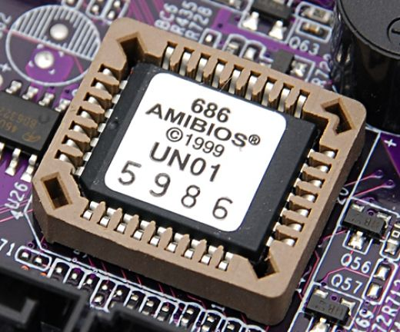
BIOS Setup

Slide 5
Function of BIOS
POST - Test the computer hardware and make sure no errors exist before loading the operating system.
BIOS drivers - Low level drivers that give the computer basic operational control over your computer's hardware.

Slide 6
Function of BIOS
Bootstrap Loader - Locate the operating system. If a capable operating system is located, the BIOS will pass control to it.
BIOS or CMOS Setup - Configuration program that allows you to configure hardware settings including system settings such as computer passwords, time, and date.

Slide 7
BIOS vs. UEFI
BIOS and UEFI are two firmware interfaces for computers which work as an interpreter between the operating system and the computer firmware. Both of these interfaces are used at the startup of the computer to initialize the hardware components and start the operating system which is stored on the hard drive.

Slide 8
BIOS vs. UEFI
BIOS works by reading the first sector of the hard drive which has the next device’s address to initialize or code to execute. BIOS also select the boot device that needs to be initialized for starting the operating system. Since BIOS has been in use since the very beginning, it still works in 16-bit mode, limiting the amount of code that can be read and executed from the firmware ROM.

Slide 9
BIOS vs. UEFI
UEFI does the same task a little differently. It stores all the information about initialization and startup in an .efi file instead of the firmware. This file is stored on the hard drive inside a special partition called EFI System Partition (ESP). The ESP partition will also contain the boot loader programs for the Operating System installed on the computer.

Slide 10
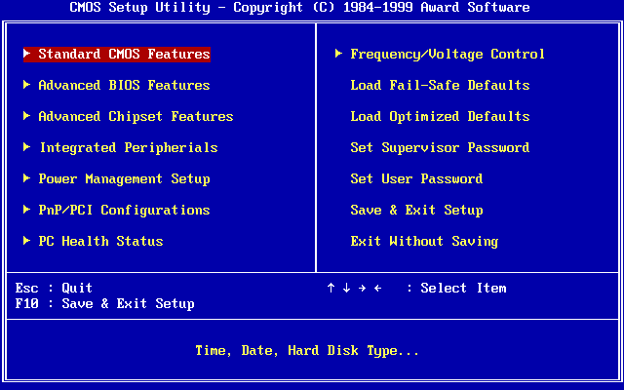
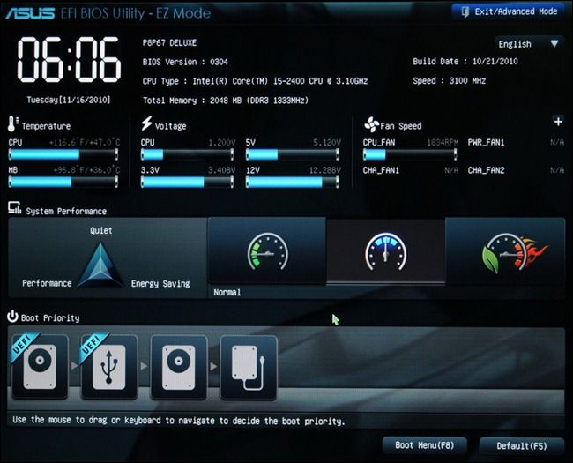
BIOS vs. UEFI

Slide 11
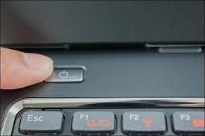
Bios Configuration (Changing booting sequence of your computer using Bootable USB Drive with Operating System)
1. Turn On your Computer by Pressing the Power Button.

Slide 12
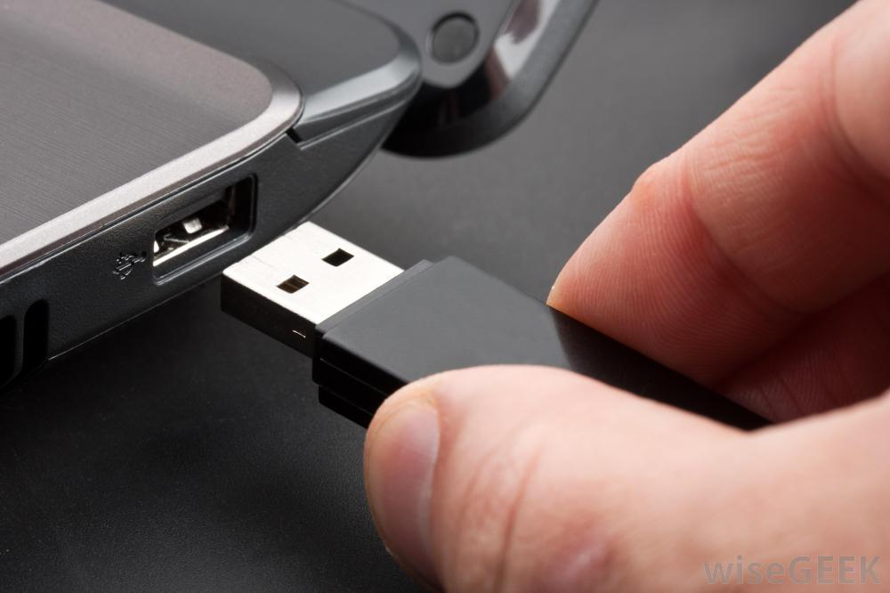
Bios Configuration (Changing booting sequence of your computer using Bootable USB Drive with Operating System)
1. Insert the Flash Drive to the USB Port.

Slide 13
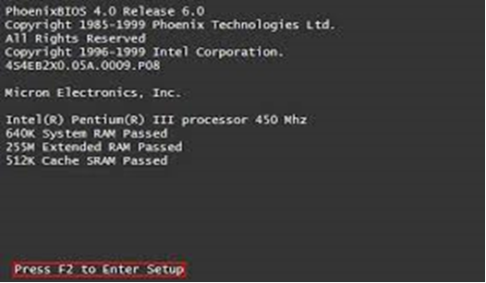
Check the Functionality of a Bootable USB Drive
3. Enter your computer's BIOS. When the BIOS screen appears or you are prompted to do so, press Del, F1, F2, F10, or F9 (depending on your computer’s motherboard) to enter the system BIOS.

Slide 14
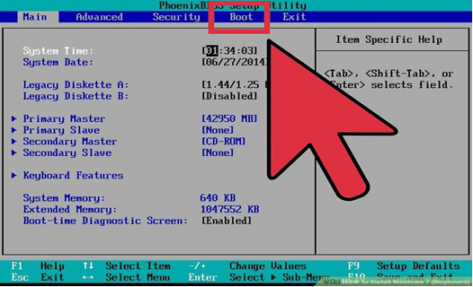
Check the Functionality of a Bootable USB Drive
4. Choose Advanced BIOS Features/Startup/Boot Tab. To change the booting sequence of your computer.

Slide 15
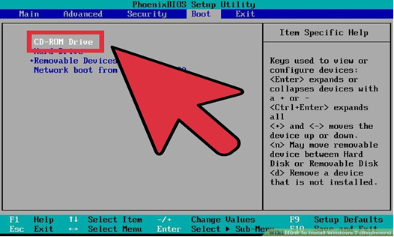
Check the Functionality of a Bootable USB Drive
5. Select the Flash drive as the first boot device of your computer.

Slide 16
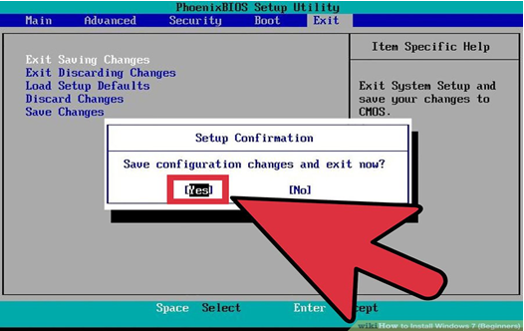
Check the Functionality of a Bootable USB Drive
6. Press F10 ( Save and Exit)

Slide 17
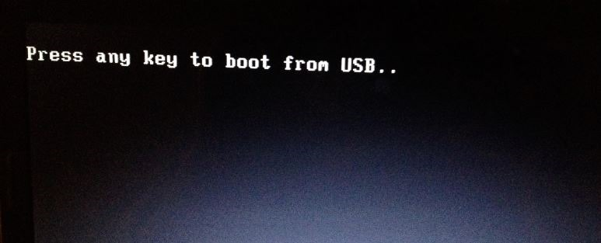
Check the Functionality of a Bootable USB Drive
7. Press any key to boot from USB will appear (Press Spacebar)

Slide 18
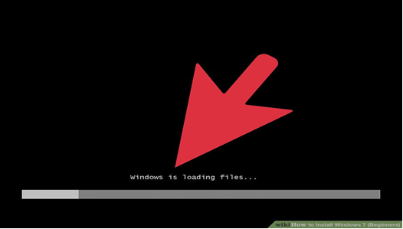
Check the Functionality of a Bootable USB Drive
8. Windows is Loading Files will appear

Slide 19
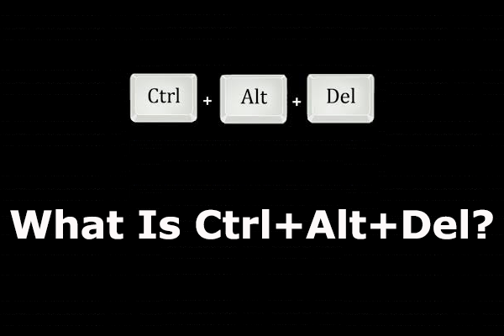
Check the Functionality of a Bootable USB Drive
9. Press CTRL+ALT+DEL simultaneously to restart your computer

Slide 20
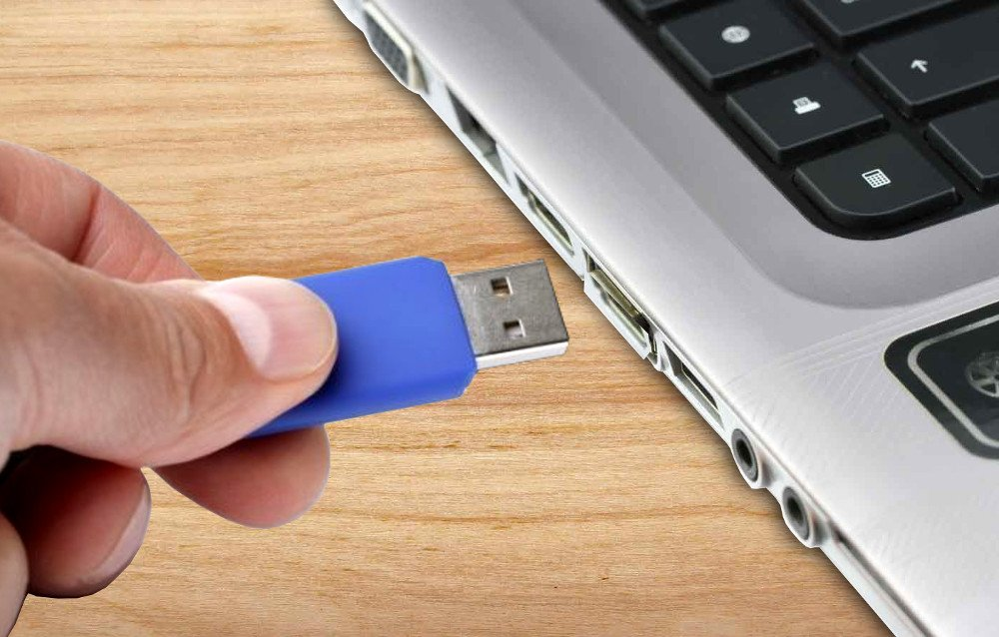
Check the Functionality of a Bootable USB Drive
10. Remove the bootable Flash Drive

Slide 21
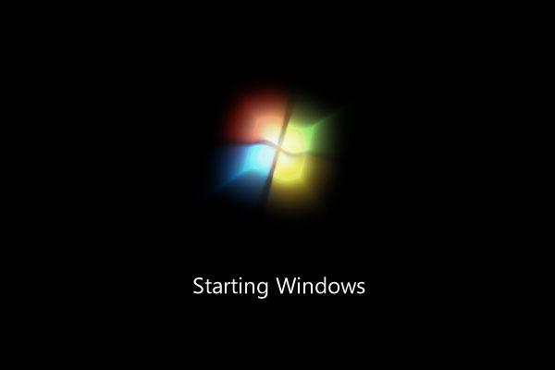
Check the Functionality of a Bootable USB Drive
11. Computer will load the Operating System.

Slide 22
Bios Configuration (Changing booting sequence of your computer using Bootable USB Drive with Operating System)
1. Turn On your Computer by Pressing the Power Button.

Slide 23
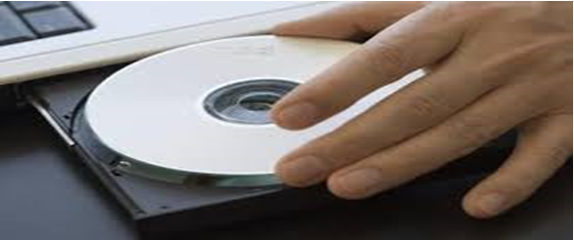
Bios Configuration (Changing booting sequence of your computer using Bootable USB Drive with Operating System)
1. Insert the CD/DVD Installer to your ODD.

Slide 24
Check the Functionality of a Bootable USB Drive
3. Enter your computer's BIOS. When the BIOS screen appears or you are prompted to do so, press Del, F1, F2, F10, or F9 (depending on your computer’s motherboard) to enter the system BIOS.

Slide 25
Check the Functionality of a Bootable USB Drive
4. Choose Advanced BIOS Features/Startup/Boot Tab. To change the booting sequence of your computer.

Slide 26
Check the Functionality of a Bootable USB Drive
5. Select the CD/DVD ROM Drive as the first boot device of your computer.

Slide 27
Check the Functionality of a Bootable USB Drive
6. Press F10 ( Save and Exit)

Slide 28
Check the Functionality of a Bootable USB Drive
7. Press any key to boot from USB will appear (Press Spacebar)
CD

Slide 29
Check the Functionality of a Bootable USB Drive
8. Windows is Loading Files will appear

Slide 30
Check the Functionality of a Bootable USB Drive
9. Press CTRL+ALT+DEL simultaneously to restart your computer

Slide 31
Bios Configuration (Changing booting sequence of your computer using Bootable USB Drive with Operating System)
1. Remove the CD/DVD Installer to your ODD.

Slide 32
Check the Functionality of a Bootable USB Drive
11. Computer will load the Operating System.

Slide 33
THANK YOU !!!

