Slide 1

Computer System Servicing

Slide 2
Windows 7
Windows 7 is an operating system that was produced by Microsoft and released as part of the Windows NT family of operating systems. It was released to manufacturing on July 22, 2009, and became generally available on October 22, 2009.

Slide 3
Most important things you should take into consideration when planning for your Windows 7 installation:
• Check System Requirements
• Check Hardware and Software Compatibility
• Determine Disk Partitioning Options
• Complete a Pre-Installation Checklist

Slide 4
System Requirements
• 1 gigahertz (GHz)
• 1 gigabyte (GB) RAM
• 16 GB available hard disk space
• DirectX 9 graphics device with WDDM 1.0 or higher driver

Slide 5
Type of Installation
• Upgrade (In-place upgrade) – This alternative replaces your present variant of Windows with Windows 7, and keeps your records, settings, and projects set up on your PC.
• Custom ("fresh" installation) – This choice replaces your present version of Windows with Windows 7, yet doesn't keep your records, settings, and programs. It's occasionally referred to a bare metal installation for that reason.

Slide 6
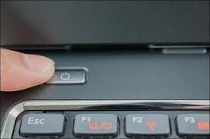
Installation of Windows 7
1. Turn On your Computer by Pressing the Power Button.

Slide 7
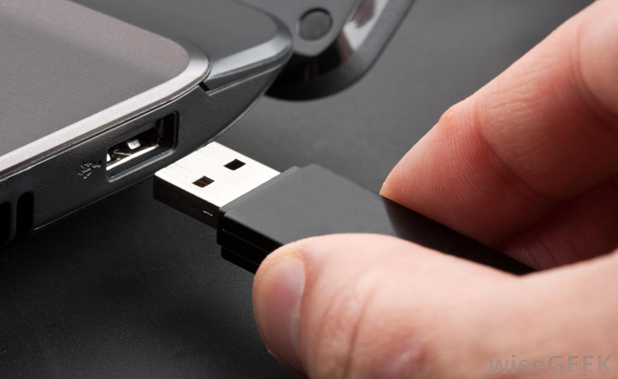
Installation of Windows 7
2. Insert the bootable USB in your USB port.
After Turned your computer ON, Insert the bootable USB Drive to the USB Port, and then Press certain key in your keyboard to go to BIOS Setup.

Slide 8
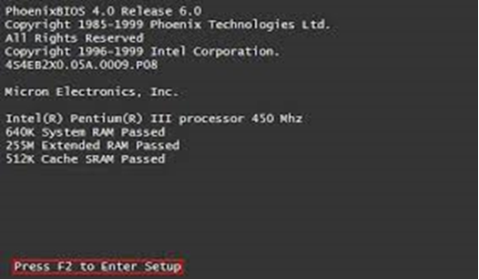
Installation of Windows 7
3. Enter your computer's BIOS. When the BIOS screen appears or you are prompted to do so, press Del, F1, F2, F10, or F9 (depending on your computer’s motherboard) to enter the system BIOS.

Slide 9
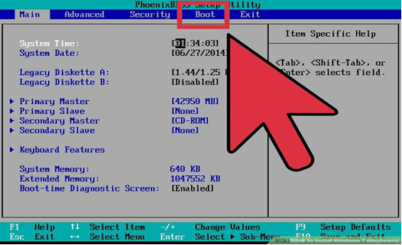
Installation of Windows 7
4. Choose Advanced BIOS Features/Startup/Boot Tab. To change the booting sequence of your computer.

Slide 10
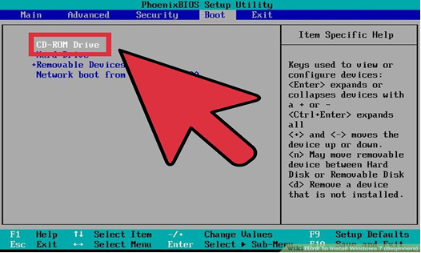
Installation of Windows 7
5. Select the Flash drive as the first boot device of your computer.

Slide 11
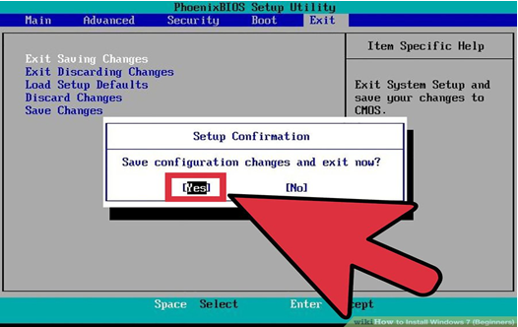
Installation of Windows 7
6. Press F10 ( Save and Exit)

Slide 12
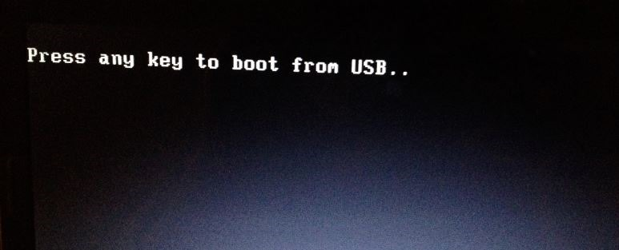
Installation of Windows 7
7. Press any key to boot from USB will appear (Press Spacebar)

Slide 13
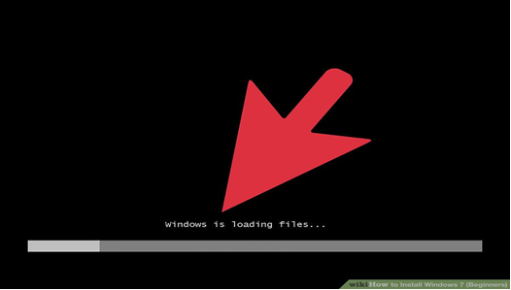
Installation of Windows 7
8. Windows is Loading Files will appear

Slide 14
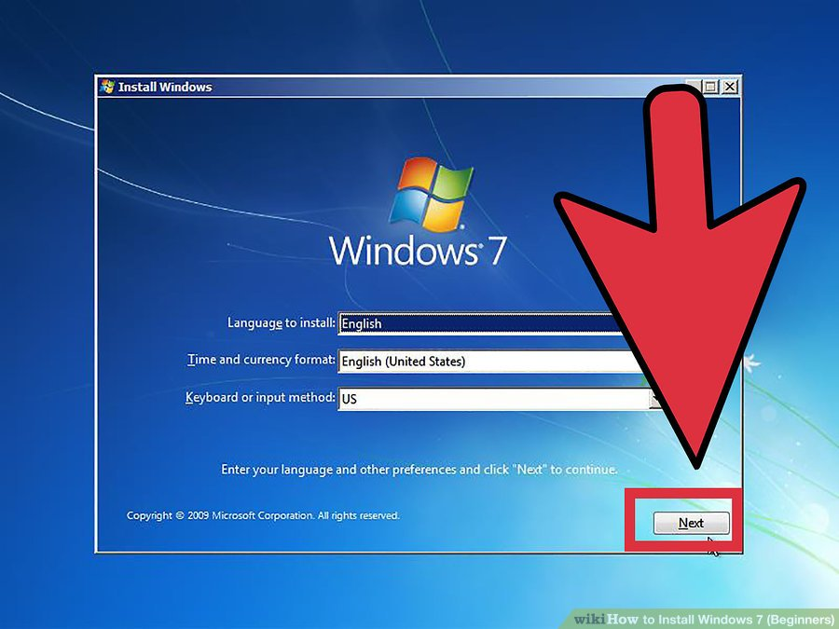
Installation of Windows 7
9. Language Option/Click Next

Slide 15
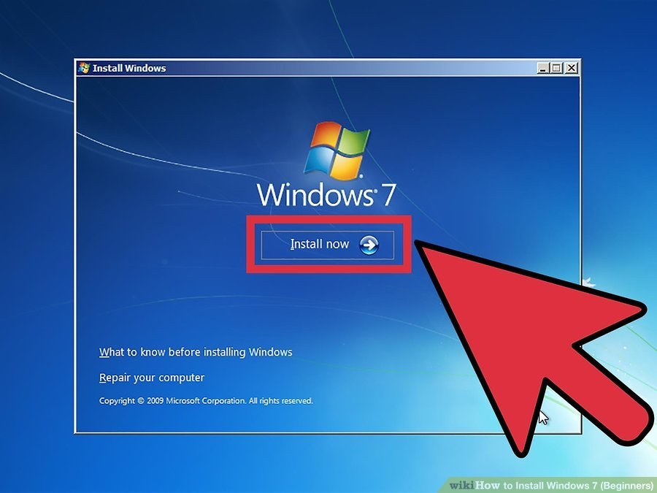
Installation of Windows 7
10. Click the Install Now button.

Slide 16
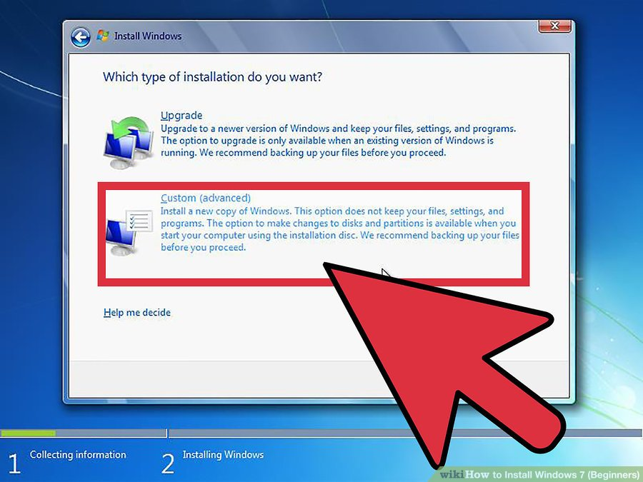
Installation of Windows 7
11. Select the Custom installation.

Slide 17
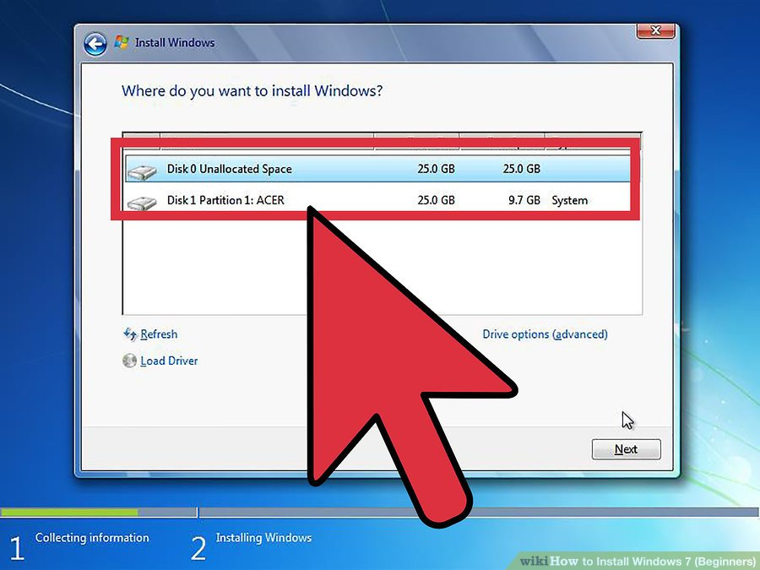
Installation of Windows 7
12. Decide on which hard drive and partition you want to install Windows on. If the hard drive has data on it, delete the data off of it, or format it.
•Select the hard drive from the list of hard drives.
•Click Drive options (advanced).
•Click Format from Drive options.
•If your computer doesn't have any partitions yet, create one to install Windows on it.
•Select the hard drive from the list of hard drives.
•Click Drive options (advanced).
•Select New from Drive options.
•Select the size, and click OK.

Slide 18
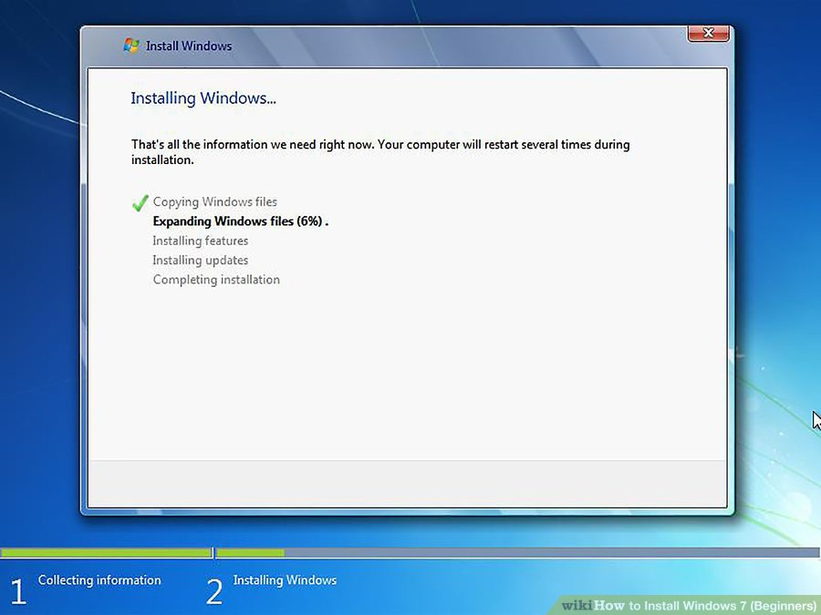
Installation of Windows 7
13. Install Windows on your preferred hard drive and partition. Once you've decided on where to install Windows, select it and click Next. Windows will begin installing.
Note: The Computer will restart after 100%, Go to BIOS Setup to change the booting Priority.

Slide 19
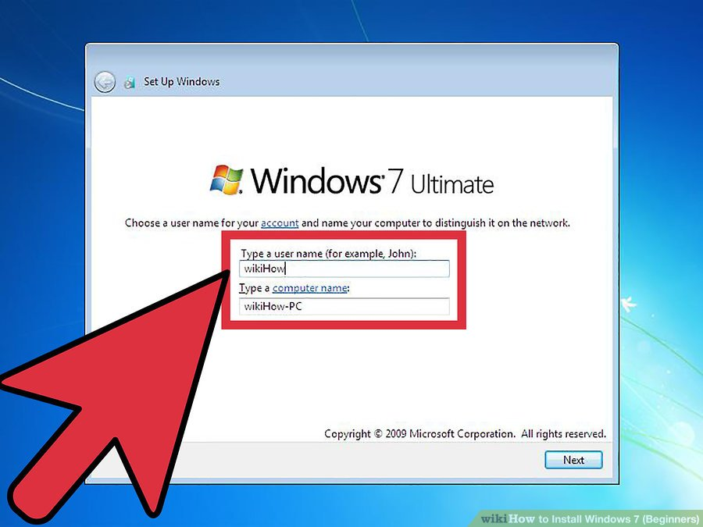
Installation of Windows 7
14. Type your username and computer's name and click Next.

Slide 20
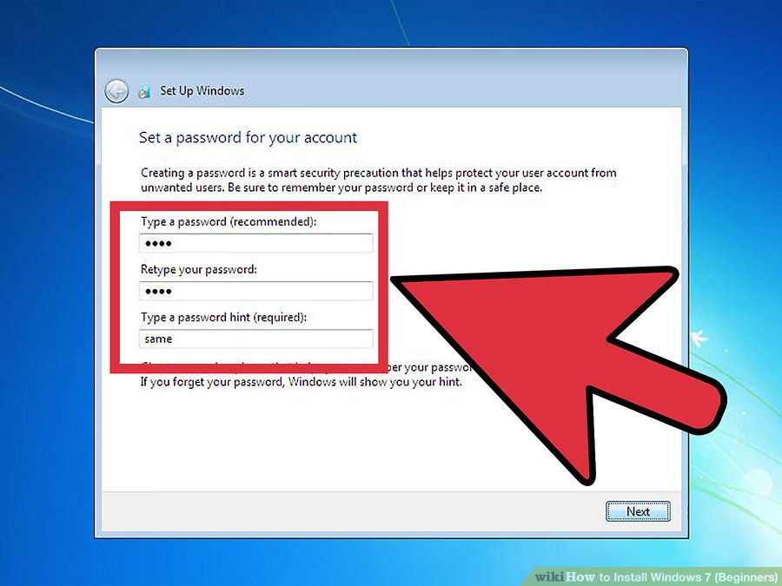
Installation of Windows 7
15. Type your password and click Next. If you don't want a password, leave the text boxes blank and then click Next.

Slide 21
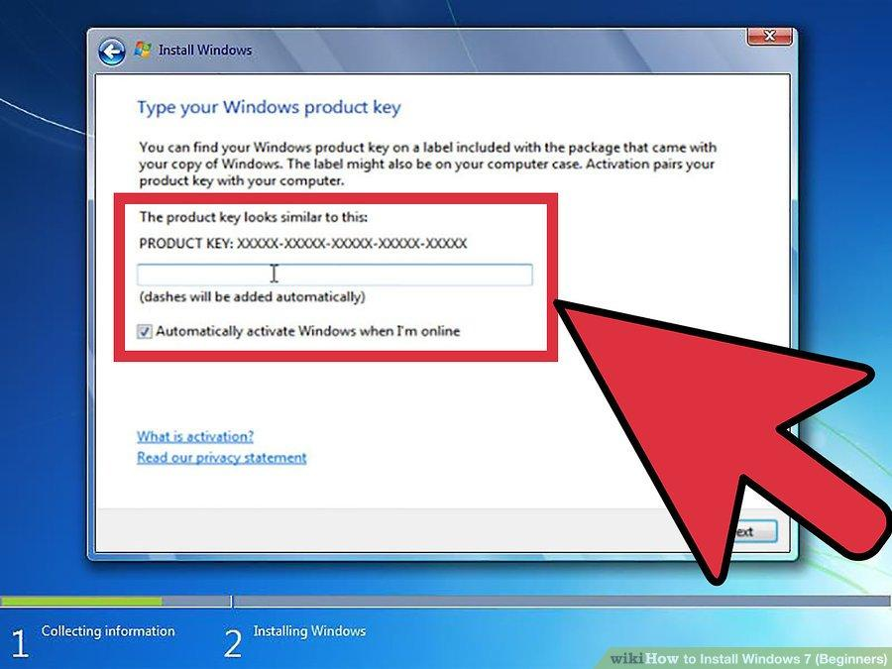
Installation of Windows 7
16. Enter your product key then click Next. Your product key is located on the case of your Windows 7 disc if you purchased the disc. To skip entering your product key, just click Next, but Windows will run on a 30-day trial, and you'll have to enter a key once the 30-day trial time is up.

Slide 22
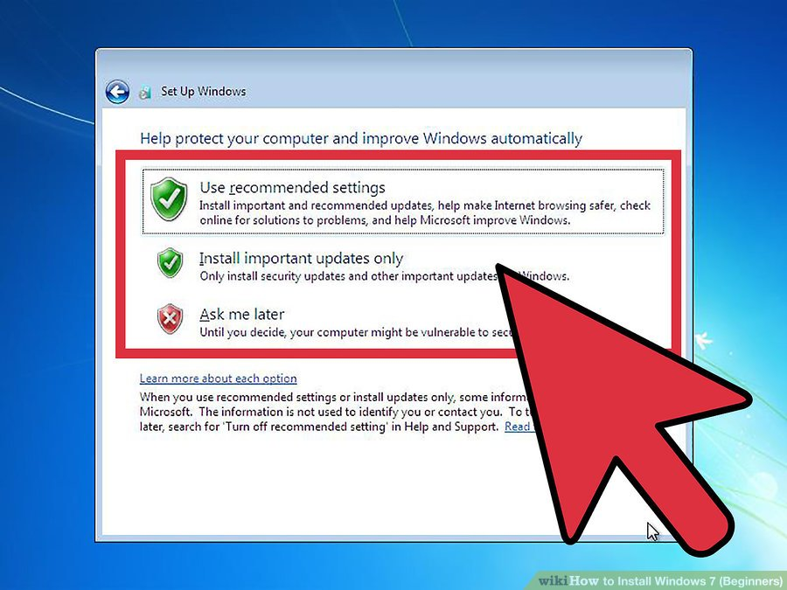
Installation of Windows 7
17. Choose your Windows Update settings.
• Use recommended settings automatically sets update and security settings recommended by Microsoft.

Slide 23
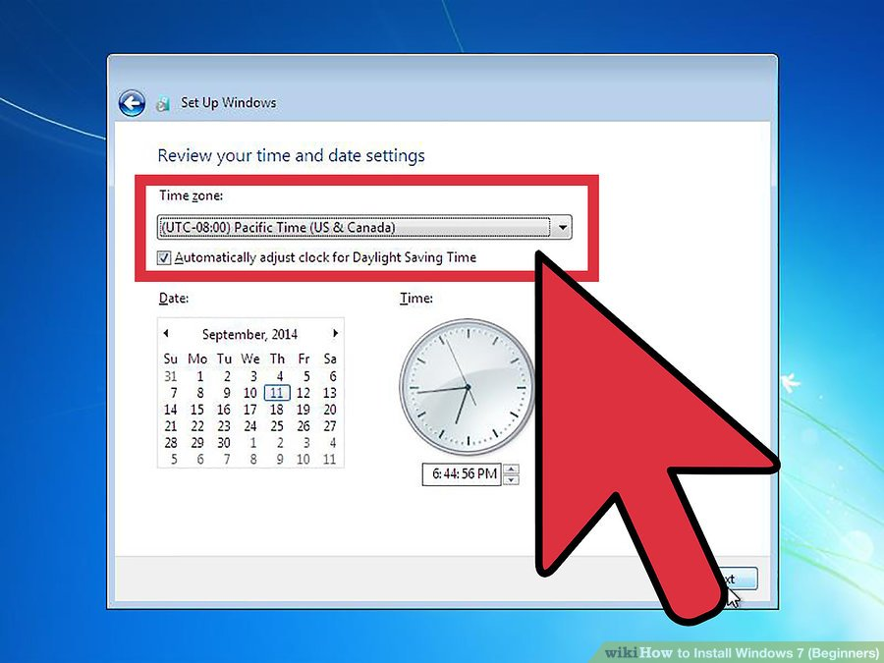
Installation of Windows 7
18. Set your time and time zone.

Slide 24
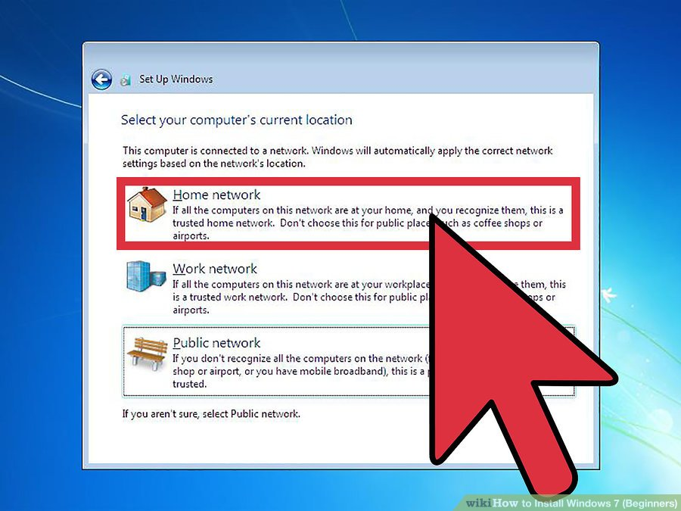
Installation of Windows 7
19. Set your network type.
•If the computer is connected to your own personal network, choose Home network.
•If you are connected to the network at your workplace, choose Work network.
•If you're connected to a public network from places such as restaurants and shops, choose Public network.

Slide 25
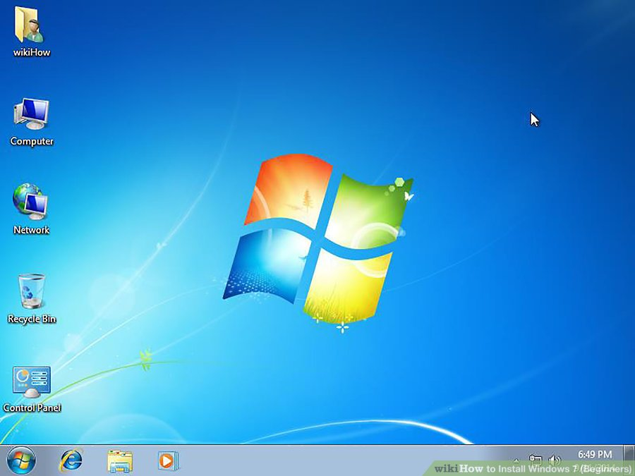
Installation of Windows 7
20. Your computer is now set up!

Slide 26
THANK YOU !!!

