Slide 1

Computer System Servicing

Slide 2
Windows 8
Windows 8 was introduced by Microsoft on October the 26 of 2012, and it had a brand new user interface and most notably removed the Start menu from the UI. About a year later, Microsoft introduced an update to Windows 8 called Windows 8.1.

Slide 3
System Requirements
•Processor: 1 gigahertz (GHz)
•RAM: 1GB (32-bit) or 2 GB (64-bit)
•Hard disk space: 16 GB (32-bit) or 20 GB (64-bit)
•Graphics card: Microsoft DirectX 9 graphics device

Slide 4
Features of Windows 8
• Easy Gestures
• Live Tiles and Lock Screen
• System-Wide Search
• Refresh and Reset
• Settings Sync
• Snap View for Multitasking
• Pin Anything
• Share Everything

Slide 5
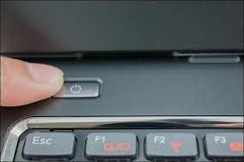
Installation of Windows 8
1. Turn On your Computer by Pressing the Power Button.

Slide 6
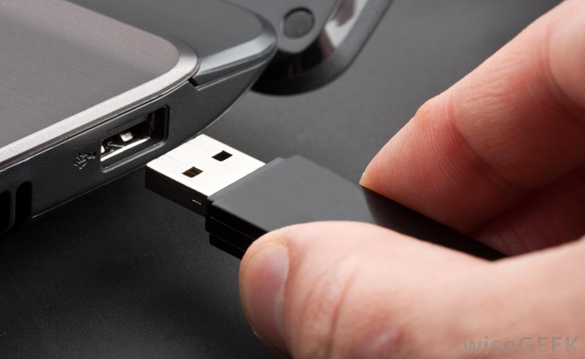
Installation of Windows 8
2. Insert the bootable USB in your USB port.
After Turned your computer ON, Insert the bootable USB Drive to the USB Port, and then Press certain key in your keyboard to go to BIOS Setup.

Slide 7
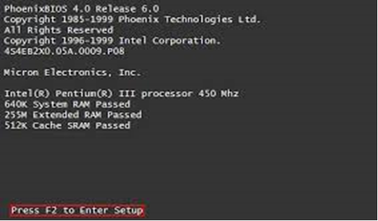
Installation of Windows 8
3. Enter your computer's BIOS. When the BIOS screen appears or you are prompted to do so, press Del, F1, F2, F10, or F9 (depending on your computer’s motherboard) to enter the system BIOS.

Slide 8
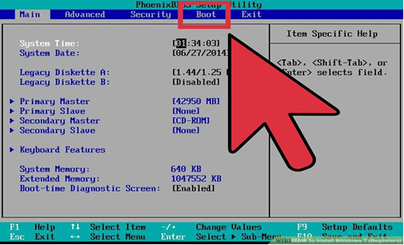
Installation of Windows 8
4. Choose Advanced BIOS Features/Startup/Boot Tab. To change the booting sequence of your computer.

Slide 9
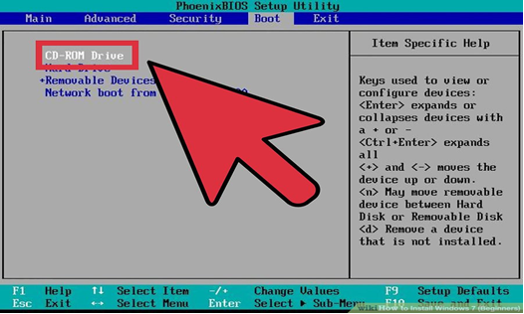
Installation of Windows 8
5. Select the Flash drive as the first boot device of your computer.

Slide 10
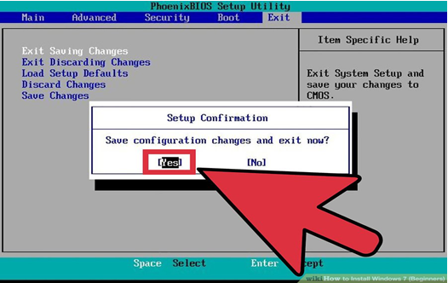
Installation of Windows 8
6. Press F10 ( Save and Exit)

Slide 11
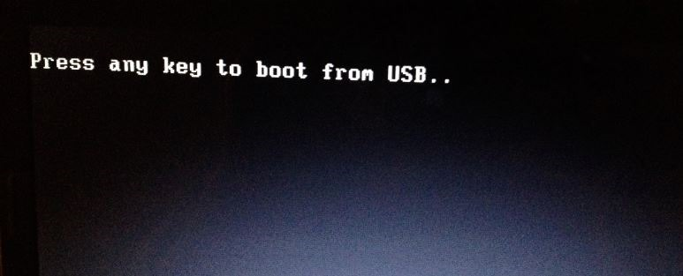
Installation of Windows 8
7. Press any key to boot from USB will appear (Press Spacebar)

Slide 12
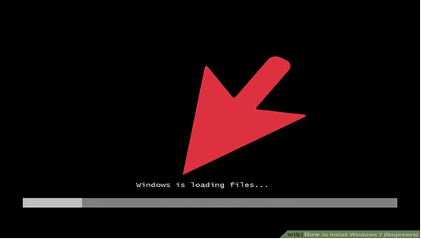
Installation of Windows 8
8. Windows is Loading Files will appear

Slide 13
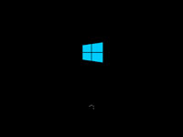
Installation of Windows 8
9. Installation Process will appear

Slide 14
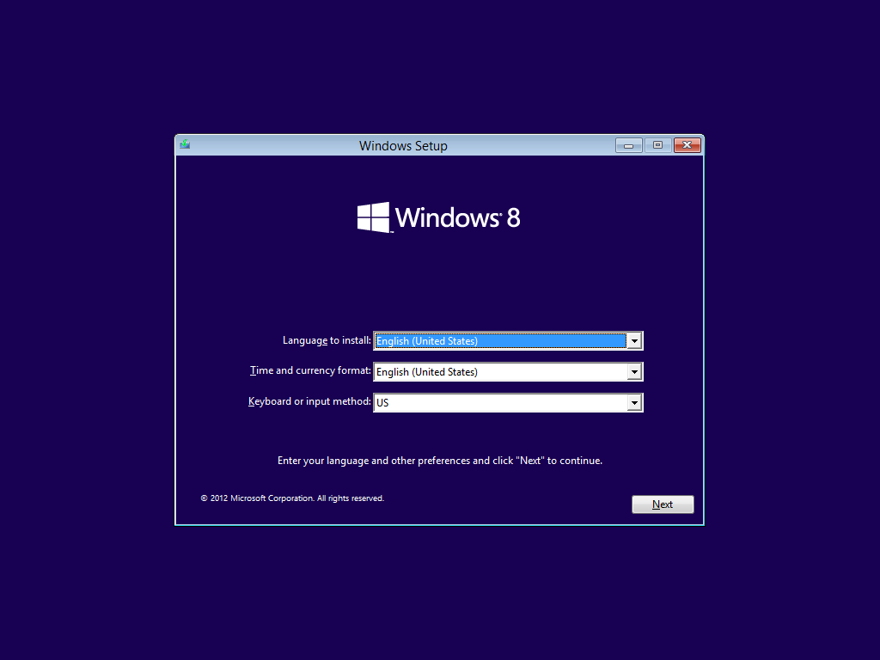
Installation of Windows 8
10. Language Option (English)

Slide 15
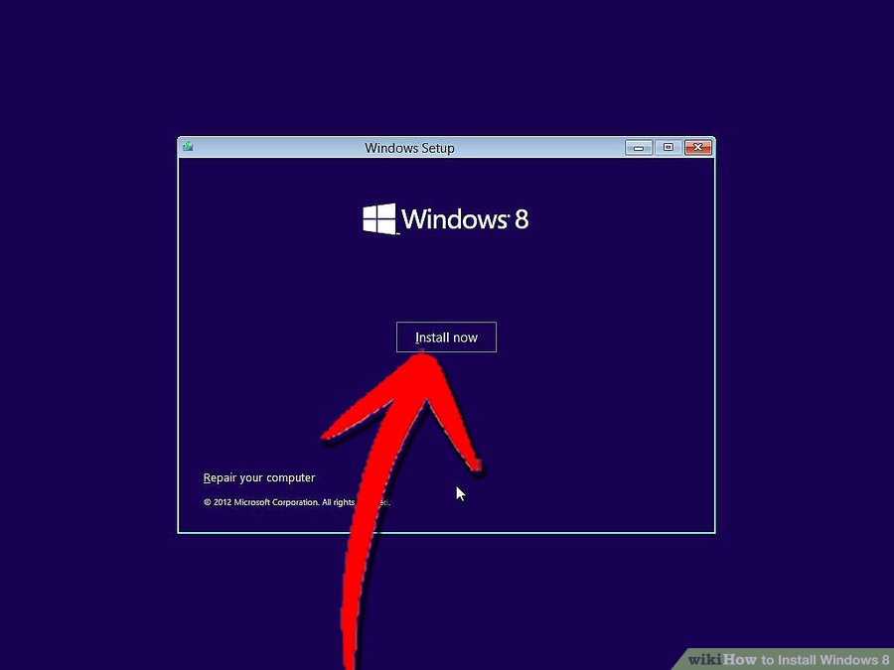
Installation of Windows 8
11. Installation Process will appear (Select INSTALL NOW)

Slide 16
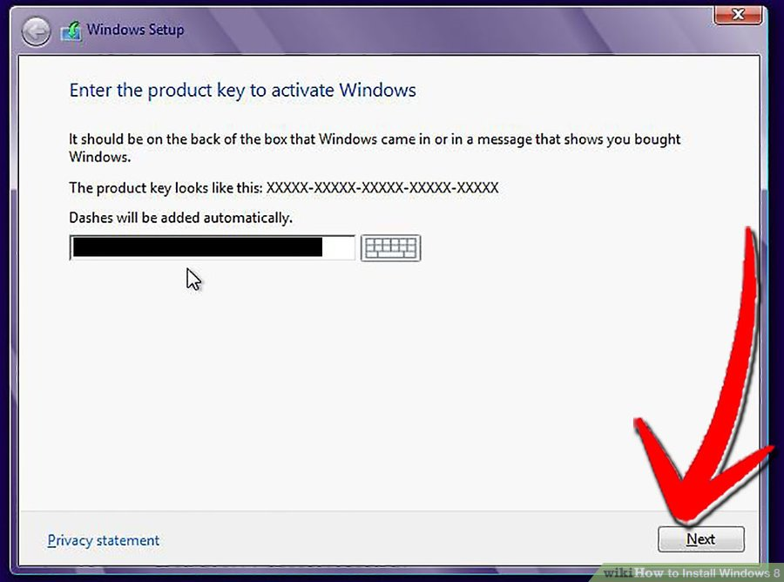
Installation of Windows 8
12. Insert the PRODUCT KEY

Slide 17
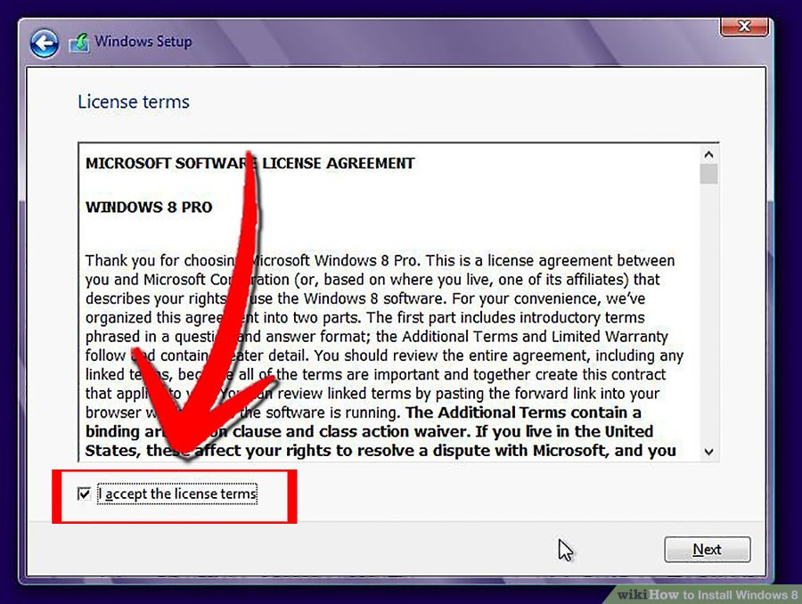
Installation of Windows 7
13. Licensing Agreement ((Accept/Agree)

Slide 18
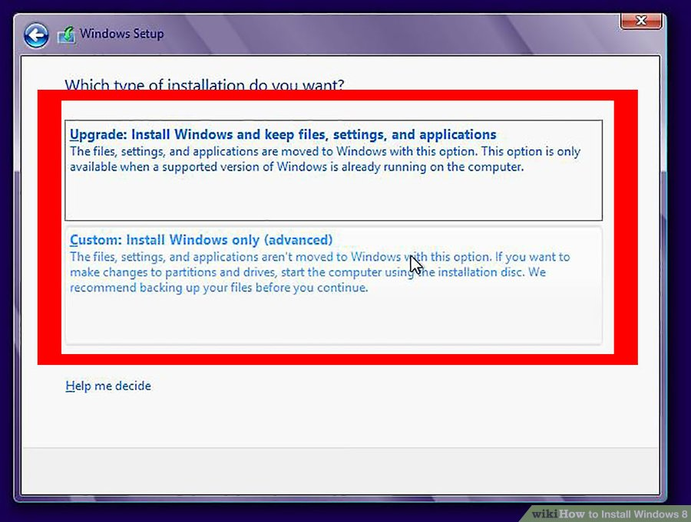
Installation of Windows 8
14. Partitioning (Select Customize Advanced Option).

Slide 19
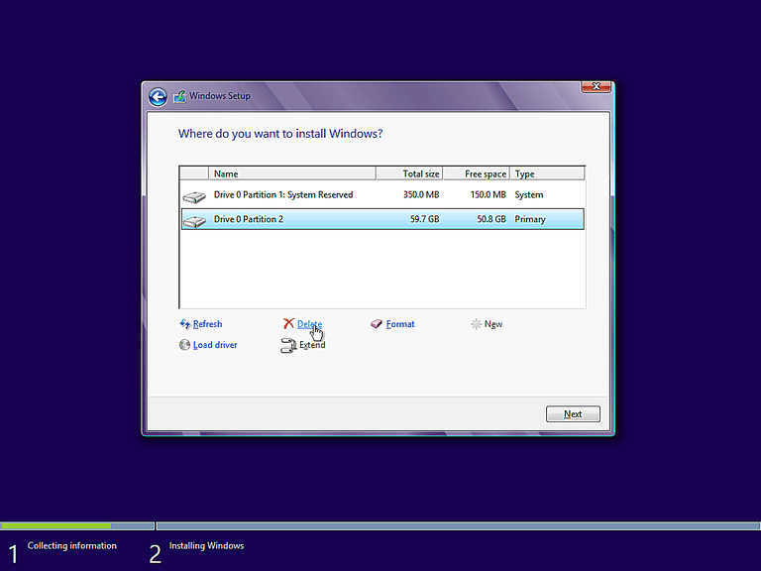
Installation of Windows 8
15. Partitioning (Delete and Create Partition). Select the Partition you want to install the Operating System, Then Click NEXT.

Slide 20
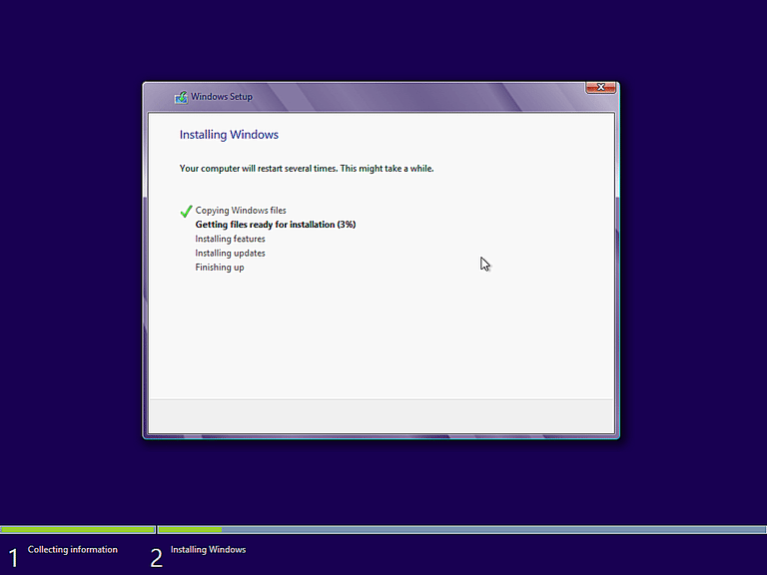
Installation of Windows 8
16. Windows starts to copy files to your hard drive and begins the installation. This process might take a few minutes depending on your computer specification.

Slide 21
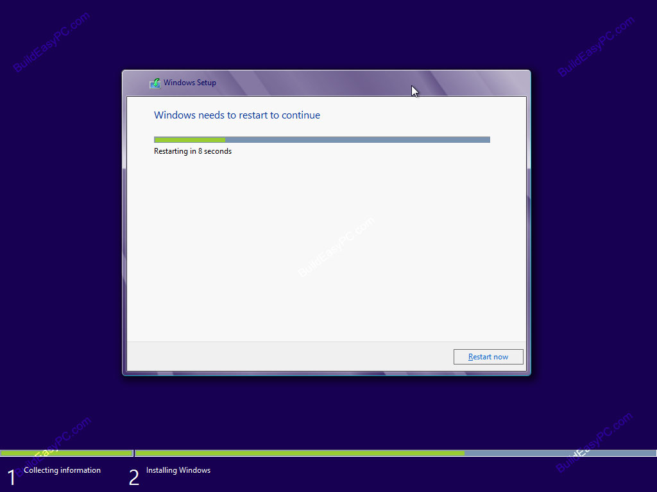
Installation of Windows 8
17. The Computer will Restart Automatically (Change the Booting Priority in BIOS, First boot should be HDD.)

Slide 22

Installation of Windows 8
18. You will go through various progress bar and information messages as shown on the following images. Windows might restart automatically second time.

Slide 23
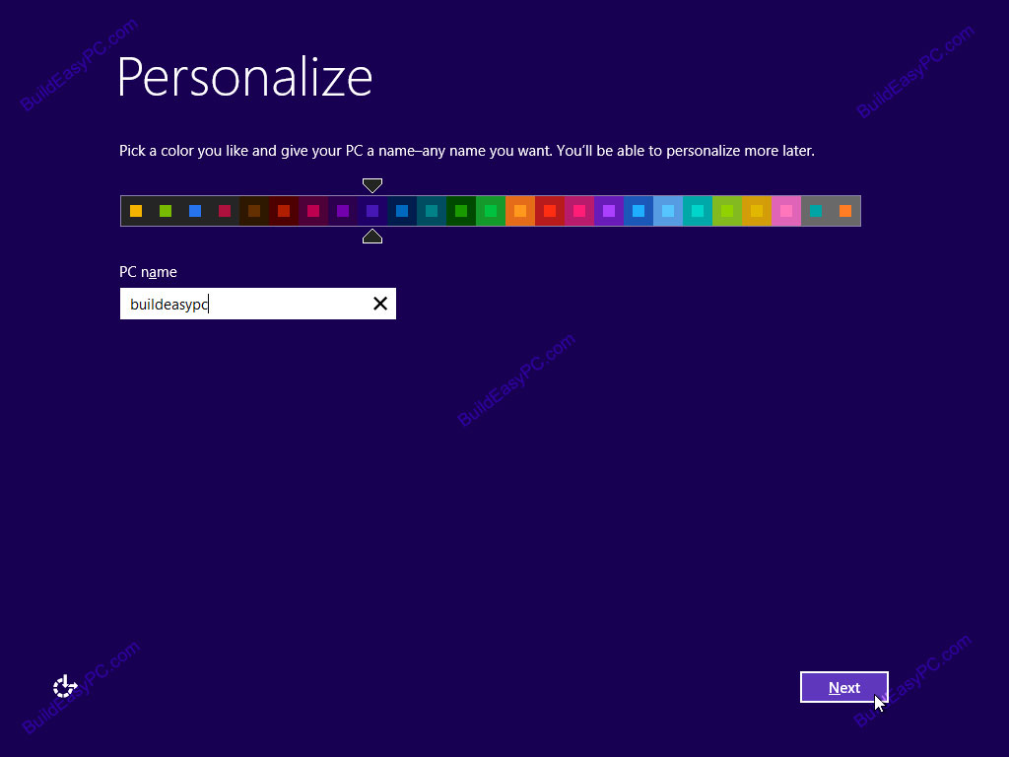
Installation of Windows 8
19. Choose your PC name and personalize the color.

Slide 24
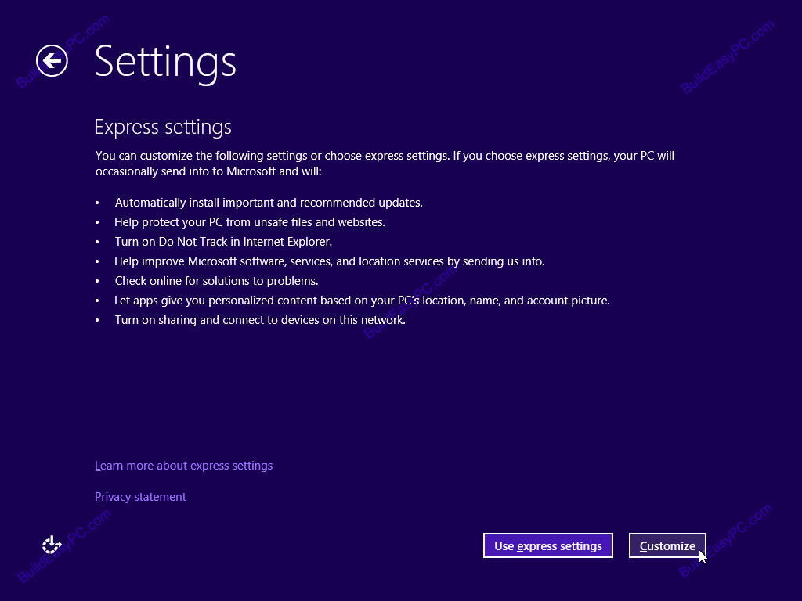
Installation of Windows 8
20. Here you can choose express settings or choose customize. Select Express Setting

Slide 25
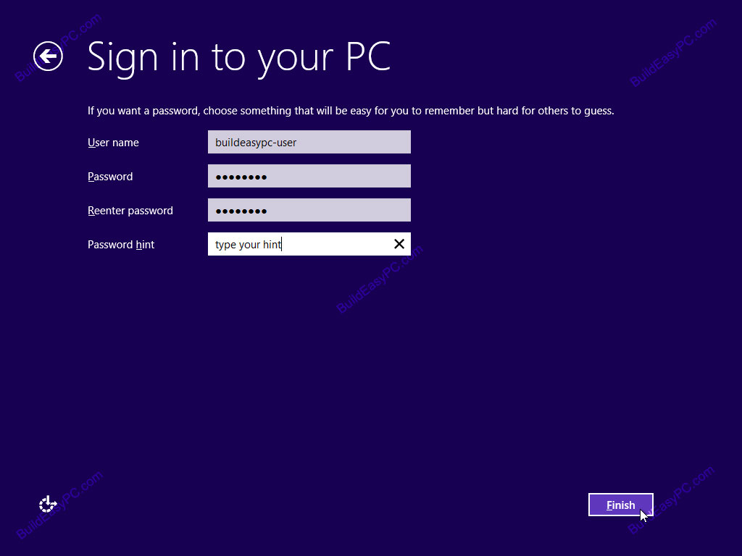
Installation of Windows 8
21. Type Username and Password

Slide 26

Installation of Windows 8
22. Finalizing Windows Setting

Slide 27
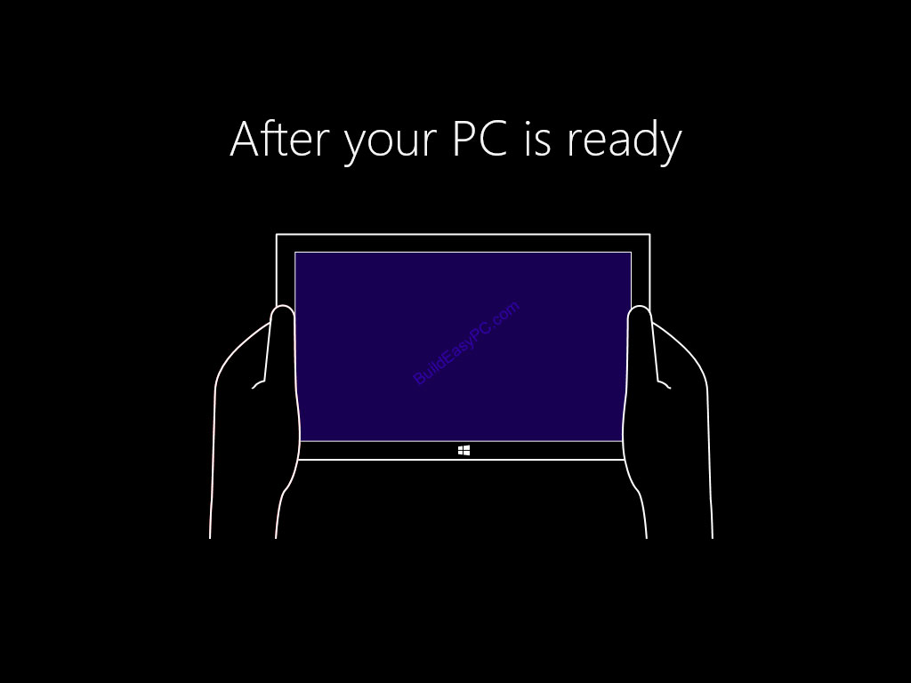
Installation of Windows 8
23. Windows 8 setup progresses you are given a presentation of the new interface.

Slide 28
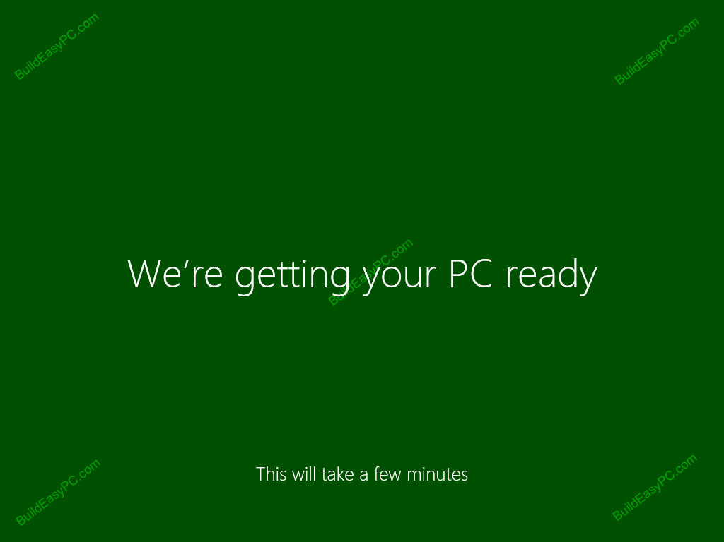
Installation of Windows 8
24. Soon as the demonstration finishes windows moves into the final stages of the setup.

Slide 29
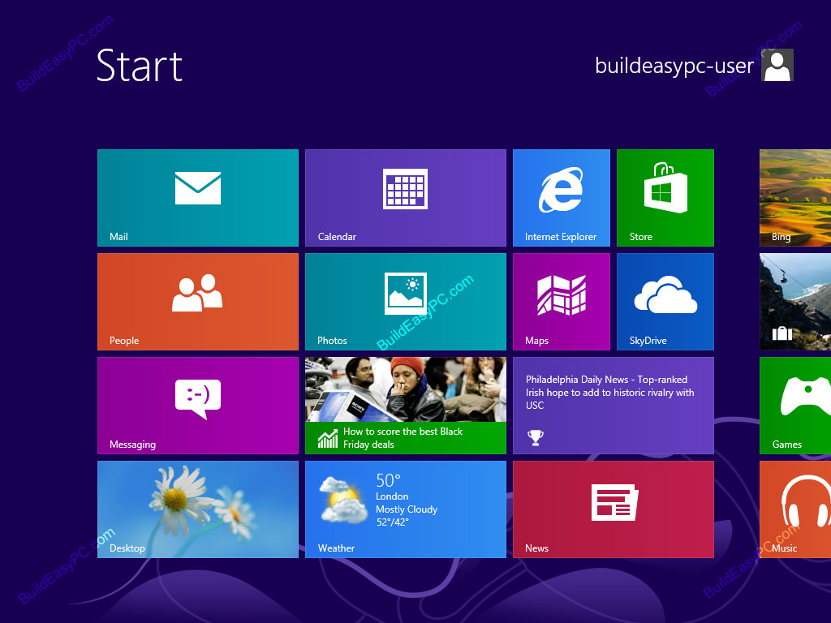
Installation of Windows 8
25. Windows 8 is Successfully Installed

Slide 30
THANK YOU !!!

