Slide 1

Computer System Servicing

Slide 2
DUAL OS
A dual boot is when you run two operating systems on one computer at the same time. This can be any combination of operating systems, for example, Windows and Mac, Windows and Linux or Windows 7 and Windows 10.

Slide 3
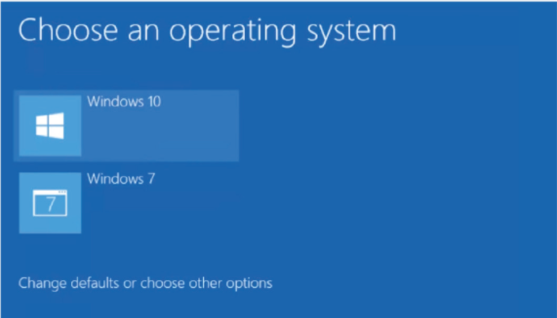
DUAL OS

Slide 4
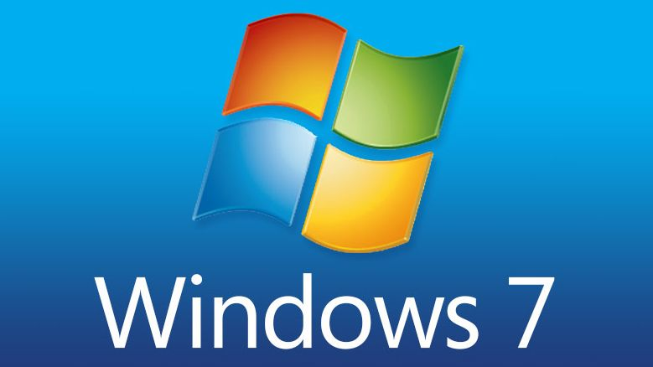
DUAL OS
Install First the Windows 7 and Create two PARTITION
( DRIVE C: & DRIVE D: )

Slide 5
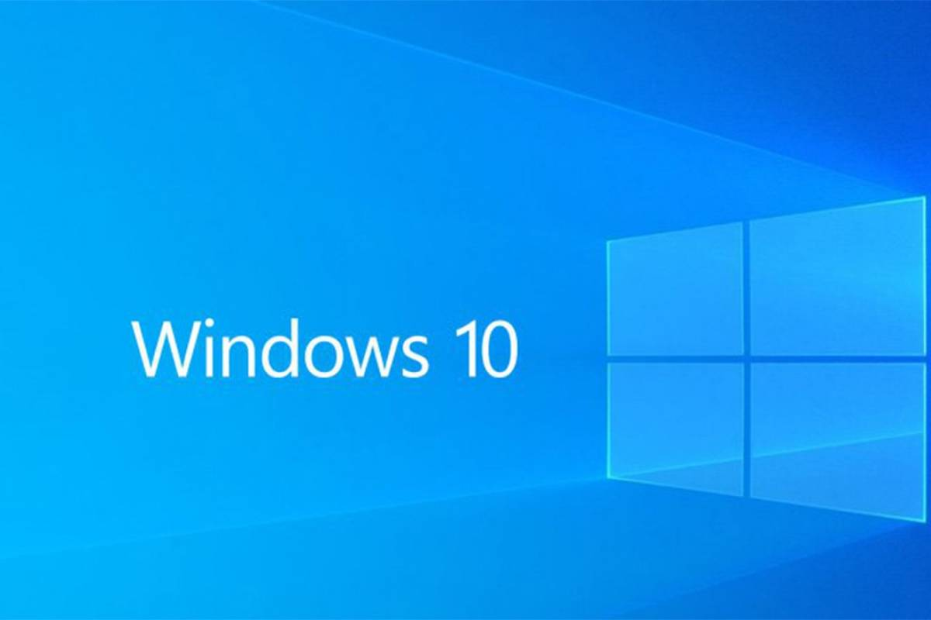
DUAL OS
2. After the installing Windows 7 in located in Drive C:, install Windows 10 in DRIVE D: )

Slide 6
THANK YOU !!!

