Slide 1

Computer System Servicing

Slide 2
Windows Server 2008 R2
Windows Server 2008 R2 is the fifth version of the Windows Server operating system produced by Microsoft and released as part of the Windows NT family of operating systems. It was released to manufacturing on July 22, 2009, and became generally available on October 22, 2009, shortly after the completion of Windows 7. It is the successor to Windows Server 2008, which is derived from the Windows Vista codebase, released the previous year, and was succeeded by the Windows 8-based Windows Server 2012.
Enhancements in Windows Server 2008 R2 include new functionality for Active Directory, new virtualization and management features, version 7.5 of the Internet Information Services web server and support for up to 256 logical processors. It is built on the same kernel used with the client-oriented Windows 7, and is the first server operating system released by Microsoft to exclusively support 64-bit processors, a move which would be followed by the consumer-oriented Windows 11 in 2021. Windows Server 2008 R2 is also the last version of Windows to support Itanium processors; its successor, Windows Server 2012, supports x64 processors only.

Slide 3
System Requirements
System requirements for Windows Server 2008 R2 are as follows:[36]
Processor: 1.4 GHz x86-64 or Itanium 2 processor
Memory: Minimum: 512 MB RAM (may limit performance and some features)
Recommended: 2 GB RAM
Maximum: 8 GB RAM (Foundation), 32 GB RAM (Standard), or 2 TB RAM (Enterprise, Datacenter and Itanium)
Display: Super VGA (800×600) or higher
Disk Space Requirements :Minimum (editions higher than Foundation): 32 GB or more
Minimum (Foundation edition) 10 GB or more.

Slide 4
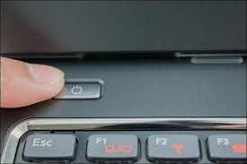
Windows Server 2008 R2
1. Turn On your Computer by Pressing the Power Button.

Slide 5

Windows Server 2008 R2
2. Insert the bootable USB in your USB port.
After Turned your computer ON, Insert the bootable USB Drive to the USB Port, and then Press certain key in your keyboard to go to BIOS Setup.

Slide 6
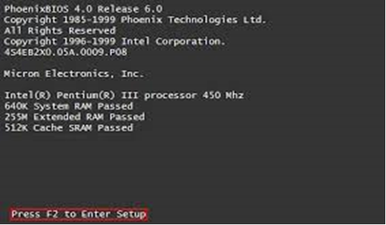
Windows Server 2008 R2
3. Enter your computer's BIOS. When the BIOS screen appears or you are prompted to do so, press Del, F1, F2, F10, or F9 (depending on your computer’s motherboard) to enter the system BIOS.

Slide 7
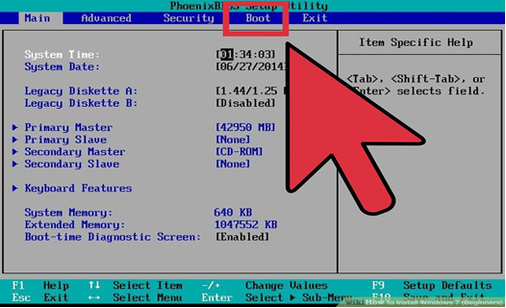
Windows Server 2008 R2
4. Choose Advanced BIOS Features/Startup/Boot Tab. To change the booting sequence of your computer.

Slide 8
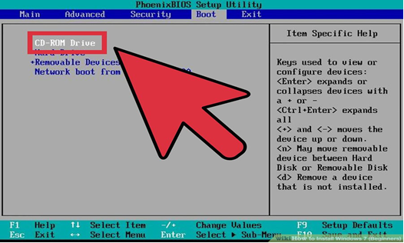
Windows Server 2008 R2
5. Select the Flash drive as the first boot device of your computer.

Slide 9
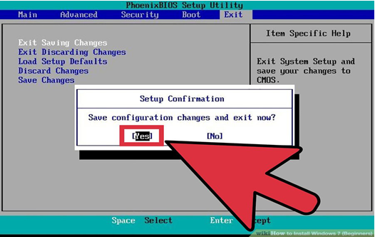
Windows Server 2008 R2
6. Press F10 ( Save and Exit)

Slide 10
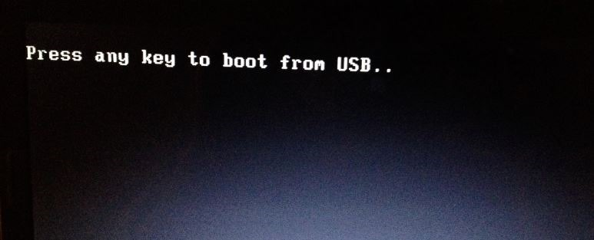
Windows Server 2008 R2
7. Press any key to boot from USB will appear (Press Spacebar)

Slide 11
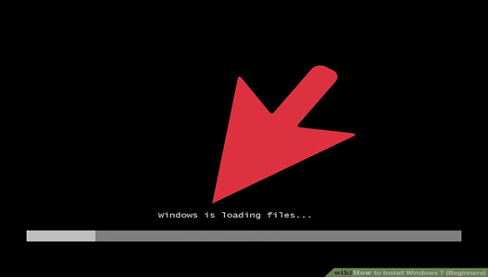
Windows Server 2008 R2
8. Windows is Loading Files will appear

Slide 12
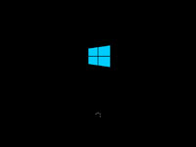
Windows Server 2008 R2
9. Installation Process will appear

Slide 13
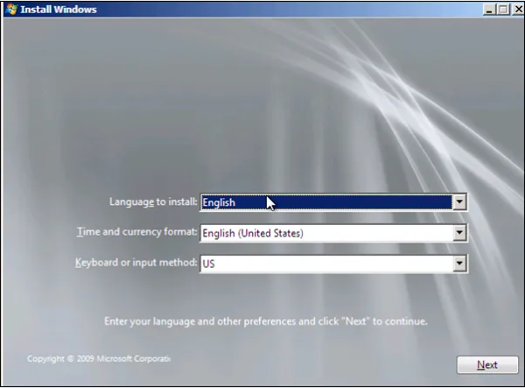
Windows Server 2008 R2
10. Language Option (English)

Slide 14
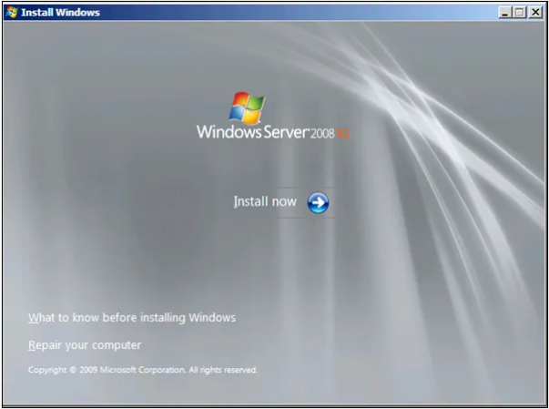
Windows Server 2008 R2
11. Installation Process will appear (Select INSTALL NOW)

Slide 15
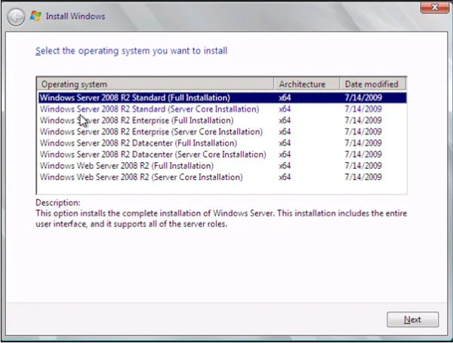
Windows Server 2008 R2
12. Select Windows Server 2008 R2 Standard (Full Installation)

Slide 16
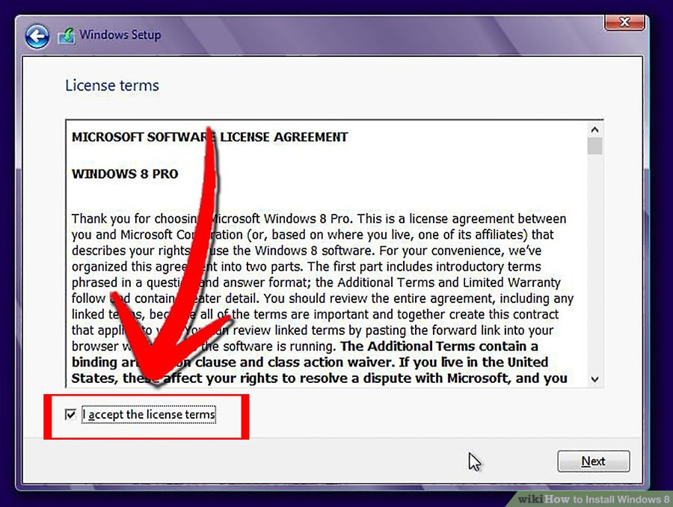
Windows Server 2008 R2
13. Licensing Agreement ((Accept/Agree)

Slide 17
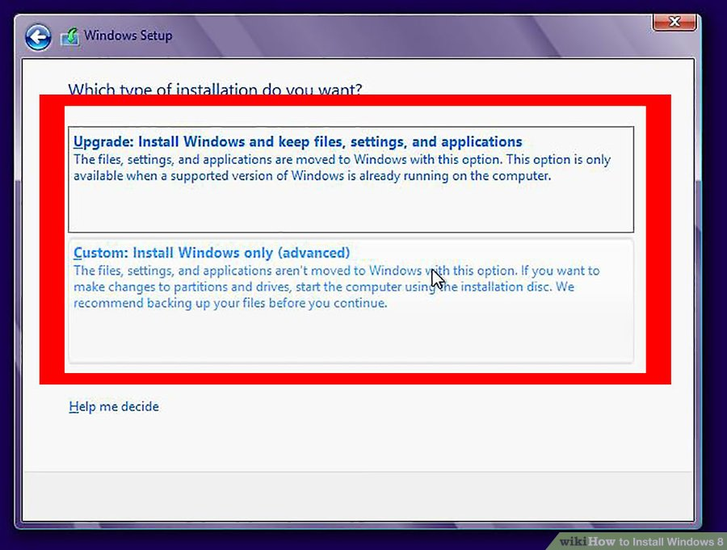
Windows Server 2008 R2
14. Partitioning (Select Customize Advanced Option).

Slide 18
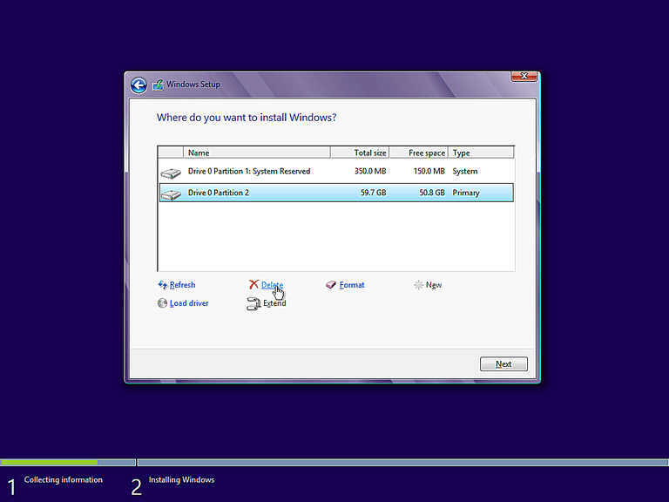
Windows Server 2008 R2
15. Partitioning (Delete and Create Partition). Select the Partition you want to install the Operating System, Then Click NEXT.

Slide 19
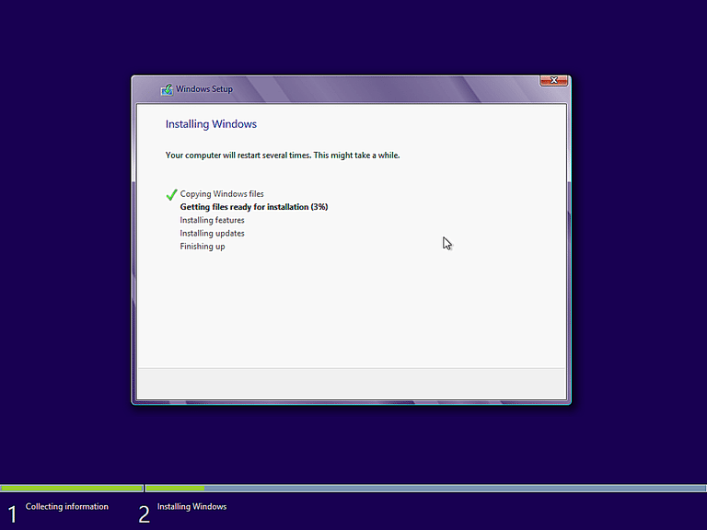
Windows Server 2008 R2
16. Windows starts to copy files to your hard drive and begins the installation. This process might take a few minutes depending on your computer specification.

Slide 20
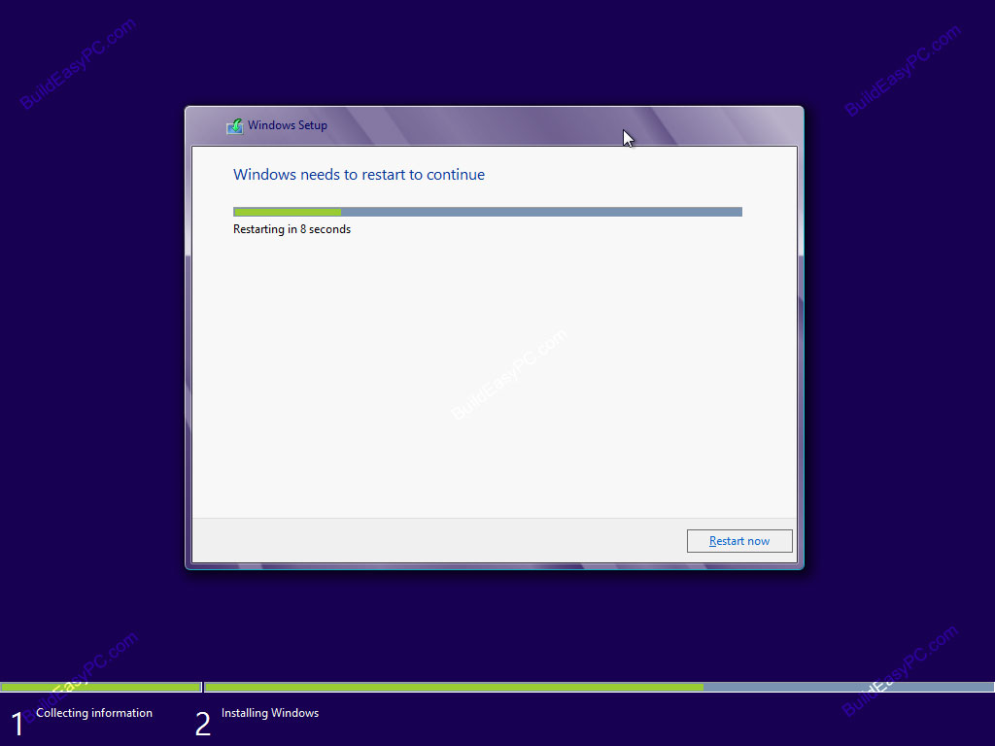
Windows Server 2008 R2
17. The Computer will Restart Automatically (Change the Booting Priority in BIOS, First boot should be HDD.)

Slide 21
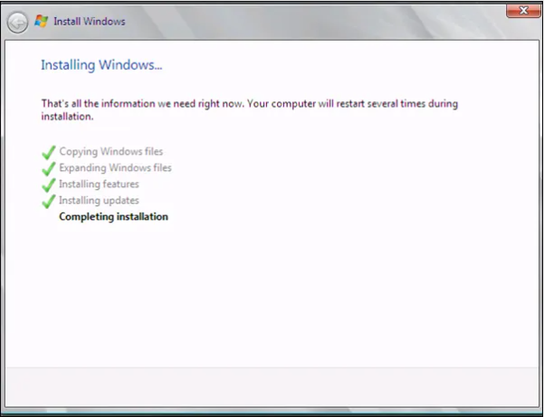
Windows Server 2008 R2
18. You will go through various progress bar and information messages as shown on the following images. Windows might restart automatically second time.

Slide 22
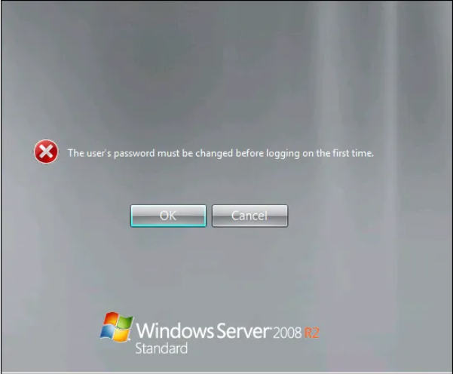
Windows Server 2008 R2
19. Changing Password

Slide 23
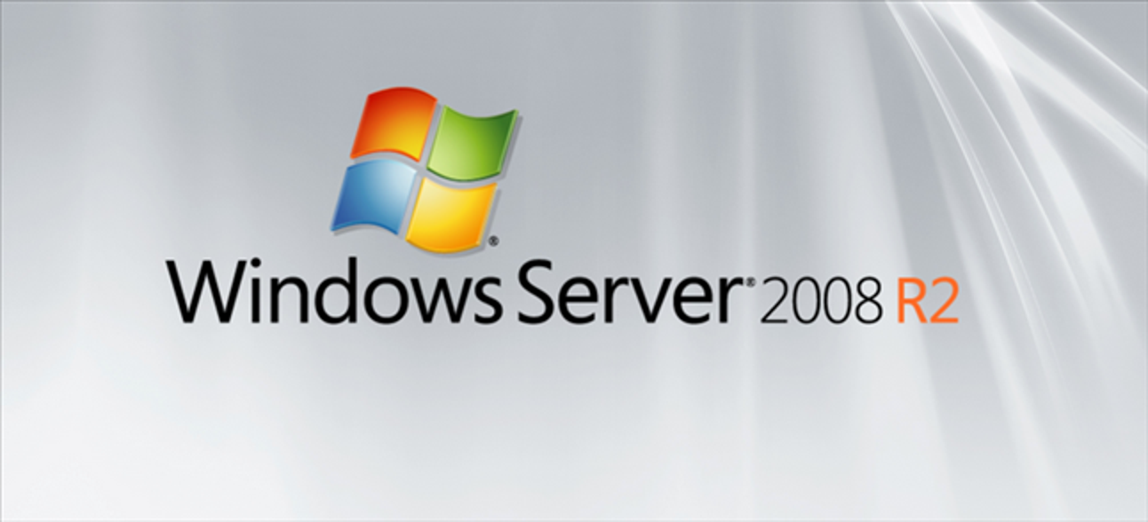
Windows Server 2008 R2
20. Windows Server 2008 R2 is Successfully Installed

Slide 24
THANK YOU !!!

