Slide 1

Computer System Servicing

Slide 2
Windows 10
Windows 10 is a major release of Microsoft's Windows NT operating system. It is the direct successor to Windows 8.1, which was released nearly two years earlier. It was released to manufacturing on July 15, 2015, and later to retail on July 29, 2015.

Slide 3
System Requirements
•Processor: 1 gigahertz (GHz) or faster
•RAM: 1GB (32-bit) or 2 GB (64-bit)
•Hard disk space: 16 GB (32-bit) or 20 GB (64-bit)
•Graphics card: Microsoft DirectX 9 graphics device

Slide 4
Features of Windows 10
• New Start Menu
• Cortana Integration
• Microsoft Edge Web Browser
• Virtual Desktop
• Universal Application

Slide 5

Installation of Windows 10
1. Turn On your Computer by Pressing the Power Button.

Slide 6

Installation of Windows 10
2. Insert the bootable USB in your USB port.
After Turned your computer ON, Insert the bootable USB Drive to the USB Port, and then Press certain key in your keyboard to go to BIOS Setup.

Slide 7
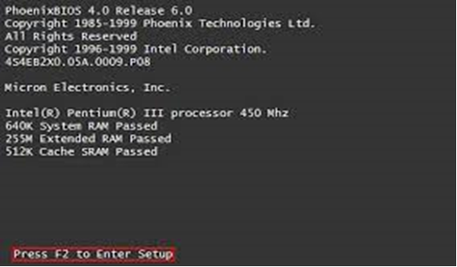
Installation of Windows 10
3. Enter your computer's BIOS. When the BIOS screen appears or you are prompted to do so, press Del, F1, F2, F10, or F9 (depending on your computer’s motherboard) to enter the system BIOS.

Slide 8
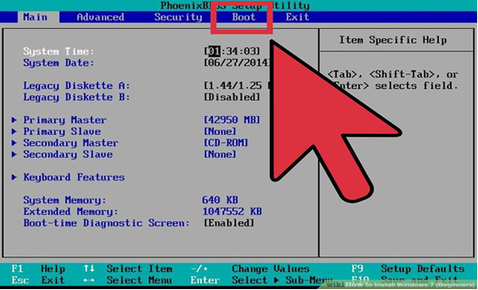
Installation of Windows 10
4. Choose Advanced BIOS Features/Startup/Boot Tab. To change the booting sequence of your computer.

Slide 9
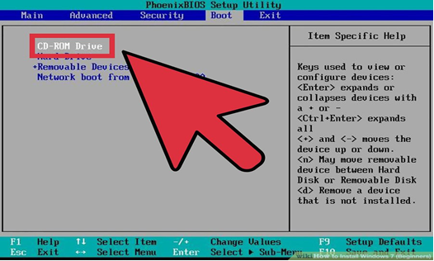
Installation of Windows 10
5. Select the Flash drive as the first boot device of your computer.

Slide 10
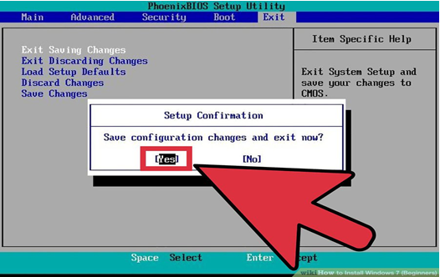
Installation of Windows 10
6. Press F10 ( Save and Exit)

Slide 11
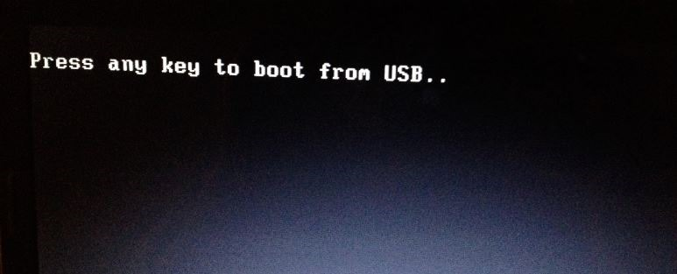
Installation of Windows 10
7. Press any key to boot from USB will appear (Press Spacebar)

Slide 12
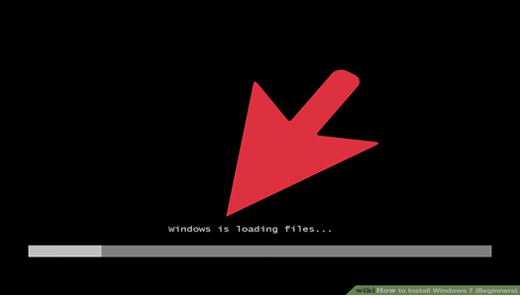
Installation of Windows 10
8. Windows is Loading Files will appear

Slide 13
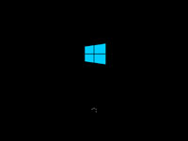
Installation of Windows 10
9. Installation Process will appear

Slide 14
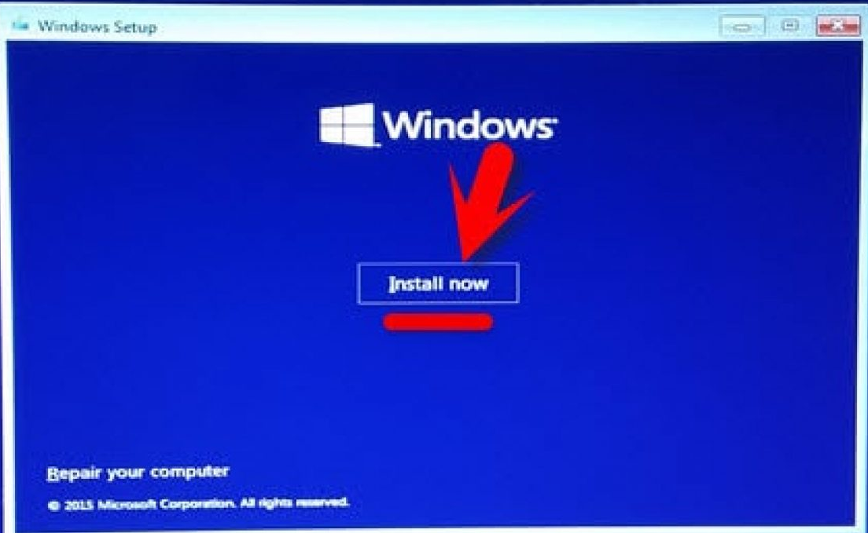
Installation of Windows 10
10. Installation Process will appear (Select INSTALL NOW)

Slide 15
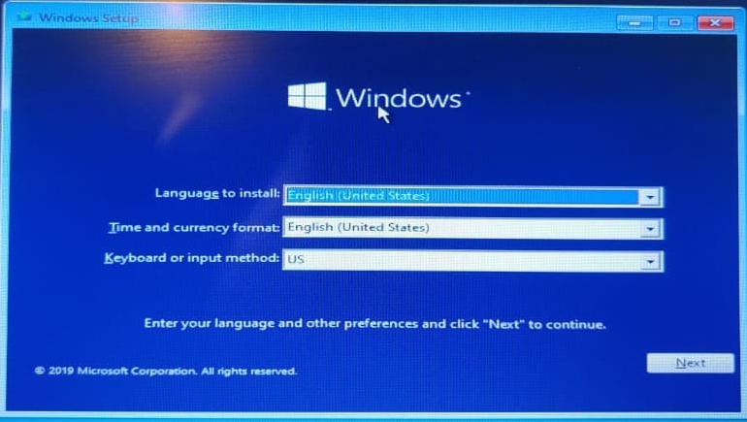
Installation of Windows 10
11. Language Option (English)

Slide 16
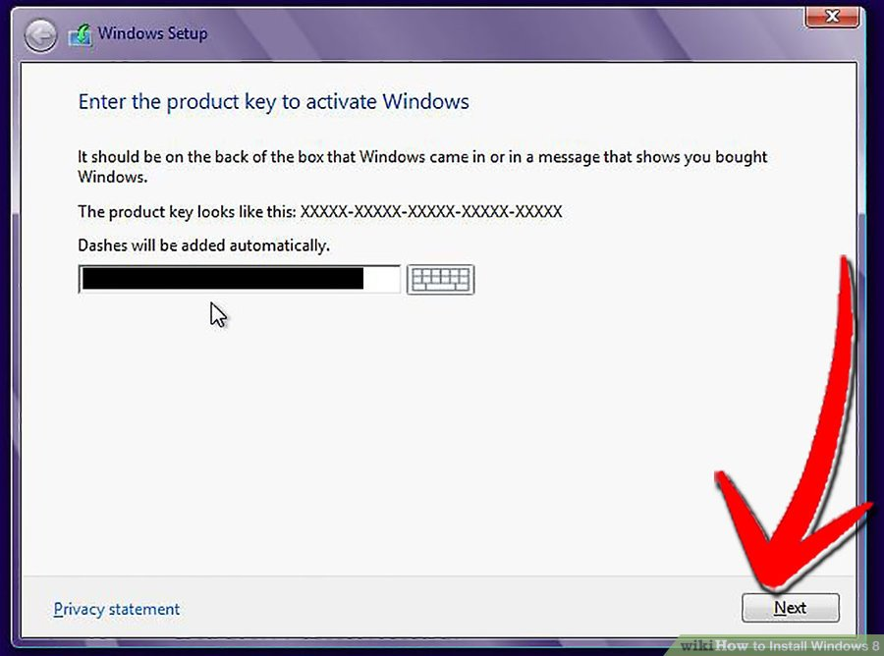
Installation of Windows 10
12. Insert the PRODUCT KEY

Slide 17
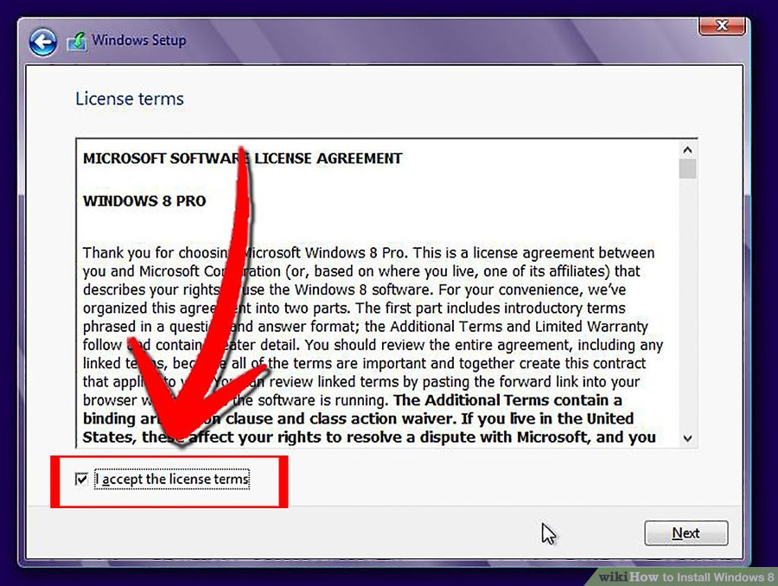
Installation of Windows 10
13. Licensing Agreement ((Accept/Agree)

Slide 18
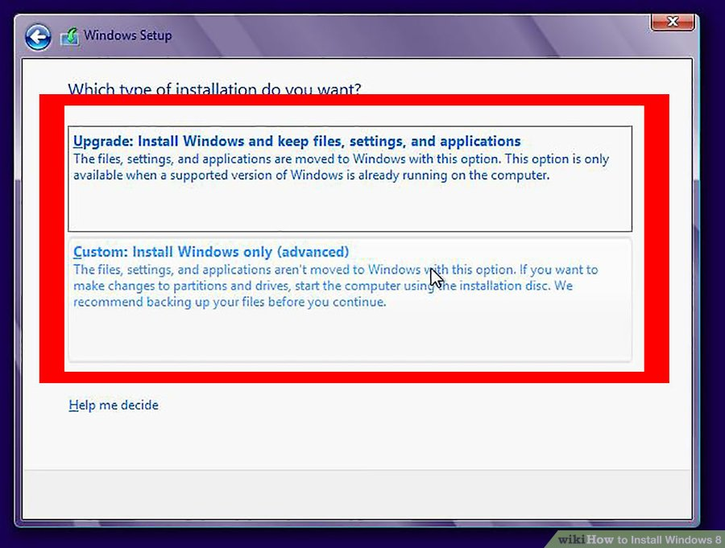
Installation of Windows 10
14. Partitioning (Select Customize Advanced Option).

Slide 19
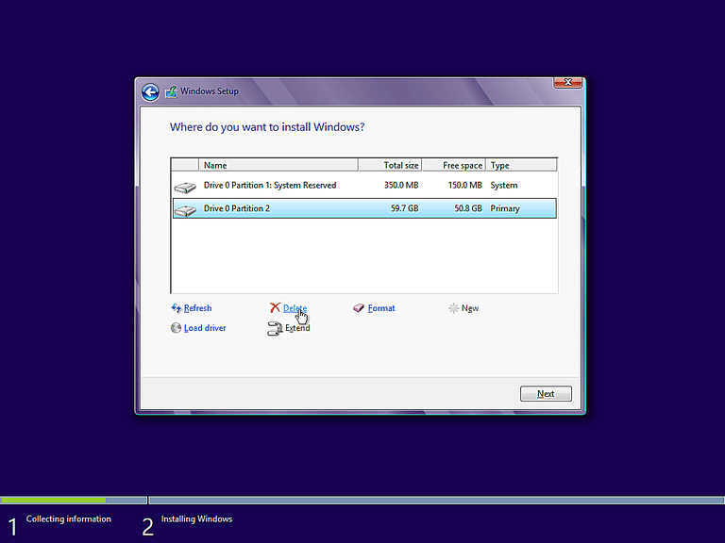
Installation of Windows 10
15. Partitioning (Delete and Create Partition). Select the Partition you want to install the Operating System, Then Click NEXT.

Slide 20
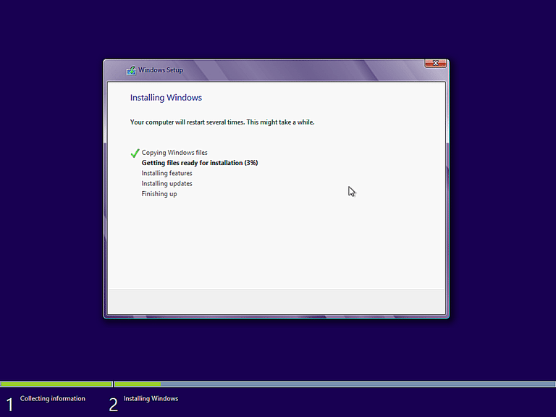
Installation of Windows 10
16. Windows starts to copy files to your hard drive and begins the installation. This process might take a few minutes depending on your computer specification.

Slide 21
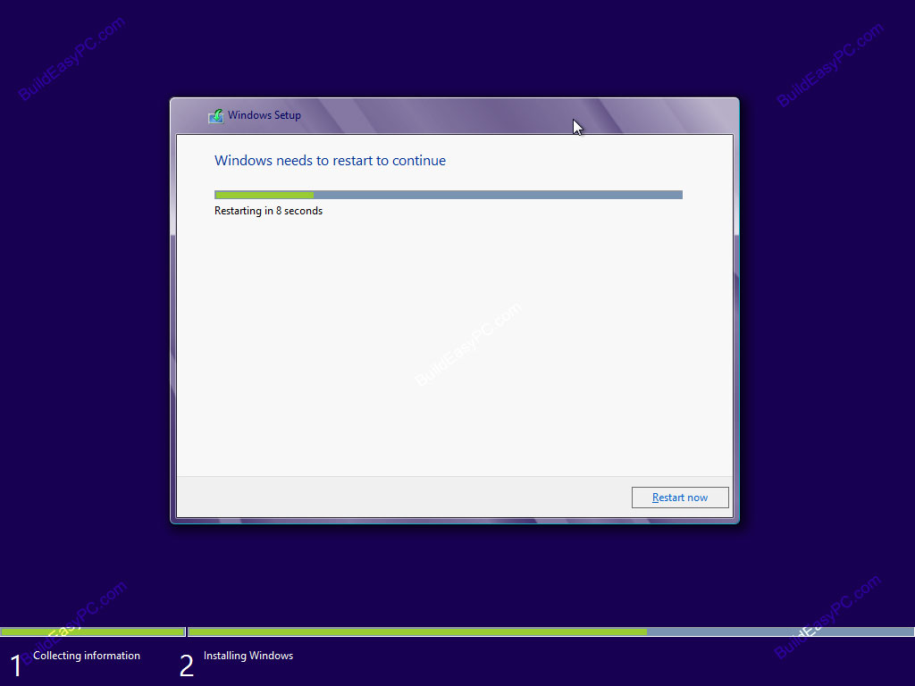
Installation of Windows 10
17. The Computer will Restart Automatically (Change the Booting Priority in BIOS, First boot should be HDD.)

Slide 22

Installation of Windows 10
18. You will go through various progress bar and information messages as shown on the following images. Windows might restart automatically second time.

Slide 23
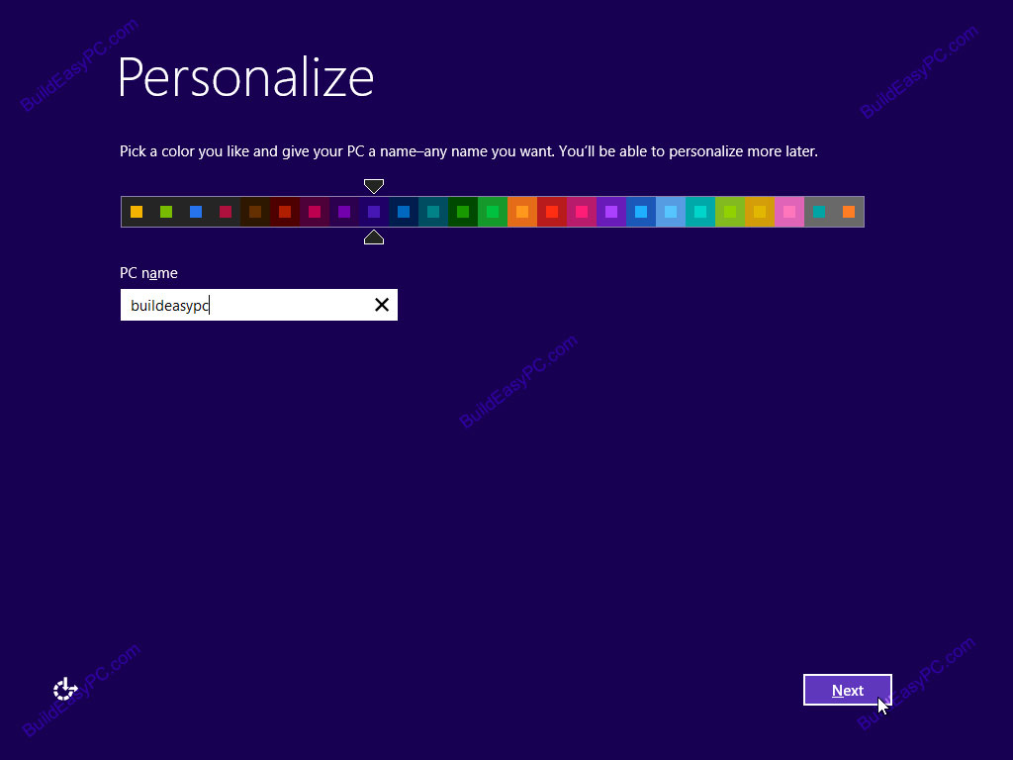
Installation of Windows 10
19. Choose your PC name and personalize the color.

Slide 24
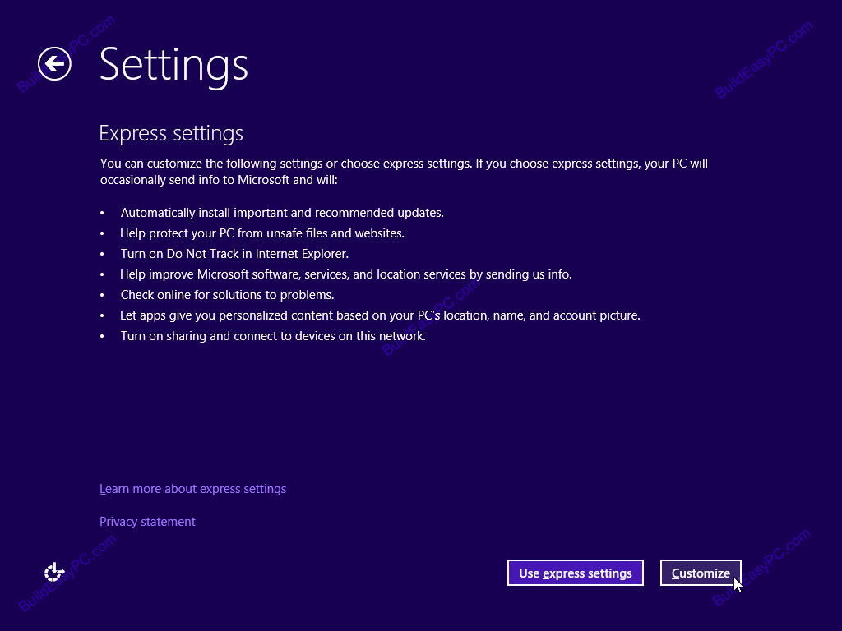
Installation of Windows 10
20. Here you can choose express settings or choose customize. Select Express Setting

Slide 25
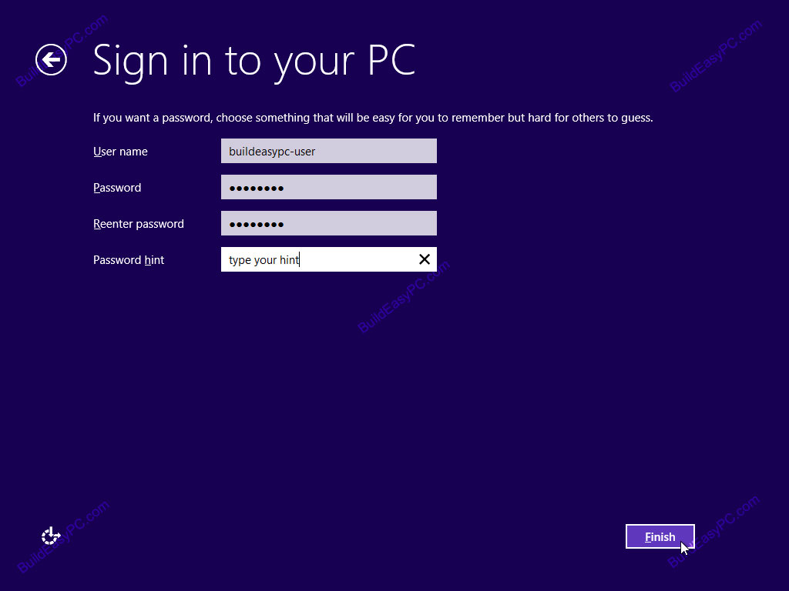
Installation of Windows 10
21. Type Username and Password

Slide 26

Installation of Windows 10
22. Finalizing Windows Setting

Slide 27
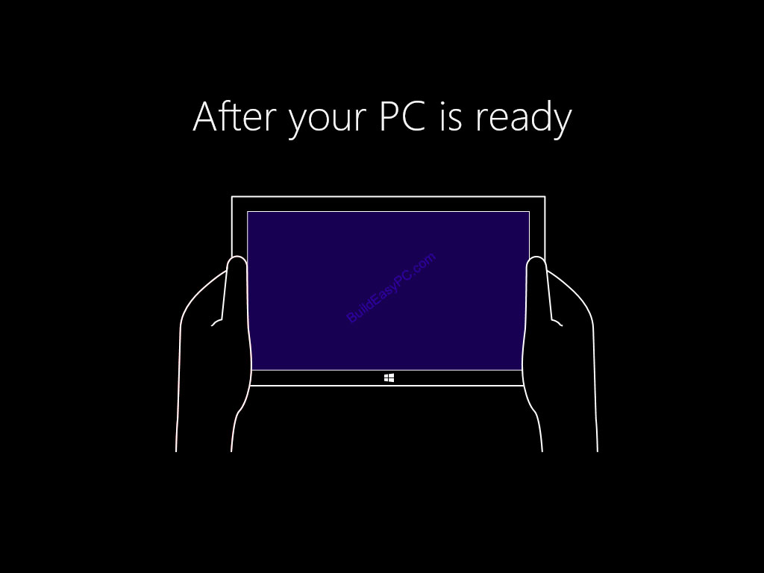
Installation of Windows 10
23. Windows 8 setup progresses you are given a presentation of the new interface.

Slide 28
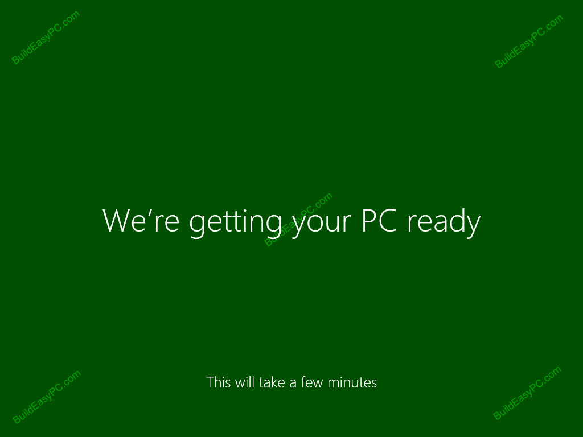
Installation of Windows 10
24. Soon as the demonstration finishes windows moves into the final stages of the setup.

Slide 29
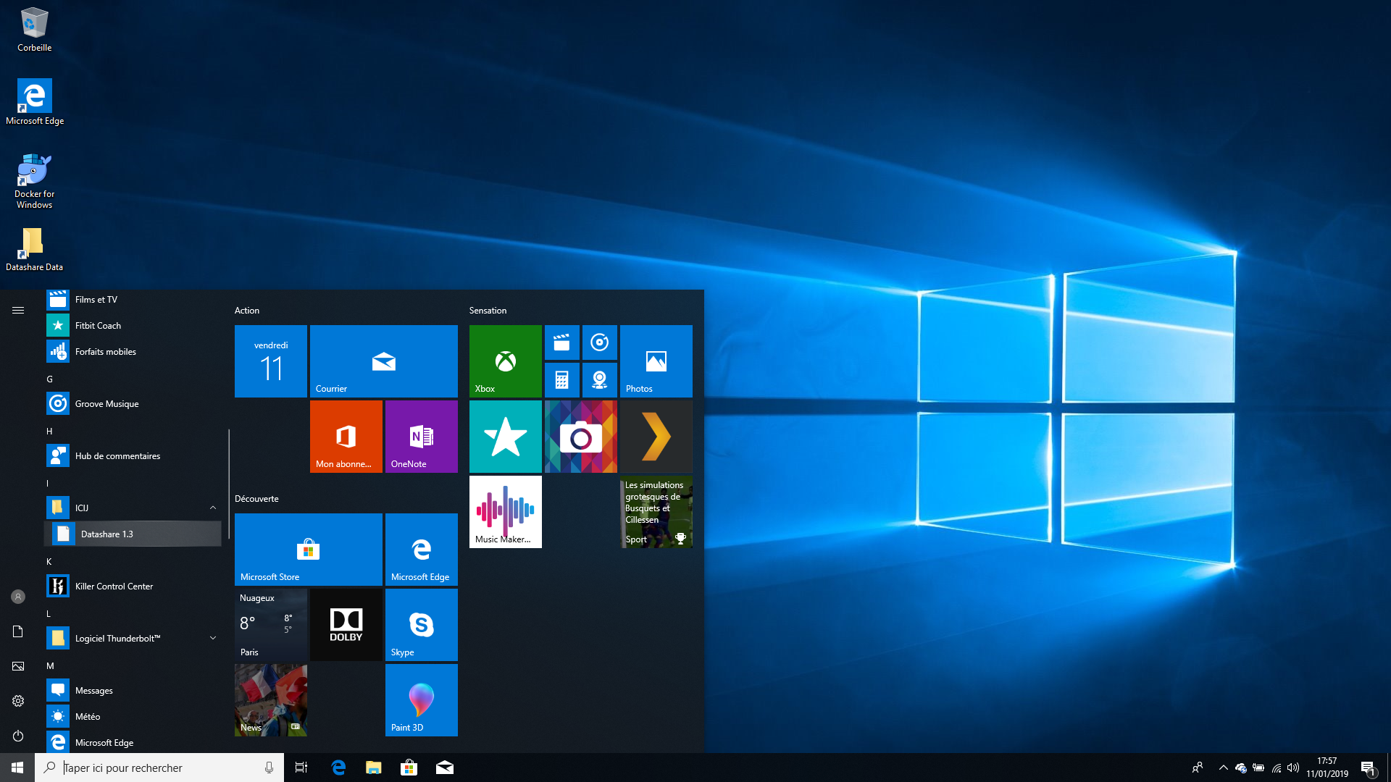
Installation of Windows 10
25. Windows 10 is Successfully Installed

Slide 30
THANK YOU!!!

