Slide 1

Weekly Meeting (05/31/23)

Slide 2
Outline
Review & Understand Fanchen's data
How distance between emitter and sensor is found
Translation of data to graphs
The "Lookup Table"
Summary

Slide 3
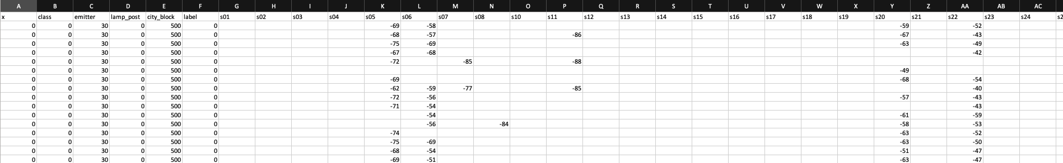
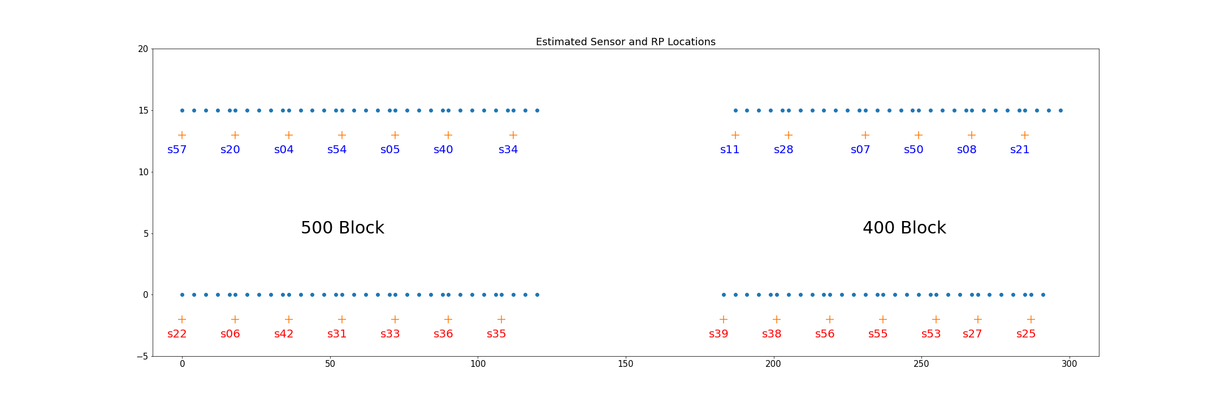
Fanchen's Data
58 sensors in total
Emitter
ID number of emitter used
City_block
City block 500 means we are in Q2 or Q3
City block 400 means we are in Q1 or Q4
Class
If class is 0, we are on south side of street (blue box)
If class is 1, we are on north side of street (green box)
Lamp_post
Within each quadrant, from left to right, we start at lamp_post = 0
s57 -> lp0, s22 -> lp0, s11 -> lp0, s39 -> lp0
X
How far east, in meters, the emitter is from the lamp_post
Label
ID of each data collection bout. Irrelavent for our purposes
Ex) (cityBlock, class, lampPost, x) = (500, 1, 4, 8) = emitter is 8m east of s05
Each position of the emitter is recorded ~300 times at same label. Label changes but does not correlate to position

Slide 4
How is distance between emitter and sensor found?
(cityBlock, class, lampPost) determines the Sensor#
Using an API, we can get (latitude, longitude) of Sensor# = sensorLoc
Now need to know emitter location
Use algorithm to determine newLong = longitude + X
(lat, newLong) = emitter geo location
dist = distance.distance(emitterLoc, sensorLoc).meters
We do this for every sensor that captures an rssi value
Given any emitter location, we now can find its distance to all sensors
def adjustedCoordinates(t, x):
"""t is the tuple of (lat,long) of reference location.
x is the distance, in meters, from the reference point - east from it.
Returns a new (lat,long) that is adjusted by x meters east"""
rEarth = 6371000.0
newLongitude = t[1] + (x / rEarth) * (180/pi) / cos(t[0] * pi/180)
return (t[0], newLongitude)

Slide 5
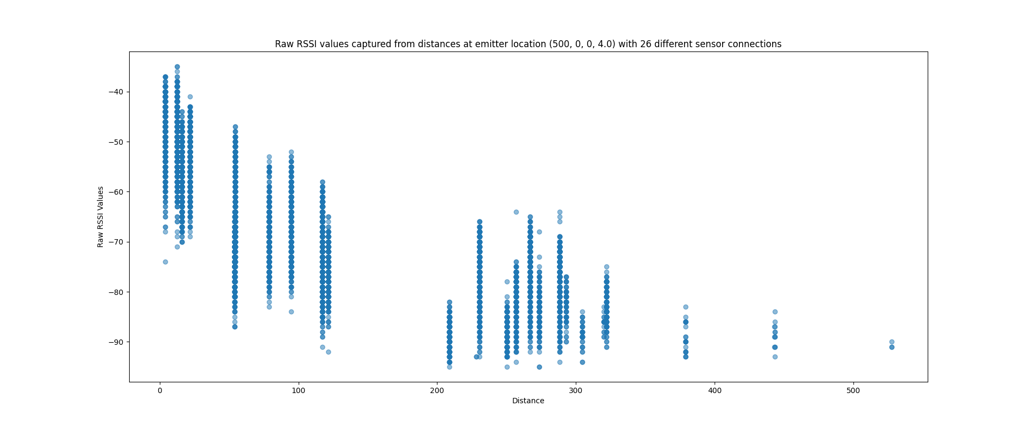
RSSI vs. Distance on Original Dataset
Multiple rssi values captured at a specific distance
The signals sent by emitter at location (500,0,0,4) was captured by 26 sensors
26 'columns' - some are hard to see due to them being so close
Around 390 of these graphs, each at different emitter location
Somewhat of a downward trend

Slide 6
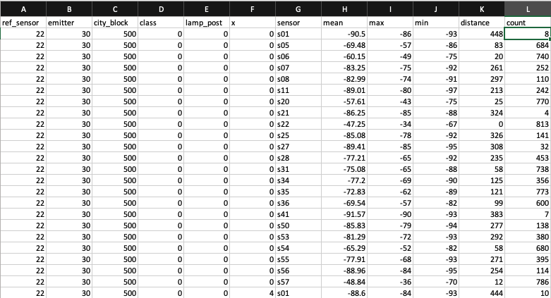
Translation of Datasets
I've grabbed all the rows that have the same x, class, emitter, lamp_post, and city_block. Then I move to each sensor column that is not empty and compute math functions on them. This produces the mean, max, and min columns.

Slide 7
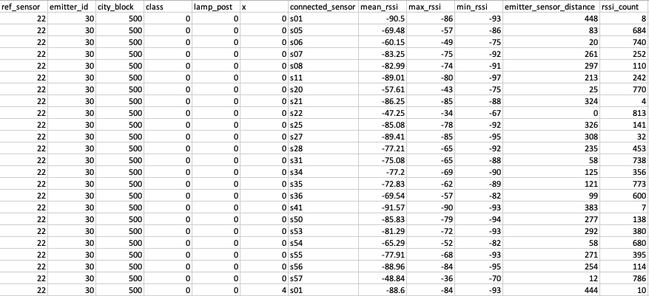
New Dataset Explanation
Ref_sensor
(cityBlock, class, lampPost)
Emitter_id
ID of emitter
City_block, class, lamp_post, x
Mean the same thing as previous dataset
Connected_sensor
The sensor of focus. It's the sensor that we are using data from to compute the mean, max, and min values
Mean, Max, Min
Statistical functions based on column of rssi data
Emitter_sensor_distance
Calculated same way as before
Rssi_count
The amount of rssi values captured by 'connected_sensor' from 'emitter'
Ex) sensor s01 captured 8 signals from emitter 30. These 8 signals are used to create mean, max, and min values.

Slide 8
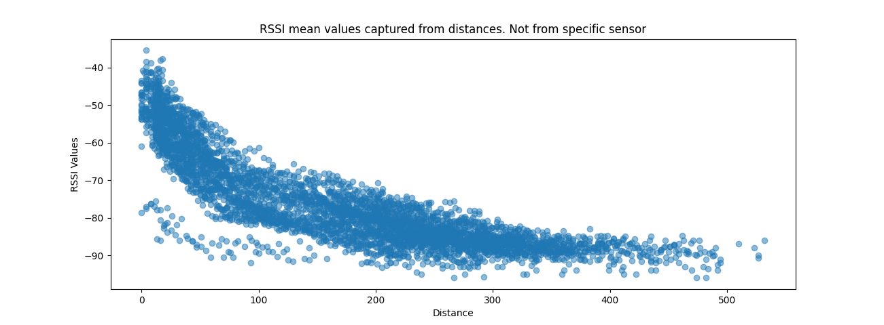
RSSI Mean Values Vs. Distance
Each blue dot represents a row in new dataset
Utilizing the mean_rssi (y-axis), and emitter_sensor_distance (x-axis)
Ex) Get all mean_rssi values where distance = 200
This results in multiple mean_rssi values associated with one distance

Slide 9
Look Up Table
Can't really make a 'look up' table from this graph
If we find the mean of these mean values, we can get an exact point correlated to an exact distance
Distances range from 0m to 532m with only a couple missing distances (i.e., 528, 529)
Create subset where "emitter_sensor_distance" are the same
This results in a list of mean_rssi values
Find the mean value of the "mean_rssi" column
Returns a single value – I call this value mean_mean_rssi

Slide 10
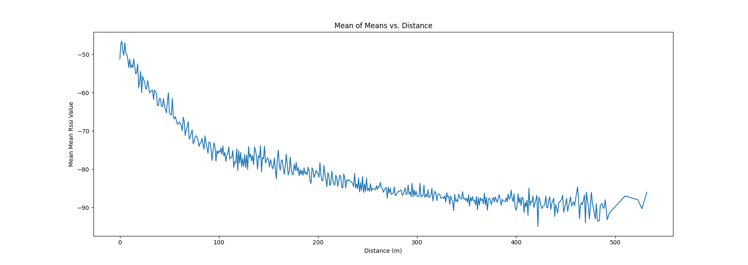
Mean of RSSI Means vs. Distance
This graph attempts to correlate a distance to an rssi value. But what about the other way around?
In this graph, an rssi value can still be associated with several distances.
To fix this, we find the average distance associated with the "mean mean rssi" value – hopefully resulting in a 1-to-1 graph

Slide 11
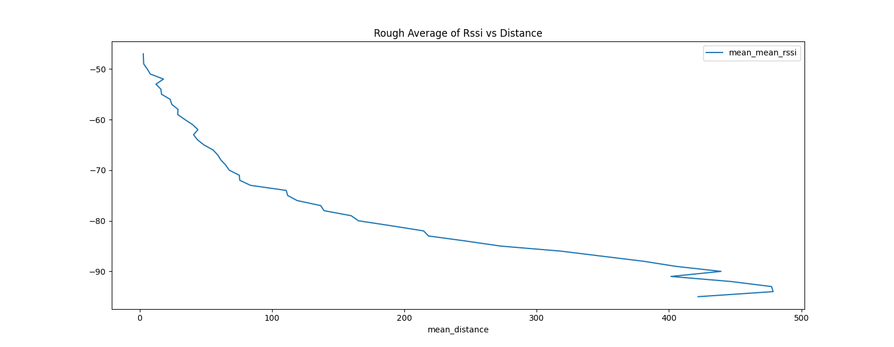
RSSI vs Distance Lookup Graph
This graph shows us that we have a 1-to-1 association between an rssi value and a distance
Right side not what I expected

Slide 12
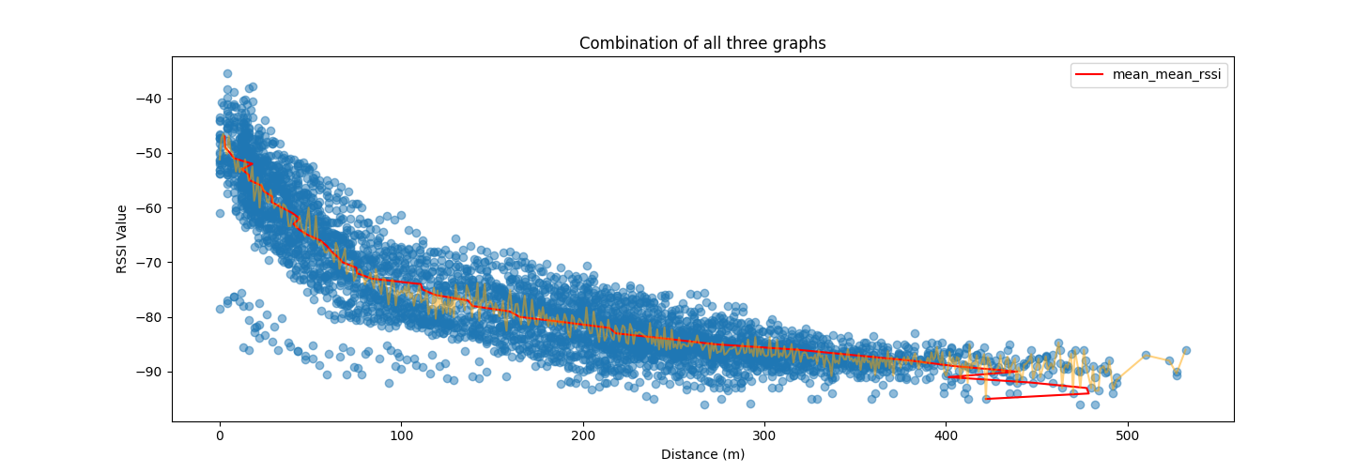
Summary
Blue Scatter Plot – mean_rssi vs. Distance (many-to-many correlation)
Orange Line Plot – mean_mean_rssi vs. Distance (1-to-many correlation)
Red Line Plot – mean_mean_rssi vs mean_distance (1-to-1 correlation)
Keep in mind that rssi to distance correlation is not supposed to be very accurate in real world scenarios!

Slide 13
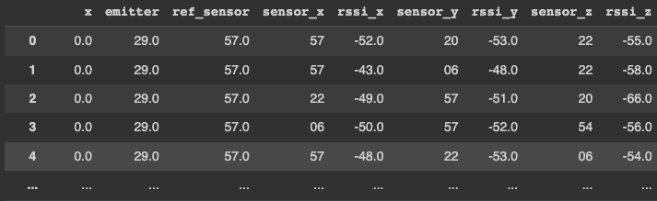
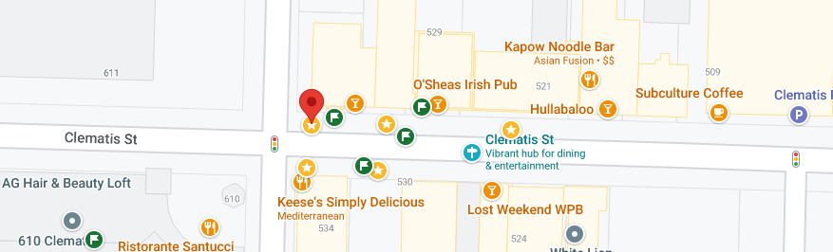






Test Results
Test results are not promising
Stars are sensor locations
Flags are trilaterated locations of emitter
Red point is where the emitter is
Hypothetically, All the flag points should be near the red point
Green flag did better than the others. Why?

