Slide 1
CSC435: Web Programming Lecture 10: JavaScript: Objects
Bei Xiao
American University
Feb 15, Monday, 2016

Slide 2
Activity Outline
Exercises
More on Event-driven Programming
Form inputs
JavaScript DOM
Unobtrusive JavaScript
JavaScript Object

Slide 3
Define Functions
function name() {
statement ;
statement ;
...
statement ;
}
function myFunction() {
alert("Hello!");
alert("How are you?");
}
The above could be the contents of example.js linked to our HTML page.
Statements placed into functions can be evaluated in responses to user events.
To display results, you can use document.write()

Slide 4
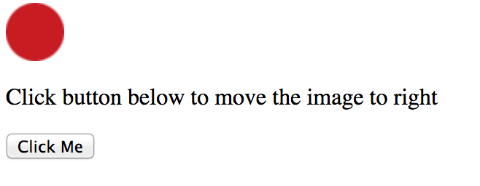
Exercise 0: move the ball
Hint: You can access to ball’s position as this:
imgObj = document.getElementById('myImage');
imgObj.style.position= 'relative';
imgObj.style.left = '0px';
// to move the ball
parseInt(imgObj.style.left)

Slide 5
Accessing an Element:
Document.getElementById
let name= document.getElementByID(“id”);
document.getElementById returns the DOM object for an element with a given id(note that you omit the # when giving an id)

Slide 6
Exercise 0: move the ball
<script type="text/javascript">
let imgObj = null;
function init(){
imgObj = document.getElementById('myImage');
imgObj.style.position= 'relative';
imgObj.style.left = '0px';
}
function moveRight(){
imgObj.style.left = parseInt(imgObj.style.left) + 10 + 'px';
}
window.onload =init;
</script>

Slide 7
Exercise 1: smallest
Write a function named findMin that accepts an array of numbers as a parameter and returns the smallest number in the array. For example, if an array variable named nums stored the following values:
let nums = [-1, 3.2, 12, 15, -4, 1, -12.5, 1, 8];
Then the call of findMin(nums) should return -12.5 since that is the smallest numerical value in the array.
You may assume that the array passed to your function is non-empty and contains only number types.
To display results, you can use document.write()
Or you can create a button to trigger your function
<button onclick=”findmin();">Click me!</button>

Slide 8
Exercise 2: reverse a number
Write a JavaScript function that reverse a number. E.g: 25368 -> 86352
Step 1: Create a simple .html file.
Step 2: Write a function and save it as ReverseString.js
Step 3: link the .js into the <head></head> in your .html
First change the number to string.
Then n.split(“”).reverse().join(“”);
Again, you can create a button to trigger the function or use alter.

Slide 9
Exercise 2: reverse a number e.g. 123->321 123.456>654.321
Solution 2 (does it work with decimal numbers? handle negative numbers?)
Solution 1 Negative numbers?
function rev_num()
{
let num = prompt("Enter the number to be reveresed :", " ");
let z = num.split("").reverse().join("");
let rev = Number(z);
document.write("The given number is : " +num+ " <br/> The reversed number is : " +rev+ "\n");
}
function rev_num() {
num = prompt("Enter the number to be reveresed :", " ")
n = parseInt(num);
for(let r = 0; n; n = Math.floor(n / 10)) {
r *= 10;
r += n % 10;
}
document.write("The given number is : " +num+ " <br/> The reversed number is : " +r+ "\n");
}
There are many other solutions, what is yours?

Slide 10
Exercise 3: guess a number
Write a JavaScript program where the program takes a random integer between 1 and 10, the user then prompted to input a guess number. If the user input matches the guess number, the program will display “good work”, otherwise, it will display “not matched”.
Hint: use alert() function to pop out text message.
Use Prompt() for user input. E.g.
var gnum = prompt('Guess the number between 1 and 10

Slide 11
Exercise 4: split string
Write a JavaScript function to split a string and convert it to an array of words.
alert(string_to_array(“ Monday is blue”) ;
Output: “Monday”, “is”, “Blue”

Slide 12
Exercise 5: show today’s date
Write a JavaScript function to display today’s day in the following format:
Today is Thursday. It is 5:30pm.
Think about how to display “pm” versus “am” depends on the hour.
You can use document.write or alert to display the message.
Consider makes the days into an array of strings. Again array starts with 0.
let d = new Date(); //get the date
let day = d.getDay(); // get the day of the date
let hour = d.getHours(); // get hours
let minuets = d.getMinuets(); //get minuets

Slide 13
Exercise 5 (take home): show dates until Christmas
Write a JavaScript to display how many dates until Christmas of 2018.
You might find the following function useful:
Expected month from 0 to 11. 11 will be December, 12 will be start of the next year
JS complete date references:
http://www.w3schools.com/jsref/jsref_obj_date.asp
var d = new Date(); //get the date
var n = d.getFulLyear(); // get the year of the date
var d = d.getMonth(); // get the month of the date
d.setFullYear(2020, 10,3); // Tue Nov 03 2020 11:17:37 GMT -500 (EST)

Slide 14
Form Element: <input>
<!-- 'q' happens to be the name of Google's required paramter -->
<input type="text" name="q" value="Colbert Report" />
<input type="submit" value="Booyah!" />
HTML
output
Input element is used to create many UI controls (an inline element that must be self-closed)
name attribute specifies name of query parameter to pass to server.
type can be button, checkbox, file, hidden, password, radio, reset, submit, text,…
value attribute specifies control’s initial text.

Slide 15
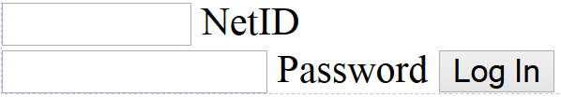
Text fields: <input>
<input type="text" size="10" maxlength="8" /> NetID <br />
<input type="password" size="16" /> Password HTML
output
input attributes: disabled, maxlength, readonly, size, value
size attribute controls onscreen width of text field
maxlength limits how many characters user is able to type into field

Slide 16
Form Elements: Text boxes: <textarea>
<textarea rows=“4”, cols=“20”>
Type your comments here.
</textrea>
HTML
Initial text is placed inside textarea tag (optional)
Required rows and cols attributes specify height/width in characters
optional readonly attribute means text cannot be modified

Slide 17

Use InnerHTML to add text
<button onclick="addText();">Click me!</button>
<span id="output">Hello </span> HTML
function addText() {
var span = document.getElementById("output");
span.innerHTML += " bro";
} JS
output
can change the text inside most elements by setting the
innerHTML property

Slide 18
JavaScript Programming: Resources
Review programming basics: using variables, arrays, loops, if-statements, and functions
Go over some JavaScript tutorials - there are many great ones!
Mozilla's JavaScript Basics Tutorial
Basic interactive tutorials:
LearnJS
Check out cool examples of JavaScript on the web!
Dennis Music Video
JavaScript Memroy Game
Robby Leonardi Mario-style Resume
Species in Pieces
Rainbow Worm
OMFGDOGS

Slide 19
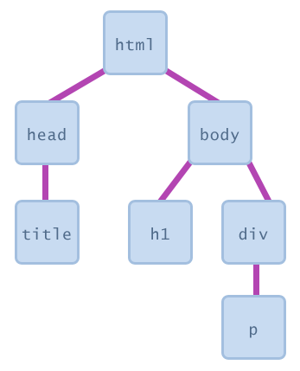
Document Object Model (DOM)
a set of JavaScript objects that represent each element on the page
<html>
<head>
<title> ... </title>
</head>
<body>
<h1> ... </h1>
<div>
<p> ... </p>
</div>
</body>
</html>

Slide 20
Document Object Model (DOM)
a set of JavaScript objects that represent each element on the page
each tag in a page corresponds to a JavaScript DOM object
JS code can talk to these objects to examine elements' state
e.g. see whether a box is checked
we can change state
e.g. insert some new text into a div
we can change styles
e.g. make a paragraph red

Slide 21
Document Object Model (DOM)
How to get DOM elements in JS
Ask them by id: document.getElementById(…)
Query for them with CSS style selectors:
document.querySelector(…)
document.querySelectorall(…)
3. Make new ones! document.createElement(…)

Slide 22
Getting a DOM element in JavaScript
<p id=“october”></p>
html
Let pTag = document.getElementbyId(“october”)
JS

Slide 23
What is inside a DOM object?
For starters, the HTML attributes. This is HTML:
<img src=“images/puppy.png” alt= “A fantastic puppy photo”>
HTML
Has a DOM object (let's call it puppyImg) with these two properties:
puppyImg.src -- set by the browser to images/puppy.png
puppyImg.alt -- set by the browser to "A fantastic puppy photo"

Slide 24
Accessing Properties of a DOM object (Example)
<p>See our <a href="sale.html" id="saleslink">Sales</a> today!</p>
<img id="icon" src="images/borat.jpg" alt="Borat" />
<caption class="photo user-upload">Beauty.</caption> HTML
let icon = document.getElementById("icon");
let theLink = document.getElementById("saleslink");
let caption = document.querySelector("caption"); JS
Property | Description | Example
tagName | element’s HTML tag | icon.tagName is “IMG”
className | CSS classes of element | caption.className is “photo user-upload”
src | URL target of an image | icon.src is “images/borat.jpg”
href | URL target of a link | theLink.href is “sale.html”

Slide 25
innerHTML property
All DOM elements have a property called innerHTML that has the contents of the HTML tag as a string.
<ul id="dr-seuss">
<li>Thing 1</li>
<li>Thing 2</li>
</ul>
HTML
let elm = document.getElementById("dr-seuss");
//elm.innerHTML: “\n <li>Thing 1</li>
<li>Thing 2</li> \n”
JS

Slide 26
Modifying DOM Elements (Example
<a id=“fb-link” href=http://www.facebook.com> Facebook </a>
HTML
Before the JavaScript runs, we’d see:
Facebook
And after we run this JavaScript:
let link = document.getElementById("fb-link”);
link.innerHTML = "MySpace is back in a really big way.";
We ‘d see
My space is back in big way.

Slide 27
Unobtrusive JavaScript

Slide 28
Unobtrusive JavaScript
What is unobtrusive JavaScript?
HTML with NO JavaScript code inside the tags
Uses the JS DOM to attach and execute all JavaScript event handlers.
Allows separation of web site into 3 major categories.
Content(HTML) – what is it?
Presentation (CSS) – how does it look?
Behavior (JavaScript) – how does it respond to user interactions.
Quote: Breaking up is hard to do. But in web design, separation can be a good thing. Content, style, and behavior all deserve their own space.

Slide 29
Obtrusive Event Handler (bad)
<button onclick="okayClick();">OK</button> HTML
// called when OK button is clicked
function okayClick() {
alert("booyah");
} JavaScript
OK
This is a bad style (HTML is cluttered with JS code)
Goal: remove all JavaScript code from HTML body

Slide 30
Solution: attach an event handler in JavaScript Code
let objectName.onevent = function() JS
<button id=“ok”">OK</button> HTML
let okButton = document.getElementById("ok");
okButton.onclick = okayClick; JS
It is legal to attach event handlers to elements’ DOM objects in your JavaScript code.
Notice that you do not put parentheses after the function’s name
This is better style than attaching them in the HTML.

Slide 31
When does my code run?
<html>
<head>
<script src="myfile.js" type="text/javascript"></script>
</head>
<body> ... </body>
</html> HTML
let x = 3;
function f(n) { return n + 1; }
function g(n) { return n - 1; }
x = f(x); JavaScript/myfile.js
Your file's JS code runs the moment the browser loads the script tag
Any variables are declared immediately
Any functions are declared but not called, unless your global code explicitly calls them
At this point in time, the browser has not yet read your page's body
None of the DOM objects for tags on the page have been created yet

Slide 32
A failed attempt at being unobtrusive
<html>
<head>
<script src="myfile.js" type="text/javascript"></script>
</head>
<body>
<div><button <em>id="ok"</em>>OK</button></div>
(... more html ...) HTML
let btn = document.getElementById("ok");
btn.onclick = okayClick; // this is bad: btn is null at this point
JavaScript/myfile.js
Problem: global JS code runs the moment the script is loaded.
Script in head is processed before page’s body has loaded.
No elements are available yet or can be accessed yet via the DOM
We need a way to attach the handler after the page is loaded.

Slide 33
The window.onload Event
function functionName() {
// put code to initialize the page here
}
// instruct window to run the function when the page has loaded:
window.onload = functionName; // notice no () after function name
There is a global event called window.onload event that happens once everything in the page is loaded.
If you attach a function as a handler for window.onload, it will run at that moment.

Slide 34
Exercise 1: unobtrusive JS event
Write a HTML with a button “OK”
Write a unobtrusive JavaScript that when the user click the OK button, then the page pop out ”Booyah”.
Check with your neighbor to see if your code is truly Unobtrusive.
<button id=“ok”>OK </button>
Hint: wrote two functions
function pageLoad(){} // load the page and event handler
Function okayClick(){} // alert

Slide 35
Exercise 2: Modify the codes (movingimage.html) in the exercise folder in blackboard to make it unobtrusive

Slide 36
Modifying DOM Elements (Example
<a id=“fb-link” href=http://www.facebook.com> Facebook </a>
HTML
Before the JavaScript runs, we’d see:
Facebook
And after we run this JavaScript:
let link = document.getElementById("fb-link”);
link.innerHTML = "MySpace is back in a really big way.";
We ‘d see
My space is back in big way.

Slide 37
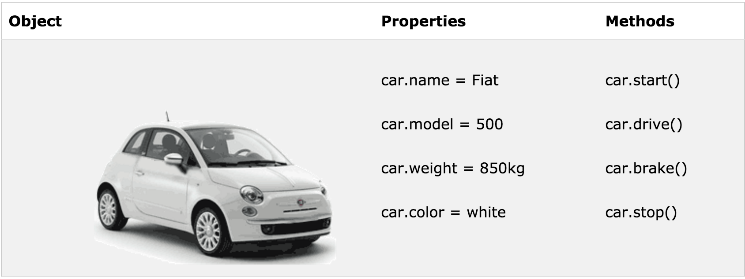
JavaScript objects
var car {
name: “Fiat”,
model: “500”,
color: “white”,
Weight: “850kg”};
// retrieval
car.name //”Fiat”
car[name] // “Fiat”

Slide 38
Object: construction and retrieval
An object is a container of properties, where a property has a name and a value.
Construction
Retrieval
Var flight {
airline: “Oceanic”,
Number: 815,
Departure:{
IATA: “SYD”,
time: “2004-09-22 14:55”,
city: “Sidney”
};
Arrival: {
IATA: “LAX”,
time: “2004-09-23 10:42”,
city: “Los Angeles”
}
};
flight.departure.IATAL // “SYD”
flight[airline] // “Oceanic”
// use || to fill in default value
Var status = flight.status || ”unknown”;
flight.equipement //undefined
flight.equipment.model //throw “TypeError”

Slide 39
Object: update
A value in an object can be updated by assignment. If the property name already exist in the object, the property value is replaced:
Construction
update
Var flight {
airline: “Oceanic”,
Number: 815,
Departure:{
IATA: “SYD”,
time: “2004-09-22 14:55”,
city: “Sidney”
};
Arrival: {
IATA: “LAX”,
time: “2004-09-23 10:42”,
city: “Los Angeles”
}
};
flight[‘airline’] = ‘wow’
// if the object doesn’t have the property name, the object is augmented:
flight.equipment = {
model:’Boeing 777’
};
flight.status = ‘overdue’

Slide 40
Object: reference
var Stooge = {
“first-name”:”Jeremy”,
“second-name”:”Howard”
}
var x = stooge;
x.nickname = ‘Curly’;
var nick = stooge.nickname;
//nick is ‘Curly’ because x and stooge are references to the same object

Slide 41
Object: function construct with “this”
_{function} person(firstname,lastname,age,eyecolor)
{
_{this.firstname=firstname;}
_{this.lastname=lastname;}
_{this.age=age;}
_{this.eyecolor=eyecolor;}
}
_{// new instance}
myFather=new person("John","Doe",50,"blue");
https://developer.mozilla.org/en-US/docs/Web/JavaScript/Reference/Operators/this

Slide 42
Object: adding method
_{myFather.name = function () {}
return this.firstName + " " + this.lastName;
};
Notes:
See blackboard CreateObject.html

Slide 43
Object: quiz
Which is the following is a valid way to create a direct instance of an object?
myObject.create ();
myObject = new Object;
myObject = new Object();
Notes:
See blackboard CreateObject.html

Slide 44
Object: quiz
What is the the output of the following code after “alert”?
function person (firstname,lastname,age,eyecolor)
{
this.firstname=firstname;
this.lastname=lastname;
this.age=age;
this.eyecolor=eyecolor;
}
myFather = new person("John","Doe",50,"blue");
var x =myFather;
x.job = “Teacher”;
var profession = myFather.job;
alert(profession);
document.writeln("father's firstname is ", myFather.firstname,"<br>");

Slide 45
Using “reference”
Add code to the code in the last slide and print:
my father 's nickname is Johny using document.writeln

Slide 46
Demo: show info
In a JavaScript, create an object.
Create a property called “info” and assign a string.
Write a function (object method) myFunct() that alert the “info” value of the .info property to the browser.
you can say: “I am a new shinny object”
Create a instance of the method of the object by calling myFunct()
Create a button uses onClick to evoke the method. How do you display the “info” to the browser?
Notes:
See blackboard CreateObject.html

Slide 47
Enumeration of object
for (var key in object ) {
print(object[key]);
}
var obj = {first: “prop1”, second: “propr2”, 3: “proper3”}
for (var key in obj) {
s += key + “:” + obj[key] + “ “;
}
document.write(s);
Notes:
See blackboard CreateObject.html

Slide 48
Object: exercise 1
Write a JavaScript program to list the property of the following sample object:
var student = {
Name: “Jenny Klein”
Class: “ Senior”
AUID: “ 31635”
Hobby: “writing code”
};
Sample output: name, Class, AU ID, Hobby
Hint: write a function to output the list of property. E.G. you can use string.push() to append to an empty array and then print out the array.

Slide 49
Object: exercise 2
Write a JavaScript program to display the reading status (i.e. display book name, author name, and reading status) of the following books.
var library = [
{
title: 'Bill Gates',
author: 'The Road Ahead',
readingStatus: true
},
{
title: 'Steve Jobs',
author: 'Walter Isaacson',
readingStatus: true
},
{
title: 'Mockingjay: The Final Book of The Hunger Games',
author: 'Suzanne Collins',
readingStatus: false
}];

Slide 50
Exercise: input number
Create a simple UI input field
Ask the user to input numbers between 1-10
If the input number is not within the range,
Tell them the input is not valid.
If the input number is within the range,
Tell them the input is valid.

Slide 51
Exercise: input number
Create HTML element with ID:
In JavaScript, create a function to validate the number:
a ) Get the element of the input field by id.
var numb = document.getElementById(“num”).value
b) see if the number is a number IsNan() and whether it is between 1 and 10.
c) report the results to the browser using
document.getElementById("demo").innerHTML = text;
<p>Please input a number between 1 and 10:</p>
<input id="numb”>
<button type="button" onclick="myFunction(">Submit</button>
<p id="demo"></p>

Slide 52
Take-home reading and exercise
Introduction to JavaScript (must read):
https://developer.mozilla.org/en-US/docs/Web/JavaScript/A_re-introduction_to_JavaScript
DOC model:
https://developer.mozilla.org/en-US/docs/Web/API/Document_Object_Model/Introduction

