Slide 1
CSC435: Web Programming Lecture 12: JavaScript: Objects
Bei Xiao
American University
March 2, Friday, 2018

Slide 2
Future lecture plan
Lectures | Content | homework
Feb 26 (today) | Unobtrusive JS OOP in JavaScript Functions | Homework 3 Due Thursday
March 1 (Friday) | OOP, Form validation.
March 5 (Tuesday) | DOM, Events and Timers
March 8 ( Friday) | More JS, Mid-term review
March 12-17 | Spring break | Homework 4 (UI control is out
March 19 | Mid-term exam | In-class exam (HTML, CSS, JS)
March 22 | Ajax, Fetch, Json | Homework 4 is due
March 27 | jQuery

Slide 3
Activity Outline
JavaScript Forms and events.
JavaScript Objects
OOP Exercises.
Friday: Quiz 2 (in-class requires turn in on blackboard). 15 mins.

Slide 4
Take-home reading
Introduction to JavaScript (must read). Many readings are required!!
JavaScript and Browser, DOM:
http://eloquentjavascript.net/13_browser.html
http://eloquentjavascript.net/14_dom.html
DOC model:
https://developer.mozilla.org/en-US/docs/Web/API/Document_Object_Model/Introduction
Objects and arrays:
http://eloquentjavascript.net/04_data.html

Slide 5
JS skeleton
<!-- in the <head> block -->
<script src="path/to/javascript/file.js" type="text/javascrpt"></script> HTML
(function() {
// set-up code that doesn't involve the DOM
// (e.g. setting up initial values, arrays, etc.)
window.onload = function() {
// phew! your code goes here
};
//function definitions go here
})(); JS

Slide 6
Homework 3: Grading
<body>
<h1>Grade Calculator</h1>
<div id="assignments">
<div class="hw">
HW <input class="earned" type="text" size="2" />
/ <input class="max" type="text" size="2" />
</div>
<div class="hw">
HW <input class="earned" type="text" size="2" />
/ <input class="max" type="text" size="2" />
</div>
<div class="hw">
HW <input class="earned" type="text" size="2" />
/ <input class="max" type="text" size="2" />
</div>
</div>

Slide 7
Homework 3: JS
window.onload = function() {
document.getElementById("compute").onclick = computeGrade;
document.getElementById("clear").onclick = clearClick;
};
function computeGrade() {
var earned = 0;
var earnedInputs = document.querySelectorAll(".earned");
alert(earnedInputs[0].value);
}
}

Slide 8
Homework 3: Grading
<body>
<h1>Grade Calculator</h1>
<div id="assignments">
<div class="hw">
HW <input class="earned" type="text" size="2" />
/ <input class="max" type="text" size="2" />
</div>
<div class="hw">
HW <input class="earned" type="text" size="2" />
/ <input class="max" type="text" size="2" />
</div>
<div class="hw">
HW <input class="earned" type="text" size="2" />
/ <input class="max" type="text" size="2" />
</div>
</div>

Slide 9
Homework 3: getDocumentByID?
<!DOCTYPE html>
<html>
<body>
Name: <input type="text" id="myText" value="Mickey">
<p>Click the button to change the value of the text field.</p>
<button onclick="myFunction()">Try it</button>
</body>
</html>
<script>
function myFunction() {
document.getElementById("myText").value = "Johnny Bravo";
}
</script>

Slide 10
Modifying DOM Elements (Example
<a id=“fb-link” href=http://www.facebook.com> Facebook </a>
HTML
Before the JavaScript runs, we’d see:
Facebook
And after we run this JavaScript:
let link = document.getElementById("fb-link”);
link.innerHTML = "MySpace is back in a really big way.";
We ‘d see
My space is back in big way.

Slide 11
JavaScript “ strict” mode
“use strict”;
….. Your code ……
Writing "use strict"; at the very top of your JS file turns on strict syntax checking:
Shows an error if you try to assign to an undeclared variable
Stops you from overwriting key JS system libraries
Forbids some unsafe or error-prone language features
You should always turn on strict mode for your code in this class!

Slide 12
Checkboxes:<input>
yes/no choices that can be checked and unchecked (inline)
<input type="checkbox" name="lettuce" /> Lettuce
<input type="checkbox" name="tomato" checked="checked" /> Tomato
<input type="checkbox" name="pickles" checked="checked" /> Pickles HTML
output
none, 1, or many checkboxes can be checked at same time
when sent to server, any checked boxes will be sent with value on:
http://webster.cs.washington.edu/params.php?tomato=on&pickles=on
use checked="checked" attribute in HTML to initially check the box

Slide 13
document.querySelectorAll
var inputs = document.querySelectorAll("input[type='checkbox']");
for(var i = 0; i < inputs.length; i++) {
inputs[i].checked = true;
}
var checked = document.querySelectorAll("#checks
input[type='checkbox']:checked");
for (var i = 0; i < checked.length; i++) {
str+=checked[i].value + " ";
}

Slide 14
document.querySelectorAll
elementList = document.querySelectorAll(seletors);
<p class=“example”>A paragraph with class="example”</p> HTML
// Get all <p> elements in the document
var x = document.querySelectorAll("p");
// Set the background color of the first <p> element
x[0].style.backgroundColor = "red"; JS
Return value: a list of the elements within the document (using depth-first pre-order traversal of the document's nodes) that match the specified group of selectors. The object returned is a NodeList.

Slide 15
document.querySelectorAll
elementList = document.querySelectorAll(seletors);
<h2 class="example">A heading with class="example"</h2>
<p class="example">A paragraph with class="example".</p>
<p class="example">Another paragraph with class="example".</p> HTML
var x = document.querySelectorAll("p.example");
x[0].style.backgroundColor = "red"; JS
Return value: a list of the elements within the document (using depth-first pre-order traversal of the document's nodes) that match the specified group of selectors. The object returned is a NodeList.

Slide 16
docucment.querySelector
elementList = document.querySelector(seletors);
<h2 class="example">A heading with class="example"</h2>
<p class="example">A paragraph with class="example".</p>
<p class="example">Another paragraph with class="example".</p> HTML
var el = document.querySelector(”.example"); el. .style.backgroundColor = "red";
//In this example, the first element in the document with the class ”example" is returned:
Return value: A Element object representing the first element in the document that matches the specified set of CSS selectors.

Slide 17
Unobtrusive styling
function okayClick() {
this.style.color = "red"; // <-- bad style
this.className = "highlighted"; // <-- better style
}
JS
.highlighted{color:red;}
CSS
Well-written JavaScript code should contain as little CSS as possible
Use JS to set CSS classes/IDs on elements
Define the styles of those classes/IDs in your CSS file
We will discuss this in another class

Slide 18
Radio buttons: <input>
sets of mutually exclusive choices (inline)
<input type="radio" name="cc" value="visa" checked="checked" /> Visa
<input type="radio" name="cc" value="mastercard" /> MasterCard
<input type="radio" name="cc" value="amex" /> American Express HTML
output
grouped by name attribute (only one can be checked at a time)
must specify a value for each one or else it will be sent as value on
Set the “Visa” to be checked
document.getElementById(”visa").checked = true;
document.querySelector("input[namecc]:checked").value

Slide 19
Text Labels: <label>
<label>
<input type="radio" name="cc" value="visa" checked="checked"> Visa
</label>
<label>
<input type="radio" name="cc" value="mastercard"> MasterCard
</label>
<label>
<input type="radio" name="cc" value="amex"> American Express
</label> HTML
output
Associates nearby text with control, so you can click text to activate control
Can e used with check boxes or radio buttons.
Label element can be targeted by CSS rule.

Slide 20
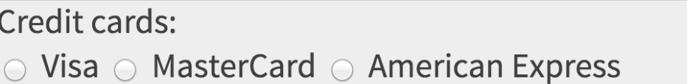
Grouping input: <fieldset> <legend> group of input fields with optional caption
<fieldlset>
<legend> Credit Careds: </legends>
<input type="radio" name="cc" value="visa" checked="checked"> Visa
</label>
<label>
<input type="radio" name="cc" value="mastercard"> MasterCard
</label>
<label>
<input type="radio" name="cc" value="amex"> American Express
</fieldset> HTML
Fieldset group related input fields, adds a border; legend supplies a caption.

Slide 21
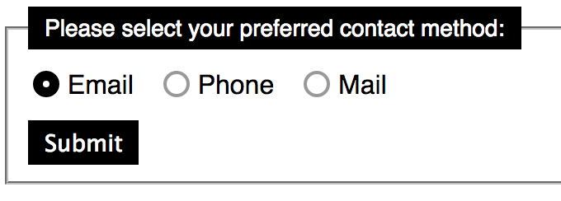
Style Form Elements
input {
border: 2px solid #999;
}
Input: checked{
border: 6px solid: black;} CSS

Slide 22
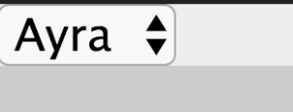
Drop-down list: <select>,<option> menus of choices that collapse and expand (inline)
<select name="favorite-character">
<option>Rob</option>
<option>John</option>
<option selected="selected">Ayra</option>
<option>Sansa</option>
</select>
Option element represents each choice
Select optional attributes: disabled, multiple, size
Optional selected attribute sets which one is initially chosen

Slide 23

The innerHTML property
<button onclick="addText();">Click me!</button>
<span id="output">Hello </span> HTML
function addText() {
var span = document.getElementById("output");
span.innerHTML += " bro";
} JS
output
can change the text inside most elements by setting the innerHTML property

Slide 24
simple computations Lecture 11 Exercise folder
Write a dropdown menu use
<input class="numberInput" type="text">
<select id = ‘input1t”>
<option value =“square”>square
<option value =“cube”>cube
<option value =“factorial”>factorial
</select>
Use <input id =“input1”> to ask users to input a number.
To allow users to compute various functions of the number entered in the input area such as square, cube, or factorial.
Display the results in the browser when they select the method.
Hint: let input = document.querySelector(‘.numberInput’)
let output = document.getElementByID(‘output’)
function pageLoad() {
let input = document.querySelector('.numberInput');
let para = document.querySelector('p’);
input.onchange = outputNumber;
}
function outputNumber(){
//Your code goes here
}

Slide 25
JavaScript Properties and methods
Properties: example
Methods: example
array.length
myString.length
Math.max
array.push()
string.toUpperCase()

Slide 26
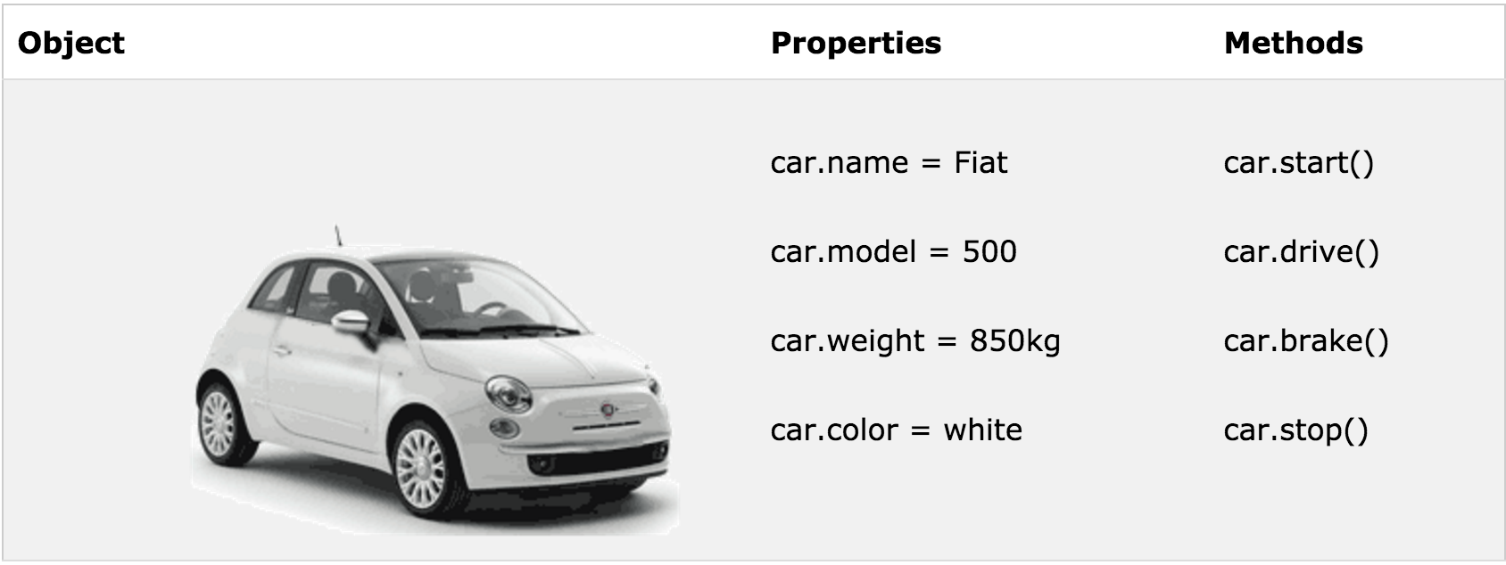
JavaScript objects
var car {
name: “Fiat”,
model: “500”,
color: “white”,
Weight: “850kg”};
// retrieval
car.name //”Fiat”
car[name] // “Fiat”

Slide 27
Object: construction and retrieval
An object is a container of properties, where a property has a name and a value.
Construction
Retrieval
Var flight {
airline: “Oceanic”,
Number: 815,
Departure:{
IATA: “SYD”,
time: “2004-09-22 14:55”,
city: “Sidney”
};
Arrival: {
IATA: “LAX”,
time: “2004-09-23 10:42”,
city: “Los Angeles”
}
};
flight.departure.IATAL // “SYD”
flight[airline] // “Oceanic”
// use || to fill in default value
Var status = flight.status || ”unknown”;
flight.equipement //undefined
flight.equipment.model //throw “TypeError”

Slide 28
Object: update
A value in an object can be updated by assignment. If the property name already exist in the object, the property value is replaced:
Construction
update
Var flight {
airline: “Oceanic”,
Number: 815,
Departure:{
IATA: “SYD”,
time: “2004-09-22 14:55”,
city: “Sidney”
};
Arrival: {
IATA: “LAX”,
time: “2004-09-23 10:42”,
city: “Los Angeles”
}
};
flight[‘airline’] = ‘wow’
// if the object doesn’t have the property name, the object is augmented:
flight.equipment = {
model:’Boeing 777’
};
flight.status = ‘overdue’

Slide 29
Object: reference
var Stooge = {
“first-name”:”Jeremy”,
“second-name”:”Howard”
}
var x = Stooge;
x.nickname = ‘Curly’;
var nick = Stooge.nickname;
//nick is ‘Curly’ because x and stooge are references to the same object

Slide 30
Object: function construct with “this”
_{function} person(firstname,lastname,age,eyecolor)
{
_{this.firstname=firstname;}
_{this.lastname=lastname;}
_{this.age=age;}
_{this.eyecolor=eyecolor;}
}
_{// new instance}
myFather=new person("John","Doe",50,"blue");
https://developer.mozilla.org/en-US/docs/Web/JavaScript/Reference/Operators/this

Slide 31
Object: adding method
_{myFather.name = function () {}
return this.firstName + " " + this.lastName;
};
Notes:
See blackboard CreateObject.html

Slide 32
Object: quiz
Which is the following is a valid way to create a direct instance of an object?
myObject.create ();
myObject = new Object;
myObject = new Object();
Notes:
See blackboard CreateObject.html

Slide 33
Object: quiz
What is the the output of the following code after “alert”?
function person (firstname,lastname,age,eyecolor)
{
this.firstname=firstname;
this.lastname=lastname;
this.age=age;
this.eyecolor=eyecolor;
}
myFather = new person("John","Doe",50,"blue");
var x =myFather;
x.job = “Teacher”;
var profession = myFather.job;
alert(profession);
document.writeln("father's firstname is ", myFather.firstname,"<br>");

Slide 34
Using “reference”
Add code to the code in the last slide and print:
my father 's nickname is Johny using document.writeln

Slide 35
Demo: show info
In a JavaScript, create an object.
Create a property called “info” and assign a string.
Write a function (object method) myFunct() that alert the “info” value of the .info property to the browser.
you can say: “I am a new shinny object”
Create a instance of the method of the object by calling myFunct()
Create a button uses onClick to evoke the method. How do you display the “info” to the browser?
Notes:
See blackboard CreateObject.html

Slide 36
Enumeration of object
for (var key in object ) {
print(object[key]);
}
var obj = {first: “prop1”, second: “propr2”, 3: “proper3”}
for (var key in obj) {
s += key + “:” + obj[key] + “ “;
}
document.write(s);
Notes:
See blackboard CreateObject.html

Slide 37
Object: exercise 1
Write a JavaScript program to list the property of the following sample object:
var student = {
Name: “Jenny Klein”
Class: “ Senior”
AUID: “ 31635”
Hobby: “writing code”
};
Sample output: name, Class, AU ID, Hobby
Hint: write a function to output the list of property. E.G. you can use string.push() to append to an empty array and then print out the array.

Slide 38
Object: exercise 2
Write a JavaScript program to display the reading status (i.e. display book name, author name, and reading status) of the following books.
var library = [
{
title: 'Bill Gates',
author: 'The Road Ahead',
readingStatus: true
},
{
title: 'Steve Jobs',
author: 'Walter Isaacson',
readingStatus: true
},
{
title: 'Mockingjay: The Final Book of The Hunger Games',
author: 'Suzanne Collins',
readingStatus: false
}];

Slide 39
Exercise: input number
Create a simple UI input field
Ask the user to input numbers between 1-10
If the input number is not within the range,
Tell them the input is not valid.
If the input number is within the range,
Tell them the input is valid.

Slide 40
Exercise: input number
Create HTML element with ID:
In JavaScript, create a function to validate the number:
a ) Get the element of the input field by id.
var numb = document.getElementById(“num”).value
b) see if the number is a number IsNan() and whether it is between 1 and 10.
c) report the results to the browser using
document.getElementById("demo").innerHTML = text;
<p>Please input a number between 1 and 10:</p>
<input id="numb”>
<button type="button" onclick="myFunction(">Submit</button>
<p id="demo"></p>

