Slide 1
CSC435: Web Programming Lecture 2: HTML basics
Bei Xiao
American University
Jan 18, 2019
Slide Content Borrowed from: Web programming courses from
University of Washington, Stanford University, MIT

Slide 2
Take-home reading & Tutorial (Please do, Quiz next class)
HTML Tutorial:
https://developer.mozilla.org/en-US/docs/Web/Guide/HTML/Introduction

Slide 3
GITHUB Page
https://github.com/fruittree/CSC435WebProgramming
Slides will be updated frequently
Check out the repo

Slide 4
How to do well in the course?
We are going to cover 5 languages or more in one semester (3 credits!) and without a lab session…..
Lectures are ONLY guidance. Read the take-home online tutorials and materials for further understanding.
Work with a peer.
Contribute at least 1 hour a week to Creative Project.
Do lots of coding exercises and practices.
Complete homework EARLY and leave room for improvement (perfectionism is KEY for web development).

Slide 5
2017 Turing Award: Sir. Tim Berners-Lee for the invention of the WWW
Invention of URL
Hypertext Transfer Protocol (HTTP) that allows transfer of object on the Internet
Web browser, a software application that retrieves and renders resources on the World Wide Web with clickable links.
Hypertext markup Language (HTML)
Browse the first website
Read more about the Turing award.

Slide 6
Website Organization
Content and Structure: HTML
Style: CSS
Behavior: JavaScript

Slide 7
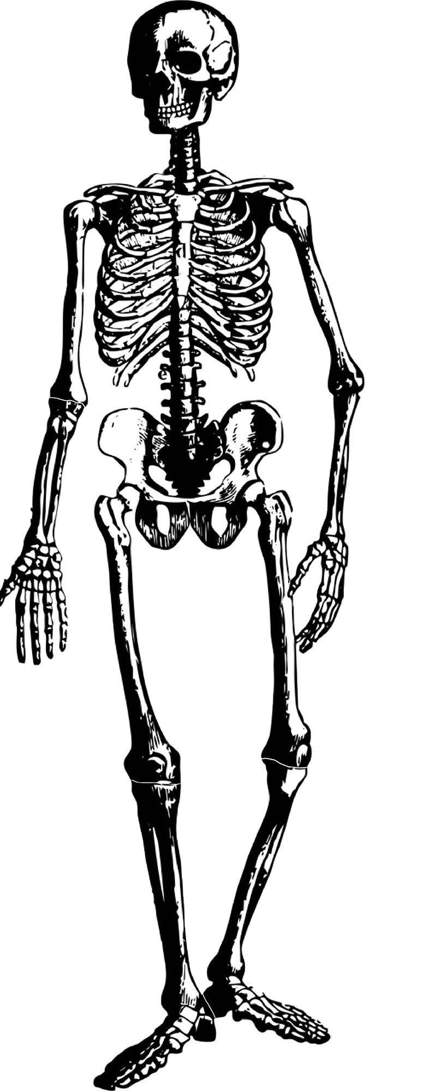
HTML
Hypertext Markup Language
What is markup?
A language with specific syntax that instructs a Web browser how to display a page

Slide 8
HTML
Describes the content and structure of information on a web page
Not the same as presentation.
Surrounds text content with Opening and closing tags
Each tag’s name is called an element
Syntax: <element>
Example: <p> This is a paragraph
Most whitespace is insignificant in HTML.

Slide 9
What is HTML?
HTML allows you to describe the content of a website.
Headers
Paragraphs
Images
Hyperlinks
HTML also allows you to specify relationships between elements and group them using classes and div tag.

Slide 10
HTML Syntax
HTML revolves around tag
Opening and closing tags
<tag> content <tag>
Example:
bold a word
<b>content</b>, will bold the word “content”
<u>text </u> underline the text

Slide 11
Structure of an HTML page
<!DOCTYPE html>
<html>
<head>
information about the page
</head>
<body>
page contents
</body>
</html>
The DOCTYPE tag tells the browser to interpret our page as HTML5,
the latest/greatest version of the linguae

Slide 12
Structure of an HTML page
<!DOCTYPE html>
<html>
<head>
information about the page
</head>
<body>
page contents
</body>
</html>

Slide 13
Structure of an HTML page
<!DOCTYPE html>
<html>
<head>
information about the page
</head>
<body>
page contents
</body>
</html>

Slide 14
Structure of an HTML page
<!DOCTYPE html>
<html>
<head>
information about the page
</head>
<body>
page contents
</body>
</html>

Slide 15
Structure of an HTML page
The <head> tag describes the page and the <body> tag contains the page’s content.
An HTML page is saved into a file ending with .html.
The DOCTYPE tag tells the browser to interpret our page’s code as HTML5, the latest/greatest version of the language.

Slide 16
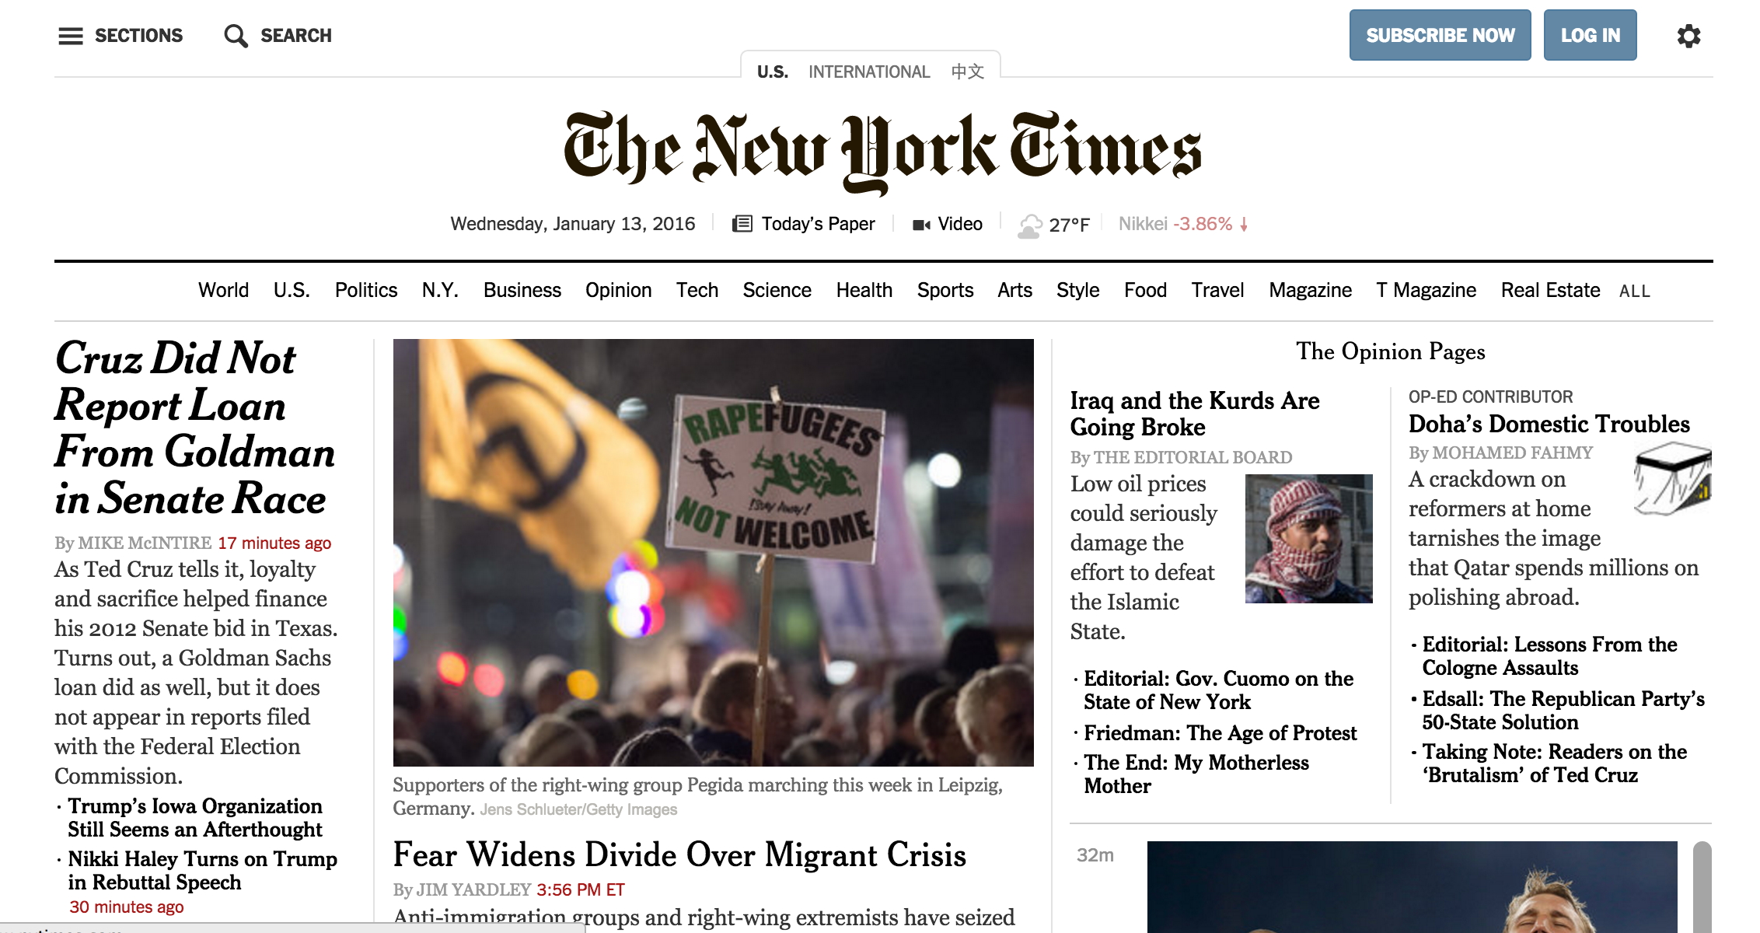

Slide 21
Basic web page
Open your favorite text editor (I use Brackets) and choose Syntax as html, type the following:
<!DOCTYPE html>
<html>
<head> My page </head>
<body>
<h1> Bio</h1>
<p> Write something here. </p>
</body>
</html>
Save the file as a myfirst.html
Open myfirst.html file using Chrome browser or any other default browser
Just click the file
Notes:
<body> defines the visible content of the web page

Slide 22
HTML Elements
Element is a pair of tags and the content between them.
<p>content </p> is a paragraph element.
Elements can have empty content and be closed in start tag.
<br> defines a new line.

Slide 23
HTML Tags-Table of Common Tags (1/2)
Tag | Description
<title> | Page title in <head>
<meta> | Meta information in <head>
<p> | Paragraph tag
<h1>…<h6> | Heading tags
<header>,<footer> | Header/Footer tag
<article>,<section> | Articles and section tag
<hr/> | Horizontal rule tag
<br/> | Line break tag
<a> | Anchor tag (page links).

Slide 24
HTML Elements
<html> Root of HTML Document
<body> Document Body
<head> Information about the doc
<h1>, <h2>, <h3>… Header Tags
<p> Paragraph Tag
<img> Image
<a> Hyperlink
<div> Section in a Document
<span> Section in a Document (text)
<ul> unordered list
<li> list items

Slide 25
Web Page Meta data
<head>
<meta charset= “utf-8>
<title> My webpage </title>
</head>
HTML
Here the <meta> element specifies the document character encoding.
Many <meta> elements include name and content attributes.
<meta name=“author” content=“Java, textbook”>
HTML
Specify author is useful for automatically extract author info
More on meta data

Slide 26
Page Title: <title>
<head>
<title>
The New York Times –Breaking news, World News & Multimedia
</title>
</head>
HTML
Placed within the <head> of the page.
Displayed in the web browser’s title bar and when bookmarking the page, otherwise not visible to the user as page content.

Slide 27
Paragraph: <p>
<p> You 're not your job </p>
<p> You 're not how much money you make in the bank</p>
<p> you are not the car you drive</p>
HTML
You 're not your job
You 're not how much money you make in the bank
you are not the car you drive
Placed within the <body> of the page.
More paragraph examples

Slide 28
Headings: <h1>,<h2>,…,<h6> headings separate major areas of the page (block)
<h1>University of Neverland</h1>
<h2>Department of Computer Science</h2>
<h3>Sponsored by Micro$oft</h3>
HTML
University of Neverland
Department of Computer Science
Sponsored by Micro$oft
output
More heading examples.

Slide 29
<header> and <footer>
<header> tags usually contain one or more <h1-6> elements, maybe a logo, and authorship information.
<footer> tags might contain site map links, authorship information, copy right information, etc.
<header> more html elements </header>
...maybe some other stuff...
<footer> more html elements, copyright @ </footer>
HTML
These tags are both block element
Note: not to be confused with the <head> tag, <header> is designed to contain headings for a document.
Usage of <header>
Notes:
https://www.w3schools.com/tags/tag_header.asp

Slide 30
<article> and <section>
The <article> tag is a standalone piece of content (e.g. entire blog post, news story, etc) (block)
The <section> tag is a piece of content that doesn’t make sense on its own( a chapter, paragraph, etc)(block).
<article>
<h2>George's Resume
</h2>
<section>
<h3>Objective:</h3>
</section>
<section>
<h3>Work Experience:</h3>
</section>
<section>
<h3>Education:</h3>
</section>
</article>
HTML
Notes:
https://www.w3schools.com/tags/tag_header.asp

Slide 31
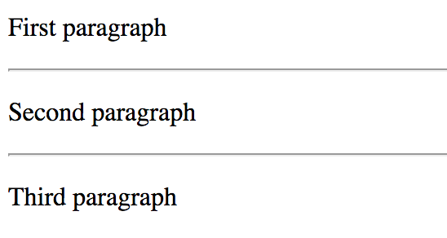
Horizontal rule: <hr> a horizontal line to visually separate sections of a page (block)
<p>First paragraph</p>
<hr>
<p>Second paragraph</p>
<hr>
<p>Third paragraph</p>
HTML
This is the first example we’ve seen of a void (self-closing) tag: more on HTML tag types.
Notes:
https://www.w3schools.com/tags/tag_header.asp

Slide 32

Links: <a> links, or “anchors”, to other pages(inline)
<P>
Search for it on <a href="http://www.google.com/">Google</a>
</P>
HTML
Output
Use the href attribute to specify the destination URL
Can be absolute (to another website) or relative (to another page on this site).
Anchors are inline elements; must be placed be placed in block element such as <p> or <h1>
Notes:
https://www.w3schools.com/tags/tag_header.asp

Slide 33
More about HTML attributes
Some tags can contain additional information called attributes
Syntax:
<element attribute=‘value’ attribute=‘value’> content</element>
Example:
I am from <a href=“http://www.american.edu”> American University </a> in Washington, DC.
Some tags don’t’ contain content and can be opened and closed in one tag
Syntax:
<element attribute=‘value’ attribute=‘value’>
Example:
<br />, <hr />, <br>, <hr>
Example:
<img src=‘bunny.jpg’, alt=“pic from Easter”>
Note: whether you use the ‘/’ in a self-closing tag is up to you, as long as you are consistent.

Slide 34
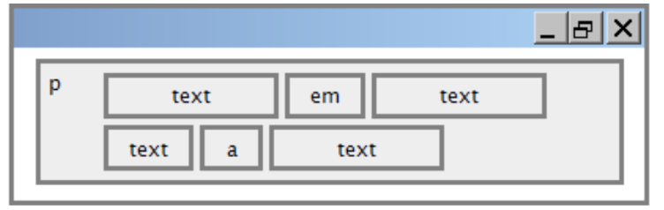
Block and Inline
Block elements contain an entire large region of content.
Examples: paragraphs, lists, table cells.
The browser places a margin of white space between block elements for separation.
Inline elements affects affects a small amount of content.
Examples: bold txt, code fragments, images.
The browser allows many inline elements to appear on the same line.
Must be nested a block element.

Slide 35
Exceptions and rules
Block vs. inline:
Some block elements can contain only other block elements: <body>, <form>
<p> tags can contain only inline elements and plain text
Some block elements can contain <div>,<li>
Some elements are only allowed to contain certain other elements
<ul> is only allowed to contain <li>
Some elements are only allowed once per document:
<html>
<body>
<head>
<main>

Slide 36

Images: <img>
Inserts a graphical image onto the page (inline)
<img src='images/duck.jpg', alt= 'giant yellow du’>
HTML
output
The src attribute specifies the image URL
HTML5 also requires an alt attribute describing the image, which improves accessibility for users who can’t otherwise see it.
If put in a <a> anchor tag, the images becomes a link.

Slide 37
Line Break: <br /> forces a line break in the middle of a block element (inline)
<p>
Among twenty snowy mountains,<br>
The only moving thing <br>
Was the eye of the blackbird.
</p>
HTML
Among twenty snowy mountains,
The only moving thing
Was the eye of the blackbird.
OUTPUT
Warning: Don’t over-use br (guideline: >=2 in a row is bad, better not to use any)
br tags should not be used to separate paragraphs or uses multiple times in a row to create spacing.

Slide 38
Nesting Tags
<p>HTML is <em>really, <strong> REALLY</em>
lots of <strong> fun!
</p>
HTML bad
<p>HTML is <em>Really </em> , <strong> lots of </strong> fun!
</p>
HTML good
Tags must be correctly nested.
A closing tag must match the most recently opened tag.
The browser may render it correctly anyway, but it is invalid HTML

Slide 39
Comments: <!-- …> comments do document your HTML file
<!-- My first web page. -->
<p> CSC Courses are so much fun!
HTML
CSC Courses are so much fun!
OUTPUT
Many web pages are not thoroughly commented( or at all).
Comments are useful at top fo page and for disabling code.
Comments can’t be nested and cannot contain a “—”
Do not leave commented-out HMTL code in your homework.
Toggle block comment in Brackets: option+command+/
Toggle line comments in Brackets: command +/

Slide 40
Web Standards
It is important to write proper HMTL code and.
Why use valid HMTL and web standards?
More rigid and structured language
More interoperable across different web browsers
More Likely that our pages will display correctly in the future
can be interchanged with other XML data: SVG (graphics), MathML, MusicML, etc.
Do the proper HTML code for your homework!! Meet the official standards.

Slide 41
W3C HTML Validator
Check http://validator.w3.org/
Checks your HTML code to make sure it follows the official HTML syntax.
More picky than the browser, which may render bad HMTL correctly.

Slide 42
Unordered List: <ul>,<li>
u1 represents a bulleted list of items(block)
li represents a single items within the list (block)
<ul> vacation
<li> no cell phone
</li>
<li> no computer
</li>
<li> no newspaper
</li>
</ul>
HTML
vacation
no cell phone
no computer
no newspaper
OUTPUT

Slide 43
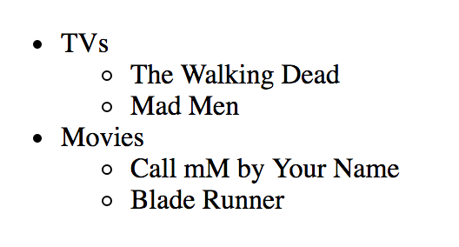
Nested List
<ul>
<li> TVs
<ul>
<li> The Walking Dead
</li>
<li> Mad Men
</li>
</ul>
</li>
<li> Movies
<ul>
<li>Call mM by Your Name</li>
<li>Blade Runner</li>
</ul>
</li>
</ul>
OUTPUT
HTML

Slide 44
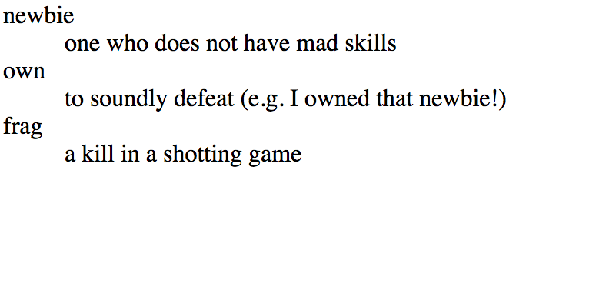
Definition list: <dl>,<dt>,<dd>
<dl>
<dt>newbie</dt>
<dd>one who does not have mad skills
</dd>
<dt>own</dt>
<dd>to soundly defeat (e.g. I owned that newbie!)</dd>
<dt>frag</dt>
<dd>a kill in a shooting game</dd>
</dl>
OUTPUT
HTML

Slide 45
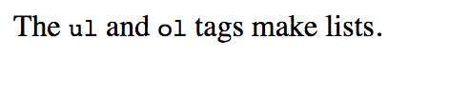
Computer Code: <code> a short section of computer code (usually with fixed width)
<p>
The <code>ul</code> and <code>ol</code> tags make lists.
</p>
HTML
Output

Slide 46
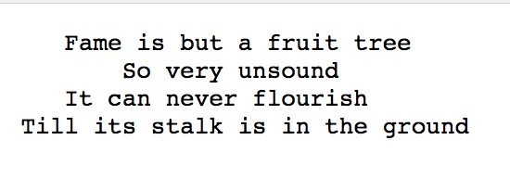
Preformatted Text: <pre> a short section of computer code (usualy with fixed wdith)
<pre>
Fame is but a fruit tree
So very unsound
It can never flourish
Till its stalk is in the ground
</pre>
HTML
Output

Slide 47
Quiz
What will happen if you forgot the closing tag of </a> in the following paragraph:
I am from <a href=“http://www.american.edu”> American University in Washington, DC.
Notes:
href tells the link where to direct to

Slide 48
Quiz
What will happen if you removing http:// in the URL you give to the href, For example:
<a href=“www.nytimes.com”>new york times</a>
Try it out yourself.

Slide 49
Lab session
The last 20 mins of every class we dedicate to a short lab session.

Slide 50
HTML Exercise 1: Set up development environment
Writing HTML and CSS with an editor is similar to writing Java in an IDE like jGrasp, Eclipse, or BlueJ. Conveniently, we don't need to compile HTML/CSS, and to "run" the code, we just open the HTML page on the browser.

Slide 51
HTML Exercise 1: How to use Firefox or Chrome Web Inspectors
FireFox Developer Tools is a Firefox add-on that lets you dynamically examine or modify the content and styling of web pages. It comes pre-installed with the FireFox browser. To open it, right-click an element and choose Inspect Element.
The Chrome Web Inspector tool behaves the same way, and comes conveniently built-in with Chrome. You can launch both by hitting F12 while in your browser.

Slide 52
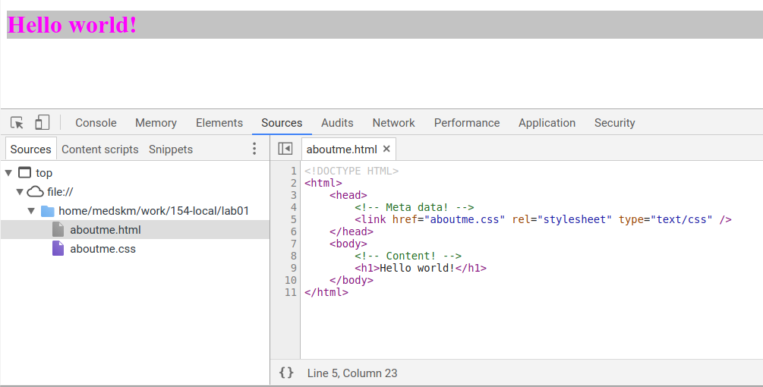
Chrome DevTools Source tab
On both Chrome and FireFox, you'll see a tab that shows all of your source files in the current directory, relative to the file path you have in your browser's file path (where URL's are). Below is a screenshot that is similar to what you would see when clicking on the aboutme.html file you have created.

Slide 53
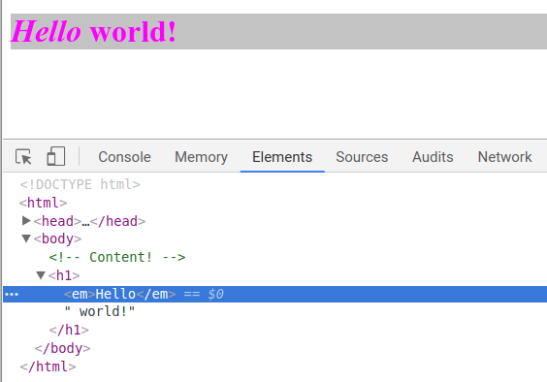
Modifying the HTML in the Browser (Elements Tag)
One handy way to quickly test the effects of changing HTML tags is to edit the HTML directory in the browser. When clicking on the "Elements" Tab in Chrome, you can do so by right-clicking on the HTML you're looking at and choosing the option to edit HTML (this may be worded differently between Chrome, FireFox, and other browsers). Then the HTML will be editable - after making any changes (new tags, changing tags, etc.) you should see the effects on your page immediately!

Slide 54
HTML Exercise 1: Set up development environment
To develop a web page, you need the following:
A text editor to write your HTML and CSS files (we recommend Bracket or Sublime Text)
Follow the instructions on the website. Once installed, open and start writing your HTML!
A browser (we recommend Chrome or FireFox, which both have useful web development features)
When browsing the web, you need Internet access. But when writing HTML and CSS webpages, you don't!

Slide 55
HTML Exercise 1: About me
Create a page aboutme.html that describes you, including the information such as:
Your name
A brief description of you in 1-2 sentences
A list of classes you are taking now at AU
Your 4 favorite movies, books, games and TV shows. Make at least one link to an interesting site about that favorite movie/book/game/show.
Two images that represent when you re happy and sad.
Something about one of your neighbors (student sitting next to you)
Hint: use proper header tags, unordered lists, ordered lists.
We will learn how to stylize this page next class.

Slide 56
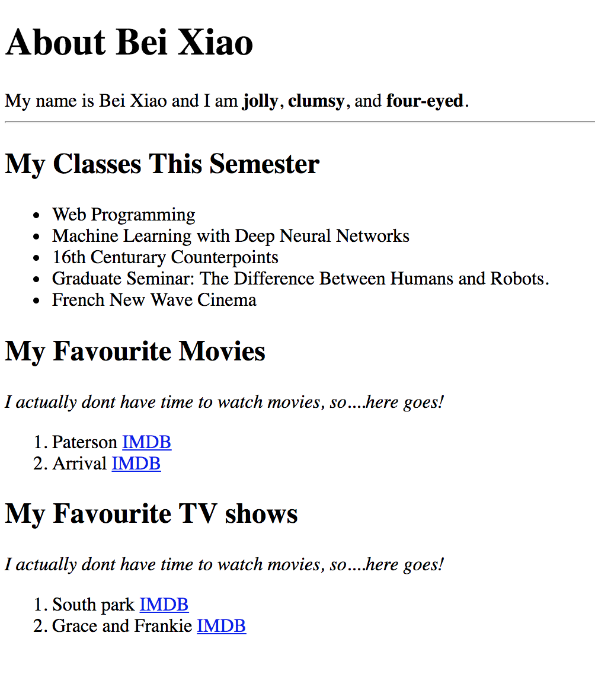
HTML Exercise 1: Example

Slide 57

Exercise 1 Tips: Unordered List <ul>,<li>
<ul>
<li>No shoes</li>
<li>No shirt</li>
<li>No problem</li>
</ul>

Slide 58
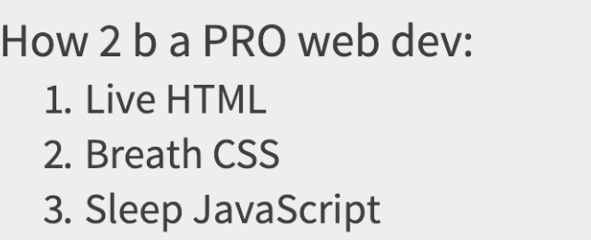
Exercise 1 Tips: Ordered List <ul>,<li>
<p>How 2 b a PRO web dev:</p>
<ol>
<li>Live HTML</li>
<li>Breath CSS</li>
<li>Sleep JavaScript</li>
</ol>

