Slide 1
CSC435: Web Programming Lecture 3: HTML, CSS
Bei Xiao
American University
Jan 22, 2019

Slide 2
Take-home reading & Tutorial
HTML Tutorial (finish):
https://developer.mozilla.org/en-US/docs/Web/Guide/HTML/Introduction
CSS Tutorial (start):
https://developer.mozilla.org/en-US/docs/Learn/CSS/Introduction_to_CSS

Slide 3
Today’s agenda
Teaching Assistant: Jiachen Yao
jy3695a@student.american.edu
TA Office hour?
Aboutme.html check
A bit of review
More on HTML
CSS
Stylize Aboutme.html exercise

Slide 4
Exercise: Aboutme
Create a page aboutme.html that describes you, including the information such as:
Your name
A brief description of you in 1-2 sentences
A list of classes you are taking now at AU
Your 4 favorite movies, books, games and TV shows. Make at least one link to an interesting site about that favorite movie/book/game/show.
Two images that represent when you re happy and sad.
Something about one of your neighbors (student sitting next to you)
Hint: use proper header tags, unordered lists, ordered lists.
We will learn how to stylize this page next class.

Slide 5
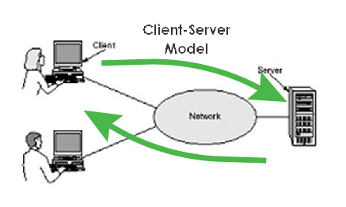
Review: Internet
Things that are relevant
There are layers
IP= Internet Protocal, also addresses like
192.168.01
No centralized control but…
DNS maps the numbers to names like Google.com
W3C Validates web pages.
Websites uses a client-server model over the Internet

Slide 6
More on HTML tags
Some tags can contain additional information called attributes
Syntax: <element attribute="value" attribute="value"> content </element>
Example: <a href="page2.html">Next page</a>
Some tags don't contain content and can be opened and closed in one tag
Syntax: <element attribute="value" attribute="value" />
Example: <br />, <hr />, <br>, <hr>
Example: <img src="bunny.jpg" alt="pic from Easter" />
Note: whether you use the '/' in a self-closing tag is up to you, as long as you're consistent

Slide 7
Nesting Tags
<p>
HTML is <em>really,
<strong>REALLY</em> lots of</strong> fun!
</p>
HTML bad
<p>
HTML is <em>really</em>,
<strong>REALLY lots of</strong> fun!
</p>
HTML good
Tags must be correctly nested
A closing tag must match the most recently opened tag
The browser may render it correctly anyway, but it is invalid HTML
How would we get the above effect in a valid way?

Slide 8
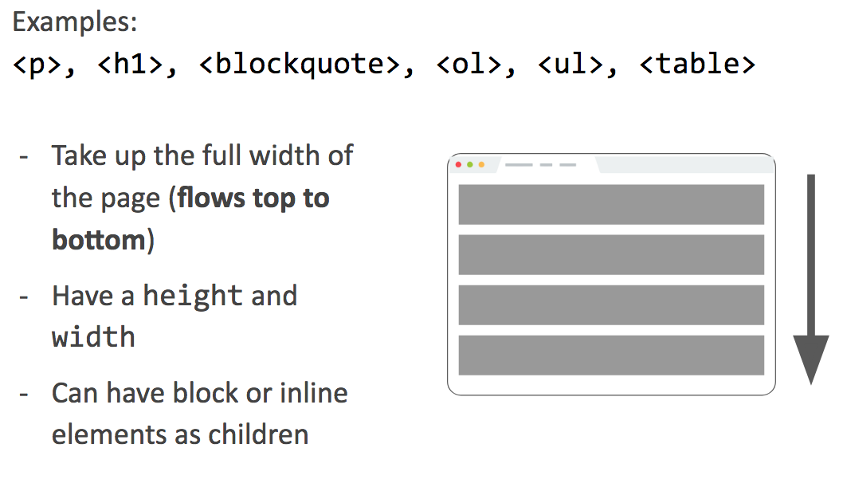
Block Elements
Slide courtesy: Victoria Kirst, Stanford University

Slide 9
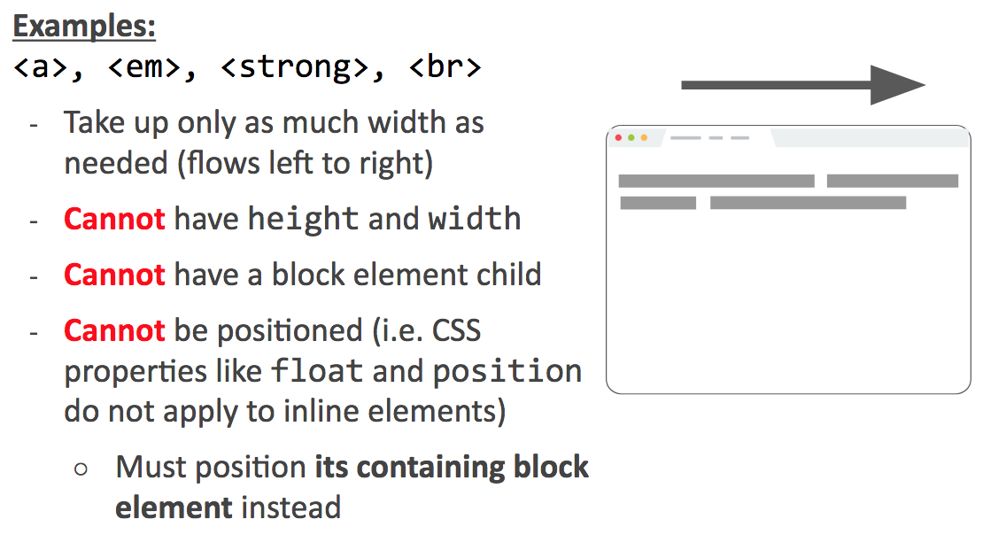
Inline Elements
Slide courtesy: Victoria Kirst, Stanford University

Slide 10

Example: inline
<strong>Web programming resources:</strong>
<a href="https://developer.mozilla.org/en-US/">MDN</a>
<a href="http://google.com">Google</a> HTML
output

Slide 11
Examples
Inline element:
<a>
<span>
<img>
Block element:
<p>
<div>

Slide 12
Block and Inline Elements
<p>As Lincoln said in his famous Gettysburg Address:</p>
<blockquote>
<p>Fourscore and seven years ago, our fathers brought forth
on this continent a new nation, conceived in liberty, and
dedicated to the proposition that all men are created equal.</p>
</blockquote>
HTML
As Lincoln said in his famous Gettysburg Address:
Fourscore and seven years ago, our fathers brought forth on this continent a new nation, conceived in liberty, and dedicated to the proposition that all men are created equal. output

Slide 13
Phase elements: <em>, <strong>
em: emphasized text (usually rendered in italic)
strong: strongly emphasized text (usually rendered in bold)
<p>
HTML is <em>really</em>,
<strong>REALLY</strong> fun!
</p>
HTML is really, REALLY fun!
as usual, the tags must be properly nested for a valid page

Slide 14
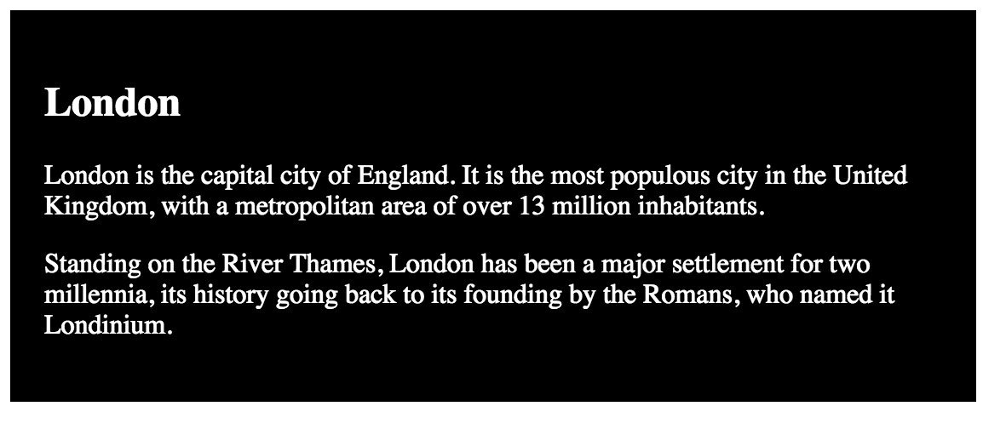
Exercise: block element
Using block element <div> and <p> create the following page:

Slide 15

Exercise: in-line element
Using in-line element <span> create the following page:
Use <q></q> to generate this:
Quoth the Raven, “Nevermore.”

Slide 16

Images: <img>
Inserts a graphical image into the page (inline)
<img src="img/koalafications.jpg" alt="Koalified koala">
HTML
The src attribute specifies the image URL
HTML5 also requires an alt attribute describing the image, which improves accessibility for users who can't otherwise see it

Slide 17
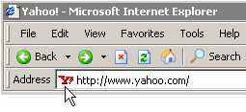

Favorite icon (“favicon”)
<link href="filename" type="MIME type" rel="shortcut icon" /> HTML
<link href="yahoo.gif" type="image/gif" rel="shortcut icon" /> HTML
output
http://tools.dynamicdrive.com/favicon/

Slide 18
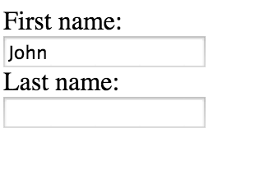
HTML Forms: <input>
<form action="">
First name:<br>
<input type="text" name="firstname" value="John">
<br>
Last name:<br>
<input type="text" name="lastname">
</form>
HTML

Slide 19
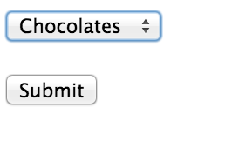
HTML Forms: <select>
<form action="action_page.php">
<select name="sweets">
<option value="Choclates">Chocolates</option>
<option value="Cake">Cake</option>
<option value="Cookies>Cookies</option>
<option value="Icecream">Icecream</option>
</select>
<br><br>
<input type="submit">
</form>
HTML

Slide 20
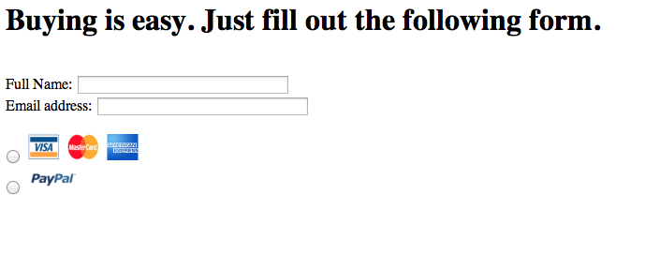
Exercise: payment forms
Please create a .html that generate a page looks like this. You can download icon images from the folder on blackboard or search them online.

Slide 21
The bad way to produce styles
<p>
<font face="Arial">Welcome to Greasy Joe's.</font>
You will <b>never</b>, <i>ever</i>, <u>EVER</u> beat
<font size="+4" color="red">OUR</font> prices!
</p>
Tags such as b, I, u and font are discouraged in strict CSS. Why is this bad?

Slide 22
Website Organization
Content and Structure: HTML
Style: CSS
Behavior: JavaScript

Slide 23
Cascading Style Sheets (CSS): <link>
<head>
...
<link href="filename" type="text/css" rel="stylesheet" />
...
</head>
CSS describes the appearance and layout of information on a web page (as opposed to HTML, which describes the content of the page)
can be embedded in HTML or placed into separate .css file (preferred)

Slide 24
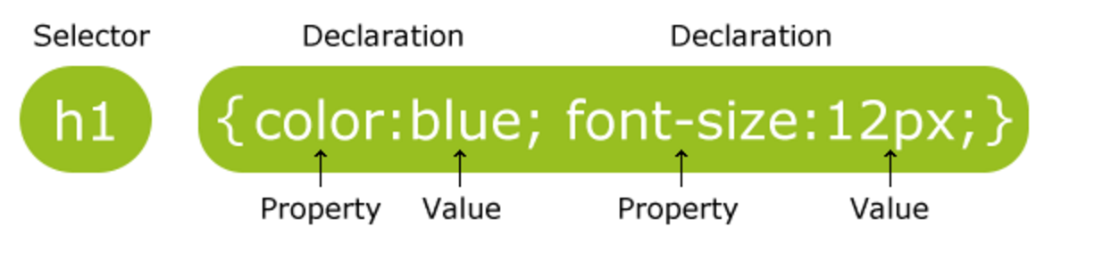
Cascading Style Sheets (CSS) syntax
selector {
property: value;
property: value;
...
property: value;
}
p {
font-family: sans-serif;
color: red;
}

Slide 25
Basic CSS Rule Syntax
Selector{
property: value;
property: value;
property: value;
}
p{
color:red;
font-family:sans-serif;
}
CSS example
A CSS file consists of one or more rules
A rule selector specifies HTML element(s) and applies style properties

Slide 26
CSS properties for colors
p {
color: red;
background-color: yellow;
}
CSS
This paragraph uses the style above.
Property | Description
color | color of an element’s text
background-color | color that will appear behind the element

Slide 27
Specifying color
p { color: red; }
h2 { color: rgb(128, 0, 196); }
h4 { color: #FF8800; }
CSS
This paragraph uses the first style above.
This h2 uses the second style above.
This h4 uses the third style above.
output
color names: aqua, black, blue, fuchsia, gray, green, lime, maroon, navy, olive, purple, red, silver, teal, white (white), yellow
RGB codes: red, green, and blue values from 0 (none) to 255 (full)
Hex codes: RGB values in base-16 from 00 (0, none) to FF (255, full)

Slide 28
Specifying attributes with class
<head>
<style type="text/css">
p.blue_paragraphs{
color:blue;
}
</style>
</head>
<body>
<p class="blue_paragraphs"> Paragraph 1</p>
p>
</body>

Slide 29
Color picker
http://www.w3schools.com/tags/ref_colorpicker.asp
http://www.w3schools.com/tags/ref_colormixer.asp

Slide 30
CSS: Fonts
property | description
font-family | which font will be used
font-size | how large the letters will be drawn
font-style | used to enable/disable italic style
font-weight | used to enable/disable bold style
Complete list of font properties

Slide 31
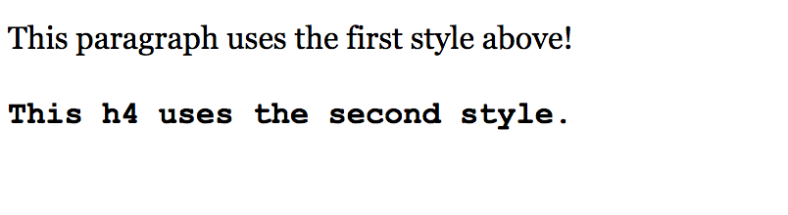
font-family
p{
font-family: Georgia;
}
h4{
font-family: "Courier New";
}
CSS
output
Enclose multi-word font names in quotes.

Slide 32
More about font-family
p{
font-family:Garamond, "Times new Roman",serif;
}
CSS
This paragraph uses this style!
output
Can specify multiple fonts from highest to lowest priority.
Generic font names: serif, sans-serif, cursive, fantasy, monospace.
If the first font is not found on the user’s computer, the second is tried.
Place a generic font name at the end of your list.

Slide 33
Using Google fonts
Specify in HTML the Google font link:
<head>
<link rel="stylesheet" href=”mystyle.css" href="https://fonts.googleapis.com/css?family=Tangerine|Inconsolata|Droid+Sans|Open+Sans">
</head>
HTML
Request font in mystyle.css:
body {
font: lighter 17px/20px Open+Sans,Droid+Sans，HelveticaNeue-Light, 'Helvetica Neue', Helvetica, Arial, sans-serif;
}
CSS
https://developers.google.com/fonts/docs/getting_started?hl=en

Slide 34

font-size
p{
font-size:16pt
}
CSS
output
units: pixels (px) vs. point (pt) vs. m-size (em)
16px, 16pt, 1.16em
vague font sizes: xx-small, x-small, small, medium, large, x-large, xx-large, smaller, larger
percentage font sizes, e.g.: 90%, 120%

Slide 35
More on size
Pixels(px) are referred to as absolute unites because they will always be the same regardless of any other related settings. Other absolute units are:
mm, cm, in: Millimeters, centimeters or inches.
pt, pc: Points(1/72 of an inch) or picas (12 points)
em: 1em is the same as font-size of the current element (more specifically, the width of a capital letter M). Default font-size by web browser before CSS styling is 16 pixels (1em) for an element.
We will learn about this when we learn margins.
Read more on CSS values and units.

Slide 36
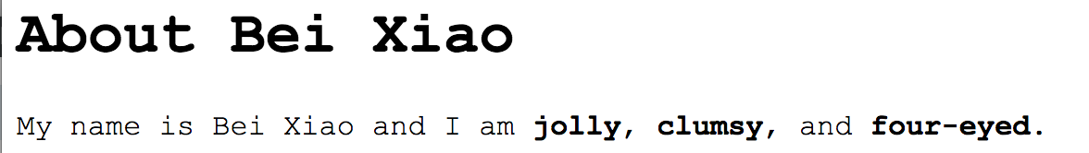
Body style
body{
font-family: "Courier New";
}
CSS
output
CSS
To apply a style to the entire body of the page, write a selector for the body (saves you from manually applying a style to each element.

Slide 37
CSS comments: /*…*/
/*
This is a comment.
It can span manylines in a CSS file.
*/
body{
background-color:lightgreen;
font-family: "Courier New";
}
CSS
CSS (like HTML) is usually not commented as much as code like Python
The // single-line comment is NOT supported in CS.
The ←…→ HTML comment is also NOT supported in CS.

Slide 38
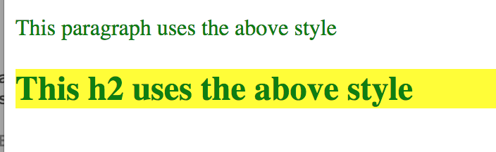
Grouping Styles
p,h1,h2{
color:green;
}
h2{
background-color:yellow;
}
CSS
Output
A style can select multiple elements separated by commas
The individual elements can also have their own styles (like h2 style).

Slide 39
Styles that Conflict
p,h1,h2{
background-color:green;
}
h2{
background-color:yellow;
}
CSS
Output
When two styles set conflicting values for the same property, the later style takes precedence.

Slide 40
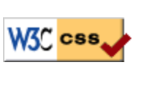
W3C CSS Validator
<p>
<a target="_blank" href="http://jigsaw.w3.org/css-validator/">
<img src="http://jigsaw.w3.org/css-validator/images/vcss"
alt="Valid CSS!" />
</a>
CSS
Checks your CSS to make sure it meets the official CSS specifications
More picky than the web browsers

Slide 41
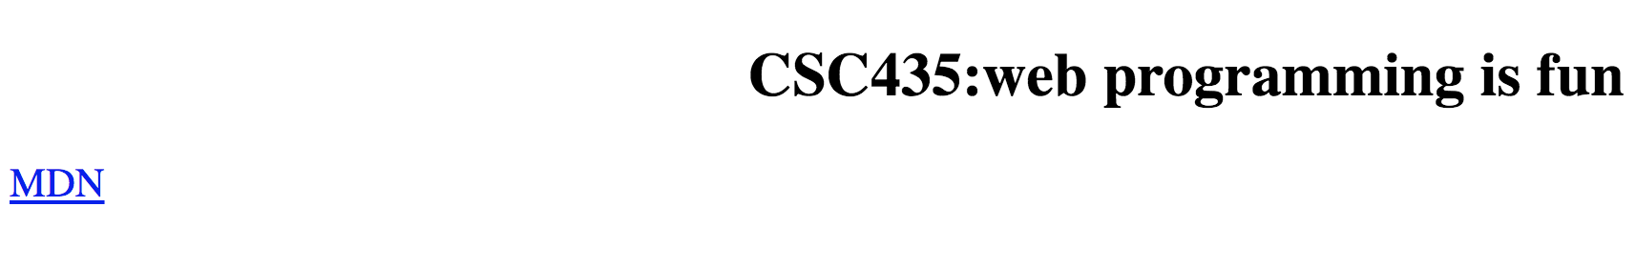
Text-align mystery
h2{
/* works*/
text-align:center;
}
a{
/* fails*/
text-align:center;
}
CSS
Recall that we can’t align <a> tag directly, we could center <h2>, why?
Please read MDN description of text-align.

Slide 42
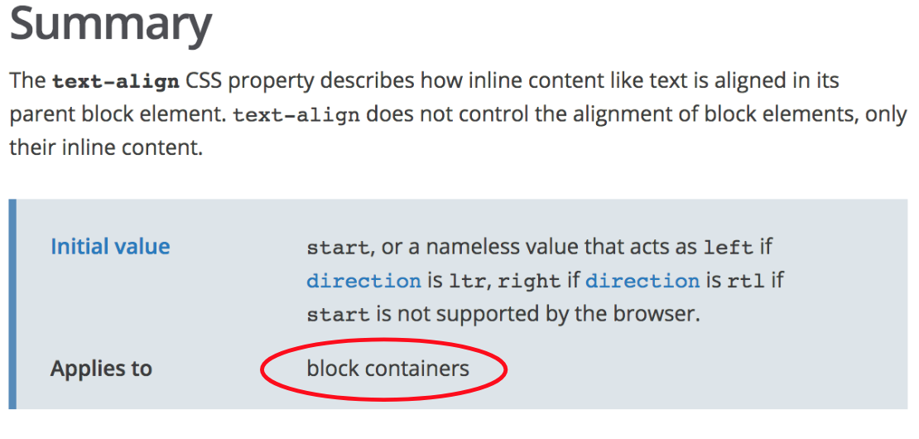
Text-align mystery
Please read MDN description of text-align.

Slide 43

Text-align demystified.
<h2>CSC435:web programming is fun</h2>
<p><a href="https://developer.mozilla.org/en-US/">MDN</a></p>
HTML
p{
/* works*/
text-align:center;
}
CSS
Please read MDN description of text-align.

Slide 44
CSS properties for text
Property | Description
text-align | Alignment of text within its element
text-decoration | Decorations such as underlying
text-indent | Indents the first letter of each paragraph
text-shadow | A colored shadow near an existing piece of text (CSS3)
line-height, word-spacing, letter-spacing | Gaps between the various portions of the text.
Complete list of text properties

Slide 45
CSS properties for background
c | Description
background-color | Color to fill the background
background-image | Image to place in background
background-position | Placement of background image within element
background-repeat | How background image should be repeated
background-attachment | Whether background image scroll with the page
More background properties

Slide 46
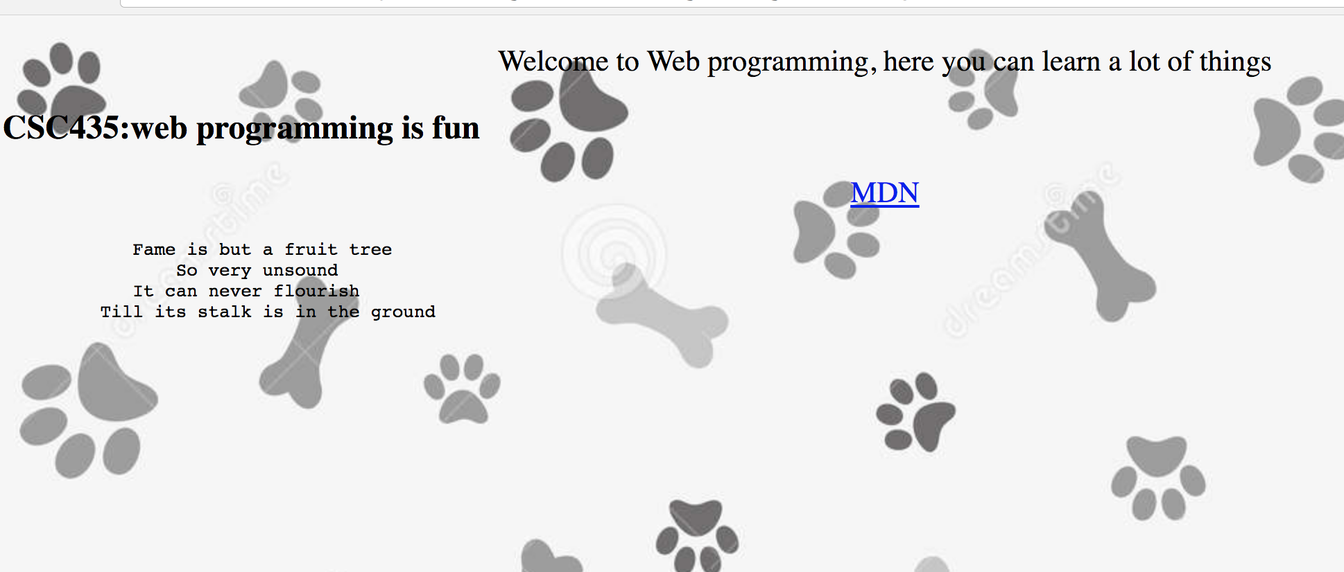
background-image
body{
background-image:url('images/paw2.jpg');
}

Slide 47
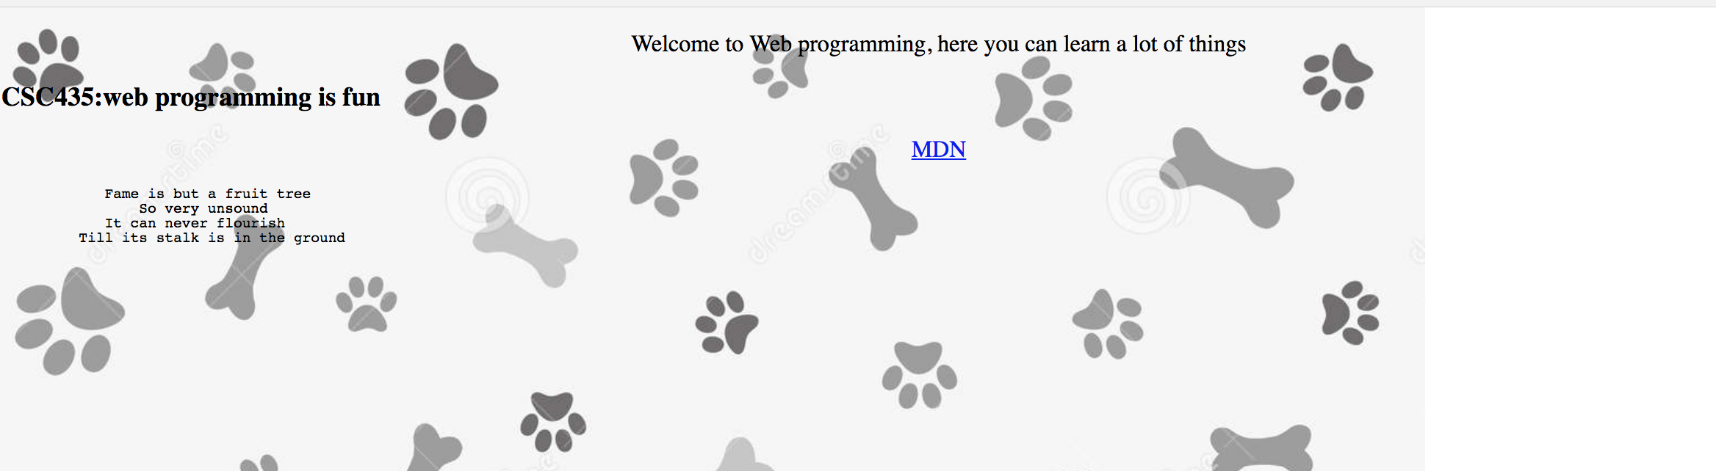
background-image
body{
background-image:url('images/paw2.jpg');
background-repeat:repeat-y;
}
CSS
Can be repeat (default), repeat-x, repeat-y, or no-repeat

Slide 48
Embedding style sheets
<head>
<style type="text/css">
p { font-family: sans-serif; color: red; }
h2 { background-color: yellow; }
</style>
</head>
HTML
CSS code can be embedded within the head of an HTML file
This is bad style; DO NOT DO THIS (why?)
Can be repeat (default), repeat-x, repeat-y, or no-repeat

Slide 49
Inline styles: the style attribute
<p style="font-family: sans-serif; color: red">
This is a paragraph</p>
HTML
Hither precedence than embedded or linked styles.
Used for one-time overrides and styling a particular element.
Can be repeat (default), repeat-x, repeat-y, or no-repeat

Slide 50
Content vs. Presentation
HTML is for content, what is ON the webpage.
CSS is for presentation, how to display the page, (margin)
Keep content separate from presentation is very important for web design
If HTML contains no style, its entire appearance can be changed by by swapping .css file.
See CSS Zen garden.
Can be repeat (default), repeat-x, repeat-y, or no-repeat

Slide 51
Exercise: Stylize Aboutme.html
Create a CSS style seet named styleme.css to improve the appearance of your AboutMe page.
For example, you can change the type face of the texts and size of the headings.
Try use different background colors for different sections.
You can find some CSS properties in the lecture or online.
Use a <link>tag to reference your CSS file in your HTML:
<head>
...
<link href="filename" type="text/css" rel="stylesheet" />
...
</head>

Slide 52
Exercise:
Download the resume.html from blackboard.
Please fix the typos and inconsistency in the .html
Can you create a resume.css so that this page looks better?
For the body text: use one of the Google font:
https://www.google.com/fonts/specimen/Open+Sans
For the headers, choose another font.
Make a nice background color for the page
Make the header have different font from the paragraph
Experiment with font size and font spacing.

Slide 53
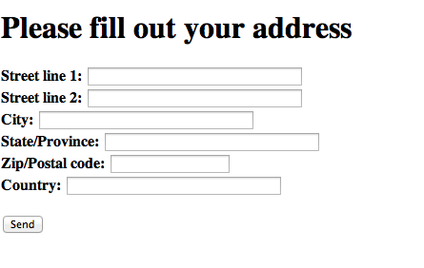
Exercise: Address forms
Please create a .html that generate a page looks like this.

Slide 54
Homework & Exercises
Today’s reading (Introduction to CSS):
https://developer.mozilla.org/en-US/docs/Web/Guide/CSS/Getting_Started/What_is_CSS
https://developer.mozilla.org/en-US/docs/Web/Guide/CSS/Getting_Started/Why_use_CSS

Slide 55
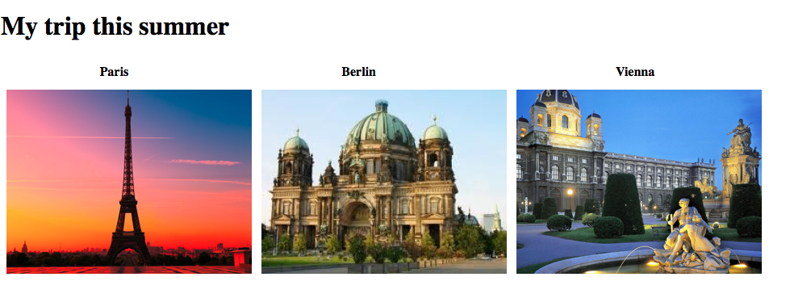
Exercise
Using <table> tag, create a page like this. Don’t forget cell padding.

Slide 56
Linking within a page
Link to another location in the same page
<p>
<a href="#C4">See also Chapter 4.</a>
</p>
<h2>Chapter 1</h2>
<p>This chapter explains ba bla bla</p>
<h2>Chapter 2</h2>
<p>This chapter explains ba bla bla</p>
<h2>Chapter 3</h2>
<p>This chapter explains ba bla bla</p>
<h2><a id="C4">Chapter 4</a></h2>
<p>This chapter explains ba bla bla</p>

