Slide 1
CSC435: Web Programming Lecture 4: CSS
Bei Xiao
American University
Jan 25, 2019

Slide 2
Activity Outline
Review CSS text and list properties
Cascading Style
Id and Class
Grouping content
Exercise: Resume
Creative Project 1 is due next Friday.
Homework 2 is out today (Jan 25th) due next Friday).

Slide 3
Exercises & Take-home reading (must read before next class)
Finish resumu.html, resume.css
Take-home reading:
How to use CSS to Stylize Texts:
https://developer.mozilla.org/en-US/docs/Learn/CSS/Styling_text
Cascading and inheritance
https://developer.mozilla.org/en-US/docs/Web/Guide/CSS/Getting_Started/Cascading_and_inheritance
CSS Selectors
https://developer.mozilla.org/en-US/docs/Web/Guide/CSS/Getting_Started/Selectors

Slide 4
Review: is <img> an inline or inline-block?
<img> tags are considered an inline element and an inline-block element.
Recall a "block" element (e.g. <body>, <p>, <div>) can contain other elements
An image tag is ok on it's own
<img src="img/koalafications.jpg" alt="Koalified koala" />
Or in a block element.
<p> <img src="img/koalafications.jpg" alt="Koalified koala" /> </p>

Slide 5
Review: Cascading Style Sheets (CSS):
<link>
CSS describes the appearance and layout of information on a web page (as opposed to HTML, which describes the content)
Can be embedded in HTML or placed into separate .css file (preferred)
<head> ... <link type="text/css" href="filename" rel="stylesheet" /> ... </head>

Slide 6
Review: Basic CSS Rule Syntax
selector {
property: value;
property: value; ...
property: value; }
p { font-family: sans-serif;
color: red;
}
A CSS file consists of one or more rules .
A rule selector specifies HTML element(s) and applies styles)

Slide 7
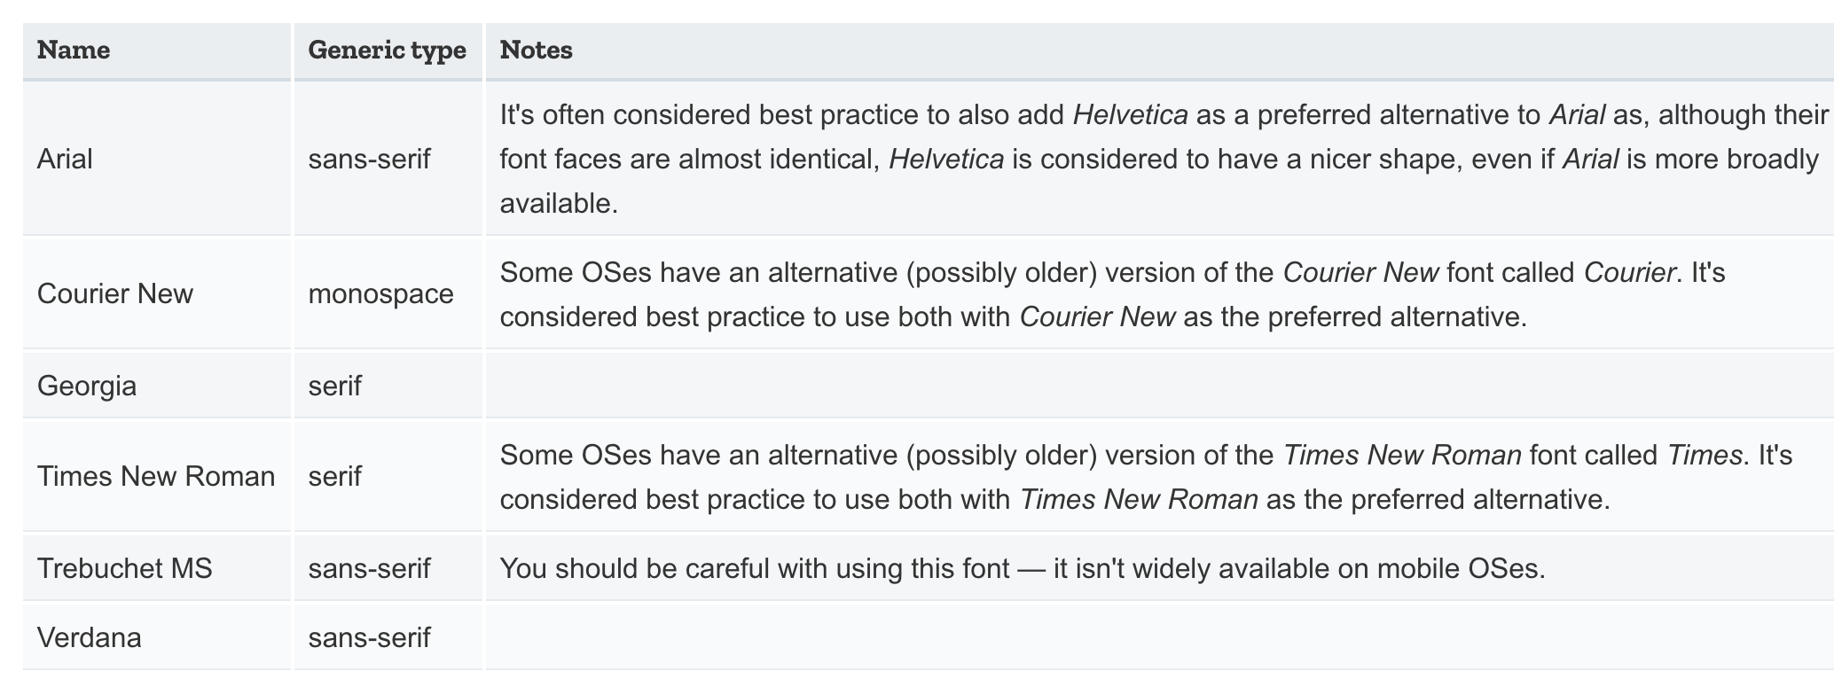
Stylize text and fonts

Slide 8
Stylize text and fonts

Slide 9
Specifying color
p { color: red; }
h2 { color: rgb(128, 0, 196); }
h4 { color: #FF8800; }
CSS
This paragraph uses the first style above.
This h2 uses the second style above.
This h4 uses the third style above.
output
color names: aqua, black, blue, fuchsia, gray, green, lime, maroon, navy, olive, purple, red, silver, teal, white (white), yellow
RGB codes: red, green, and blue values from 0 (none) to 255 (full)
Hex codes: RGB values in base-16 from 00 (0, none) to FF (255, full)

Slide 10
Using Google fonts
Specify in HTML the Google font link:
<head>
<link rel="stylesheet" href=”mystyle.css" href="https://fonts.googleapis.com/css?family=Tangerine|Inconsolata|Droid+Sans|Open+Sans">
</head>
HTML
Request font in mystyle.css:
body {
font: lighter 17px/20px Open+Sans,Droid+Sans，HelveticaNeue-Light, 'Helvetica Neue', Helvetica, Arial, sans-serif;
}
CSS
https://developers.google.com/fonts/docs/getting_started?hl=en

Slide 11
Using Google fonts
Specify in HTML the Google font link:
Go to https://fonts.google.com
Find the font(s) you like. Press the + button for each
Click on the black bar that says the number of families you have selected
Click on @import and copy the text inbetween the <style> and <style> tags
Paste the code into your .css document
https://developers.google.com/fonts/docs/getting_started?hl=en

Slide 12

Body Styles
body { font-size: 16pt; }
CSS
To apply a style to the entire body of your page, write a selector for the body (saves you from manually applying a style to each element)

Slide 13
Grouping Styles
p, h1, h2 {
color: green;
}
h2 {
background-color: yellow;
}
CSS
A style can select multiple elements separated by commas
The individual elements can also have their own styles (like h2 above)

Slide 14
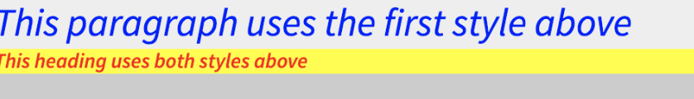
What happens when styles are conflicting?
body {
color: green;
}
p, h1, h2 {
color: blue; font-style: italic;
}
h2 { color: red; background-color: yellow;
}
CSS

Slide 15

Example: Inline-block
<img src="http://static.tvtropes.org/pmwiki/pub/images/Hello_Kitty_Pink_2981.jpg" />
<img src="http://static.tvtropes.org/pmwiki/pub/images/Hello_Kitty_Pink_2981.jpg" />
<img src="http://static.tvtropes.org/pmwiki/pub/images/Hello_Kitty_Pink_2981.jpg" />
<img src="http://static.tvtropes.org/pmwiki/pub/images/Hello_Kitty_Pink_2981.jpg" />
html
img {
width: 50px;
}
CSS
What does this look like in the browser?

Slide 16
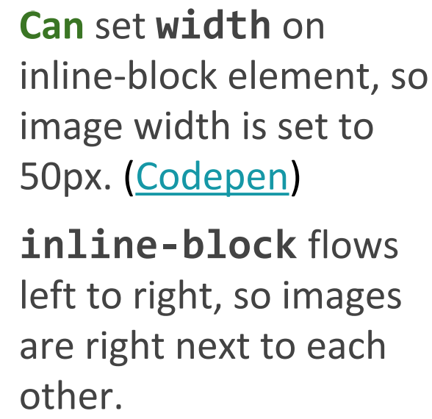

Inline-block has width and height; flows left to right
https://codepen.io/pen

Slide 17
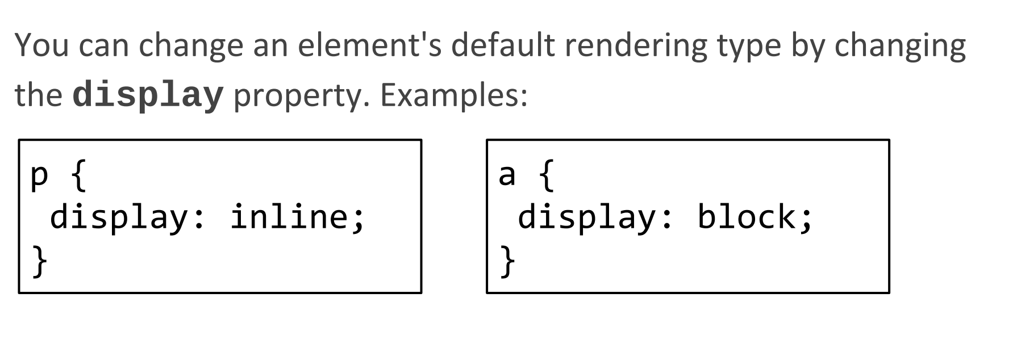
The display CSS property
Possible values for display:
Block
Inline
Inline-block

Slide 18
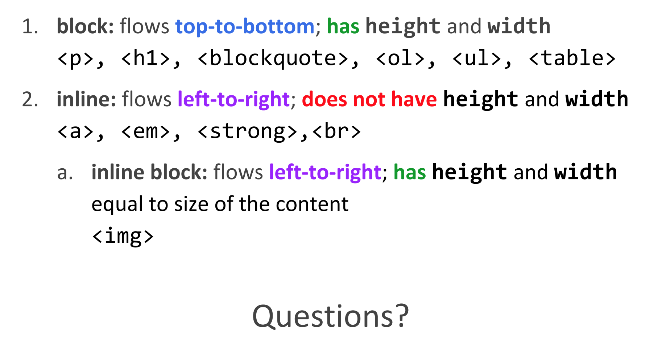
Review

Slide 19
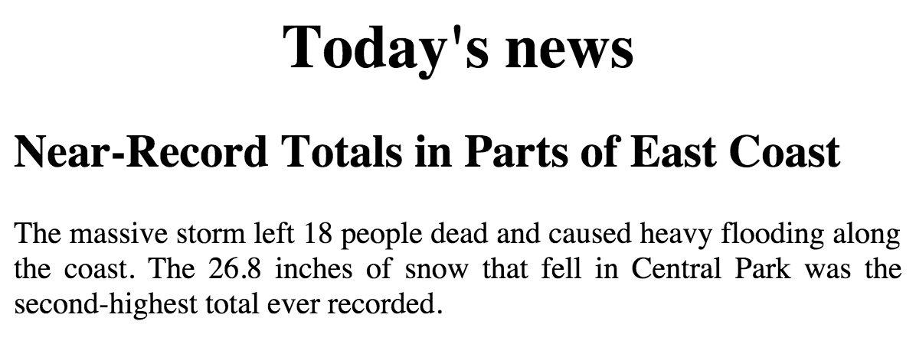
CSS properties for text: Example
<body>
<h1>The weather channel</h1>
<h2>DC Weather and road condition</h2>
<p>The massive storm left 18 people dead and caused heavy flooding</p>
</body>
HTML
<style>
h1 {
text-align: center;
}
h2 {
text-align: left;
}
p {
text-align: justify;
}
</style>
CSS

Slide 20
CSS properties for text: Example
blockquote { text-align: justify; }
h2 { text-align: center; }
The Emperor's Quote
[TO LUKE SKYWALKER] The alliance... will die. As will your friends. Good, I can feel your anger. I am unarmed. Take your weapon. Strike me down with all of your hatred and your journey towards the dark side will be complete.
can be left, right, center, or justify (which widens all full lines of the element so that they occupy its entire width)

Slide 21
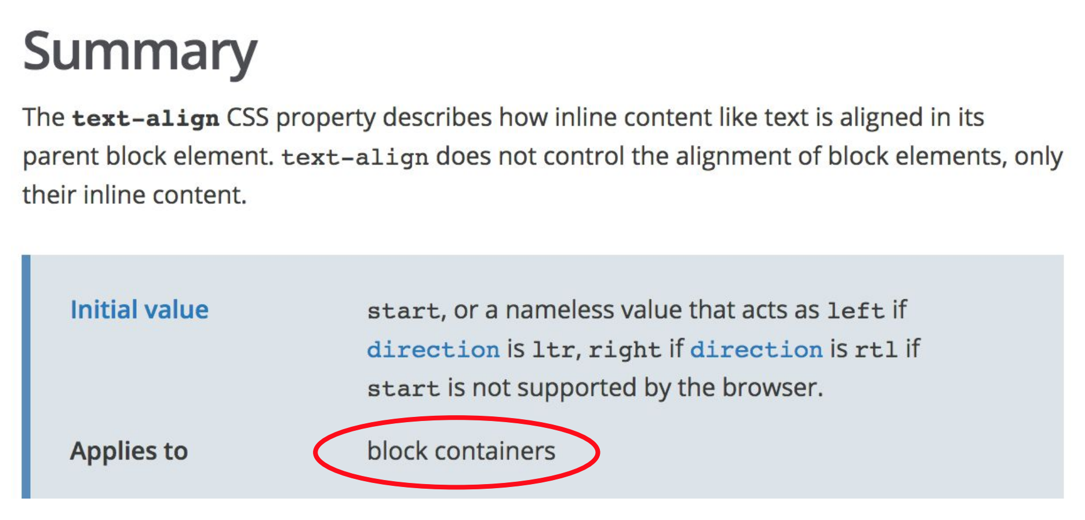
text-align mystery

Slide 22
Text-decoration
p {
text-decoration: underline;
}
This paragraph uses the style above.
can also be overline, line-through, blink, or none
effects can be combined:
text-decoration: overline underline;

Slide 23
Text-shadow
p {
font-weight: bold;
text-shadow: 2px 2px gray;
}
This paragraph uses the style above.
shadow is specified as an X-offset, a Y-offset, and an optional color

Slide 24
List type property
ol { list-style-type: lower-roman; }
Possible values:
i. none : No marker
ii. disc (default), circle, square
iii. Decimal: 1, 2, 3, etc.
iv. decimal-leading-zero: 01, 02, 03, etc.
v. lower-roman: i, ii, iii, iv, v, etc.
vi. upper-roman: I, II, III, IV, V, etc.
vii. lower-alpha: a, b, c, d, e, etc.
viii. upper-alpha: A, B, C, D, E, etc.
x. lower-greek: alpha, beta, gamma, etc.
others: hebrew, armenian, georgian, cjk-ideographic, hiragana…

Slide 25
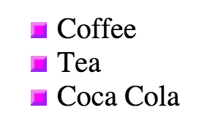
List type property
ul {
List-style: square url(“squarepurple.gif”)
}
<ul>
<li>Coffee</li>
<li>Tea</li>
<li>Coca Cola</li>
</ul>

Slide 26
The bad way to produce styles
<p>
<font face="Arial">Welcome to Greasy Joe's.</font>
You will <b>never</b>, <i>ever</i>, <u>EVER</u> beat
<font size="+4" color="red">OUR</font> prices!
</p>
CSS
Welcome to Greasy Joe's. You will never, ever, EVER beat OUR prices!

Slide 27
Cascading Style Sheets (CSS): <link>
<head>
...
<link href="filename" type="text/css" rel="stylesheet" />
...
</head>
CSS
CSS describes the appearance and layout of information on a web page (as opposed to HTML, which describes the content of the page)
can be embedded in HTML or placed into separate .css file (preferred)

Slide 28
Three ways to use style
Inline: add a “style” attribute containing the CSS rule directly to an HTML
Internal: Define CSS Rules in the style tag in the HTML
<head>
<style type="text/css">
p{
color:red;
}
</style>
</head>
External: Add a link to an external stylesheet in the head of your HTML page
<head>
<link rel="stylesheet" type="text/css" href="exercise1.css">
</head>

Slide 29
Three ways to use style
Inline: add a “style” attribute containing the CSS rule directly to an HTML
Internal: Define CSS Rules in the style tag in the HTML
<head>
<style type="text/css">
p{
color:red;
}
</style>
</head>
External: Add a link to an external stylesheet in the head of your HTML page
<head>
<link rel="stylesheet" type="text/css" href="exercise1.css">
</head>
Bad

Slide 30
Convent vs. Presentation
HTML is for content; what is on the page (heading; list; code; etc.)
CSS is for presentation; how to display the page (bold; centered; 20px margin; etc.)
keeping content separate from presentation is a very important web design principle
If the HTML contains no styles, its entire appearance can be changed by swapping .css files
see also: CSS Zen Garden

Slide 31
Cascading Style Sheets
HTML is for content; what is on the page (heading; list; code; etc.)
CSS is for presentation; how to display the page (bold; centered; 20px margin; etc.)
keeping content separate from presentation is a very important web design principle
If the HTML contains no styles, its entire appearance can be changed by swapping .css files
see also: CSS Zen Garden

Slide 32
Cascading Style Sheets
It's called Cascading Style Sheets because the properties of an element cascade together in this order:
Browser's default styles (reference)
External style sheet files (in a <link> tag)
Internal style sheets (in a <style> tag in the page header)
Inline style (the style attribute of an HTML element)

Slide 33
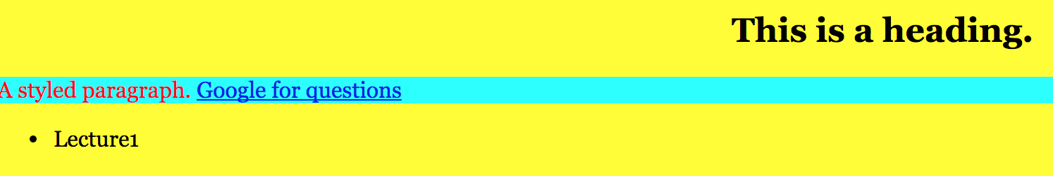
Inheriting styles (explanation)
body{
background-color:yellow;
font-family: georgia ;
}
p{background-color:aqua;color:red;}
a{text-decoration:overline udnerline;}
h2{font-weight:bold;
text-align:center;}
CSS
Output
When multiple styles apply to an element, they are inherited.
A more tightly-matching rule can override a more general inherited rule.
Not all properties are inherited (notice link’s color above.

Slide 34
CSS pseudo-classes
A pseudo-class is used to define a special state of an element.
It can be used:
Style an element when a user mouse over it.
Style visited and unvisited links differently
Style en element when it gets focus

Slide 35

CSS pseudo-classes
a:link{color:#FF0000;}
a:visited{color:#00FF00;}
a:hover{ color:#FF00FF;}
CSS
HTML
Pseudo-class can be combined with CSS class.
Example: div:hover{ background-color:blue;}

Slide 36
CSS pseudo-classes
Class | Description
:active | An activated or selected element
:focus | An element that has the keyboard focus
:hover | An element that has the mouse over
:link | A link that has not been visited
:visited | A link that has been already visited
:first-letter | the first letter of text inside an element
:first-line | The first line of text inside an element
More on pseudo-classes

Slide 37
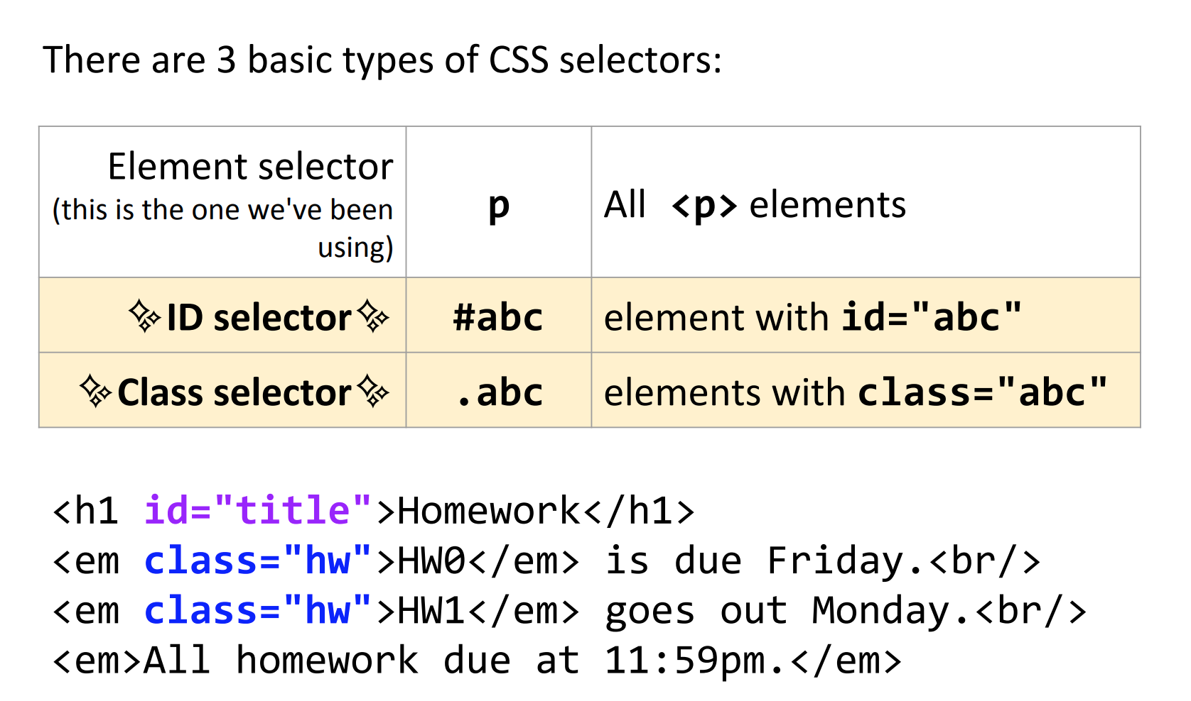
id and class

Slide 38
id and class
Id’s are unique
Unique identifier for an element
Each element can only have one id
Only allowed one id per element per page
Classes are NOT unique
Non-unique grouping attribute to share with many elements
Many elements (even of different types) can share the same class.
Each element can have many different classes.
More on difference between id and Class.

Slide 39
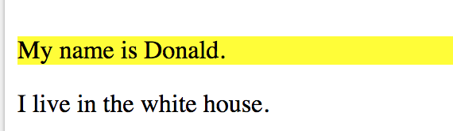
id Example
<div class="intro">
<p id="firstname">My name is Donald.</p>
<p id="hometown">I live in the whitehouse.</p>
</div>
HTML
#firstname {
background-color: yellow;
}
CSS

Slide 40
Why are these useful?
#my-id{
/* properties*/
}
.my-class{
/* other properties*/
}
CSS
Gives you another way to talk about your content in CSS (and later in JavaScript) .
A mnemonic:. Java programs compile into .class files so ….
try to remember dot(.) class and hash(#) id.

Slide 41
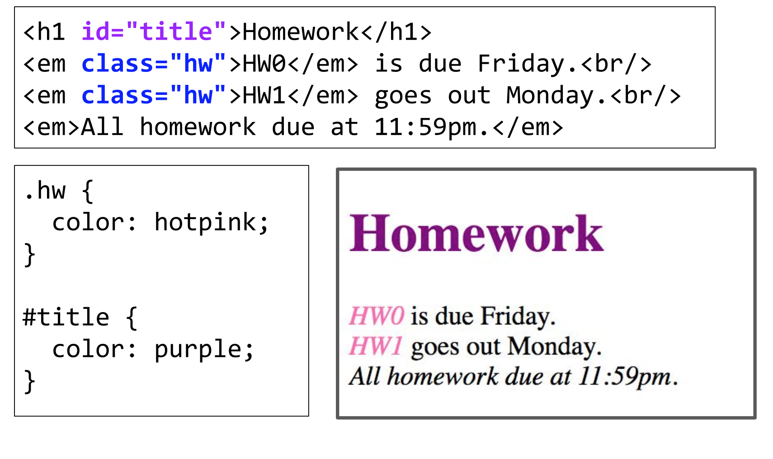
Why are these useful?
CSS

Slide 42
id or class?
How do you decide whether to use an id or class?
Probably prefer class. You can use an id per page, so it is good to be a little stingy with them. Classes are free.
On the other hand, if you know you are making a unique section or page element (form, submit button), id is the way to go.

Slide 43
A caveat:
It’s easy to just make classes for everything, but don’t forget the that HTML is made to describe your content. So, prefer a <p> tag over a class named paragraph.

Slide 44
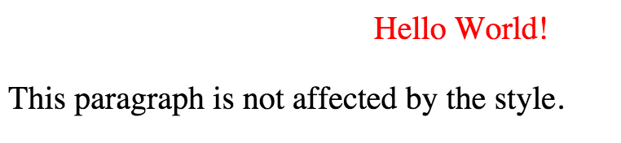
Demo: id selector (#nameofid)
<style>
#para1 {
text-align: center;
color: red;
}
</style>
CSS
<body>
<p id="para1">Hello World!</p>
<p>This paragraph is not affected by the style.</p>
</body>

Slide 45
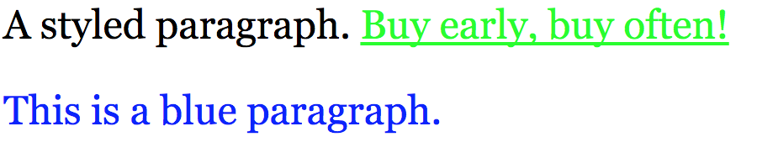
Demo: class selector (.nameofclass)
p.blue_paragraphs{
color:blue;
}
<p>A styled paragraph. <a href="http:www.google.com">Buy early, buy often!</a></p>
<p class="blue_paragraphs">This is a blue paragraph. <

Slide 46
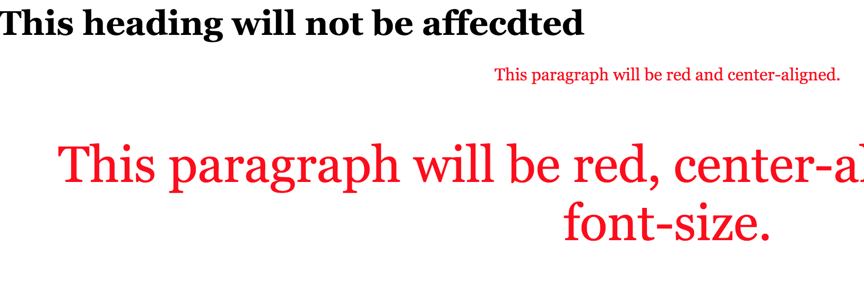
Demo: more than one class
p.center {
text-align: center;
color: red;
}
p.large {
font-size: 300%;
}
CSS
<h1 class="center">This heading will not be affected</h1>
<p class="center">This paragraph will be red and center-aligned.</p>
<p class="center large">This paragraph will be red, center-aligned, and in a large font-size.</p>
HTML

Slide 47
CSS Selector Combinators
A combinator is something that explains the relationship between the selectors.
A CSS selector can contain more than one simple selector. There are mainly two different combinators in CSS:
descendant selector (space)
Child selector (>)

Slide 48
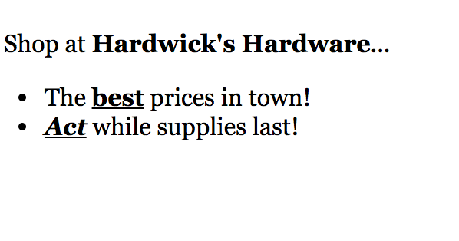
CSS descendant selector Example (without >)
<p>Shop at <strong>Hardwick's Hardware</strong>...</p>
<ul>
<li>The <strong>best</strong> prices in town!</li>
<li><em><strong>Act</strong></em> while supplies last!</li>
</ul>
HTML
li strong { text-decoration: underline; }
CSS
Produces:

Slide 49
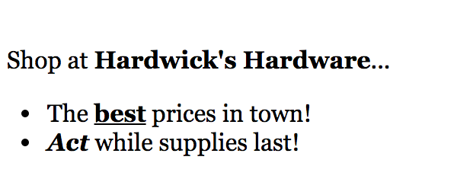
CSS child selector Example (with >)
The child selector selects all elements that are the immediate children of a specified element.
<p>Shop at <strong>Hardwick's Hardware</strong>...</p>
<ul>
<li>The <strong>best</strong> prices in town!</li>
<li><em><strong>Act</strong></em> while supplies last!</li>
</ul>
HTML
CSS
Li >strong { text-decoration: underline; }
Produces:

Slide 50
Exercise 1: Fix the validation error
Download the dogs.html from blackboard.
Please fix all possible validation errors.

Slide 51
Exercise 2: Resume
Download the resume.html from blackboard.
Please fix the typos and inconsistency in the .html
Can you create a style.css so that this page looks better?
For the body text: use one of the Google font:
https://www.google.com/fonts/specimen/Open+Sans
For the headers, choose another font.
Make a nice background color for the page
Make the header have different font from the paragraph
Experiment with font size and font spacing.
Experiment with Class and Ids.

Slide 52
Next Class:
CSS Box model
Read here:
https://www.w3schools.com/css/css_boxmodel.asp
Page layout
Quiz on Tuesday
Homework 2 out today, due in a week (Feb 6).

