Slide 1
CSC435: Web Programming Lecture 8: Intro to JavaScript, data types, variables, functions.
Bei Xiao
American University
Feb 12, Tuesday, 2018

Slide 2
What we have learned so far
How to write content for a webpage using HTML
How to add styles to a webpage using CSS and link a CSS file to an HTML file
How to inspect HTML and CSS webpages in a browser and use Validators to check the correctness

Slide 3
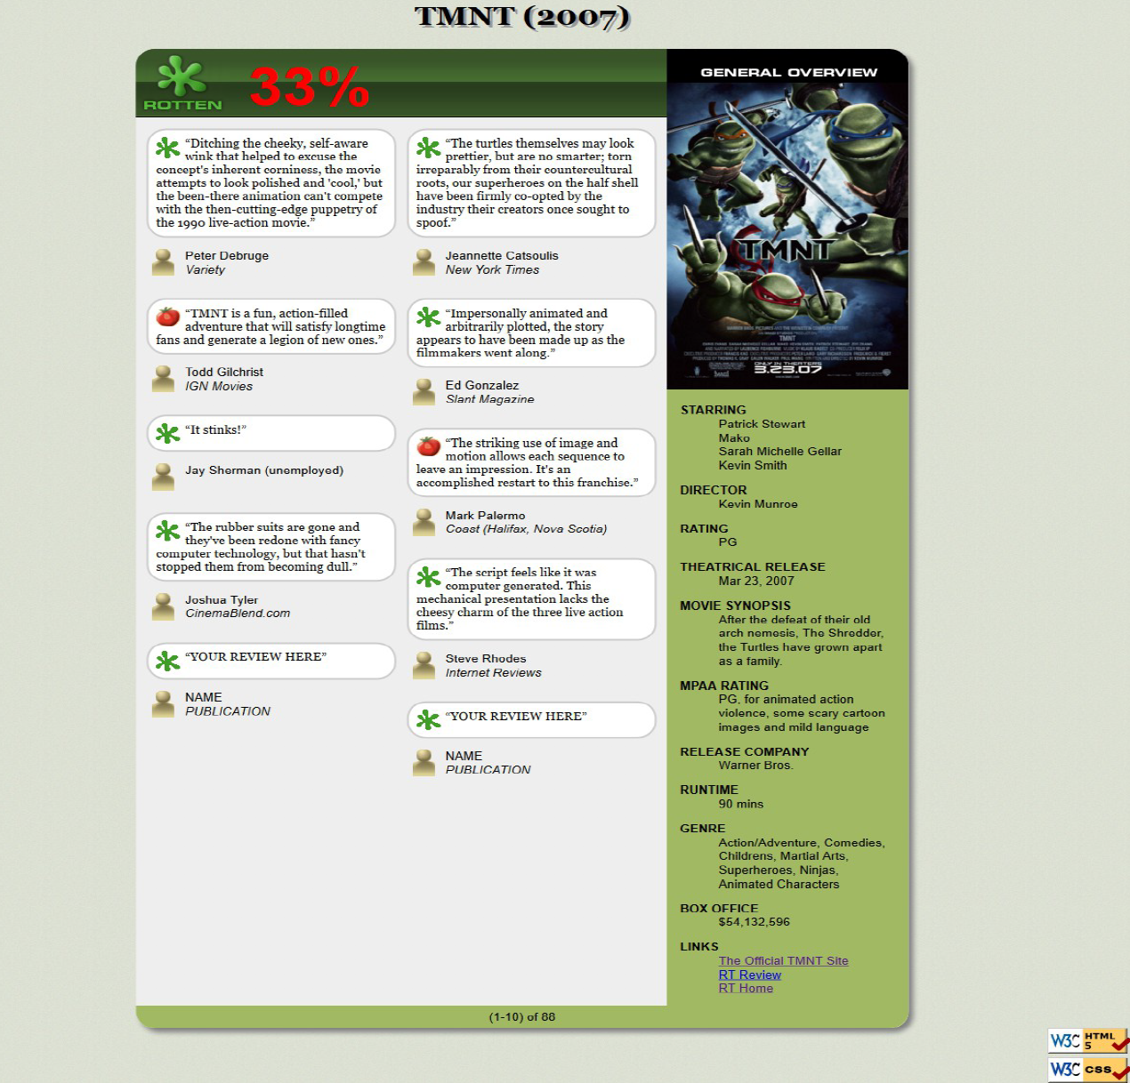
Brief note on HW2

Slide 4
Brief note on HW2
Float
Left
Float
right
float: right
margin: auto;
Clear

Slide 5
Brief tips on HW2
Use class to group common elements (e.g. the movie reviews).
Use class to group elements that share the same layout (e.g. float to the right or left).
Use percentage to specify the width of the columns

Slide 6
Activity Outline
What is JavaScript
Linking to JavaScript
Demo of simple scripts
Variable types
JavaScript Objects: Array, Data, Math,
Defining Functions
Exercises
Homework 3 is out and due next Sunday.

Slide 7
Learning goal
Write very simple JavaScript functions to do stuff like:
A. Simple Math
B. Simple string manipulations.
D. Dates, time, year.
C. Alert the results to Browser

Slide 8
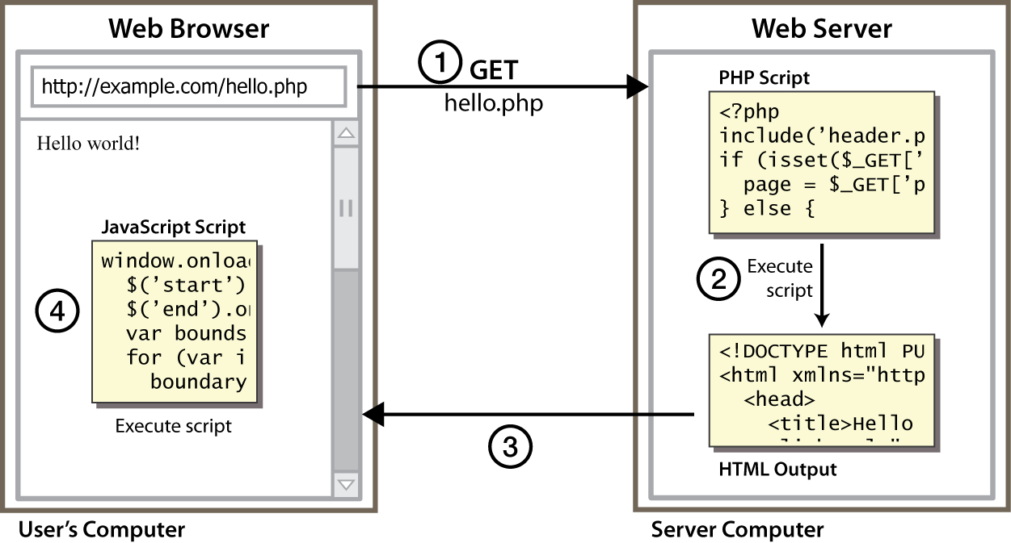
Client-side scripting
client-side script: code runs in browser after page is sent back from server often this code manipulates the page or responds to user actions

Slide 9
JavaScript Demo
Matrix:
http://codepen.io/neilcarpenter/pen/oeGwD
JavaScript and Canvas
http://fabricjs.com/intersection/

Slide 10
HTML, CSS, JavaScript
HTML: Content
CSS: Style
JavaScript: Behavior

Slide 11
What is JavaScript
A lightweight object-oriented programming language ("scripting language")
Created in 1995 ( over 10 days) by Brendan Eich (originally called Mocha then LiveScript)
used to make web pages interactive
insert dynamic text into HTML (ex: user name)
react to events (ex: page load user click)
get information about a user's computer (ex: browser type)
perform calculations on user's computer (ex: form validation)
a web standard (but not supported identically by all browsers)
NOT related to Java other than by name and some syntactic similarities

Slide 12
Links to JavaScript
<script src="example.js" type="text/javascript"></script>
script tag should be placed in HTML page's head
script code is stored in a separate .js file
JS code can be placed directly in the HTML file's body or head (like CSS)
but this is bad style (should separate content, presentation, and behavior)

Slide 13
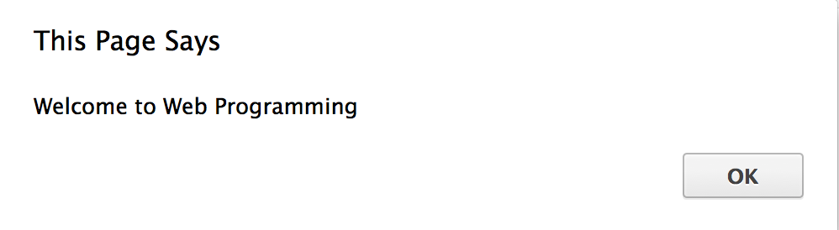
Very first JS
function first() {
alert("Welcome to Web Programming");
}

Slide 14
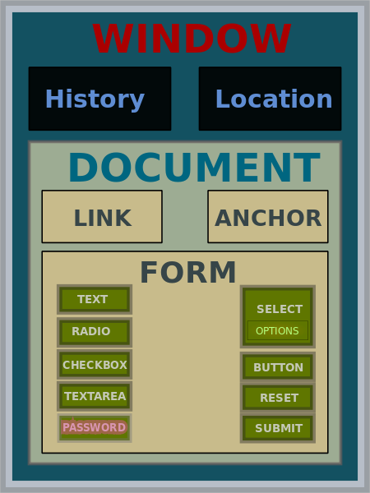
Document Object Model (DOM)

Slide 15
Document Object Model
window
document
location
history
navigator

Slide 16
Object Notation
Window object, document object
Object notation: parent.child
Examples: window. document
window. document. body

Slide 17
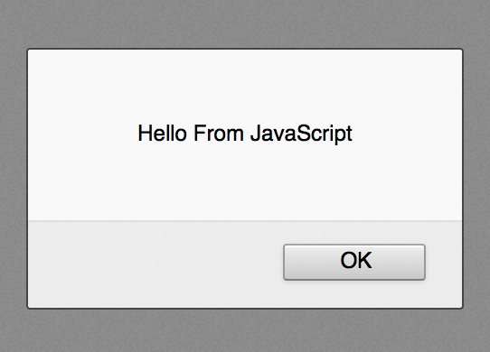
Example: window.alert
window.alert(”Hello From JavaScript!");
<script type="text/javascript">
alert(document.title);
</script>
a JS command that pops up a dialog box with a message

Slide 18
Example: document.write
Document.write
How do you write to the browser the title of your HTML?
a JS command that pops up a dialog box with a message

Slide 19
Example: document.write
Document.write
How do you write to the browser the title of your HTML?
<script type="text/javascript">
document.write(document.title)
</script>
a JS command that pops up a dialog box with a message

Slide 20
Quiz
The top level of the DOM hierarchy is occupied by
The document property
The window object
The document object
The document method

Slide 21
Variables and types
let name = expression;
let age = 32;
let weight = 127.4;
let clientName = "Connie Client";
variables are declared with the let keyword (case sensitive). You might also use var instead of let- this is an older convention.
types are not specified, but JS does have types ("loosely typed")
Number, Boolean, String, Array, Object, Function, Null, Undefined
can find out a variable's type by calling typeof

Slide 22
let vs. var
let allows you to declare variables that are limited in scope to the block, statement, or expression on which it is used. This is unlike var keyword, which defines a variable globally, or locally to an entire function regardless of block scope.
Further reading:
https://developer.mozilla.org/en-US/docs/Web/JavaScript/Reference/Statements/let
Why let not var?
https://hackernoon.com/why-you-shouldnt-use-var-anymore-f109a58b9b70

Slide 23
let vs. var
function varTest() {
var x = 1;
if (true) {
var x = 2; // same variable!
console.log(x); // 2
}
console.log(x); // 2
}
function letTest() {
let x = 1;
if (true) {
let x = 2; // different variable
console.log(x); // 2
}
console.log(x); // 1
}

Slide 24
Number type
let enrollment = 99;
let medianGrade = 2.8;
let credits = 5 + 4 + (2 * 3);
integers and real numbers are the same type (no int vs. double)
same operators: + - * / % ++ -- = += -= *= /= %=
similar precedence to Java
many operators auto-convert types: "2" * 3 is 6
Practice!
Notes:
%= equals to /= equals to /

Slide 25
String type
String is an array of characters (can use both “” and ‘’)
concatenation with + : 1 + 1 is 2, but "1" + 1 is "11”
let myString1 = “hello”;
let myString2 = “world ”;
let len = myString.length;
let S = “ ”;
document.write(myString[0]+myString[1]) \\ “ho”

Slide 26
String property and methods
“hello”.length; // 5
“hello”.charAt(0); //”h”
“hello,world”.replace(“hello”,”goodbye”); //”good bye, world”
“hello”.toUpperCase(); //”HELLO”
“hello,world”.indexOf(‘world’); //6
“hello,world”.lastIndexof(‘l’); //9
length is a property (not a method), like Java
methods: charAt, charCodeAt, fromCharCode, indexOf, lastIndexOf, replace, split, substring, toLowerCase, toUpperCase
Practice repeat, containTwice

Slide 27
More on String
escape sequences behave as in Java: \' \" \& \n \t \\
https://msdn.microsoft.com/en-us/library/2yfce773(v=vs.94).aspx
to convert between numbers and Strings:
let count = 10;
let s1 = "" + count; // "10"
let s2 = count + " bananas, ah ah!"; // "10 bananas, ah ah!"
let n1 = parseInt("42 is the answer"); // 42
let n2 = parseFloat("booyah"); // NaN
to access characters of a String, use [index] or s.charAt(index):
let s = ‘Hello World’;
let firstLetter = s[0];
let firstLetter = s.charAt(0);
let lastLetter = s.charAt(s.length - 1);

Slide 28
Converting strings to number
parseInt() function parse a string and returns an integer.
let a = parseInt(“10”); //10
let b = parseInt(“10.33”); //10
let c = parseInt(“40 years”); //40
let d = parseInt(“He was 40”); /NaN
let e = parseFloat(‘1.45kg’); //1.45
Only the first number in a string is returned.
If the first character can’t be converted to a number, it returns NaN
parseFloat() pass a string and returns a floating number.
Read more: http://www.javascripter.net/faq/convert2.htm

Slide 29
Number to string
let num = 15;
let n = num.toString(); //string ”15”
let n = num.toString(2); //string ”1111”
let num = num+ ” “; ///string ”15”
Math.PI + “ “ // string “3.1415”

Slide 30
Comments
// single-line comment
/* multiple-line comments*/
Recall: 3 comment syntaxes
HTML: <!-- comment -->
CSS/Java/JS: /* comment */
Java/JS: // comment

Slide 31
for loop
for (initialization; condition; update) {
statements;
}
let sum = 0;
for (let i = 0; i < 100; i++) {
sum = sum + i; // same as sum += i;
}
What is the output of this?
let s1 = "It's a-me, Mario!";
let s2 = "";
for (let i = 0; i < s.length; i++) {
s2 += s1[i] + s1[i];
}

Slide 32
Define Functions
function name() {
statement ;
statement ;
...
statement ;
}
function myFunction() {
alert("Hello!");
alert("How are you?");
}
The above could be the contents of example.js linked to our HTML page.
Statements placed into functions can be evaluated in responses to user events.
To display results, you can use document.write()

Slide 33
Exercise : converting length in cm to inches
Write a .js that converts inches to cm.
First start with a .html and put this in the head:
<!DOCTYPE html>
<html>
<head>
<meta charset=utf-8 />
<title>Conerting length in cm to inches</title>
<script src="Exercise3.js" type="text/javascript"></script>
</head>
<body>
</body>
</html>

Slide 34
Exercise : converting length in cm to inches
Write a .js that converts inches to cm.
Write the result to browser as the following:
“length in inches”, 10 inches
“length in cm, 25.4 cm
Hint: use document.write

Slide 35
Math object
let rand1to10 = Math.floor(Math.random() * 10 + 1);
let three = Math.floor(Math.PI);
let power = Math.pow(Math.random(),2); // power of 2
Math.round(10*x)/10; // round to the tenth.
methods: abs, ceil, cos, floor, log, max, min, pow, random, round, sin, sqrt, tan
properties: E, PI
http://www.w3schools.com/js/js_math.asp
Notes:
Math.floor (Math.random()*11);

Slide 36
Boolean type
let iLikeJS = true;
let ieIsGood = "IE6" > 0; // false
if ("web dev is great") { /* true */ }
if (0) { /* false */ }
any value can be used as a Boolean
"falsey" values: 0, 0.0, NaN, "", null, and undefined
"truthy" values: anything else
converting a value into a Boolean explicitly:
var boolValue = Boolean(otherValue);

Slide 37
Logical operators
Relational: > < >= <=
Logical: && || !
Equality: == != === !==
Most logical operators automatically convert types.
These are all true:
5 < "7"
42 == 42.0
"5.0" == 5
The === and !== are strict equality tests; checks both type and value:
"5.0" === 5 is false

Slide 38
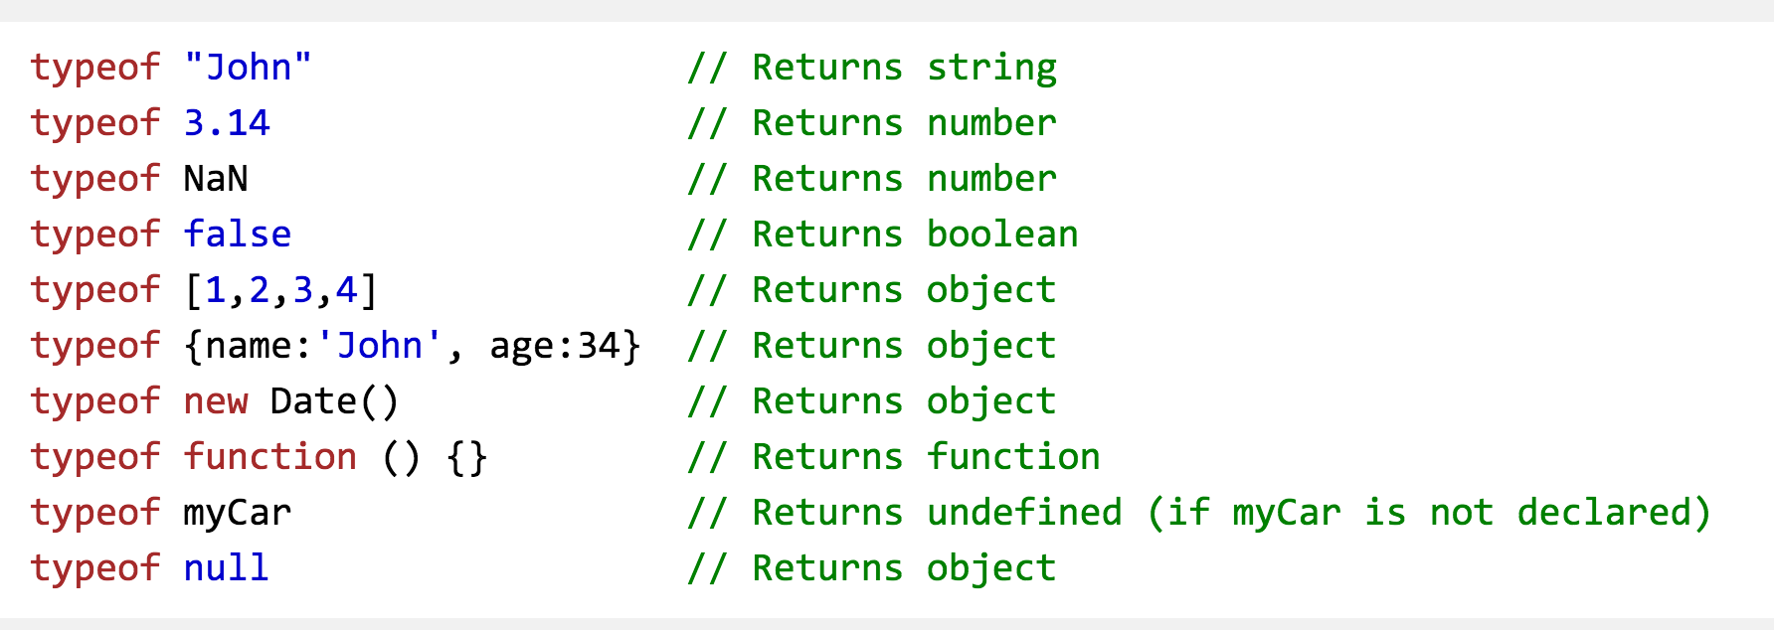
Typeof
More no type conversions:
http://www.w3schools.com/js/js_type_conversion.asp

Slide 39
Arrays
let name = []; // empty array
let name = [value, value, ..., value]; // pre-filled
name[index] = value; // store element
let ducks = ["Huey", "Dewey", "Louie"];
let stooges = []; // stooges.length is 0
stooges[0] = "Larry"; // stooges.length is 1
stooges[1] = "Moe"; // stooges.length is 2
stooges[4] = "Curly"; // stooges.length is 5
stooges[4] = "Shemp"; // stooges.length is 5
Two ways to initialize an array
length property (grows as needed when elements are added)

Slide 40
Array Methods
let a = ["Stef", "Jason"]; // Stef, Jason
a.push("Brian"); // Stef, Jason, Brian
a.unshift("Kelly"); // Kelly, Stef, Jason, Brian
a.pop(); // Kelly, Stef, Jason
a.shift(); // Stef, Jason
a.sort(); // Jason, Stef
array serves as many data structures: list, queue, stack, ...
methods: concat, join, pop, push, reverse, shift, slice, sort, splice, toString, unshift
push and pop add / remove from back
unshift and shift add / remove from front
shift and pop return the element that is removed
Lear more here:
http://www.w3schools.com/js/js_array_methods.asp

Slide 41
Splitting strings
var s = "the quick brown fox";
var a = s.split(" "); // ["the", "quick", "brown", "fox"]
a.reverse(); // ["fox", "brown", "quick", "the"]
s = a.join("!"); // "fox!brown!quick!the“
split breaks apart a string into an array using a delimiter
join merges an array into a single string, placing a delimiter between them
s.splice () can add new items into the array.
s.splice(position, howmany, item)
s.splice(0,1); can remove the first element

Slide 42
Exercise
What are the outputs?
let fruits = [‘banana’, ‘kiwi’,’melon’]
fruits[fruits.length] = ‘apple’
fruits.shift()
fruits.unshift(‘pear’) [‘pear’, ‘kiwi’,’melon’,’apple’]
fruits.splice(2, 0, ‘lemon’, ‘mongo’)
[‘pear’,’kiwi’,’lemon’,’mongo’,’apple’]
fruits.reverse()

Slide 43
If/else statement (same as java)
if (condition) {
statements;
} else if (condition) {
statements;
} else {
statements;
}
identical structure to Java's if/else statement
JavaScript allows almost anything as a condition

Slide 44
If/else statement (same as java)
var name = “kittens”;
If (name == “puppies”) {
name += “!”;
} else if (name == “kittens”){
name +=“!!”;
} else {
name = “!” + name;
}
name == “kittens!!”
identical structure to Java's if/else statement
JavaScript allows almost anything as a condition

Slide 45
Conditional operators
var Age = 18
voteable = (Age < 18) ? "Too young":"Old’; // “old”
var elvisLives = Math.PI > 4 ? “Yes”: “No”;
Takes three parameters: condition ? expr1 : expr2
If the condition is true, the operator returns the the value of expr1, otherwise, it returns expr 2
Can be used instead of if/else

Slide 46
Conditional operators: multiple ternary evaluations
var firstCheck = false,
secondCheck = false,
access = firstCheck ? “Access denied”: secondCheck? “Access denied”: “Access granted”
What is the value of access?
Conditional operator is right associative.
Use this with Caution.
More on conditional operators:
https://developer.mozilla.org/en-US/docs/Web/JavaScript/Reference/Operators/Conditional_Operator

Slide 47
Exercise 1: smallest
Write a function named findMin that accepts an array of numbers as a parameter and returns the smallest number in the array. For example, if an array variable named nums stored the following values:
let nums = [-1, 3.2, 12, 15, -4, 1, -12.5, 1, 8];
Then the call of findMin(nums) should return -12.5 since that is the smallest numerical value in the array.
You may assume that the array passed to your function is non-empty and contains only number types.
To display results, you can use document.write()

Slide 48
Exercise 2: reverse a number
Write a JavaScript function that reverse a number. E.g: 25368 -> 86352
Step 1: Create a simple .html file.
Step 2: Write a function and save it as ReverseString.js
Step 3: link the .js into the <head></head> in your .html
First change the number to string.
Then n.split(“”).reverse().join(“”);

Slide 49
Exercise 3: guess a number
Write a JavaScript program where the program takes a random integer between 1 and 10, the user then prompted to input a guess number. If the user input matches the guess number, the program will display “good work”, otherwise, it will display “not matched”.
Hint: use alert() function to pop out text message.
Use Prompt() for user input. E.g.
var gnum = prompt('Guess the number between 1 and 10

Slide 50
Exercise 4: split string
Write a JavaScript function to split a string and convert it to an array of words.
alert(string_to_array(“ Monday is blue”) ;
Output: “Monday”, “is”, “Blue”

Slide 51
Exercise 5: show today’s date
Write a JavaScript function to display today’s day in the following format:
Today is Thursday. It is 5:30pm.
Think about how to display “pm” versus “am” depends on the hour.
You can use document.write or alert to display the message.
Consider makes the days into an array of strings. Again array starts with 0.
var d = new Date(); //get the date
var day = d.getDay(); // get the day of the date
var hour = d.getHours(); // get hours
var minuets = d.getMinuets(); //get minuets

Slide 52
Exercise 5 (take home): show dates until Christmas
Write a JavaScript to display how many dates until Christmas of 2016.
You might find the following function useful:
Expected month from 0 to 11. 11 will be December, 12 will be start of the next year
JS complete date references:
http://www.w3schools.com/jsref/jsref_obj_date.asp
var d = new Date(); //get the date
var n = d.getFulLyear(); // get the year of the date
var d = d.getMonth(); // get the month of the date
d.setFullYear(2020, 10,3); // Tue Nov 03 2020 11:17:37 GMT -500 (EST)

Slide 53
Next Class
JavaScript Loops
Event-Driven Programming (Buttons, Forms)
JavaScript and DOM

Slide 54
Take-home reading and exercise
Introduction to JavaScript (must read):
https://developer.mozilla.org/en-US/docs/Web/JavaScript/A_re-introduction_to_JavaScript
DOC model:
https://developer.mozilla.org/en-US/docs/Web/API/Document_Object_Model/Introduction
JavaScript tutorial:
https://www.codecademy.com/learn/javascript

