Slide 1
CSC435: Web Programming Lecture 9: JavaScript: Conditional and Loops, Event-driven programming
Bei Xiao
American University
Feb 15, Friday, 2019

Slide 2
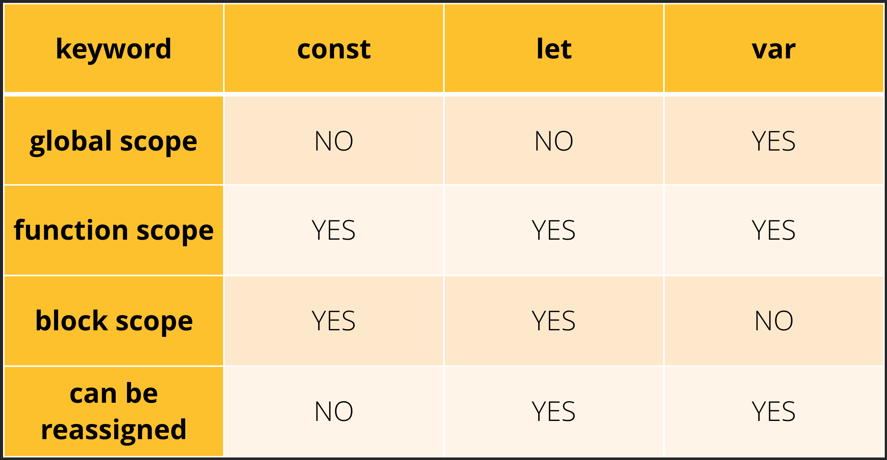
Const versus Var versus Let

Slide 3
global window object
var varVariable = “this is a var variable”;
let letVariable = “this is a let variable”;
console.log(window.varVariable); //this is a var variable
console.log(window.letVariable); //undefined

Slide 4
Redeclaration within the same scope not possible for let
// let variables cannot be re-declared while var variable can be re-declared in the same scope.
'use strict'; var temp = "this is a temp variable"; var temp = "this is a second temp variable"; //replaced easily
'use strict’;
let temp = "this is a temp variable";
let temp = "this is a second temp variable" //SyntaxError: temp is already declared

Slide 5
Define Functions
function name() {
statement ;
statement ;
...
statement ;
}
function myFunction() {
alert("Hello!");
alert("How are you?");
}
The above could be the contents of example.js linked to our HTML page.
Statements placed into functions can be evaluated in responses to user events.
To display results, you can use document.write()

Slide 6
Activity Outline
Continue with basic JS data structure
Semicolons
Event Driven Programming
Exercises

Slide 7
Exercise : converting length in cm to inches
Write a .js that converts inches to cm.
First start with a .html and put this in the head:
<!DOCTYPE html>
<html>
<head>
<meta charset=utf-8 />
<title>Conerting length in cm to inches</title>
<script src="Exercise3.js" type="text/javascript"></script>
</head>
<body>
</body>
</html>

Slide 8
Exercise : converting length in cm to inches
Write a .js that converts inches to cm.
Write the result to browser as the following:
“length in inches”, 10 inches
“length in cm, 25.4 cm
Hint: use document.write

Slide 9
Exercise : converting length in cm to inches
<html>
<head>
<title>Calculate Inches to cm</title>
<script type="text/javascript" src="Exercise1.js"></script>
</head>
<body>
</body>
</html>
HTML
function cmtoinches() {
let inches = prompt("tell me a number in inces");
let cm = inches * 2.54;
document.write("length in Inches:"+ inches + " inches <br/>");
document.write("length in centimeters:"+ cm + " cm <br/>");
}
// calling your function
cmtoinches()
.js

Slide 10
Math object
let rand1to10 = Math.floor(Math.random() * 10 + 1);
let three = Math.floor(Math.PI);
let power = Math.pow(Math.random(),2); // power of 2
Math.round(10*x)/10; // round to the tenth.
methods: abs, ceil, cos, floor, log, max, min, pow, random, round, sin, sqrt, tan
properties: E, PI
http://www.w3schools.com/js/js_math.asp
Notes:
Math.floor (Math.random()*11);

Slide 11
Boolean type
let iLikeJS = true;
let ieIsGood = "IE6" > 0; // false
if ("web dev is great") { /* true */ }
if (0) { /* false */ }
any value can be used as a Boolean
"falsey" values: 0, 0.0, NaN, "", null, and undefined
"truthy" values: anything else
converting a value into a Boolean explicitly:
var boolValue = Boolean(otherValue);

Slide 12
Logical operators
Relational: > < >= <=
Logical: && || !
Equality: == != === !==
Most logical operators automatically convert types.
These are all true:
5 < "7"
42 == 42.0
"5.0" == 5
The === and !== are strict equality tests; checks both type and value:
"5.0" === 5 is false

Slide 13
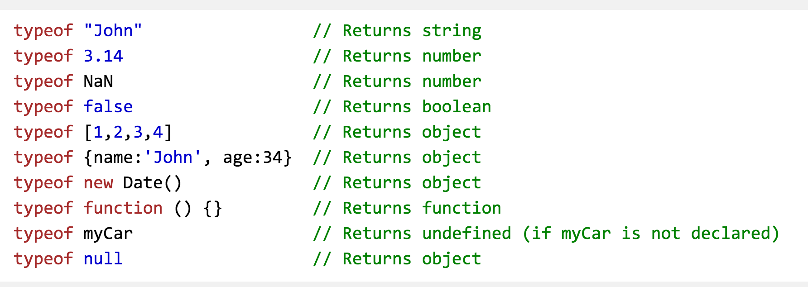
Typeof
More no type conversions:
http://www.w3schools.com/js/js_type_conversion.asp

Slide 14
If/else statement (same as java)
if (condition) {
statements;
} else if (condition) {
statements;
} else {
statements;
}
identical structure to Java's if/else statement
JavaScript allows almost anything as a condition

Slide 15
If/else statement (same as java)
let name = “kittens”;
If (name == “puppies”) {
name += “!”;
} else if (name == “kittens”){
name +=“!!”;
} else {
name = “!” + name;
}
name == “kittens!!”
identical structure to Java's if/else statement
JavaScript allows almost anything as a condition

Slide 16
for loop
for (initialization; condition; update) {
statements;
}
let sum = 0;
for (let i = 0; i < 100; i++) {
sum = sum + i; // same as sum += i;
}
What is the output of this?
let s1 = "It's a-me, Mario!";
let s2 = "";
for (let i = 0; i < s.length; i++) {
s2 += s1[i] + s1[i];
}

Slide 17
While loops (same as Java)
while(condition){
statements;
}
do{
statements;
} while (conditions);

Slide 18
Exercise: predicting outcome
function forloop() {
for (var i = 1; i <= 10; i++) {
let mystery = "";
// inner loop 1
for (var j = 1; j <= 10 - i; j++) {
mystery += " ";
}
// inner loop 2
document.write("<br>");
for (var j = 1; j <= 2 * i - 1; j++) {
mystery += "*";
}
document.write(mystery);
}
}

Slide 19
Exercise: predicting outcome
function myFunction() {
var text = ""
var i = 0;
do {
text += "<br>The number is " + i;
i++;
}
while (i < 5);
document.getElementById("demo").innerHTML = text;
}
</script>
Notes:
The number is 0
The number is 1
The number is 2
The number is 3
The number is 4

Slide 20
Typeof
More no type conversions:
http://www.w3schools.com/js/js_type_conversion.asp

Slide 21
Arrays
let name = []; // empty array
let name = [value, value, ..., value]; // pre-filled
name[index] = value; // store element
let ducks = ["Huey", "Dewey", "Louie"];
let stooges = []; // stooges.length is 0
stooges[0] = "Larry"; // stooges.length is 1
stooges[1] = "Moe"; // stooges.length is 2
stooges[4] = "Curly"; // stooges.length is 5
stooges[4] = "Shemp"; // stooges.length is 5
Two ways to initialize an array
length property (grows as needed when elements are added)

Slide 22
Array Methods
let a = ["Stef", "Jason"]; // Stef, Jason
a.push("Brian"); // Stef, Jason, Brian
a.unshift("Kelly"); // Kelly, Stef, Jason, Brian
a.pop(); // Kelly, Stef, Jason
a.shift(); // Stef, Jason
a.sort(); // Jason, Stef
array serves as many data structures: list, queue, stack, ...
methods: concat, join, pop, push, reverse, shift, slice, sort, splice, toString, unshift
push and pop add / remove from back
unshift and shift add / remove from front
shift and pop return the element that is removed
Lear more here:
http://www.w3schools.com/js/js_array_methods.asp
Notes:
The shift() method removes the first element from an array and returns that removed element. This method changes the length of the array.

Slide 23
Examples: splice
let months = ['Jan', 'March', 'April', 'June'];
months.splice(1, 0, 'Feb');
// inserts at 1st index position
console.log(months);
// expected output: Array ['Jan', 'Feb', 'March', 'April', 'June']
months.splice(4, 1, 'May');
// replaces 1 element at 4th index
console.log(months);
// expected output: Array ['Jan', 'Feb', 'March', 'April', 'May']
Notes:
The splice() method changes the contents of an array by removing existing elements and/or adding new elements.

Slide 24
Examples: shift()
var array1 = [1, 2, 3];
var firstElement = array1.shift();
console.log(array1);
// expected output: Array [2, 3]
console.log(firstElement);
// expected output: 1
Notes:
The shift() method removes the first element from an array and returns that removed element. This method changes the length of the array.

Slide 25
Examples: unshift()
var array1 = [1, 2, 3];
console.log(array1.unshift(4, 5));
// expected output: 5
console.log(array1);
// expected output: Array [4, 5, 1, 2, 3]
Notes:
he unshift() method adds one or more elements to the beginning of an array and returns the new length of the array.

Slide 26
Exercise
What are the outputs?
let fruits = [‘banana’, ‘kiwi’,’melon’]
fruits[fruits.length] = ‘apple’
fruits.shift()
fruits.unshift(‘pear’)
fruits.splice(2, 0, ‘lemon’, ‘mongo’)
fruits.reverse()
Notes:
The shift() method removes the first element from an array and returns that removed element. This method changes the length of the array.
he unshift() method adds one or more elements to the beginning of an array and returns the new length of the array.
The splice() method changes the contents of an array by removing existing elements and/or adding new elements.

Slide 27
Splitting strings
var s = "the quick brown fox";
var a = s.split(" "); // ["the", "quick", "brown", "fox"]
a.reverse(); // ["fox", "brown", "quick", "the"]
s = a.join("!"); // "fox!brown!quick!the“
split breaks apart a string into an array using a delimiter
join merges an array into a single string, placing a delimiter between them
s.splice () can add new items into the array.
s.splice(position, howmany, item)
s.splice(0,1); can remove the first element

Slide 28
Rules of semi-colon
Normally, statements are terminated by semi-colons.
The exception is statement ending with blocks.
Loops: for, while (but not do-while)
Branching: if, switch,try
Function declarations (not function expressions).
http://speakingjs.com/es5/ch07.html#_rules_for_using_semicolons

Slide 29
String methods
String concatenation:
Extract Substrings:
> ‘abc’. charAt(1)
‘b’
> ‘abc’.slice(1,2)
‘b’
> ‘ab’
var arr = [];
arr.push(‘Say hello’);
arr.push (7);
arr.join(‘’ )
‘Say hello 7 times fast’
http://speakingjs.com/es5/ch12.html

Slide 30
Prediction of output of the following code
string1 = "foobar";
document.write(string1.length + "<BR>");
for (i = 0; i < string1.length; i++) {
document.write(string1.charAt(i));
}
document.write("<BR>");
string2 = "";
for (i = 0; i < string1.length; i++) {
string2 = string2 + string1.charAt(i);
}
document.write(string2 + "<BR>");

Slide 31
Prediction of output of the following code
string1 = "foobar";
document.write(string1.length + "<BR>");
for (i = 0; i < string1.length; i++) {
document.write(string1.charAt(i));
}
document.write("<BR>");
string2 = "";
for (i = 0; i < string1.length; i++) {
string2 = string2 + string1.charAt(i);
}
document.write(string2 + "<BR>");

Slide 32
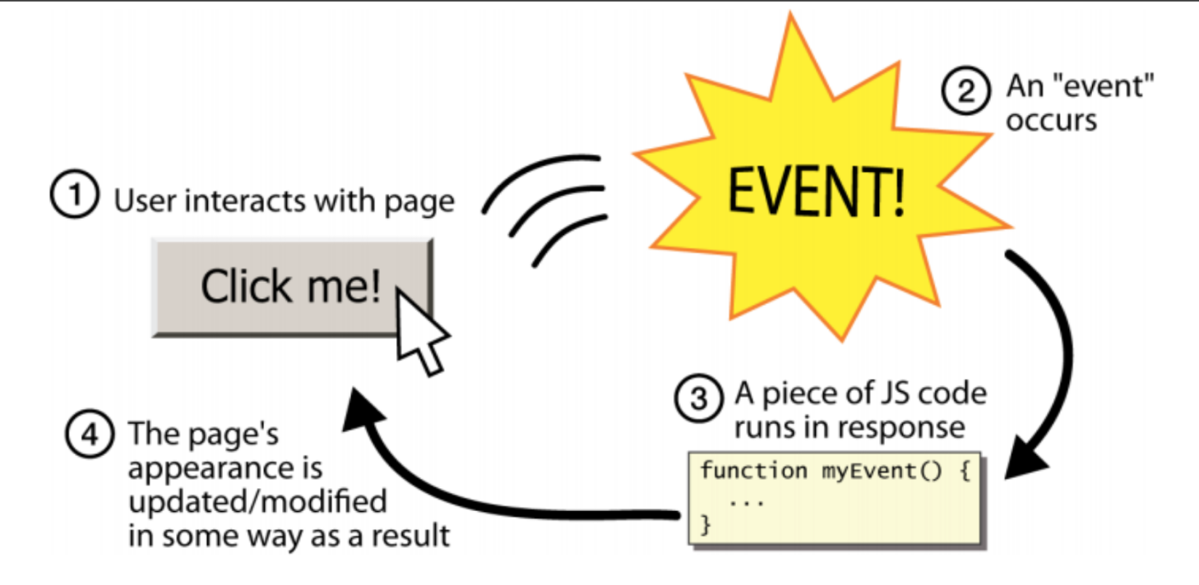
Event-Driven Programming
Unlike Java programs, JS programs have no main; they respond to user activation called events.
Event-driven programming: writing programs driven by user events

Slide 33
What is user events?
A user drags a page’s scrollbar
A user accidentally spilling coffee on their computer.
A user visits a web page and the page load successfully.
A user typing their name into a text input box on a webpage.
A user clicks on hyperlink to visit a different page.
A user clicking a web pages submit button

Slide 34
Event Handlers
<element attributes onlick=“function();”>…..
html template
<div onlick=“myFunction();”>Click me! </div>
html example
Click me!
output
JavaScript functions can be set as event handlers
When you interact with the element, the function will execute
onclick is just one of many event HTML attribute we will see.

Slide 35
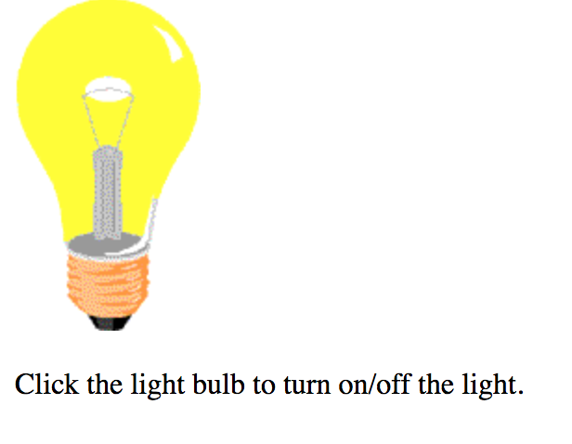
Event Handlers
<element attributes onlick=“function();”>…..
html template
<img id="myImage" onclick="changeImage()" src="pic_bulboff.gif" width="100" height="180">

Slide 36
Buttons: <button>
<button onclick-”muFuction();”>Click me! </button>
HTML
Click me!
Output
Button’s text appears inside the tag; can also contain image

Slide 37
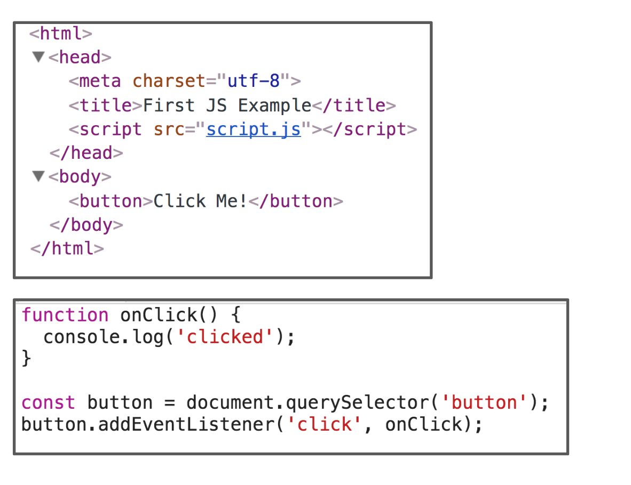

Slide 38

document.getElemengById Example
<img id="pokeball" src="images/pokeball.jpg" alt="a pokeball" />
<button onclick="changeImage();">Click me!</button>
function changeImage() {
let pokeballImg = document.getElementById("pokeball");
pokeballImg.src = "images/mystery.gif";
}

Slide 39
document.getElemengById Example
How do you make the code toggle between pikachu and the pokeball?
You can start with pokeball.html and pokeball.js
Hink:
Use image.src.match
Demo here:
https://www.w3schools.com/js/tryit.asp?filename=tryjs_lightbulb

Slide 40
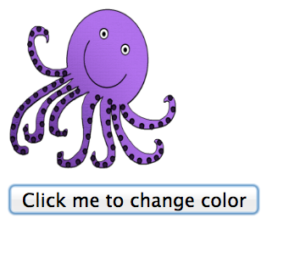

Demo: click a button to toggle an image

Slide 41
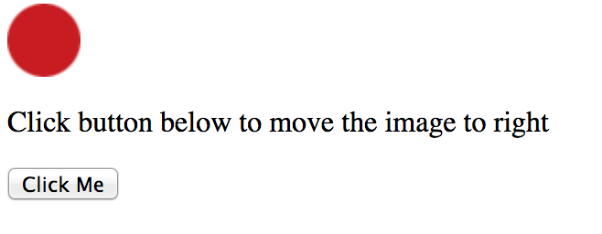
Exercise 0: move the ball
Hint: You can access to ball’s position as this:
imgObj = document.getElementById('myImage');
imgObj.style.position= 'relative';
imgObj.style.left = '0px';
// to move the ball
parseInt(imgObj.style.left)

Slide 42
Exercise 1: smallest
Write a function named findMin that accepts an array of numbers as a parameter and returns the smallest number in the array. For example, if an array variable named nums stored the following values:
let nums = [-1, 3.2, 12, 15, -4, 1, -12.5, 1, 8];
Then the call of findMin(nums) should return -12.5 since that is the smallest numerical value in the array.
You may assume that the array passed to your function is non-empty and contains only number types.
To display results, you can use document.write()
Or you can create a button to trigger your function
<button onclick=”findmin();">Click me!</button>

Slide 43
Exercise 2: reverse a number
Write a JavaScript function that reverse a number. E.g: 25368 -> 86352
Step 1: Create a simple .html file.
Step 2: Write a function and save it as ReverseString.js
Step 3: link the .js into the <head></head> in your .html
First change the number to string.
Then n.split(“”).reverse().join(“”);
Again, you can create a button to trigger the function or use alter.

Slide 44
Exercise 3: guess a number
Write a JavaScript program where the program takes a random integer between 1 and 10, the user then prompted to input a guess number. If the user input matches the guess number, the program will display “good work”, otherwise, it will display “not matched”.
Hint: use alert() function to pop out text message.
Use Prompt() for user input. E.g.
var gnum = prompt('Guess the number between 1 and 10

Slide 45
Exercise 4: split string
Write a JavaScript function to split a string and convert it to an array of words.
alert(string_to_array(“ Monday is blue”) ;
Output: “Monday”, “is”, “Blue”

Slide 46
Exercise 5: show today’s date
Write a JavaScript function to display today’s day in the following format:
Today is Thursday. It is 5:30pm.
Think about how to display “pm” versus “am” depends on the hour.
You can use document.write or alert to display the message.
Consider makes the days into an array of strings. Again array starts with 0.
let d = new Date(); //get the date
let day = d.getDay(); // get the day of the date
let hour = d.getHours(); // get hours
let minuets = d.getMinuets(); //get minuets

Slide 47
Exercise 5 (take home): show dates until Christmas
Write a JavaScript to display how many dates until Christmas of 2018.
You might find the following function useful:
Expected month from 0 to 11. 11 will be December, 12 will be start of the next year
JS complete date references:
http://www.w3schools.com/jsref/jsref_obj_date.asp
var d = new Date(); //get the date
var n = d.getFulLyear(); // get the year of the date
var d = d.getMonth(); // get the month of the date
d.setFullYear(2020, 10,3); // Tue Nov 03 2020 11:17:37 GMT -500 (EST)

Slide 48
Take-home reading and exercise
Introduction to JavaScript (must read):
https://developer.mozilla.org/en-US/docs/Web/JavaScript/A_re-introduction_to_JavaScript
DOC model:
https://developer.mozilla.org/en-US/docs/Web/API/Document_Object_Model/Introduction

