Slide 1
CSC589 Introduction to Computer Vision Lecture 4
More on Histogram Equalization, Border Effect, Image Derivatives
Bei Xiao

Slide 2
Last lecture
Unsharp masking
Gaussian Filter
Image histograms
Basic image tutorial with Python

Slide 3
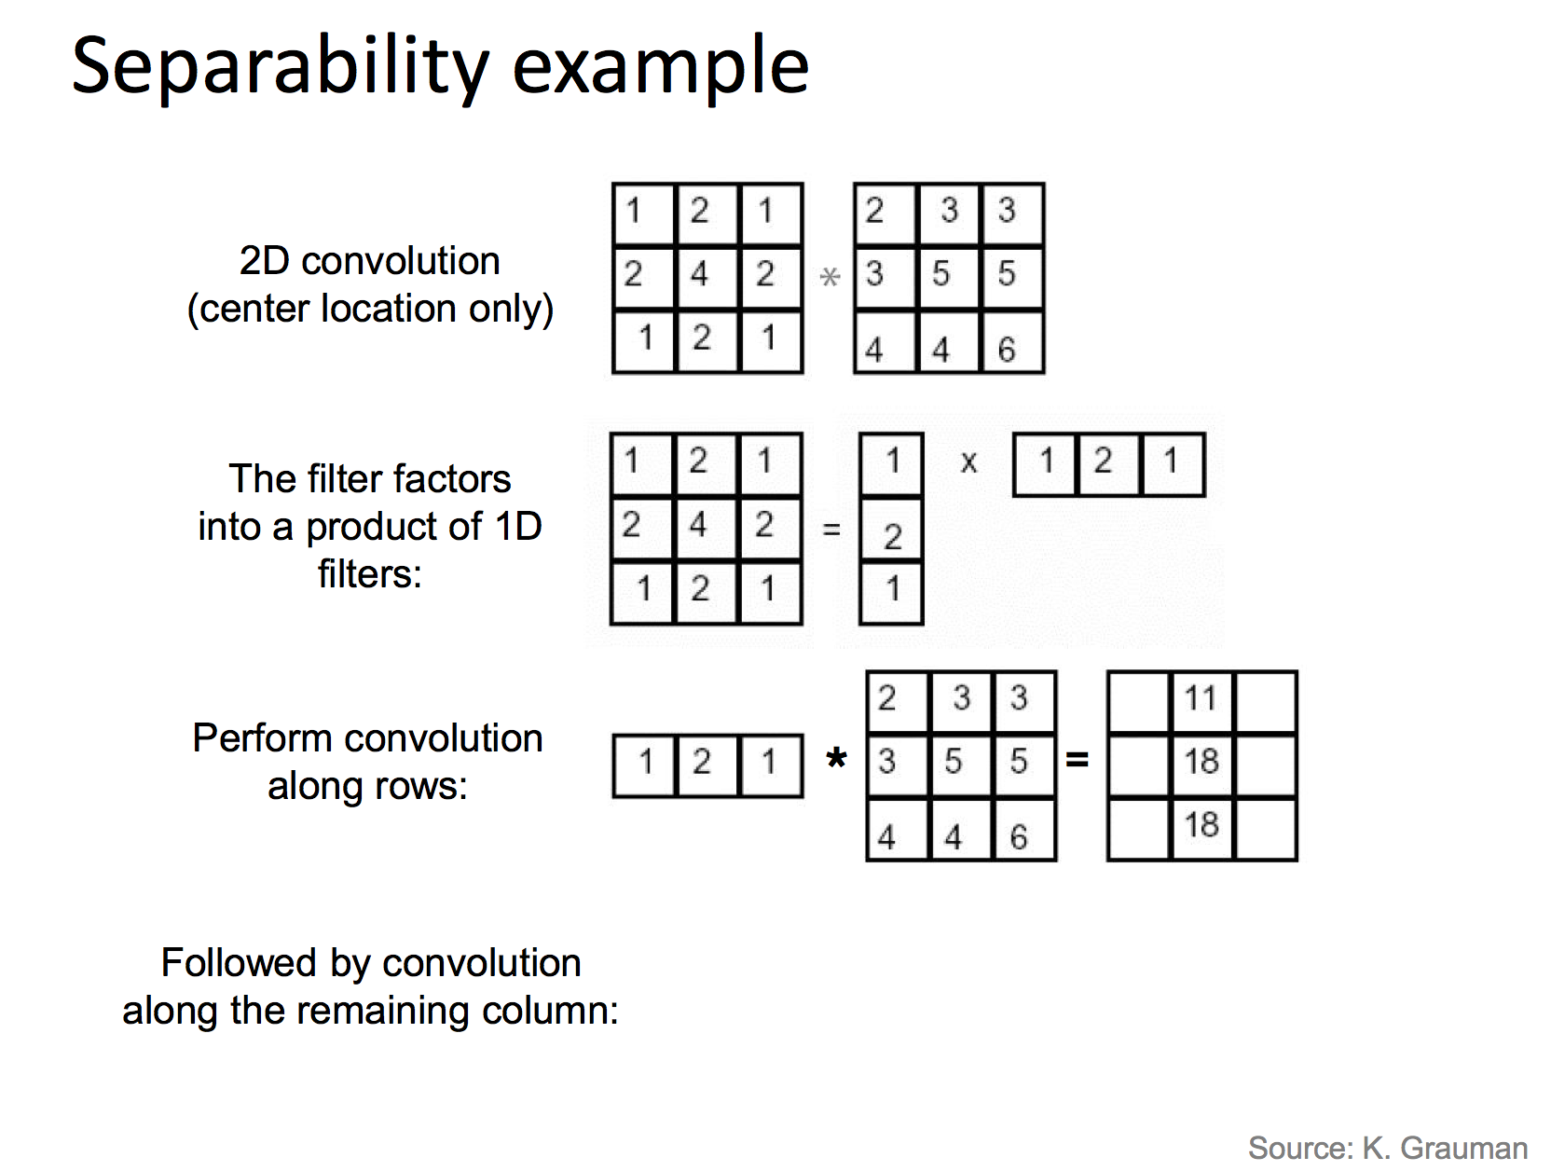

Slide 4
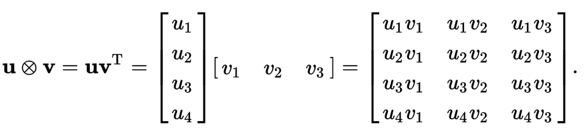
Matrix Multiplication

Slide 5
Today’s Lecture
More on image histograms
Border effect and padding
Image Derivatives/gradients

Slide 6
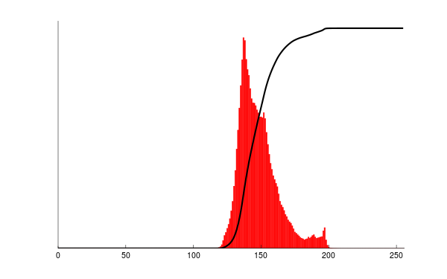
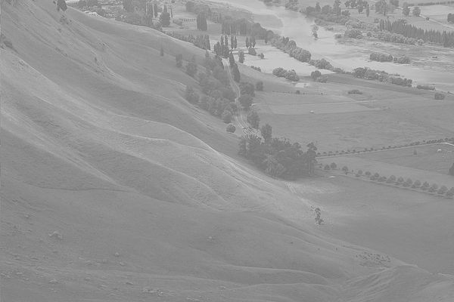
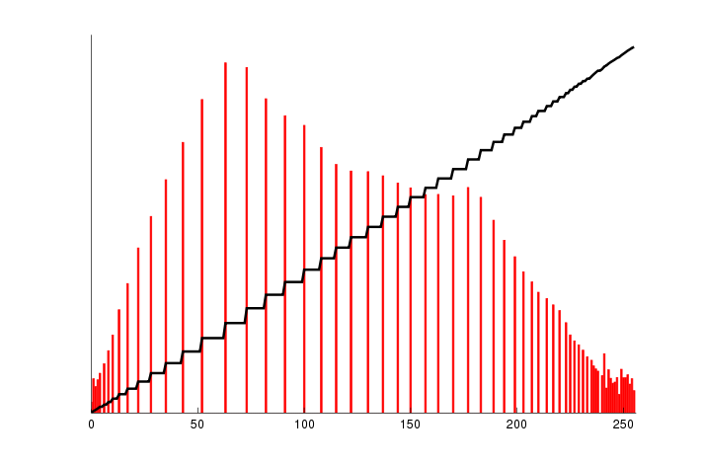
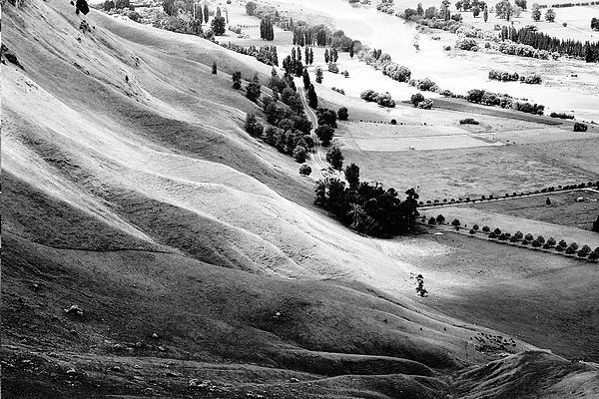
Image Histogram Equalization
Notice the “shape” of the histogram is preserved!
Same number of pixels
In each bin!

Slide 7
Questions
Why don’t we do the equalization directly on the histograms? What will happen to the image if it has a perfectly flat histograms?
What is CDF? Why are there steps (zig-zags) on the CDF?
How to make sure the “shape” of the PDF is preserved in the transformation?

Slide 8
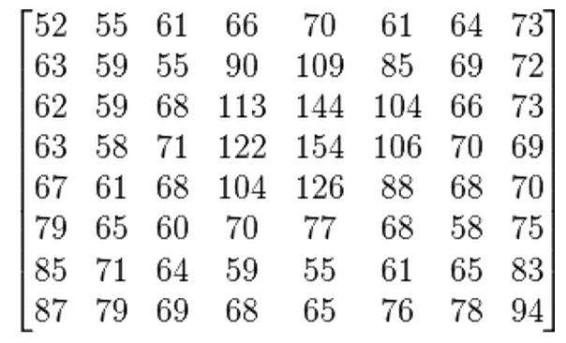
Let’s look at in more details
We start with a gray-scale jpeg image of 8 by 8
https://en.wikipedia.org/wiki/Histogram_equalization

Slide 9
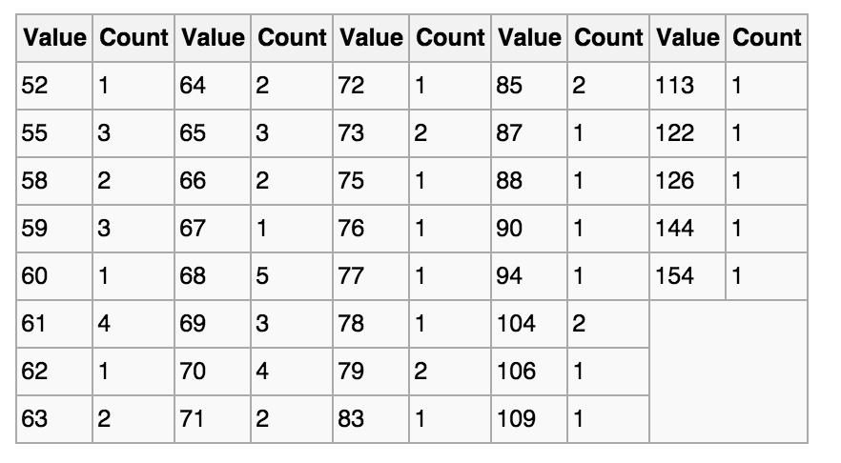
Let’s look at in more details
The histograms for this image (8 by 8 pixels) is shown in the following table (intensity that has zero pixels are skipped:

Slide 10
Let’s look at in more details
The cumulative distribution function (CDF) is shown below
Value | cdf | scaled cdf
52 | 1 | 0
55 | 4
58 | 6
59 | 9
60 | 10
61 | 14
62 | 15
… | …
154 | 64 | 255
This cdf shows that the min value in the subimage is 52 and max is 154. The cdf of value 154 corresponding to the total number of pixels (64)
Number of pixels

Slide 11
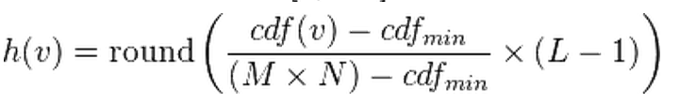
Let’s look at in more details
How do we compute the normalized CDF?
Cdf(v): original cdf of pixel v
Cdfmin: minimum non-zero vale of the cdf
M×N: number of pixels, e.g. 64 (8x8)
L: 256

Slide 12
Quiz:
How do we compute normalized CDF of pixel 62?
Value | cdf | scaled cdf
52 | 1 | 0
55 | 4
58 | 6
59 | 9
60 | 10
61 | 14
62 | 15 | ?
… | …
154 | 64 | 255

Slide 13
Quiz:
How do we compute normalized CDF of pixel 62?
Value | cdf | scaled cdf
52 | 1 | 0
55 | 4
58 | 6
59 | 9
60 | 10
61 | 14
62 | 15 | ?
… | …
154 | 64 | 255
H(62) = round((15-1)/63*255)
= 57

Slide 14
Let’s look at in more details
The cumulative distribution function (CDF) is shown below
Value | cdf | scaled cdf
52 | 1 | 0
55 | 4 | 12
58 | 6 | 22
59 | 9 | 32
60 | 10 | 36
61 | 14 | 53
62 | 15 | 57
… | … | …
154 | 64 | 255

Slide 15
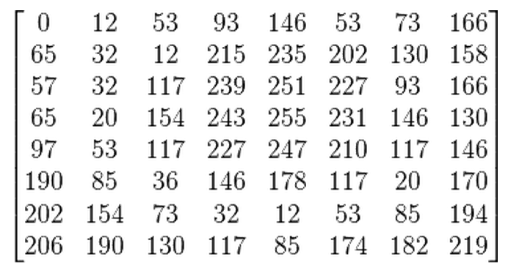
Let’s look at in more details
Now we can directly map the scaled cdf back to pixel values using the look up table we derived above
52
55
61
66

Slide 16
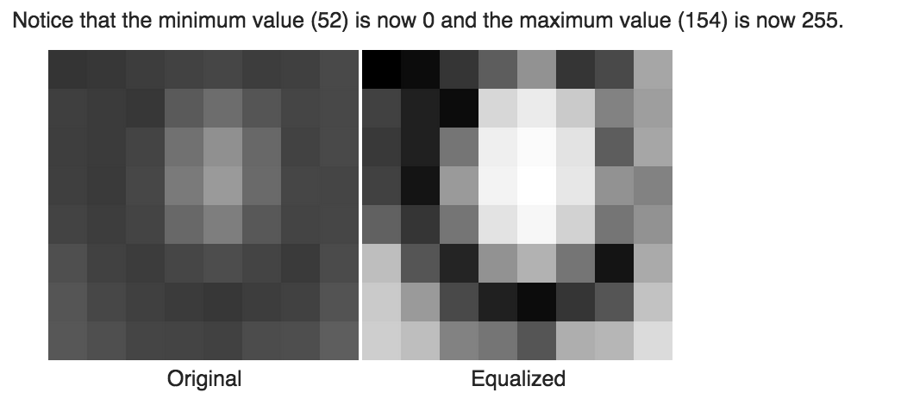
Let’s look at in more details

Slide 17
Let’s look at in more details

Slide 18
Homework 2: histogram equalization
Hint:
#Compute cdf in Python:
np.histogram(im.flatten(),nbr_bins,normed=True)
cdf = imhist.cumsum()
# normalize
cdf = 255 * cdf / cdf[-1]
# Using linear interpretation of cdf to find new pixels.
im2 = np.interp(im.flatten(),bins[:-1],cdf)

Slide 19
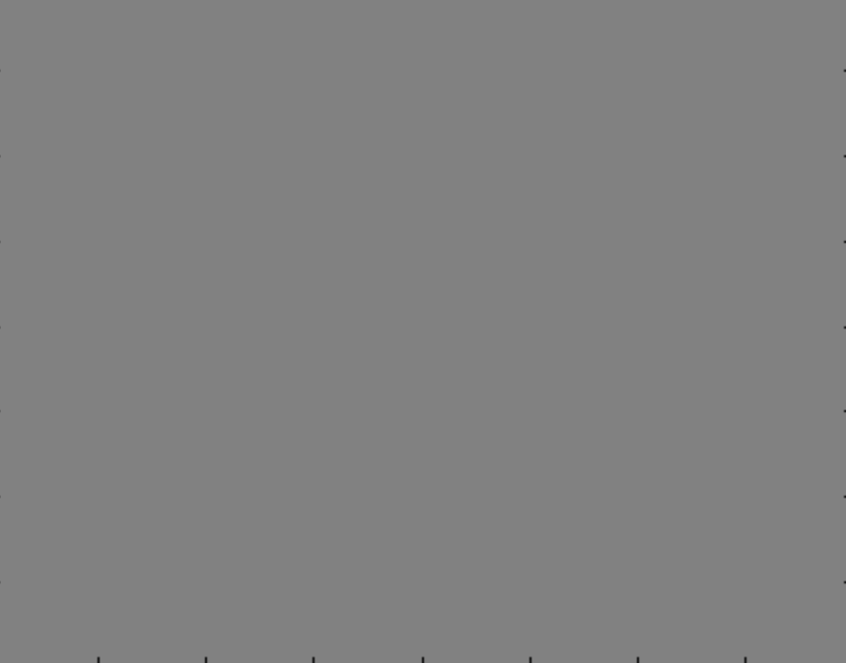
Back to Convolution
Let’s blur a flat gray image:
How should it look like?

Slide 20
Back to Convolution
Convolve with a box kernel
1/9 | 1/9 | 1/9
1/9 | 1/9 | 1/9
1/9 | 1/9 | 1/9
20 | 20 | 20 | 20
20 | 20 | 20 | 20
20 | 20 | 20 | 20
20 | 20 | 20 | 20

Slide 21
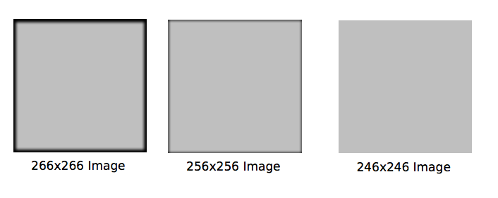
Border Handling
Depending on how you do the convolution, you could end up with 3 different images.
full
same
valid

Slide 22
Back to Convolution
Zero padding:
Filled in borders with zeros, computed everywhere the kernel touches.
Numpy.convolve(a,v,mode =‘full’ or ‘same’)
This returns the convolution at each point of overlap, with an output shape of (N+M-1,). At the end-points of the convolution, the signals do not overlap completely, and boundary effects may be seen.

Slide 23
Back to Convolution
Convolve with a box kernel, suppose there are zeros outside the image matrix.
1/9 | 1/9 | 1/9
1/9 | 1/9 | 1/9
1/9 | 1/9 | 1/9
8.9 | 13.3 | 13.3 | 8.9
13.3 | 20.0 | 20.0 | 13.3
13.3 | 20.0 | 20.0 | 13.3
8.9 | 13.3 | 13.3 | 8.9
20 | 20 | 20 | 20
20 | 20 | 20 | 20
20 | 20 | 20 | 20
20 | 20 | 20 | 20

Slide 24
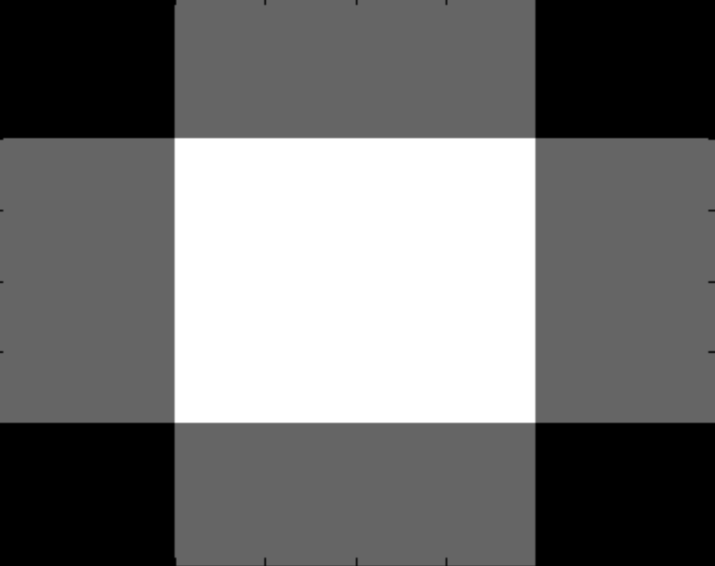
Back to Convolution
This is called “same” in MATLAB/Numpy
4 ×4
4 ×4

Slide 25
Back to Convolution
1/9 | 1/9 | 1/9
1/9 | 1/9 | 1/9
1/9 | 1/9 | 1/9
2.2 | 4.4 | 6.6 | 6.6 | 4.4 | 2.2
4.4 | 8.9 | 13.3 | 13.3 | 8.9 | 4.4
6.6 | 13.3 | 20.0 | 20.0 | 13.3 | 6.7
6.6 | 13.3 | 20.0 | 20.0 | 13.3 | 6.7
4.4 | 8.9 | 13.3 | 13.3 | 8.9 | 4.4
2.2 | 4.4 | 6.6 | 6.6 | 4.4 | 2.2
20 | 20 | 20 | 20
20 | 20 | 20 | 20
20 | 20 | 20 | 20
20 | 20 | 20 | 20

Slide 26
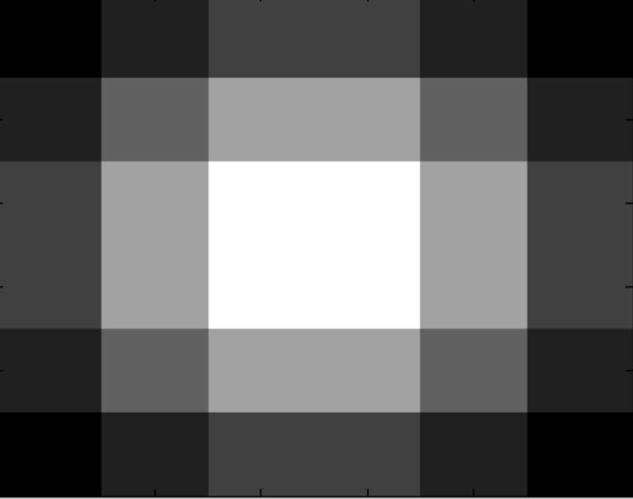
Back to Convolution
This is called “full” in MATLAB/Numpy.
4 ×4
6 ×6

Slide 27
Back to Convolution
Only compute at places where the kernel fits the image
1/9 | 1/9 | 1/9
1/9 | 1/9 | 1/9
1/9 | 1/9 | 1/9
20 | 20 | 20 | 20
20 | 20 | 20 | 20
20 | 20 | 20 | 20
20 | 20 | 20 | 20
20 | 20
20 | 20

Slide 28
Back to Convolution
This is called “valid” in MATLAB/Numpy.
4 ×4
2 ×2

Slide 29
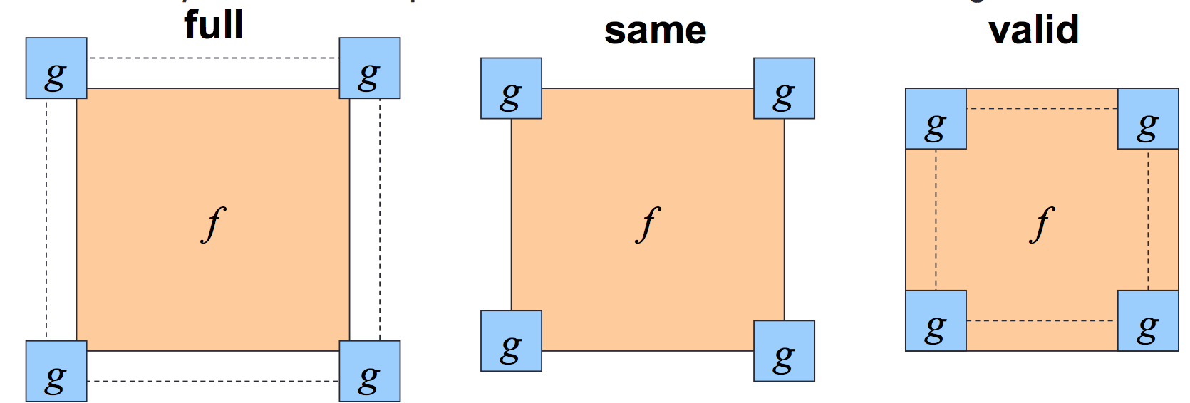
To summarize
Python:
Numpy.convolve(a,v,mode)
Scipy.signal.convole2d(a,v,mode, boundary, value)

Slide 30
There are other methods
The first two methods that I described fill missing values in by substituting zero
Can fill in values with different methods
Reflect image along border
Pull values from other side
Read Chapter 3.2 “padding”.

Slide 31
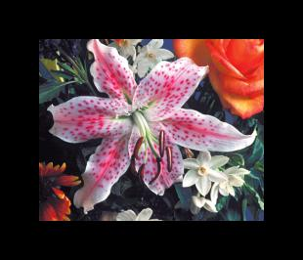
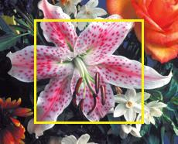

There are other methods
zero
valid
Nearest neighbor

Slide 32
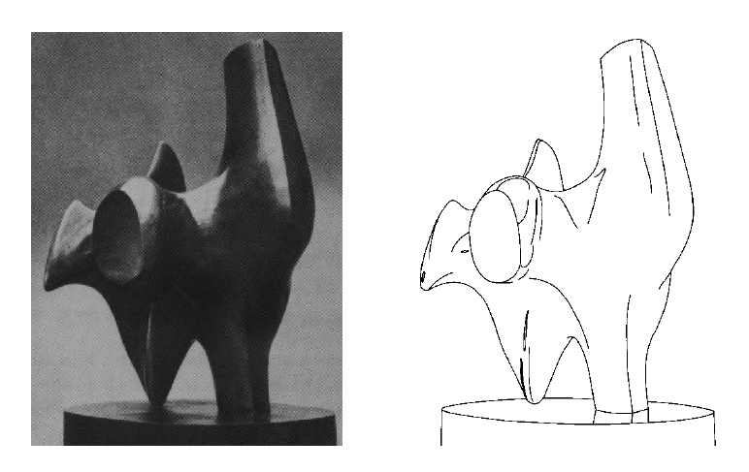
Edge detection
Convert a 2D image into a set of curves
Extracts salient features of the scene
More compact than pixels
Source: N. Snavely
TexPoint fonts used in EMF.
Read the TexPoint manual before you delete this box.: AAA

Slide 33
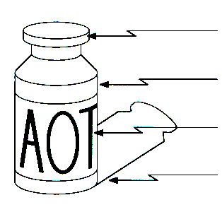
Origin of Edges
surface normal discontinuity
depth discontinuity
surface color discontinuity
illumination discontinuity
Edges are caused by a variety of factors
It is still a very active research topic! We will learn more about it!

Slide 34
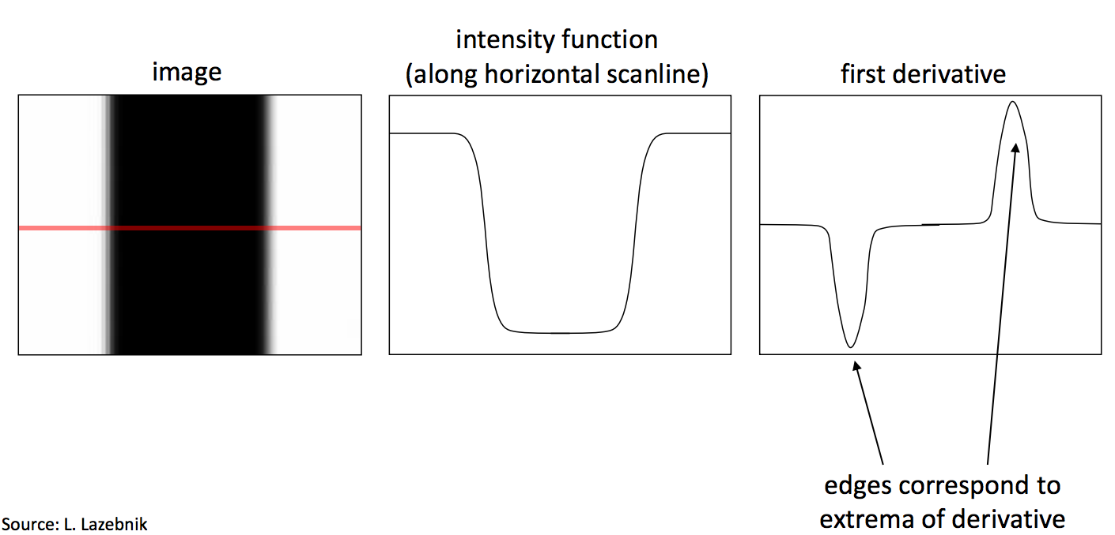
Image derivate and edges
An edge is a place of rapid change in image intensity function

Slide 35
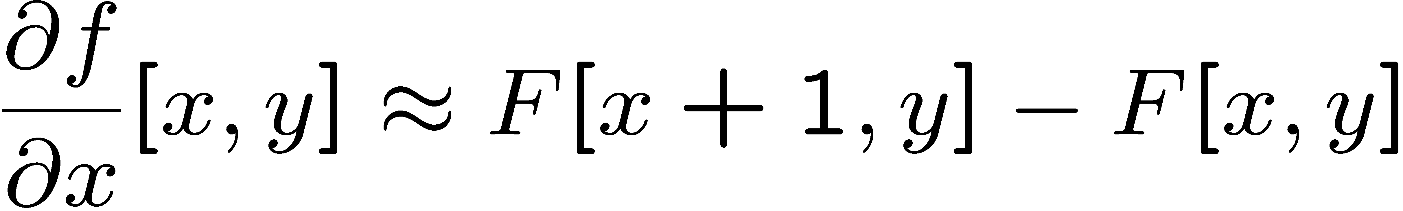




Image derivatives
How can we differentiate a digital image F[x,y]?
Option 1: reconstruct a continuous image, f, then compute the derivative
Option 2: take discrete derivative (finite difference)
How would you implement this as a linear filter?
1 | -1
 | -1
 | 1
:
:
Source: S. Seitz

Slide 36
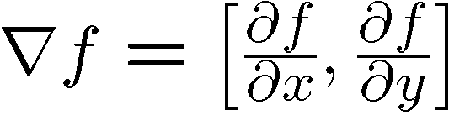
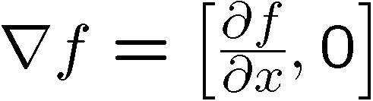
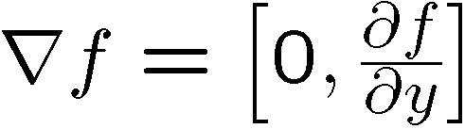
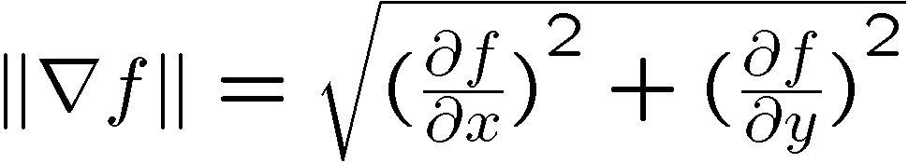
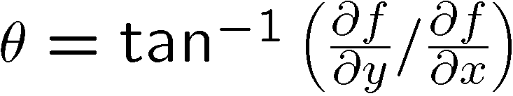
Image gradient
The gradient of an image:
The gradient points in the direction of most rapid increase in intensity
The edge strength is given by the gradient magnitude:
The gradient direction is given by:
how does this relate to the direction of the edge?
Source: Steve Seitz
Notes:
give definition of partial derivative: lim h->0 [f(x+h,y) – f(x,y)]/h

Slide 37
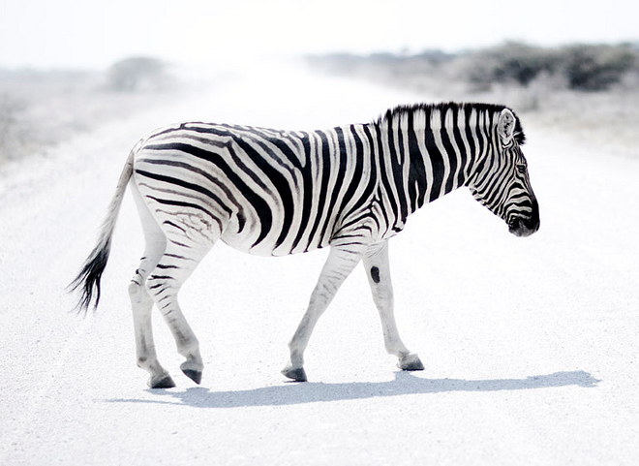
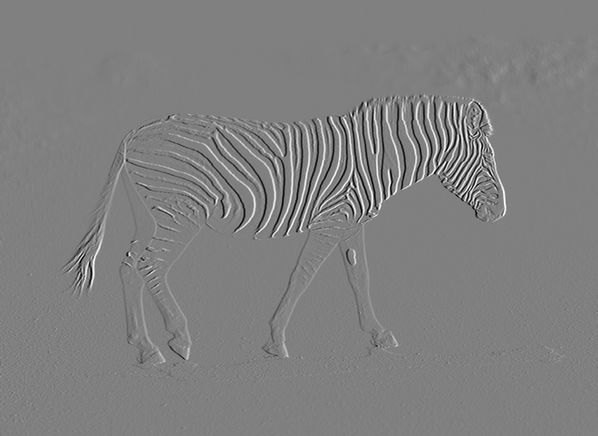

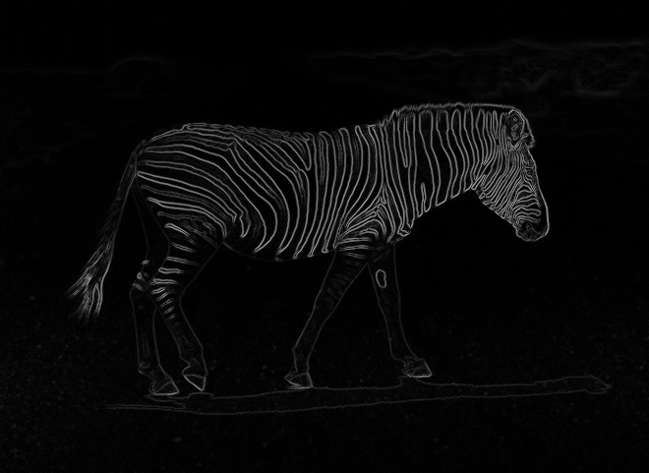
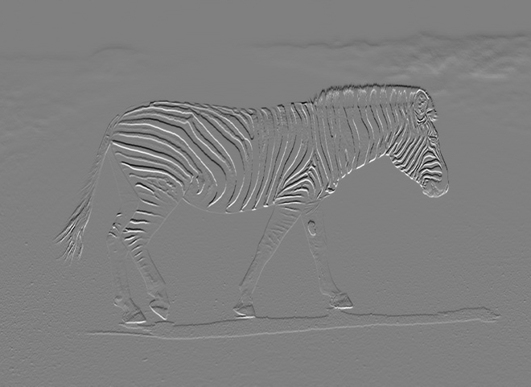

Image gradient

Slide 38
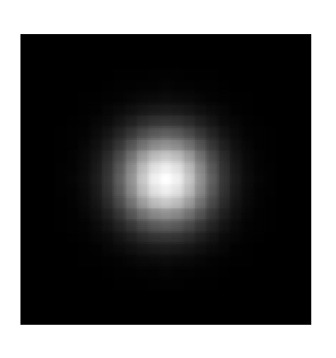
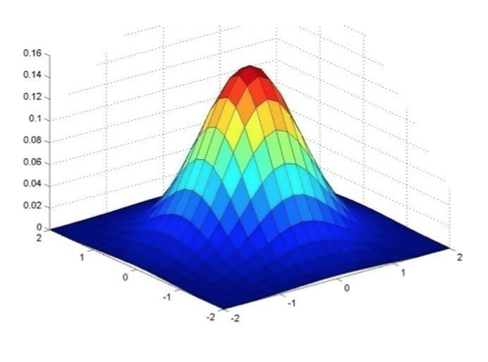

Gaussian Filter
Gaussian = normal distribution function

Slide 39
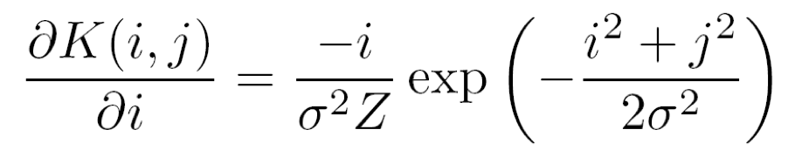
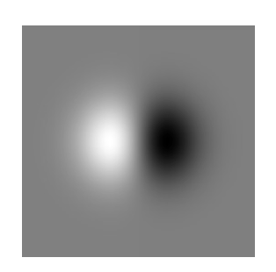
Derivative of Gaussian
Take the derivative of the filter with respect to i:
Filter looks like:
Basically blur then take the derivative
Source: M. Tappen
Notes:
How many 2nd derivative filters are there? There are four 2nd partial derivative filters.
In practice, it’s handy to define a single 2nd derivative filter—the Laplacian

Slide 40
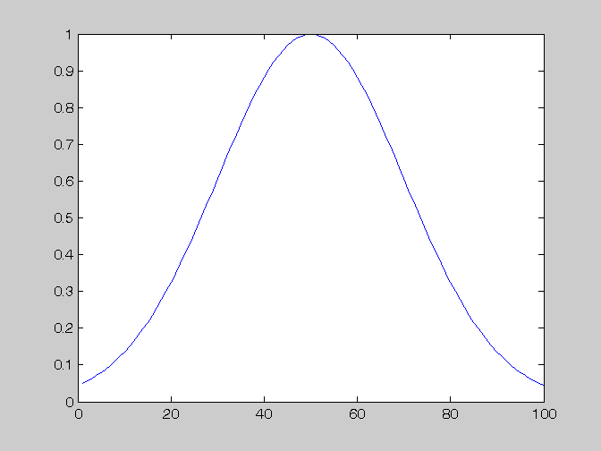
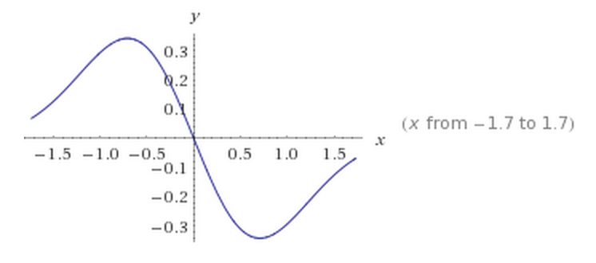
Derivative of Gaussian
Notes:
How many 2nd derivative filters are there? There are four 2nd partial derivative filters.
In practice, it’s handy to define a single 2nd derivative filter—the Laplacian

Slide 41
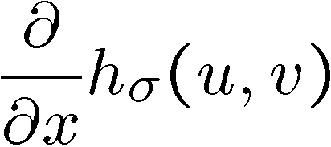
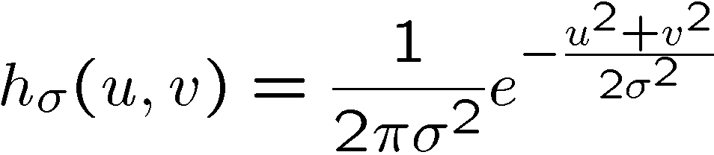
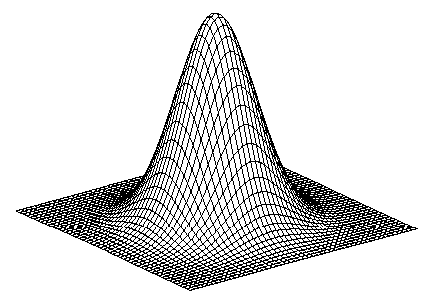
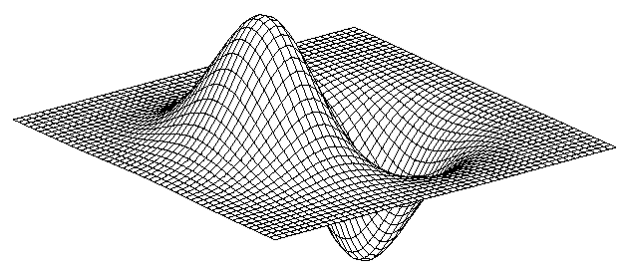
2D edge detection filters
derivative of Gaussian (x)
Gaussian
Notes:
How many 2nd derivative filters are there? There are four 2nd partial derivative filters.
In practice, it’s handy to define a single 2nd derivative filter—the Laplacian

Slide 42
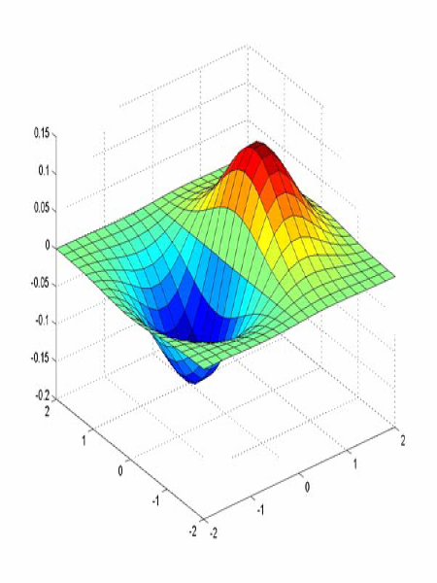
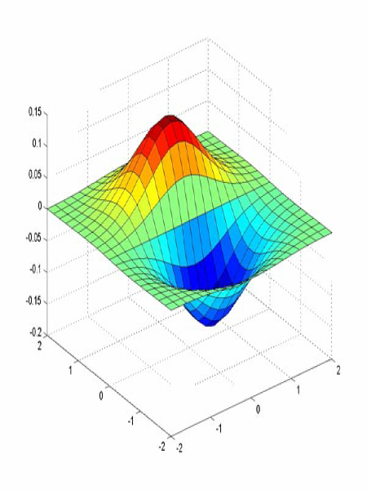


Derivative of Gaussian filter
x-direction
y-direction

Slide 43



The Sobel operator
Common approximation of derivative of Gaussian
-1 | 0 | 1
-2 | 0 | 2
-1 | 0 | 1
1 | 2 | 1
0 | 0 | 0
-1 | -2 | -1
The standard defn. of the Sobel operator omits the 1/8 term
doesn’t make a difference for edge detection
the 1/8 term is needed to get the right gradient value
Notes:
43
Q: Why might these work better?
A: more stable when there is noise

Slide 44
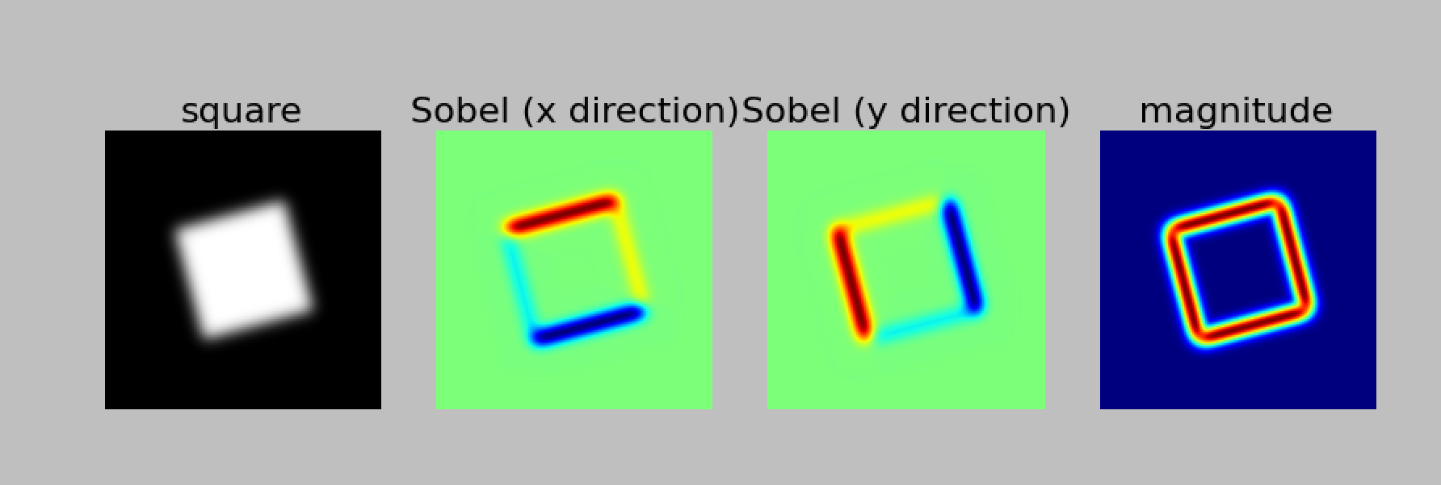
Example of Sobel filtered image
Notes:
44
Q: Why might these work better?
A: more stable when there is noise

Slide 45
Take-home exercise: Create image derivatives using Sobel filter
Generate an image of a rotated rectangle
import numpy as np
from scipy import ndimage
import matplotlib.pyplot as plt
im = np.zeros((256, 256))
im[64:-64, 64:-64] = 1
im = ndimage.rotate(im, 15, mode='constant’)
2. Blur the image using a Gaussian filter
im = ndimage.gaussian_filter(im, 8)
3. Apply Sobel filter to both x and y direction.
sx = ndimage.sobel(im, axis=0, mode='constant’)
4. Display the original image, x-derivatives, y-derivatives, and the gradient magnitude. You can use np.hypot to compute magnitude.
See here: http://docs.scipy.org/doc/numpy/reference/generated/numpy.hypot.html)

Slide 46
Next class
Laplacian of Gaussian
Steerable filter
Fourier transform
Reading: Chapter 3.1-3.3! Very important to keep up the reading.
You should have read Chapter 1. Skip Chapter 2 since we haven’t covered it.

