Slide 1
CSC589 Introduction to Computer Vision Lecture 5
A brief review of matrices and vector
Bei Xiao

Slide 2
Last lecture
Image histogram equalization
Border effect and padding
Image gradients

Slide 3
Today’s lecture
A brief review of linear algebra

Slide 4
Motivational statement
The happiest time of my day is to be able to get up early, solving math problems while drinking coffee and eating oatmeal.
- Me

Slide 5
Take-home reading
https://www2.bc.edu/ilker-yuce/Spring11/MT2100102/mt210test.html
An excellent chapter:
http://www.deeplearningbook.org/contents/linear_algebra.html

Slide 6

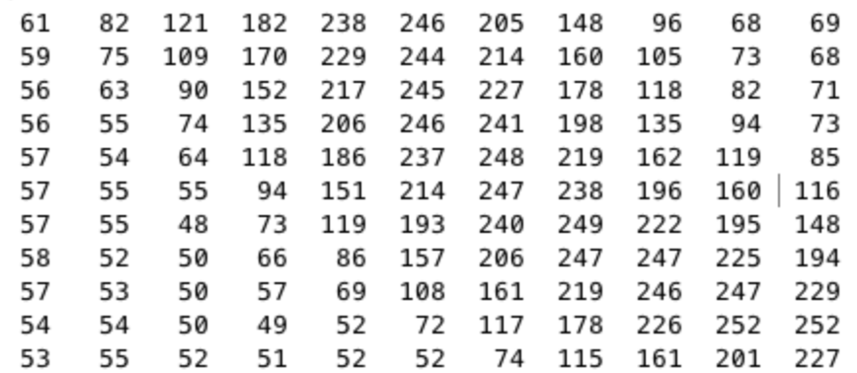
Grayscale Intensity Image as Matrices
row
The pixel P(i,j) has
intensity value of 151
column

Slide 7
8 bit intensity image
8 bit graphics is a method of storing image information in a computer’s memory or in an image file, such that each pixel is represented by one 8-bit type.
The range of 8 bit intensity image is [0 255].

Slide 8
A mini tutorial on linear algebra

Slide 9
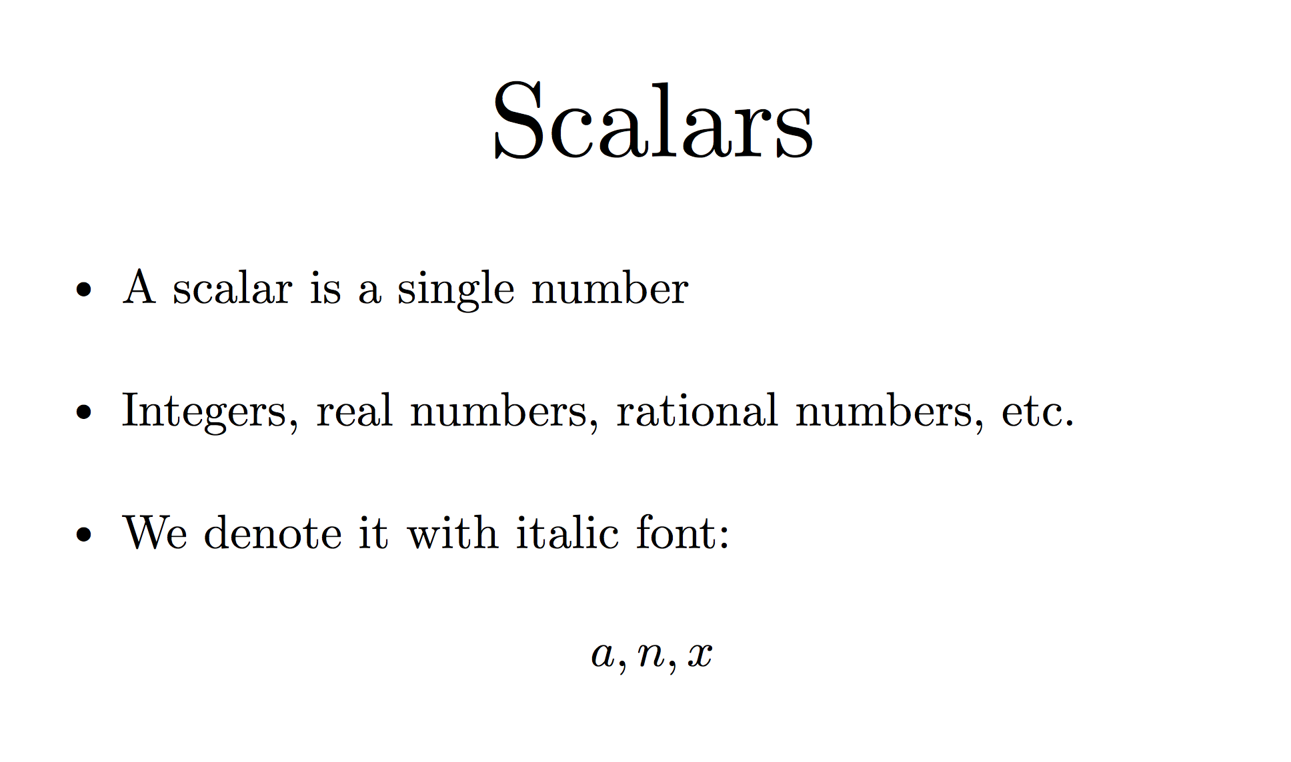
Notes:
Italic notation. Single letter names.

Slide 10
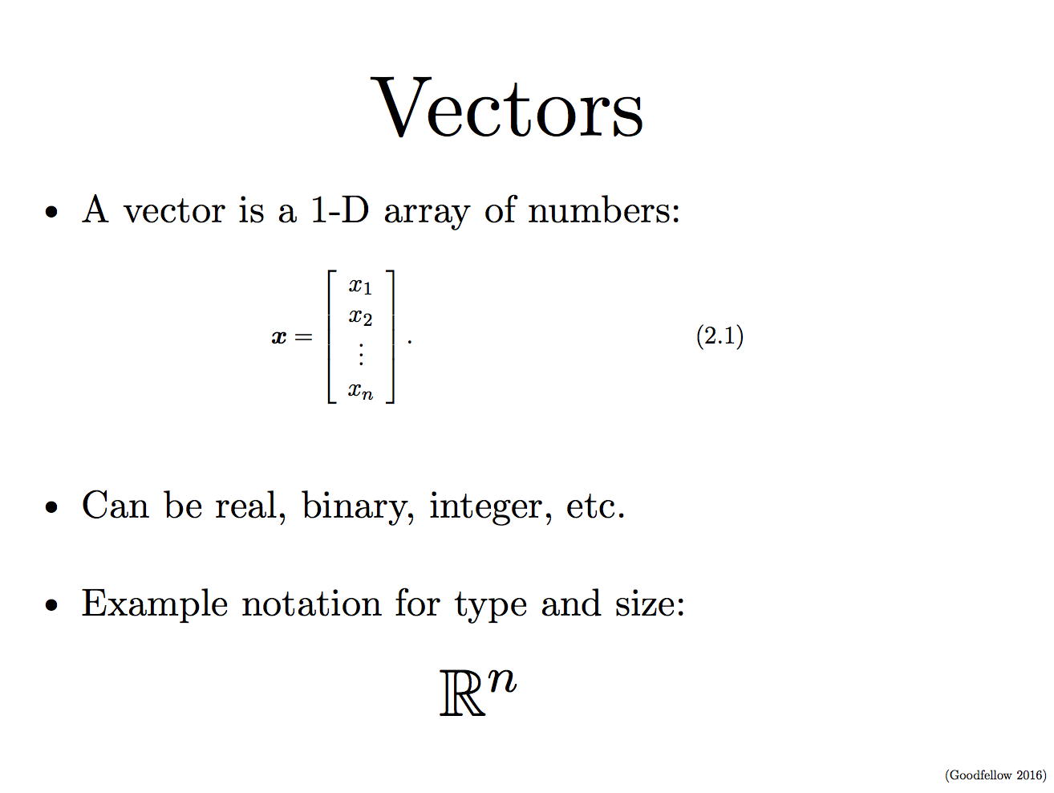
Notes:
We can identify each number by its index.
We can think of vectors as identifying points in space, which each element giving the coordinate along a different axis.
Column vector, row vector.

Slide 11
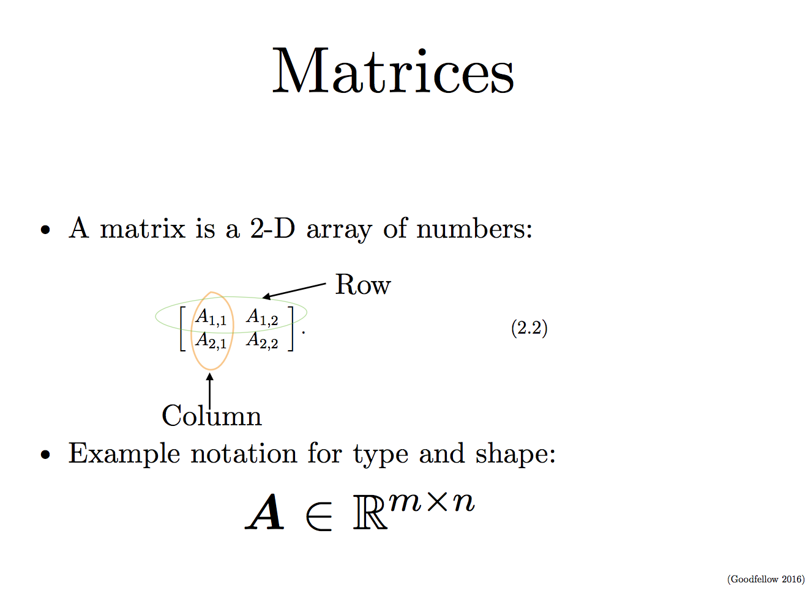
Notes:
Each element is identified by two indices. We usually gave matrices upper case letter names and bold type face.

Slide 12
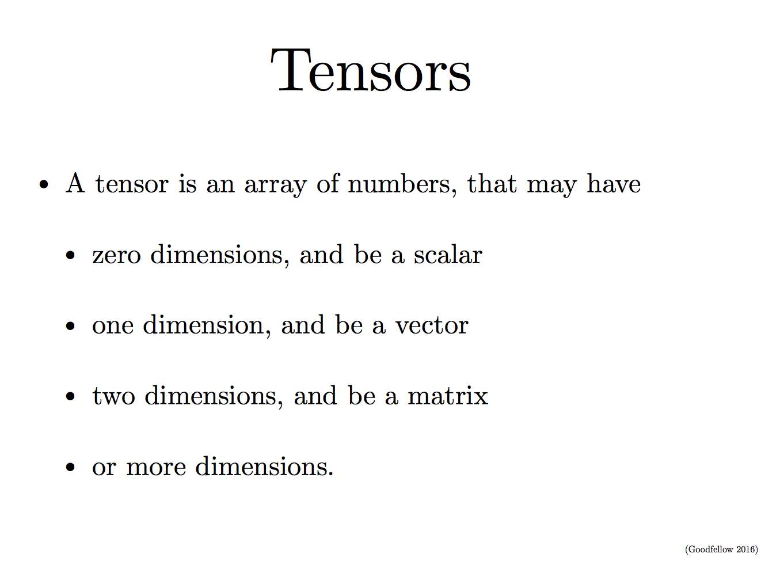
Notes:
An array with more than two axies

Slide 13
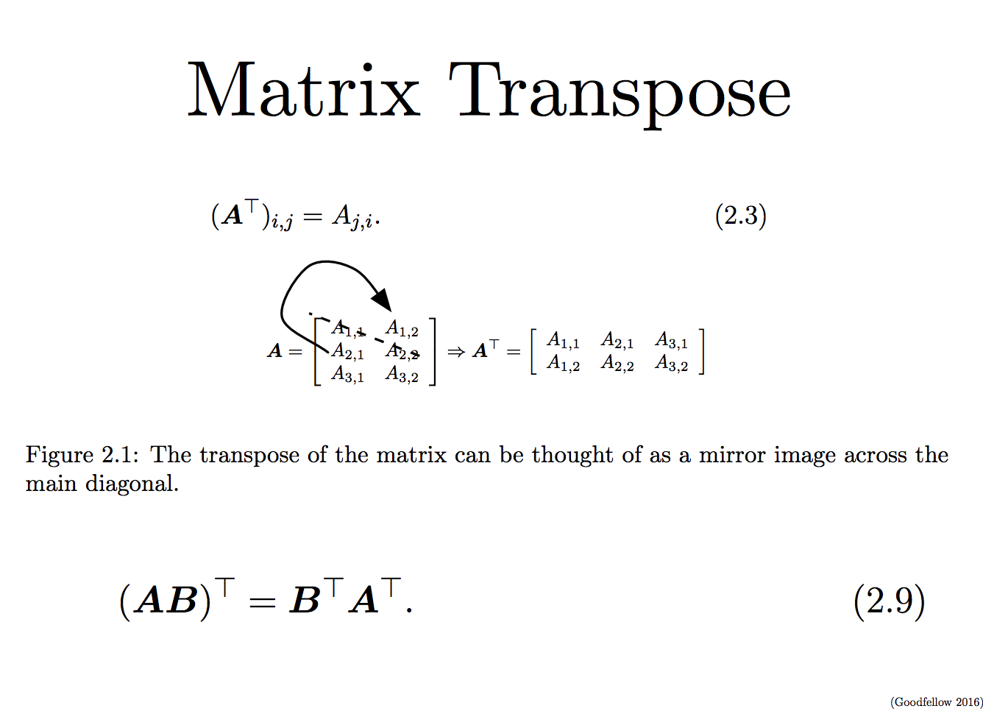
Notes:
The transpose of a matrix is the mirror image of the matrix across a diagonal line, called the main diagonal.
Vectors can be thought of matrix containing one column.

Slide 14
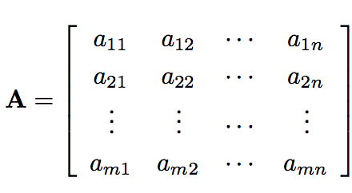
Basic Matrix Operations
ai,j represents the (i,j)

Slide 15
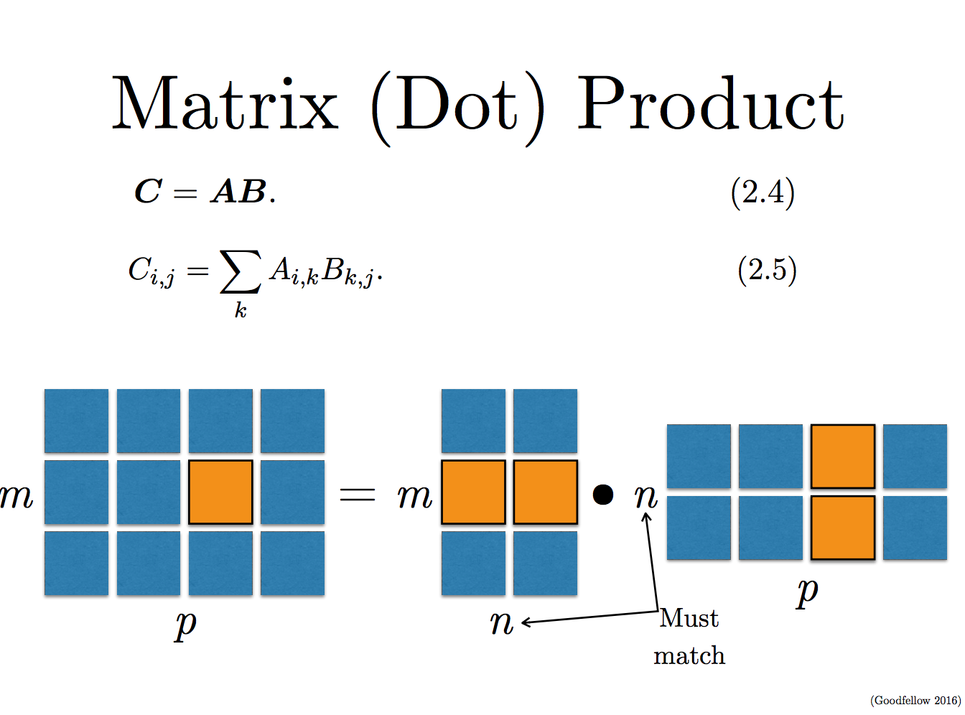

Slide 16
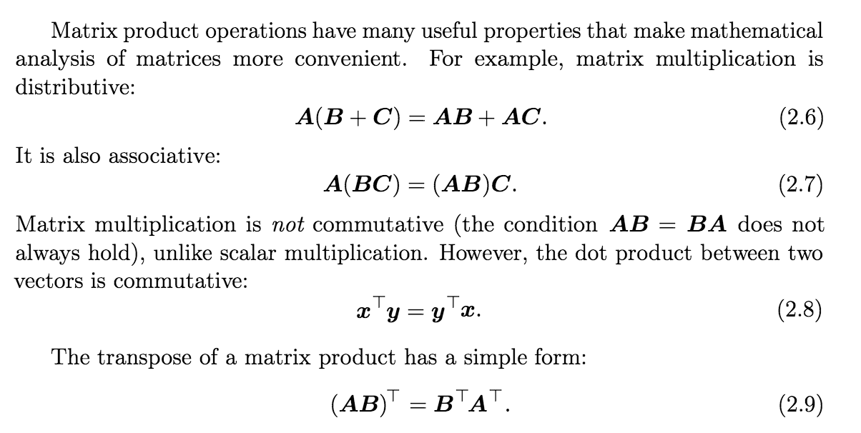

Slide 17
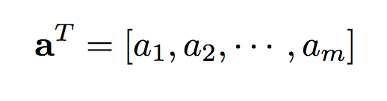
Basic Matrix Operations
Matrix products:
Vector dot product:
Transpose of the column vector is a row vector

Slide 18
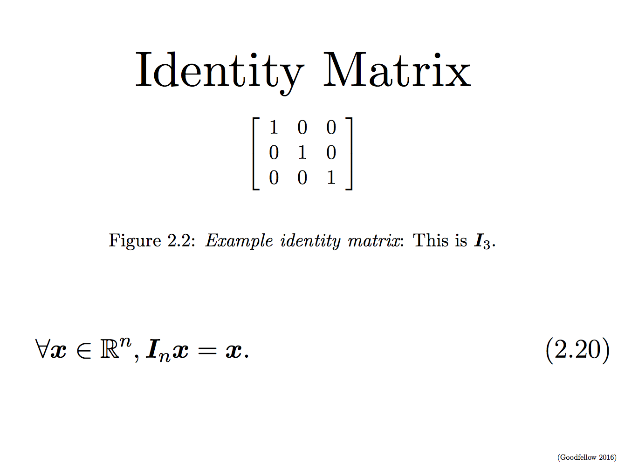

Slide 19
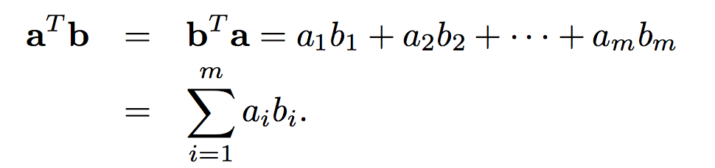
Dot product of two vectors (Algebraic definition)
Dot product is a sum of pair-wise product of components

Slide 20
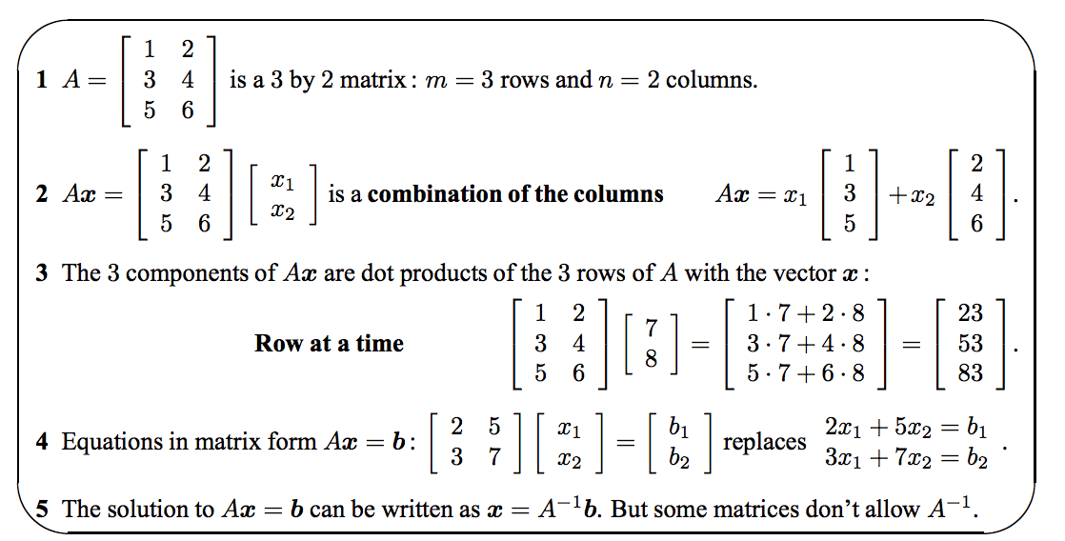

Slide 21
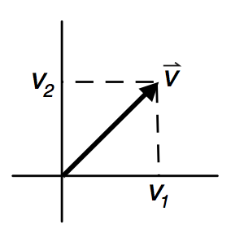
What is a vector?
Vectors of dimension 2 or 3 can be graphically depicted as arrows, with the tail at the origin and the head at the coordinate location specific by the vector components.
Vector has a length and a direction. The norm or length is defined as:

Slide 22
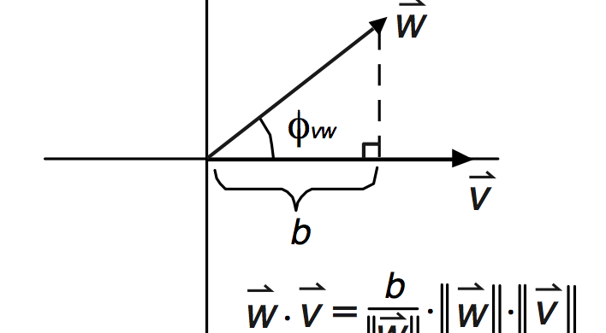

Dot product (inner) of two vectors (Geometric definition)
Φ is the angle between the two vectors

Slide 23
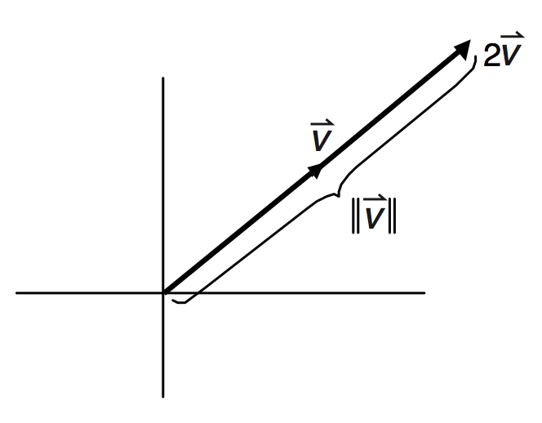
Scalar product
Multiplying a vector by a scalar simply changes the length of the vector by that factor

Slide 24
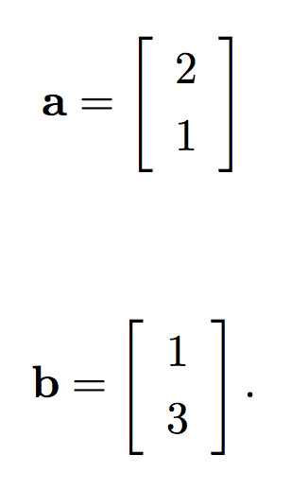
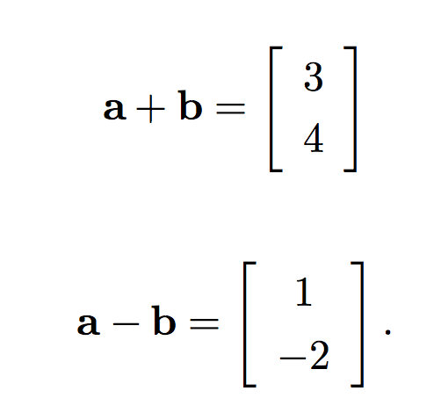
Vector Space
A vector space is a collection of vectors that is closed under linear combination.

Slide 25
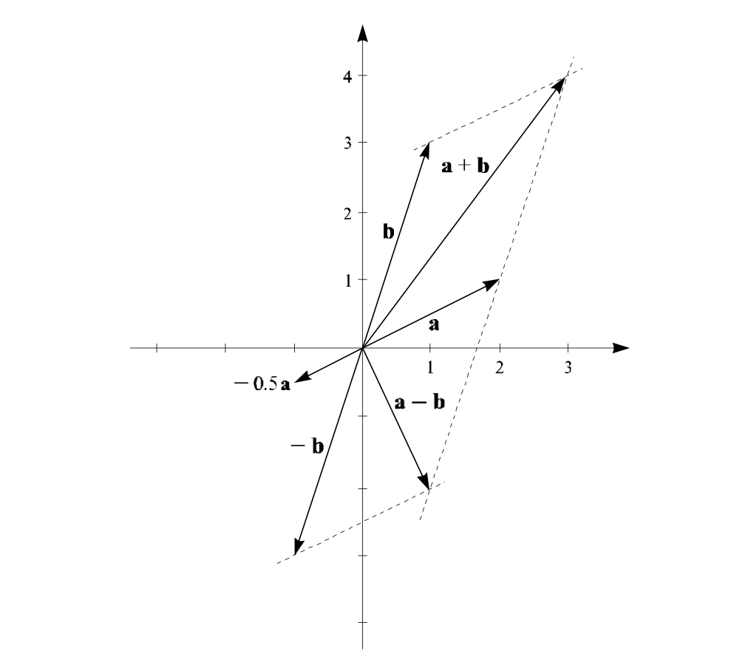
Vector Space (geometric)

Slide 26
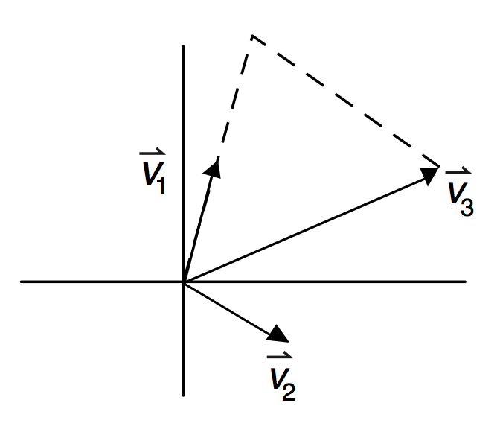
Vector Space (geometric)

Slide 27
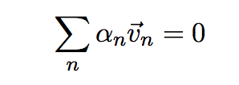
Basis
A set of vectors in a vector space V is called a basis, or a set of basis vectors.
A basis B of a vector space V is linearly independent if and only if:
A basis for a vector space is linearly independent spanning set.

Slide 28
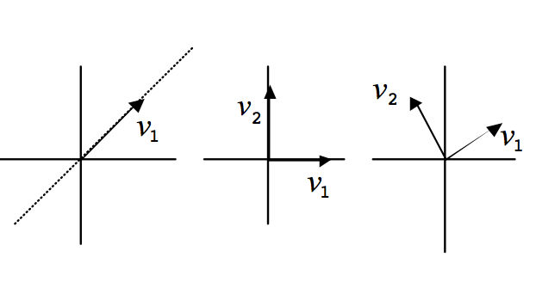
Basis vectors

Slide 29
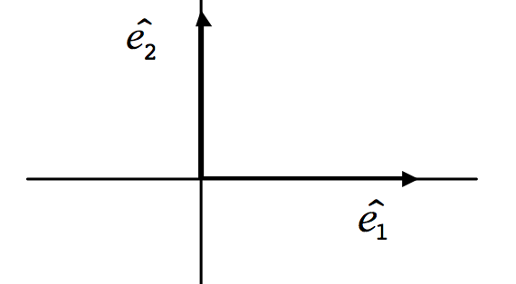
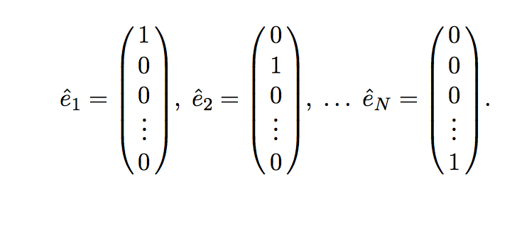
Standard Basis (unit vectors)

Slide 30
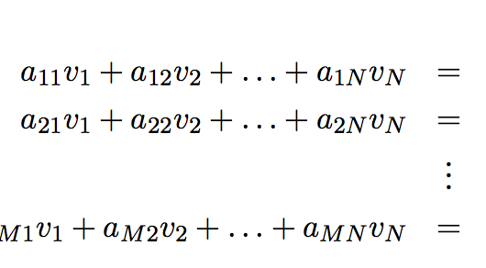
Linear Equations
If we put the variables v_{n} and constant b_{m} into vectors and the constants am into a matrix A, these equations maybe written more compactly:
To solve:

Slide 31
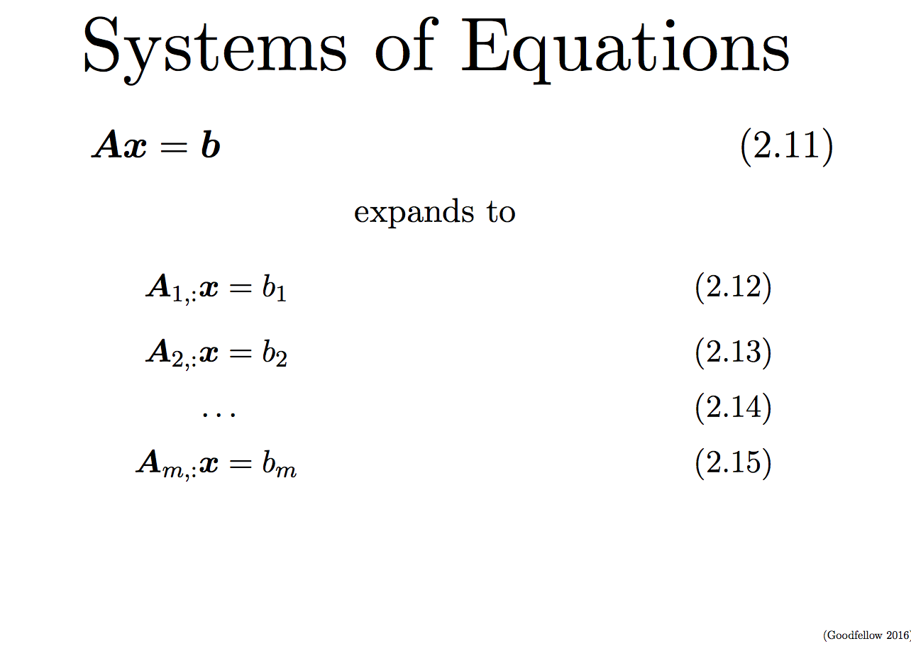

Slide 32
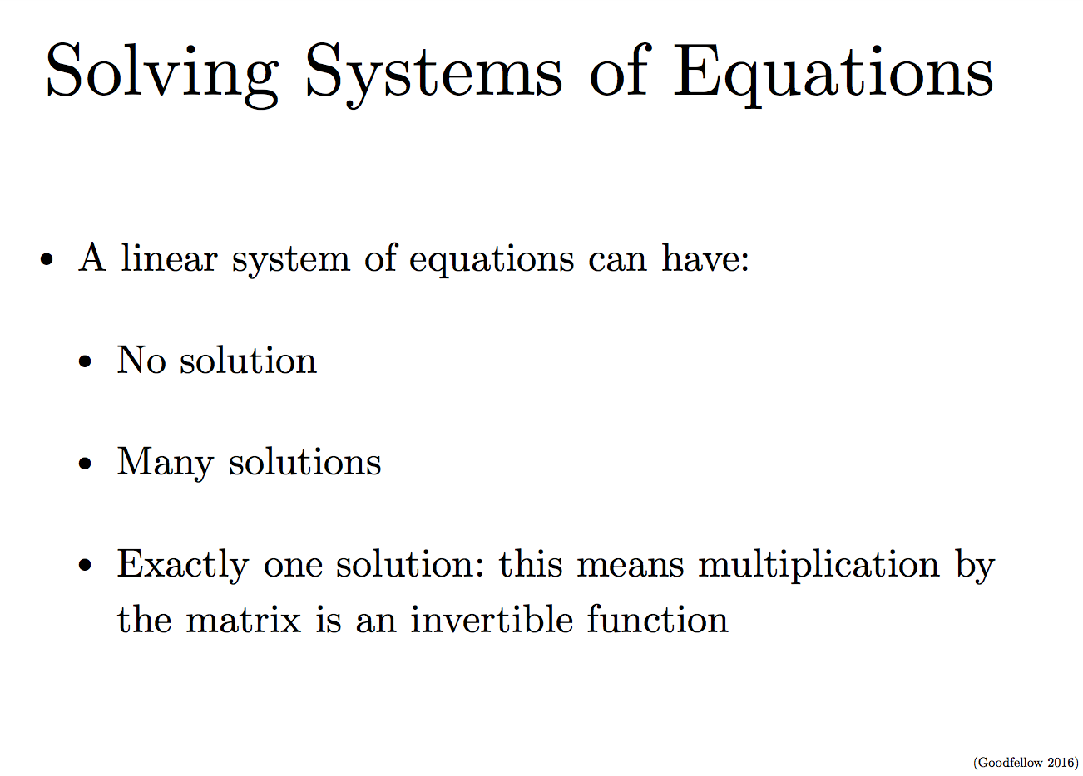

Slide 33
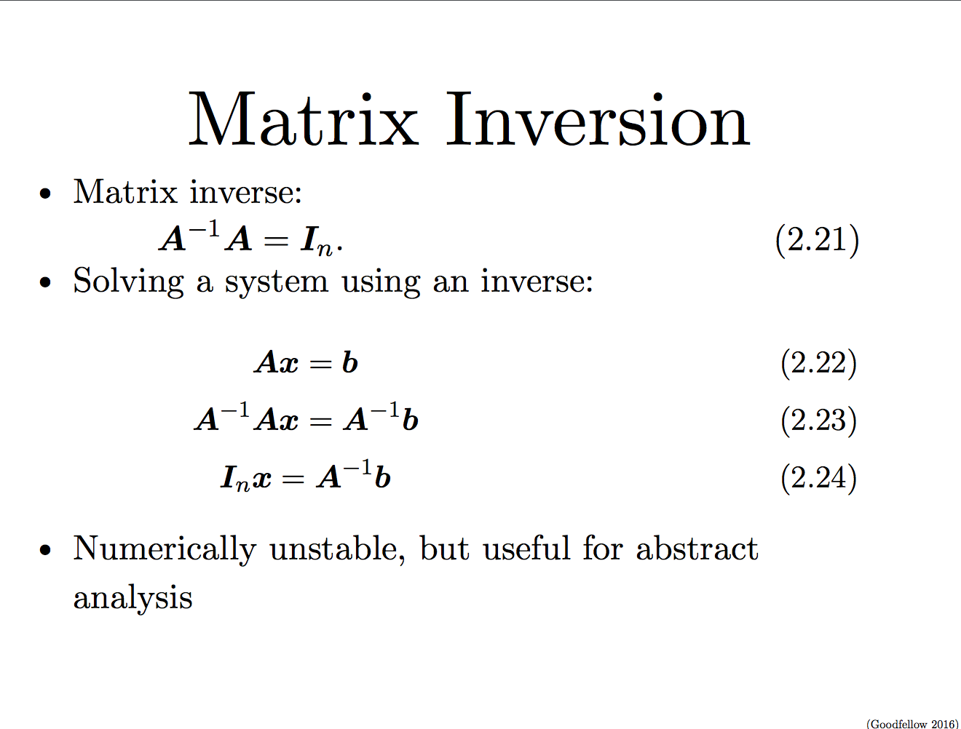

Slide 34
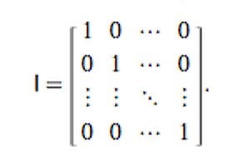
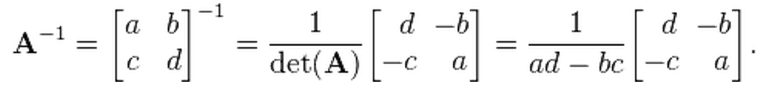
Matrix Inverse
Matrix Inverse:
A⁻¹A = I, I is identity matrix
Inversion of a 2× 2 matrix
http://mathworld.wolfram.com/MatrixInverse.html

Slide 35
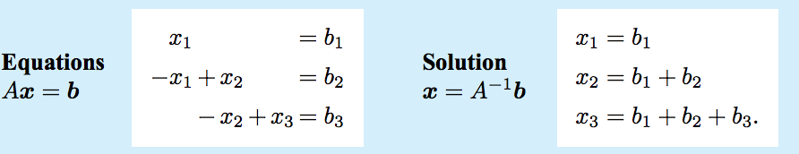
Solving linear equations

Slide 36
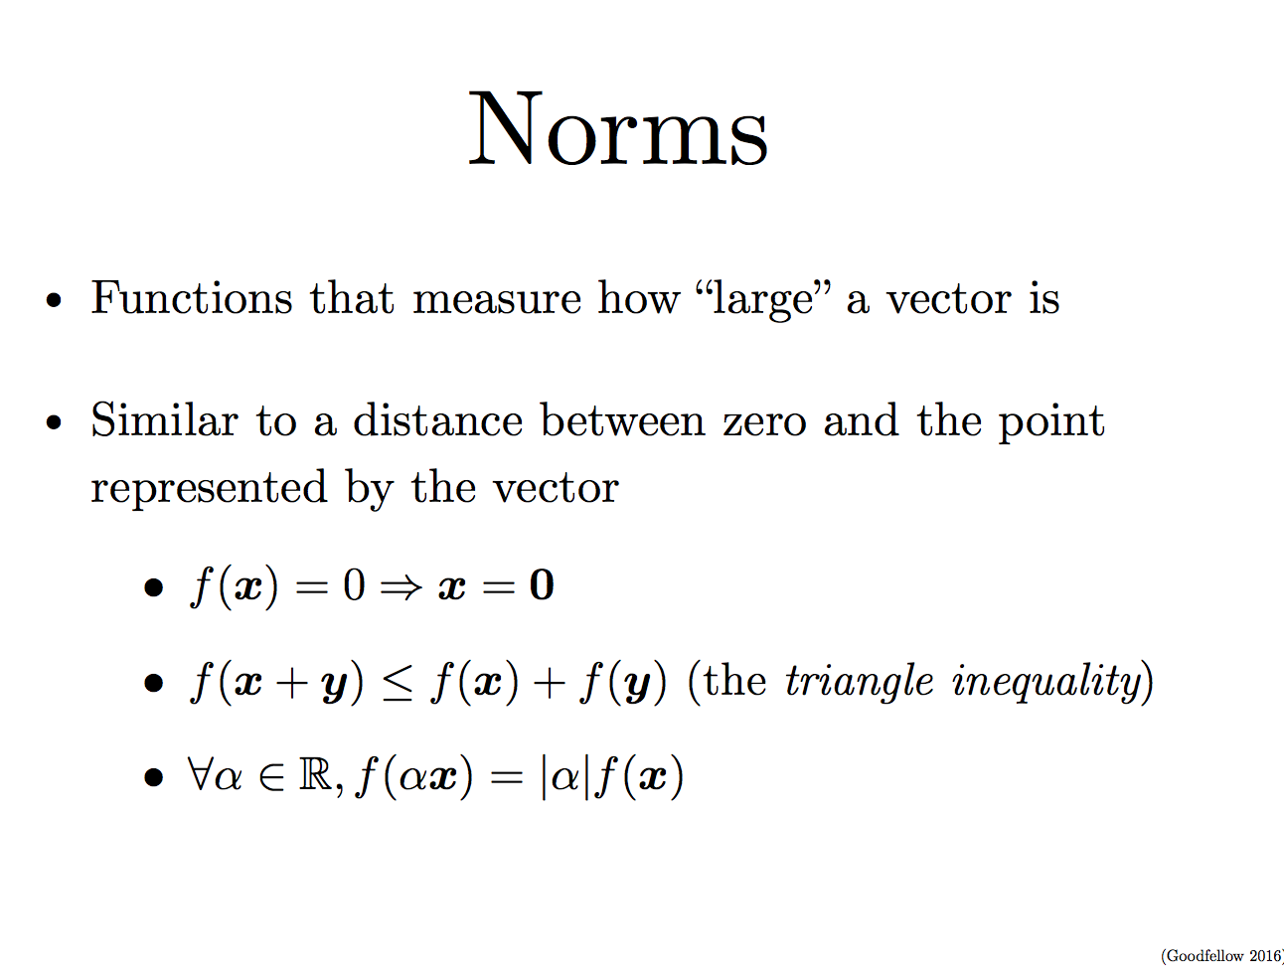

Slide 37
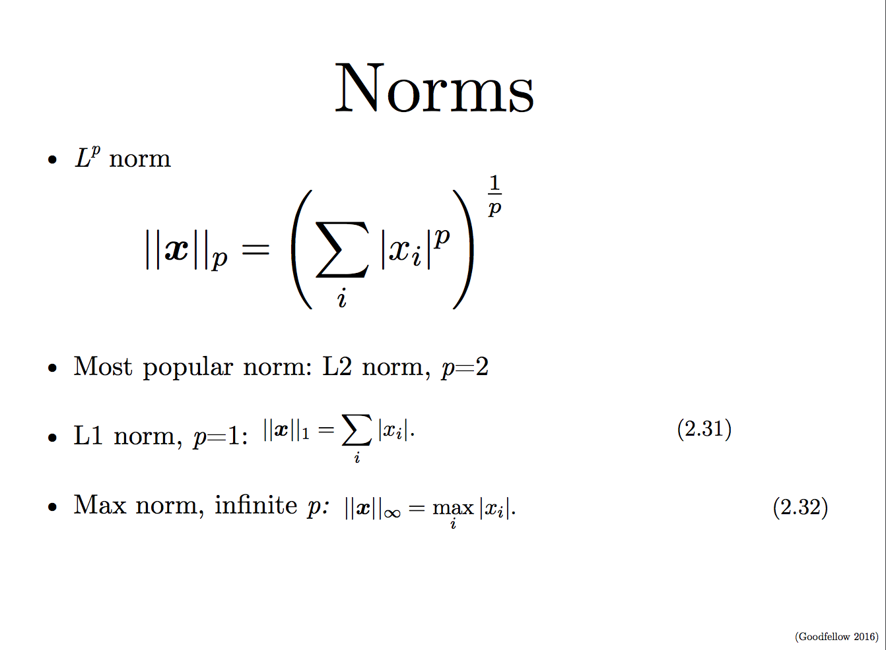

Slide 38
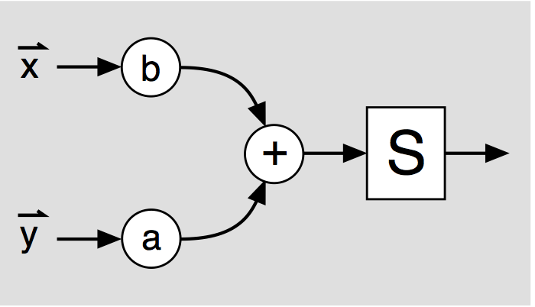
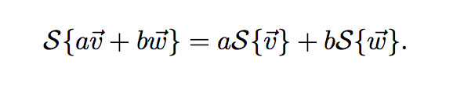
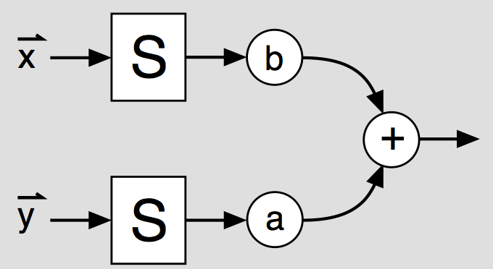
Linear System
A linear system S transforms vectors in one vector space into those of another vector space,
in such a way that it obeys the principle of superposition:

Slide 39
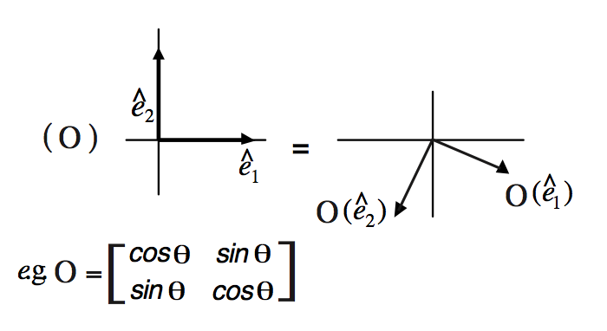
Orthogonal marix
O^{T}O = I, transpose of the matrix mulitplied by itself gives the identity matrix

Slide 40
Linear algebra with Python
Arrays
import numpy as np
from numpy.linalg import *
# create a single array
a = np.array([1, 4, 5, 8], float)
# create a multidimensional arary
a = np.array([[1, 2, 3], [4, 5, 6]], float)

Slide 41
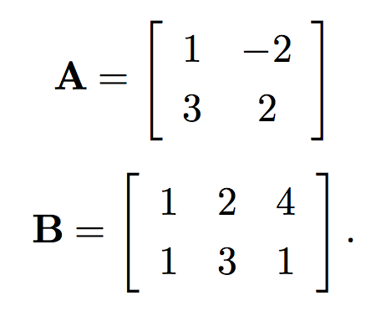
Quiz
what is the result of the following matrix product:

Slide 42
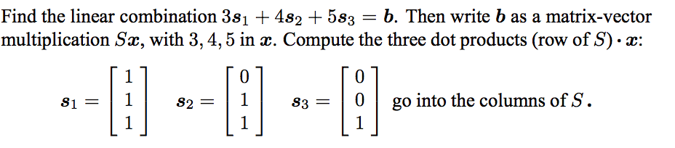
Take-home exercise

