Slide 1

Can two safe answers
reveal a secret?
AIM HEALTHCARE HACKATHON VIENNA 2026 · TRACK 3 · EUROPEAN HEALTH DATA SPACE
HealthCare Rocket
As fast as a rocket. Without the complexity.
Notes:
SLIDE 1 · CAN TWO SAFE ANSWERS REVEAL A SECRET?
SCRIPT, about 20 seconds
What if a system follows every privacy rule and still reveals what those rules protect?
The European Health Data Space will open health data for research, mostly as anonymised statistics. One of its simplest safeguards: never publish a count below ten.
Here is why that is not enough.
TRANSITION: Advance on "Here is why".
BEFORE PRESENTING: Pause for a full second after the opening question and look at the jury, not the screen.

Slide 2
Both answers pass the rule.
Together, they break the protection.
THE PROBLEM · A DIFFERENCING ATTACK
THE RULE
Counts below 10 are shown as “<10”
REQUEST A
REQUEST B
1
Women aged 45 to 74 with breast cancer
Women aged 45 to 74 with breast cancer
AUSTRIA
AUSTRIA WITHOUT BURGENLAND
72
−
71
=
One woman in Burgenland.
A count the rule would show as “<10”.
✓ Released
✓ Released
Counts verified on the official synthetic hackathon dataset (20,000 patients) · ICD-10 C50 · age on 31 Dec 2025 · opted-out patients excluded
Notes:
SLIDE 2 · 72 − 71 = 1
SCRIPT, about 37 seconds
Two questions. How many women aged 45 to 74 have breast cancer in Austria? Seventy-two. Above ten, so it is released.
[CLICK] The same question, excluding Burgenland. Seventy-one. Also released.
[CLICK] But seventy-two minus seventy-one is one. Exactly one woman in Burgenland. We don't know who she is, but we have revealed exactly the small number the rule exists to hide. In statistical disclosure control this is called a differencing attack, and these are real counts from the hackathon's synthetic dataset.
Both answers pass the rule. Together, they break the protection.
TRANSITION: Advance while saying "That is why we designed".
BEFORE PRESENTING: Verified on the official dataset: female, ICD-10 C50, aged 45 to 74 on 31 December 2025 (2025 minus birth year), opted-out patients excluded. Austria 72, without Burgenland 71. Without the age band the pair is 114 and 112, a gap of 2. Why 45 to 74: it is the age band of the Austrian breast screening programme. PowerPoint builds this slide in two clicks; the PDF shows everything at once, so skip the click cues there.

Slide 3
Allowed is not the same as safe.
OUR SOLUTION · HEALTHCARE ROCKET
Every request passes two checks before anything is released.
CHECK 1
CHECK 2
Answer
WORKING
WORKING
statistics or secure access
Is the request allowed?
Is the answer safe to release?
INPUT
Ask
Research question
Purpose permitted
Small cells hidden
when information is missing
in plain language
Statistics or secure access
A ledger records every release
Minimum necessary data
Say no
72 released → 71 withheld
Opt-outs excluded
WORKING
verified in tests
prohibited purpose or unsafe output
Notes:
SLIDE 3 · ALLOWED IS NOT THE SAME AS SAFE
SCRIPT, about 32 seconds
That is why we designed the Intelligent Health Data Access Gateway around two checks.
First: is the request allowed? Is the purpose permitted, are statistics enough, what is the minimum data, who has opted out.
Second: is the answer safe, given everything released before? Our prototype already records every release in a disclosure ledger. The goal is to withhold an answer like seventy-one; that part we have not verified yet.
Allowed is not the same as safe.
TRANSITION: "Safety only matters" leads into slide 4.
BEFORE PRESENTING: The ledger exists (Devin's verification); whether it stops differencing attacks is not verified. Keep IN TESTING and "not yet verified" until you have seen it withhold 71 after 72, and never say it prevents differencing attacks before then.

Slide 4
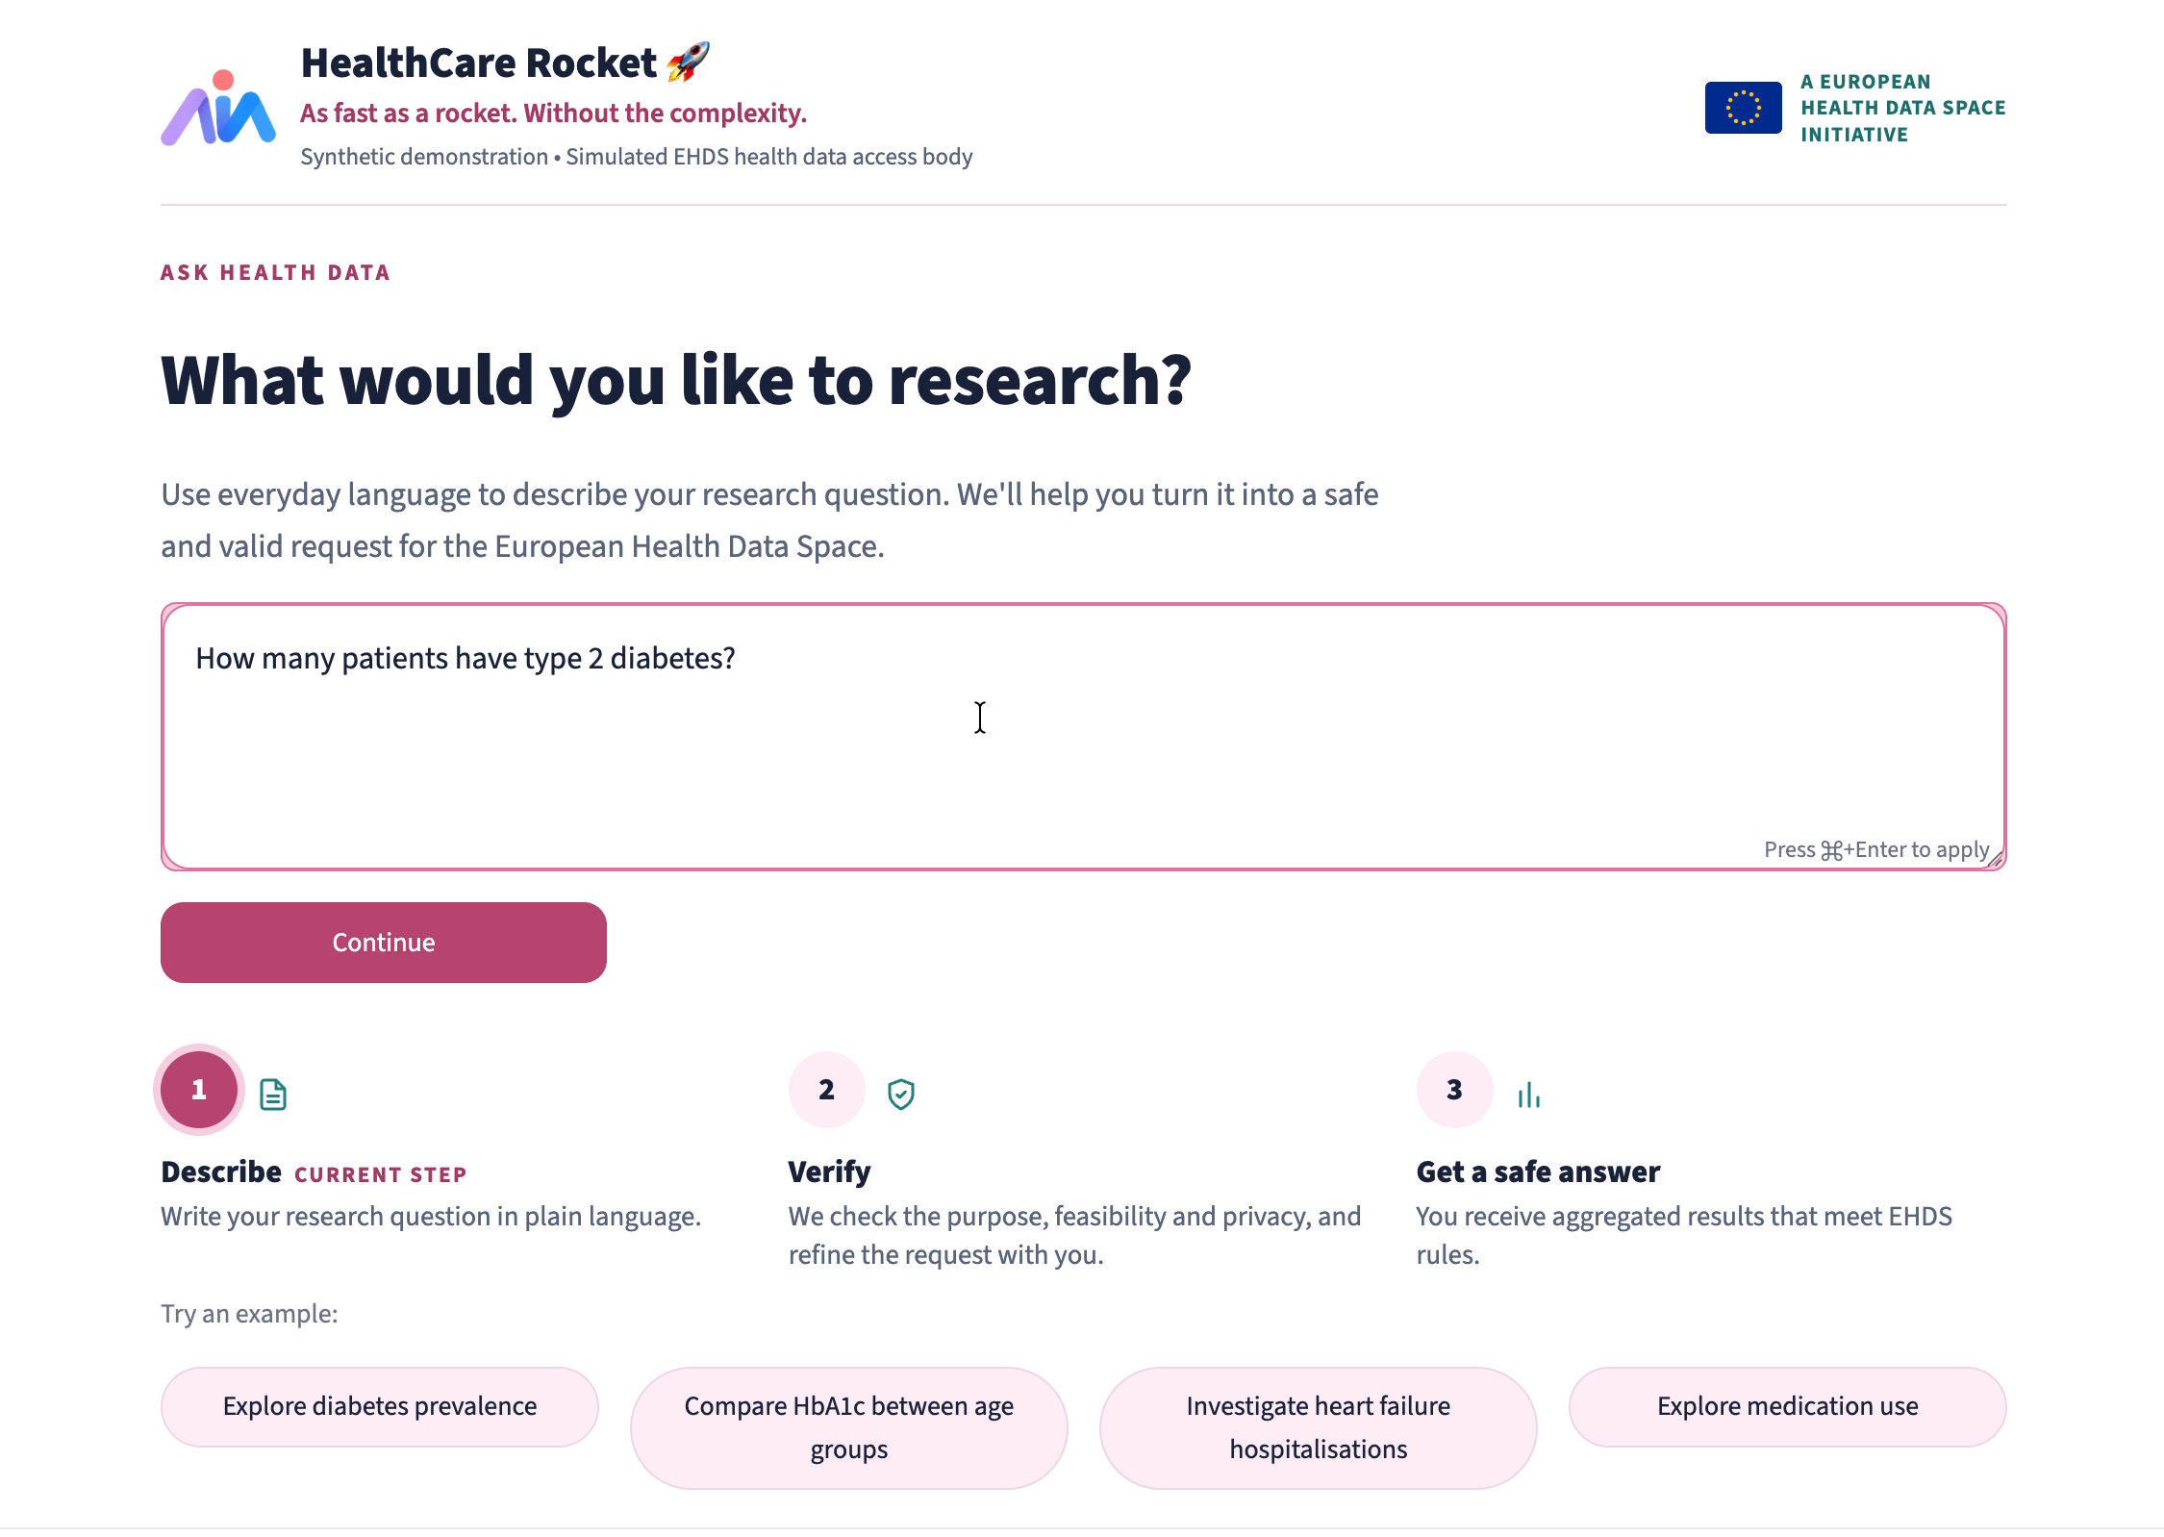
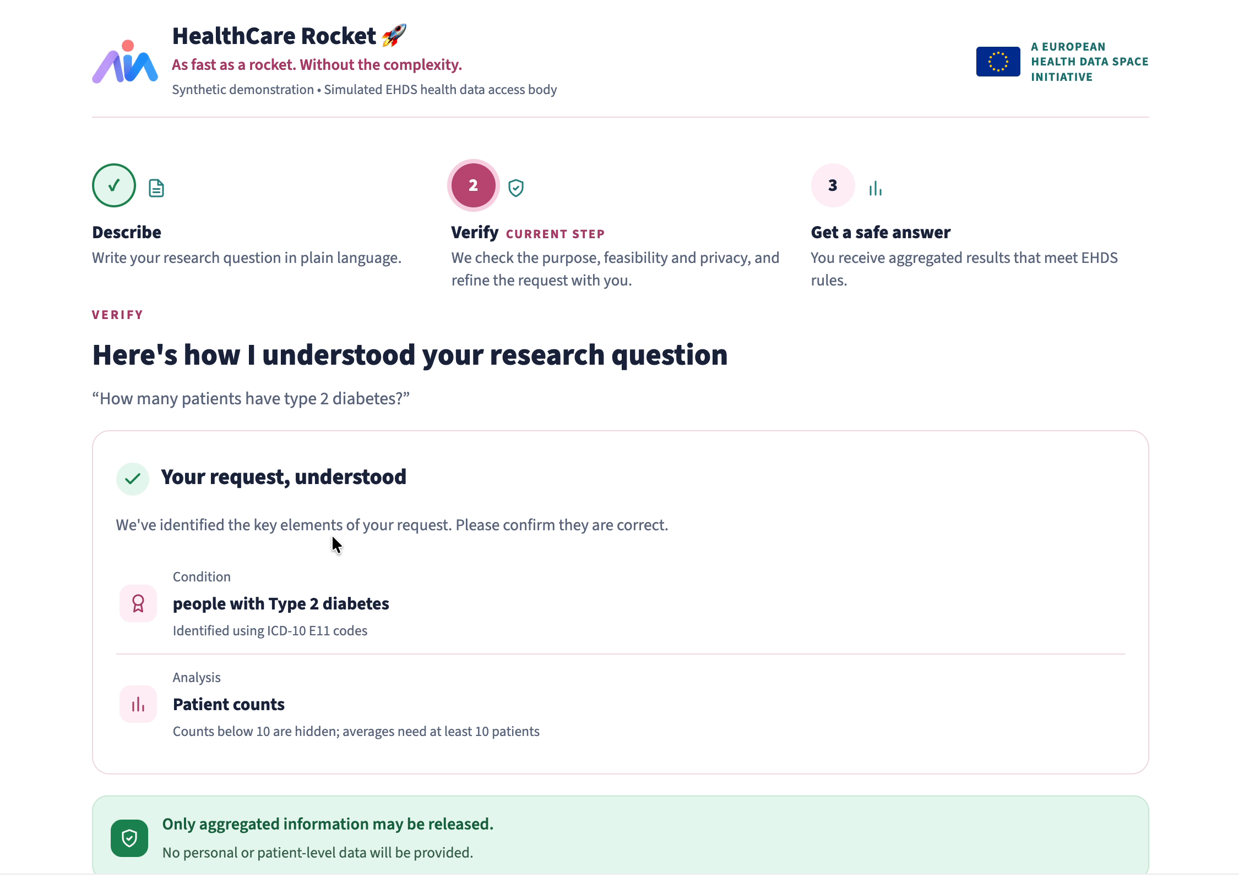
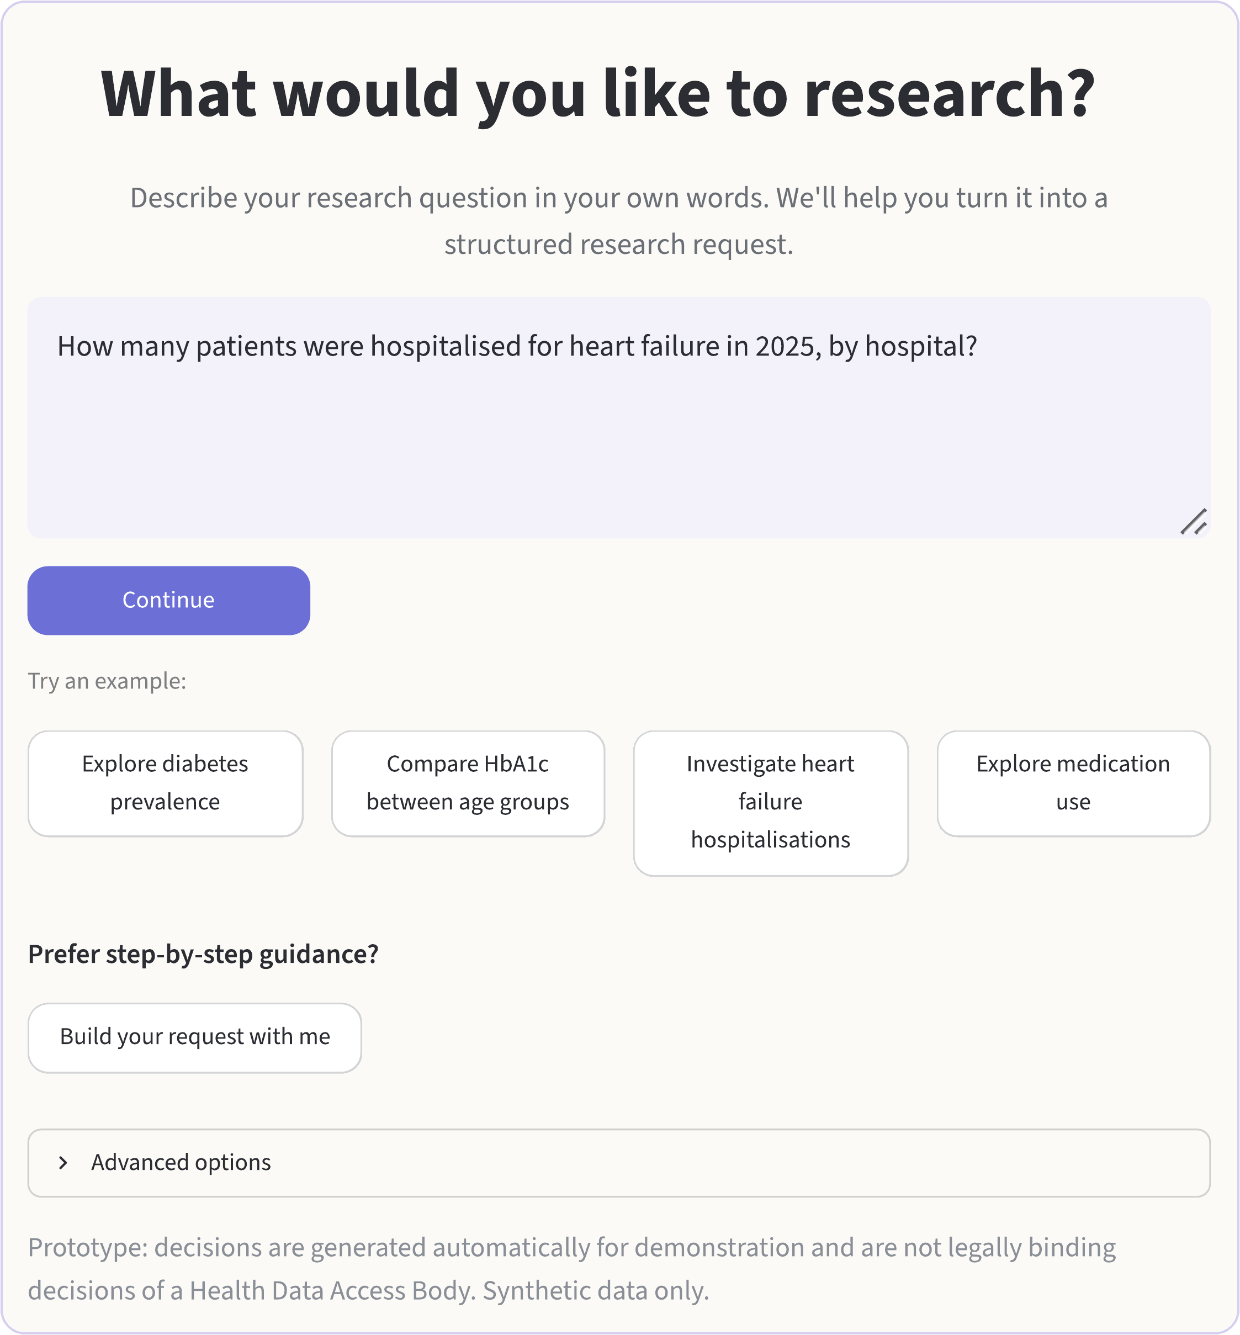
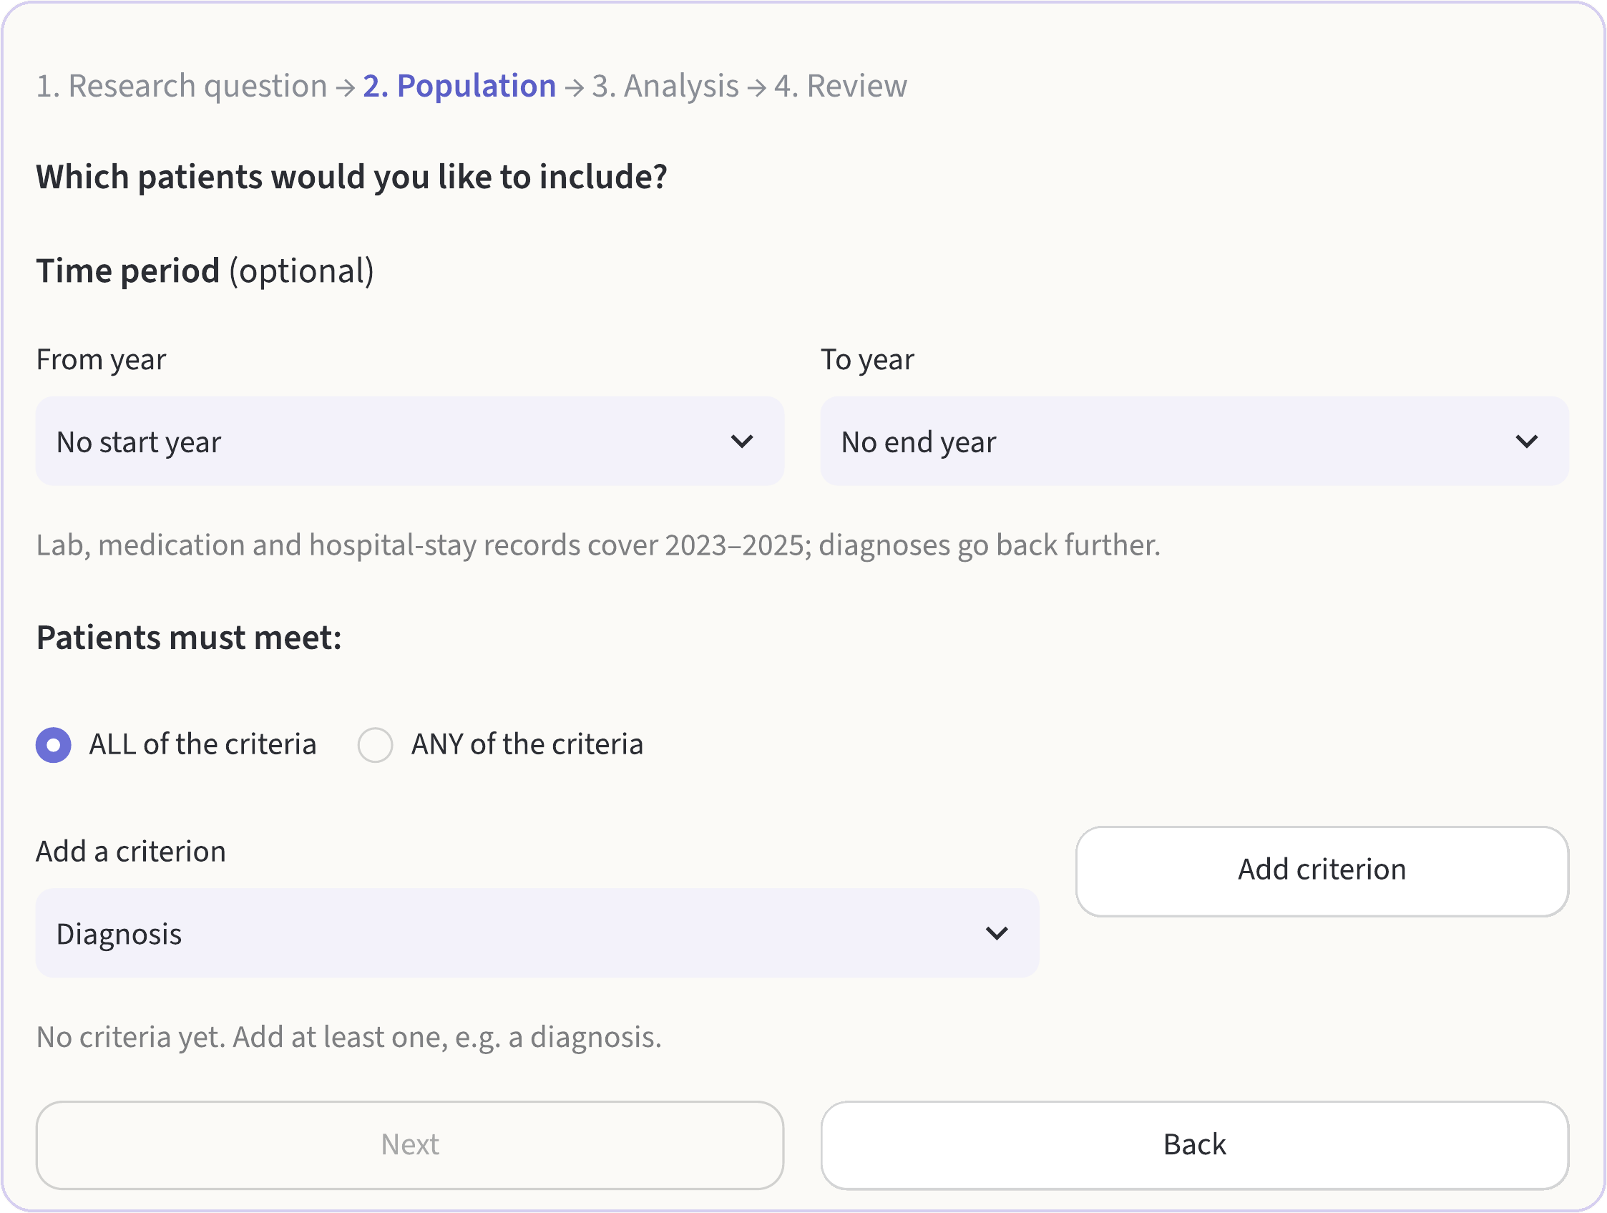
The complexity should be in the system,
not in the researcher’s experience.
RESEARCHER-FIRST EXPERIENCE
Researchers should describe their question, not assemble JSON.
1
Describe it in your own words
WORKING
No code, no JSON, no database terms
2
See how it was understood
WORKING
1
A plain-language summary before it runs
3
Fill in what is missing
WORKING
It asks for the purpose or a missing criterion
4
Or build it step by step
WORKING
Question, population, analysis, review
2
5
Receive authorised statistics
WORKING
3
Small counts hidden, articles cited
CURRENT PROTOTYPE SCREENSHOTS · SYNTHETIC DATA ONLY
Notes:
SLIDE 4 · THE COMPLEXITY SHOULD BE IN THE SYSTEM
SCRIPT, about 37 seconds
Safety only matters if researchers can use the system. I'm a medical researcher myself, and I don't think anyone should need JSON or code just to ask a clinical question.
In our prototype, you describe your question in your own words and see how it was understood. If something is missing, like the purpose or a criterion, the app asks for it. Prefer structure? Build it step by step; the advanced options are still there, just tucked away.
The complexity should be in the system, not in the researcher's experience.
TRANSITION: "Underneath" leads into slide 5.
BEFORE PRESENTING: Markers 1, 3 and 4 point to the real screenshots. Step 5, authorised statistics, is IN TESTING, so make no claim about results on this slide.

Slide 5
Read the words.
Protect the data.
TRUST BY DESIGN
Research question
01
WORKING
In the researcher’s own words
02
Interpretation
WORKING
Rule-based: patterns and medical dictionaries
03
Structured query
WORKING
Shown back in plain language before it runs
INTERPRETATION
WORKING
ONLY THE STRUCTURED QUERY CROSSES ↓
Rule-based today: patterns and medical dictionaries
04
Authorisation
WORKING
✓
Reads only the question
EHDS rules: Art. 53, 54, 66, 68, 69, 73
×
Never sees a patient record
Computation
05
WORKING
×
Never calculates a number
Deterministic statistics, identical on every run
06
Privacy enforcement
WORKING
OPTIONAL AI ADAPTERS
FUTURE
Small cells, opt-outs, disclosure ledger
Mistral and Ollama adapters are in the code, not yet connected or tested with real models.
07
Result with reasons
WORKING
Decision and cited articles for applicant and staff
CONTROLLED ENVIRONMENT · PATIENT-LEVEL DATA STAYS INSIDE
Notes:
SLIDE 5 · READ THE WORDS. PROTECT THE DATA.
SCRIPT, about 33 seconds
Underneath, interpretation is kept apart from everything that touches patient data.
Today the interpreter is rule-based, using patterns and medical dictionaries; it never sees a patient record or calculates a number. AI model adapters exist for later, but are not connected or tested.
[OPTIONAL, only if accurate] As someone who researches AI safety in healthcare: a model can stay optional, the protection cannot.
After that, everything is deterministic: rules decide access, code computes the statistics, and privacy enforcement hides small numbers and records every release. All of this is built and in testing.
Read the words. Protect the data.
OPTIONAL LINE: Only with verified results, in place of "All of this is built and in testing": "On the ten official requests we reached [X] of 10 correct decisions, [X] of 6 correct numbers and zero privacy leaks." Then update the chips.
TRANSITION: "The European Health Data Space needs" leads into the close.
BEFORE PRESENTING: Verified by Devin: interpretation uses regular expressions and medical dictionaries; no language model is connected; Mistral and Ollama adapters exist but are untested. Never say that AI interprets the question. Still confirm that the interpreter takes only the question text as input.

Slide 6
Making health data accessible
without making patients identifiable.
THE VISION
FOR RESEARCHERS
FOR ACCESS BODIES
FOR PATIENTS
Questions in their own words, answers they can trust.
Consistent decisions, explained in plain language.
Protection that looks across answers, not only at one.
A gateway that knows when to answer, when to ask, and when to say no.
HEALTHCARE ROCKET · AIM HEALTHCARE HACKATHON VIENNA 2026 · TRACK 3
Notes:
SLIDE 6 · MAKING HEALTH DATA ACCESSIBLE WITHOUT MAKING PATIENTS IDENTIFIABLE
SCRIPT, about 21 seconds
The European Health Data Space needs two things at once: researchers who can use it, and patients who can trust it.
We designed our gateway for both. Making health data accessible, without making patients identifiable.
A gateway that knows when to answer, when to ask, and when to say no.
TRANSITION: Pause, then "Thank you." Stay on this slide for questions.
BEFORE PRESENTING: Backup slides 7 to 10 follow for technical questions.

Slide 7
How the gateway is built
BACKUP 1 · SYSTEM ARCHITECTURE AND STATUS
WORKING
PLANNED
FUTURE
APPLICANT SIDE
INTERPRETATION
CONTROLLED ENVIRONMENT
What researchers and staff see
Question text only, no patient data
Patient-level data stays here
Plain-language entry
Rule-based interpreter
Decision rules, Art. 53 to 73
Guided request builder
Medical dictionaries
Deterministic statistics
Advanced options, JSON
Clarifying questions
Small cells, opt-outs excluded
Applicant and purpose form
AI model adapters (future, untested)
Disclosure ledger
Plain-language summary
SPE, download block (simulated)
Decision with reasons
Audit record
20,000 PATIENTS · 839 OPTED OUT
Notes:
BACKUP 1 · HOW THE GATEWAY IS BUILT
LIKELY QUESTIONS
What works today? Point at the dots: the researcher interface works; rule-based interpretation, decision rules, statistics, small-cell suppression and the disclosure ledger are built and in testing; clarifying questions and an audit record are planned; AI model adapters are a future step.
Do you use a language model? Not in the running prototype. Interpretation is rule-based, with patterns and medical dictionaries. Adapters for Mistral and for local models through Ollama are in the code but are not connected or tested with real models.
Why rules rather than a model? Rules are predictable, explainable and give the same result on every run, which an access body needs. The challenge allows rules, a model or both. A model could later help with unusual wording, but only after it has been tested.
BEFORE PRESENTING: Update each dot from your repository and test run. A dot turns green only with evidence.

Slide 8
Clinical words in, standard codes out
BACKUP 2 · TERMINOLOGY AND CLINICAL VALIDATION
FROM THE OFFICIAL REQUESTS
SAME WORDS, TWO COHORTS
CLINICAL REALISM
Type 2 diabetes
ICD-10 E11
“Hospitalised for heart failure in 2025”
Synthetic data is cleaner than hospital data. Real records add free text, local codes, mixed units and missing context.
Atrial fibrillation
ICD-10 I48
Breast cancer
ICD-10 C50
103
patients whose stay had heart failure as the main diagnosis
Before deployment
Oral anticoagulant
ATC B01AA, B01AF
FUTURE
SGLT2 inhibitor
ATC A10BK
Harmonisation to OMOP or FHIR, unit checks, and validation on real-world data.
123
patients with heart failure who had any inpatient stay
HbA1c
LOINC 4548-4
A working prototype is the beginning of clinical validation, not the end.
BMI
LOINC 39156-5
The gateway asks which one you mean.
Codes match on the prefixes given in each request’s definitions.
WORKING
Official synthetic dataset · stays starting in 2025 · opt-outs excluded
Notes:
BACKUP 2 · CLINICAL WORDS IN, STANDARD CODES OUT
LIKELY QUESTIONS
How do you map clinical language to codes? The interpreter's medical dictionaries map plain words to ICD-10, ATC and LOINC; the examples come straight from the official requests.
Why would the gateway ask questions? Because wording changes the cohort: "hospitalised for heart failure in 2025" gives 103 patients if heart failure was the main diagnosis of the stay and 123 if any 2025 stay of a patient with heart failure counts. Asking this automatically is planned, not yet built.
Is this ready for real hospital data? No. Synthetic data is cleaner than real records; harmonisation and validation on representative real-world data come first.
BEFORE PRESENTING: 103 and 123 are distinct patients with inpatient stays starting in 2025, opted-out patients excluded, computed on the official dataset.

Slide 9
What we enforce, and where it ends
BACKUP 3 · STATISTICAL DISCLOSURE CONTROL
PER ANSWER
WORKING
ACROSS ANSWERS
WORKING
WHERE IT ENDS
Counts below 10, including 0, shown as “<10”
Built: a disclosure ledger records every released result
Overlapping, non-nested queries
Percentages hidden if numerator or denominator is below 10
Chains of three or more answers
Each new result is compared with everything released before, to any applicant
Several applicants combining results
Means hidden below 10 patients
Withheld when one population contains the other and they differ by fewer than 10, including 0
Outside knowledge about individuals
Every requested group shown, even if empty
NEXT
FUTURE
Tested: subset and complement pairs, other applicants, reruns (pytest)
Query budgets, staff output checks, noise for high-risk outputs
All 839 opted-out patients excluded
VERIFIED ON THE OFFICIAL SYNTHETIC DATASET
Women aged 45 to 74 with breast cancer: 72 − 71 = 1 · All ages: 114 − 112 = 2 · Official R08 answer: Burgenland “<10”
Notes:
BACKUP 3 · WHAT WE ENFORCE, AND WHERE IT ENDS
LIKELY QUESTIONS
Does the ledger stop differencing attacks? Not verified yet. The prototype records every release in a disclosure ledger; whether it withholds a pair like 72 and 71 still has to be shown. Even then, overlapping queries, longer chains, several applicants combining results and outside knowledge need further measures.
Why include zero? The official rule hides counts below ten including zero, so a difference of zero is also a protected result.
What would you add next? Query budgets, output checks by access-body staff, and noise-based methods for high-risk outputs.
BEFORE PRESENTING: Change the ledger wording only after you have seen it withhold 71 after 72.

Slide 10
Measured results, then the road ahead
BACKUP 4 · OFFICIAL METRICS AND ROADMAP · MEASURED WITH evaluate.py
OFFICIAL CHALLENGE METRICS · THE 10 REQUESTS
ROADMAP
01
Today
Correct decisions
Correct numbers
Privacy leaks
Target 10 of 10
Target 6 of 6
Target 0
Working end to end: plain-language entry, interpretation, EHDS decisions, statistics, disclosure ledger. HDAB and SPE simulated.
Ours: 10 of 10
Ours: 6 of 6
Ours: 0
02
Next
PLANNED
Harden the ledger: chains of three or more answers, means, cumulative release accounting
Consistency
Slowest answer
Our own tests
Target 10 of 10
Target under 60 s
208 automated tests pass: new requests, reworded purposes, prompt injection, differencing pairs, UI flows
03
Then
FUTURE
Ours: 10 of 10
Ours: 0.25 s
Test the optional AI adapters against the rule-based interpreter, with documented data flows
04
Pilot
FUTURE
With access-body staff and researchers, on harmonised real-world data
Notes:
BACKUP 4 · MEASURED RESULTS, THEN THE ROAD AHEAD
LIKELY QUESTIONS
What are your metric results? Read them from your own run of the ten official requests. Do not estimate.
What comes next? Verify the disclosure ledger against differencing scenarios, test the optional AI adapters against the rule-based interpreter, then pilot with access-body staff and researchers on harmonised real-world data.
BEFORE PRESENTING: Replace every bracketed placeholder with measured results, or delete the tile.

