Slide 1
Data Pre-processing

Slide 2
Data Pre-processing
Introduction to Data Pre-processing
Types of Data
Outliers
Data Transformation
Missing Data
2

Slide 3
Why Data Preprocessing?
Data in the real world is dirty
incomplete: lacking attribute values, lacking certain attributes of interest, or containing only aggregate data
noisy: containing errors or outliers
inconsistent: containing discrepancies in codes or names
No quality data, no quality mining results!
Quality decisions must be based on quality data
Data warehouse needs consistent integration of quality data
A multi-dimensional measure of data quality:
A well-accepted multi-dimensional view:
accuracy, completeness, consistency, timeliness, believability, value added, interpretability, accessibility
Broad categories:
intrinsic, contextual, representational, and accessibility.

Slide 4
Why Prepare Data?
Some data preparation is needed for all mining tools
The purpose of preparation is to transform data sets so that their information content is best exposed to the mining tool
Error prediction rate should be lower (or the same) after the preparation as before it
4

Slide 5
Why Prepare Data?
Preparing data also prepares the miner so that when using prepared data the miner produces better models, faster
GIGO - good data is a prerequisite for producing effective models of any type
5

Slide 6
Why Prepare Data?
Data need to be formatted for a given software tool
Data need to be made adequate for a given method
Data in the real world is dirty
incomplete: lacking attribute values, lacking certain attributes of interest, or containing only aggregate data
e.g., occupation=“”
noisy: containing errors or outliers
e.g., Salary=“-10”, Age=“222”
inconsistent: containing discrepancies in codes or names
e.g., Age=“42” Birthday=“03/07/1997”
e.g., Was rating “1,2,3”, now rating “A, B, C”
e.g., discrepancy between duplicate records
e.g., Endereço: travessa da Igreja de Nevogilde Freguesia: Paranhos
6

Slide 7
Major Tasks in Data Preparation
Data discretization
Part of data reduction but with particular importance, especially for numerical data
Data cleaning
Fill in missing values, smooth noisy data, identify or remove outliers, and resolve inconsistencies
Data integration
Integration of multiple databases, data cubes, or files
Data transformation
Normalization and aggregation
Data reduction
Obtains reduced representation in volume but produces the same or similar analytical results
7

Slide 8
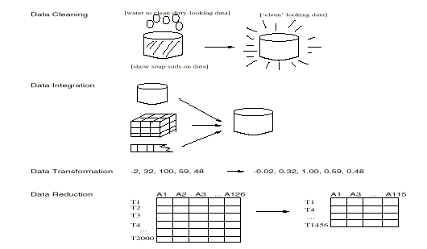
Forms of data preprocessing

Slide 9
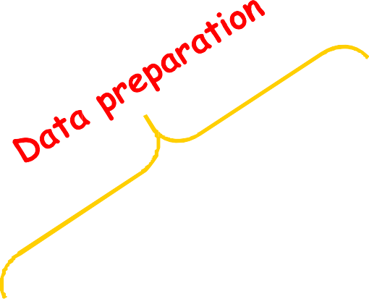
Data Preparation as a step in the Knowledge Discovery Process
Knowledge
Evaluation and Presentation
Data Mining
Selection and Transformation
Cleaning and Integration
DW
DB
9

Slide 10
TYPES OF DATA
10

Slide 11
Types of Measurements
Nominal scale
Categorical scale
Ordinal scale
Interval scale
Ratio scale
More information content
Qualitative
Quantitative
Discrete or Continuous
11

Slide 12
Types of Measurements: Examples
Nominal:
ID numbers, Names of people
Categorical:
eye color, zip codes
Ordinal:
rankings (e.g., taste of potato chips on a scale from 1-10), grades, height in {tall, medium, short}
Interval:
calendar dates, temperatures in Celsius or Fahrenheit, GRE (Graduate Record Examination) and IQ scores
Ratio:
temperature in Kelvin, length, time, counts
12

Slide 13
Data Conversion
Some tools can deal with nominal values but other need fields to be numeric
Convert ordinal fields to numeric to be able to use “>” and “<“ comparisons on such fields.
A → 4.0
A- → 3.7
B+ → 3.3
B → 3.0
Multi-valued, unordered attributes with small no. of values
e.g. Color=Red, Orange, Yellow, …, Violet
for each value v create a binary “flag” variable C_v , which is 1 if Color=v, 0 otherwise
20

Slide 14
Conversion: Nominal, Many Values
Examples:
US State Code (50 values)
Profession Code (7,000 values, but only few frequent)
Ignore ID-like fields whose values are unique for each record
For other fields, group values “naturally”:
e.g. 50 US States → 3 or 5 regions
Profession – select most frequent ones, group the rest
Create binary flag-fields for selected values

Slide 15
OUTLIERS

Slide 16
Outliers
Outliers are values thought to be out of range.
“An outlier is an observation that deviates so much from other observations as to arouse suspicion that it was generated by a different mechanism”
Can be detected by standardizing observations and label the standardized values outside a predetermined bound as outliers
Outlier detection can be used for fraud detection or data cleaning
Approaches:
do nothing
enforce upper and lower bounds
let binning handle the problem

Slide 17
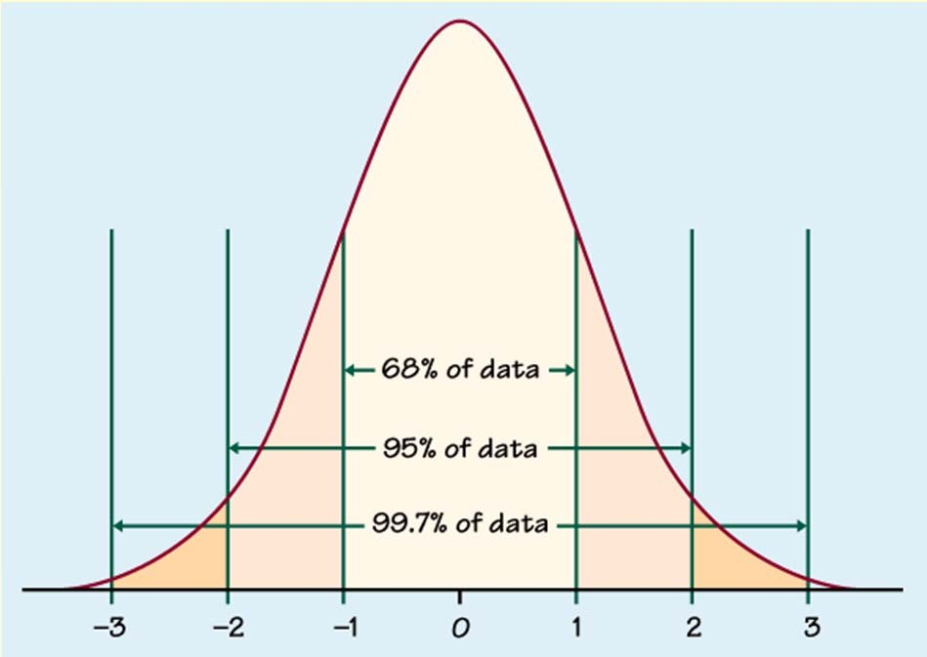
Outlier detection
Univariate
Compute mean and std. deviation. For k=2 or 3, x is an outlier if outside limits (normal distribution assumed)
(x − ks, x + ks)

Slide 18
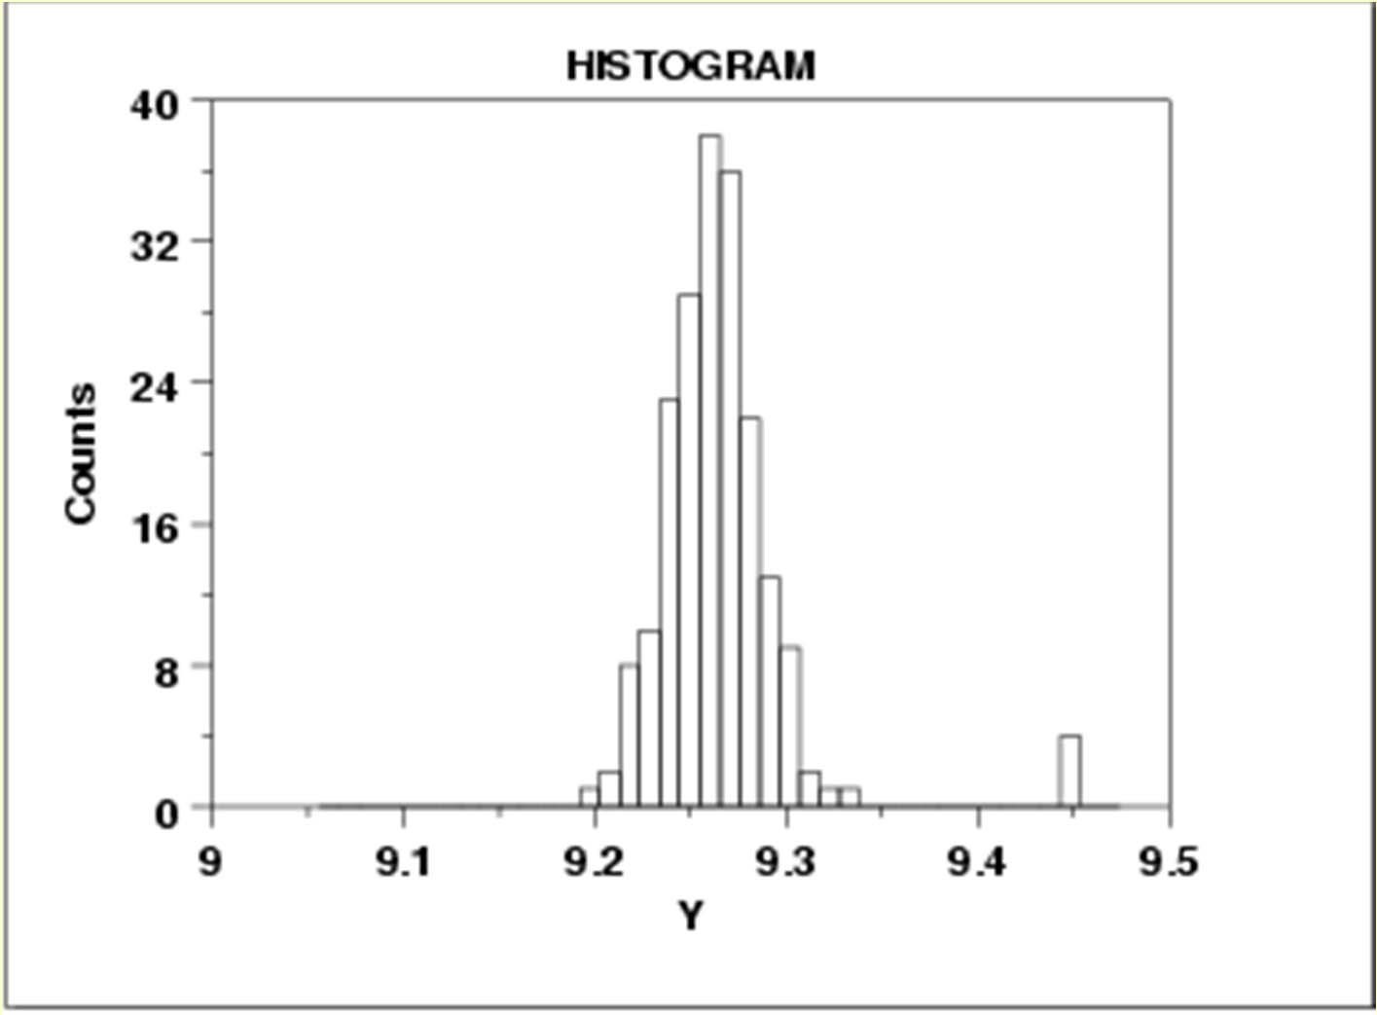

Slide 19
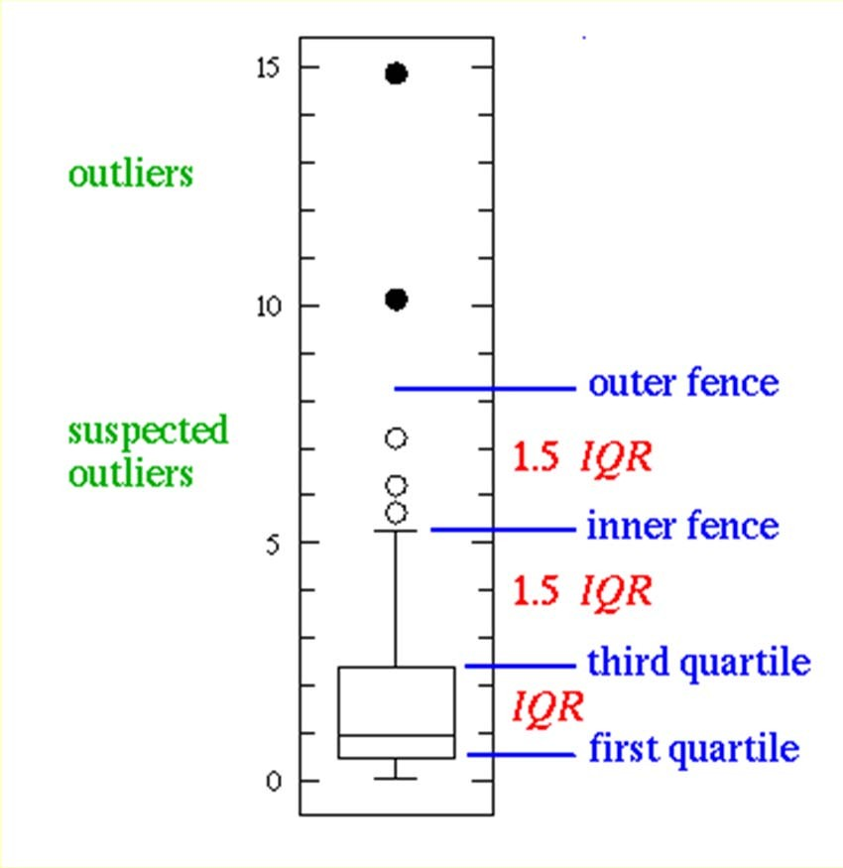
Outlier detection
Univariate
Boxplot: An observation is an extreme outlier if
(Q1-3×IQR, Q3+3×IQR), where IQR=Q3-Q1
(IQR = Inter Quartile Range)
and declared a mild outlier if it lies outside of the interval
(Q1-1.5×IQR, Q3+1.5×IQR).
http://www.physics.csbsju.edu/stats/box2.html
44

Slide 20
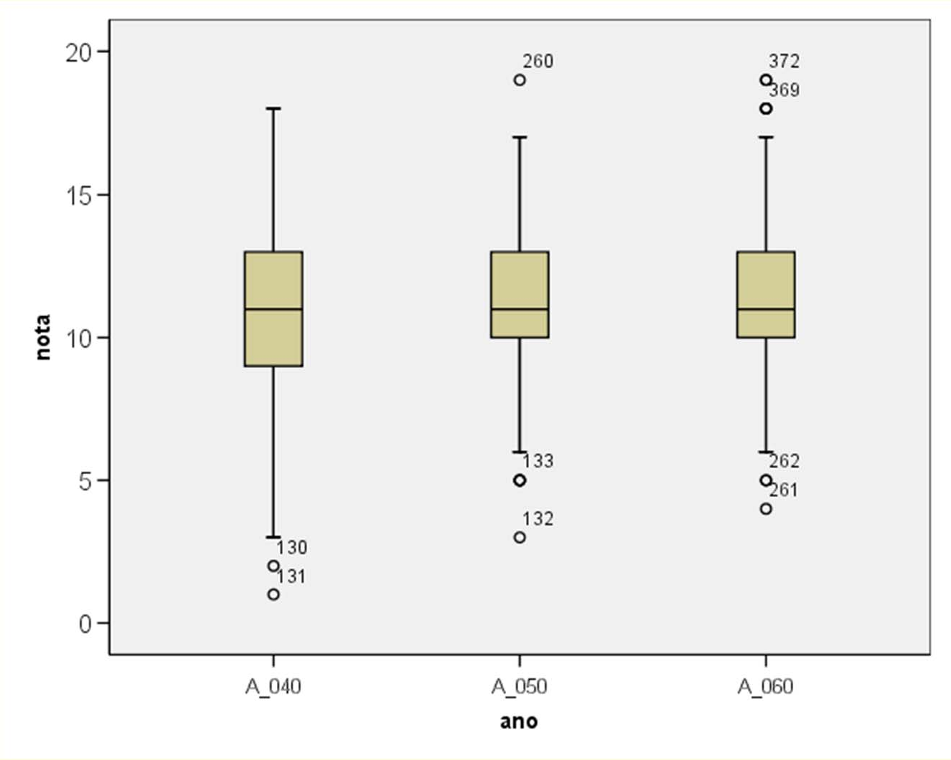
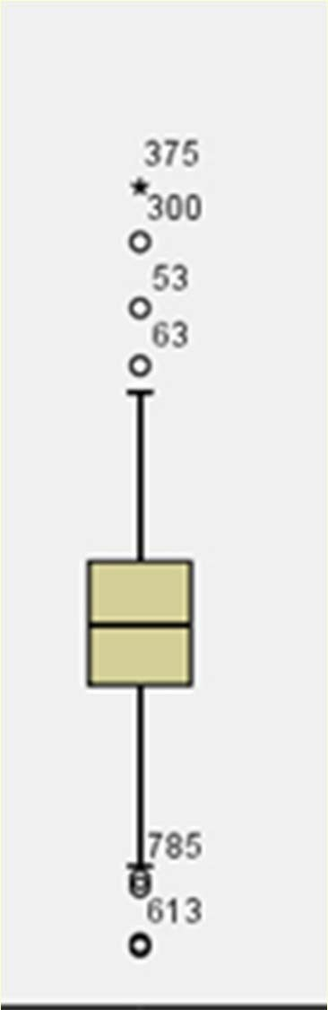
> 3 L
> 1.5 L
L

Slide 21
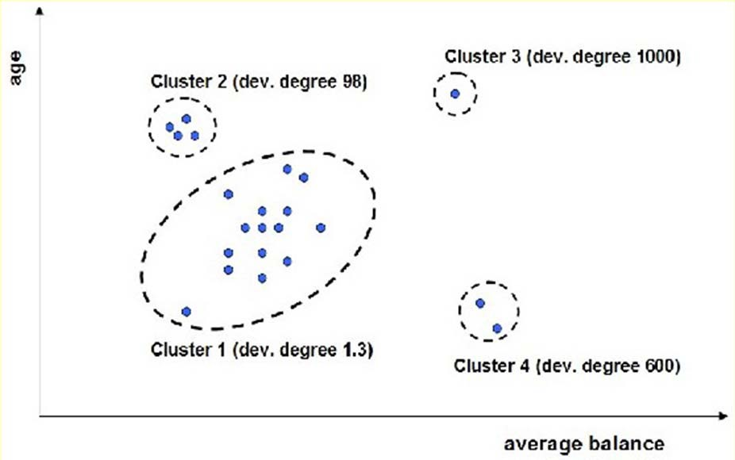
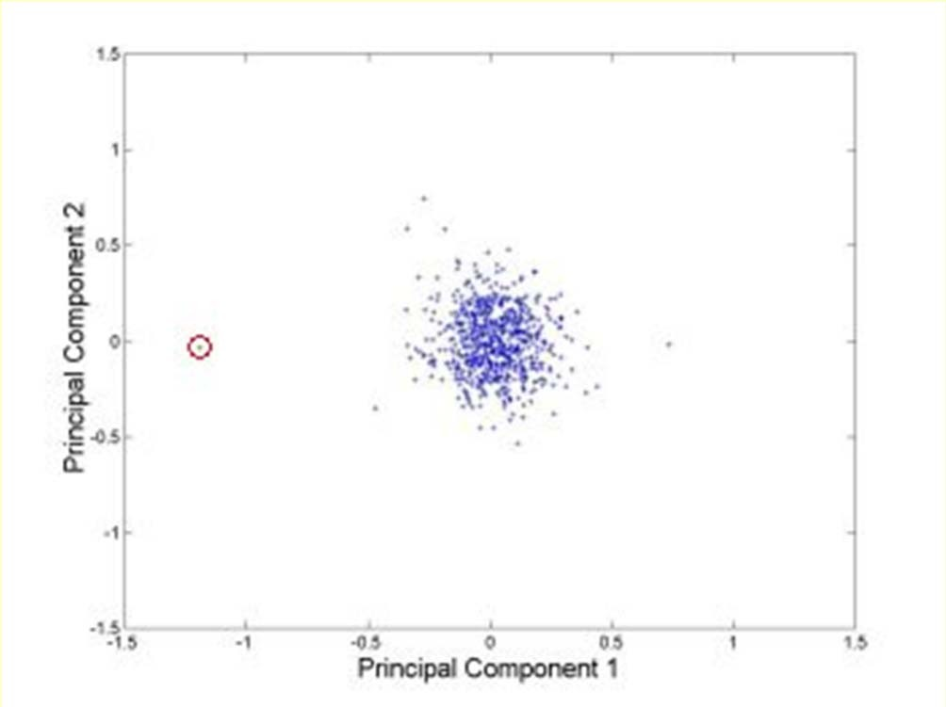
Outlier detection
Multivariate
Clustering
Very small clusters are outliers
http://www.ibm.com/developerworks/data/li brary/techarticle/dm-0811wurst/

Slide 22
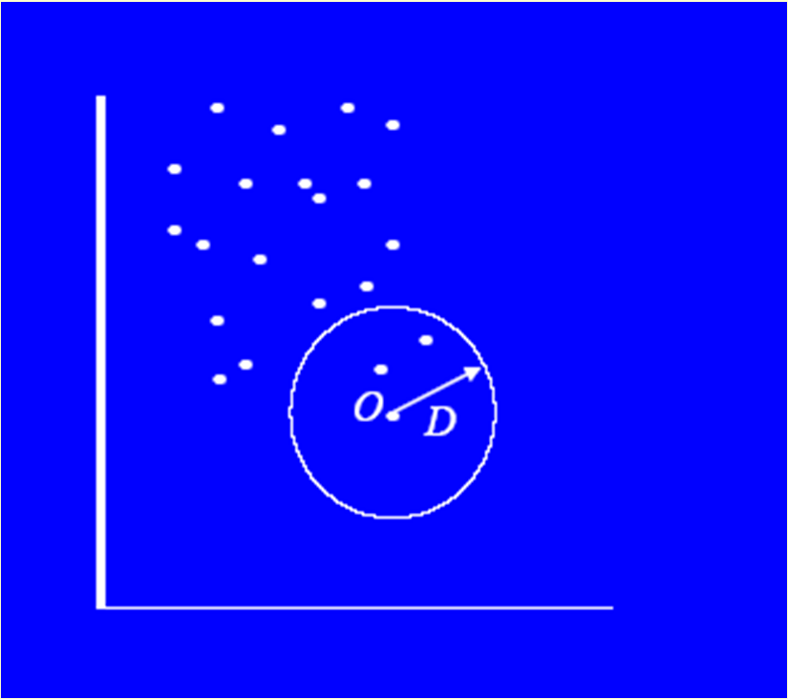
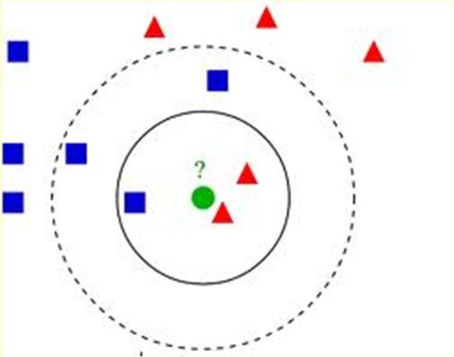
Outlier detection
Multivariate
Distance based
An instance with very few neighbors within D is regarded as an outlier
Knn algorithm

Slide 23
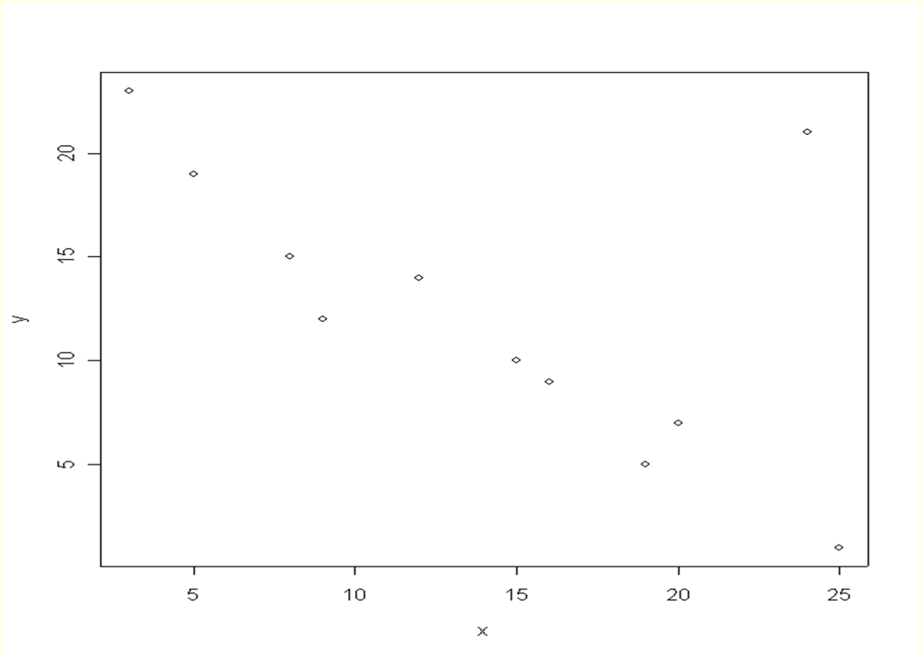
A bi-dimensional outlier that is not an outlier in either of its projections.

Slide 24

Recommended reading
Only with hard work and a favorable context you will have the chance to become an outlier!!!

Slide 25
DATA TRANSFORMATION

Slide 26
Normalization
For distance-based methods, normalization helps to prevent that attributes with large ranges out-weight attributes with small ranges
min-max normalization
z-score normalization
normalization by decimal scaling

Slide 27
Normalization
min-max normalization
v ' =
v − min v
(new _ max v − new_min )
v + new_minv
max v − min v
z-score normalization
_{v ' =} v − v
does not eliminate outliers
σ _{v}
normalization by decimal scaling
v
10 ^{j}
Where j is the smallest integer such that Max(| v' |)<1
range: -986 to 917 => j=3 -986 -> -0.986 917 -> 0.917
v' =

Slide 28
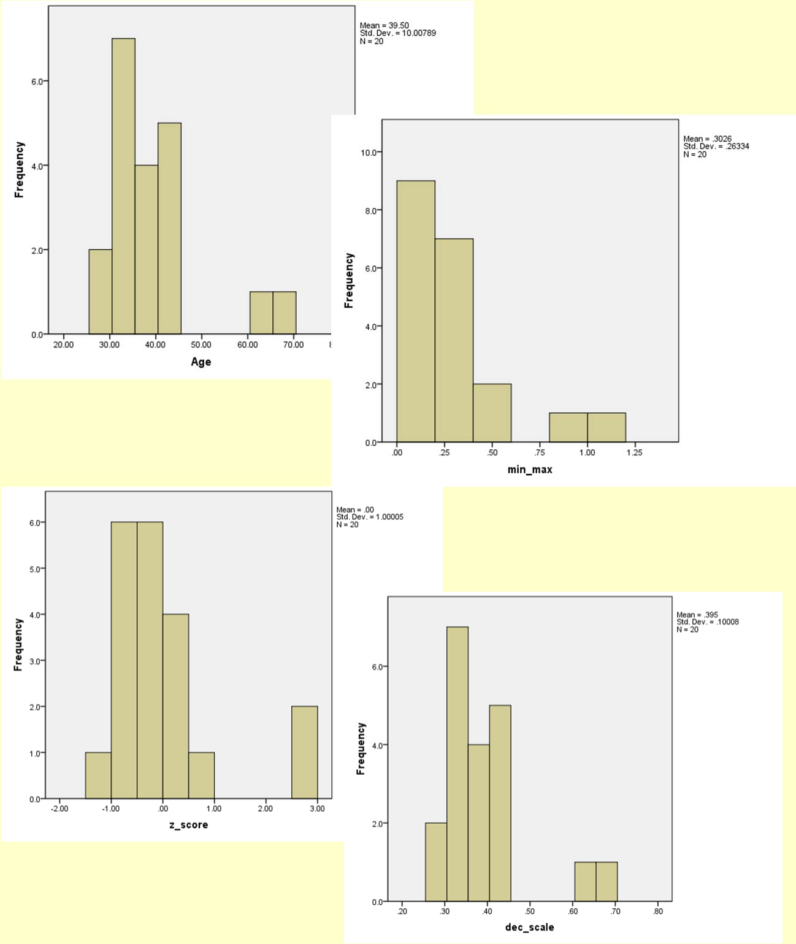
Age | min‐max (0‐1) | z‐score | dec. scaling
44 | 0.421 | 0.450 | 0.44
35 | 0.184 | ‐0.450 | 0.35
34 | 0.158 | ‐0.550 | 0.34
34 | 0.158 | ‐0.550 | 0.34
39 | 0.289 | ‐0.050 | 0.39
41 | 0.342 | 0.150 | 0.41
42 | 0.368 | 0.250 | 0.42
31 | 0.079 | ‐0.849 | 0.31
28 | 0.000 | ‐1.149 | 0.28
30 | 0.053 | ‐0.949 | 0.3
38 | 0.263 | ‐0.150 | 0.38
36 | 0.211 | ‐0.350 | 0.36
42 | 0.368 | 0.250 | 0.42
35 | 0.184 | ‐0.450 | 0.35
33 | 0.132 | ‐0.649 | 0.33
45 | 0.447 | 0.550 | 0.45
34 | 0.158 | ‐0.550 | 0.34
65 | 0.974 | 2.548 | 0.65
66 | 1.000 | 2.648 | 0.66
38 | 0.263 | ‐0.150 | 0.38
28 | minimun
66 | maximum
39.50 | avgerage
10.01 | standard deviation
53

Slide 29
MISSING DATA

Slide 30
Missing Data
Data is not always available
E.g., many tuples have no recorded value for several attributes, such as customer income in sales data
Missing data may be due to
equipment malfunction
inconsistent with other recorded data and thus deleted
data not entered due to misunderstanding
certain data may not be considered important at the time of entry
not register history or changes of the data
Missing data may need to be inferred.
Missing values may carry some information content: e.g. a credit application may carry information by noting which field the applicant did not complete

Slide 31
Missing Values
There are always MVs in a real dataset
MVs may have an impact on modelling, in fact, they can destroy it!
Some tools ignore missing values, others use some metric to fill in replacements
The modeller should avoid default automated replacement techniques
Difficult to know limitations, problems and introduced bias
Replacing missing values without elsewhere capturing that information removes information from the dataset

Slide 32
How to Handle Missing Data?
Ignore records (use only cases with all values)
Usually done when class label is missing as most prediction methods do not handle missing data well
Not effective when the percentage of missing values per attribute varies considerably as it can lead to insufficient and/or biased sample sizes
Ignore attributes with missing values
Use only features (attributes) with all values (may leave out important features)
Fill in the missing value manually
tedious + infeasible?

Slide 33
How to Handle Missing Data?
Use a global constant to fill in the missing value
e.g., “unknown”. (May create a new class!)
Use the attribute mean to fill in the missing value
It will do the least harm to the mean of existing data
If the mean is to be unbiased
What if the standard deviation is to be unbiased?
Use the attribute mean for all samples belonging to the same class to fill in the missing value

Slide 34
How to Handle Missing Data?
Use the most probable value to fill in the missing value
Inference-based such as Bayesian formula or decision tree
Identify relationships among variables
Linear regression, Multiple linear regression, Nonlinear regression
Nearest-Neighbour estimator
Finding the k neighbours nearest to the point and fill in the most frequent value or the average value
Finding neighbours in a large dataset may be slow

Slide 35
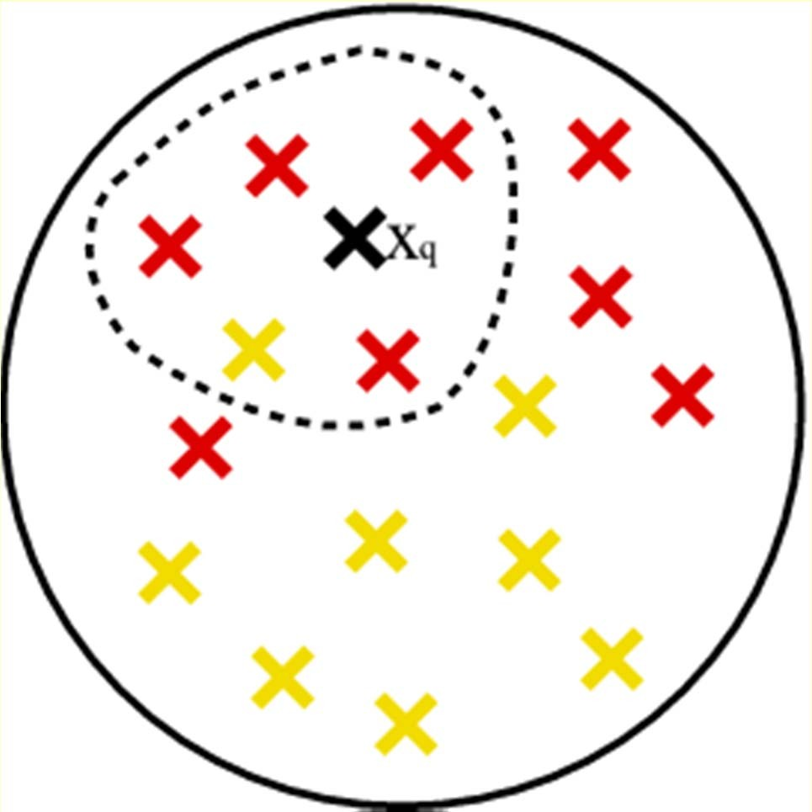
Nearest-Neighbour

Slide 36
How to Handle Missing Data?
Note that, it is as important to avoid adding bias and distortion to the data as it is to make the information available.
bias is added when a wrong value is filled-in
No matter what techniques you use to conquer the problem, it comes at a price. The more guessing you have to do, the further away from the real data the database becomes. Thus, in turn, it can affect the accuracy and validation of the mining results.

Slide 37
Summary
Every real world data set needs some kind of data pre-processing
Deal with missing values
Correct erroneous values
Select relevant attributes
Adapt data set format to the software tool to be used
In general, data pre-processing consumes more than 60% of a data mining project effort

Slide 38
Noisy Data
Q: What is noise?
A: Random error in a measured variable.
Incorrect attribute values may be due to
faulty data collection instruments
data entry problems
data transmission problems
technology limitation
inconsistency in naming convention
Other data problems which requires data cleaning
duplicate records
incomplete data
inconsistent data

Slide 39
How to Handle Noisy Data?
Binning method:
first sort data and partition into (equi-depth) bins
then one can smooth by bin means, smooth by bin median, smooth by bin boundaries, etc.
used also for discretization (discussed later)
Clustering
detect and remove outliers
Semi-automated method: combined computer and human inspection
detect suspicious values and check manually
Regression
smooth by fitting the data into regression functions

Slide 40
Simple Discretization Methods: Binning
Equal-width (distance) partitioning:
It divides the range into N intervals of equal size: uniform grid
if A and B are the lowest and highest values of the attribute, the width of intervals will be: W = (B-A)/N.
The most straightforward
But outliers may dominate presentation
Skewed data is not handled well.
Equal-depth (frequency) partitioning:
It divides the range into N intervals, each containing approximately same number of samples
Good data scaling
Managing categorical attributes can be tricky.

Slide 41
Binning Methods for Data Smoothing
* Sorted data for price (in dollars): 4, 8, 9, 15, 21, 21, 24, 25, 26, 28, 29, 34
* Partition into (equi-depth) bins:
- Bin 1: 4, 8, 9, 15
- Bin 2: 21, 21, 24, 25
- Bin 3: 26, 28, 29, 34
* Smoothing by bin means:
- Bin 1: 9, 9, 9, 9
- Bin 2: 23, 23, 23, 23
- Bin 3: 29, 29, 29, 29
* Smoothing by bin boundaries:
- Bin 1: 4, 4, 4, 15
- Bin 2: 21, 21, 25, 25
- Bin 3: 26, 26, 26, 34

Slide 42
How to Handle Inconsistent Data?
Manual correction using external references
Semi-automatic using various tools
To detect violation of known functional dependencies and data constraints
To correct redundant data

Slide 43
Data Integration
Data integration:
combines data from multiple sources into a coherent store
Schema integration
integrate metadata from different sources
Entity identification problem: identify real world entities from multiple data sources, e.g., A.cust-id ≡ B.cust-#
Detecting and resolving data value conflicts
for the same real world entity, attribute values from different sources are different
possible reasons: different representations, different scales, e.g., metric vs. British units, different currency

Slide 44
Handling Redundant Data in Data Integration
Redundant data occur often when integrating multiple DBs
The same attribute may have different names in different databases
One attribute may be a “derived” attribute in another table, e.g., annual revenue
Redundant data may be able to be detected by correlational analysis
Careful integration can help reduce/avoid redundancies and inconsistencies and improve mining speed and quality

Slide 45
Data Reduction
Problem:
Data Warehouse may store terabytes of data: Complex data analysis/mining may take a very long time to run on the complete data set
Solution?
Data reduction…

Slide 46
Data Reduction
Obtains a reduced representation of the data set that is much smaller in volume but yet produces the same (or almost the same) analytical results
Data reduction strategies
Data cube aggregation
Dimensionality reduction
Data compression
Numerosity reduction
Discretization and concept hierarchy generation

Slide 47
Dimensionality Reduction
Problem: Feature selection (i.e., attribute subset selection):
Select a minimum set of features such that the probability distribution of different classes given the values for those features is as close as possible to the original distribution given the values of all features
Nice side-effect: reduces # of attributes in the discovered patterns (which are now easier to understand)
Solution: Heuristic methods (due to exponential # of choices) usually greedy:
step-wise forward selection
step-wise backward elimination
combining forward selection and backward elimination
decision-tree induction

Slide 48
Example of Decision Tree Induction
nonleaf nodes: tests
branches: outcomes of tests
leaf nodes: class prediction
Initial attribute set:
{A1, A2, A3, A4, A5, A6}
A4 ?
A1?
A6?
Class 1
Class 2
Class 1
Class 2
>
Reduced attribute set: {A1, A4, A6}

Slide 49
Heuristic Feature Selection Methods
There are 2^{d} possible sub-features of d features
Several heuristic feature selection methods:
Best single features under the feature independence assumption: choose by significance tests.
Step-wise feature selection:
The best single-feature is picked first
Then next best feature condition to the first, ...
Step-wise feature elimination:
Repeatedly eliminate the worst feature
Combined feature selection and elimination:
Optimal branch and bound:
Use feature elimination and backtracking

Slide 50
Data Compression
String compression
There are extensive theories and well-tuned algorithms
Typically lossless
But only limited manipulation is possible without expansion
Audio/video, image compression
Typically lossy compression, with progressive refinement
Sometimes small fragments of signal can be reconstructed without reconstructing the whole
Time sequence is not audio
Typically short and vary slowly with time

Slide 51
Data Compression
Original Data
Compressed
Data
lossless
Original Data
Approximated
lossy

Slide 52
Principal Component Analysis (PCA) Karhunen-Loeve (K-L) method
Given N data vectors from k-dimensions, find
c <= k orthogonal vectors that can be best used to represent data
The original data set is reduced (projected) to one consisting of N data vectors on c principal components (reduced dimensions)
Each data vector is a linear combination of the c principal component vectors
Works for ordered and unordered attributes
Used when the number of dimensions is large

Slide 53
Principal Component Analysis
The principal components (new set of axes) give important information about variance.
Using the strongest components one can reconstruct a good approximation of the original signal.
X2
Y1
Y2
X1

Slide 54
Numerosity Reduction
Parametric methods
Assume the data fits some model, estimate model parameters, store only the parameters, and discard the data (except possible outliers)
E.g.: Log-linear models: obtain value at a point in m-D space as the product on appropriate marginal subspaces
Non-parametric methods
Do not assume models
Major families: histograms, clustering, sampling

Slide 55
Regression and Log-Linear Models
Linear regression: Data are modeled to fit a straight line:
Often uses the least-square method to fit the line
Multiple regression: allows a response variable y to be modeled as a linear function of multidimensional feature vector (predictor variables)
Log-linear model: approximates discrete multidimensional joint probability distributions

Slide 56
Regression Analysis and Log-Linear Models
Linear regression: Y = α + β X
Two parameters , α and β specify the line and are to be estimated by using the data at hand.
using the least squares criterion to the known values of Y1, Y2, …, X1, X2, ….
Multiple regression: Y = b0 + b1 X1 + b2 X2.
Many nonlinear functions can be transformed into the above.
Log-linear models:
The multi-way table of joint probabilities is approximated by a product of lower-order tables.
Probability: p(a, b, c, d) = αab βacχad δbcd

Slide 57
Histograms
Approximate data distributions
Divide data into buckets and store average (sum) for each bucket
A bucket represents an attribute-value/frequency pair
Can be constructed optimally in one dimension using dynamic programming
Related to quantization problems.

Slide 58
Clustering
Partition data set into clusters, and store cluster representation only
Quality of clusters measured by their diameter (max distance between any two objects in the cluster) or centroid distance (avg. distance of each cluster object from its centroid)
Can be very effective if data is clustered but not if data is “smeared”
Can have hierarchical clustering (possibly stored in multi-dimensional index tree structures (B+-tree, R-tree, quad-tree, etc))
There are many choices of clustering definitions and clustering algorithms (further details later)

Slide 59
Sampling
Allow a mining algorithm to run in complexity that is potentially sub-linear to the size of the data
Cost of sampling: proportional to the size of the sample, increases linearly with the number of dimensions
Choose a representative subset of the data
Simple random sampling may have very poor performance in the presence of skew
Develop adaptive sampling methods
Stratified sampling:
Approximate the percentage of each class (or subpopulation of interest) in the overall database
Used in conjunction with skewed data
Sampling may not reduce database I/Os (page at a time).
Sampling: natural choice for progressive refinement of a reduced data set.

Slide 60
Sampling
SRSWOR
(simple random
sample without
replacement)
SRSWR
Raw Data

Slide 61
Sampling
Raw Data
Cluster/Stratified Sample

Slide 62
Hierarchical Reduction
Use multi-resolution structure with different degrees of reduction
Hierarchical clustering is often performed but tends to define partitions of data sets rather than “clusters”
Parametric methods are usually not amenable to hierarchical representation
Hierarchical aggregation
An index tree hierarchically divides a data set into partitions by value range of some attributes
Each partition can be considered as a bucket
Thus an index tree with aggregates stored at each node is a hierarchical histogram

Slide 63
Discretization/Quantization
Three types of attributes:
Nominal — values from an unordered set
Ordinal — values from an ordered set
Continuous — real numbers
Discretization/Quantization:
divide the range of a continuous attribute into intervals
Some classification algorithms only accept categorical attributes.
Reduce data size by discretization
Prepare for further analysis
x1
x2
x3
x4
x5
y1
y2
y3
y4
y5
y6

Slide 64
Discretization and Concept Hierarchy
Discretization
reduce the number of values for a given continuous attribute by dividing the range of the attribute into intervals. Interval labels can then be used to replace actual data values.
Concept Hierarchies
reduce the data by collecting and replacing low level concepts (such as numeric values for the attribute age) by higher level concepts (such as young, middle-aged, or senior).

Slide 65
Discretization and concept hierarchy generation for numeric data
Hierarchical and recursive decomposition using:
Binning (data smoothing)
Histogram analysis (numerosity reduction)
Clustering analysis (numerosity reduction)
Entropy-based discretization
Segmentation by natural partitioning

Slide 66
Segmentation by natural partitioning
3-4-5 rule can be used to segment numeric data into relatively uniform, “natural” intervals.
It partitions a given range into 3,4, or 5 equiwidth intervals recursively level-by-level based on the value range of the most significant digit.
* If an interval covers 3, 6, 7 or 9 distinct values at the most significant digit, partition the range into 3 equi-width intervals
* If it covers 2, 4, or 8 distinct values at the most significant digit, partition the range into 4 intervals
* If it covers 1, 5, or 10 distinct values at the most significant digit, partition the range into 5 intervals

Slide 67
Example of 3-4-5 rule
count
Step 1:
-$351 -$159 profit $1,838 $4,700
Min Low (i.e, 5%-tile) High(i.e, 95%-0 tile) Max
Step 2:
msd=1,000 Low=-$1,000 High=$2,000
Step 3:
(-$1,000 - $2,000)
(-$1,000 - 0)
(0 -$ 1,000)
($1,000 - $2,000)
Step 4:
(-$4000 -$5,000)
(-$400 - 0)
(0 - $1,000)
($1,000 - $2, 000)
($2,000 - $5, 000)
(0 -
$200)
($1,000 -
$1,200)
(-$400 -
-$300)
($2,000 -
$3,000)
($200 -
$400)
($1,200 -
$1,400)
(-$300 -
-$200)
($3,000 -
$4,000)
($400 -
$600)
($1,400 -
$1,600)
(-$200 -
-$100)
($4,000 -
$5,000)
($600 -
$800)
($1,600 -
$1,800)
($1,800 -
$2,000)
($800 -
$1,000)
(-$100 -
0)

Slide 68
Concept hierarchy generation for categorical data
Categorical data: no ordering among values
Specification of a partial ordering of attributes explicitly at the schema level by users or experts
Specification of a portion of a hierarchy by explicit data grouping
Specification of a set of attributes, but not of their partial ordering
Specification of only a partial set of attributes

Slide 69
Concept hierarchy generation w/o data semantics - Specification of a set of attributes
Concept hierarchy can be automatically generated based on the number of distinct values per attribute in the given attribute set. The attribute with the most distinct values is placed at the lowest level of the hierarchy (limitations?)
country
15 distinct values
province_or_ state
65 distinct values
city
3567 distinct values
street
674,339 distinct values

Slide 70
Summary
Data preparation is a big issue for both warehousing and mining
Data preparation includes
Data cleaning and data integration
Data reduction and feature selection
Discretization
A lot a methods have been developed but still an active area of research

