Slide 1
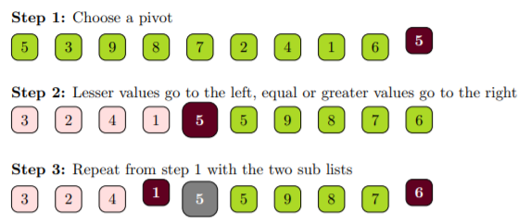
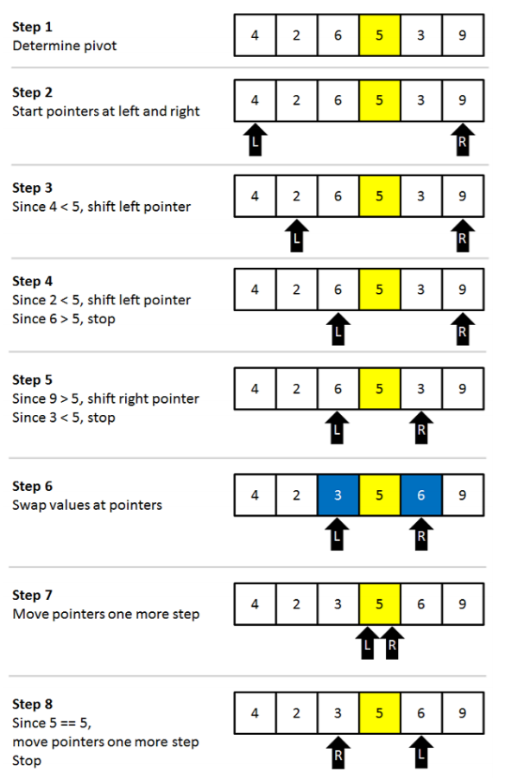
Best Case, Average Case and Worst
Case of Quick Sort
Hammad Ansari
Abstract
MATERIALS AND METHODS
While L is to the left of R, we move L right, skipping all the elements less than the pivot. If an element is found greater then the pivot, L stops. While R is to the right of L, we move R left, skipping all the elements greater than the pivot. If an element is found less then the pivot, R stops. When both L and R have stopped, the elements are swapped. When L and R have crossed, no swap is performed, scanning stops, and the element pointed to by L is swapped with the pivot. In the example the first swapping will be between 3 and 6.
2. Restore the pivot.
After restoring the pivot we obtain the following partitioning into three groups:
[4,2,3] [ 5 ] [6,9]
STEP 3: Recursively quicksort the left and the right parts.
Fig 2. How Quick Sort Works
Quicksort is a sorting algorithm and also known as a Partition-Exchange Sort in which
partition is carried out dynamically. Quicksort is a comparison sort and is popular because it
is not difficult to implement, works well for a variety of different kinds of input data, and is
substantially faster than any other sorting method in typical applications.
In this paper we study about how quicksort is implemented, its algorithm and examples. We
even look at the partitioning in detail with comparisons to the other sorts and its complexity.
Example :
Pick an element, say P(the pivot).
Re-arrange the elements into 3 sub-blocks,
1. Those less than or equal to <= P (the left-block)
2. P (the only element in the middle-block)
3. Those greater then or equal to >= P (the right-block)
Repeat the process recursively for the left and right sub-blocks.(That is the results of left-block, followed by P, followed by the results of right-block).
Fig 1. Example
Partitioning:
The Basic Partition:
Choose an arbitrary element. Place the all smaller values to the left. Place the all larger values to the right.
Improved Partitioning:
Different ways to select a good pivot:
1)Median-of-three elements - Pick three elements, and find the median x of these elements. Use that median as the pivot.
2)Random element - Randomly pick a element as a pivot.
Implementation :
STEP 1: Choosing the pivot
Choosing the pivot is an essential step. Depending on the pivot the algorithm may run very fast, or in quadric time. Some fixed element: e.g. the first, the last, the one in the middle. The median-of-three choice: take the first, the last and the middle element. Choose the median of these three elements.
Example:
4,2,6,5,3,9
The first element is 4, the middle is 5 , the last is 9 .
The median of [4,5,9] is 5
STEP 2: Partitioning
Partitioning is illustrated on the below example.
1. We want larger elements to go to the right and smaller elements to go to the left.
Two pointers L,R are used to scan the elements from left to right and from right to left:
[4,2,6,5,3,9]
L = first element 4 R = last element 9
Results
Objectives
One of the most widely studied practical problems in computer science is sorting: the use of a computer to put files in order. A person wishing to use a computer to sort is faced with the problem of determining which of the many available algorithms is best suited for his purpose. This task is becoming less difficult than it once was for three reasons. First, sorting is an area in which the mathematical analysis of algorithms has been particularly successful: we can predict the performance of many sorting methods and compare them intelligently. Second, we have a great deal of experience using sorting algorithm, and we can learn from that experience to separate good algorithms from bad ones. Third, if the tile fits into the memory of the computer, there is one algorithm, called Quicksort, which has been shown to perform well in a variety of situations. Not only is this algorithm simpler than many other sorting algorithms, but empirical and analytic studies show that Quicksort can be expected to be up to twice as fast as its nearest competitors.
The three steps of quicksort are :
Divide : Rearrange the elements and split the array into two sub arrays such that each element
on the left sub array is less than or equal to the middle element and each element in the right
sub array is greater than the middle element.
Conquer : Recursively sort the two sub arrays.
Combine : None.

