Slide 1
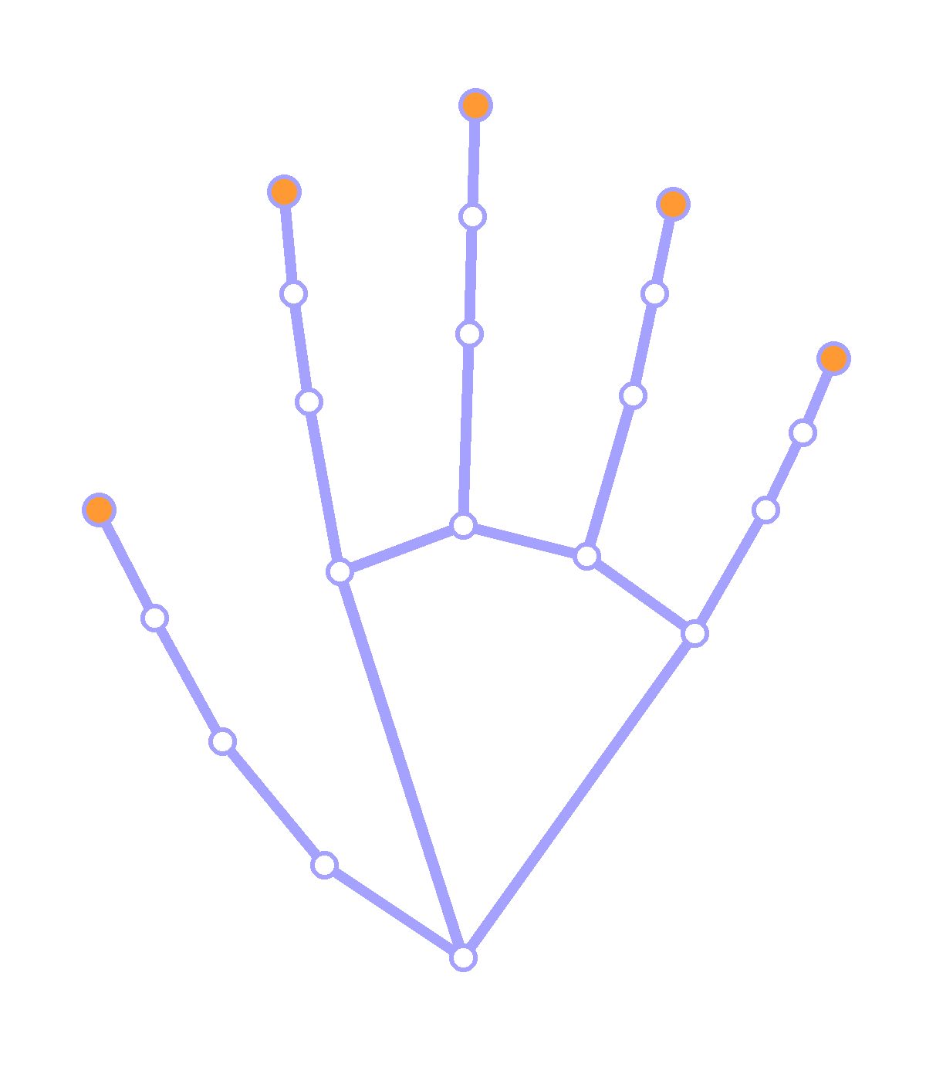
Hack for Social Cause | Theme 10: Assistive Technology
Sanket Setu
सउकेत सेतु
Har sanket, ab samajhne ke aur kareeb.
A limited-vocabulary ISL sign-recognition and communication-support prototype for help desks. One hand sign in, Hindi and English out, and a human always confirms before anything is understood.
Team:
[ team member names and roles ]
21 landmarks
MediaPipe hand tracking, drawn to scale
VBYLD 2027 | Public source repository

Slide 2
THE PROBLEM - NO SHARED LANGUAGE AT THE COUNTER
A signing visitor and a hearing clerk, with no way to talk
AVAILABILITY
ACCURACY
FIT FOR THE TASK
Bring an interpreter
Paper note, or guess the gesture
Existing sign-to-text ML
Not present at every counter on every day. Costs money, costs time, and the queue does not wait.
Slow and ambiguous, and often wrong exactly when it matters most. There is no shared vocabulary to fall back on.
Trained on videos of full signs. A single still frame of a static one-hand sign is a different task, and the public datasets are small or closed.
THE GAP
There is no dependable, offline, single-snapshot aid for the static signs people actually use at a counter.
2
We are not quoting a statistic we cannot source. If the team has a citable figure on access to services, put it here with its citation.

Slide 3
THE SOLUTION - ONE INTERFACE, TWO CLEARLY LABELLED ENGINES
Two engines, each honest about what it is
What the visitor sees
ENGINE A - AVAILABLE TODAY
Geometric baseline
तीन
Counts the extended fingers straight from the landmarks. Needs no training data, so it works on a real hand from day one.
Three
Rule-based, not machine learning. Numeral signs only. No accuracy claim.
model score 0.87 (not accuracy)
visitor confirms before it reaches the clerk
ENGINE B - NEEDS REAL DATA
ML classifier
Mock of the interface. Replace with a real screenshot before you present.
A RandomForest over 63-d landmark vectors collected from real consenting signers, with a signer-held-out split.
Score is an uncalibrated model score, not accuracy. Threshold tuned on validation only.
Photo
>
21 landmarks
>
63 numbers
>
Classify or refuse
>
Hindi + English
3
Both engines share one inference module, so the web app and the webcam runner can never disagree.

Slide 4
HOW IT WORKS - ONE PIPELINE, FOUR GUARDRAILS
Why the numbers mean something
>
>
>
>
1
2
3
4
5
Capture
Landmarks
Normalise
Classify
Confirm
Photo or webcam frame
MediaPipe finds 21 points
Wrist-relative, hand-size scaled
Forest score, or a rule count
Visitor agrees, staff replies
The four guardrails
Signer-held-out split
Threshold tuned on validation only
Refuses below threshold
Landmarks only, never images
A random split over frames of the same person inflates the score and means nothing.
The test partition is read exactly once, and the threshold is never fitted to it.
A confident wrong answer is worse than no answer, so the app says 'try again'.
Consent is asked first, and a signer can withdraw their rows at any time.
Capture-time gates that stop a bad dataset: one deliberate sample per press, a stability gate, a size gate, and a minimum separation between two samples of the same sign.
4

Slide 5
IMPACT AND SCALABILITY - TARGETS SET, RESULTS MEASURED
What we have measured, and what we have promised
MEASURED RESULTS
PROPOSED KPIs - TARGETS ONLY
Not yet measured
Per-class held-out macro F1
[ target ]
The team is collecting samples from consenting signers. Every number below will be copied from reports/metrics.json after a real training run.
Unknown-sign rejection rate
[ target ]
End-to-end response time
[ target ]
Held-out test accuracy
pending
Task completion in user testing
[ target ]
Macro F1
pending
User-reported ease of use
[ target ]
Per held-out signer accuracy
pending
These are the KPIs the team will be judged against once the pilot runs. They are labelled as targets on purpose.
Unknown-sign rejection rate
pending
SCALABILITY
The vocabulary is configuration, not code. More signs, regions and languages are added by editing one JSON file, not by rewriting the model.
5

Slide 6
STATUS AND ROADMAP - WHAT IS FINISHED, WHAT IS NOT
Where we actually are, and what we do next
Where we actually are
Roadmap
Y
Consent-gated capture with stability, size and separation gates
WEEK 1
Verify the vocabulary with an interpreter. Collect from signers 1 to 3.
Y
Two engines behind one shared inference module
Y
Group-aware training, per-signer report, honest threshold
WEEK 2
Extend to 5 signers. Train. Read the held-out report. Fill the model card.
Y
Web app plus a local webcam runner
Y
Test suite, model card, data protocol, slide outline, demo script
WEEK 3
Pilot at a help desk with 3 to 5 Deaf visitors. Measure task completion.
Dataset from real consenting signers
Sign verification by a Deaf signer or ISL interpreter
WEEK 4
Add moving signs with a temporal model. Write the deployment guide.
Trained model with measured held-out metrics
User study with Deaf participants
The critical path is the interpreter session. It is also the thing a judge should push us on.
6
Y = built and tested empty box = still open

Slide 7
TEAM AND DISCLOSURE
Sanket Setu
सउकेत सेतु
TEAM
AI-USE DISCLOSURE
[ member name ] - [ role ]
Tools used: [ AI coding and research tools, with versions ]
Helped with: [ code scaffolding, test skeletons, documentation wording ]
Built and verified by us: [ vocabulary verification, data collection, training, evaluation ]
Estimated AI-assisted share: [ estimate ]
[ member name ] - [ role ]
[ member name ] - [ role ]
One team member per role. Fill in names before submitting.
PUBLIC SOURCE REPOSITORY
[ repository URL ]
Har sanket, ab samajhne ke aur kareeb.
We would rather ship five signs we verified with a Deaf signer than five hundred we guessed. The app refuses when it is not sure, and so does this project.
Thank you.
7

