Slide 1
Forward Hook
Real-time liquidity underwriting for Uniswap V4
2026, frwd labs
01 / 11

Slide 2
02
Goal
Sustainable Liquidity & MEV Protection
Permissionless
Attract Liquidity
Solve the Hookathon problem without sacrificing open execution.
Composable
Trust-minimized
Goal: attract more durable liquidity while reducing value leakage from MEV and LVR.
frwd labs
02 / 11
Notes:
We are looking to solve the Hookathon problem of sustainable liquidity and MEV Protection

Slide 3
03
Existing Solutions
Existing Approaches
Dynamic fees via volatility predictors
Oracle-anchored pools
Auction the lag
Contracts try to price risk with formulas or volatility signals set before execution.
Oracles move the AMM closer to external market prices, but still update in discrete steps.
Auctions and solver systems route the price gap to a competition layer.
These approaches help, but each still has to deal with the synchronization boundary.
frwd labs
03 / 11

Slide 4
04
Existing Solutions: Concessions
What each approach concedes
Program in advance
Oracle-anchored pools
Sync failure: no formula can perfectly predict external market state before it changes.
Shifts the sync problem to the oracle. Latency, update thresholds, and ordering risk remain.
Auction the lag
Solver systems
OFAs & MEV-Share
Accepts lag instead of removing it.
Can introduce centralization or permissioning around execution.
May look competitive while still depending on who controls order flow.
frwd labs
04 / 11

Slide 5
05
Traditional Finance Analogy
TradFi baseline
Forward Hook adaptation
Markout analytics measures what happens after a trade to evaluate flow quality and adverse selection.
Use the same idea to underwrite liquidity in real time: assess expected flow quality before execution and feed the result into controls.
Forward Hook adapts markout logic to onchain liquidity underwriting.
frwd labs
05 / 11

Slide 6
06
Insight
Information asymmetry is profitable because of a State Synchronization inherent to the execution environment. Informed Flow can adapt faster than a static smart contract
Price lag
Block time
Mempool visibility
The DEX state falls out of sync with the global market state. MEV and LVR are the economic value of that gap.
The chain updates in discrete intervals. Between blocks, AMM state is frozen while external markets keep moving.
Public pending transactions let informed actors react to synchronization attempts before execution.
Why hardcoding the contract fails
A contract cannot pre-program every future external market state or guarantee where a transaction will land in a block.
frwd labs
06 / 11

Slide 7
07
Forward Hook Solution
Forward Hook treats MEV and LVR as state synchronization problems, and uses feed forward prediction to identify counterparties and implement controls before value leaks.
Generalize the problem
Assess risk ahead of execution
Impose a cost
LPs and uninformed traders leak value when DEX state lags informed traders.
A feed-forward risk assessment can implement controls before the trade settles.
Unknown or high-risk addresses can face fees or controls high enough to reduce exploitability.
frwd labs
07 / 11

Slide 8
08
Interface & Verification
The interface makes the risk logic visible enough for LPs, users, and regulated asset issuers to inspect.
LPs
Users
Regulators / Asset Issuers
Verify why a trade received a fee or control.
Understand execution constraints before interacting.
Review the rationale behind risk decisions.
Verification should be understandable from the interface itself.
frwd labs
08 / 11

Slide 9
09
Benefits
Permissionless execution
Keeps the system open while adding risk-aware controls.
Better flow discrimination
Dynamic fees can distinguish informed flow from uninformed flow.
More durable liquidity
Better protection can attract more and better liquidity.
Verifiable logic
LPs and stakeholders can inspect the basis for risk decisions.
frwd labs
09 / 11

Slide 10
10
Future Impacts
The same structure can extend beyond MEV protection into broader onchain risk controls.
Regulated assets
Market structure
• Regulatory impact for RWAs
• Natural opening for AI | ML onchain
• Applies to other risk types
• LPs can change underwriters to avoid vendor lock-in
• Risk gates without forcing KYC onchain
• Funding-source controls through trusted exchanges with AML programs
frwd labs
10 / 11

Slide 11
11
Ongoing Research
The remaining work is making the underwriting layer useful without making it a new gatekeeper.
Information centralization
Verifiable logic
Underwriter choice
How to mitigate the concentration of risk models, data, and decision power.
How to make the logic auditable enough for distributed consensus.
How LPs can switch underwriters while preserving trust-minimized execution.
frwd labs
11 / 11

Slide 12
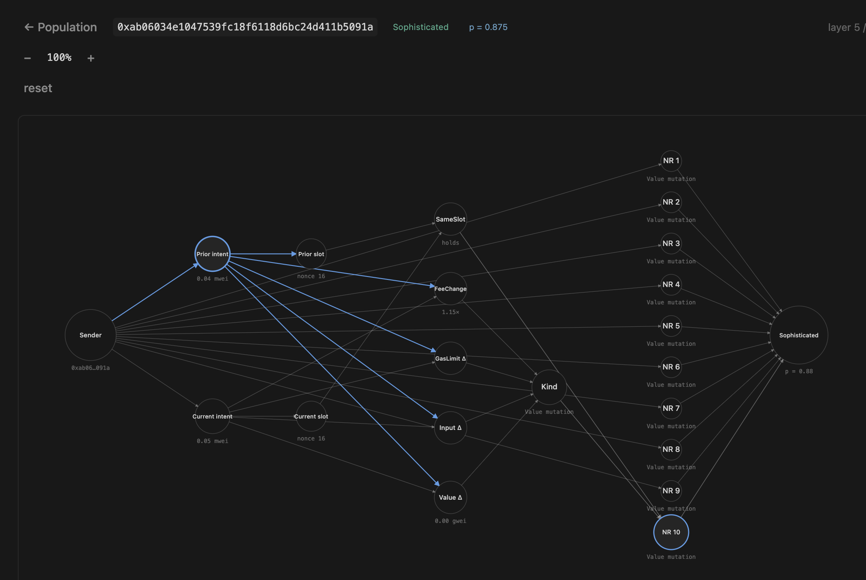
08
Core Product: Automated Onchain Risk Decision Support
Enables:
Real Time Action
Non-Brittle, Adaptable Detection
frwd labs
08 /11

Slide 13
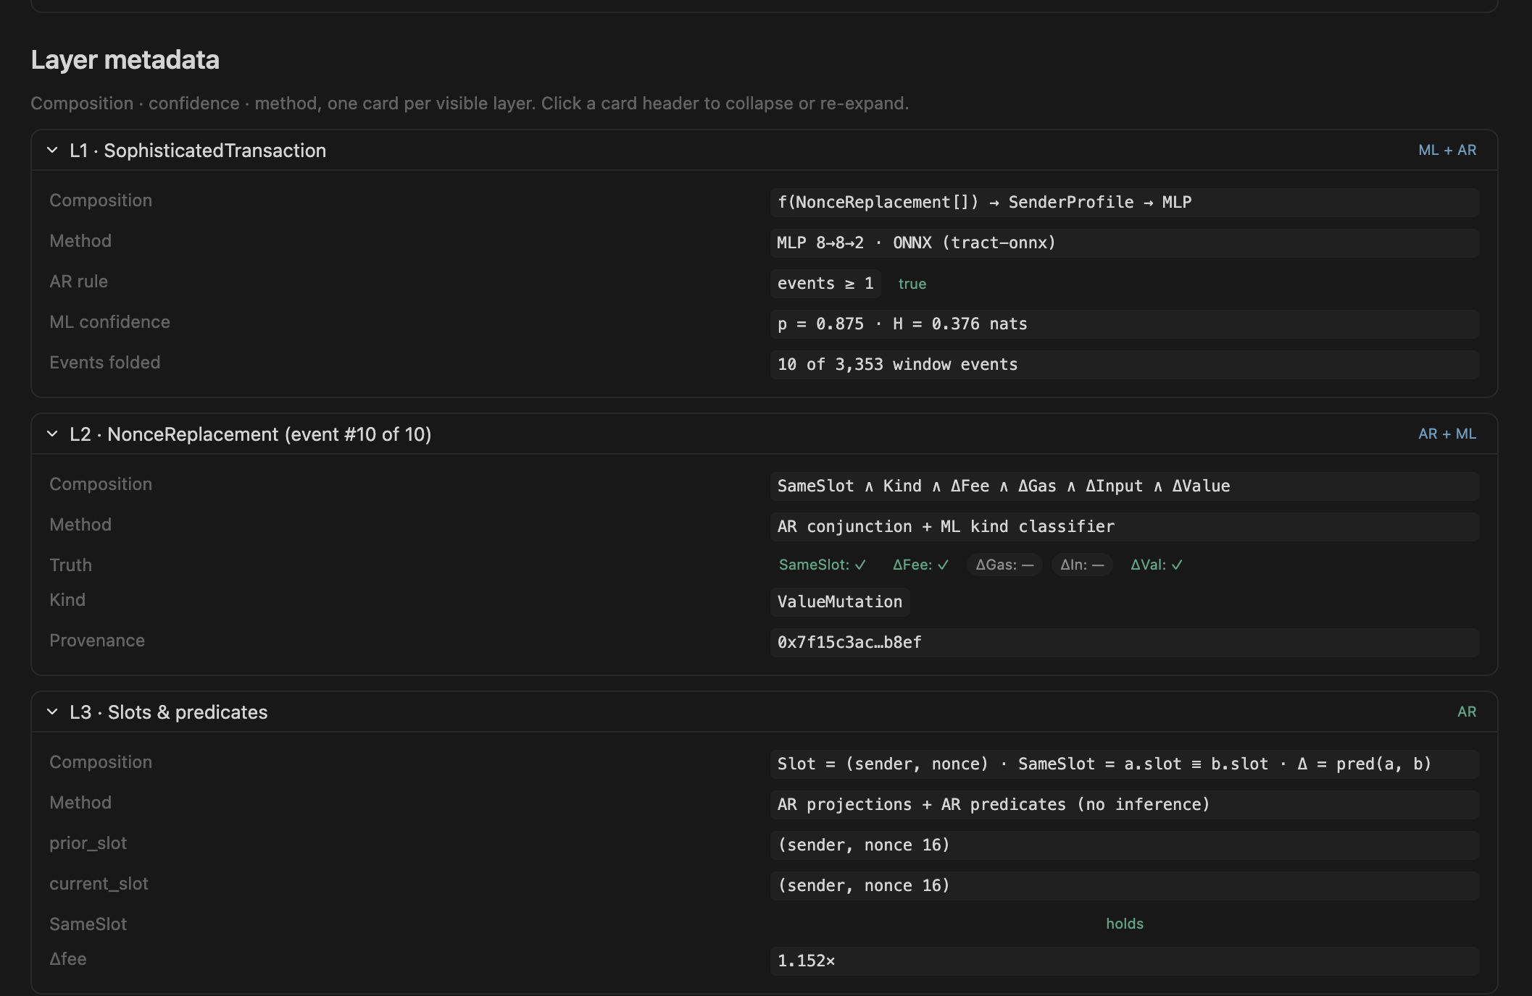
08
Core Product: Automated Onchain Risk Decision Support
Enables:
Decision Assurance – Reasoning Chain Fully Auditable
Provide regulators and stakeholders with supporting rational, not just black-box ML
frwd labs
08 /11

Slide 14
09
Opportunity | Financial Markets Move Onchain
Existing category:
After the Fact Intelligence
Use Case
Investigation Entity attribution Flow Tracing
Customer Profile:
Law enforcement
Banks & Traditional Finance
Chainalysis TRM Labs Nansen
Emerging category:
Real Time Risk Infrastructure
Use Case
automation integration programmable enforcement
Customer Profile
stablecoins tokenized securities onchain funds regulated DeFi
Law enforcement
Supplement
Frwd Labs
Build
frwd labs
09 / 11

Slide 15
10
Business Model
Current wedge customers
Compliance platforms
enhance existing risk-analysis (example: Scorechain)
Onchain ecosystems
support immediate needs - detect market manipulation / incentive farming / wash trading (example: Plume)
Pricing Model
Behavior-based risk signal API:
$25k–150k annual license
Long-term vision customers
Digital Asset Issuers Onchain Exchanges
Blockchain Networks
Pricing model
platform license: $250k – $1.5M annually
usage-based pricing:
per risk query or transaction volume tier
frwd labs
10 / 11

