Slide 1
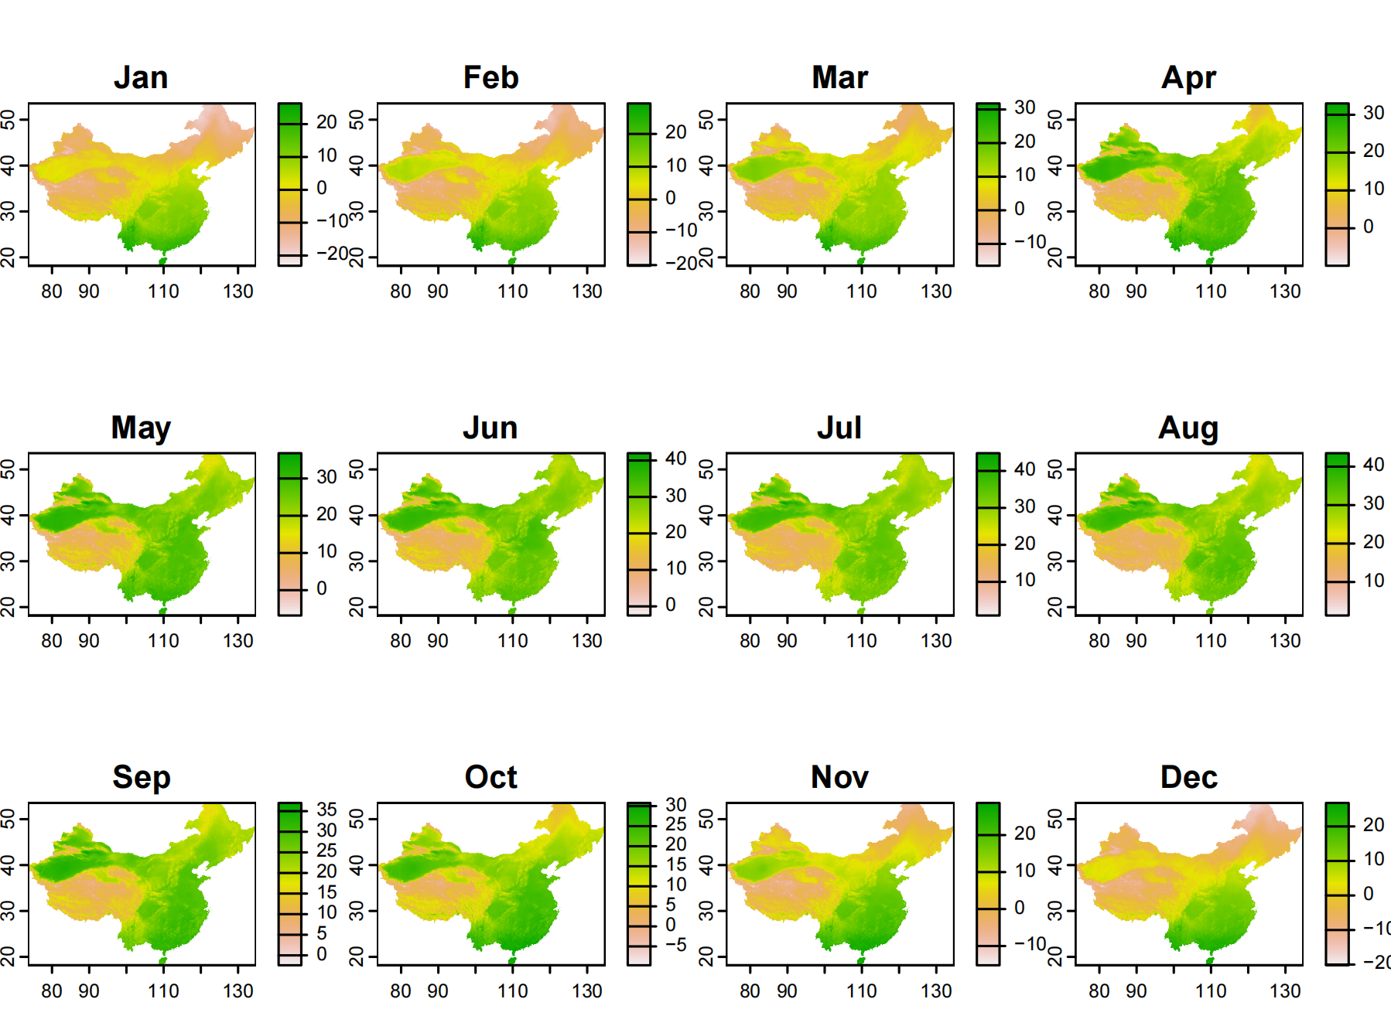
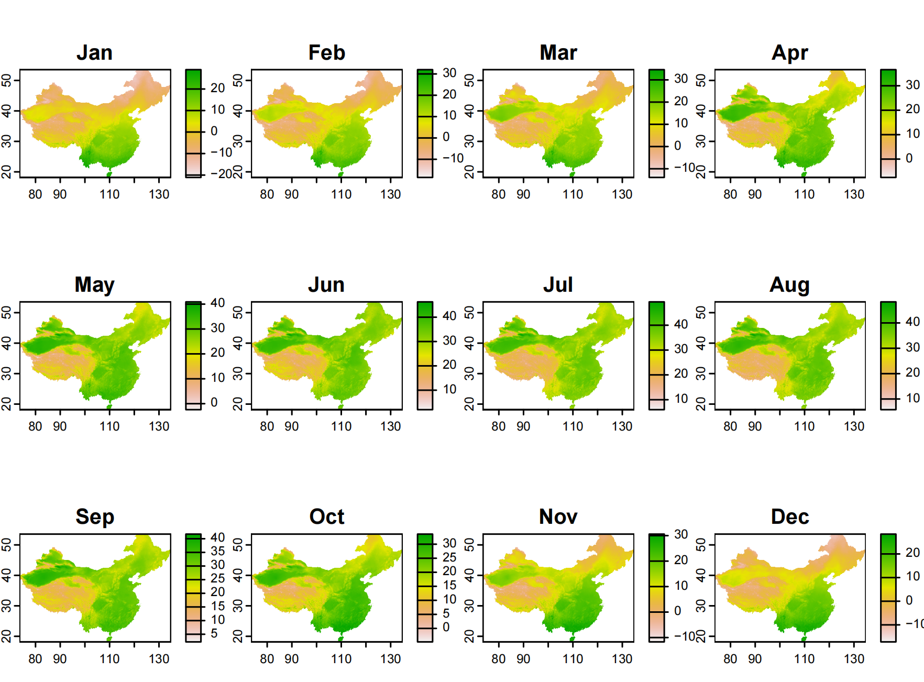
SSP126
SSP585
A Whole Picture of Temp Differences in China Between SSP1 and SSP5

Slide 2
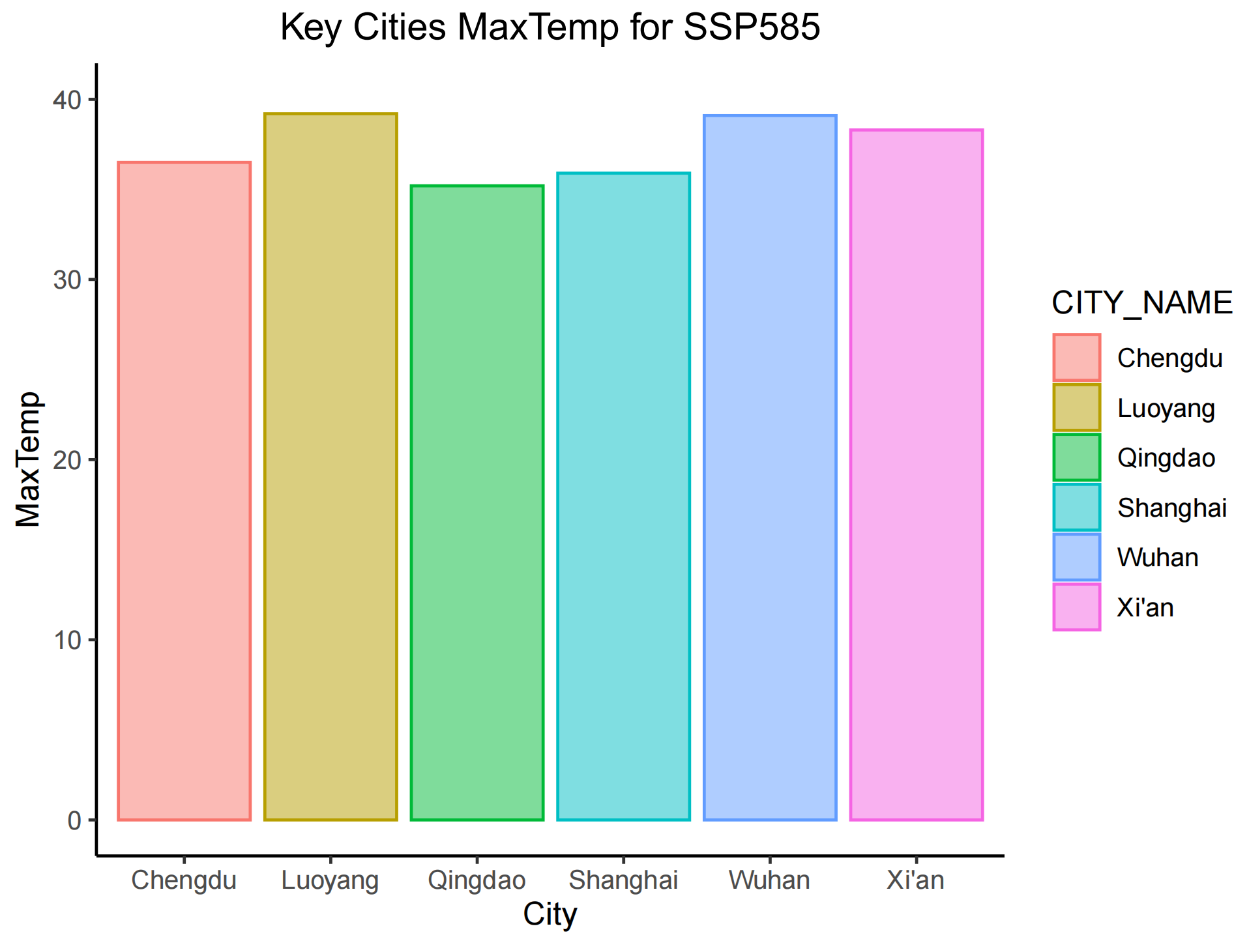
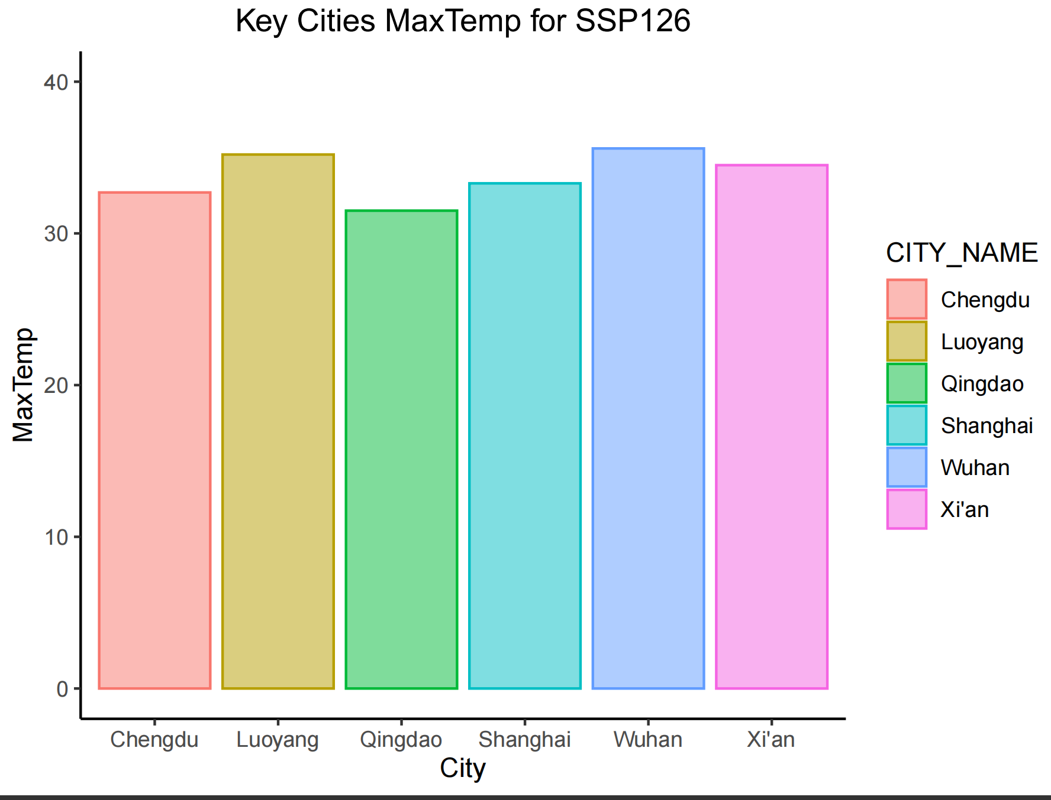
SSP126
SSP585
Difference in Maximum Annual Temperature of Several Chinese Cities Between SSP1 and SSP5
Viewing through the two diagram, we can draw a conclusion that the SSP5 future have a higher leverage of annual tempertuare for cities in average. Such increase of temperture will cause significant climate changes and disasters. It indicates that we should pay more effort to environmental policy, international relationship, even lifestyles, so that changing our development mode, and pursue for a low-energy-consumption future.

