Slide 1
Layer Assignment
Thomas Dost, Jonas Lange, Francesca Rybicki

Slide 2
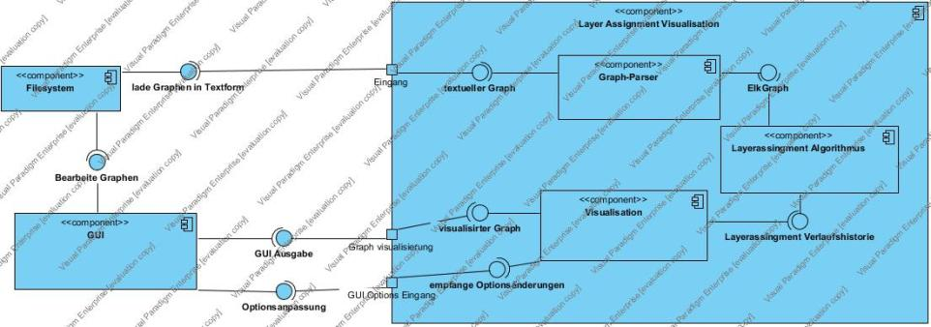
Layer Assignment
Component Diagram

Slide 3
Layer Assignment
Component Diagram

Slide 5
Layer Assignment Visualized

Slide 6
Layer Assignment Visualized
Parsing

Slide 7
Layer Assignment Visualized
Parsing
Applying the Algorithm

Slide 8
Layer Assignment Visualized
Parsing
Visualization
Applying the Algorithm

Slide 9
Parsing

Slide 10
Parsing
Textformat for Graphs
Translate Textformat to ElkGraph
Error Handling
Cycle breaking
Parsing
1 node n1
2 node n2
3 node n3
4 node n4
5 edge n1 n3
6 edge n2 n3
7 edge n3 n4
8 edge n2 n4
ElkGraph

Slide 11
Parsing
Textformat for Graphs
Translate Textformat to ElkGraph
Error Handling
Cycle breaking
Parsing
1 node n1
2 node n2
3 node n3
4 node n4
5 edge n1 n3
6 edge n2 n3
7 edge n3 n4
8 edge n2 n4
ElkGraph

Slide 12
Assigning Layers

Slide 13
Assigning Layers
Implementing the Layer Assignment Algorithm
Translate ElkGraph to MyGraph
Output: Array of MyGraph
Testing
Applying the Algorithm
Cycle-free ElkGraph
Array of MyGraph

Slide 14
Assigning Layers
Implementing the Layer Assignment Algorithm
Translate ElkGraph to MyGraph
Output: Array of MyGraph
Testing
Applying the Algorithm
Cycle-free ElkGraph
Array of MyGraph

Slide 15
Visualizing

Slide 16
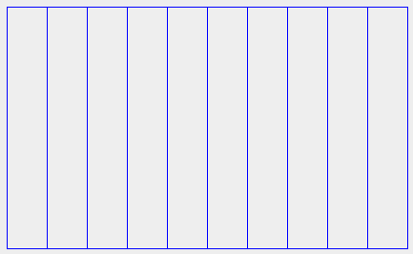
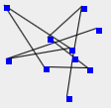

Visualizing
Toolbox (not fancy)
Toolbox (fancy)
MiniGraph and Layer
Animating Assignment
Toggle Textual View
Multiple Tabs
Visualization

Slide 17
Visualizing
Toolbox (not fancy)
Toolbox (fancy)
MiniGraph and Layer
Animating Assignment
Toggle Textual View
Multiple Tabs
Visualization

Slide 18
To Dos:
Textformat for Graphs
Translate Textformat to ElkGraph
Error Handling
Cycle breaking
Implementing the Layer Assignment Algorithm
Translate ElkGraph to MyGraph
Output: Array of MyGraph
Testing
Toolbox (not fancy)
Toolbox (fancy)
MiniGraph and Layer
Animating Assignment
Toggle Textual View
Multiple Tabs
Parsing
Applying the Algorithm
Visualization

