Slide 1
Layer Assignment
Thomas Dost, Jonas Lange, Francesca Rybicki

Slide 2
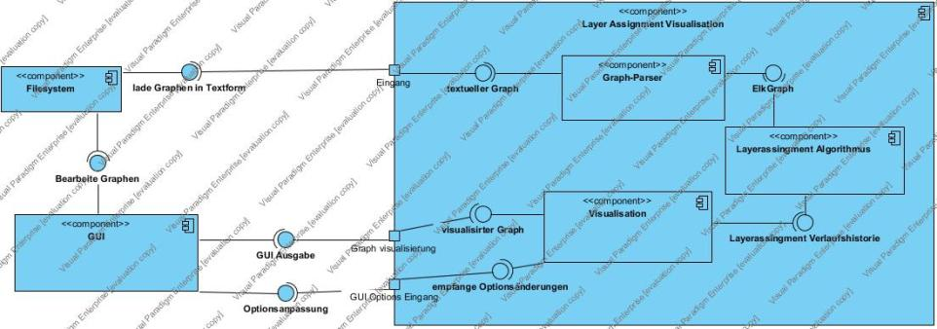
Layer Assignment
Component Diagram

Slide 3
Layer Assignment
Component Diagram

Slide 5
Layer Assignment Visualized

Slide 6
Layer Assignment Visualized
Parsing

Slide 7
Layer Assignment Visualized
Parsing
Applying the Algorithm

Slide 8
Layer Assignment Visualized
Parsing
Visualization
Applying the Algorithm

Slide 9
Parsing
Textformat für Graphen
Textformat in ElkGraph übersetzen
Error Handling
Cycle breaking
Parsing
1 node n1
2 node n2
3 node n3
4 node n4
5 edge n1 n3
6 edge n2 n3
7 edge n3 n4
8 edge n2 n4
ElkGraph

Slide 10
Parsing
Textformat für Graphen
Textformat in ElkGraph übersetzen
Error Handling
Cycle breaking
Parsing
1 node n1
2 node n2
3 node n3
4 node n4
5 edge n1 n3
6 edge n2 n3
7 edge n3 n4
8 edge n2 n4
ElkGraph

Slide 11
Assigning Layers
Implementing the Layer Assignment Algorithm
Translate ElkGraph to MyGraph
Output: Array of MyGraph
Testing
Applying the Algorithm
Zykelfreier ElkGraph
Array of MyGraph

Slide 12
Assigning Layers
Implementing the Layer Assignment Algorithm
Translate ElkGraph to MyGraph
Output: Array of MyGraph
Testing
Applying the Algorithm
Zykelfreier ElkGraph
Array of MyGraph

Slide 13
Visualizing
Textformat für Graphen
Textformat in ElkGraph übersetzen
Error Handling
Cycle breaking
Visualization

Slide 14
To Dos:
Textformat für Graphen
Textformat in ElkGraph übersetzen
Error Handling
Cycle breaking
Implementing the Layer Assignment Algorithm
Translate ElkGraph to MyGraph
Output: Array of MyGraph
Testing
Textformat für Graphen
Textformat in ElkGraph übersetzen
Error Handling
Cycle breaking
Parsing
Applying the Algorithm
Visualization

