Slide 1
IE410 — Advanced Computer Programming
Diabetes Prediction with
Machine Learning on CDC BRFSS 2015
An End-to-End Study: EDA → Modeling → Calibration → Explainability
İBRAHİM HAKKI KELEŞ
Student ID: 22050351013
Yıldırım Beyazıt University · Spring 2026

Slide 2
Outline
• 1. Motivation & Problem Definition
• 2. Dataset Overview (BRFSS 2015)
• 3. Exploratory Data Analysis
• 4. Preprocessing Pipeline
• 5. Methodology & Evaluation Metrics
• 6. Candidate Models (6 Algorithms)
• 7. Study 2 — Model Screening
• 8. Study 2 — Hyperparameter Tuning
• 9. Study 3 — Default Baselines
• 10. Class-Weight Balancing
• 11. SMOTE Resampling Comparison
• 12. ROC Curves — All Models
• 13. Threshold Optimization
• 14. Probability Calibration
• 15. SHAP — Explainable AI
• 16. Partial Dependence Plots
• 17. Conclusions & Limitations
• 18. Q&A
IE410 — Diabetes Prediction (BRFSS 2015) | İbrahim Hakkı Keleş
2 / 18

Slide 3
Motivation & Problem Definition
Why predict diabetes from low-cost survey indicators?
• Diabetes is a leading chronic disease affecting hundreds of millions globally.
• Early identification of at-risk individuals enables preventative intervention.
• Clinical lab tests (HbA1c, fasting glucose) are accurate but expensive to scale.
• Goal: use a free, self-reported survey to flag candidates for clinical follow-up.
Task
Success criterion
Binary classification: Diabetes_binary ∈ {0, 1} from 21 survey-based features (demographics, lifestyle, medical history).
High recall on the diabetic class without sacrificing AUC — false negatives are the costly error.
IE410 — Diabetes Prediction (BRFSS 2015) | İbrahim Hakkı Keleş
3 / 18

Slide 4
Dataset — CDC BRFSS 2015
Behavioral Risk Factor Surveillance System (CDC, 2015)
253,680
21 + 1 target
13.9%
0
rows (respondents)
features
diabetic prevalence
missing values
Feature groups
• Medical: HighBP, HighChol, Stroke, HeartDiseaseorAttack, CholCheck, DiffWalk
• Lifestyle: BMI, Smoker, PhysActivity, Fruits, Veggies, HvyAlcoholConsump
• Healthcare: AnyHealthcare, NoDocbcCost, GenHlth, MentHlth, PhysHlth
• Demographics: Sex, Age, Education, Income
IE410 — Diabetes Prediction (BRFSS 2015) | İbrahim Hakkı Keleş
4 / 18

Slide 5
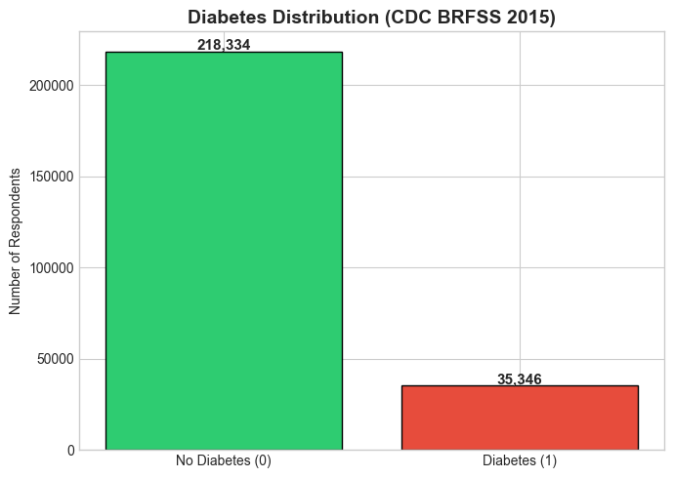
EDA — Class Imbalance & Key Distributions
Major class imbalance
• Healthy ≈ 218,334 (86.1%)
• Diabetic ≈ 35,346 (13.9%)
• Imbalance ratio ≈ 6.2 : 1
• Accuracy is misleading — even a naive 'always healthy' model scores 86%.
• Must use AUC, F1, recall on the diabetic class.
IE410 — Diabetes Prediction (BRFSS 2015) | İbrahim Hakkı Keleş
5 / 18

Slide 6
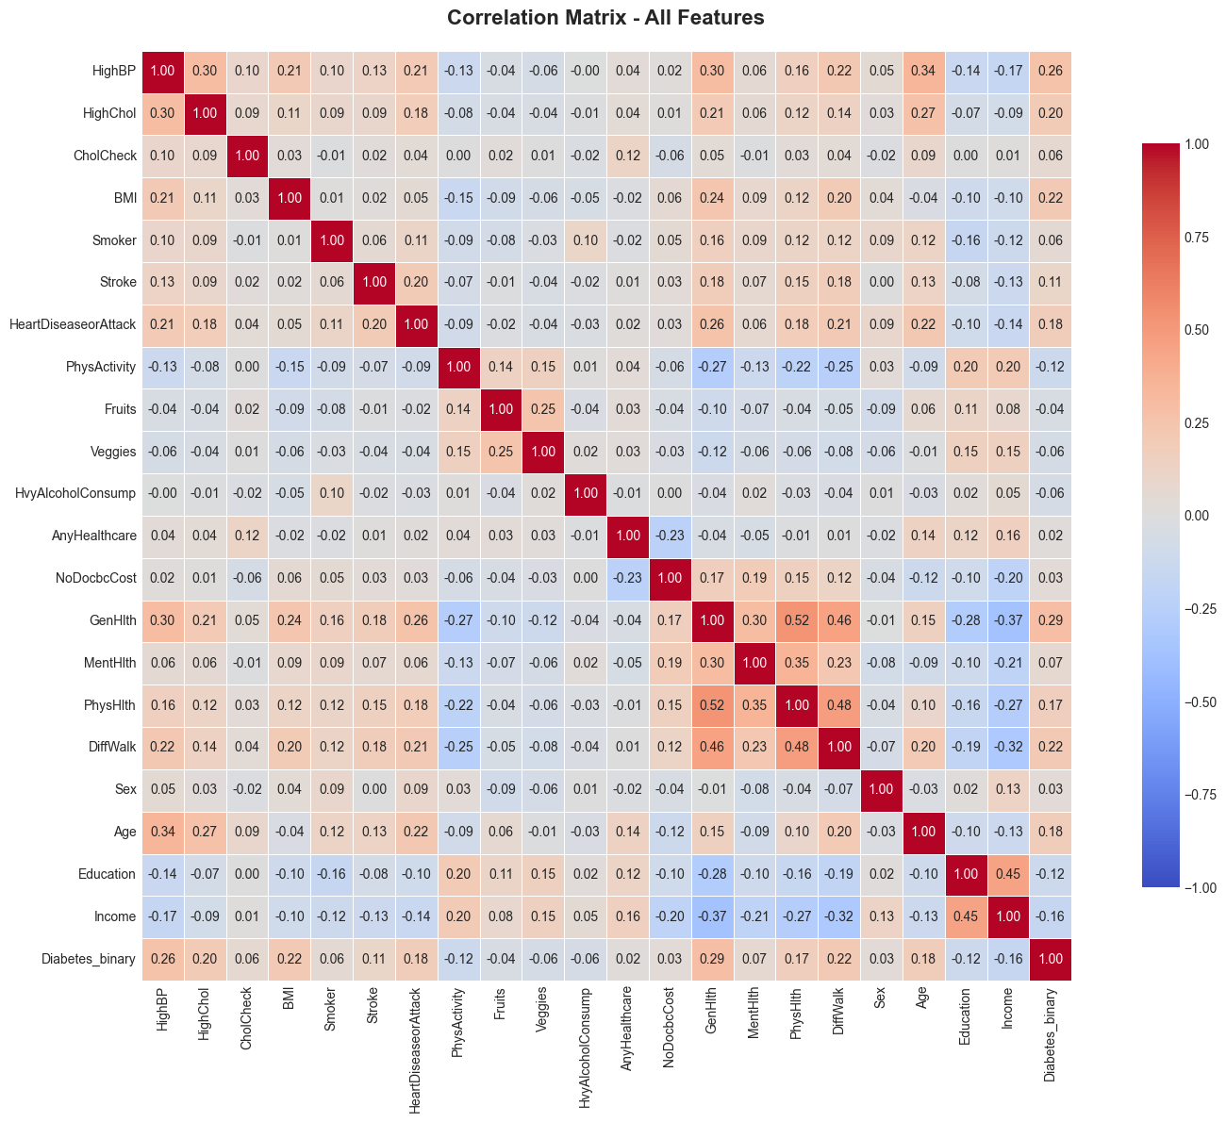
Preprocessing Pipeline
X = df.drop('Diabetes_binary', axis=1)
y = df['Diabetes_binary']
X_train, X_test, y_train, y_test = train_test_split(
X, y, test_size=0.2, stratify=y, random_state=42)
scaler = StandardScaler()
X_train_scaled = scaler.fit_transform(X_train)
X_test_scaled = scaler.transform(X_test)
Pipeline notes
• Stratified 80/20 train-test split preserves class ratio.
• StandardScaler fit on train only — no leakage into test set.
• No missing values, no imputation required.
• Categorical-ordinal features kept as integers (GenHlth, Education, …).
IE410 — Diabetes Prediction (BRFSS 2015) | İbrahim Hakkı Keleş
6 / 18

Slide 7
Methodology & Evaluation Metrics
Cross-validation and metric choice
• 5-fold StratifiedKFold cross-validation on the 80% training partition.
• Hyperparameter search: GridSearchCV for compact spaces, RandomizedSearchCV for larger ones.
• Final evaluation on the held-out 20% test set, untouched until the end.
Metric | Formula / Definition | Why we use it
Accuracy | (TP + TN) / N | Reference only — misleading under imbalance.
Precision | TP / (TP + FP) | How clean are the positive predictions?
Recall | TP / (TP + FN) | Catch as many diabetics as possible.
F1-score | 2·Precision·Recall / (Precision + Recall) | Balanced view when imbalance dominates.
ROC-AUC | Area under the TPR-FPR curve | Threshold-free ranking quality.
Brier | Mean squared error on probabilities | Probability calibration quality.
IE410 — Diabetes Prediction (BRFSS 2015) | İbrahim Hakkı Keleş
7 / 18

Slide 8
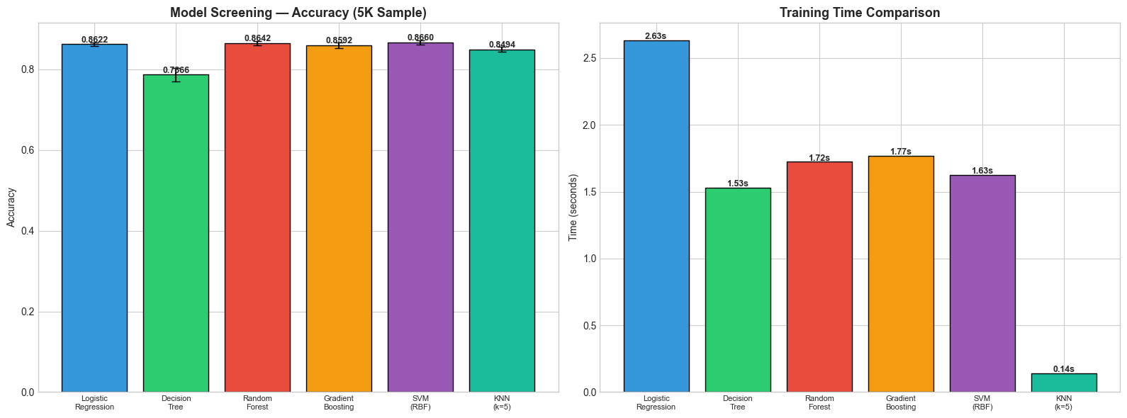
Six Candidate Algorithms
Selection rationale
• Mix of linear, tree, kernel, and instance-based models.
• Screened on 5,000-row sample for speed before tuning.
• Top performers carried into GridSearch (30,000 rows).
candidates = {
'Logistic Regression': LogisticRegression(max_iter=1000),
'Decision Tree': DecisionTreeClassifier(),
'Random Forest': RandomForestClassifier(
n_estimators=100, n_jobs=-1),
'Gradient Boosting': GradientBoostingClassifier(
n_estimators=100),
'SVM (RBF)': SVC(kernel='rbf'),
'KNN (k=5)': KNeighborsClassifier(n_neighbors=5),
}
IE410 — Diabetes Prediction (BRFSS 2015) | İbrahim Hakkı Keleş
8 / 18

Slide 9
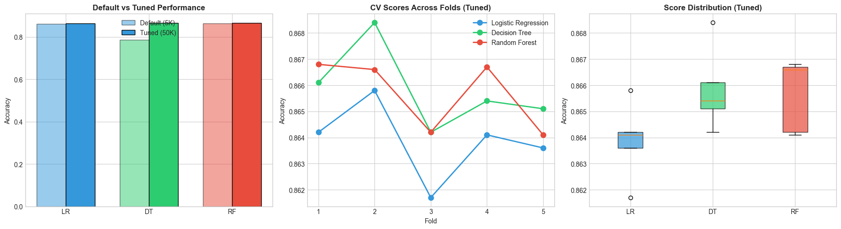
Study 2 — Hyperparameter Tuning (GridSearchCV)
Top result (5-fold CV mean accuracy)
cv_tune = StratifiedKFold(n_splits=5, shuffle=True, random_state=42)
grid_rf = GridSearchCV(
RandomForestClassifier(n_jobs=-1),
{'n_estimators': [50, 100, 200],
'max_depth': [5, 10, 15],
'min_samples_split': [2, 5]},
cv=cv_tune, scoring='accuracy', n_jobs=-1
)
grid_rf.fit(X_tune, y_tune)
• Logistic Regression: 0.8639 (C=0.01, l2)
• Decision Tree: 0.8658 (max_depth=5)
• Random Forest: 0.8657 (max_depth=10, n=200)
• Differences are within ±0.002 — models tie on accuracy.
IE410 — Diabetes Prediction (BRFSS 2015) | İbrahim Hakkı Keleş
9 / 18

Slide 10
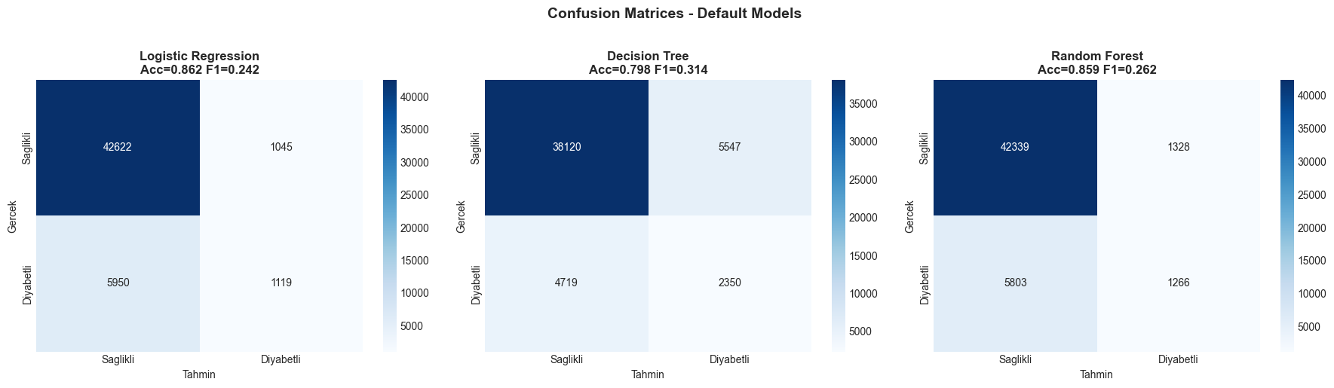
Study 3 — Default Baselines (no rebalancing)
models = {
'LR': LogisticRegression(max_iter=1000),
'DT': DecisionTreeClassifier(max_depth=10),
'RF': RandomForestClassifier(
n_estimators=100, n_jobs=-1),
}
for name, m in models.items():
m.fit(X_train_scaled, y_train)
y_pred = m.predict(X_test_scaled)
print(name, accuracy_score(y_test, y_pred))
Observation
• Accuracy ≈ 0.86 — looks great, but...
• Recall on diabetic class ≈ 0.16 (LR), 0.18 (RF).
• Models default to predicting 'healthy' — the imbalance bias.
• Need class-rebalancing strategies.
IE410 — Diabetes Prediction (BRFSS 2015) | İbrahim Hakkı Keleş
10 / 18

Slide 11
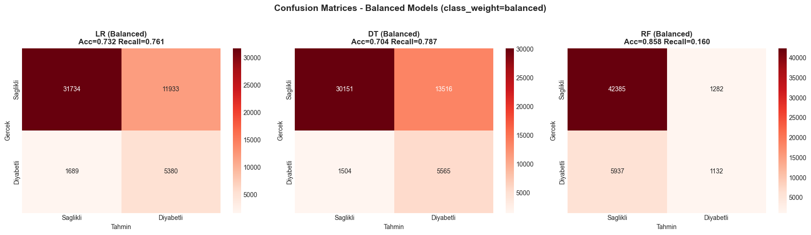
Class-Weight Balancing (cost-sensitive learning)
cw = 'balanced' # cost-sensitive weight
models_balanced = {
'LR': LogisticRegression(class_weight=cw),
'DT': DecisionTreeClassifier(
class_weight=cw, max_depth=10),
'RF': RandomForestClassifier(
class_weight=cw,
n_estimators=100, n_jobs=-1),
}
Result after balancing
• LR recall 0.16 → 0.76 (F1: 0.24 → 0.44)
• DT recall 0.33 → 0.79 (F1: 0.31 → 0.43)
• RF recall barely moved — depth absorbs the weight.
• Trade-off: accuracy drops from ~0.86 to ~0.73 (LR, DT).
IE410 — Diabetes Prediction (BRFSS 2015) | İbrahim Hakkı Keleş
11 / 18

Slide 12
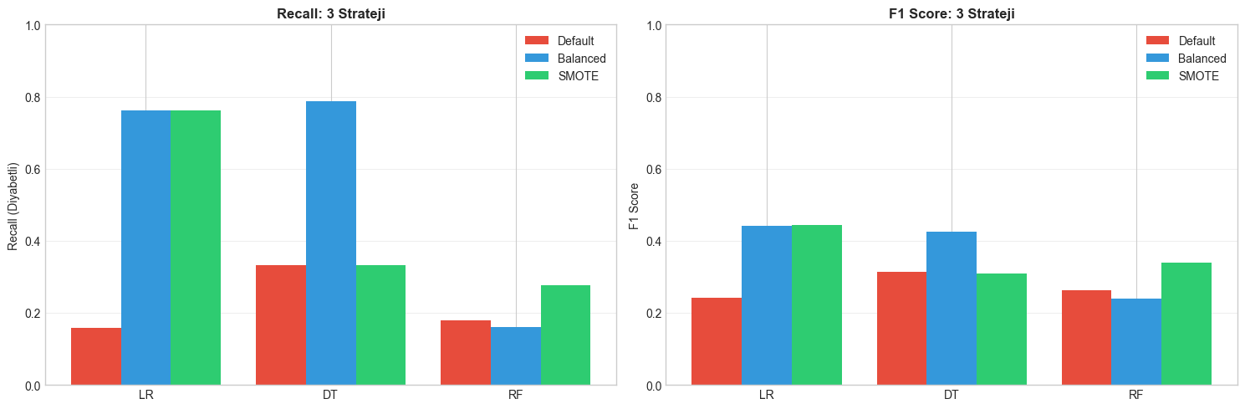
SMOTE — Synthetic Minority Oversampling
from imblearn.over_sampling import SMOTE
# Apply SMOTE ONLY on training data
# — never touch the test set.
smote = SMOTE(random_state=42, k_neighbors=5)
X_tr_s, y_tr_s = smote.fit_resample(
X_train_scaled, y_train)
# Minority class now matches the majority count.
Comparison vs. class_weight='balanced'
• SMOTE produces synthetic minority samples in feature space.
• Yielded similar recall/F1 to class-weight balancing.
• Higher memory and training cost — train set ≈ doubled.
• Risk: synthetic samples in noisy regions may hurt precision.
IE410 — Diabetes Prediction (BRFSS 2015) | İbrahim Hakkı Keleş
12 / 18

Slide 13
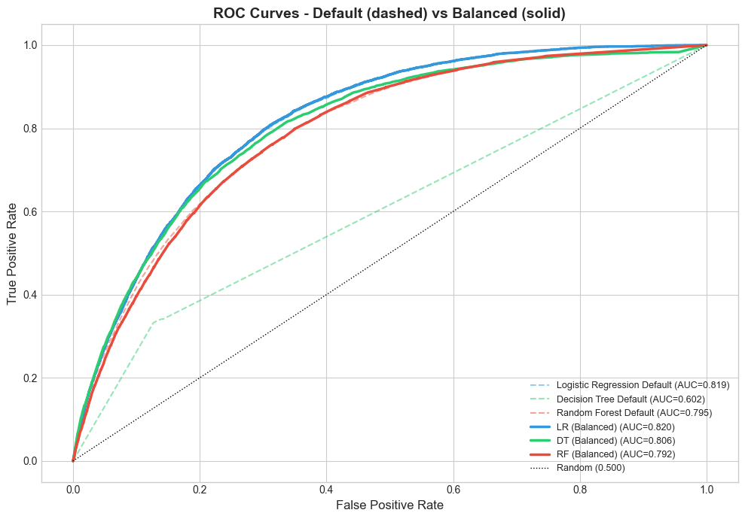
ROC Curves Default vs Balanced (all six models)
Key takeaways
• LR balanced AUC ≈ 0.82 — best overall ranking.
• RF balanced AUC ≈ 0.79 — close behind.
• DT lags at AUC ≈ 0.61 (default) → 0.81 (balanced).
• AUC is invariant to rebalancing for LR — only the threshold moves.
• DT benefits most because the structure itself reshapes under weights.
IE410 — Diabetes Prediction (BRFSS 2015) | İbrahim Hakkı Keleş
13 / 18

Slide 14
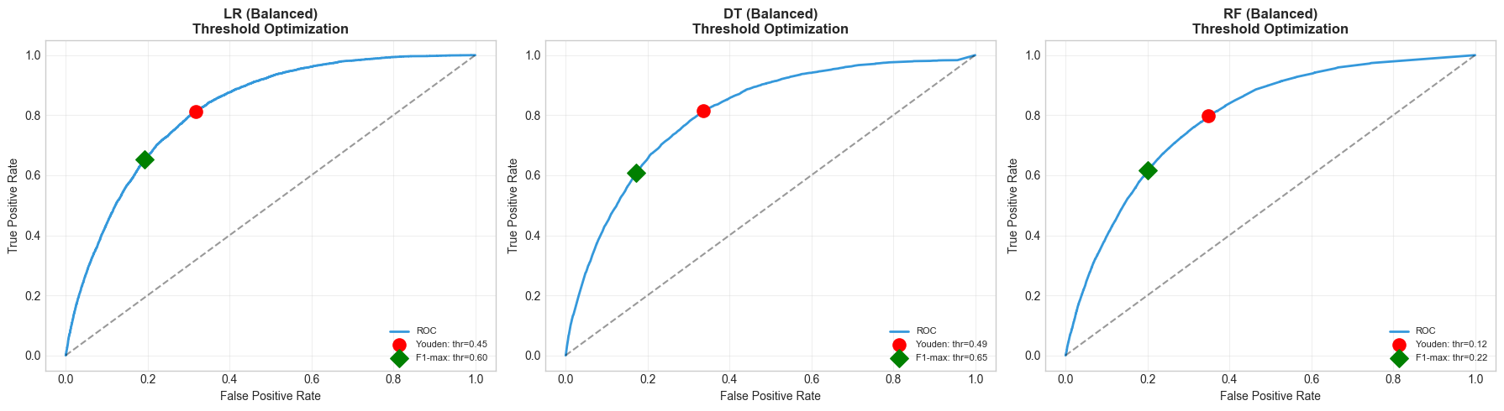
Threshold Optimization Beyond the 0.5 Default
fpr, tpr, thr = roc_curve(y_test, y_proba)
youden_idx = np.argmax(tpr - fpr)
best_thr = thr[youden_idx]
prec, rec, thr_pr = precision_recall_curve(
y_test, y_proba)
f1 = 2 * prec * rec / (prec + rec + 1e-9)
f1_max_idx = np.argmax(f1)
Strategies compared
• Default 0.5 — favors majority class.
• Youden's J = TPR − FPR — maximizes separation.
• F1-max — best precision-recall trade-off.
• Choice depends on clinical cost of FN vs FP.
IE410 — Diabetes Prediction (BRFSS 2015) | İbrahim Hakkı Keleş
14 / 18

Slide 15
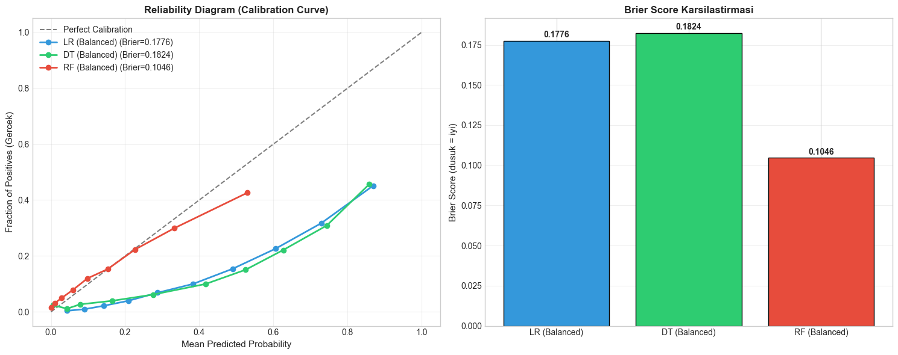
Probability Calibration — Reliability Diagram
from sklearn.calibration import calibration_curve
from sklearn.metrics import brier_score_loss
prob_true, prob_pred = calibration_curve(
y_test, y_proba, n_bins=10, strategy='quantile')
brier = brier_score_loss(y_test, y_proba)
Why calibration matters
• A score is not a probability unless calibrated.
• Clinical decisions need 'p(diabetic) = 0.30' to mean 30%.
• LR is naturally well-calibrated; trees are over-confident.
• Brier score quantifies calibration error.
• Use CalibratedClassifierCV (sigmoid / isotonic) if needed.
IE410 — Diabetes Prediction (BRFSS 2015) | İbrahim Hakkı Keleş
15 / 18

Slide 16
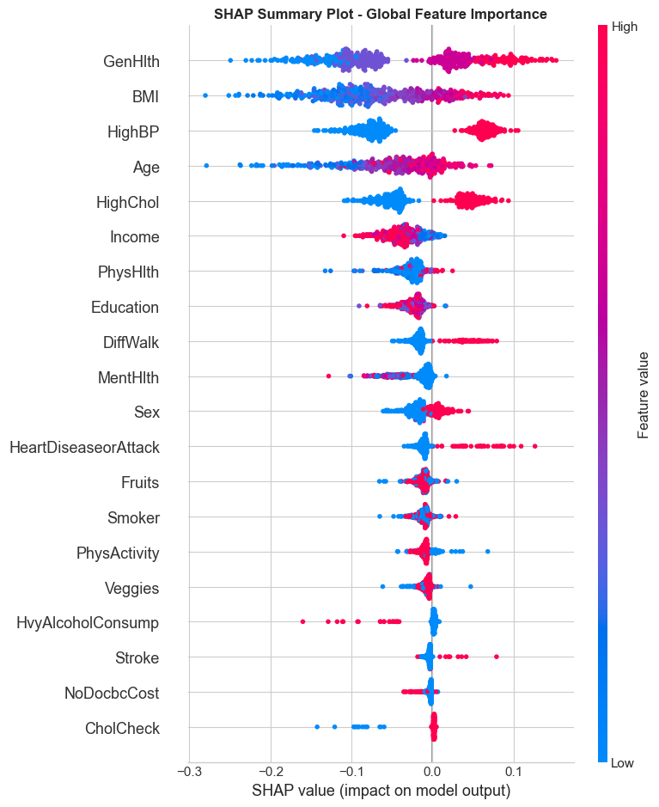
SHAP — Explainable AI (Random Forest, Balanced)
import shap
best_rf = balanced_results['RF (Balanced)']['model']
explainer = shap.TreeExplainer(best_rf)
shap_values = explainer.shap_values(X_test_sample)
shap.summary_plot(shap_values[1], X_test_sample,
feature_names=feature_names)
Top global drivers
• GenHlth (self-reported general health) — strongest signal.
• HighBP — clinical risk factor confirmed by the data.
• BMI — higher BMI ⇒ higher predicted risk.
• Age, HighChol, HeartDiseaseorAttack also dominant.
• Direction (red / blue) matches medical intuition.
IE410 — Diabetes Prediction (BRFSS 2015) | İbrahim Hakkı Keleş
16 / 18

Slide 17
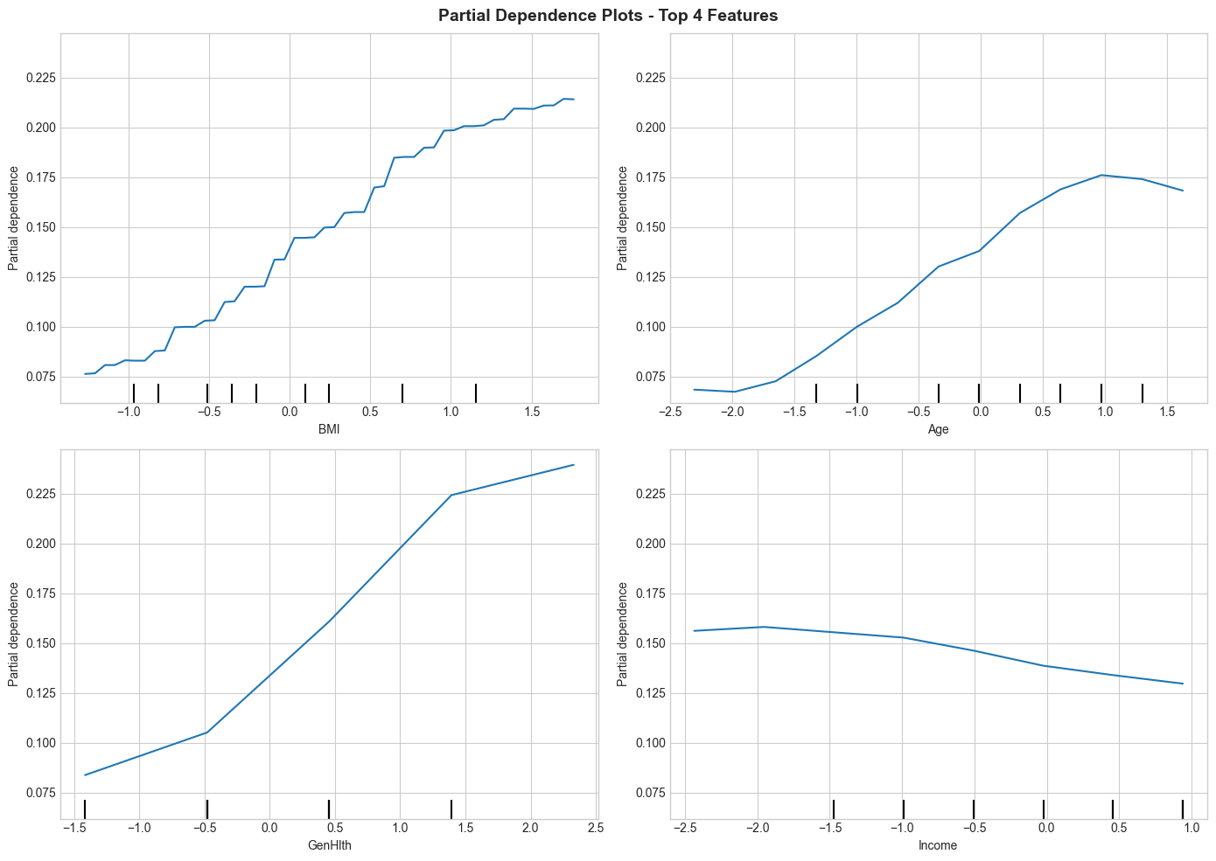
Partial Dependence — Feature-Level Effects
What PDPs tell us
• 1-D PDP shows the marginal effect of a single feature on predicted risk.
• BMI: risk rises monotonically — clear dose-response.
• Age: risk plateaus after middle age — saturation effect.
• GenHlth (1=excellent → 5=poor): steep, near-linear increase.
• 2-D PDP for BMI × Age uncovers an interaction: high BMI worsens with age.
• PDPs assume feature independence — interpret directional, not absolute.
IE410 — Diabetes Prediction (BRFSS 2015) | İbrahim Hakkı Keleş
17 / 18

Slide 18
Conclusions, Limitations & Future Work
Key findings
Limitations
Future work
• Best model: LR / RF (Balanced), AUC ≈ 0.82.
• Class balancing lifts recall 0.16 → 0.76.
• GenHlth, HighBP, BMI dominate predictions.
• Probability calibration is essential for clinical use.
• Self-report bias — survey ≠ clinical truth.
• Imbalance limits absolute precision.
• Generalization beyond 2015 / U.S. not tested.
• No external validation cohort.
• Add LightGBM tuned with focal loss.
• Try cost-sensitive thresholding per subgroup.
• Deploy as a screening triage tool with explanations.
• Validate on newer BRFSS (2021+) waves.
Thank you
IE410 — Diabetes Prediction (BRFSS 2015) | İbrahim Hakkı Keleş
18 / 18

