Slide 1
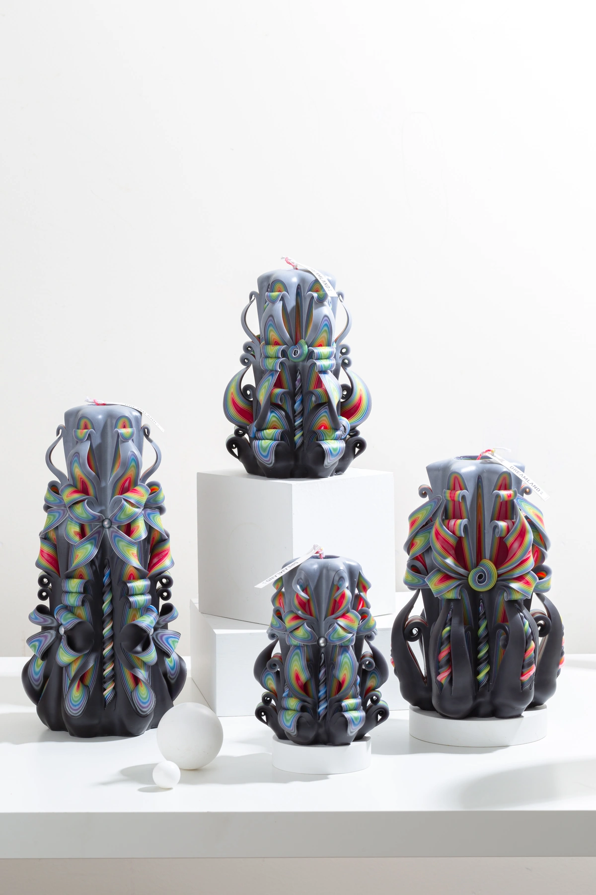
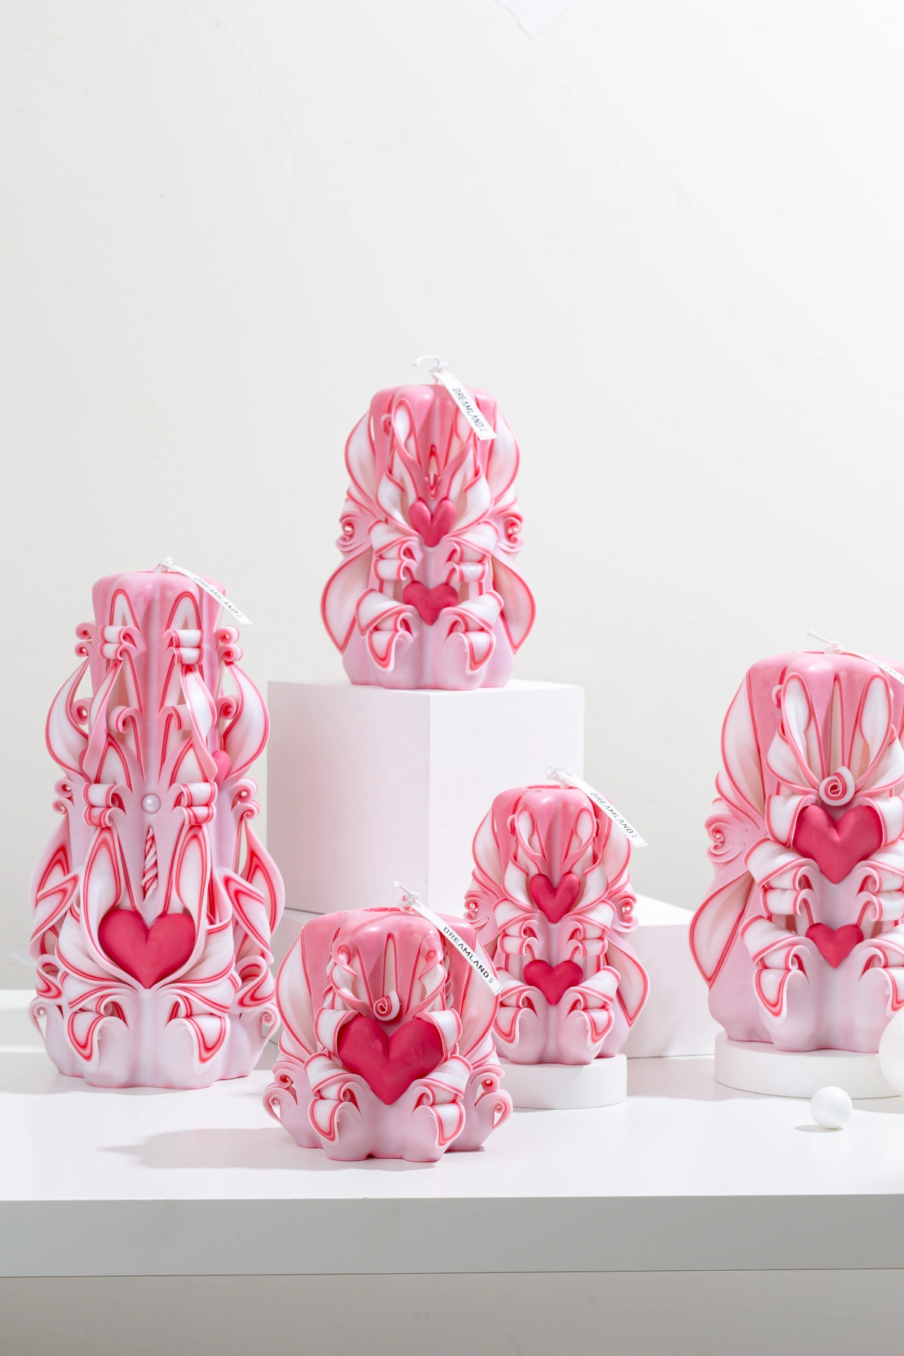
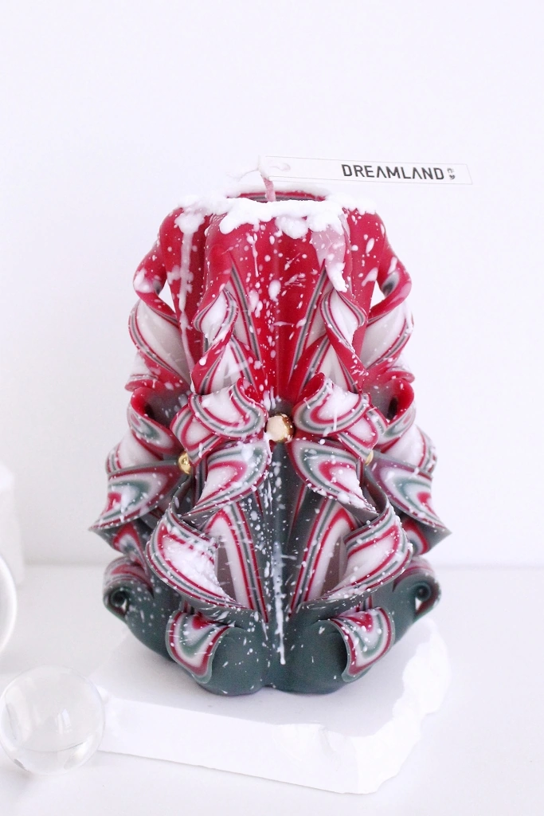
DREAMLAND
WHOLESALE
PRODUCT CATALOG
ENGLISH EDITION · 2026
Hand-carved candles for wholesale,
gifting and custom projects.
89 ACTIVE PRODUCTS
Advanced 19 / Masterpiece 46 / Holiday 16 / Classic 8
SELECT BY PRODUCT ID · CONFIGURE IN QUOTATION
CURRENT ACTIVE CATALOG
DREAMLAND · WHOLESALE PRODUCT CATALOG
SOURCE 3B28FE20 · 01

Slide 2
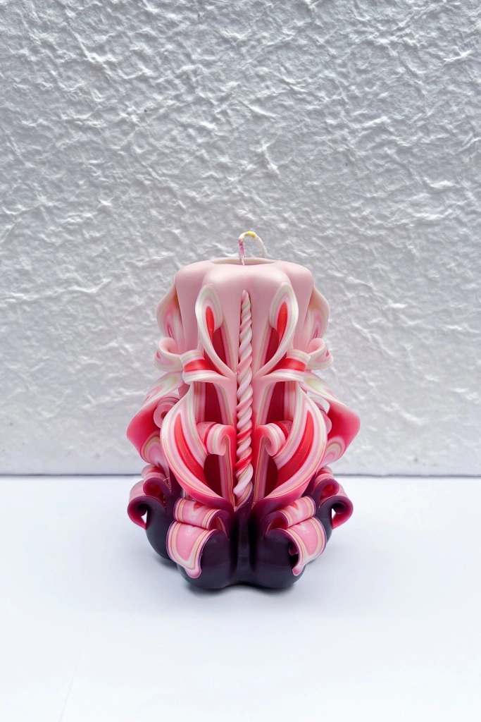
CATALOG OVERVIEW
Four collections. One clear selection flow.
Only products marked active at the source commit are included.
19
ADVANCED
46
MASTERPIECE
Refined everyday carved candles with Robertet fragrance options.
Premium carved candles paired with CandleScience fragrance oils.
MOQ from 18 pcs
19 active designs
MOQ from 18 pcs
46 active designs
16
HOLIDAY
08
CLASSIC
Seasonal carved candles with selectable fragrance-series options.
Essential carved candles with a lighter fragrance profile.
MOQ from 18 pcs
16 active designs
MOQ from 18 pcs
8 active designs
HOW TO USE THIS CATALOG
Use the product ID as the reference. Size and MOQ are confirmed by series; fragrance, packaging and customization are finalized with the quotation.
PRICING IS NOT EMBEDDED
DREAMLAND · WHOLESALE PRODUCT CATALOG
SOURCE 3B28FE20 · 02

Slide 3
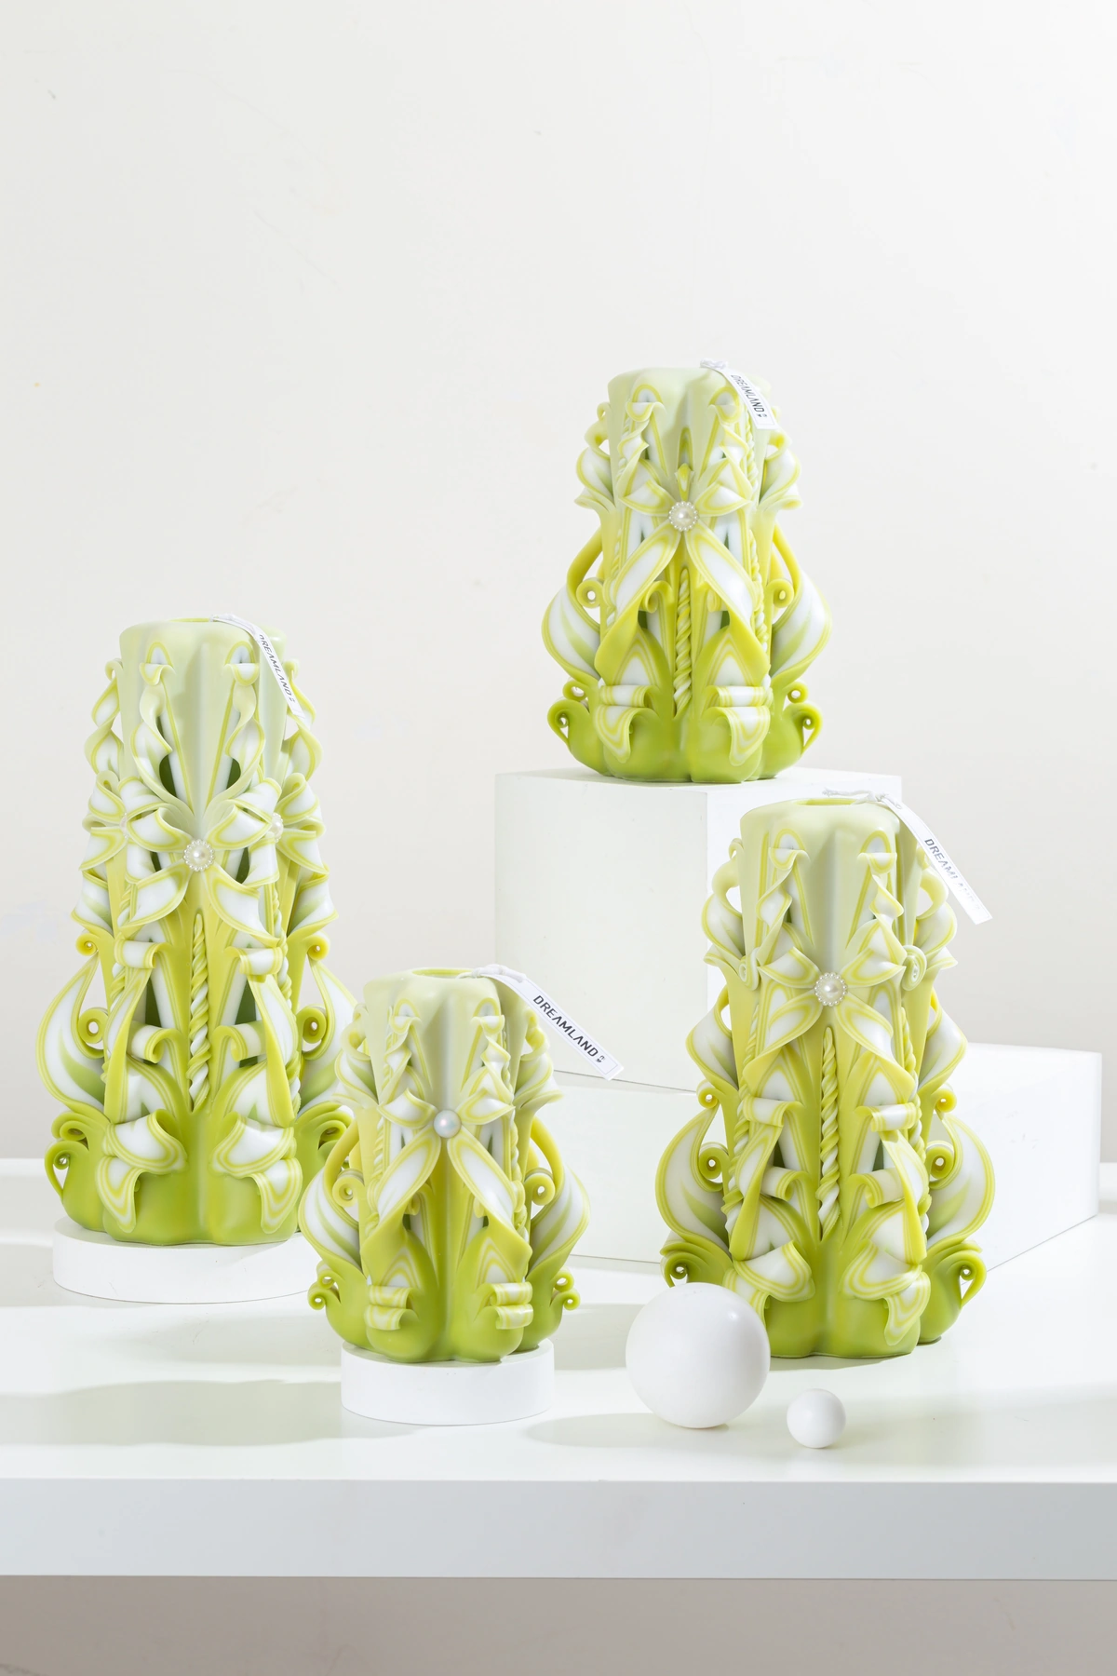
01
ADVANCED COLLECTION
Advanced
Refined everyday carved candles with Robertet fragrance options.
ACTIVE DESIGNS
MOQ BY SIZE
SERIES NOTES
19
S 36 · M 24 · L 18 · XL 18
Robertet · 8% fragrance
ADV002
DREAMLAND · WHOLESALE PRODUCT CATALOG
SOURCE 3B28FE20 · 03

Slide 4
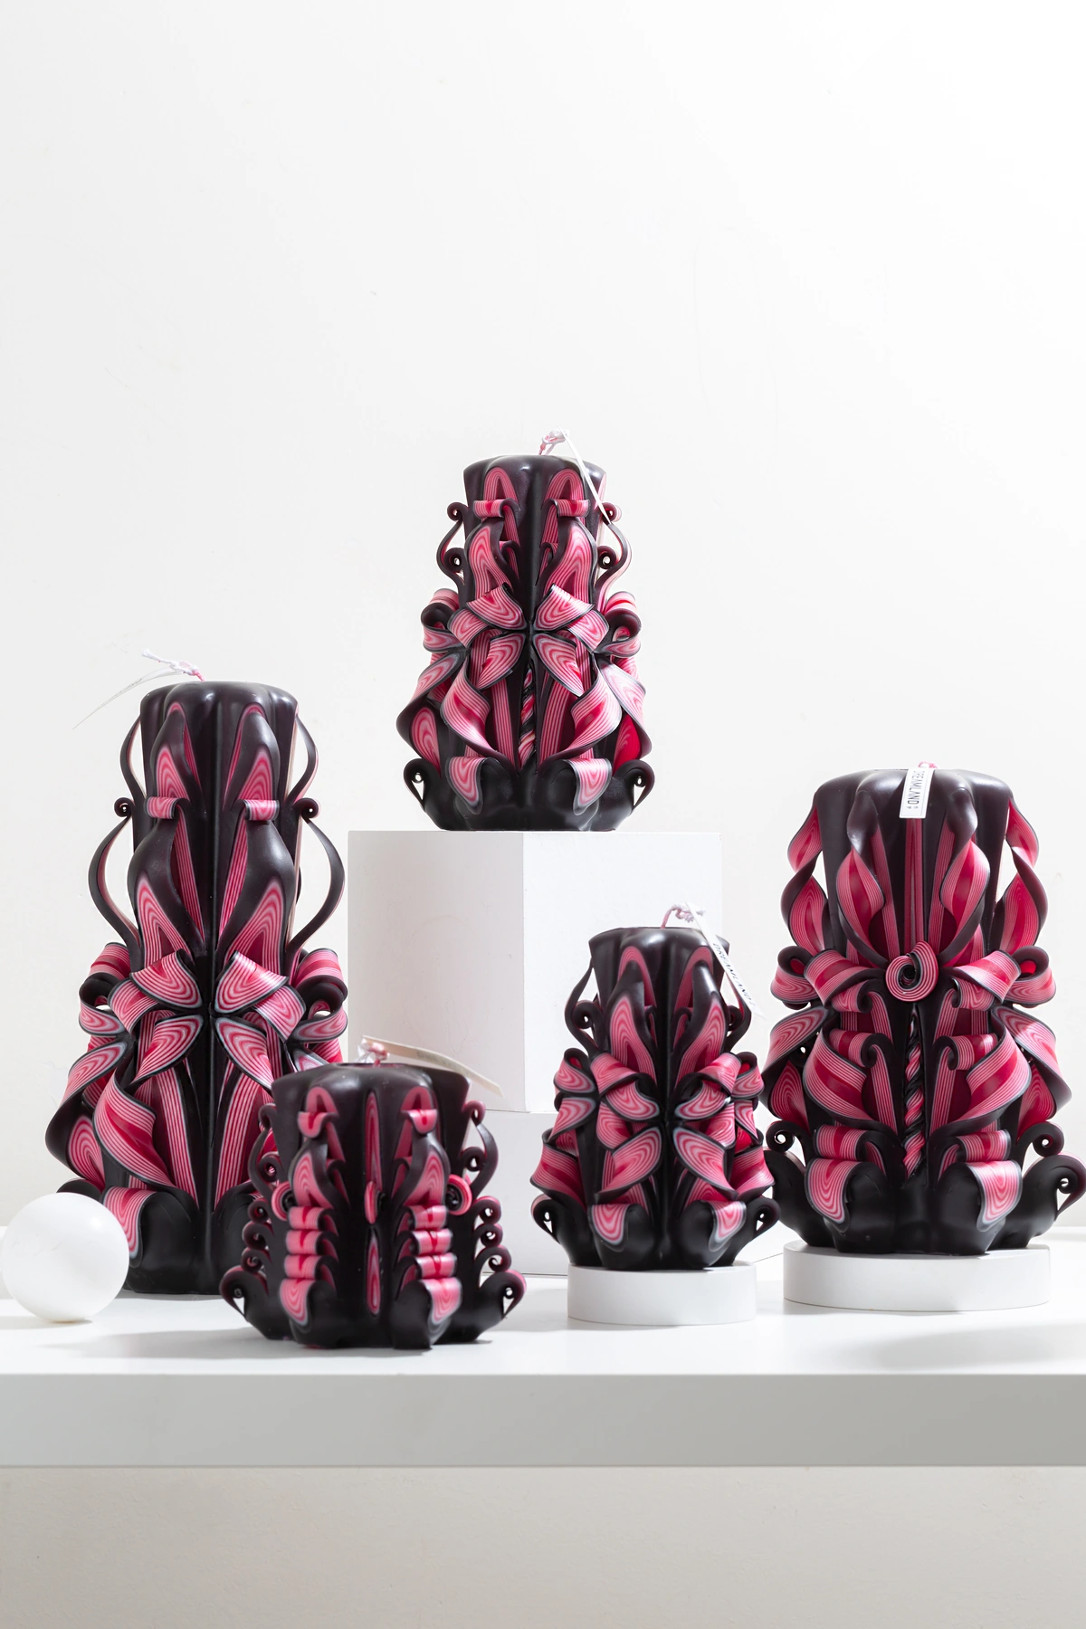
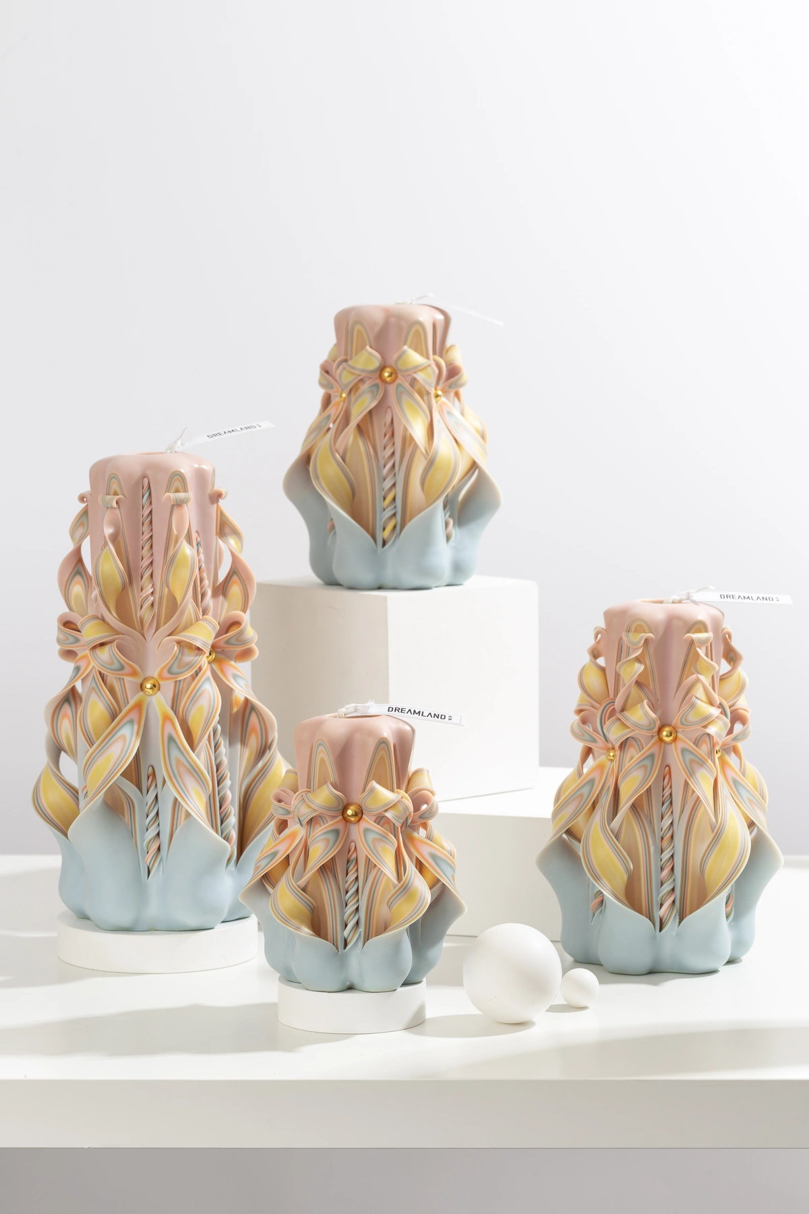
ADVANCED COLLECTION
Advanced — Product Selection
01–04 of 19 · 1/5
ADV001
ADV002
ADV003
ADV004
Noir Rainbow
Misty Reeds
Freud
Golden Coast
COLOR
AVAILABLE SIZES
COLOR
AVAILABLE SIZES
COLOR
AVAILABLE SIZES
COLOR
AVAILABLE SIZES
C01
S / M / L / XL
C02
S / M / L / XL
C03
S / M / L / XL
C04
S / M / L / XL
FRAGRANCE / NOTES
FRAGRANCE / NOTES
FRAGRANCE / NOTES
FRAGRANCE / NOTES
Robertet · 8% fragrance
Robertet · 8% fragrance
Robertet · 8% fragrance
Robertet · 8% fragrance
REFERENCE IMAGES · HANDMADE VARIATION EXPECTED
DREAMLAND · WHOLESALE PRODUCT CATALOG
SOURCE 3B28FE20 · 04

Slide 5
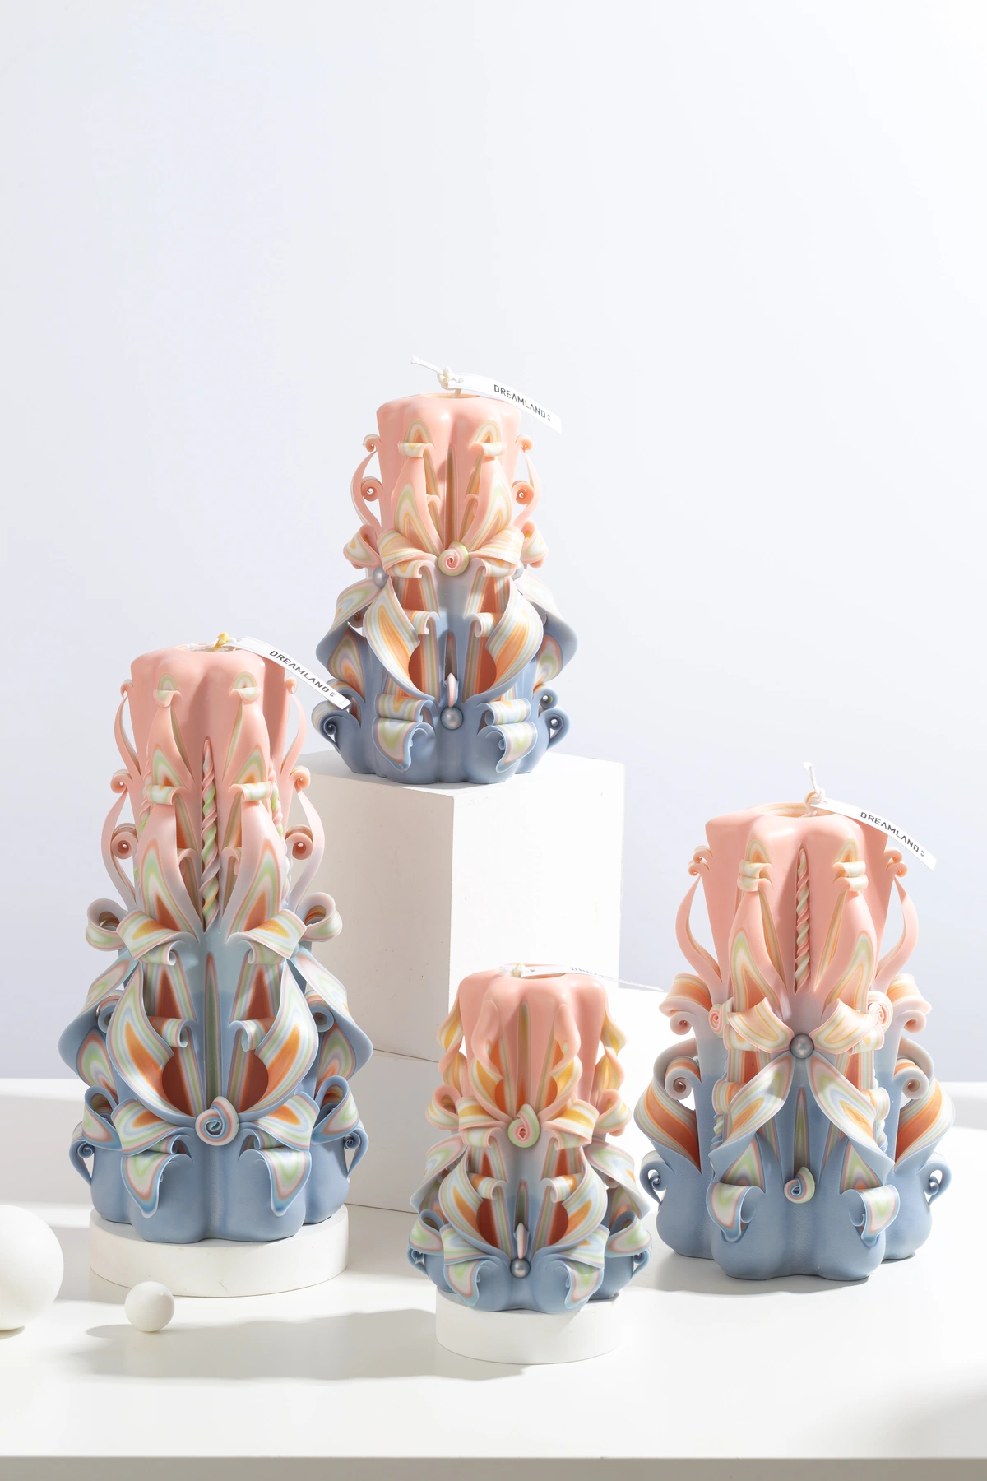
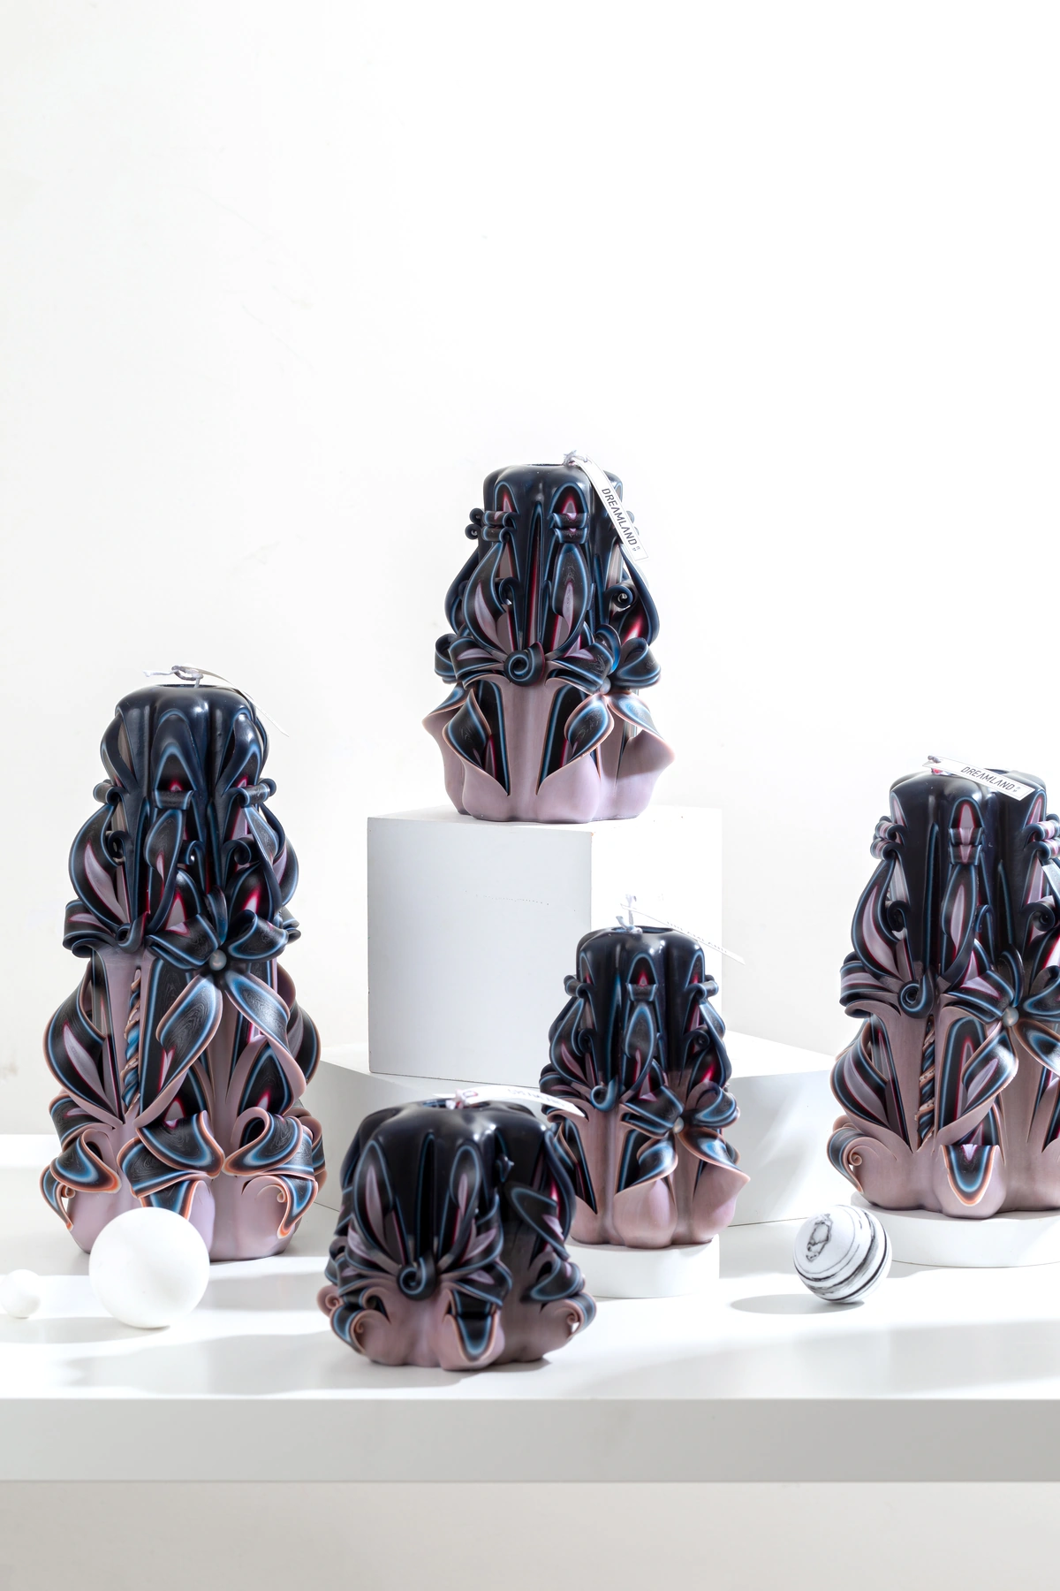
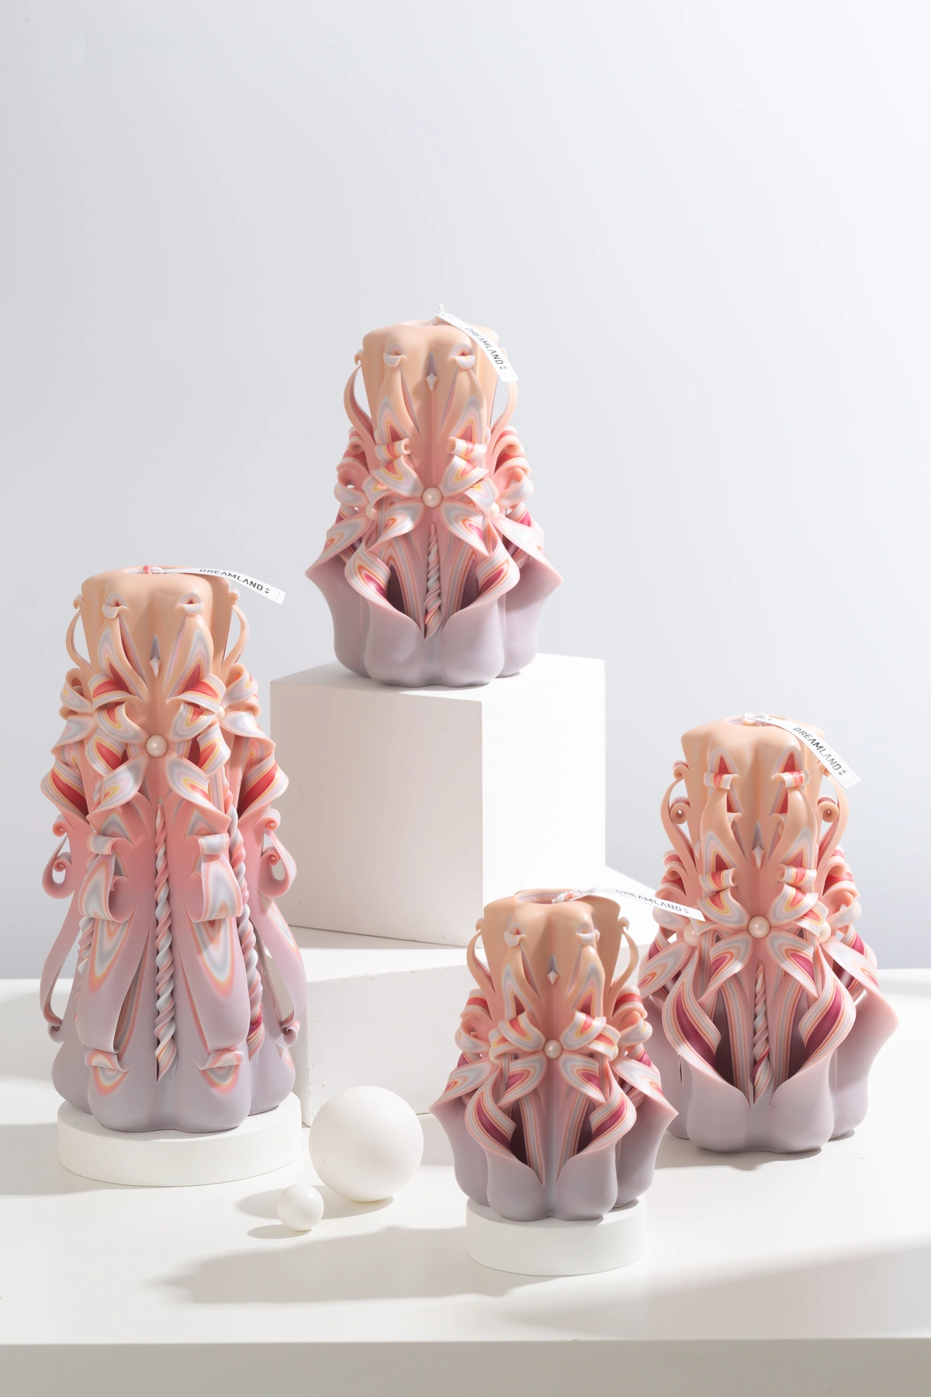
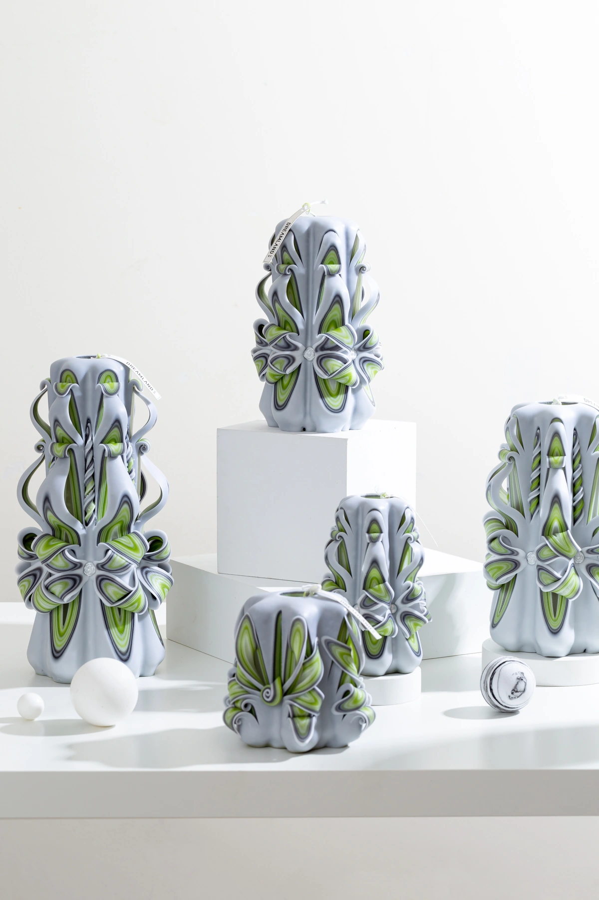
ADVANCED COLLECTION
Advanced — Product Selection
05–08 of 19 · 2/5
ADV005
ADV006
ADV007
ADV008
Sunset Coral
Pumpkin Pie
Peach Reverie
Forest Tide
COLOR
AVAILABLE SIZES
COLOR
AVAILABLE SIZES
COLOR
AVAILABLE SIZES
COLOR
AVAILABLE SIZES
C05
S / M / L / XL
C06
S / M / L / XL
C07
S / M / L / XL
C08
S / M / L / XL
FRAGRANCE / NOTES
FRAGRANCE / NOTES
FRAGRANCE / NOTES
FRAGRANCE / NOTES
Robertet · 8% fragrance
Robertet · 8% fragrance
Robertet · 8% fragrance
Robertet · 8% fragrance
REFERENCE IMAGES · HANDMADE VARIATION EXPECTED
DREAMLAND · WHOLESALE PRODUCT CATALOG
SOURCE 3B28FE20 · 05

Slide 6
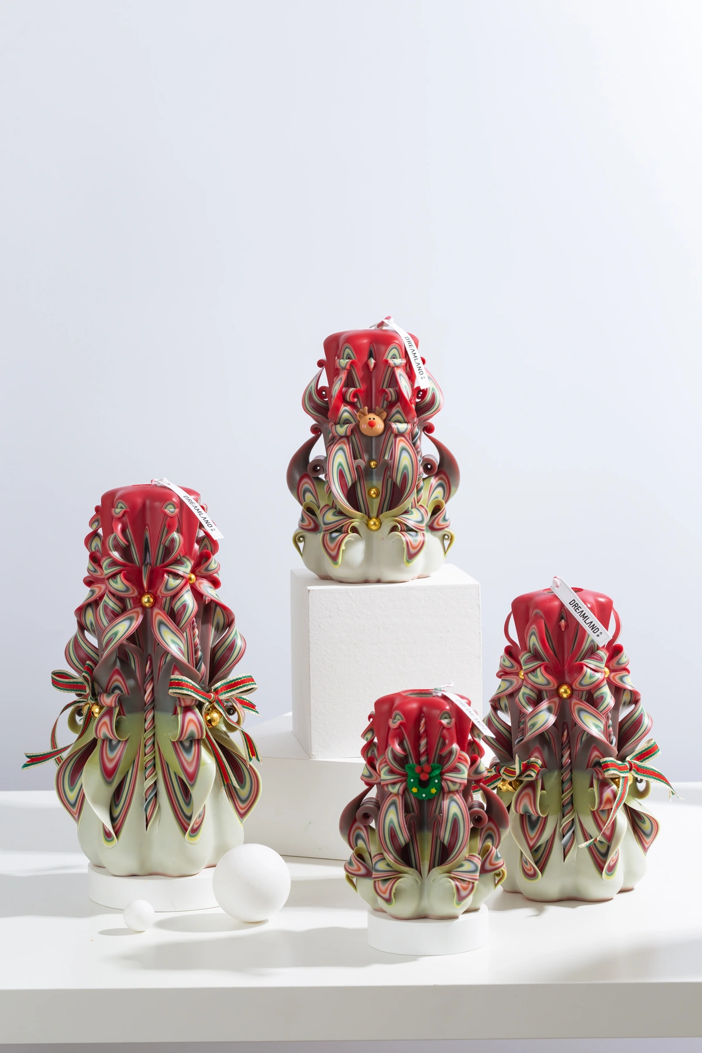
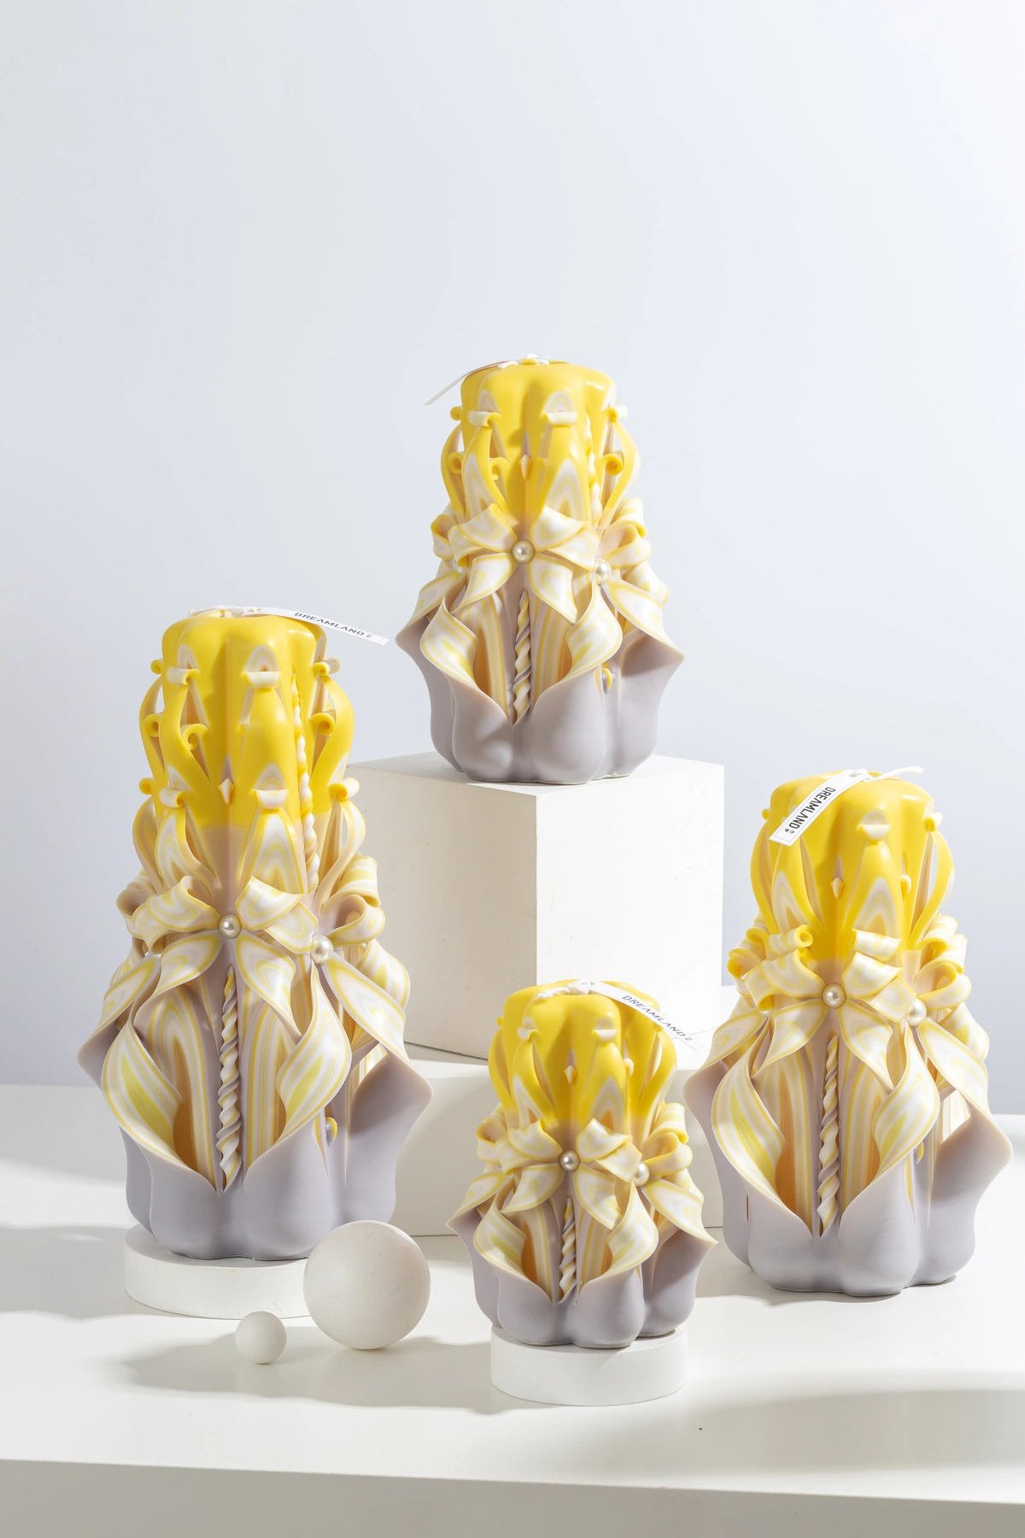
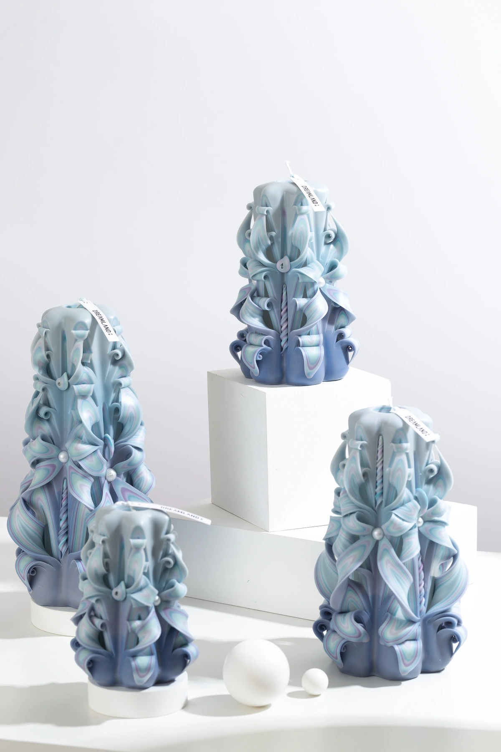
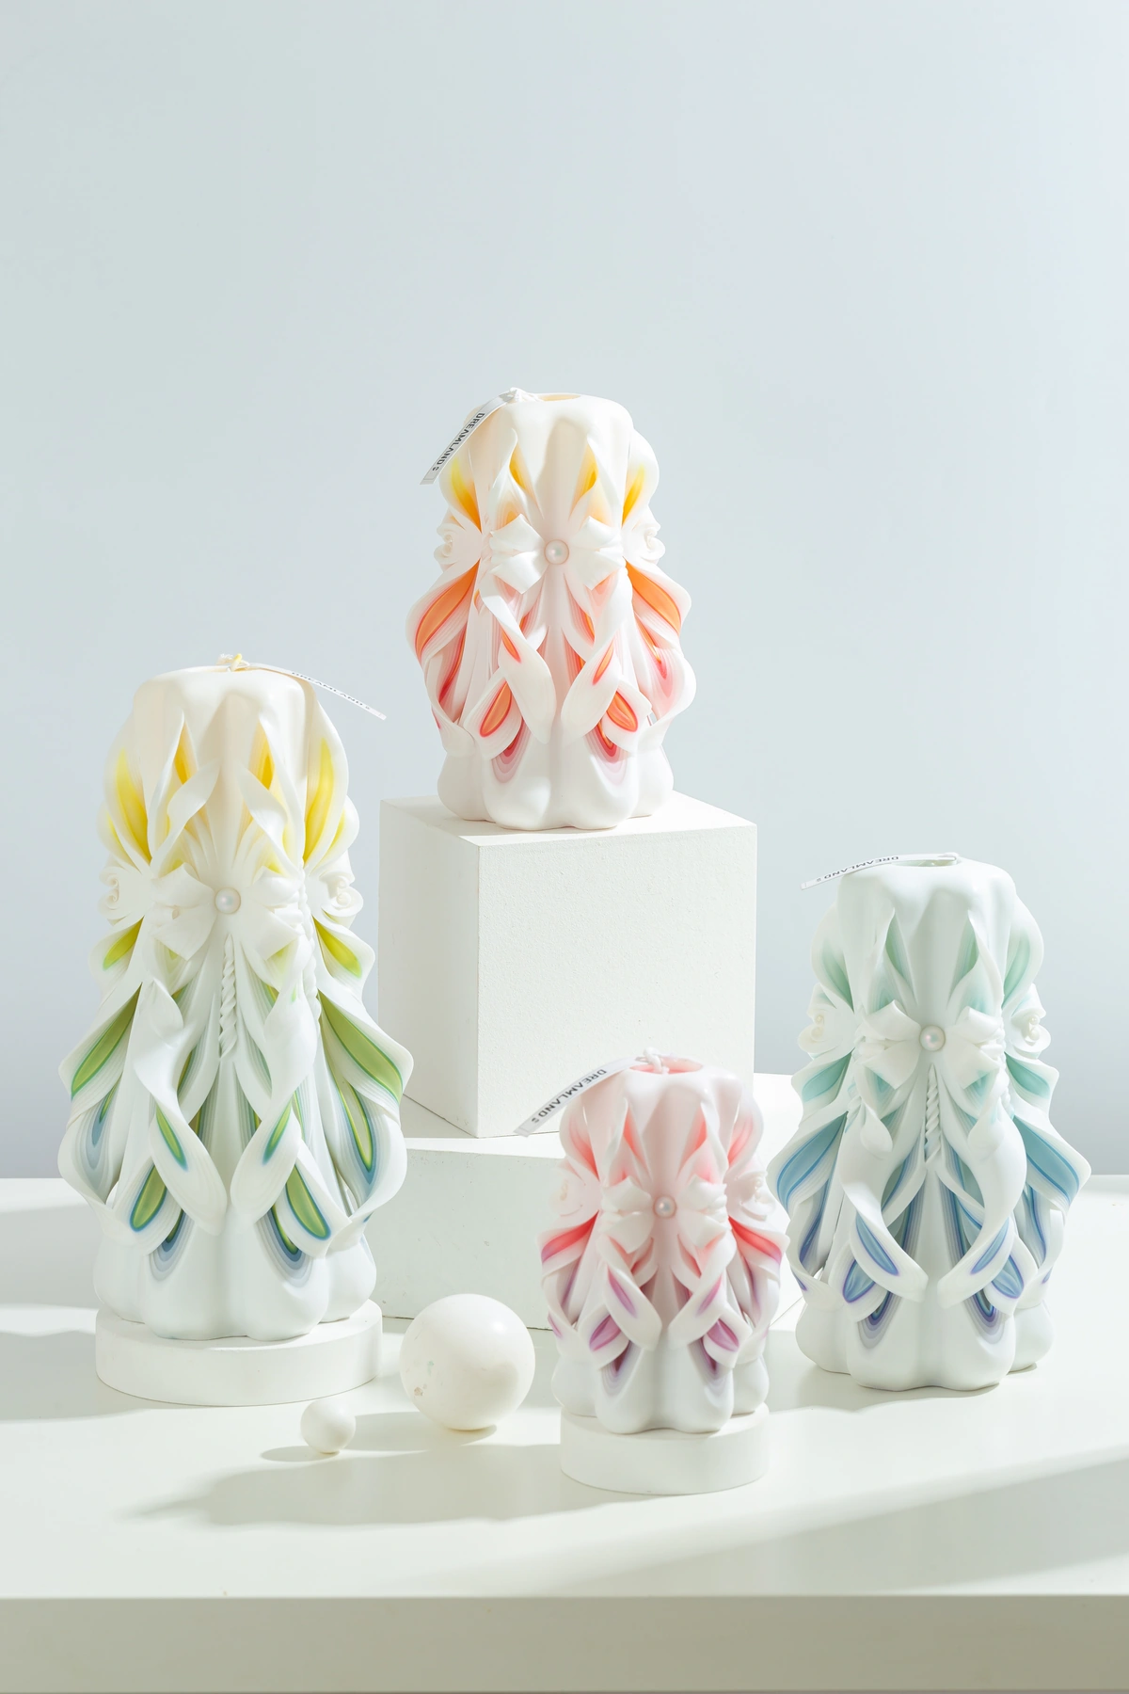
ADVANCED COLLECTION
Advanced — Product Selection
09–12 of 19 · 3/5
ADV009
ADV010
ADV011
ADV012
Fireside Christmas
Gentle Warmth
Clear Sky Rain
Eden
COLOR
AVAILABLE SIZES
COLOR
AVAILABLE SIZES
COLOR
AVAILABLE SIZES
COLOR
AVAILABLE SIZES
C09
S / M / L / XL
C10
S / M / L / XL
C11
S / M / L / XL
C12
S / M / L / XL
FRAGRANCE / NOTES
FRAGRANCE / NOTES
FRAGRANCE / NOTES
FRAGRANCE / NOTES
Robertet · 8% fragrance
Robertet · 8% fragrance
Robertet · 8% fragrance
Robertet · 8% fragrance
REFERENCE IMAGES · HANDMADE VARIATION EXPECTED
DREAMLAND · WHOLESALE PRODUCT CATALOG
SOURCE 3B28FE20 · 06

Slide 7
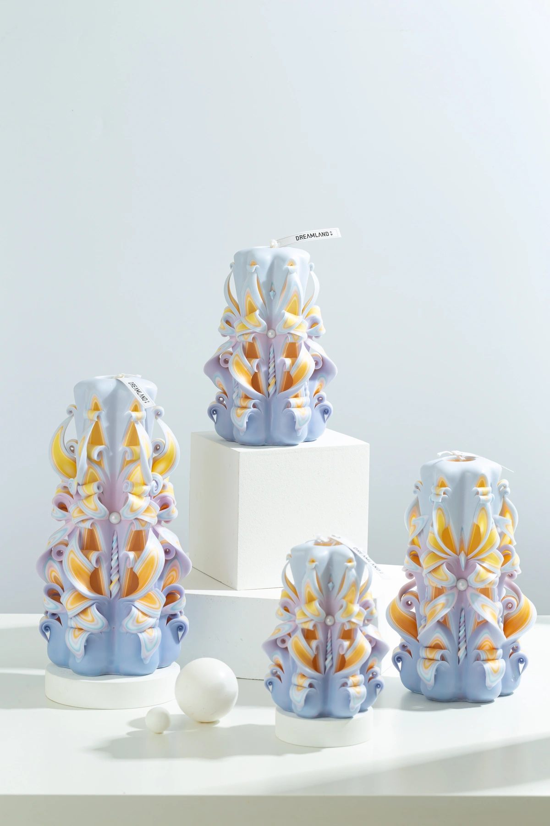
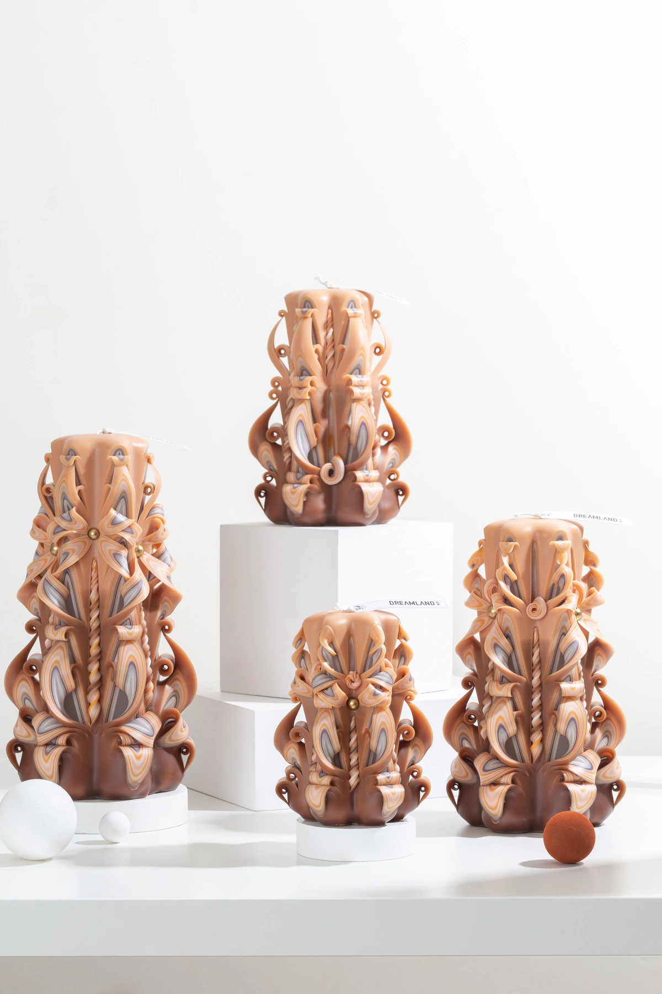
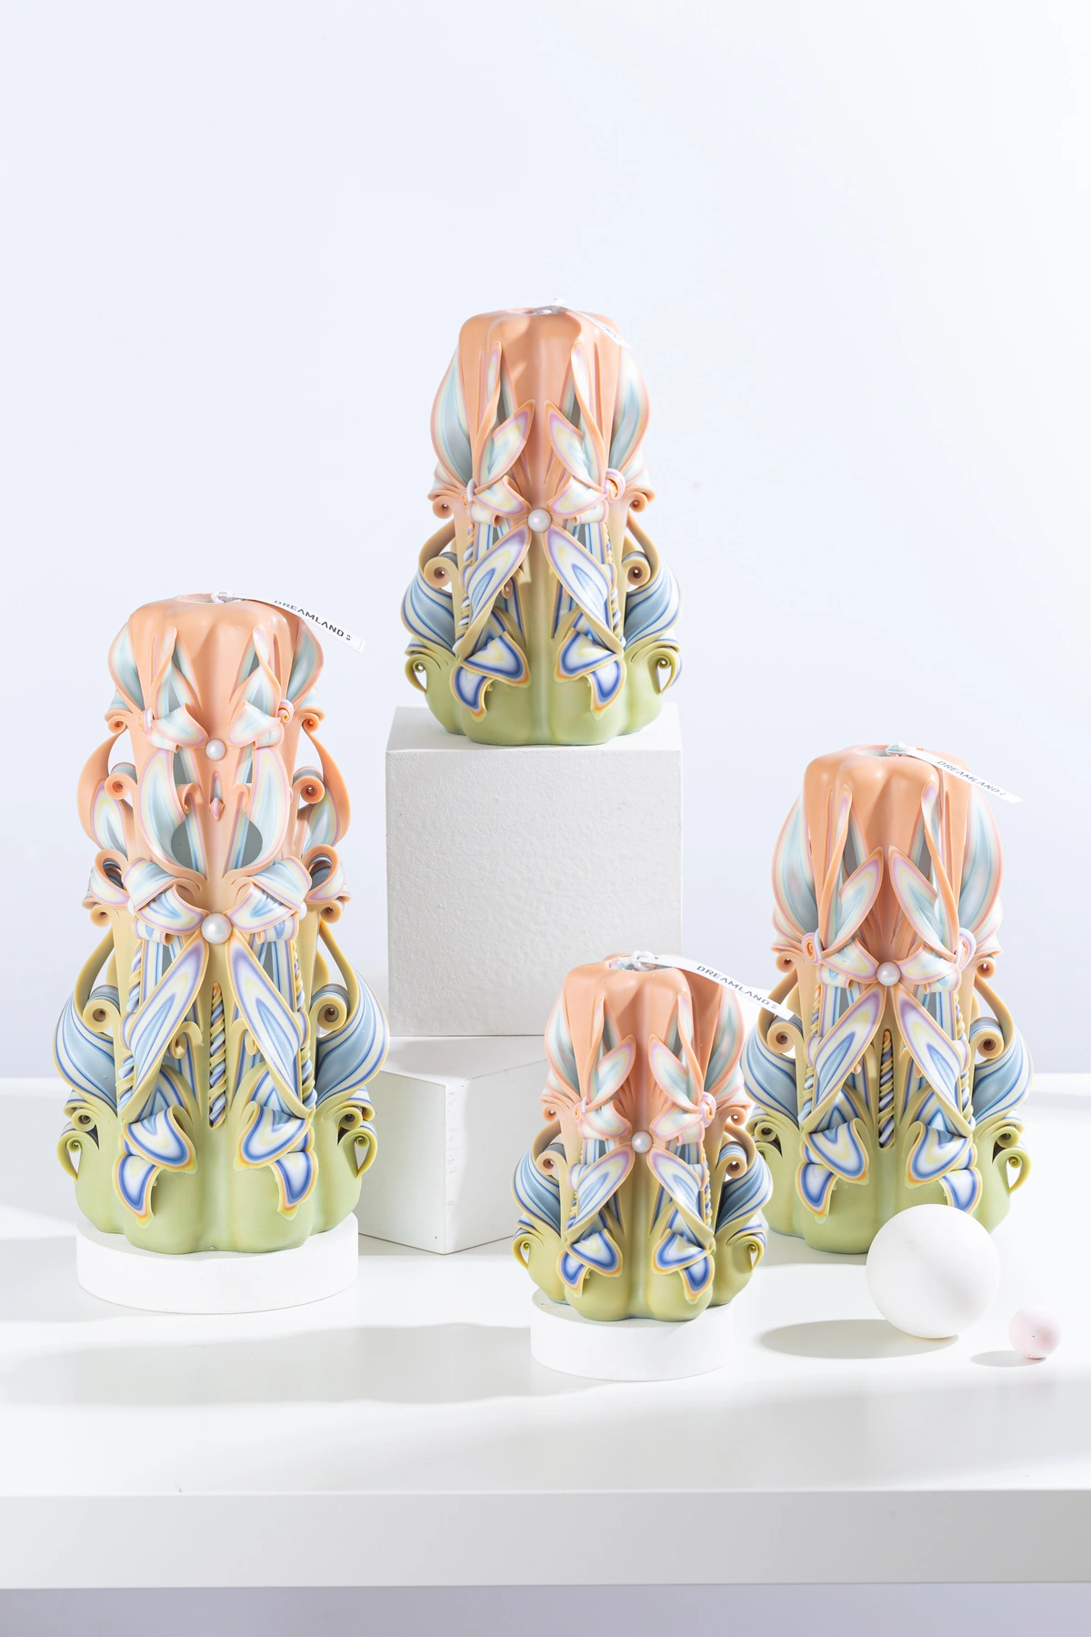
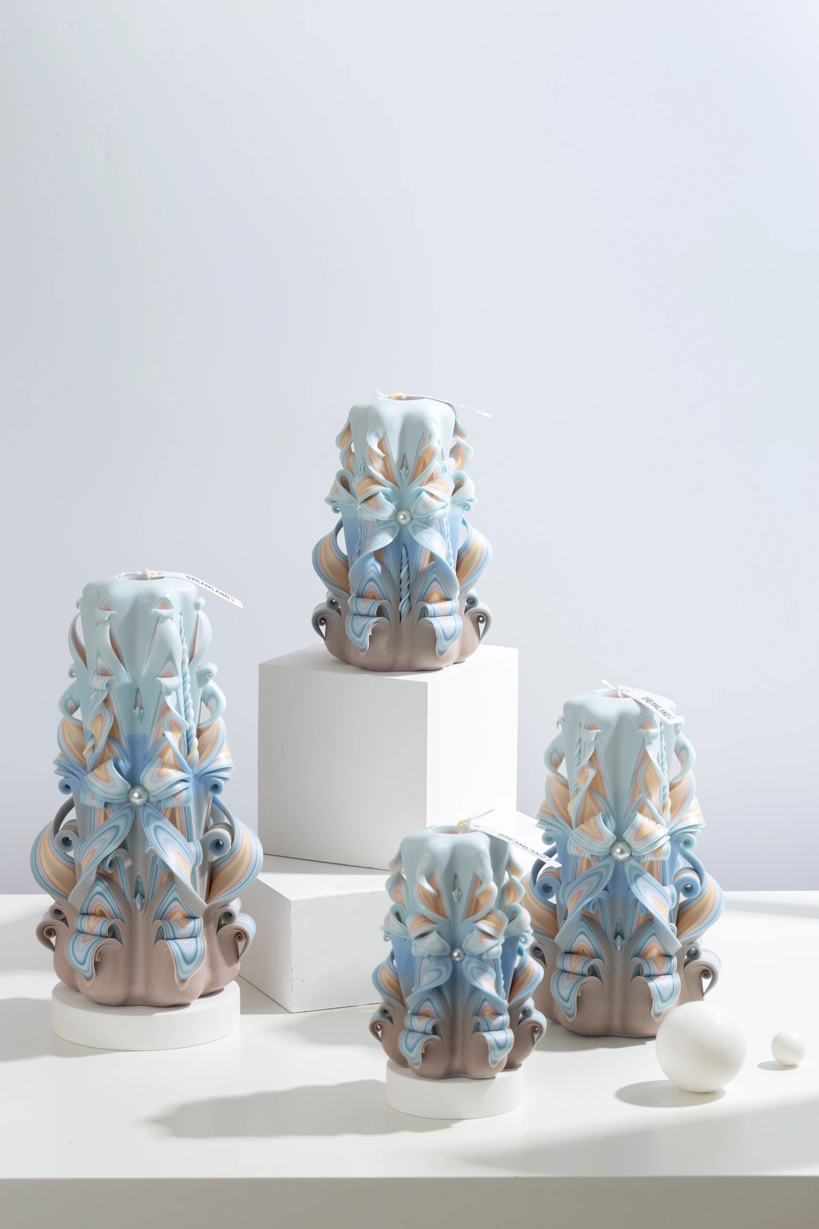
ADVANCED COLLECTION
Advanced — Product Selection
13–16 of 19 · 4/5
ADV013
ADV014
ADV015
ADV016
Moonlit Treasure
Cosmic Mocha
Yellow Green
Arles Ocean
COLOR
AVAILABLE SIZES
COLOR
AVAILABLE SIZES
COLOR
AVAILABLE SIZES
COLOR
AVAILABLE SIZES
C13
S / M / L / XL
C14
S / M / L / XL
C15
S / M / L / XL
C16
S / M / L / XL
FRAGRANCE / NOTES
FRAGRANCE / NOTES
FRAGRANCE / NOTES
FRAGRANCE / NOTES
Robertet · 8% fragrance
Robertet · 8% fragrance
Robertet · 8% fragrance
Robertet · 8% fragrance
REFERENCE IMAGES · HANDMADE VARIATION EXPECTED
DREAMLAND · WHOLESALE PRODUCT CATALOG
SOURCE 3B28FE20 · 07

Slide 8
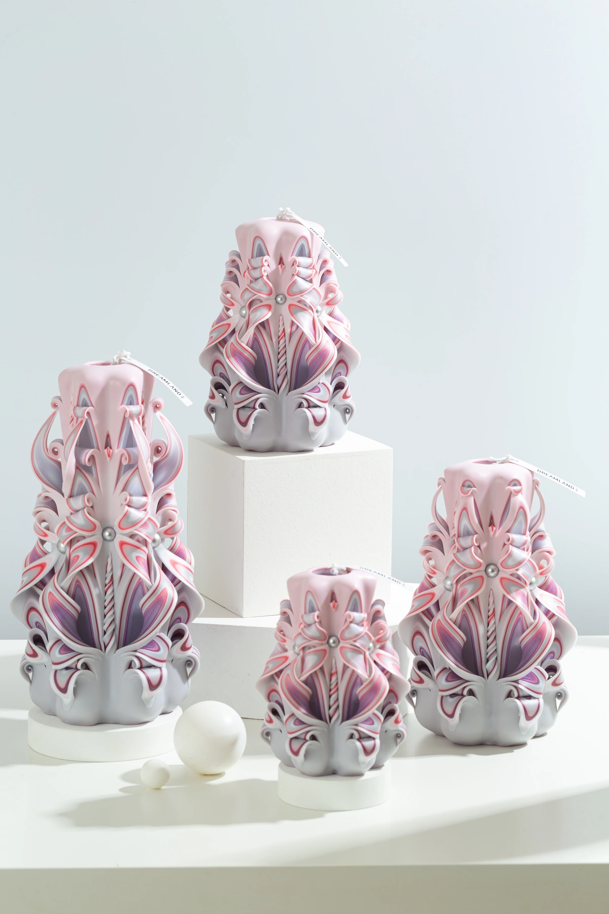
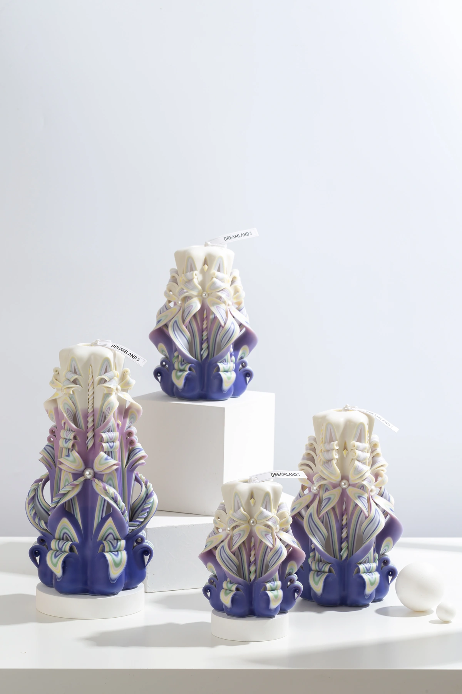
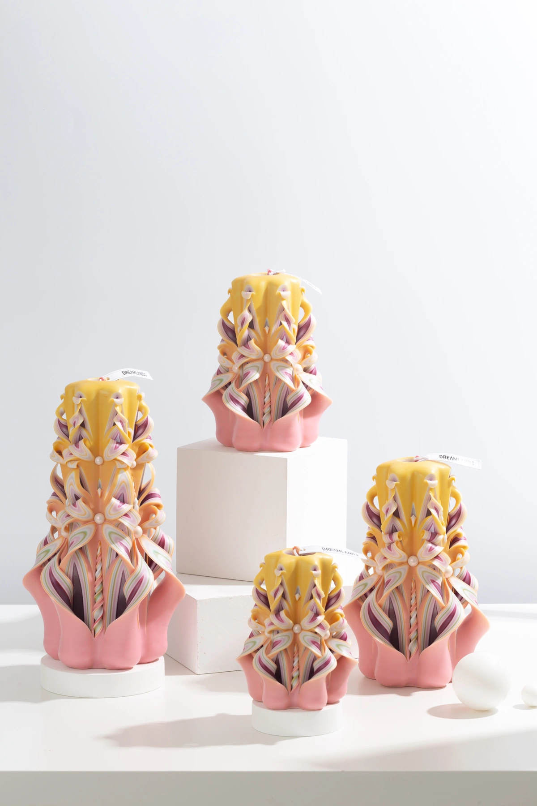
ADVANCED COLLECTION
Advanced — Product Selection
17–19 of 19 · 5/5
ADV017
ADV018
ADV019
Dusky Afterglow
Migratory Isle
California Dream
COLOR
AVAILABLE SIZES
COLOR
AVAILABLE SIZES
COLOR
AVAILABLE SIZES
C17
S / M / L / XL
C18
S / M / L / XL
C19
S / M / L / XL
FRAGRANCE / NOTES
FRAGRANCE / NOTES
FRAGRANCE / NOTES
Robertet · 8% fragrance
Robertet · 8% fragrance
Robertet · 8% fragrance
REFERENCE IMAGES · HANDMADE VARIATION EXPECTED
DREAMLAND · WHOLESALE PRODUCT CATALOG
SOURCE 3B28FE20 · 08

Slide 9
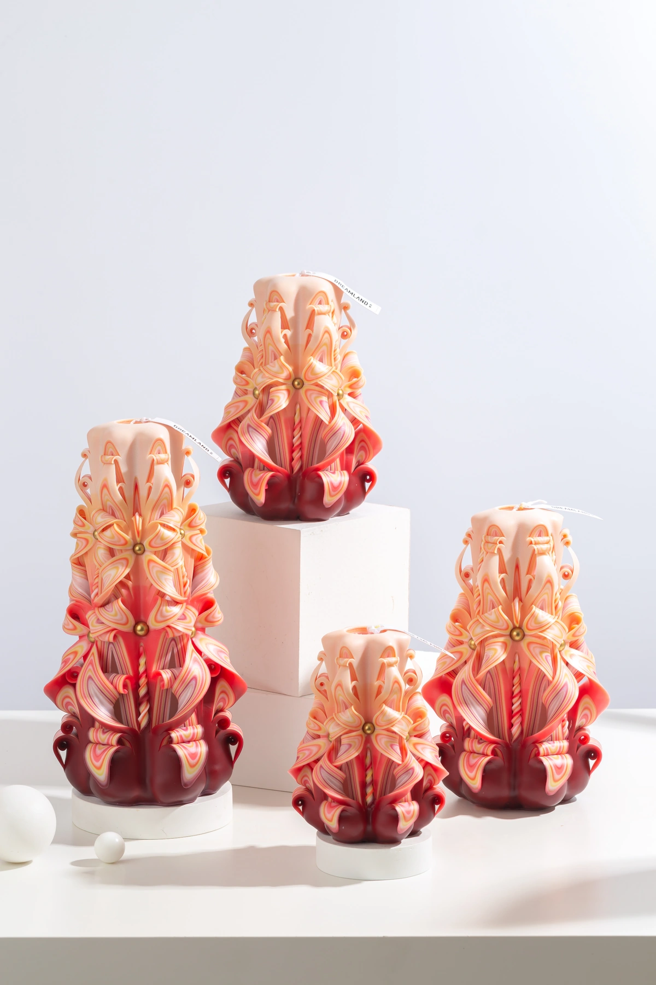
02
MASTERPIECE COLLECTION
Masterpiece
Premium carved candles paired with CandleScience fragrance oils.
ACTIVE DESIGNS
MOQ BY SIZE
SERIES NOTES
46
S 36 · M 24 · L 18 · XL 18
CandleScience · 10% fragrance
MPC002
DREAMLAND · WHOLESALE PRODUCT CATALOG
SOURCE 3B28FE20 · 09

Slide 10
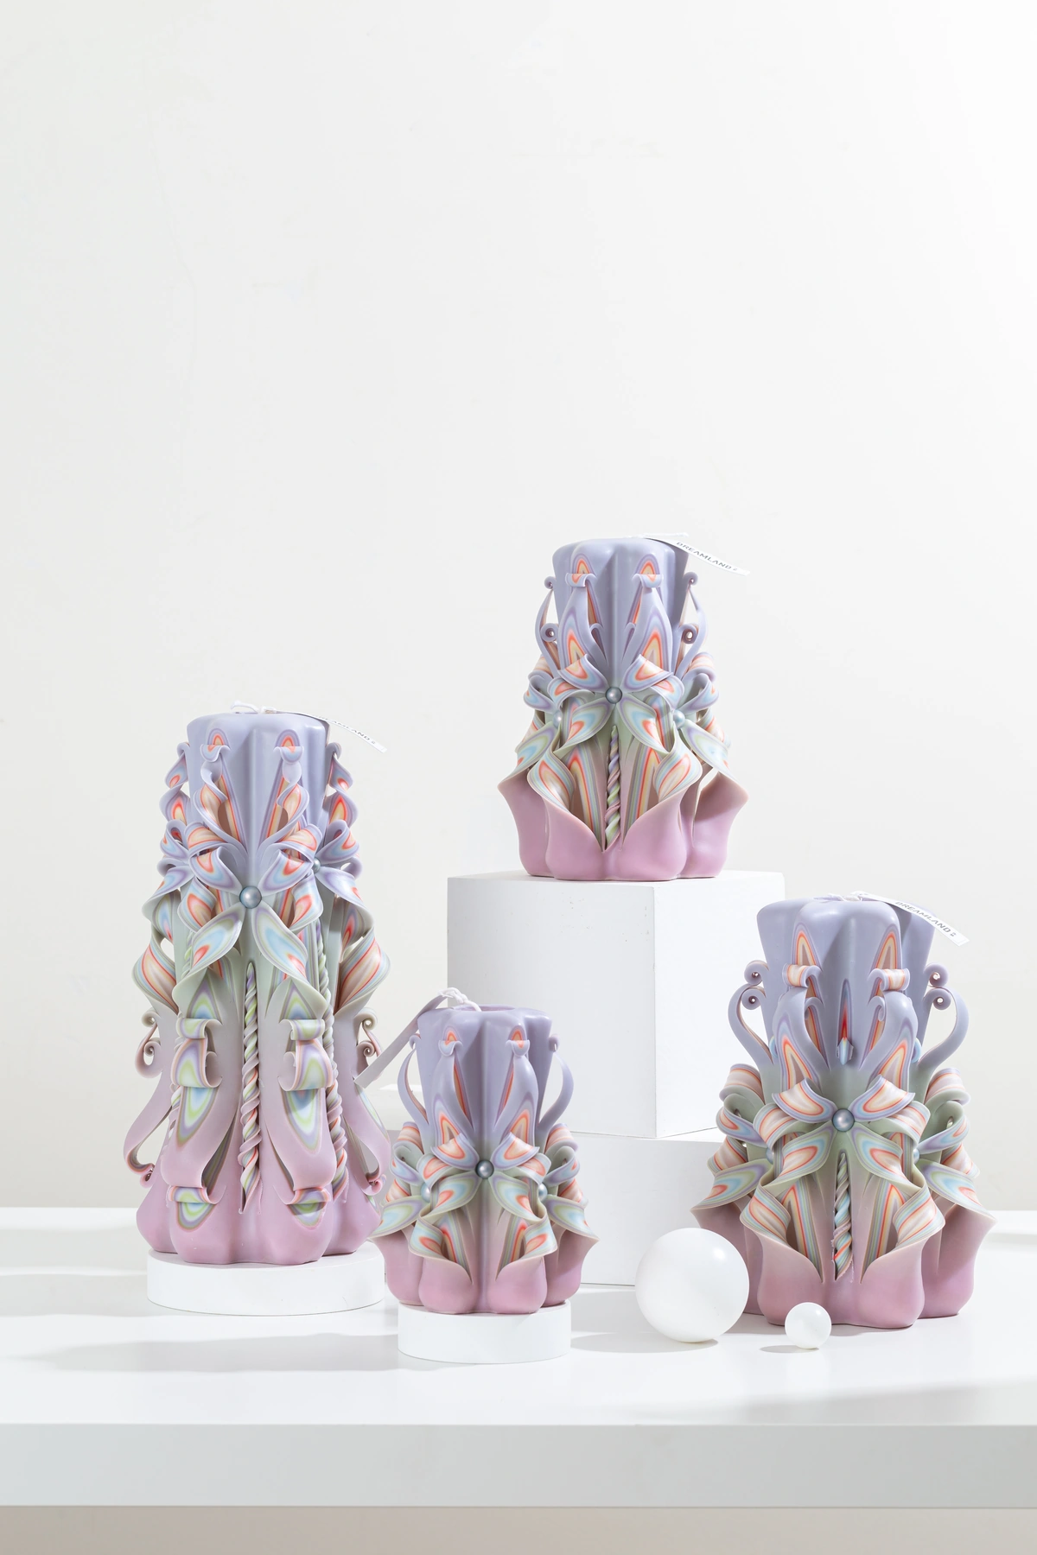
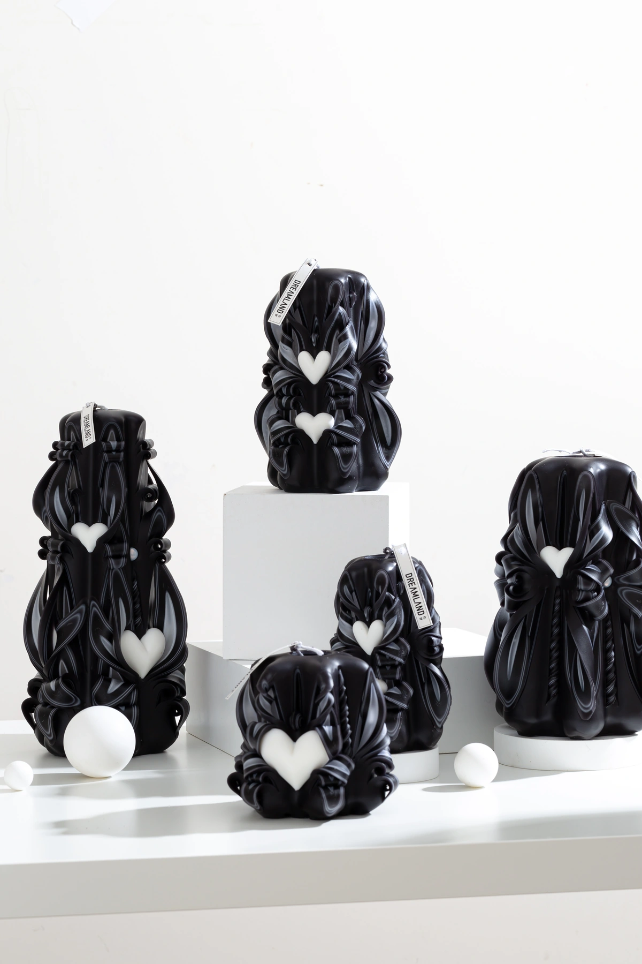
MASTERPIECE COLLECTION
Masterpiece — Product Selection
01–04 of 46 · 1/12
MPC001
MPC002
MPC003
MPC004
Heartbeat
Joy
Secret Garden
Brown Sugar Latte
COLOR
AVAILABLE SIZES
COLOR
AVAILABLE SIZES
COLOR
AVAILABLE SIZES
COLOR
AVAILABLE SIZES
C20
S / M / L / XL
C21
S / M / L / XL
C22
S / M / L / XL
C23
S / M / L / XL
FRAGRANCE / NOTES
FRAGRANCE / NOTES
FRAGRANCE / NOTES
FRAGRANCE / NOTES
CandleScience · 10% fragrance
CandleScience · 10% fragrance
CandleScience · 10% fragrance
CandleScience · 10% fragrance
REFERENCE IMAGES · HANDMADE VARIATION EXPECTED
DREAMLAND · WHOLESALE PRODUCT CATALOG
SOURCE 3B28FE20 · 10

Slide 11
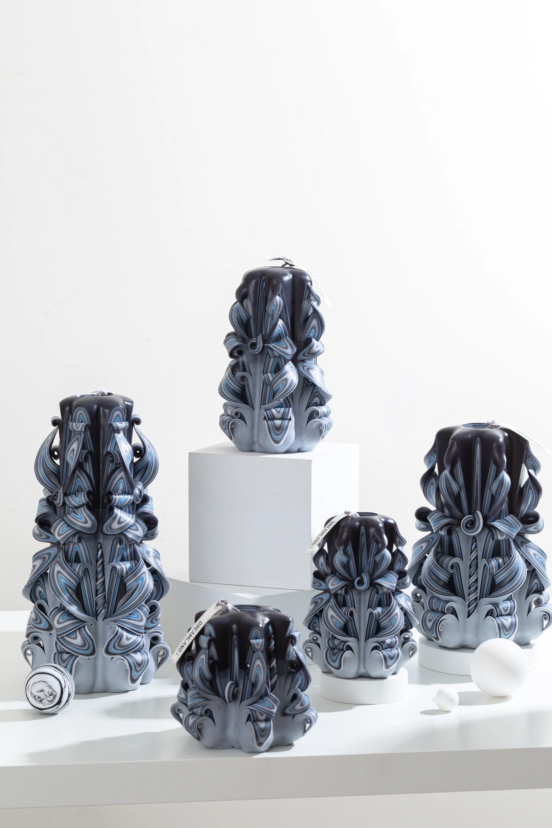
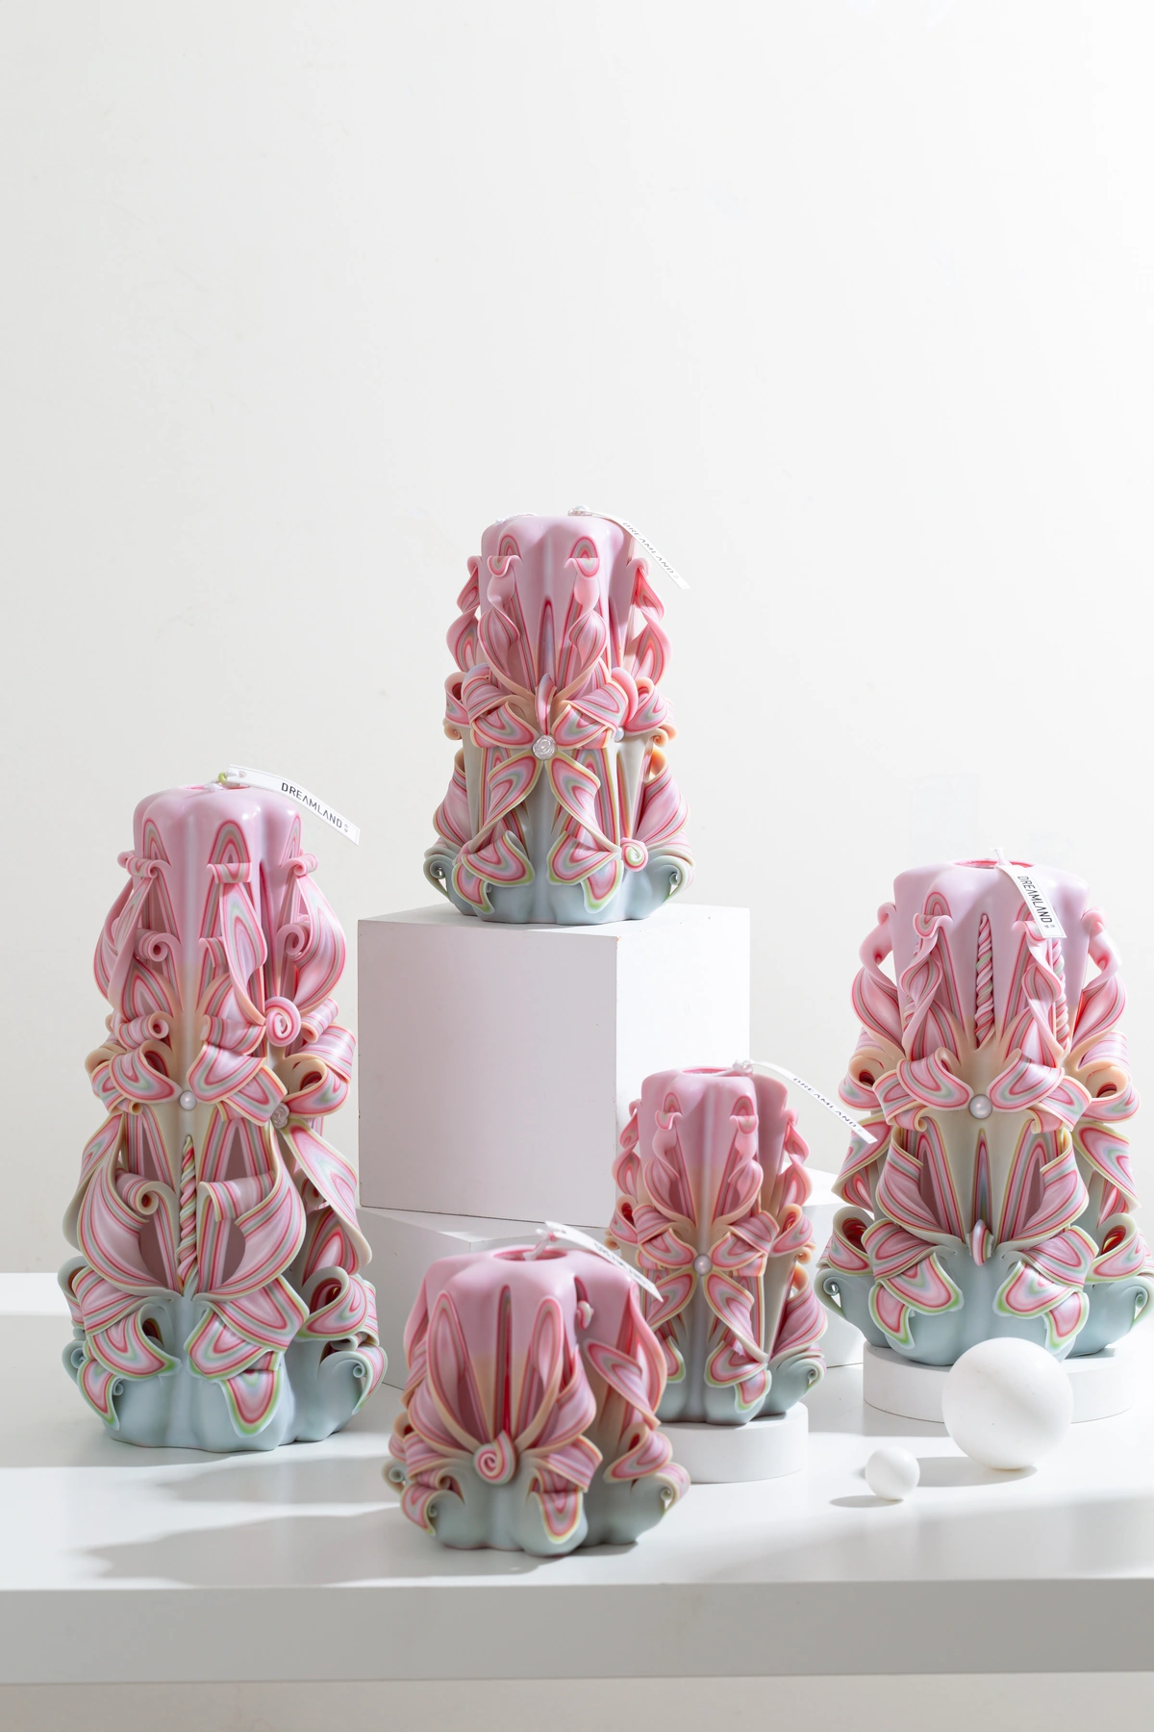
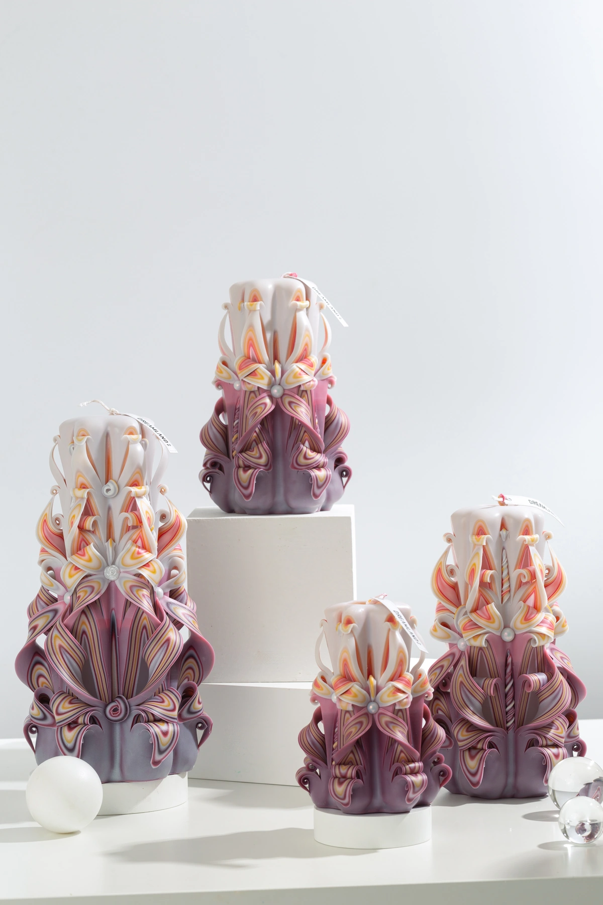
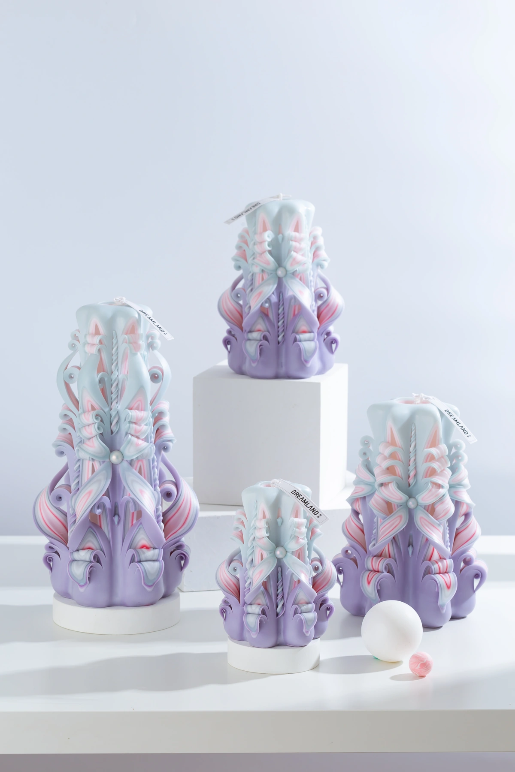
MASTERPIECE COLLECTION
Masterpiece — Product Selection
05–08 of 46 · 2/12
MPC005
MPC006
MPC007
MPC008
Silent Night
Isabella
Cranberry Rouge
Madame Butterfly
COLOR
AVAILABLE SIZES
COLOR
AVAILABLE SIZES
COLOR
AVAILABLE SIZES
COLOR
AVAILABLE SIZES
C24
S / M / L / XL
C25
S / M / L / XL
C26
S / M / L / XL
C27
S / M / L / XL
FRAGRANCE / NOTES
FRAGRANCE / NOTES
FRAGRANCE / NOTES
FRAGRANCE / NOTES
CandleScience · 10% fragrance
CandleScience · 10% fragrance
CandleScience · 10% fragrance
CandleScience · 10% fragrance
REFERENCE IMAGES · HANDMADE VARIATION EXPECTED
DREAMLAND · WHOLESALE PRODUCT CATALOG
SOURCE 3B28FE20 · 11

Slide 12
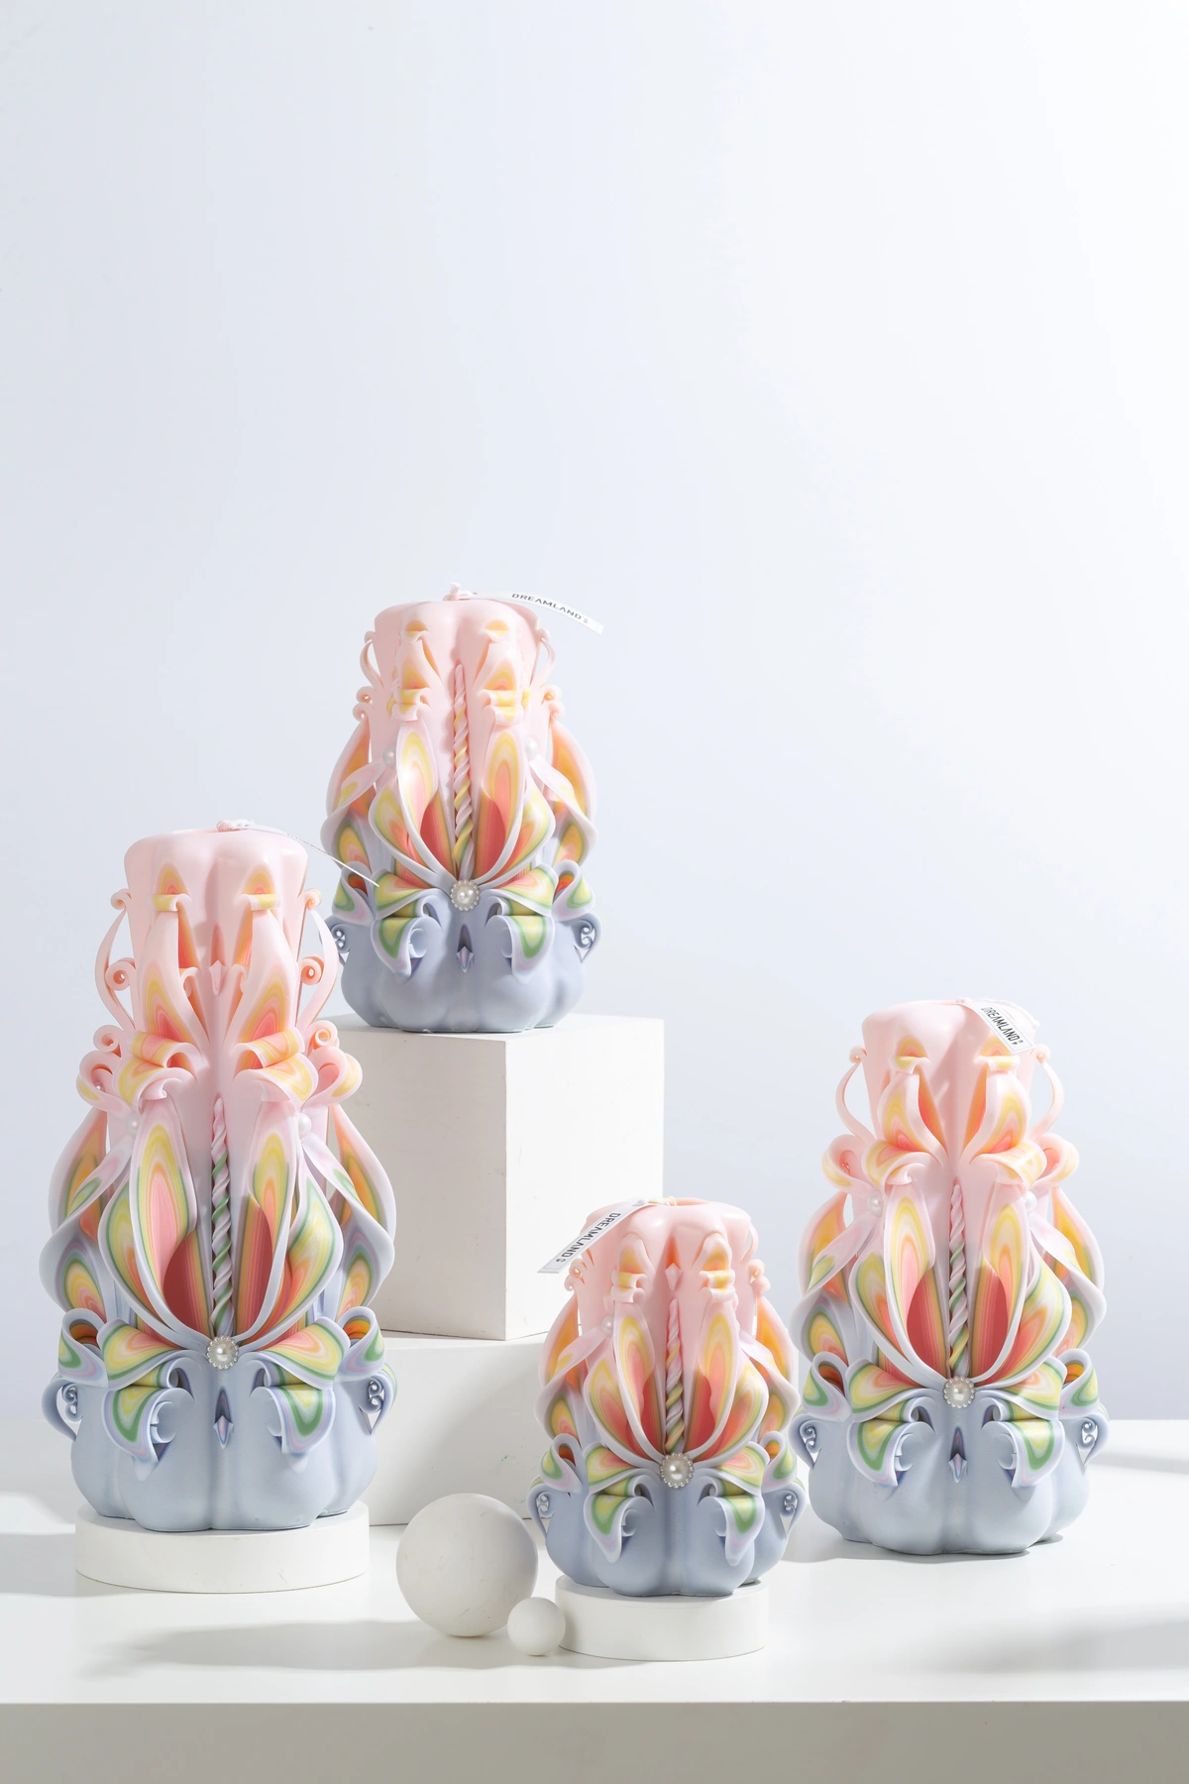
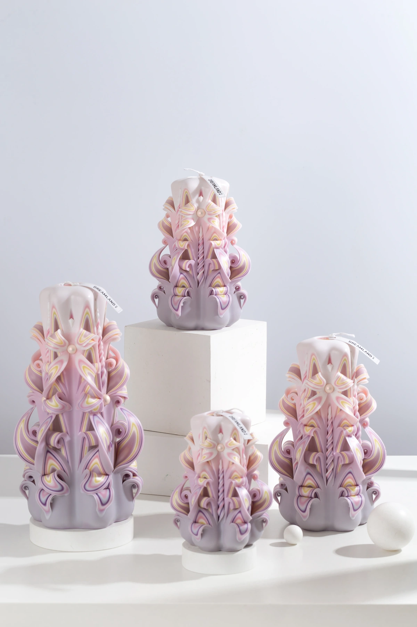
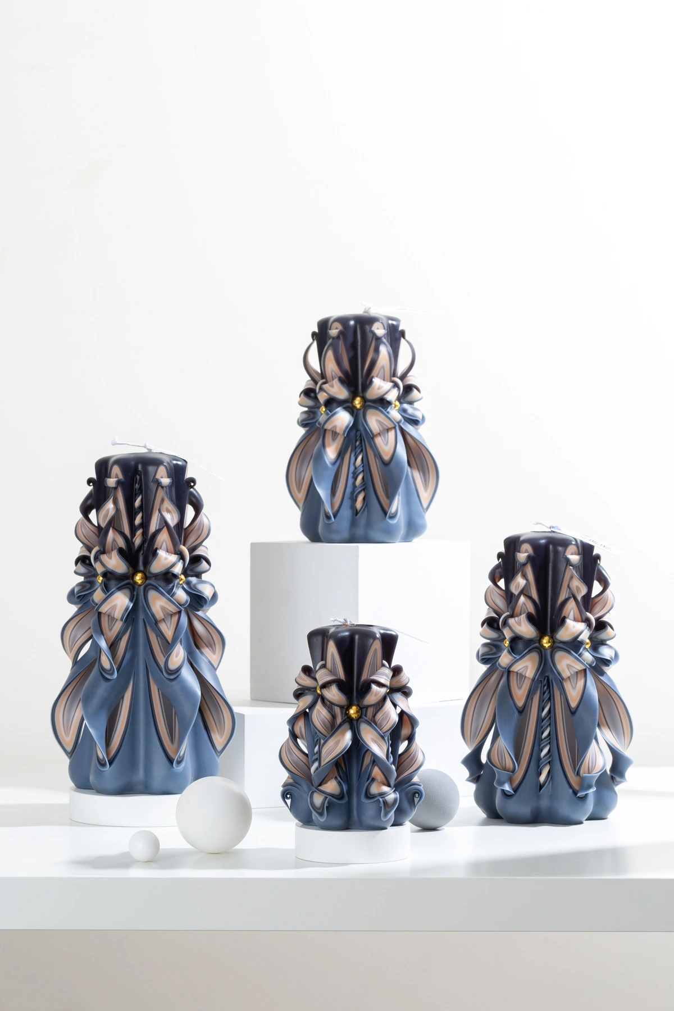
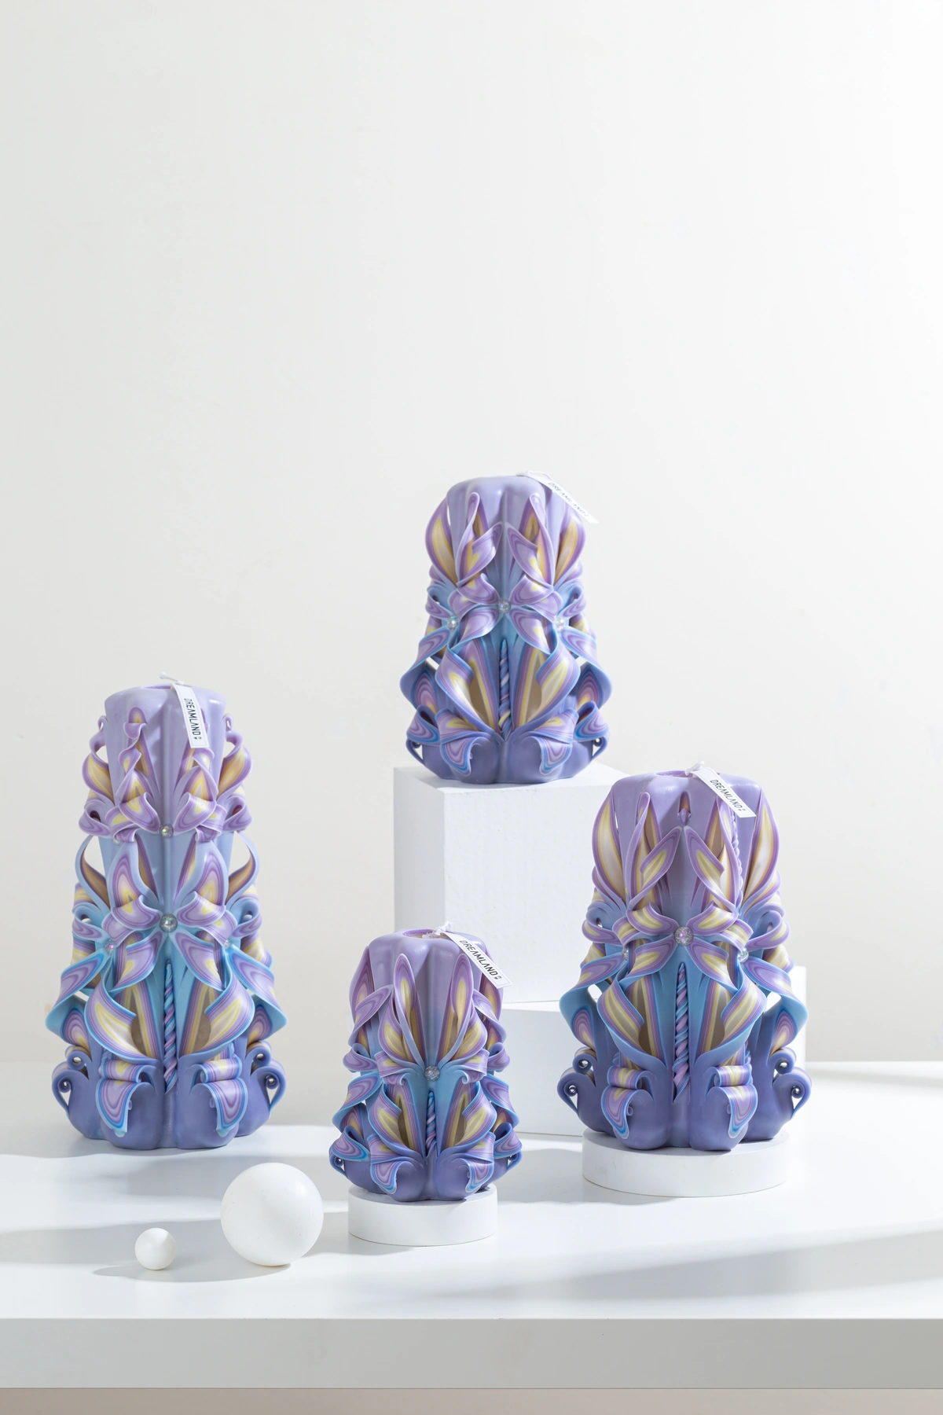
MASTERPIECE COLLECTION
Masterpiece — Product Selection
09–12 of 46 · 3/12
MPC009
MPC010
MPC011
MPC012
Blooming Wonderland
Island With You
Sirius
Starry Serenity
COLOR
AVAILABLE SIZES
COLOR
AVAILABLE SIZES
COLOR
AVAILABLE SIZES
COLOR
AVAILABLE SIZES
C28
S / M / L / XL
C29
S / M / L / XL
C30
S / M / L / XL
C31
S / M / L / XL
FRAGRANCE / NOTES
FRAGRANCE / NOTES
FRAGRANCE / NOTES
FRAGRANCE / NOTES
CandleScience · 10% fragrance
CandleScience · 10% fragrance
CandleScience · 10% fragrance
CandleScience · 10% fragrance
REFERENCE IMAGES · HANDMADE VARIATION EXPECTED
DREAMLAND · WHOLESALE PRODUCT CATALOG
SOURCE 3B28FE20 · 12

Slide 13
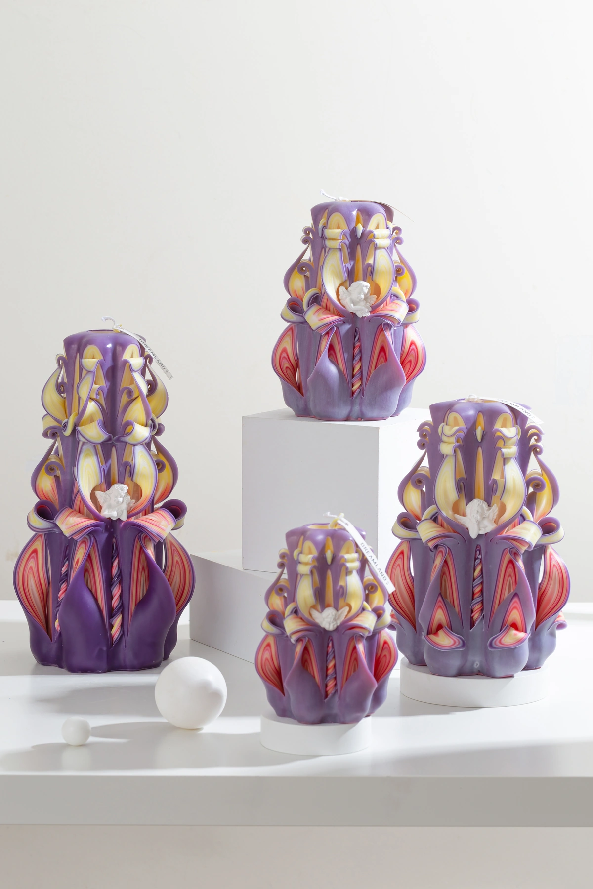
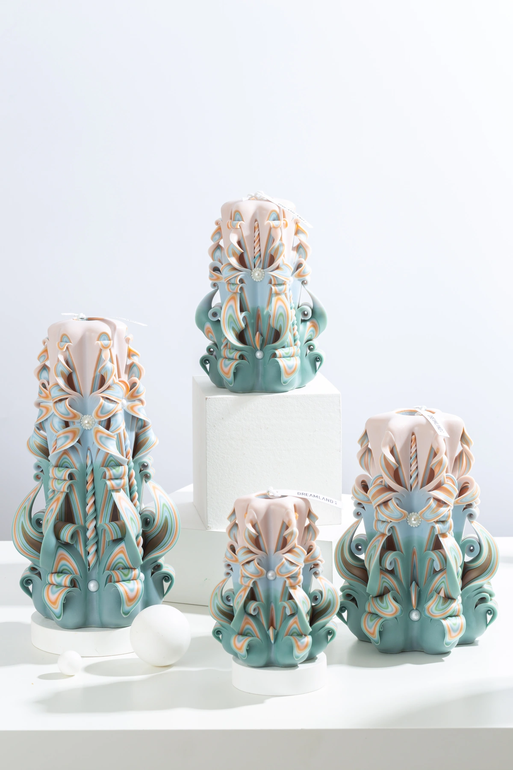
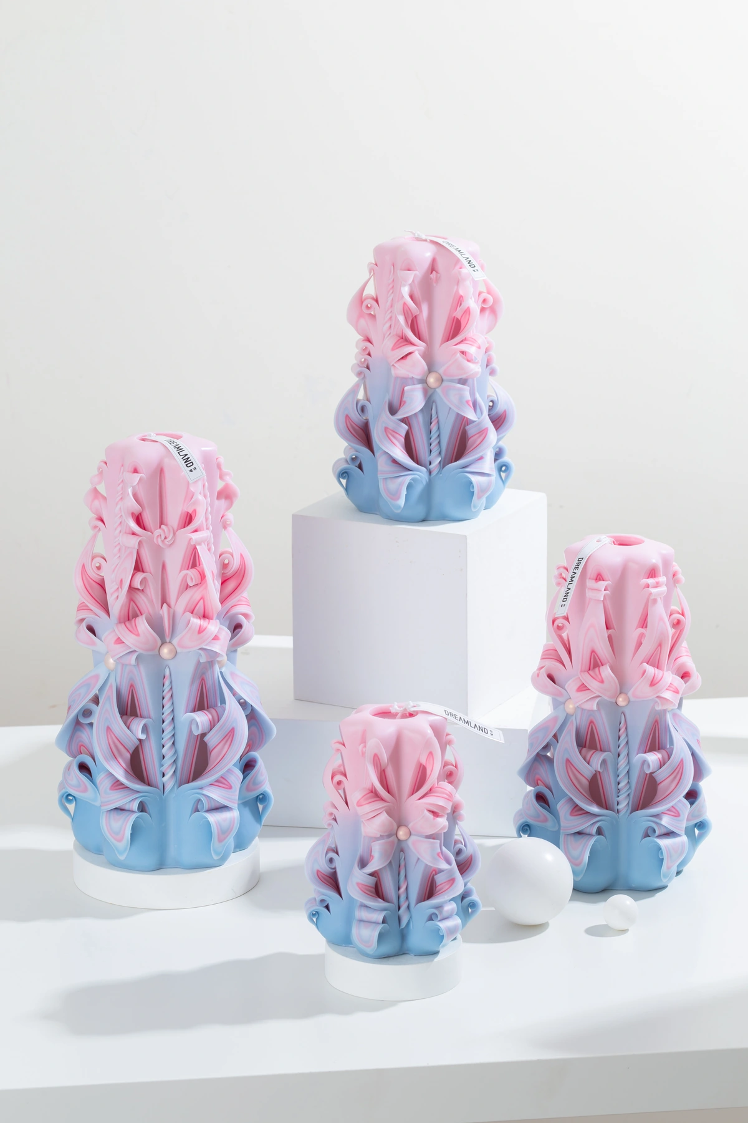
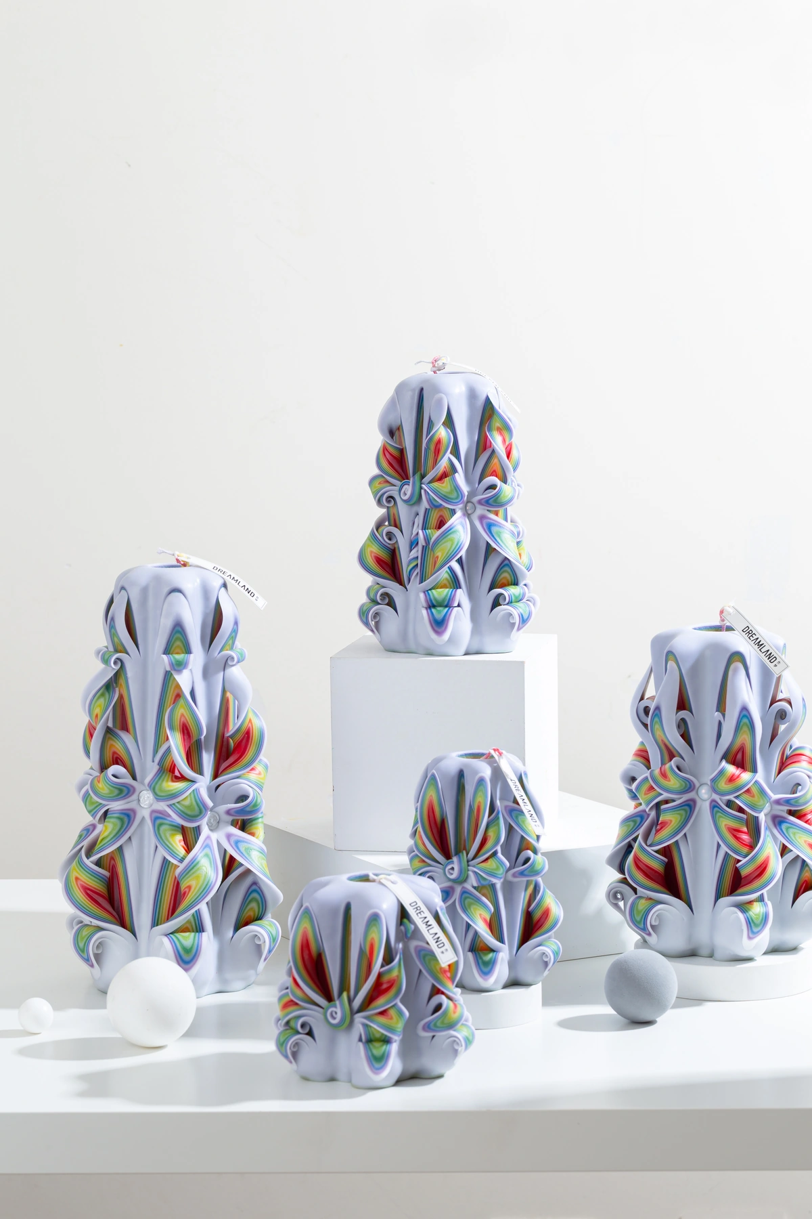
MASTERPIECE COLLECTION
Masterpiece — Product Selection
13–16 of 46 · 4/12
MPC013
MPC014
MPC015
MPC016
Seraph
Celadon Green
Bahama Mirage
Light Encounter
COLOR
AVAILABLE SIZES
COLOR
AVAILABLE SIZES
COLOR
AVAILABLE SIZES
COLOR
AVAILABLE SIZES
C32
S / M / L / XL
C33
S / M / L / XL
C34
S / M / L / XL
C35
S / M / L / XL
FRAGRANCE / NOTES
FRAGRANCE / NOTES
FRAGRANCE / NOTES
FRAGRANCE / NOTES
CandleScience · 10% fragrance
CandleScience · 10% fragrance
CandleScience · 10% fragrance
CandleScience · 10% fragrance
REFERENCE IMAGES · HANDMADE VARIATION EXPECTED
DREAMLAND · WHOLESALE PRODUCT CATALOG
SOURCE 3B28FE20 · 13

Slide 14
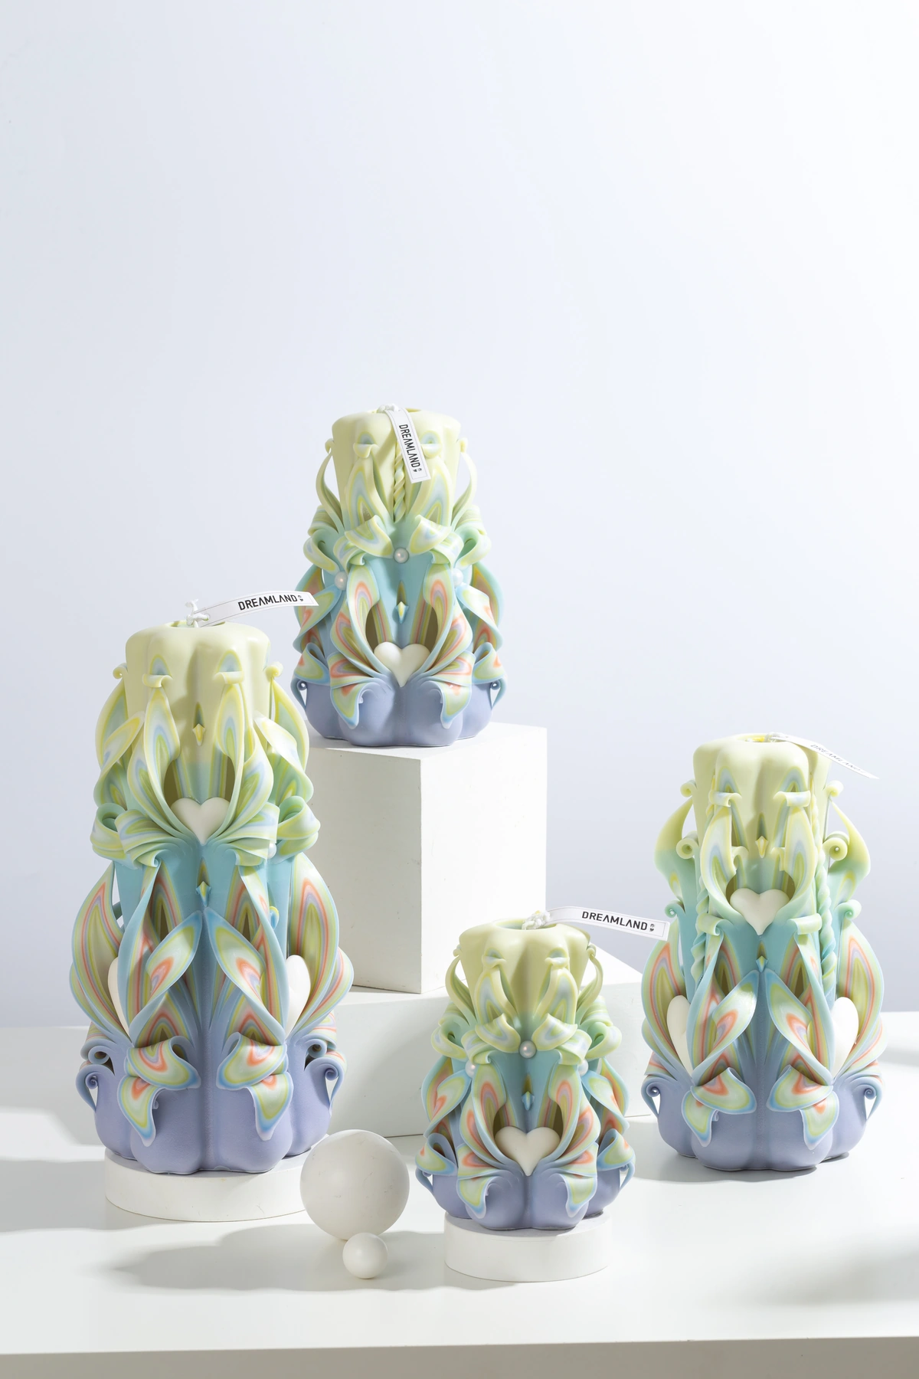
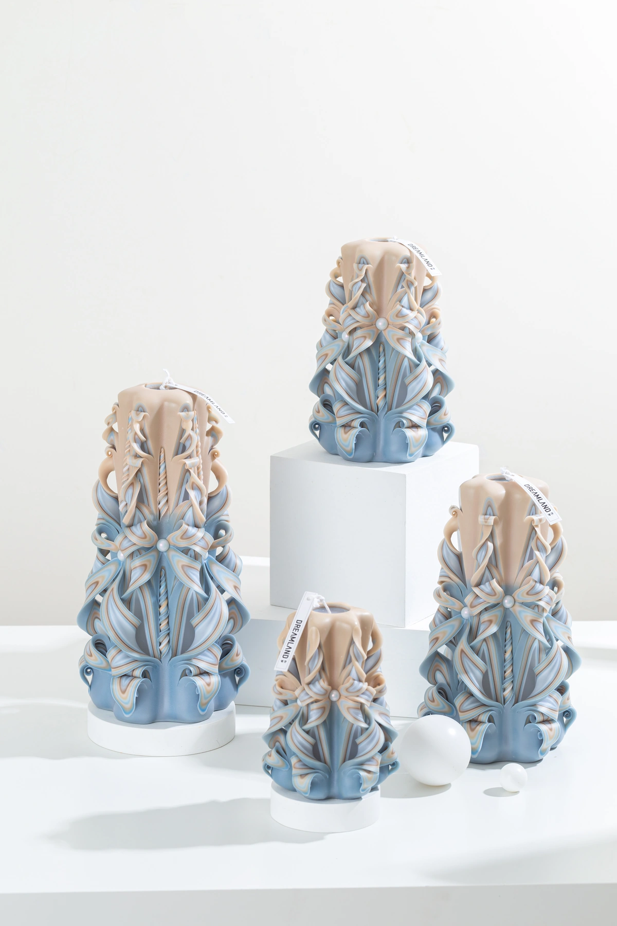
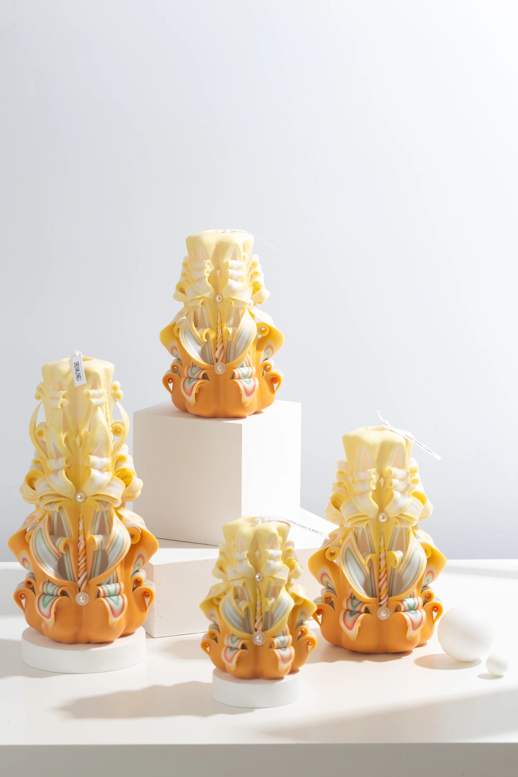
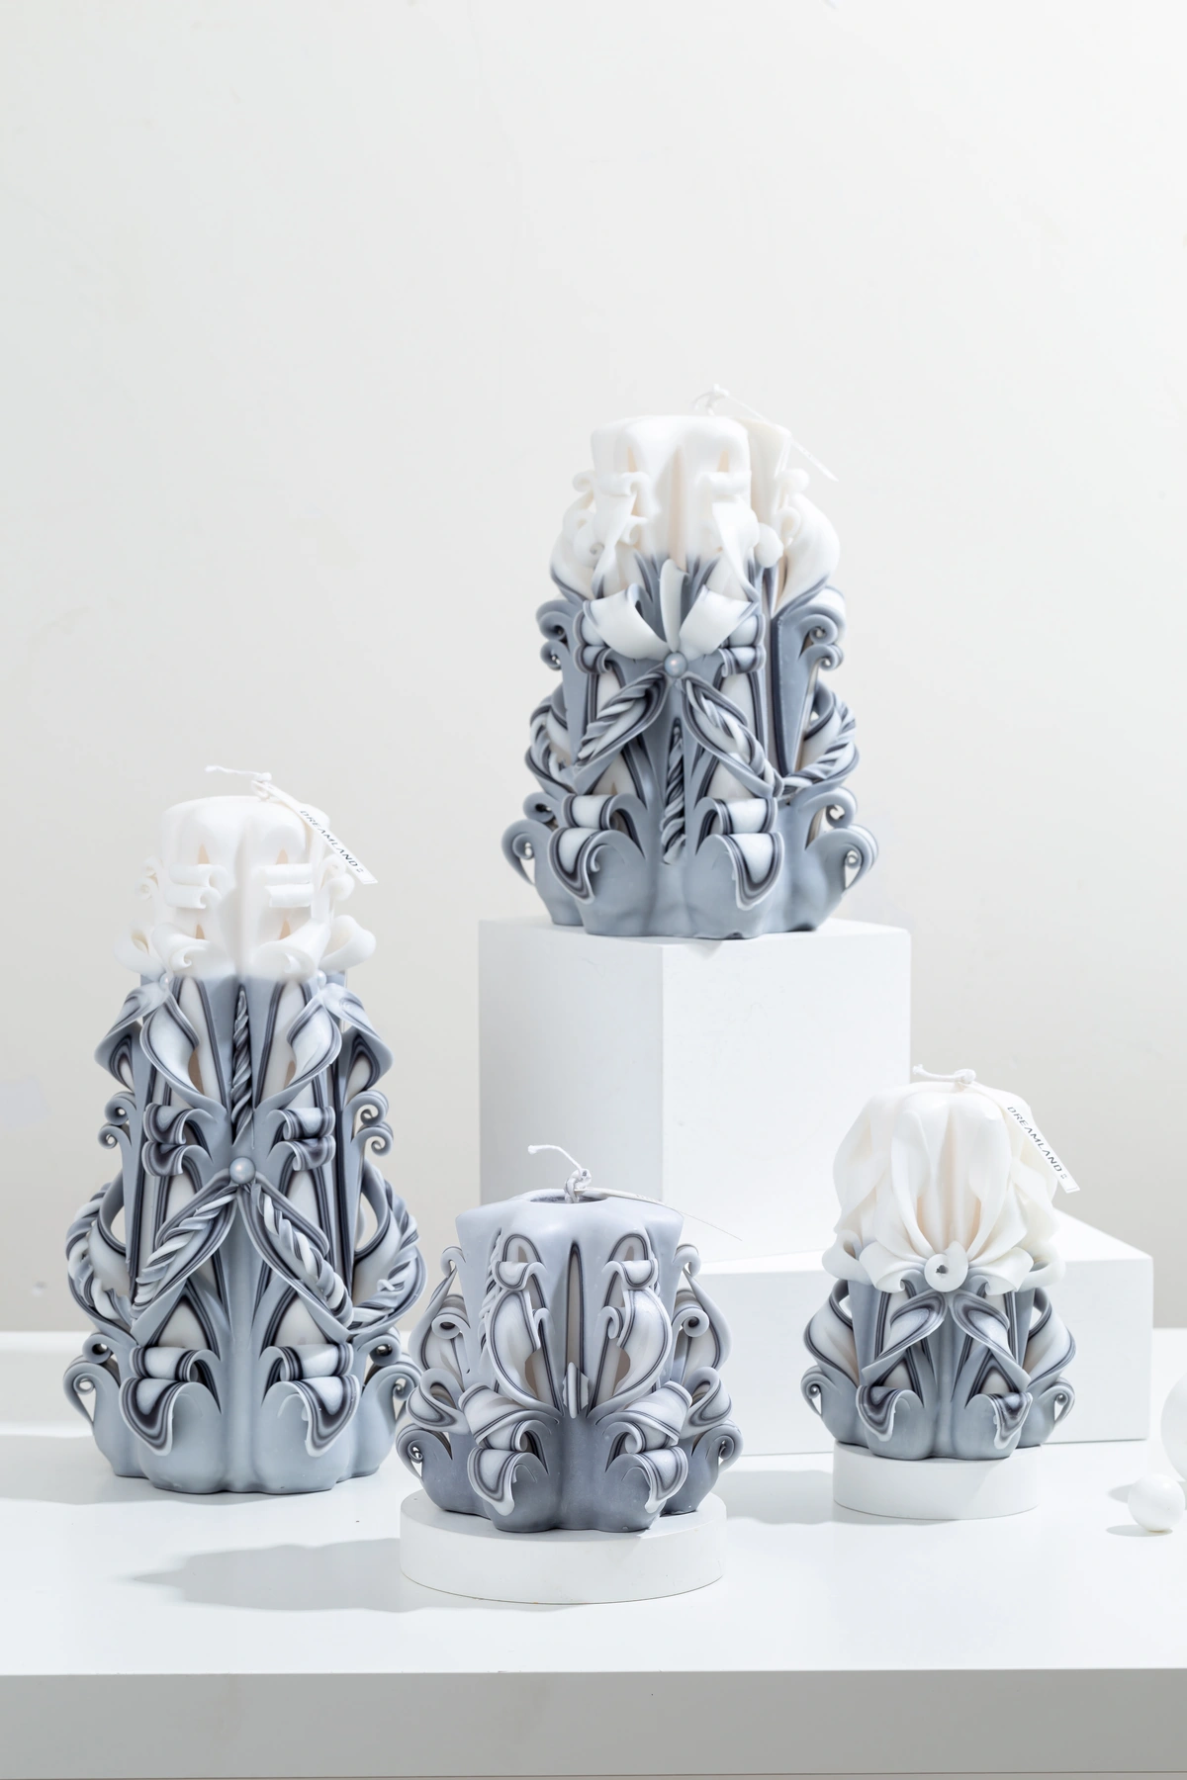
MASTERPIECE COLLECTION
Masterpiece — Product Selection
17–20 of 46 · 5/12
MPC017
MPC018
MPC019
MPC020
Qingqing Zijin
Mist
Orange Soda
Moonlit Frost
COLOR
AVAILABLE SIZES
COLOR
AVAILABLE SIZES
COLOR
AVAILABLE SIZES
COLOR
AVAILABLE SIZES
C36
S / M / L / XL
C37
S / M / L / XL
C38
S / M / L / XL
C39
S / M / L / XL
FRAGRANCE / NOTES
FRAGRANCE / NOTES
FRAGRANCE / NOTES
FRAGRANCE / NOTES
CandleScience · 10% fragrance
CandleScience · 10% fragrance
CandleScience · 10% fragrance
CandleScience · 10% fragrance
REFERENCE IMAGES · HANDMADE VARIATION EXPECTED
DREAMLAND · WHOLESALE PRODUCT CATALOG
SOURCE 3B28FE20 · 14

Slide 15
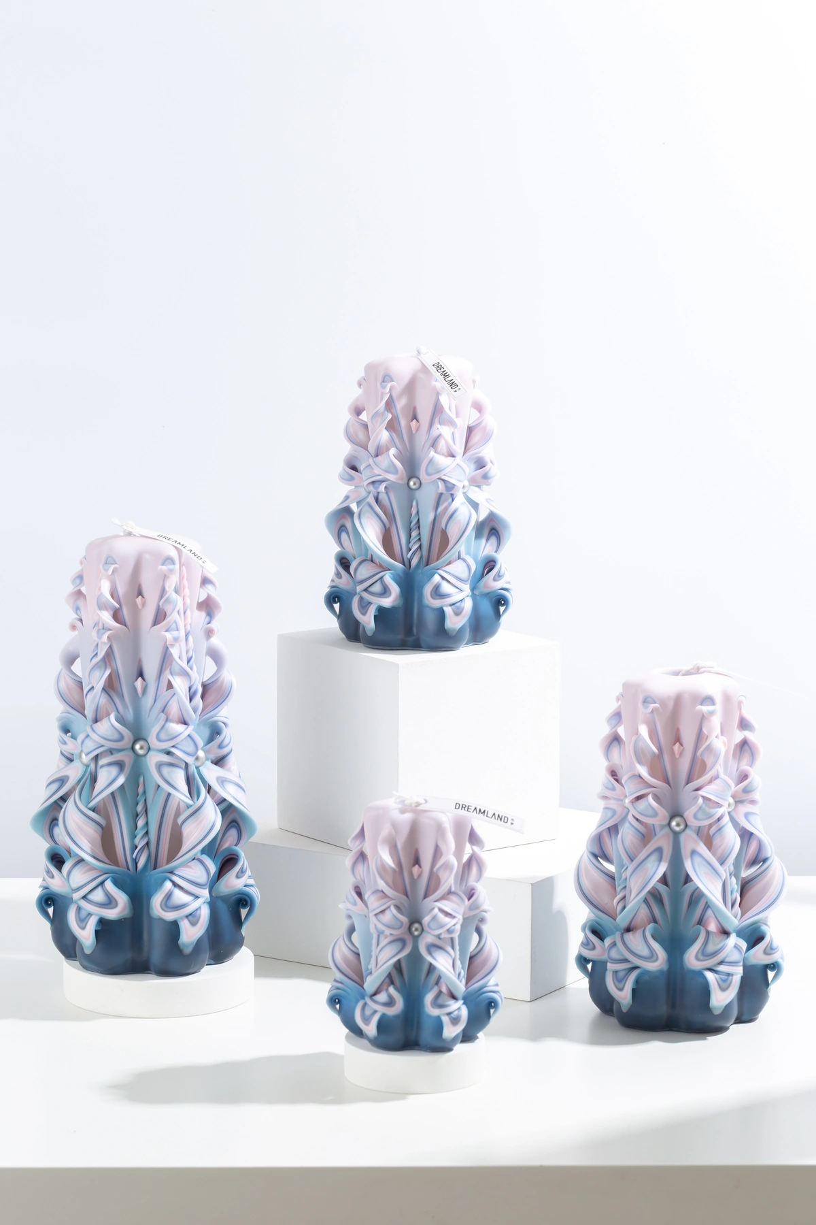
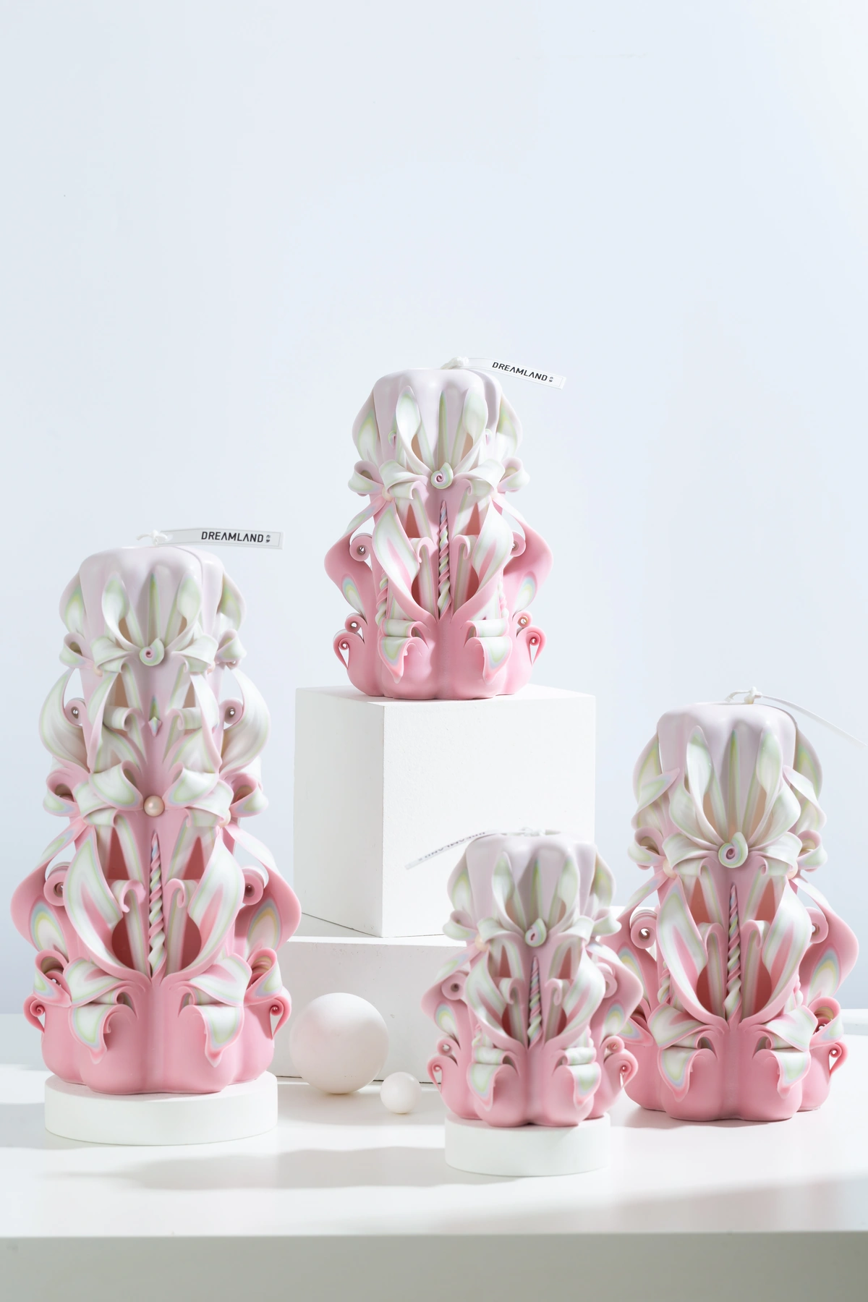
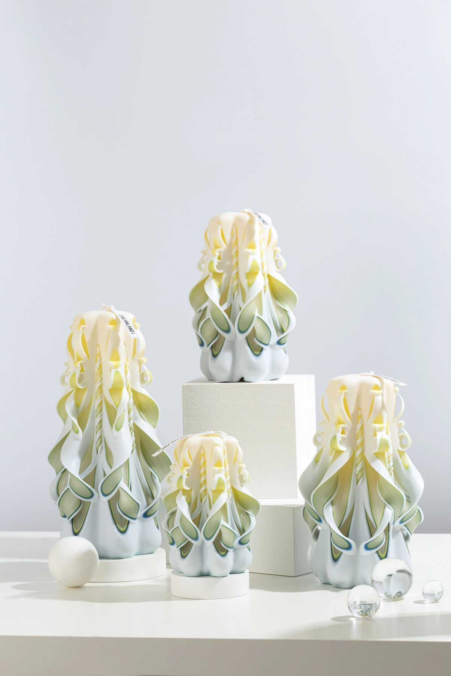
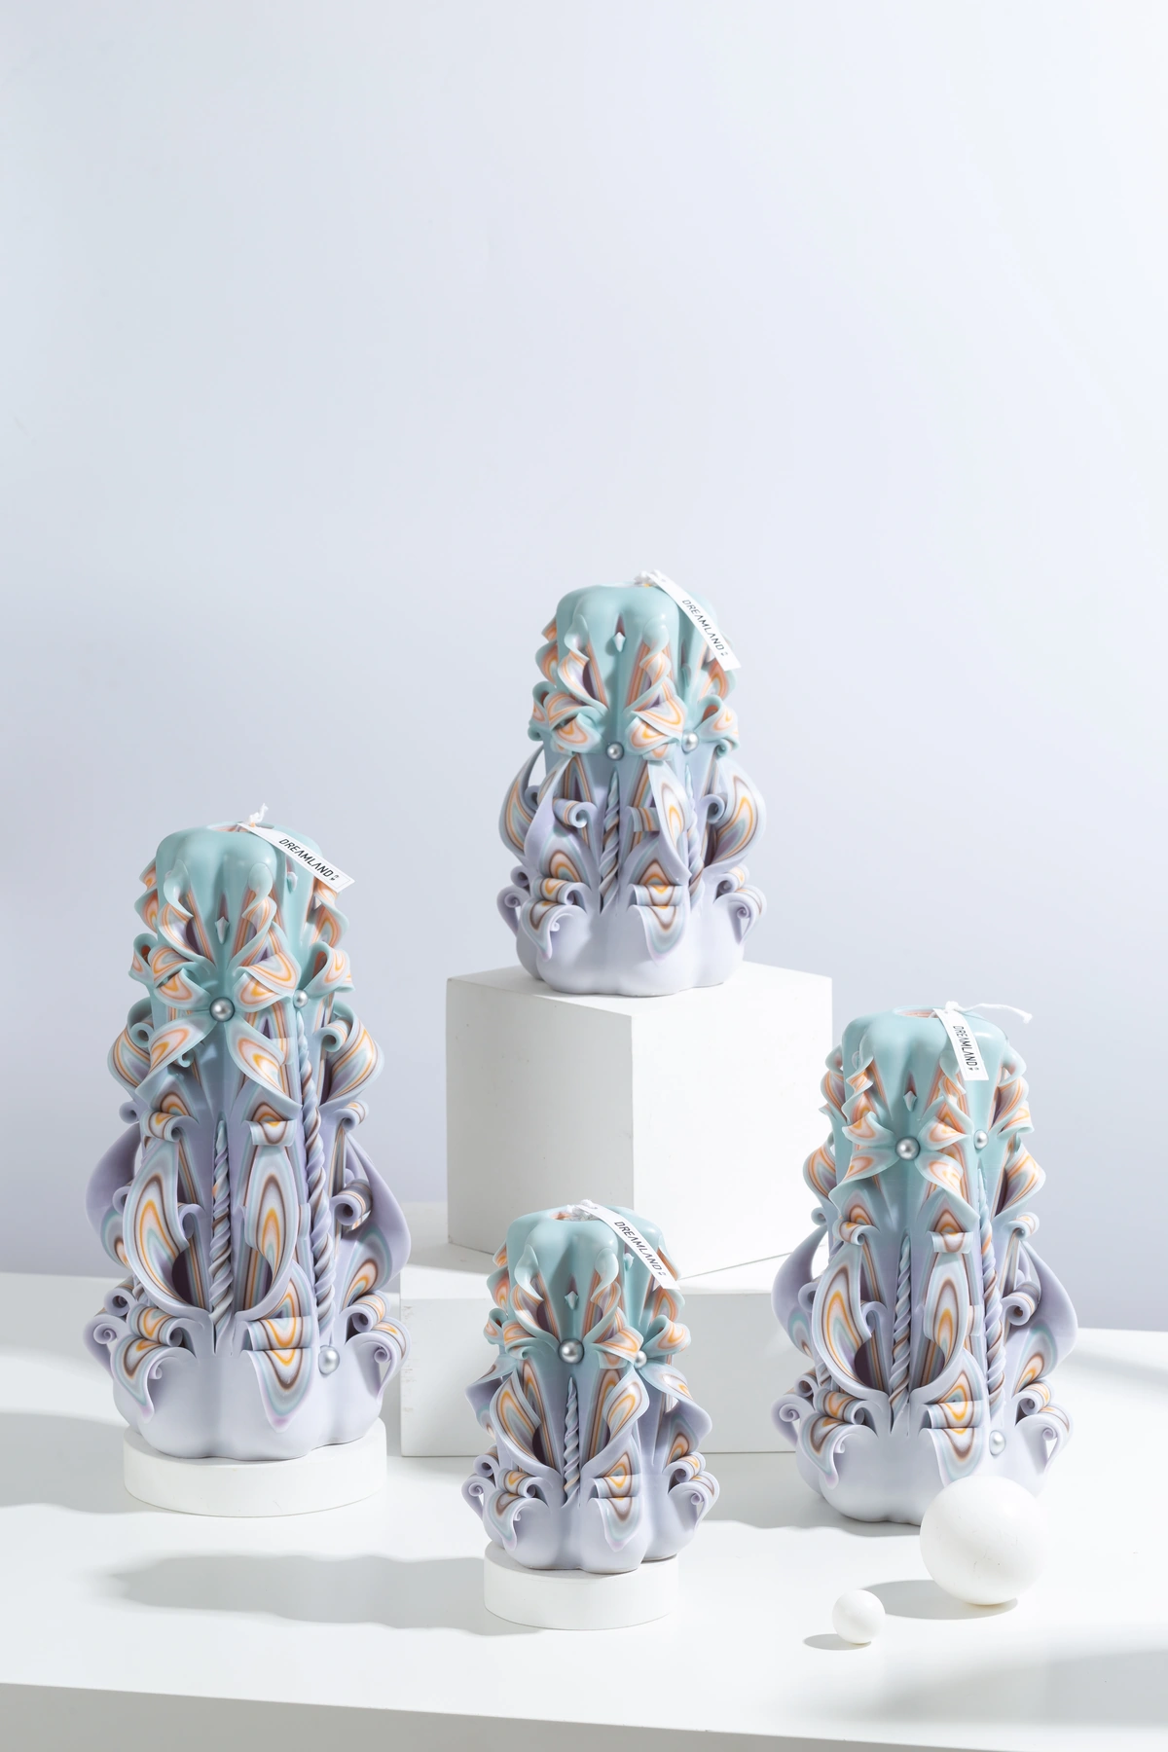
MASTERPIECE COLLECTION
Masterpiece — Product Selection
21–24 of 46 · 6/12
MPC021
MPC022
MPC023
MPC024
Deep Sea
Love You
Paradise
Whale Fall Galaxy
COLOR
AVAILABLE SIZES
COLOR
AVAILABLE SIZES
COLOR
AVAILABLE SIZES
COLOR
AVAILABLE SIZES
C40
S / M / L / XL
C41
S / M / L / XL
C42
S / M / L / XL
C43
S / M / L / XL
FRAGRANCE / NOTES
FRAGRANCE / NOTES
FRAGRANCE / NOTES
FRAGRANCE / NOTES
CandleScience · 10% fragrance
CandleScience · 10% fragrance
CandleScience · 10% fragrance
CandleScience · 10% fragrance
REFERENCE IMAGES · HANDMADE VARIATION EXPECTED
DREAMLAND · WHOLESALE PRODUCT CATALOG
SOURCE 3B28FE20 · 15

Slide 16
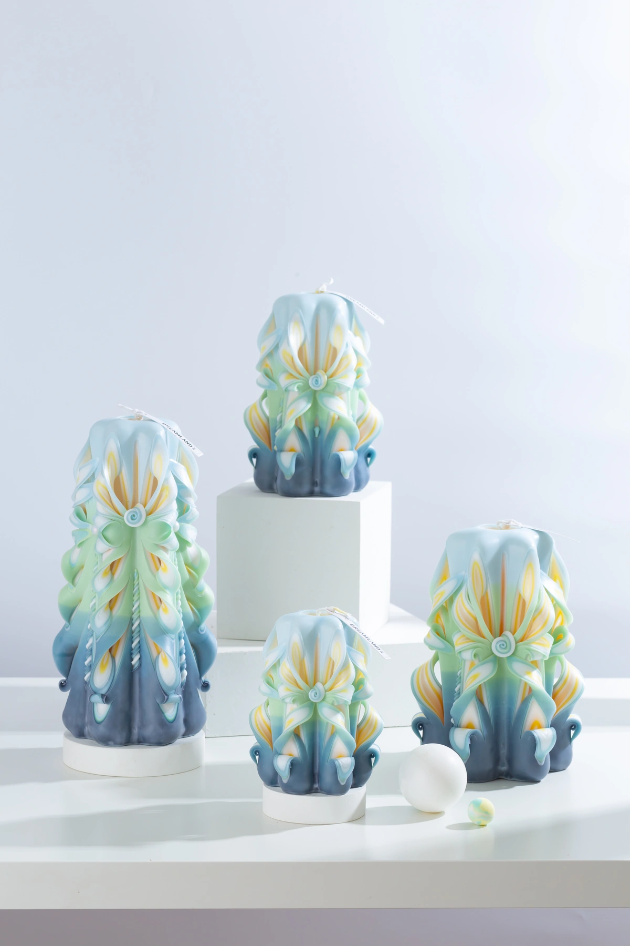
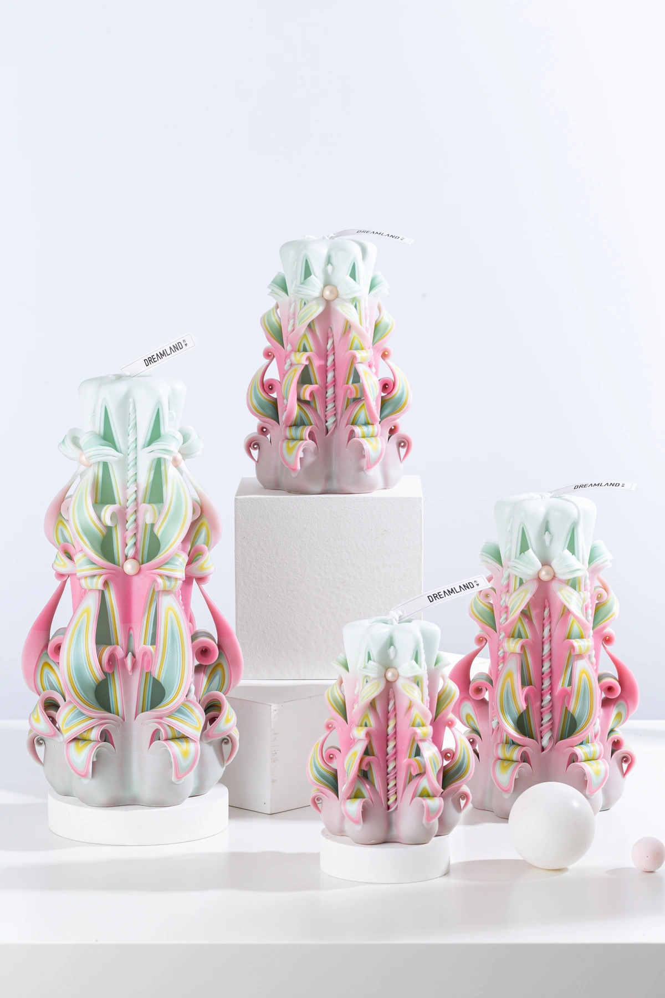
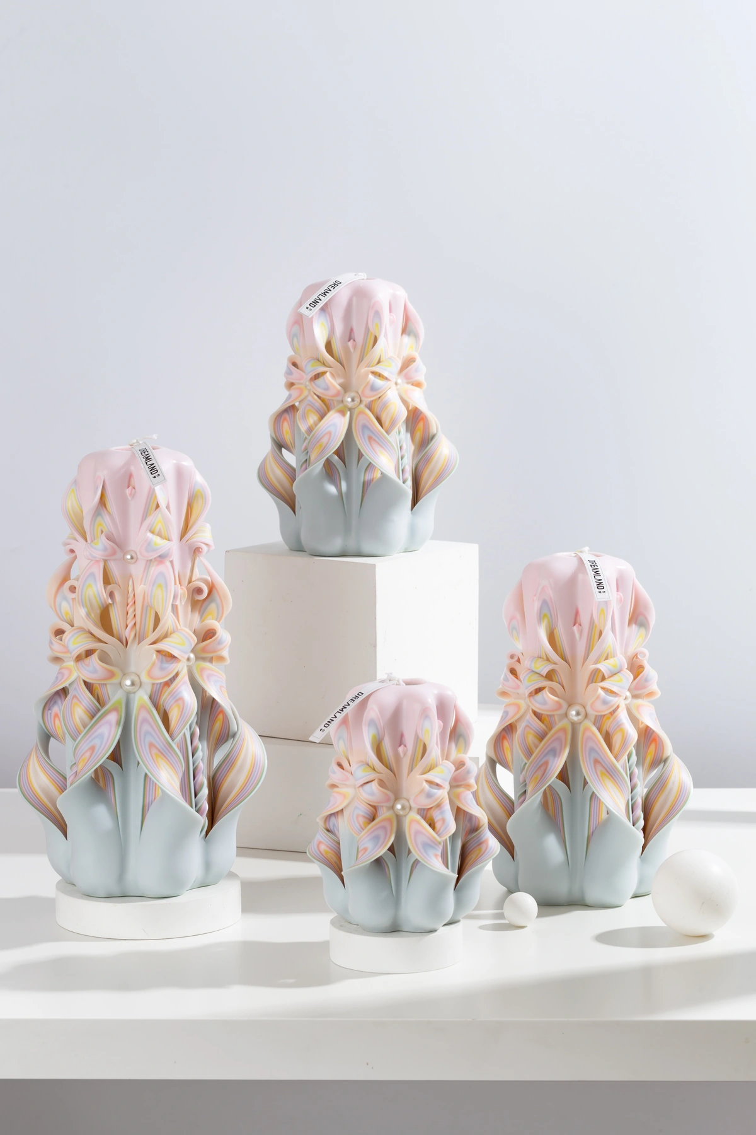
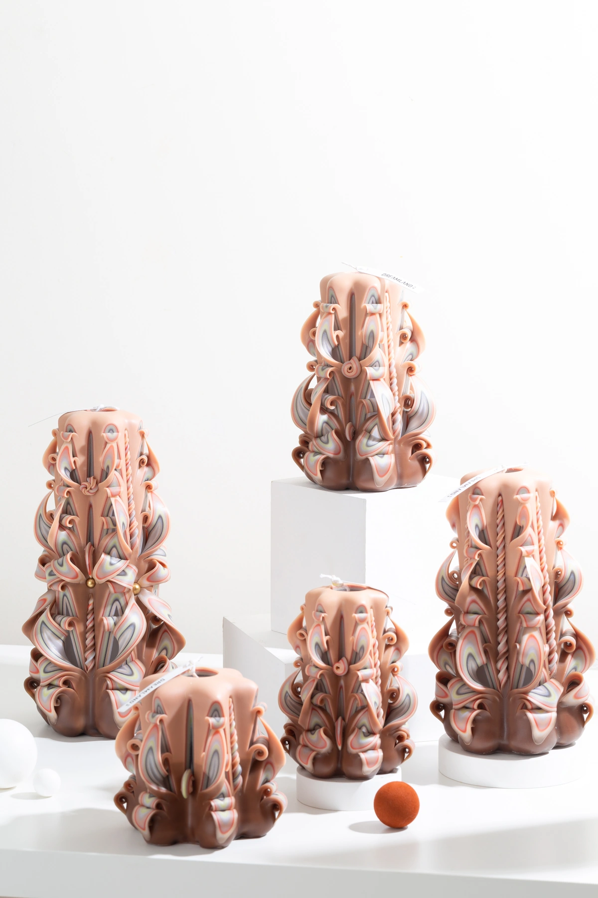
MASTERPIECE COLLECTION
Masterpiece — Product Selection
25–28 of 46 · 7/12
MPC025
MPC026
MPC027
MPC028
Sea Salt Jasmine
Peach Blossom Dream
Fairy Tale
Winnie Bear
COLOR
AVAILABLE SIZES
COLOR
AVAILABLE SIZES
COLOR
AVAILABLE SIZES
COLOR
AVAILABLE SIZES
C44
S / M / L / XL
C45
S / M / L / XL
C46
S / M / L / XL
C47
S / M / L / XL
FRAGRANCE / NOTES
FRAGRANCE / NOTES
FRAGRANCE / NOTES
FRAGRANCE / NOTES
CandleScience · 10% fragrance
CandleScience · 10% fragrance
CandleScience · 10% fragrance
CandleScience · 10% fragrance
REFERENCE IMAGES · HANDMADE VARIATION EXPECTED
DREAMLAND · WHOLESALE PRODUCT CATALOG
SOURCE 3B28FE20 · 16

Slide 17
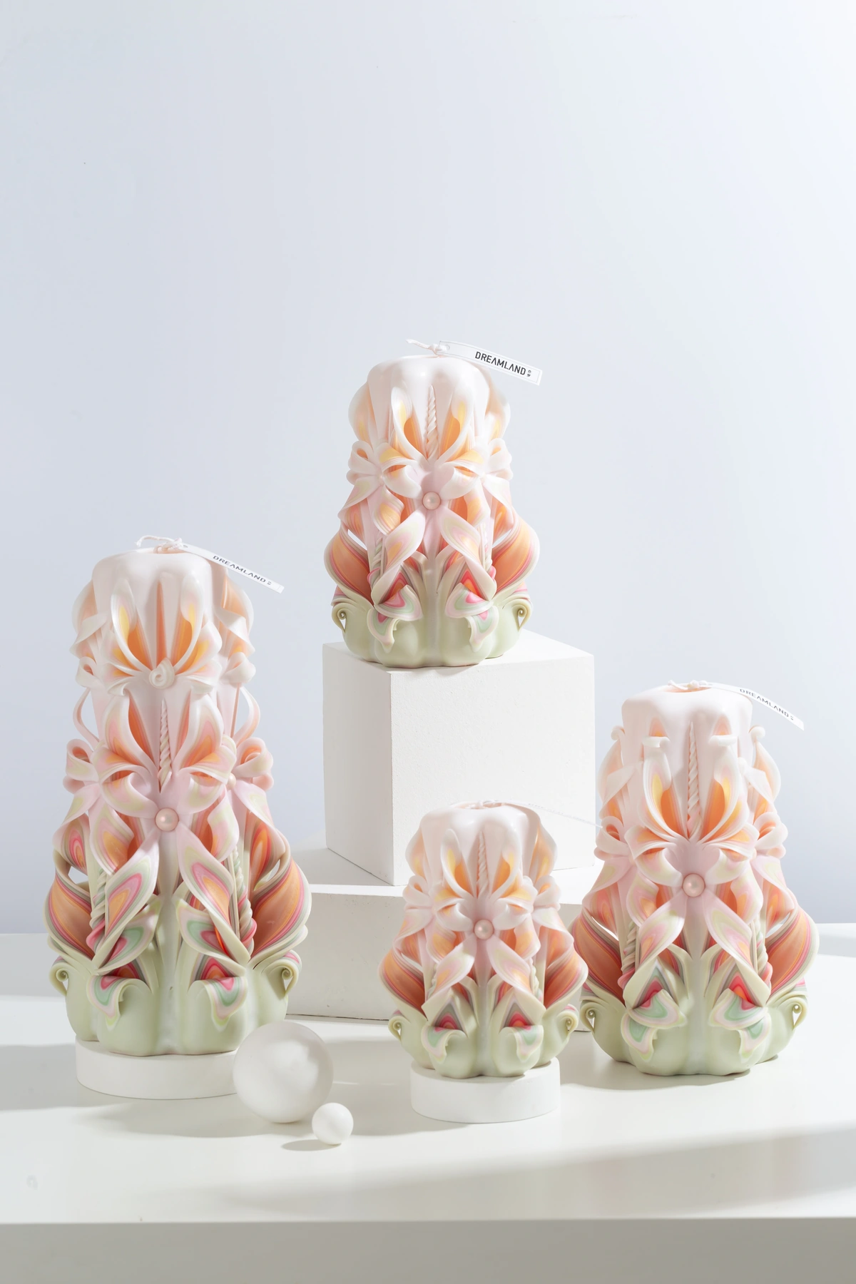



MASTERPIECE COLLECTION
Masterpiece — Product Selection
29–32 of 46 · 8/12
MPC029
MPC030
MPC031
MPC032
Summer Dream
Night Wish
Colored Glaze
Dune
COLOR
AVAILABLE SIZES
COLOR
AVAILABLE SIZES
COLOR
AVAILABLE SIZES
COLOR
AVAILABLE SIZES
C48
S / M / L / XL
C49
S / M / L / XL
C50
S / M / L / XL
C51
S / M / L / XL
FRAGRANCE / NOTES
FRAGRANCE / NOTES
FRAGRANCE / NOTES
FRAGRANCE / NOTES
CandleScience · 10% fragrance
CandleScience · 10% fragrance
CandleScience · 10% fragrance
CandleScience · 10% fragrance
REFERENCE IMAGES · HANDMADE VARIATION EXPECTED
DREAMLAND · WHOLESALE PRODUCT CATALOG
SOURCE 3B28FE20 · 17

Slide 18


MASTERPIECE COLLECTION
Masterpiece — Product Selection
33–36 of 46 · 9/12
MPC033
MPC034
MPC036
MPC037
Little Prince
Bubble
Arles Ocean
Noir Rainbow
COLOR
AVAILABLE SIZES
COLOR
AVAILABLE SIZES
COLOR
AVAILABLE SIZES
COLOR
AVAILABLE SIZES
C52
S / M / L / XL
C53
S / M / L / XL
reference
S / M / L / XL
reference
S / M / L / XL
FRAGRANCE / NOTES
FRAGRANCE / NOTES
FRAGRANCE / NOTES
FRAGRANCE / NOTES
CandleScience · 10% fragrance
CandleScience · 10% fragrance
CandleScience · 10% fragrance
CandleScience · 10% fragrance
REFERENCE IMAGES · HANDMADE VARIATION EXPECTED
DREAMLAND · WHOLESALE PRODUCT CATALOG
SOURCE 3B28FE20 · 18

Slide 19
MASTERPIECE COLLECTION
Masterpiece — Product Selection
37–40 of 46 · 10/12
MPC038
MPC039
MPC040
MPC041
Misty Reeds
Freud
Golden Coast
Dusky Afterglow
COLOR
AVAILABLE SIZES
COLOR
AVAILABLE SIZES
COLOR
AVAILABLE SIZES
COLOR
AVAILABLE SIZES
reference
S / M / L / XL
reference
S / M / L / XL
reference
S / M / L / XL
reference
S / M / L / XL
FRAGRANCE / NOTES
FRAGRANCE / NOTES
FRAGRANCE / NOTES
FRAGRANCE / NOTES
CandleScience · 10% fragrance
CandleScience · 10% fragrance
CandleScience · 10% fragrance
CandleScience · 10% fragrance
REFERENCE IMAGES · HANDMADE VARIATION EXPECTED
DREAMLAND · WHOLESALE PRODUCT CATALOG
SOURCE 3B28FE20 · 19

Slide 20
MASTERPIECE COLLECTION
Masterpiece — Product Selection
41–44 of 46 · 11/12
MPC042
MPC043
MPC044
MPC048
Migratory Isle
California Dream
Moonlit Treasure
Fireside Christmas
COLOR
AVAILABLE SIZES
COLOR
AVAILABLE SIZES
COLOR
AVAILABLE SIZES
COLOR
AVAILABLE SIZES
reference
S / M / L / XL
reference
S / M / L / XL
reference
S / M / L / XL
reference
S / M / L / XL
FRAGRANCE / NOTES
FRAGRANCE / NOTES
FRAGRANCE / NOTES
FRAGRANCE / NOTES
CandleScience · 10% fragrance
CandleScience · 10% fragrance
CandleScience · 10% fragrance
CandleScience · 10% fragrance
REFERENCE IMAGES · HANDMADE VARIATION EXPECTED
DREAMLAND · WHOLESALE PRODUCT CATALOG
SOURCE 3B28FE20 · 20

Slide 21
MASTERPIECE COLLECTION
Masterpiece — Product Selection
45–46 of 46 · 12/12
MPC049
MPC050
Forest Tide
Cosmic Mocha
COLOR
AVAILABLE SIZES
COLOR
AVAILABLE SIZES
reference
S / M / L / XL
reference
S / M / L / XL
FRAGRANCE / NOTES
FRAGRANCE / NOTES
CandleScience · 10% fragrance
CandleScience · 10% fragrance
REFERENCE IMAGES · HANDMADE VARIATION EXPECTED
DREAMLAND · WHOLESALE PRODUCT CATALOG
SOURCE 3B28FE20 · 21

Slide 22

03
HOLIDAY COLLECTION
Holiday
Seasonal carved candles with selectable fragrance-series options.
ACTIVE DESIGNS
MOQ BY SIZE
SERIES NOTES
16
S 36 · M 24 · L 18 · XL 18
Christmas · selectable scent series
HOL002
DREAMLAND · WHOLESALE PRODUCT CATALOG
SOURCE 3B28FE20 · 22

Slide 23


HOLIDAY COLLECTION
Holiday — Product Selection
01–04 of 16 · 1/4
HOL001
HOL002
HOL003
HOL004
C01
C02
Christmas Carved Candle C03
Christmas Carved Candle C04
COLOR
AVAILABLE SIZES
COLOR
AVAILABLE SIZES
COLOR
AVAILABLE SIZES
COLOR
AVAILABLE SIZES
C01
S / M / L / XL
C02
S / M / L / XL
C03
S / M / L / XL
C04
S / M / L / XL
FRAGRANCE / NOTES
FRAGRANCE / NOTES
FRAGRANCE / NOTES
FRAGRANCE / NOTES
Christmas · selectable scent series
Christmas · selectable scent series
Christmas · selectable scent series
Christmas · selectable scent series
REFERENCE IMAGES · HANDMADE VARIATION EXPECTED
DREAMLAND · WHOLESALE PRODUCT CATALOG
SOURCE 3B28FE20 · 23

Slide 24




HOLIDAY COLLECTION
Holiday — Product Selection
05–08 of 16 · 2/4
HOL005
HOL006
HOL007
HOL008
Christmas Carved Candle C05
Christmas Carved Candle C06
Christmas Carved Candle C07
Christmas Carved Candle C08
COLOR
AVAILABLE SIZES
COLOR
AVAILABLE SIZES
COLOR
AVAILABLE SIZES
COLOR
AVAILABLE SIZES
C05
S / M / L / XL
C06
S / M / L / XL
C07
S / M / L / XL
C08
S / M / L / XL
FRAGRANCE / NOTES
FRAGRANCE / NOTES
FRAGRANCE / NOTES
FRAGRANCE / NOTES
Christmas · selectable scent series
Christmas · selectable scent series
Christmas · selectable scent series
Christmas · selectable scent series
REFERENCE IMAGES · HANDMADE VARIATION EXPECTED
DREAMLAND · WHOLESALE PRODUCT CATALOG
SOURCE 3B28FE20 · 24

Slide 25




HOLIDAY COLLECTION
Holiday — Product Selection
09–12 of 16 · 3/4
HOL009
HOL010
HOL011
HOL012
Christmas Carved Candle - No White Snowflake Drizzle
Christmas Carved Candle C10
Christmas Carved Candle C11
Christmas Carved Candle C12
COLOR
AVAILABLE SIZES
COLOR
AVAILABLE SIZES
COLOR
AVAILABLE SIZES
COLOR
AVAILABLE SIZES
C09
S / M / L / XL
C10
S / M / L / XL
C11
S / M / L / XL
C12
S / M / L / XL
FRAGRANCE / NOTES
FRAGRANCE / NOTES
FRAGRANCE / NOTES
FRAGRANCE / NOTES
Christmas · selectable scent series
Christmas · selectable scent series
Christmas · selectable scent series
Christmas · selectable scent series
REFERENCE IMAGES · HANDMADE VARIATION EXPECTED
DREAMLAND · WHOLESALE PRODUCT CATALOG
SOURCE 3B28FE20 · 25

Slide 26




HOLIDAY COLLECTION
Holiday — Product Selection
13–16 of 16 · 4/4
HOL013
HOL014
HOL015
HOL016
Christmas Carved Candle C13
Christmas Carved Candle C14
Christmas Carved Candle C15
Christmas Carved Candle C16
COLOR
AVAILABLE SIZES
COLOR
AVAILABLE SIZES
COLOR
AVAILABLE SIZES
COLOR
AVAILABLE SIZES
C13
S / M / L / XL
C14
S / M / L / XL
C15
S / M / L / XL
C16
S / M / L / XL
FRAGRANCE / NOTES
FRAGRANCE / NOTES
FRAGRANCE / NOTES
FRAGRANCE / NOTES
Christmas · selectable scent series
Christmas · selectable scent series
Christmas · selectable scent series
Christmas · selectable scent series
REFERENCE IMAGES · HANDMADE VARIATION EXPECTED
DREAMLAND · WHOLESALE PRODUCT CATALOG
SOURCE 3B28FE20 · 26

Slide 27

04
CLASSIC COLLECTION
Classic
Essential carved candles with a lighter fragrance profile.
ACTIVE DESIGNS
MOQ BY SIZE
SERIES NOTES
08
S 36 · M 24 · L 18 · XL 18
5% fragrance · S/M/L/XL mixable
CLA002
DREAMLAND · WHOLESALE PRODUCT CATALOG
SOURCE 3B28FE20 · 27

Slide 28


CLASSIC COLLECTION
Classic — Product Selection
01–04 of 8 · 1/2
CLA001
CLA002
CLA003
CLA004
Dongchuan Crimson Glow
Meili Afterglow
Luoping Golden Waves
Banna Verdant Layers
COLOR
AVAILABLE SIZES
COLOR
AVAILABLE SIZES
COLOR
AVAILABLE SIZES
COLOR
AVAILABLE SIZES
C01
S / M / L / XL
C02
S / M / L / XL
C03
S / M / L / XL
C04
S / M / L / XL
FRAGRANCE / NOTES
FRAGRANCE / NOTES
FRAGRANCE / NOTES
FRAGRANCE / NOTES
5% fragrance · S/M/L/XL mixable
5% fragrance · S/M/L/XL mixable
5% fragrance · S/M/L/XL mixable
5% fragrance · S/M/L/XL mixable
REFERENCE IMAGES · HANDMADE VARIATION EXPECTED
DREAMLAND · WHOLESALE PRODUCT CATALOG
SOURCE 3B28FE20 · 28

Slide 29




CLASSIC COLLECTION
Classic — Product Selection
05–08 of 8 · 2/2
CLA005
CLA006
CLA007
CLA008
Erhai Azure Ripples
Spring City Jacaranda
Pu'er Ink Elegance
Yunling Rainbow Glow
COLOR
AVAILABLE SIZES
COLOR
AVAILABLE SIZES
COLOR
AVAILABLE SIZES
COLOR
AVAILABLE SIZES
C05
S / M / L / XL
C06
S / M / L / XL
C07
S / M / L / XL
C08
S / M / L / XL
FRAGRANCE / NOTES
FRAGRANCE / NOTES
FRAGRANCE / NOTES
FRAGRANCE / NOTES
5% fragrance · S/M/L/XL mixable
5% fragrance · S/M/L/XL mixable
5% fragrance · S/M/L/XL mixable
5% fragrance · S/M/L/XL mixable
REFERENCE IMAGES · HANDMADE VARIATION EXPECTED
DREAMLAND · WHOLESALE PRODUCT CATALOG
SOURCE 3B28FE20 · 29

Slide 30
ORDERING &
CUSTOMIZATION
01
02
Select products
Choose configuration
Build one clear wholesale inquiry.
Choose active product IDs from the four collections.
Confirm size, fragrance series, packaging and requested quantity.
Use the product ID shown on each page as the primary reference. Final pricing, lead time and delivery are confirmed after configuration review.
03
04
Add customization
Confirm quotation
Colors, scents, packaging and branding can be included in the same project.
Final pricing, lead time and delivery are confirmed after requirements are reviewed.
PRODUCT ID → CONFIGURATION → QUOTATION
DREAMLAND · WHOLESALE PRODUCT CATALOG
SOURCE 3B28FE20 · 30

Slide 31
DREAMLAND
READY TO BUILD
YOUR INQUIRY?
Share product IDs together with size, fragrance, packaging and quantity requirements.
PRODUCT ID · SIZE · FRAGRANCE · PACKAGING · QTY
CATALOG SOURCE
89 active products · Advanced 19 / Masterpiece 46 / Holiday 16 / Classic 8
DREAMLAND · WHOLESALE PRODUCT CATALOG
SOURCE 3B28FE20 · 31

