Slide 1
CS1010X Lecture 5:
Debugging
& …

Slide 2
Humans make mistakes
You are only human
Therefore, you will
make mistakes ☺

Slide 3
Programming Stages
Till date, you should have written some amount of codes to reach this lecture, else you need to work hard or ….
Still, there is likely the myth that what is a good way to do programming….
  “I” just code and then debug lor….
Not too late to do it right….

Slide 4
Low Class Errors
Omitting return statement
>>> def square(x):
x * x
Incompatible types
>>> x = 5
>>> def square(x):
return x * x
>>> x + square
Incorrect # args
>>> square(3,5)

Slide 5
Low Class Errors
Syntax
>>> def proc(x) # forgot :
do_stuff() # different
more() # identation
Arithmetic error
>>> x = 3
>>> y = 0
>>> x/y
Undeclared variables
>>> x = 2
>>> x + k # k is undefined

Slide 6
Low Class Errors
Infinite loop
>>> def fact(n):
if n == 0:
return 1
else:
return n * fact(n-1)
>>> fact(2.1) # never get to 0
>>> fact(-1) # never get to 0
>>> def fact_iter(n):
counter, result = n, 1
while counter!= 0:
counter, result = counter-1, result*counter
return result
>>> fact_iter(-1) # never get to 0

Slide 7
Low Class Errors
Numerical imprecision
>>> def foo(n):
counter, result = 0,0
while counter != n:
counter, result = counter+0.1, result+counter
return result
>>> foo(5)
# counter never exactly equals n

Slide 8
Low Class Errors
Logic
>>> def fib(n):
if n < 2:
return n
else:
return fib(n-1) + fib(n-1)
Wrong understanding of syntax / routine
>>> k = 10 / 4 # answer is not 2

Slide 9
Programming Stages
  I just code
  and then debug
  lor….

Slide 10
Programming Stages
Should be:
  Environment setup for ease of experimentation →
  Experiment with features to know what to use →
  Plan with a big picture to break into smaller pictures, and then smaller still, etc. →
  Code and debug (together) for each smallest functions to ensure correctness (unit test), and then from them bigger functions for debugging and so on. Putting functions together for integration test…

Slide 11
What is debugging?
Means to remove errors (“bugs”) from a program.
After debugging, the program is not necessarily error-free.
  It just means that whatever errors remain are harder to find.
  This is especially true for large applications.
(using a small number of samples of small sizes that
human can comprehend)

Slide 12
Debugging is…
To understand what your program does
verify with
what your real intention may be on the 2 aspects:
(to solve your homework or mission or practical exam)
  Flow of execution (as there are all kinds of looping)
  Values change (as there are evolving)
(using a small number of samples of small sizes that
human can comprehend)

Slide 13
Worthwhile Investment
Debugging often takes up more time than coding
  Worth to “invest” in making debugging less costly
    Invest in setting up a good programming environment
    Invest in planning the intended solution
    Invest in learning about debugging tools/techniques
    Invest in writing “extra” codes
    Invest in testing individual function
    Invest in good programming practice

Slide 14
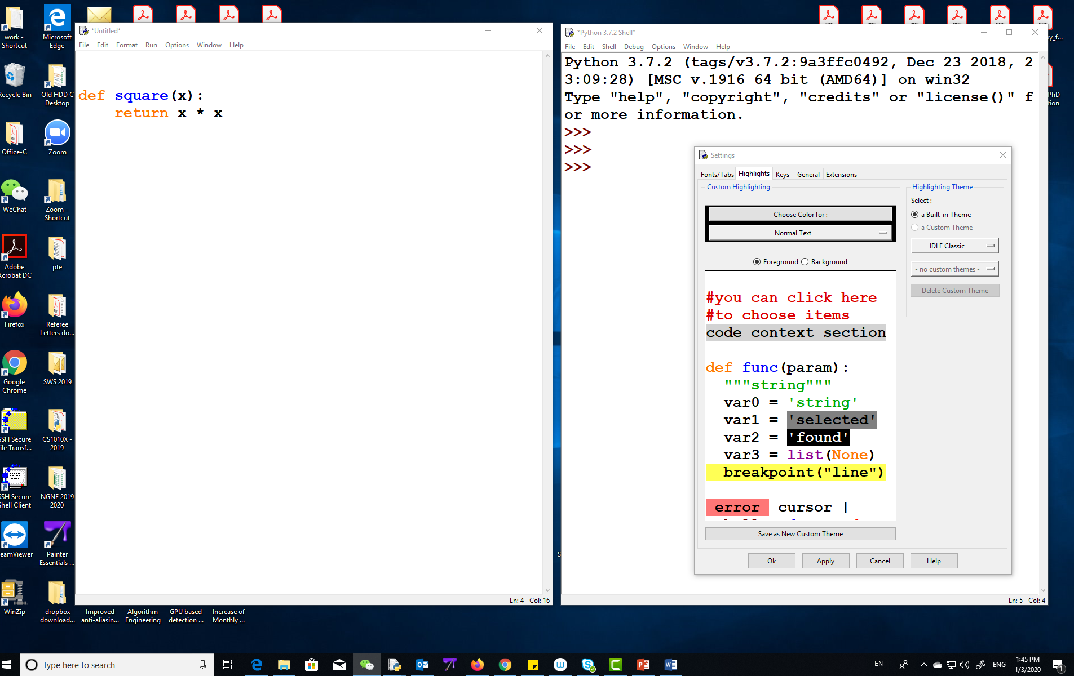
Programming Environment
(good practice)
code
window
shell
window
Put code window and shell window side-by-side
Run with F5 (to clear all), or
Cut-and-paste to experiment with some parts of codes

Slide 15
Planning
No plan is a plan to fail
Incremental Development
  Functional Abstraction vs Data Abstraction
    Each function should perform 1 task (wishful thinking)
    Pick correct data structure for the task

Slide 16
Tools…
Computer does what you have told it to do….
  While what you have told is not what you actually intended
You should have done Debugging Exercise I, II, and III
  Debugging Exercise I:
    Tracing of calls – flow of your logic
    Print statement – see evolution of values
  Debugging Exercise II:
    Debugging Mode – visualize flow and inspect values
  Debugging Exercise III:
    Python Tutor – visualize flow and inspect values

Slide 17
Debugging…
Think like a detective
Look for clues: error msg, values of variables
  Eliminate the impossible
  Run the program again with different inputs
    Does the same error occur again?
    Make sure you can repeat the error
    (comment out “random” input part first, if needed)

Slide 18
Displaying variables
>>> def debug_print(x,y,z):
if debug_printing_flag:
print(x)
print(y)
print(z)
>>> debug_printing_flag = True
>>> def foo(n):
counter, result = 0,0
while(counter != n):
debug_print(counter, n, result)
counter, result = counter + 0.1, result + counter
return result

Slide 19
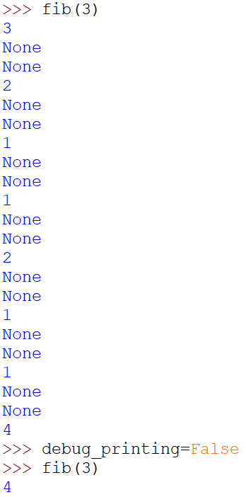

Displaying variables
>>> def debug_print(x,y,z):
if debug_printing_flag:
print(x)
print(y)
print(z)
>>> debug_printing_flag = True
>>> def fib(n):
debug_print(n, None, None)
if n < 2:
return n
else:
return fib(n-1) + fib(n-1)
>>> debug_printing_flag = False

Slide 20
Good Practices
Use a debugger (IDLE / PythonTutor)
  Trace a function (from problem area backwards)
  Display variable values
  Boundary cases generally can cost problems
Invest in writing “extra” functions
(payoff well in general)
  to do verification automatically
  to print out values of variables
Test function one by one (including “extra” functions)
  practice Incremental Development
  do testing systematically (boundary vs non-boundary case)

Slide 21
Avoid Unnecessary Debugging
with Good Programming Practice
  Meaningful variable and function names for ease of understanding by yourself or other who helps in debugging
  Provide good comments to ease understanding
  State assumption on usage of functions/routines
  Each function should do 1 task rather than mixing with many other tasks
  Good practices from Object Oriented Programming (later lecture)
Debugging effort needed can be inversely proportional
to good discipline in programming

Slide 22
Summary
Debugging often takes up more time than coding
  Invest where applicable to cut short the time
More an art than a science
  Practice makes perfect

