Slide 1





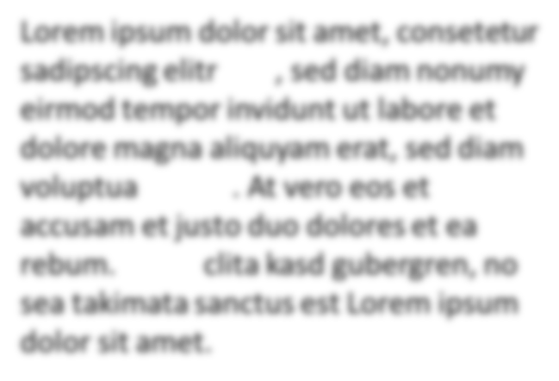







Emergent
[1]
[4]
Tabular
[2]
Narrative
[1]
[2]
[3]
[4]
[1]
[1]
Graph-based
[3,4]
[1]
[2]
[2]
[3]
Structured
Unstructured

