Slide 1
CSC 520:PHARMACY MANAGEMENT SYSTEM
By Foday M. Samura
CSC 521 Advisor : Dr. Nafa

Slide 2

OVERVIEW
Student Objectives
Problem Specification
Solution Process/Design
Benchmark Specifications
Tools List
Time Schedule
Grading Scheme
List of Deliverables
Questions

Slide 3
STUDENT OBJECTIVES
I will learn the whole software development Life cycle
Learn database design and Implementation
Learn web application front-end development
Learn web application sever-side development

Slide 4
PROBLEM SPECIFICATIONS
Pharmacy Management System is a web-based application to be develop to manage a pharmacy's operations.
The aim of my project is to develop the app to maintain the records of medicines, to handle prescription details, to generate invoices, to maintain drug inventory, etc..
The users of the app are admin, managers, pharmacists, and cashiers working in the pharmacy. Some administrator's functions will be implemented as well.
Notes:
Pharmacy Management System is a web-based application I am going to design and implemented with PHP using MySQL as the database. This project will be developed for medical stores to manage different inventories and items, customers’ and suppliers’ details as well as staffs (cashiers, managers, and pharmacists) working in the store. The application will have the entire basic module to manage the medical store operations.
Listed below are the main users of the system. They are required to register into the system to access records and details stored in the database. Only the head admin has the privilege or access over all records and users. The system access to other users in restricted as per their functions in the medical store.
Admin
Cashier
Manager
Pharmacist

Slide 5
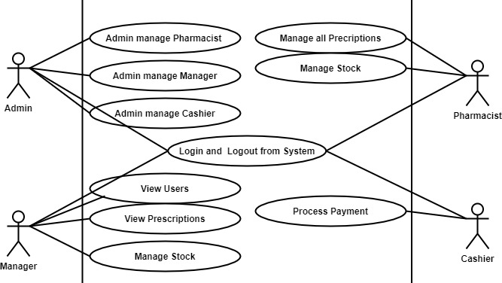
SOLUTION DESIGN: USE CASE DIAGRAM

Slide 6
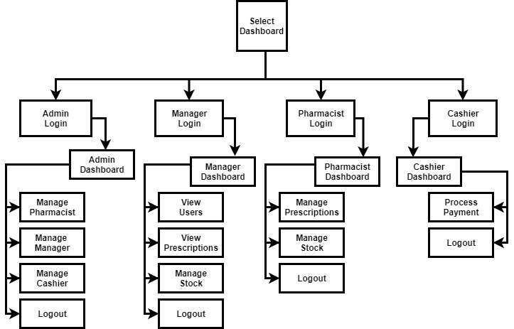
Data Flow Diagram (DFD) Pharmacy Management System

Slide 7
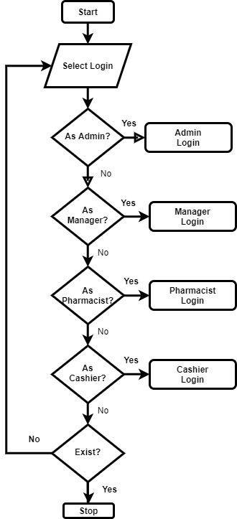
General System Flowchart

Slide 8
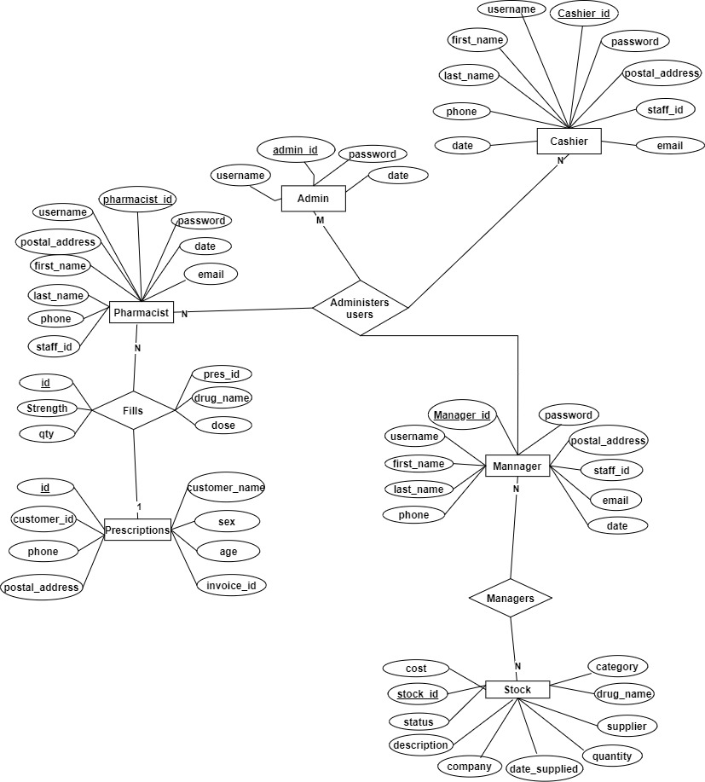
PRELIMINARY ER DIAGRAM

Slide 9

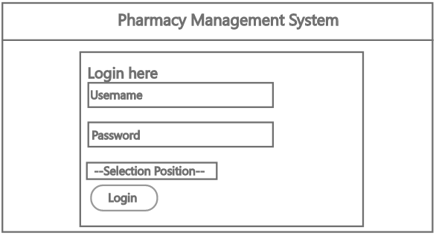
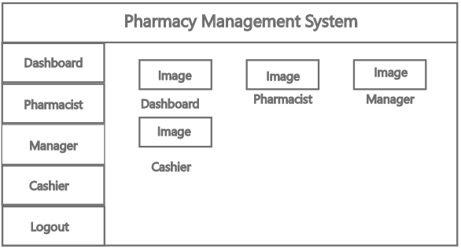
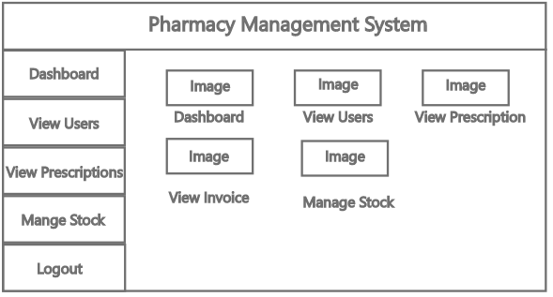
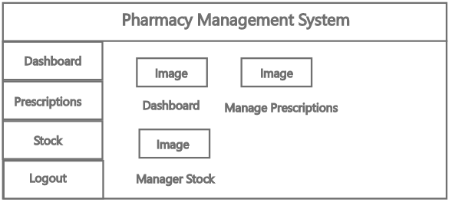
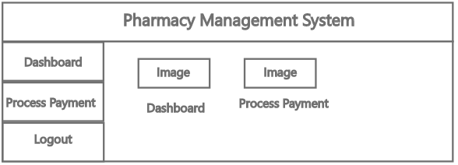
User Interface Mockup
Sample Form
Home Page Admin
Home Page Manager
Home Page Pharmacist
Home Page Cashier

Slide 10
BENCHMARK SPECIFICATIONS
Benchmark 1: Backend Database Implementation
Benchmark 2: Admin GUI, logic implementation, and testing
Benchmark 3: Manager GUI, logic implementation, and testing
Benchmark 4: Pharmacist GUI, logic implementation, and testing
Benchmark 5: Cashier GUI, logic implementation, and testing

Slide 11
TOOL LISTS
Server-side Tools
Front-End Development Tools
Back-End Database Tools
IDEs
Version Control Tools
Other Tools
PHP
Apache
HTML
CSS
JavaScript
MySQL
phpMyAdmin
Adobe Dreamweaver
Visual Studio Code
Git
GitHub
Draw.io
Inkscape
Adobe XD

Slide 12
PROPOSED TIME SCHEDUL
Task Name Duration
Benchmark 1 2 Weeks
Benchmark 2 4 Weeks
Benchmark 3 4 Weeks
Benchmark 4 2 Weeks
Benchmark 5 2 Weeks
Integrated Testing 1 Weeks

Slide 13

PROPOSED GRADING SCHEME
Benchmark 1: 15%;
Benchmark 2: 20%;
Benchmark 3: 20%;
Benchmark 4: 15%;
Benchmark 5: 10%;
Integrated Testing : 10%;
Presentation: 10%

Slide 14
LIST OF DELIVERABLES
Original proposal and presentation file (s)
Amendments to the proposal
System architecture diagram(s)
Appropriately commented source code
Documentation of project functionality
Sample output
Executables and/or projects
Presentation documents (used to support the presentation of the completed CSC 521 project), including any presentation file(s)
Project journal
Project postmortem
A list of what areas of the proposal (if any) were not completed, including reasons why
Presentation of the completed project (PowerPoint format)
User's manual

Slide 15
QUESTIONS

