Slide 1
Getting Insights using
Minneapolis Police Datasets
April 26, 2021
Fateh Sandhu, Kolby Johnson, Brennan Rhoadarmer, Nithish Reddy

Slide 2
Introduction
Started with 3 datasets from Minneapolis government website: opendata.minneapolismn.gov
Police Stop Data
Police Use Of Force Data
Shots Fired Data

Slide 3
Datasets
Police Stop Data
Police Use Of Force
Shots Fired Data
175,771 entries
Data from October 31, 2016 until present
18 attributes
32,383 entries
Data from January 2, 2008 until present
29 attributes
69,287 entries
Data from 2006 until present
14 attributes

Slide 4
Datasets - Cont.
Police Stop Data
Police Use Of Force
Shots Fired Data
Useful attributes include:
Latitude
Longitude
Problem
Reason
Gender
Race
PreRace
Citation Issued
Useful attributes include:
Latitude
Longitude
Problem
ForceType
Race
Sex
TypeOfResistance
Neighborhood
Useful attributes include:
Latitude
Longitude
Division
Problem
Response_Date

Slide 5
Datasets - Cont.
Precipitation Data
An unused dataset that we found from CoCoRaHS that listed the precipitation data from the state of Minnesota.
Wasn’t used because we decided that none of our objectives would utilize it well
50,000 entries
12 attributes
Date
Time
Longitude
Latitude
Total Precipitation
New/Total Snow Depth

Slide 6
Objective 1: Data Preprocessing

Slide 7
Preprocessing
General Preprocessing
Each objective will require its own preprocessing but general preprocessing was done by removing records with null values in important attributes and dropping pointless attributes such as lastUpdateDate, masterIncidentNumber (attributes which don’t contribute to any of our objectives)
Tools Used:
Most of the preprocessing was done in Python by converting the datasets into Pandas dataframes and then converting them back into CSV files after preprocessing was done

Slide 8
Preprocessed Datasets
Police Stop Data
Police Use Of Force
Shots Fired Data
Ended up with 138,280 entries after preprocessing
Ended up with 29,301 entries after preprocessing
Ended up with 68,866 entities after preprocessing

Slide 9
Objective 2 : Association Analysis

Slide 10
Police Stop Data
According to an article in The Guardian, Black people and people of unknown race (eg Latinos) are much more likely to be stopped and searched by the police than white people
Objectives for association analysis on stop data include:
Effects of race in police stops
If these effects changed after the BLM protests (25 May 2020)

Slide 11
Association Analysis Preprocessing
For police stop data, association analysis was done on 11 useful attributes which included race, preRace, gender, problem, reason, personSearch, vehicleSearch and more.
Then association analysis was done on two attributes at a time to find more rules that gave us further insight
Dataset was also heavily biased with respect the personSearch attribute. As this is an important feature to police stops, dataset was then balanced to have equal number of yes/no records for the person search data
At last, dataset was also split into two balanced datasets: Post BLM data and Pre BLM data to get further insights on how these protests changed the effects of race in police stops.

Slide 12
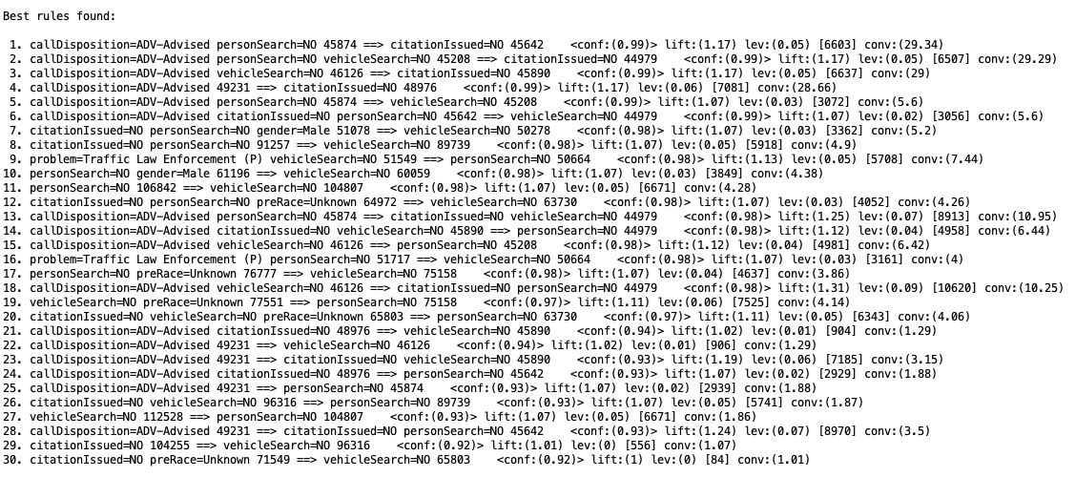
Association Analysis

Slide 13
Rules Generated from All Attributes
Association Analysis was doing using Weka with 0.1 as the minimum support bound and 1.0 as the maximum support bound. The best minimum support input was automatically chosen by Weka.
The minimum confidence input was set to 0.9
Rules to be generated were 30
Analysis using all attributes did not provide any useful insights except for the fact that if person is not searched at a police stop, their vehicle is not probably searched either

Slide 14
Rules Generated by Analysis on sets of 2 attributes
Race & Reason : If the race of a person is unknown, it is most probably reported by a citizen on a 911 call (~80%)
Race & Problem : If the race of a person is unknown, then it is mostly reported as a suspicious person or suspicious vehicle problem
Race & PersonSearch : If the race of a person is black, then he is searched (~75%) (dataset was balanced to have equal number of yes/no records in personSearch as personSearch attribute was highly skewed)
VehicleSearch & PersonSeach : Both the attributes are very closely related. If a person is not searched, then their vehicle isn’t searched either (~98%) and if a person is searched, their vehicle is searched as well (~96%)
Race & CitationIssued : No rules with high confidence generated

Slide 15
Rules Generated from Race, VehicleSearch and PersonSearch Attribute
The most useful rule generated from these attributes alone was that if a white person was stopped, he/she did not have them or their vehicle searched 93% of the time.

Slide 16
Effects of BLM Protests on Police Stops
Black Race
Other Races
Preprocessing
Dataset was split into post BLM first to find out how many records exist and then same number of most recent pre BLM records were chosen to compare
Findings:
In Pre-BLM, the stop data consisted of around 40% black people
In Post-BLM, the stop data dropped to only around 24% black people
~40%
~24%
~76%
~60%
Before 25 May 2020
After 25 May 2020

Slide 17
Police Shots Data

Slide 18
Association Analysis Preprocessing
For police shots data, association analysis was done on 3 useful attributes which included Jurisdiction, Problem, Division.
Then association analysis was done on two attributes at a time to find more rules that gave us further insight

Slide 19
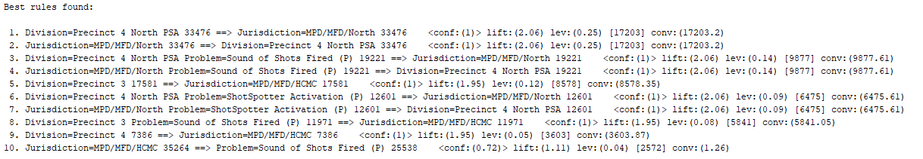
Association Analysis

Slide 20
Rules Generated by Analysis on sets of 2 attributes
Jurisdiction & Division : This didn’t tell us much just which precinct was associated to each jurisdiction.
Division & Problem : no rules with high confidence generated
Jurisdiction & Problem : If Jurisdiction was MPD/MFD/HCMC then the problem was sound of shots fired (~72%)

Slide 21
Police Force Data
According to an article in The New York Times, Minneapolis police use force 7 times more likely against black people compared to white people.
Objectives for association analysis on force data include:
Effects of race in police force
If these effects changed after the BLM protests (25 May 2020)

Slide 22
Association Analysis Preprocessing
For police force data, association analysis was done on 10 useful attributes which included race, sex, problem, forceType, subjectInjury, neighborhood and more.
Then association analysis was done on two attributes at a time to find more rules that gave us further insight
At last, dataset was also split into two balanced datasets: Post BLM data and Pre BLM data to get further insights on how these protests changed the effects of race in police use of force.

Slide 23
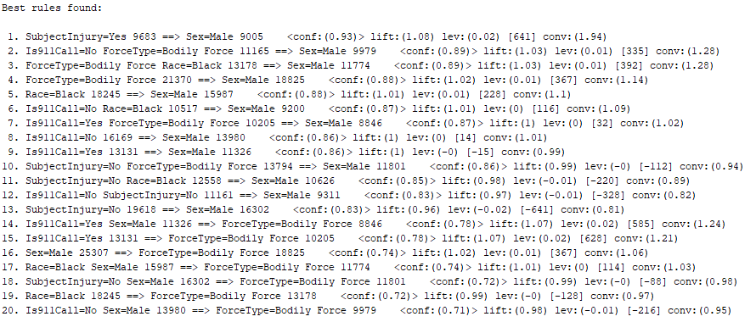
Association Analysis

Slide 24
Rules Generated by Analysis on sets of 2 attributes
Problem & Sex : If a person is seen as suspicious it is most likely that they are male (90%)
SubjectInjury & Sex : If the subject was injured due to the use of force the subject was most likely male (93%)
ForceTypeAction & Sex : If the action taken was using body weight to pin it was most likely on a male subject (87%)
ForceType & SubjectInjury : When the police use a chemical irritant it is most likely not going to lead to the injury of the subject (92%)
TypeOfResistance & ForceType : When a subject tensed most police used bodily force (84%)

Slide 25
Important/Interesting rules
The most important rule generated from these attributes was that majority of males who have police use force end up injured.
TypeOfResistance & Sex : most subjects who fled on foot where male (97%)
Problem & Is911Call : when a subject was viewed as suspicious it was normally not a 911 call (91%)
Neighborhood & Is911Call : The Downtown West neighborhood normally doesn’t have a 911 call when police use force (82%)

Slide 26
Effects of BLM Protests on Police Use of Force
Black Race
Other Races
Preprocessing
Dataset was split into post BLM first to find out how many records exist and then same number of most recent pre BLM records were chosen to compare
Findings:
In Pre-BLM, the force data consisted of around 61% black people
In Post-BLM, the force data stayed around the same at 63% black people
~61%
~63%
~39%
~37%
Before 25 May 2020
After 25 May 2020

Slide 27
Objective 3 : Spatial Clustering with Visualization

Slide 28
Features of Spatial Clustering
We improvise the design with class attributes observed from the dataset which we have pre-processed using the Police force as mentioned above.
Currently, we process different class attributes such as “Longitude, Latitude, Police force Id, Case-No, Problem and finally Locations.”
For each scenario we need to provide the clusters for class attributes on the basis of 911 call.
As per the design model we improvise a dataset from the pre-processed as mentioned below:
stopDataPreProcessed
forceDataPreProcessed

Slide 29
Spatial Clustering Using DBSCAN
As per the design requirement we import python libraries from sklearn to provide DBSCAN algorithm
For each data class feature separately we have fitted and visualized the clustering of the Longitude and Latitude for each set of dependent labels (as 911 call feature)
The features can be gender, Neighbourhood, and shots fired.
Based on these features label class are represented with locations and label class as mentioned in figures.
Separate values column values are to estimated with each set of the design model and its visualization on longitude and latitude.

Slide 30
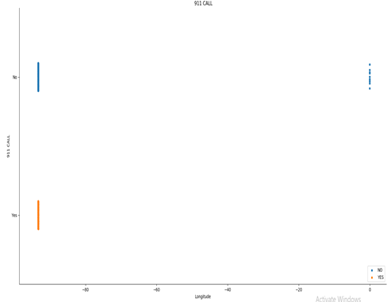
Longitude VS 911 call plot
Here we can observe a 911 call plot response on the basis of X as longitude values using catplot.
The longitude values are observed with 911 calls are at 93.3 degrees as represented.

Slide 31
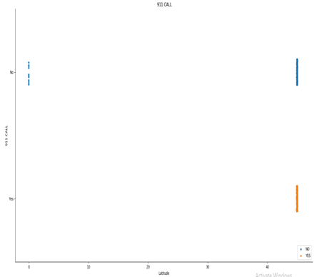
Latitude VS 911 plot
Here we can observe a 911 call plot response on the basis of X as latitude values using catplot.
The longitude values are observed with 911 calls are at 44.5 degrees as represented.
The observations for both CAT-plots are not clearer as per the values projected

Slide 32
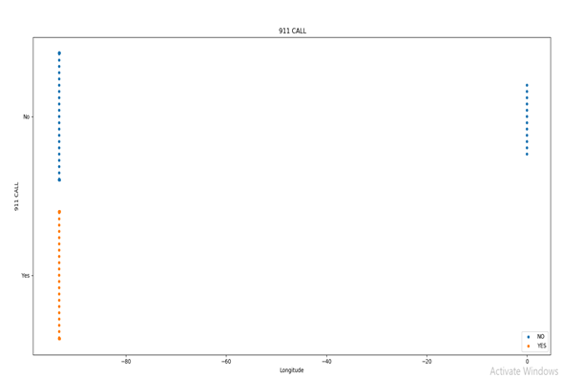
SWARM PLOT FOR 911 CALL with Longitude
Hence to avoid such situations we could use a SWARM plot on the case of Longitude and latitude also.
The projected values have a clear cut different values systematically as mentioned in the figure.

Slide 33
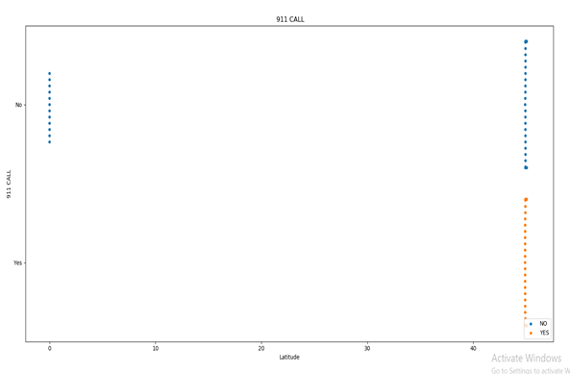
SWARM PLOT FOR 911 CALL with Latitude

Slide 34
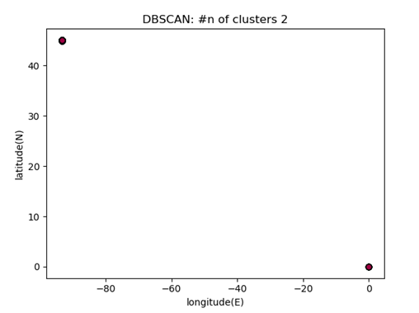
Cluster plot for DBSCAN model
●At this figure perspective we could analyse the different values from the latitude and longitude observed at 0, 44.53 degrees only.
●Since most of the clusters are either 0 and 93 and for latitude we have at either 0 or 44.5.

Slide 35
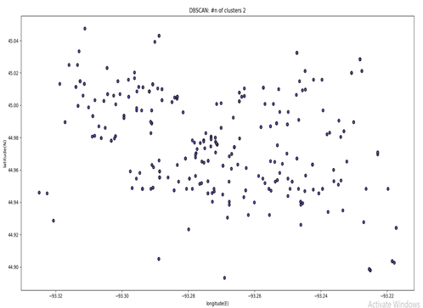
Cluster plot for DBSCAN model
●For this cluster we could observe the variations from each values ranging from 44.50-45.04 for latitude
●For longitude we have a cluster formations form -93.32 to 93.22

Slide 36
Objective 4 : Spatio-Temporal Clustering with Visualization

Slide 37
Time is the... 3rd Dimension?
Start with the results from the previous objective and add time as a third dimension
A number of different ways to do this:
Day of the week
Time of day
Weekly/Monthly/Yearly
Doing a rolling window to see how the clusters change.
Run the same spatio-temporal clustering over select attributes e.g. Primary Offense, problem, reason, is911Call

Slide 38
Visualization
Objective 3 was just finished, so we don’t have results for objective 4, but here is how they can and will be presented
Use 3D plots over top of map of Minneapolis
Allows for users to more easily see where within the city the clusters are
Slideshows/videos over time
Allows the user to more easily visualize the effect of time over the clusters

Slide 39
Future Work

Slide 40
Use weather data
Reintegrate the precipitation data
Find temperature data to combine in
Redo association analysis with new weather data

Slide 41
Predictive Analysis
Use previous data to predict new stop data
Both with and without weather data

Slide 42
Questions?
Thank You

