Slide 1
Safe System-level Concurrency on Resource-Constrained Nodes with Céu
Autor:
Francisco Sant'Anna
Orientadores:
Roberto Ierusalimschy
Noemi Rodriguez

Slide 2
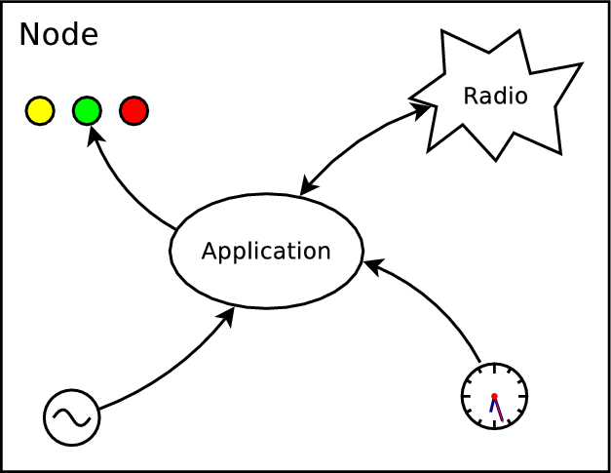
Wireless Sensor Networks
Reactive
  guided by the environment
Concurrent
  safety aspects
Constrained
  32K ROM
  4K RAM

Slide 3
Hello world!
Blinking LEDs
  on ↔ off every 500ms
  stop after 5s
  repeat after 2s
Compositions
  par, seq, loop
  avoid state vars
  static inference
par/or do
loop do
await 500ms;
_leds_toggle();
end
with
await 5s;
end
loop do
par/or do
loop do
await 500ms;
_leds_toggle();
end
with
await 5s;
end
await 2s;
end
loop do
await 500ms;
_leds_toggle();
end

Slide 4
The design of Céu
Reactive/Synchronous execution
  based on Esterel
Shared-memory concurrency
Internal events
Integration with C
Local scopes & Finalization
First-class timers

Slide 5

1. Synchronous execution
par/and do
<...> // 1
await A;
<...> // 3
with
<...> // 2
await B;
<...> // 4
end
<...> are trail segments that do not await (e.g. assignments, system calls)
Reactions to external events never overlap
The synchronous hypothesis:
“reactions run infinitely faster in
comparison to the rate of events”

Slide 6
2. Shared-memory concurrency
var int x=1;
par/and do
await A;
x = x + 1;
with
await B;
x = x * 2;
end
var int x=1;
par/and do
await A;
x = x + 1;
with
await A;
x = x * 2;
end

Slide 7
3. Internal events
Emitted by the program
  (vs environment)
Multiple can be active at the same time
  (vs single)
Stack-based execution policy
  (vs queue)

Slide 8
3. Internal events
Enable advanced control mechanisms (e.g. subroutines, exceptions)
Use bounded memory and execution time
event int* inc;
par do
// define subroutine
loop do
var int* p = await inc;
*p = *p + 1;
end
with
// use subroutine
<...>
var int v = 1;
emit inc => &v; // stack this continuation
_assert(v == 2);
end

Slide 9
4. Integration with C
Well-marked syntax (“_”)
  “C hat” (unsafe execution)
  no bounded-execution analysis
  what about side effects in parallel trails?
native _assert(), _inc(), _I;
_assert(_inc(_I));
native do
#include <assert.h>
int I = 0;
int inc (int i) {
return I+i;
}
end

Slide 10
4. Integration with C
pure and safe annotations
par do
_f(_inc(10));
with
_g();
end
pure _inc();
safe _f() with _g();
par do
_f(_inc(10));
with
_g();
end

Slide 11
5. Local scopes & Finalization
loop do
await 10ms;
var _message_t msg;
<...> // prepare msg
_send_request(&msg);
await SEND_ACK;
end

Slide 12
5. Local scopes & Finalization
par/or do
loop do
await 10ms;
var _message_t msg;
<...> // prepare msg
_send_request(&msg);
await SEND_ACK;
end
with
await STOP;
end
var int x = 1;
local pointer

Slide 13
5. Local scopes & Finalization
par/or do
loop do
await 10ms;
var _message_t msg;
<...> // prepare msg
finalize
_send_request(&msg);
with
_send_cancel(&msg);
end
await SEND_ACK;
end
with
await STOP;
end
var int x = 1;

Slide 14
6. First-class timers
Very common in WSNs
  sampling, timeouts
await supports time (i.e. ms, min)
  it also compensates system delays
par/or do
await 10ms;
<...> // no awaits
await 1ms;
v = 1;
with
await 12ms;
v = 2;
end
await 2ms;
v = 1;
await 1ms;
v = 2;
5ms elapse
late = 3ms
late = 2ms

Slide 15
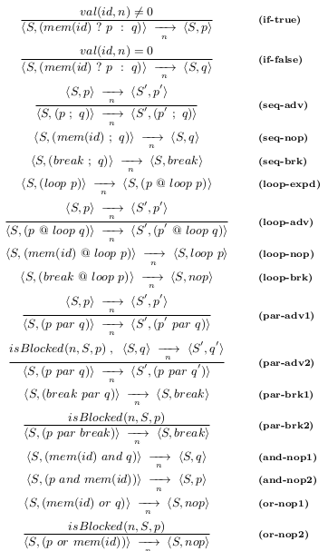
Formalization
Small-step operational semantics
Control aspects of the language
  parallel compositions,
  stack-based events, finalization
Mapping: formal → concrete

Slide 16
Evaluation
Source code size
  number of tokens, data/state variables
Memory usage
  ROM, RAM
Responsiveness
  time-consuming C calls
Comparison to nesC
  WSNs protocols, radio driver

Slide 17
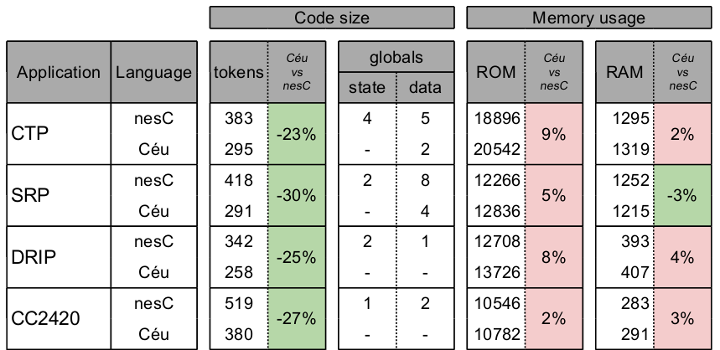
Code size & Memory usage
no control globals
globals → locals

Slide 18
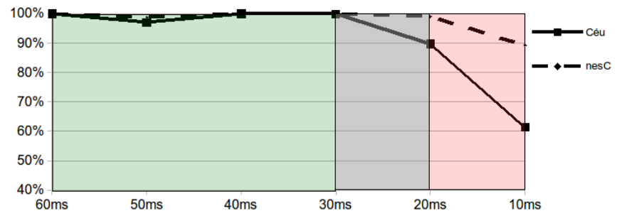
Responsiveness
10 sending nodes
  20-byte msgs, 600-100ms/msg
1 receiving node
  60-10ms/msg
  8ms operation in sequence w/ every msg

Slide 19
Conclusion
Main contributions:
  a comprehensive and resource-efficient design
  stack-based internal events
  a set of compile-time guarantees

Slide 20
Safe System-level Concurrency on Resource-Constrained Nodes with Céu
Autor:
Francisco Sant'Anna
Orientadores:
Roberto Ierusalimschy
Noemi Rodriguez

Slide 21
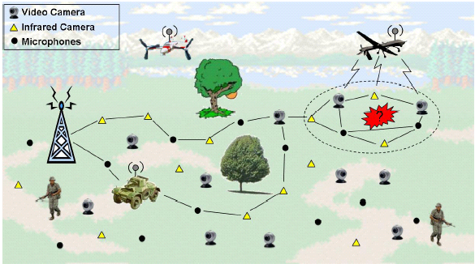
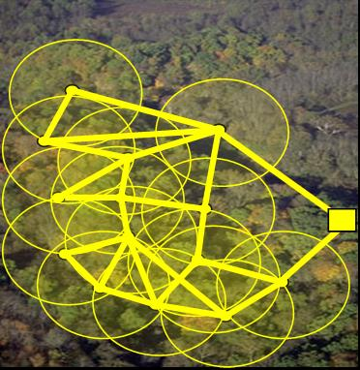
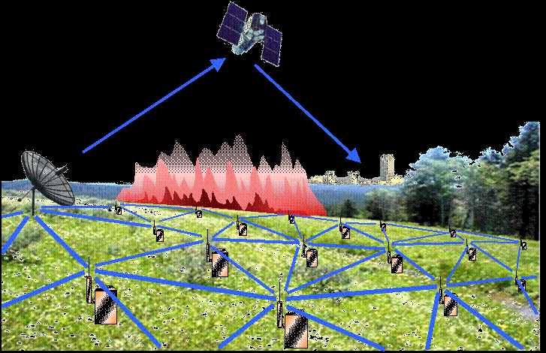
Wireless Sensor Networks

Slide 22
Programming models in WSNs
Event-driven programming
  TinyOS/nesC, Contiki/C
Multi-threading
  Protothreads, TinyThreads, OCRAM
Synchronous languages
  Sol, OSM, Céu

Slide 23
Programming models in WSNs
Event-driven programming
Multi-threading
Synchronous
(Céu)
low level
high level
- unstructred code
- manual memory
management
- multiple threads
- unrestricted shared
memory
- composable threads
- safety analysis

Slide 24
Overview of Céu
Reactive
  environment in control: events
Imperative
  sequences, loops, assignments
Concurrent
  multiple lines of execution: trails
Synchronous
  trails synchronize at each external event
Deterministic
  trails execute in a specific order

Slide 25
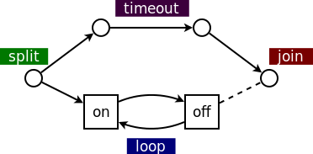
Blinking a LED
  sequential: on=2s, off=1s
  parallel: 1-minute timeout
// nesC: event-driven
event void Boot.booted () {
call T1.start(0);
call T2.start(60000);
}
event void T1.fired() {
static int on = 0;
if (on) {
call Leds.led0Off();
call T1.start(1000);
} else {
call Leds.led0On();
call T1.start(2000);
}
on = !on
}
event void T2.fired() {
call T1.cancel();
call Leds.led0Off();
<...> // continue
}
// Protothreads: multi-threaded
int main() {
PT_INIT(&blink);
timer_set(&timeout,60000);
while (
PT_SCHEDULE(blink()) &&
!timer_expired(timeout)
);
leds_off(LEDS_RED);
<...> // continue
}
PT_THREAD blink() {
while (1) {
leds_on(LEDS_RED);
timer_set(&timer,2000);
PT_WAIT(expired(&timer));
leds_off(LEDS_RED);
timer_set(&timer,1000);
PT_WAIT(expired(&timer));
}
}
// Céu: synchronous
par/or do
loop do
_Leds_led0On();
await 2s;
_Leds_led0Off();
await 1s;
end
with
await 1min;
end
_Leds_led0Off();
<...> // continue

Slide 26
Synchronous execution
Program is idle.
On any external event, awaiting trails awake.
Active trails execute, until they await or terminate.
Goto step 1.
Reactions to external events never overlap
The synchronous hypothesis:
“reactions run infinitely faster in
comparison to the rate of events”

Slide 27
Synchronous execution
Parallel compositions
Sampling and Timeout patterns
loop do
par/and do
<...>
with
await 100ms;
end
end
loop do
par/or do
<...>
with
await 100ms;
end
end

Slide 28
Synchronous execution
Céu enforces bounded execution
Limitation: time-consuming operations
loop do
if <cond> then
break;
end
end
loop do
if <cond> then
break;
else
await A;
end
end

Slide 29
Local scopes
blocks in parallel: sum memory
blocks in sequence: reusue memory
par/and do
var int a;
<...>
with
var int b;
<...>
end
var int c;
<...>

Slide 30
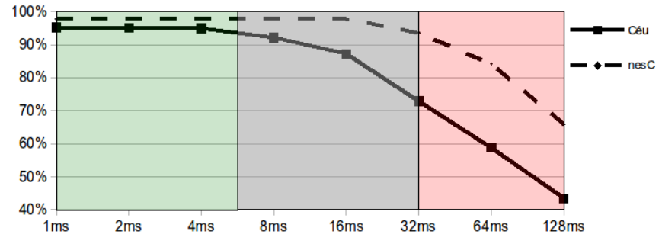
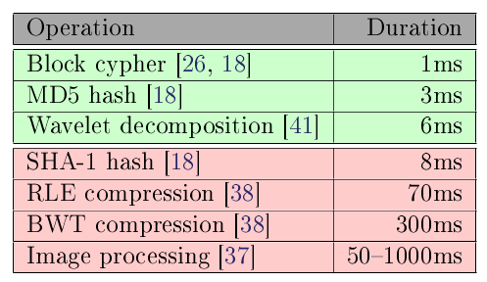
Responsiveness
10 sending nodes
  20-bytes msgs, 200ms/msg
1 receiving node
  50msg/s
  1-128ms operation (every 150ms)

Slide 31
Safety
Time-bounded reactions
No concurrency in variables
No concurrency in C calls
Finalization for blocks going out of scope
Auto-adjustment for timers in sequence
Synchronization for timers in parallel

Slide 32
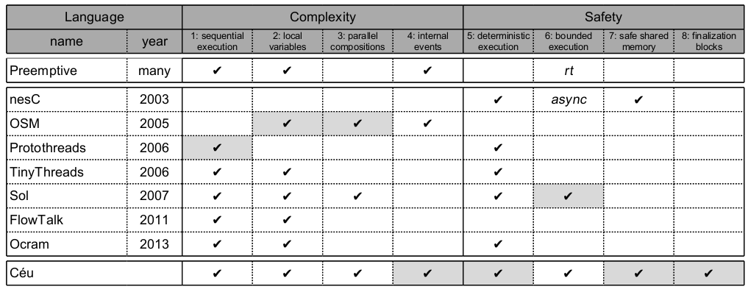
Related work

Slide 33
Demo applications
  explore the programming style of Céu
Semantics of Céu
  control aspects
    determinism, stacked internal events
Implementation of Céu
  parsing, temporal analysis, code generation

Slide 34
Safe System-level Concurrency on Resource-Constrained Nodes
Authors:
Francisco Sant'Anna
Roberto Ierusalimschy
Noemi Rodriguez
PUC-Rio, Brazil
Olaf Landsiedel
Philippas Tsigas
Chalmers, Sweden
Conference on Embedded
Networked Sensor Systems
ACM SenSys'13 – Rome

