Slide 1
A Synchronous Operating System for Reactive Applications
(i.e., OS following the concurrency model of Céu)

Slide 2
Motivations
General frustrations
  “Programmability”
    select? Really?
    Threads? Really???
  Complexity
    preemptive scheduler
    per-process resources
  Safety
    non-deterministic
    execution
Specific demands
  Micro platforms
    4MHz, (32+4)Kb
  Multiple platforms
    Arduino, WSNs
    Peripherals
  Remote reprogramming

Slide 3
Specs
Micro-kernel architecture
  Scheduler + IPC (11 system calls so far // Linux has ~200)
Scheduler
  Deterministic = Reproducible + Predictable
  Single stack + queue shared by all processes
IPC through events/calls
  Typed output => input
  Dynamic/decoupled linking

Slide 4
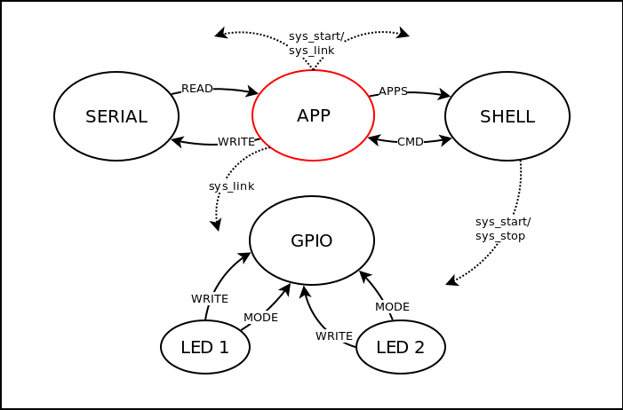
DEMO 1: shell + 2 “apps”
6 processes: 14336 (text) + 1039 (data+bss)

Slide 5
DEMO 2: GPIO driver + app
input (u8,u8)=>void PIN_MODE;
input (u8,u8)=>void DIGITAL_WRITE;
output (u8,int) DIGITAL_CHANGED;
var u16 pins_m = 0xFFFF; // all OUTPUT
var u16 pins_v = 0x0000;
input (u8 pin, u8 mode)=>void PIN_MODE do
_pinMode(pin, mode);
_bitWrite(this.pins_m, pin, mode);
end
input (u8 pin, u8 val)=>void DIGITAL_WRITE do
_digitalWrite(pin, val);
end
every 50ms do
loop i, 14 do
if _bitRead(pins_m,i) == _INPUT then
var int v = _digitalRead(i);
if v != _bitRead(pins_v,i) then
_bitWrite(pins_v, i, v);
emit DIGITAL_CHANGED => (i,v);
end
end
end
end
output (u8,u8)=>void PIN_MODE;
output (u8,u8)=>void DIGITAL_WRITE;
input (u8,int) DIGITAL_CHANGED;
call PIN_MODE => (13,_OUTPUT);
call PIN_MODE => ( 2,_INPUT);
var int dt = 1000;
par do
loop do
call DIGITAL_WRITE => (13,_HIGH);
await (dt)ms;
call DIGITAL_WRITE => (13,_LOW);
await (dt)ms;
end
with
loop do
var u8 pin;
var int v;
(pin, v) = await DIGITAL_CHANGED
until pin == 2;
if dt > 100 then
dt = dt - 50;
end
await 200ms;
end
end

Slide 6
Inter-process comm.
Events:
enqueued / deferred
no pointers as parameters, cannot return values
“distributable”
N => N (including 0)
(N emit sources may trigger 1 await sink)
(1 emit source may trigger N await sinks)
Calls:
immediate execution
pointers as parameters, can return values
local only
N => 1 (excluding 0)
(N call sources may trigger 1 definition)
(1 call source may trigger 1 definition)
(!!!) Recursive definitions

Slide 7
Safety: Recursive calls
Breaks the synchronous model
Solutions:
  Call definitions cannot make any other calls.
  Call definitions carry their dependencies, then at link time build and check the “call graph” (ceu_sys_link may fail).
  A call/rec syntax for recursive calls.

Slide 8
Safety: Finalization
Programs are enclosed by await OS_STOP
par/or do
#include "gpio.h"
output (u8,u8)=>void PIN_MODE;
output (u8,u8)=>void DIGITAL_WRITE;
call PIN_MODE => (11,_OUTPUT);
finalize with
call DIGITAL_WRITE => (11,_LOW);
end
loop do
call DIGITAL_WRITE => (11,_HIGH);
await 1s;
call DIGITAL_WRITE => (11,_LOW);
await 1s;
end
with
await OS_STOP;
end
#include "gpio.h"
output (u8,u8)=>void PIN_MODE;
output (u8,u8)=>void DIGITAL_WRITE;
call PIN_MODE => (11,_OUTPUT);
finalize with
call DIGITAL_WRITE => (11,_LOW);
end
loop do
call DIGITAL_WRITE => (11,_HIGH);
await 1s;
call DIGITAL_WRITE => (11,_LOW);
await 1s;
end

Slide 9
OS internals: System calls
void ceu_sys_start (tceu_app* app);
void ceu_sys_stop (tceu_app* app);
void ceu_sys_link (tceu_lnk* lnk);
void ceu_sys_unlink (tceu_lnk* lnk);
int ceu_sys_emit (tceu_app* app, u8 evt, tceu_p param, int sz, char* buf);
tceu_p ceu_sys_call (tceu_app* app, u8 evt, tceu_p param);
void ceu_sys_scheduler (void);
tceu_queue* ceu_sys_dequeue (void);
void ceu_sys_go_event (tceu_app* app, int id, tceu_p data);
void ceu_sys_go_async (tceu_app* app);
void ceu_sys_go_wclock (tceu_app* app, s32 dt);

Slide 10
OS internals: The scheduler
void ceu_scheduler (void) {
tceu_app* app;
tceu_lnk* lnk;
while (1) {
app = CEU_APPS;
int _dt = CEU_DT();
for (; app; app=app->nxt) {
ceu_sys_go_wclock(app, _dt);
if (! app->isAlive)
ceu_sys_stop(app);
}
app = CEU_APPS;
for (; app; app=app->nxt) {
ceu_sys_go_async(app);
if (! app->isAlive)
ceu_sys_stop(app);
}
tceu_queue* qu = ceu_sys_dequeue();
if (qu != NULL) {
lnk = CEU_LNKS;
for (; lnk; lnk=lnk->nxt) {
if (qu->app!=lnk->src_app || qu->evt!=lnk->src_evt)
continue;
ceu_sys_go_event(lnk->dst_app, lnk->dst_evt, qu->param);
if (! lnk->dst_app->isAlive)
ceu_sys_stop(lnk->dst_app);
} } } }

Slide 11
A Synchronous Operating System for Reactive Applications
(i.e., OS following the concurrency model of Céu)

Slide 12
Next
Zero-copy events
  ex. packets
Requests
  in between a call and event
  example, request a line from serial
  requires the callee to hold state to the caller
  emit must be paired with await, but across multiple reactions

Slide 13
Some definitions
Operating System
  An operating system (OS) is a collection of software that manages computer hardware resources and provides common services for computer programs. [wikipedia]
Process
  xxx
Micro kernel
  xxx

