Slide 1
Céu: A low-level imperative
reactive language

Slide 2
Objective
Support both Esterel and FRP functionality
  both models are synchronous and reactive
Esterel (imperative/control)
do
every STEP do
emit JUMP
end
watching LAP
FRP (declarative/data)
x = integral v dt
v = integral a dt
a = <ui_control>

Slide 3
Overview
Reactive
  environment in control: events
Concurrent
  multiple lines of execution: trails
Deterministic
  always yields the same outcome for a given timeline
Synchronous
  trails synchronize at each event
Imperative
  sequences, loops, assignments

Slide 4
Examples
( ~Key ~> Print )*
(~Step; ~>Jump)* || ~Lap

Slide 5
Execution Model
Time: discrete sequence of external input events
  sequence: only one event reacts at a time
  discrete: a reaction executes in bounded time
Program starts in one trail from the 1st expression.
Active trails execute without interruption. (Reaction Chain)
Check termination.
Await next event and repeat Step 2.

Slide 6
Example
(~Tick => v)* || (~End ; v)
Timeline:
2 ~> Tick
3 ~> Tick
~> End

Slide 7
Temporal Analysis
Bounded execution
  Loops: ~A ; (1)*
  Operators: 1 -> op
Determinism
  1=>v || 2=>v
  1 || 2
  (1^ && 2^)*

Slide 8
Céu -> DFA
DFA
  State: what to execute and what to await
  Transition: events
Detects:
  concurrent access to variables or events
  concurrent split/or termination
  concurrent loop escape
  unreachable expressions
  whether a program can terminate or not

Slide 9
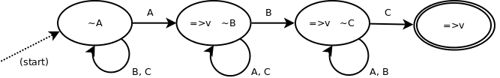
DFA example 1
~A=>v ; ~B=>v ; ~C=>v

Slide 10
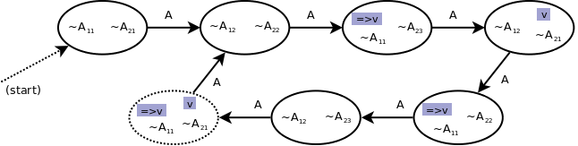
DFA example 2
(~A ; ~A ; 1=>v)* && (~A ; ~A ; ~A ; v)*

Slide 11
Basic Céu:
  similar to Esterel (equivalent?)
  better support for variables (still deterministic)
Extended Céu:
  internal events -> FRP
  ”physical” time
  asynchronous blocks -> unbounded & simulation

Slide 12
Internal events
Communication mechanism among trails
(~a ~> Print)* || (~Key ~> a)*
internal events <=> variables : reactive variables
Stack based execution policy:
( 0=>v ; ~Start ;
1~>a ; v->inc=>v -- expr.1
&&
~a~>b ; v->inc=>v -- expr.2
&&
~b~>c ; v->inc=>v ) -- expr.3

Slide 13
FRP
Behaviors: (pos2 = pos1+20)
( (~pos1,20)->add ~> pos2 )*
Integral: (pos = S(v,dt))
((pos, (v,~DT)->mul)->add ~> pos)*
Cyclic dependency:
(((~fahr,32)->sub, 5)->mul, 9)->div ~> celc)*
||
(((~celc,32)->add, 9)->mul, 5)->div ~> fahr)*

Slide 14
Physical Time
Time from real world, in hours, milliseconds, etc.
Most used input event (sampling, watchdogs, animations)
Timers in conventional languages:
  cannot ensure zero delay
  residual delta time (dt)
Time is a physical quantity:
  comparable, addable

Slide 15
Physical Time in Céu
Syntax similar to events ~1h30m10s500ms
dt is accessible: ~1s500ms => v
dt is taken into account: ~50ms ; ~50ms ; …
Time is comparable:
  (~50ms ; … ; ~49ms) || ~100ms
  (~50ms ; … ; ~50ms ; v) || (~100ms ; 1=>v)
Avoids ”Collision Tunneling”:
  ((pos, (100,~DT)->mul)->add ~> pos)* (wrong!)
  (~10ms ; pos->inc~>pos)* (right!)

Slide 16
Asynchronous Blocks
Bounded execution -> no unbounded loops
@{...} can have unbounded loops, but:
  assigned variables are local
  split blocks disallowed
  awaiting disallowed
  executes while no input events
Equivalent to unique I/O events:
  ~>Async_XXX_ini ; ~Async_XXX_end
Subjected to split/or termination:
  ~timeout || @{...}

Slide 17
Simulation in Céu
Asyncs are allowed to trigger
  external input events
  passage of time
(~10ms ; pos->inc~>pos)*
||
@{ ~>1s35ms ; (pos,103)->eq->assert) }

Slide 18
Conclusion
Céu ~ Esterel + FRP
  kernel as complex as Esterel
  FRP: state changes + internal events
Internal events
  handles cyclic dependencies
Physical Time
  convenient syntax, dt awareness, avoids tunneling
Asynchronous blocks
  unbounded execution + simulation
Temporal Analysis
  determinism / physical time

Slide 19
Next Steps
Formal Semantics
  compare to Esterel and FRP
Proofs
  temporal analysis
Expressiveness
  type system
  dynamic code
Implementation
  parser
  parallelism

Slide 20
The basic Céu
seq: e1 ; e2 ; ...
and: e1 && e2 && ...
or: e1 || e2 || ...
cond: (e1 ? e2 : e3)
loop: (e)*
break: e^
load: ID
await: ~ID
assign: e => ID
trigger: e ~> ID
op: e -> ID
exp: <all above> | CONST

