Slide 1
CoAP in Céu
Expressiveness and Safety
aspects

Slide 2
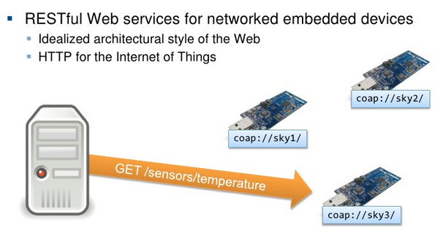
CoAP:
Constrained Application Protocol

Slide 3
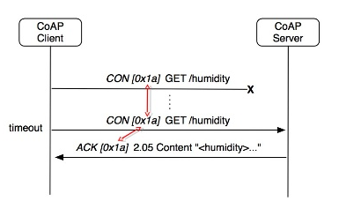
CoAP vs HTTP
over UDP
requests and responses are asynchronous
binary encoding for headers
transactions: “confirmable”
and “non-confirmable”
  retransmissions

Slide 4
The Problem
multiple concurrent transactions
  dynamic allocation
“CON” transactions (retransmissions)
  dynamic code dispatch

Slide 5
Contiki
dynamic allocation
  MEMB: manual free
dynamic code dispatch
  back to event-driven code (timers, callbacks)
    Protothreads: only static definitions

Slide 6
Contiki
manual code dispatch
  keeps list of active transactions
manual reclamation of memory and code
  coap_clear_transaction
    timer, list, memb
  (2x) coap_send_transaction
    timeout, not “CON”
  (2x) coap_engine
    response, protocol error

Slide 7
Céu
dynamic allocation
  spawn T
dynamic code dispatch
  spawn T
T is a class with memory+code
  memory is reclaimed on termination
  code reacts to the environment by itself

Slide 8
Céu
automatic code dispatch
  await X ms (retransmission)
  await COAP_RESPONSE (
automatic reclamation of code and memory
  on termination
  no “free” counterpart

