Slide 1

Algorithms for Distributed Systems under Wireless Sensor Networks
www.ceu-lang.org

Slide 2
Overview
Library of DS algorithms
  topology, broadcast, leader, etc
Wireless Sensor Networks
  unreliable communication
  hundreds of nodes
Abstractions in Céu?
Simulation in Céu?

Slide 3
Abstractions

Slide 4
Overview of Céu
Sequences
  … ; S1 ; S2 ; S3 ; …
Await
  … ; S1 ; await E1 ; S2 ; await E2 ; …
Parallelism
  par do
  … ; S11 ; await E11 ; S12 ; await E12 ; …
  with
  … ; S21 ; await E21 ; S22 ; await E22 ; …
  end

Slide 5
Abstractions
par do
… ; S11 ; await E11 ; S12 ; await E12 ; …
with
… ; S21 ; await E21 ; S22 ; await E22 ; …
end
function f1 = { S ; await E; }
par do
… ; S11 ; await E11 ; f1(); …
with
… ; f1(); S22 ; await E22 ; …
end

Slide 6
Macros
macro f1 = { S ; await E; }
par do
… ; S11 ; await E11 ; f1(); …
with
… ; f1(); S22 ; await E22 ; …
end
/************/
par do
… ; S11 ; await E11 ; S ; await E ; …
with
… ; S ; await E ; S22 ; await E22 ; …
end

Slide 7
Macros in Céu
Text substitution prior to Céu compilation
  ”macro expansion”
  GNU m4
Advantages
  minor changes to the language
  Céu remains static (analysis + faster)
Disadvantages
  duplicates code (more memory)
  error messages

Slide 8
// app.ceu
include(lib.m4)
par do
ALIVE(1s);
with
...
end
// lib.m4
define(ALIVE, `/*{-{*/
loop do
await $1;
_printf(”I'm alive\n”);
end
/*}-}*/´)

Slide 9
// app.ceu_m4
par do
/*{-{*/
loop do
await 1s;
_printf(”I'm alive\n”);
end
/*}-}*/;
with
...
end

Slide 10
Simulation

Slide 11
I/O in Céu
I/O events:
  interface with the environment
input int A;
output int B;
Multiple programs:
  each run in an OS process
  link I/O: app1 B → app2 A
  communicate through OS queues
A
B
A
B

Slide 12
Example
send_recv.lua

Slide 13
DS algorithms

Slide 14
Fault Tolerance
Sends are unreliable
  never trust it
  Example: collisions.lua
Buffers may overflow
  avoid use of buffers

Slide 15
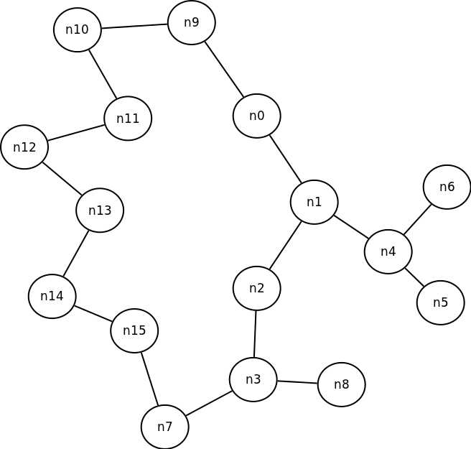

Slide 16
#1 – Neighbours
Discovers which nodes are within range
u8[2] nodes = b0000000000000000;
DS_neighbours(nodes, n_nodes, am_type, retry)
Sends an am_type broadcast message every retry event
Receives am_type messages / saves src in nodes
It never terminates!

Slide 17
#2 – Topology
Discovers the topology of the network
u8[2x16] nodes = b0000000000000000 // n0
b0000000000000000 // n1
...
DS_topology_hb(nodes, n_nodes, am_type, heartbeat)
Heartbeat algorithm
Sends an am_type broadcast message with local knowledge
Receives am_type messages with topology / ORs with local knowledge

Slide 18
#2 – Topology
First variation:
DS_topology_hb_diam(nodes, n_nodes, am_type, hb, diam)
  terminates after diam heartbeats
Second variation:
DS_topology_hb_ack(nodes, n_nodes, am_type, hb)
  terminates after
    all nodes have a neighbour
    all neighbours acknowledge

Slide 19
#3 – Broadcast
Broadcast of messages in sequence to all network
  single sender
  multiple receivers
Node broadcasts its frontier periodically to neighbours
Node re-sends requests from neighbours
Buffer to store received messages
  tolerance: sender_period x buffer_size
@DS_bcast_frontier(type, len, am_type, recv, send, ms);

