Slide 1

Advanced control flow and programming patterns with Céu
www.ceu-lang.org

Slide 2
input int Restart;
event void e;
int v = 0;
par do
loop do // 1st trail
await 1s;
v = v + 1;
emit e;
end
with
loop do // 3rd trail
v = await Restart;
emit e;
end
with
loop do // 2nd trail
await e;
_printf("v = %d\n", v);
end
end

Slide 3
Goals
Use existing constructs
  parallel compositions
  internal events
Avoid new syntax
  keep it simple
  use of macros
  maybe sugar
Precise semantics
Deterministic, safe, … (possible with the simplicity of ceu

Slide 4
XXX
Sampling
Watchdogs
Calls
  must not await
Finalizers
Exceptions
usually exceptions/finalizers are together
céu they are orthogonal

Slide 5
Calls
no stack
  safety
impossible to loop forever
no multiple concurrent calls
missed calls if it awaits

Slide 6
Finalizers (wikipedia)
piece of code that ensures that certain necessary actions are taken when an acquired resource (such as a file or access to a hardware device) is no longer being used
a finalizer is a special method that is executed when an object is garbage collected. It is similar in function to a destructor.
Unlike destructors, finalizers are usually not deterministic. A destructor is run when the program explicitly frees an object. In contrast, a finalizer is executed when the internal garbage collection system frees the object. Depending on the garbage collection method used, this may happen at an arbitrary moment after the object is freed, possibly never.
Languages with finalizers must also address the problem of object resurrection.Resurrection occurs when an object's finalizer causes the object to become reachable (that is, not garbage)
in céu: deterministic

Slide 7
Harmful example
input void A, B;
par/or do
...
FILE* f = fopen(...);
...
await A;
...
fclose(f);
...
with
await B;
end
... // memory leak

Slide 8
What we want
input void A, B;
par/or do
...
do
FILE* f = fopen(...);
...
await A;
...
finally
fclose(f);
end
...
with
await B;
end
... // f is closed

Slide 9
Syntax sugar
event void $fin; // ***
do
par/or do
emit $delay;
<open> // ***
emit $fin;
with
await $fin;
<close>
await Forever;
end
end
emit $fin; // ***
do
<open>
finally
<close>
end

Slide 10
input void A, B;
event void $fin;
par/or do
do
...
par/or do
emit $delay;
FILE* f = fopen(...);
...
await A;
...
emit $fin;
with
await $fin;
fclose(f);
await Forever;
end
...
end
with
await B;
emit $fin;
end
... // f is closed

Slide 11
Test { [[
input void A, B, C;
event void a;
int ret = 1;
par/or do
do
await A;
finally
emit a;
ret = ret * 2;
end
with
do
await B;
finally
ret = ret + 5;
end
with
loop do
await a;
ret = ret + 1;
end
end
return ret;
]],

Slide 12
Limitations
Concurrent emit $fin
  compiler complains about nondeterminism
  (but current semantics is ok)
  deterministic $fin with $fin;
jl

Slide 13
Exceptions (wikipedia)
anomalous or exceptional situations requiring special processing – often changing the normal flow of program execution
by saving the current state of execution in a predefined place and switching the execution to a specific subroutine known as an exception handler. If exceptions are continuable, the handler may later resume the execution at the original location using the saved information
the term exception is typically used in a specific sense to denote a data structure storing information about an exceptional condition. One mechanism to transfer control, or raise an exception, is known as a throw. The exception is said to be thrown. Execution is transferred to a "catch"
an input argument is invalid (e.g. value is outside of the domain of a function) or when a resource it relies on is unavailable
Exception handling mechanisms in contemporary languages are typically non-resumable

Slide 14
Java-like exceptions
try {
<normal>
throw <E>;
// unreachable
} catch (<E>) {
<handle>
} finally {
<final> // after <normal> or <handle>
}

Slide 15
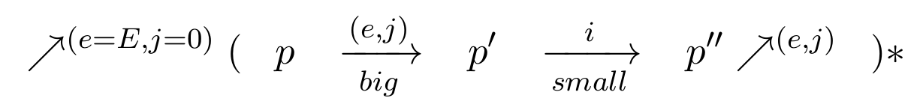
Reaction chain

Slide 16
Reaction chain
external
event
small step
(other stmts)
big-step
(eliminate all
awaiting at once;
unwind loops)
internal emit
i = 0
repeat to completion

Slide 17
Example 1
p = (await A ; await A)
(A,0)
p' = await A

Slide 18
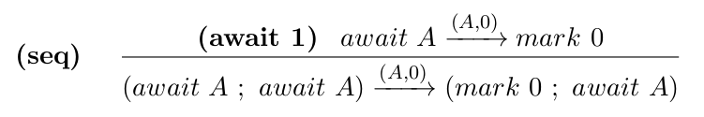
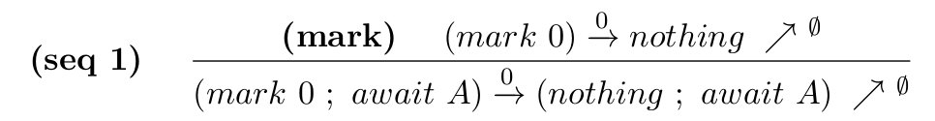
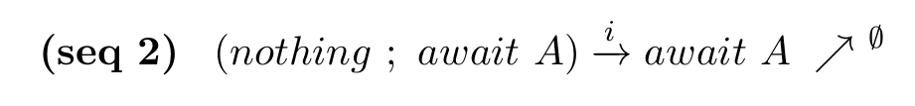
p = (await A ; await A)
big(A,0)
p' = (mark 0 ; await A)
small(0)
big(-,-)
small(0)
0

Slide 19
Example 2
p = loop
if mem then
break
else
await A
(_,0)
(A,0)

Slide 20
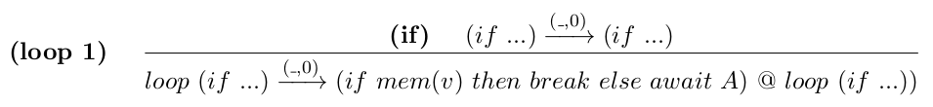


p = loop
if mem then
break
else
await A
big(_,0)
p' = (if mem(v) then break else await A)
@ loop (if …)
small(0)
small(0)

Slide 21
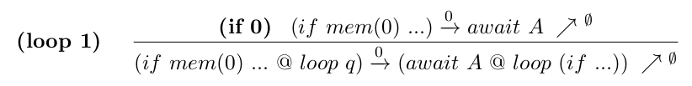
p = loop
if mem then
break
else
await A
big(_,0)
p' = (if mem(v) then break else await A)
@ loop (if …)
i = 0
small(0)

Slide 22
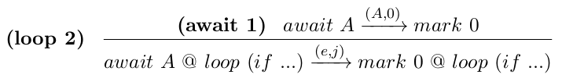

p = await A
@ loop (if …)
big(A,0)
p' = mark 0 @ loop (if ...)
small(0)
small(0)

Slide 23
Levels of priority
par/or do
await a;
with
await A;
emit a;
with
await A;
end
par/or do
await a;
??? (+2)
with
await A;
emit a;
??? (+1)
with
await A;
??? (-)
end

Slide 24
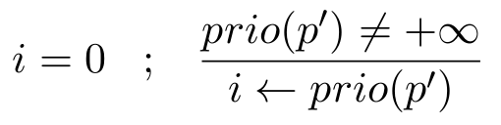
Reaction chain
external
event
small step
(other stmts)
big-step
(eliminate all
awaiting at once)
internal emit
repeat to completion

Slide 25
Example 3
par/or do
await a; // 2
emit b; // 3
// no
with
await b; // 4
// yes
with
await A;
emit a; // 1
// no
end
p = (await a ; emit b)
or
( await b
or
(await A ; emit a) )

Slide 26
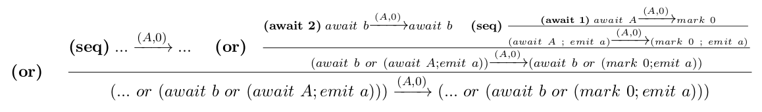
p = (await a ; emit b)
or
( await b
or
(await A ; emit a) )
big(A,0)
(await a ; emit b) or
(await b or (mark 0; emit a))

Slide 27
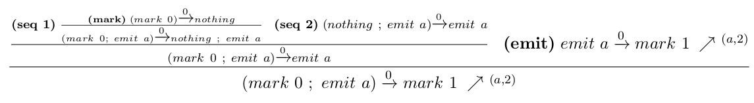
(await a ; emit b) or
(await b or (mark 0; emit a))
small*(0)
(await a ; emit b) or (await b or mark 1)
big(a,2)
(mark 2 ; emit b) or (await b or mark 1)
(await 1)
small(2)
(mark 3) or (await b or mark 1) (b,4)
big(b,4)
(mark 3) or (mark 4 or mark 1)
(or 4), (or 3)
small(4)
small(4)
nothing

Slide 28
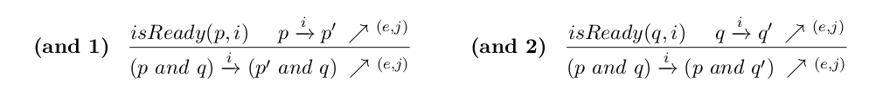
Nondeterminism
mem and mem

Slide 29
Unbounded execution
loop mem

