Slide 1

?????????:
A minimal reactive language
Francisco Sant'Anna
PUC-Rio
LabLua

Slide 2
Future Work (LuaGravity)
Formal definition
  Static model
True parallelism
  Between concurrent reactors
Notes:
NCL
- LINK symetric relationships
evento(simbolo) → callback(funcao)
less verbosity
FrTime
- functional reactive programming
- Data dependency
- Reatividade implícita
Esterel
- Se eu tivesse que escolher uma, seria essa
- voltar ao exemplo inicial

Slide 3
A minimal language
Minimal (cryptic?) syntax
Expression language
Static
  no memory allocation
  function calls / stack
Deterministic
Parallel

Slide 4
LPEG Syntax (1/3)
Block = Seq + ParAnd + ParOr
Seq = '{' * Exp * (';' * Exp)^0 * '}'
ParAnd = '{' * Exp * (',' * Exp)^0 * '}'
ParOr = '{' * Exp * ('|' * Exp)^0 * '}'
Ex. { e1 ; e2 ; e3 } → 3
{ e1 , e2 , e3 } → 3
{ e1 | e2 | e3 } → 1

Slide 5
LPEG Syntax (2/3)
If = '(' * Exp * ')' * '?' * Exp * ':' * Exp
Loop = '(' * Exp * ')' * '*'
Break = '^' * Exp
Op = ID * Exp
Ex. (e1) ? e2 : e3
((e1) ? ^e2 : e3)*
f f f 1
add{e1,e2,e3}
assert{e1|e2|e3}

Slide 6
LPEG Syntax (3/3)
Load = '$'*ID
Store = '$'*ID * '=' * Exp
Await = '!'*ID
Trigger = '!'*ID * '=' * Exp
Ex. $a $a=1 !e !e=1
{!e|!f}
{ {!e;!f=1}, !f }

Slide 7
An Expression Language
Exp = Block + If + Op
+ Loop + Break + CONST
+ Store + Load + Trigger + Await

Slide 8
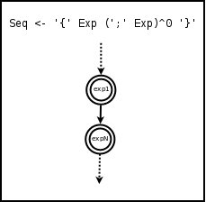
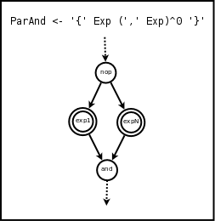
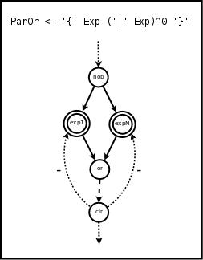
”Graph-based” Semantics (1/4)

Slide 9
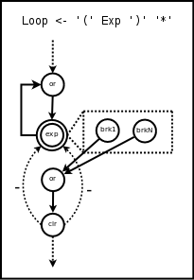
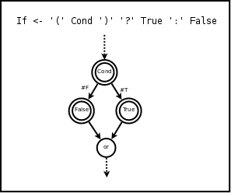
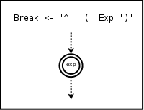
”Graph-based” Semantics (2/4)

Slide 10
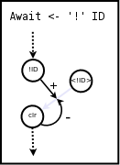
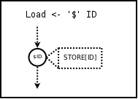
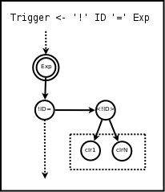
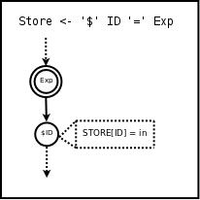
”Graph-based” Semantics (3/4)

Slide 11
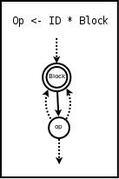
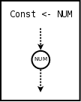
”Graph-based” Semantics (4/4)

Slide 12
The ”clr” nodes
ParOr
  the only expression that ”kills” other expressions
Await
  the only expression that ”blocks” and ”resumes”
Break
  can be inside a ParOr sub-expression
Conclusion:
  ParOr and Loop must have ”clear” nodes

Slide 13
An example
(!f= (!e) ? $a : $b )*

Slide 14
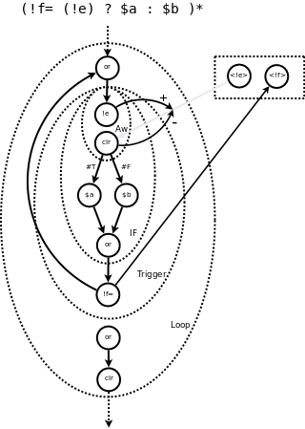

Slide 15
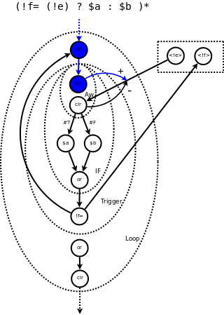
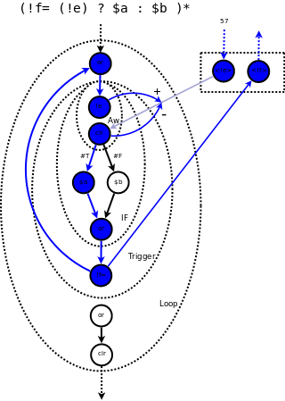

Slide 16
The Reactive Scheduler
Propagation Chain
  reactive
  definition of an instant
  atomic and instantaneous
  nop, and, or, clr, load, store, <OP>, <NUM>
Tight Cycles
Glitches
Non-determinism
Parallelism

Slide 17
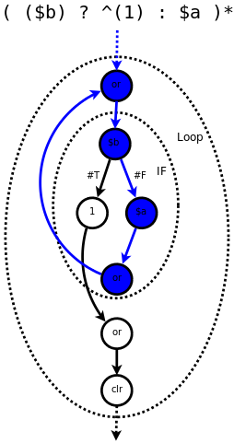
Tight Cycles
Re-executing a node due to a dependency on itself.
Only possible within Loops
Detectable at compile time!

Slide 18
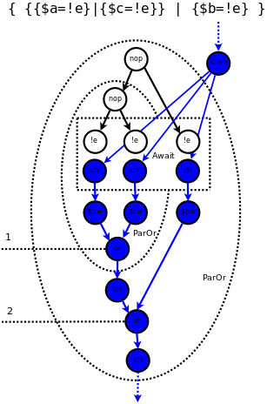
Glitches
Re-executing a node from different paths.
Only possible within ParOr
Solution:
  heights for the nodes or
  respect topological order

Slide 19
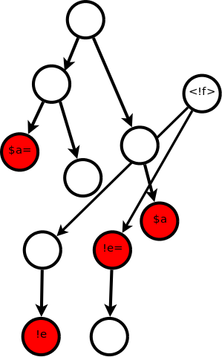
Non-determinism
Acceptable:
  External events
  ParOr result (?)
Unacceptable:
  Load / Store
  Await / Trigger
(always inside ParOr / ParAnd)
Precise definition for simultaneity

Slide 20
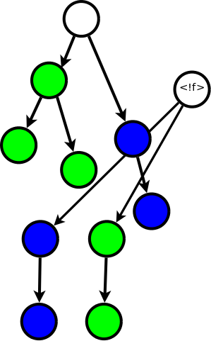
Parallelism
Determinism as prerequisite

Slide 21
The Reactive Scheduler
Propagation Chain
  reactive
  definition of an instant
  atomic and instantaneous
Tight Cycles
Glitches
Non-determinism
Parallelism

Slide 22
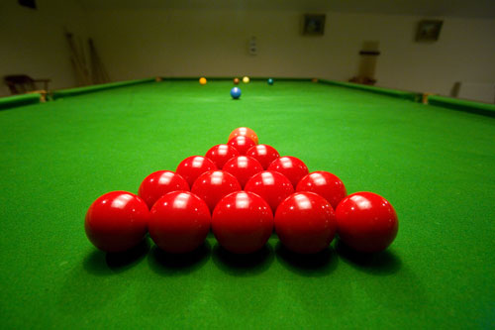
Analogy with Physics

Slide 23
Equivalence with LuaGravity
AWAIT(e) → !e
SPAWN(<f1>); <f2>() → {f1,f2} {f1|f2}
LINK(e, <f>) → ({ !e ; <f> })*
Dataflow
  S(1) → { $v=0; ($v=add{!dt,$v})* }
  c=a+b → ({ {!a|!b}; $c=add{$a,$b} })*
Notes:
Dependency: LINK/AWAIT/PROMISES
Secondary contributions:
- less verbosity
- organisms (too obvious)

Slide 24
Runtime
Graph is not needed
Virtual Machine
  queue with adresses to run
  threads consume the queue
  spawn / halt opcodes

Slide 25
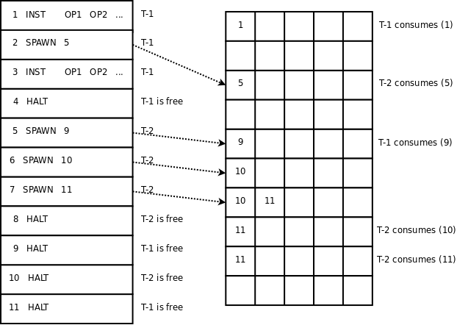

Slide 26
(!f= (!e) ? $a : $b)*
1 enable 2
2 halt
3 gate 0
4 disable -1
5 mov $1 $p
6 je $1 0 3
7 load $1 $a
8 jmp 2
9 load $1 $b
10 spawn 3
11 mov $p $1
12 jmp 6
13 jmp -12
14 disable -11
15 halt
16 tspawn -13 !e
17 halt
18 halt

Slide 27
(!f= (!e) ? $a : $b)*
1 enable 2
2 halt
3 gate 1
4 disable -1
5 mov $1 $p
6 je $1 0 3
7 load $1 $a
8 jmp 2
9 load $1 $b
10 spawn 3
11 mov $p $1
12 jmp 6
13 jmp -12
14 disable -11
15 halt
16 tspawn -13 !e
17 halt
18 halt

Slide 28
(!f= (!e) ? $a : $b)*
1 enable 2
2 halt
3 gate 1
4 disable -1
5 mov $1 $p
6 je $1 0 3
7 load $1 $a
8 jmp 2
9 load $1 $b
10 spawn 3
11 mov $p $1
12 jmp 6
13 jmp -12
14 disable -11
15 halt
16 tspawn -13 !e
17 halt
18 halt

Slide 29
(!f= (!e) ? $a : $b)*
1 enable 2
2 halt
3 gate 0
4 disable -1
5 mov $1 $p
6 je $1 0 3
7 load $1 $a
8 jmp 2
9 load $1 $b
10 spawn 3
11 mov $p $1
12 jmp 6
13 jmp -12
14 disable -11
15 halt
16 tspawn -13 !e
17 halt
18 halt

Slide 30
(!f= (!e) ? $a : $b)*
1 enable 2
2 halt
3 gate 1
4 disable -1
5 mov $1 $p
6 je $1 0 3
7 load $1 $a
8 jmp 2
9 load $1 $b
10 spawn 3
11 mov $p $1
12 jmp 6
13 jmp -12
14 disable -11
15 halt
16 tspawn -13 !e
17 halt
18 halt

Slide 31
(!f= (!e) ? $a : $b)*
1 enable 2
2 halt
3 gate 1
4 disable -1
5 mov $1 $p
6 je $1 0 3
7 load $1 $a
8 jmp 2
9 load $1 $b
10 spawn 3
11 mov $p $1
12 jmp 6
13 jmp -12
14 disable -11
15 halt
16 tspawn -13 !e
17 halt
18 halt

Slide 32
Thanks! francisco.santanna@gmail.com
http://thesynchronousblog.wordpress.com

