Slide 1

Céu: A Reactive language for Embedded Systems
www.ceu-lang.org

Slide 2
par do
loop do
await 250ms;
_Leds_led0Toggle();
end
with
loop do
await 500ms;
_Leds_led1Toggle();
end
with
loop do
await 1000ms;
_Leds_led2Toggle();
end
end

Slide 3
Overview of Céu
Reactive
  environment in control: events
Imperative
  sequences, loops, assignments
Concurrent
  multiple lines of execution: trails
Synchronous
  trails synchronize at each external event
Deterministic
  always yields the same outcome for a given timeline

Slide 4
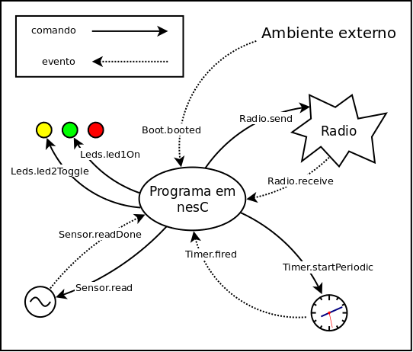

Slide 5
input int Photo_readDone;
loop do
par/or do
await 250ms;
with
_Photo_read();
int data = await Photo_readDone;
_Leds_set(data/100);
await forever;
end
end

Slide 6
Céu under TinyOS
Boot
  1st line of code
Timers
  await 500ms
Leds
  _Leds_led0Toggle(), _Leds_led1On(), _Leds_set(), …
Sensor
  _Photo_read() → await Photo_readDone
Radio
  _Radio_start() → await Radio_startDone
  _Radio_send() → await Radio_sendDone
  await Radio_receive

Slide 7
Radio - Init
loop do
int err = _Radio_start();
if err == _SUCCESS then
err = await Radio_startDone;
if err == _SUCCESS then
break;
end
else
await 1s;
end
end

Slide 8
Tarefa
http://www.lua.inf.puc-rio.br/~francisco/ort/wsn/tarefas.html
$ wget http://.../ort/wsn/ceu_nesc-current.tgz
$ tar xvzf ceu_nesc-current.tgz
$ cd ceu_nesc_2012-03-28/
$ make CEUFILE=radio_echo.ceu micaz
Verifique se a compilação ocorreu sem problemas

Slide 9
Tarefa
Mesma aplicação que roda em diversos nós
Cada um com um ID diferente
  make CEUFILE=app.ceu micaz install,6 mib510,/dev/ttyUSB0
Os nós comunicam o seu próprio ID por broadcast
  _TOS_NODE_ID
Nó com maior ID, acende o led AMARELO
Nó com menor ID, acende o led VERMELHO
Novos nós podem entrar a qualquer momento
Copiar o arquivo radio_echo.ceu

