Slide 1
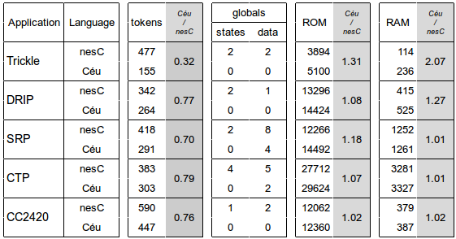





Safe Concurrent Abstractions for WSNs
Going Beyond Multi-threaded Programming
Francisco Sant'Anna Noemi Rodriguez Roberto Ierusalimschy Olaf Landsiedel Philippas Tsigas
PUC-Rio, Brazil Chalmers, Sweden
Event-driven programming
(nesC, Contiki)
Multi-threaded programming
(Protothreads, MantisOS)
Céu
(our proposal)
Motivation
low level
high level
Our goal with Céu is to provide safe and expressive abstractions for programmers.
Key features
Static analysis
loop do par/or do
_sensorRequest(); int v = await SENSOR_READ; par/and do
_radioBroadcast(&v); await RADIO_SENT; with await 10min; end with await RESTART; end end
int v = 0; par/or do await B; v = 1; await A; v = 2; with await A; v = 3; end await A; v = 4;
Céu Outlook
Evaluation
Initial Results
- unstructred
- stackless
- independent threads
- unrestricted shared memory
- composable threads
- safety analysis
- compositions
par/and par/or
- shared memory
- first-class timers
- internal events
- local scopes
- object system
“Sense & broadcast every 10 min.
Force new sampling on external request.”
- 20-70% reduction
in complexity
- no state variables
- less globals
- reasonable
footprint

